Slide 1
CDE Office Hours
September 29, 2022

Slide 2
ESSER Office Hours
Topics
Updates and Reminders
  Expiring Funds
  ESSER I Rapid Request
  Fall RNMs
  Upcoming CS UIP Trainings
ESSER Annual Financial Report (AFR)
Improving Attendance at Annual Title I Meetings and Family Engagement Events
FCC Affordable Connectivity Program
ESSA Identification Overview
Notes:
Nazie

Slide 3
Updates, Reminders, and Clarifications
Notes:
Nazie

Slide 4
Funds That will Expire At the End of September!!!
Program / Funding Stream | Obligation Due Date | Request for Funds Form
ESEA FY20 | September 30, 2022 | November 1, 2022
ESEA FY21 | September 30, 2022 | November 1, 2022
ESSER I | September 30, 2022 | November 15, 2022
March 2022, GFMU sent emails about funds expiring at end of September!
Outreach attempts and reminders!
An approved PAR is required!
  Do you have activities that are allowable, reasonable, and necessary to meet program intent?
  Do you have an approved plan?
  Can you spend by September 30 and draw down by November?
Notes:
Nazie

Slide 5
ESSER I Rapid Requests
For those who submitted an ESSER I Rapid Request, thank you for your speedy work!
We had $1.2 million in available funds
We received over $7 million in requests
  Competitive review process to identify fundable requests
  Developed a cap
  Prorated awards
We are striving to get award letters and GALs sent as soon as possible - hoping and trying for tomorrow!
Notes:
Kate

Slide 6
Fall Regional Network Meeting
We are offering virtual and in-person training opportunities in the fall. The training is structured as three one-hour sessions. LEA staff may attend for the full time or for the sessions that are relevant to them.
Session 1
New LEA staff orientation
CDE staff will give an overview of the programs administered by the Unit of Federal Programs and Supports and provide helpful tools and resources to support new staff who work on these programs. LEA staff will have time to meet their Regional Contacts from CDE and network with LEA staff in their region.
Target Audience: LEA staff who are new to administering Title I-A, I-D, II-A, III, IV-A, or V-B or ESSER programs
Session 2
Post Award Revision Training
CDE staff will provide training on when and how LEAs should submit Post Award Revision in their ESEA Consolidated Application or ESSER applications. There will be time for LEA staff to work on Post Award Revisions with CDE staff available to answer questions.
Target Audience: LEA staff who complete the Consolidated Application or ESSER applications or who administer federal programs
Session 3
Monitoring Work Group
CDE staff will provide an overview of the 22-23 monitoring process, including the new self-assessment tools. Then, LEA staff will have time to work on completing the self-assessment and preparing documents for review with CDE staff present to support and answer questions.
Target Audience: Staff members from LEAs who are being monitored for ESEA or ESSER during the 22-23 school year.
Notes:
Karen

Slide 7
Fall RNM Dates and Locations
Northwest and West Central- Montrose
Tuesday, October 18, 9:00-12:00
Montrose School District Board Room
Register HERE
Pikes Peak Region- Colorado Springs
Tuesday, October 25, 12:30-3:30
District 49 Creekside Success Center Peak View Hall
Register HERE
Northeast and North Central- Fort Morgan
Thursday, November 10, 9:30-12:30
Fort Morgan Public Library
Register HERE
Northwest and West Central- Steamboat Springs
Wednesday, October 19, 9:00-12:00
Alpine Bank Conference Room
Register HERE
Metro Region- Denver
Thursday, October 27, 9:00-12:00
Colorado Talking Book Library
Register HERE
VIRTUAL
Tuesday, November 15, 9:00-12:00
Zoom
Register HERE
Southwest Region- Alamosa
Thursday, October 20, 12:30-3:30
San Luis Valley BOCES
Register HERE
Southeast Region- Lamar
Tuesday, November 8, 12:30-3:30
Southeastern BOCES
Register HERE
Note:
LEAs may attend at any location, regardless of region
Notes:
Karen

Slide 8
Comprehensive Support Planning Training
CS- UIP
Notes:
Karen

Slide 9
Upcoming Training for Comprehensive Support
and Improvement Requirements and Planning
Comprehensive Support and Improvement (CS) - UIP School Level Planning Training
This training will be a workshop model based on identification type with a drilled-down look at the requirements for each type of identification. CDE staff will be available to assist with any questions and help work to get the plans to meet requirements.
Target Identifications: Newly Identified for Low Graduation Rate or Lowest 5% Elementary and Secondary
Target Audience: Principals or the individuals writing the school-level plans, as well as the district personnel responsible for supporting development of, review, and approval of the school UIPs
Related trainings held in August and September 2022 provided an overview of the Unified Improvement Planning for currently identified Comprehensive Support (CS) schools and the identification process as well as specific trainings related to currently identified CS schools for low graduation and lowest 5%: Refer to the ESSA Planning Requirements Link (bottom of page under trainings) for recordings and Powerpoints of past trainings.
Contact Karen Bixler, bixler_k@cde.state.co.us with questions about any of the sessions.
Notes:
Karen

Slide 10
Comprehensive Support and Improvement Plan Training (CS-UIP):
Identified Schools by Specific Identification Type
Session focus: Newly Identified CS Lowest 5% Elementary
and Secondary and Low Graduation Rates
Date: Tuesday, October 11, 2022
Time: 11:00-12:30
Register HERE
Notes:
Karen

Slide 11
ESSER Annual Financial Report (AFR)
Notes:
Michelle

Slide 12
ESSER Reporting Period(s)
ESSER I
Previously reported March 2020 - June 30, 2021 in last year’s ESSER I AFR This year, please report expenditures from July 1, 2021 - June 30, 2022 (FY21-22) Due October 28th
ESSER II
No AFR has been submitted for ESSER II. ESSER II will contain three AFR links: FY19-20: March 13, 2020 - June 30, 2020 FY20-21: July 1, 2020 - June 30, 2021 FY21-22: July 1, 2021 - June 30, 2022 Due October 28th
ESSER III
No AFR has been submitted for ESSER III. ESSER III will contain three AFR links: FY19-20: March 13, 2020 - June 30, 2020 FY20-21: July 1, 2020 - June 30, 2021 FY21-22: July 1, 2021 - June 30, 2022 Due October 28th

Slide 13
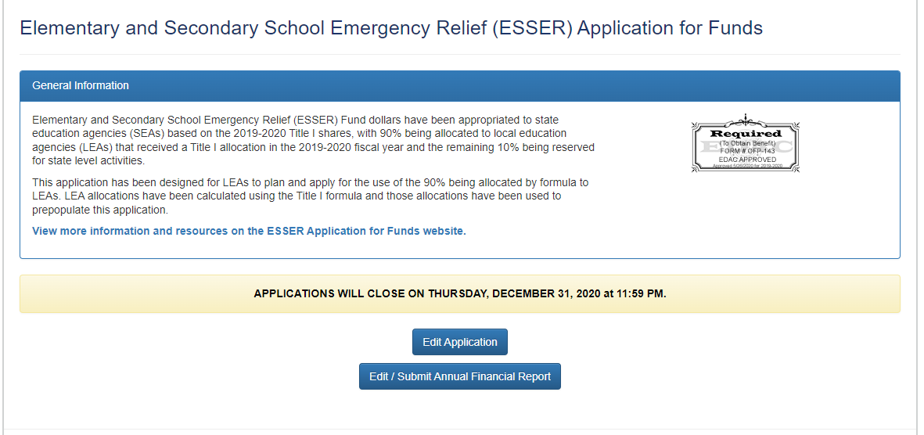
ESSER I AFR
When you go to edit your application, you will see an Edit/Submit Annual Financial Report button.
Select the Edit/Submit Annual Financial Report to access ESSER I’s AFR.

Slide 14
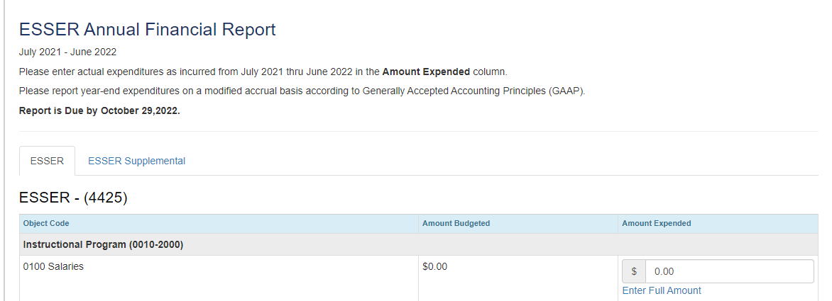
ESSER I AFR Continued
Once inside your AFR, you will see the same format as last year’s ESSER I AFR.
Please note that you won’t be able to see what you submitted for last year’s AFR.

Slide 15
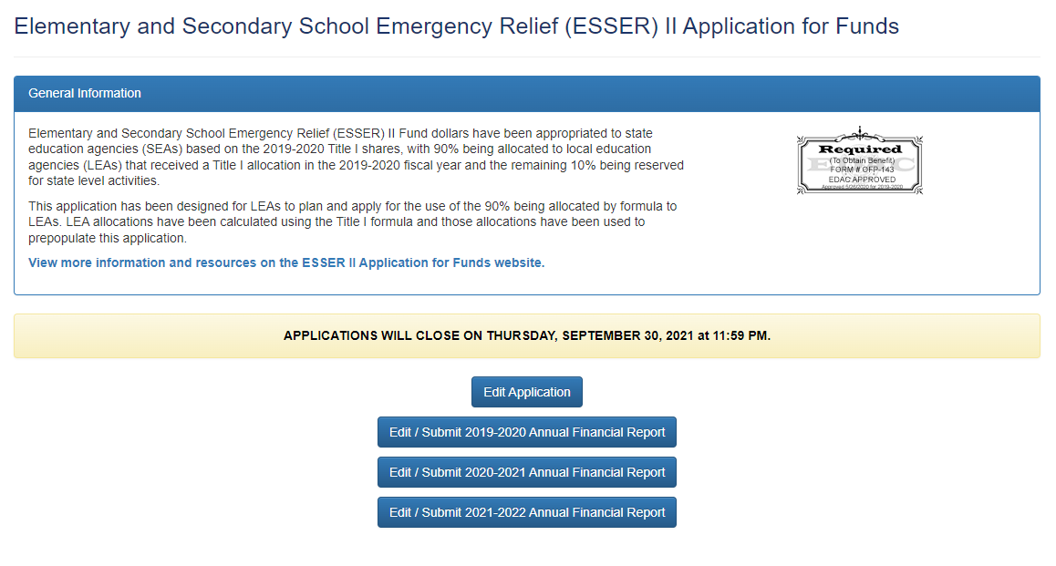
ESSER II AFR
Since ESSER II expenditures weren’t collected last year, CDE needs to collect three years of data in this AFR submission.
When you go to edit your application, you will see three additional links, each to a different fiscal year.
March 13, 2020 - June 30, 2020
July 1, 2020 - June 30, 2021
July 1, 2021 - June 30, 2022

Slide 16
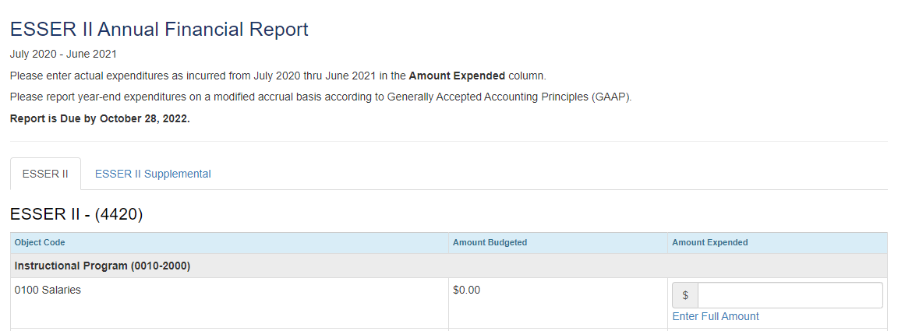
ESSER II AFR Layout
However, once inside one of the AFRs, you will see the same format as ESSER I.

Slide 17
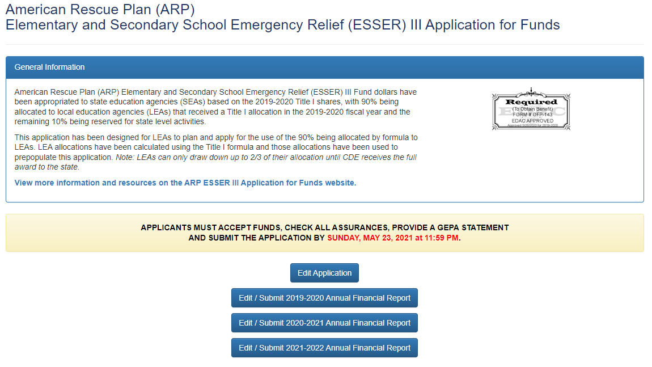
ESSER III AFR
The ESSER III AFR will be very similar to ESSER II.
March 13, 2020 - June 30, 2020
July 1, 2020 - June 30, 2021
July 1, 2021 - June 30, 2022

Slide 18
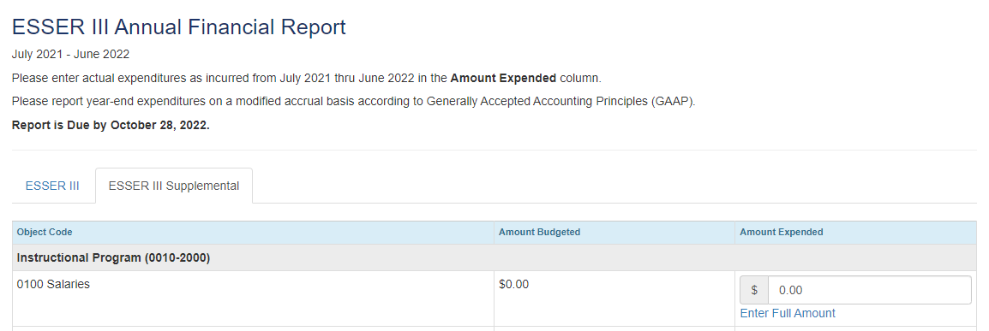
ESSER III AFR Layout
Again, the layout will be very similar to ESSER I and ESSER II

Slide 19
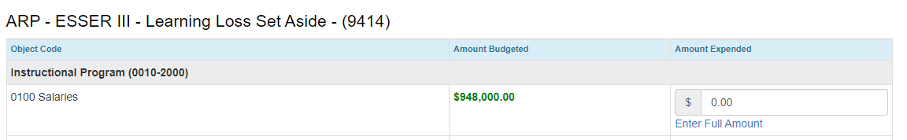
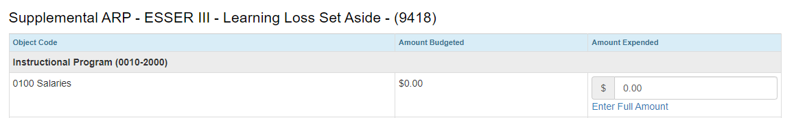
ESSER III AFR Layout
However, ESSER III has additional sections regarding what was spent on learning loss:

Slide 20

Reminders
Anytime your application is on CDE’s side, you will not be able to access or enter information for the AFR. Once it is back on your side to edit, you will then be able to select the AFR buttons.
Ensure you go through all of the tabs across the top of your AFRs before selecting “Submit Report as Final.”
Every application will have all three funding years, even if nothing was budgeted for those years. If you didn’t spend any funds in a particular year, still submit the report.
The different years (FY19-20, FY20-21, FY21-22) do not communicate with each other.
All AFRs are due October 28, 2022

Slide 21
Contact Us!
If you have questions regarding the AFR, please contact the Grants Fiscal Office:
  Steven Kaleda Kaleda_S@cde.state.co.us
  Robert Hawkins Hawkins_R@cde.state.co.us
If you have questions regarding the system, please contact the Grants Program Administration Office:
  Michelle Prael Prael_M@cde.state.co.us
  DeLilah Collins Collins_D@cde.state.co.us

Slide 22
Improving Attendance at Annual Title I meetings and Family Engagement Events
Recommendations from LRP Publications Title1Admin.com
Notes:
Evita

Slide 23
Strategies to Raise Attendance at the Annual Title I Meeting
Advertise the Title I meeting in at least three ways.
  Mix traditional ways (letters) and social media.
  Calls or texts are highly effective.
  Advertise that younger children are welcome.
Schedule multiple meetings.
  Lack of free time prevents many parents from attending school events.
  Try two meetings at different times of day and in different locations.
  For location, consider a community center or library that is on a public transit route.
  Try a hybrid where the meeting is in-person and posted online.
Offer different language options (translators).
Accommodate families with younger children.
  Offer childcare with activities.
  Light snacks are beneficial, but avoid using federal funds for full meals.
Distribute a parent cheat sheet.
  Provide a reference guide to the district’s services which could include attendance, technical support for take-home devices, transportation, free or reduced meals, or other needs.
  This also helps to establish the expectations for the parents’ responsibilities regarding homework, attendance, etc.
Notes:
Evita
Best practices for obligatory Title I meeting

Slide 24
Strategies to Increase Attendance at Family Engagement Events
Host activities that apply to students’ Literacy and Math skills.
  Try a STEM night which uses grade-level Math and technical Literacy skills.
  Host a MakerEd event.
https://makered.org/
https://makerlearningnetwork.org/
  Planning question: “What skills are participants learning?”
Encourage families to have fun learning together.
  Multicultural fairs
  Educational games
  Competitions
  Make-and-take projects
Consider refreshments within fiscal confines.
  Federal funds require snacks to be reasonable and necessary.
  Fund food through state or local funds.
  Partner with community organizations to donate food to schools.
Send attendees home with something extra.
  Books
  Make-and-take items including games
  Consult with CDE content and standards specialists, the Family, School, and Community Partnership Office (Dr. Darcy Hutchins), and district curriculum specialists for ideas.
  Planning question: “Can families recreate the activity at home?”
Notes:
Evita
Two Arkansas districts' attempts to focus on integration of family engagement events into a student's wider academic or school experience make them noteworthy examples of how to encourage parental involvement in Title I programs.
MakerEd is based in CA, but there are online options.

Slide 25
FCC Affordable Connectivity Program
Notes:
Karen

Slide 26
Federal Communication Commission's Affordable Connectivity Program
On December 31, 2021, the Federal Communications Commission (FCC) launched the Affordable Connectivity Program (ACP).
ACP is a federal program that helps low income families afford the cost of internet services.
Data shows the lack of these essential technologies impact communities of color and low-income communities to a disproportionate extent.
Providing access to reliable, high-speed internet and connected devices to facilitate everywhere, all-the-time learning is important to help close the digital divide.

Slide 27
For Learners and Families
The FCC’s Affordable Connectivity Program (ACP) allows qualifying households to reduce their internet costs by up to $30/month ($75/month on Tribal lands).
Getinternet.gov is a simple, easy-to-use website with details on how households can sign up for ACP and find participating providers in their area.
Several companies additionally committed to offer ACP-eligible families at least one high-speed plan for $30/month or less, with no additional fees and no data caps.
This means that if households apply their ACP benefit to one of these plans, they could have no out-of-pocket cost for internet.

Slide 28
For Schools and Districts
Schools and districts may refer to Affordable Connectivity Program outreach toolkit website:
https://www.fcc.gov/acp-consumer-outreach-toolkit
This site will help you assist families and learners with signing-up for the program.
Consumer handouts to let families know their child receives free or reduced-price school meals and therefore may meet the ACP’s eligibility criteria
Consumer Awareness Content Fact Sheets and overview videos
Sample form that can be used to obtain families’ consent to share their child’s eligibility for free or reduced-price school meals with ACP-participating providers.
ACP Outreach Toolkit include many other resources and tools to help promote the ACP to eligible households

Slide 29
Internet for All Approach
Educators are increasingly leveraging active and innovative learning opportunities made possible through technology. Schools are also accelerating the implementation of whole-learner approaches with technology, including:
Online-learning opportunities
Connections to social-emotional supports
Parent-educator engagement opportunities
Tele-health and tele-mental health
Basic needs services
The resources shared today can help ensure these opportunities become equitably and sustainably available to all learners, families, and communities.
Additional information about Internet for All: internetforall.gov

Slide 30
ESSA Identification Overview
Notes:
Nazie

Slide 31
Support and Improvement Under ESSA
Every state that accepts funds under the Every Student Succeeds Act (ESSA) must have an approved methodology for meaningfully differentiating the performance of and identifying schools for support and improvement.
  Developed in consultation with stakeholders.
  ESSA State Plan approved by the U.S. Department of Education in 2018.
  Accountability pause (2020-21 and 2021-22) as a result of the COVID-19 pandemic.
  Identification process resumed in Fall 2022.

Slide 32
Annual Identification of Schools
Annual identification of schools for Support and Improvement under ESSA:
Comprehensive Support and Improvement (CS)
  CS - Lowest 5%
    Title I schools with the lowest total percentage points earned
  CS - Low Graduation Rate
    All public high schools with 4-year and 7-year graduation rates below 67 percent for three consecutive years
  CS - Former ATS (first year of possible identification)
    Title I schools identified for Additional Targeted Support for four consecutive years for the same student group will be moved to this category
Targeted Support and Improvement (TS)
  Targeted Support (TS)
    Schools with at least one consistently underperforming student group
  Additional Targeted Support (ATS)
    Subset of TS schools with at least one disaggregated group that, on its own, meets the criteria for CS - Lowest 5%
Possible to be identified due to participation only

Slide 33
Addendum for SY 2022-23
Due to the COVID-19 pandemic, Colorado was approved to amend its State plan to account for short-term changes in the 2022-2023 school year (http://www.cde.state.co.us/fedprograms/essa).
  Use 1-year of accountability data, instead of 3-years of aggregated data.
  Modify the Academic Progress indicator to only include mathematics growth for grades 5 and 7, and English language arts growth for grades 4, 6, and 8.
  Modify the School Quality or Student Success (SQSS) indicator to:
    Exclude science achievement.
    Alter the definition of chronic absenteeism to include unexcused absences only.
  For schools identified for Comprehensive Support and Improvement in Fall 2022, modify the exit criteria such that schools may be eligible to exit after two consecutive years, rather than three consecutive years.

Slide 34
ESSA Indicators
Academic Achievement
  English Language Arts
    CMAS and SAT mean scale scores
  Math
    CMAS and SAT mean scale scores
Academic Progress (Growth)
  English Language Arts
    CMAS and SAT median growth percentiles
  Math
    CMAS and SAT median growth percentiles
Progress in Achieving English Language Proficiency
  Median growth percentiles
  On-track to attain fluency
School Quality or Student Success (SQSS)
  CMAS science mean scale scores
  Chronic absenteeism (Elementary/Middle)
  Dropout rates (High)
Graduation Rates
  Four-year graduation rate
  Seven-year graduation rate
K-2 School Identification
  Academic Achievement
    READ Act – Percent with a Significant Reading Deficiency (SRD)
  Academic Progress
    Change in SRD
    English Language Proficiency
      Median growth percentiles
      On-track to attain fluency
Alternative Education Campuses (AECs)
  When necessary, the following indicators are also used to differentiate among lowest performing AECs, in addition to the other indicators listed to the left
    Attendance rate
    Truancy rate

Slide 35
ESSA Student Groups
All students
English learners
Students with disabilities
Students experiencing poverty
Students from each racial/ethnic group, separately
  Aggregated Non-White group - Any non-White students from racial/ethnic groups that do not meet the minimum number of students to be reported on their own will be combined into one group for accountability purposes

Slide 36
ESSA Identification Categories in SY 2022-23
Under ESSA, districts may have schools identified in the following categories:
CS - Lowest 5%
  HOLD - School no longer meets identification criteria, but has not yet exited CS status (CS is a multi-year designation)
  Year 4 Or More - School met identification criteria for four or more consecutive years
  Due to Participation Only - School met identification criteria as a result of participation-adjusted calculations
CS - Low Graduation Rate
  HOLD - School no longer meets identification criteria, but has not yet exited CS status (CS is a multi-year designation)
  Year 4 Or More - School met identification criteria for four or more consecutive years
CS - Former ATS (first year of possible identification)
  No schools identified for this category in 2022-2023
Targeted Support (TS)
  2018-19/2019-20 - Not Exited by District - School no longer meets identification criteria, but was not exited by district
  Due to Participation Only - School met identification criteria as a result of participation-adjusted calculations
Additional Targeted Support (ATS)
  2018-19/2019-20 - Not Exited by District - School no longer meets identification criteria, but was not exited by district
  Due to Participation Only - School met identification criteria as a result of participation-adjusted calculations

Slide 37
Additional Information
For more information, please visit Colorado’s ESSA Methods and Criteria for Identification of Schools for Support and Improvement Webpage (http://www.cde.state.co.us/fedprograms/essa_csi_tsi)
For additional information regarding the methodology, criteria, or data used to identify schools for support and improvement under ESSA, please contact:
  Tina Negley
    Supervisor, Program Effectiveness Office
    720-766-2793
  Mary Shen
    ESEA Research Analyst
    720-766-8723
For considerations or questions about the future of ESSA Identification and/or possible revisions to the ESSA State Plan in this regard, please contact:
  Nazie Mohajeri-Nelson

Slide 38
Upcoming Meetings
Notes:
Nazie

Slide 39

Any Requests for Upcoming Topics or Questions!
Upcoming Office Hours
October 13
  2022-23 Monitoring training
October 27
November Changes!
November 10 - will stay the same
November 24 (Thanksgiving Holiday) will be moved to November 17

Slide 40
CDE Contacts!
Emails: Lastname_Firstinitial@cde.state.co.us
(e.g., Smith_a@cde.state.co.us)
Federal Programs & Supports (ESEA/ESSER Program Supports) | School Finance & Operations (Fiscal and Systems Supports)
Nazie Mohajeri-Nelson, Executive Director of Federal Programs & Supports Unit Program Specialists Program Implementation Supervisor: Laura Meushaw Program Monitoring Supervisor: Tammy Giessinger Program Effectiveness Supervisor: Tina Negley ESEA Programs Specialists and ESEA Regional Contacts (assigned by district) Title I: Laura Meushaw, Kathryn Wisner, Evita Byrd Title II: Karen Bixler Title III: Rachel Temple Title IV: Tammy Giessinger, Nathan Hickman Title V: Shannon Wilson ESSER Program Specialists Kristin Crumley Jonathan Schelke Kim Boylan Shannon Wilson ESEA and ESSER Data and Reporting Specialists Tina Negley Mary Shen Mackenzie Owens | Kate Bartlett, Executive Director of School District Operations Unit Fiscal Specialists Jennifer Austin, Director of Grants Fiscal Management ESEA Robert Hawkins, Grants Fiscal Analyst Steven Kaleda, Grants Fiscal Analyst ESSER Fiscal Specialist Steven Kaleda Grants Fiscal Analyst ESSER Monitoring Bill Parsley, ESSER Fiscal Monitoring Supervisor Hilery Morris, ESSER Fiscal Monitoring Kristina Jones, Federal Fiscal Monitoring and Reporting Specialist Werner Hagemann, ESSER Fiscal Monitoring Specialist Application Systems Specialists DeLilah Collins, Director of Grants Program Administration Online Applications Systems Technical Support Michelle Prael

