Slide 1
CDE Office Hours
August 18, 2022

Slide 2
ESSER Office Hours
Topics
Updates and Reminders
  Consolidated Application Updates
  ESSER Upcoming Deadlines
  Transitioning off ESSER funding to ESSA
  Upcoming CS Training Opportunities
  New Directors Launchpad
Request for Funds Process
CDC Update
Public Service Loan Forgiveness
Debrief Washington, D.C. Conferences

Slide 3
Updates, Reminders, and Clarifications

Slide 4
Consolidated Application Updates
22-23 Consolidated Application
  Once your application is returned to you, please look over, address any feedback and resubmit to CDE.
  Be sure to look at all sections of the application to view comments.
  If you would like to check the status of your application or have any questions, please reach out to your Regional Contact.

Slide 5
Upcoming ESSER Deadlines
Important Dates
ESSER III Supplemental budgets due - September 2
Deadline to spend ESSER I Funds - September 30 ~ Statutory Deadline! No Extensions Possible!
Deadline to submit Request for Funds forms for ESSER I funds - October 31
If you have not done so already, please submit your Use of Funds plan ASAP through this form; you can check if you have submitted yours on this site
Resources
ESSER launchpad page- includes deadlines and resources
ESSER I distribution report
Request for funds webpage
ESSER Lead Reviewer list - CDE staff to contact with questions on ESSER applications

Slide 6
Updating ESSER III Contacts
Please update your ESSER III contacts if they are outdated to ensure we can reach you for important application, monitoring, and reporting information
  You can update your contacts without submitting a PAR - simply go in to the application and update with your most current contact information, then hit the save button
For any questions, reach out to Mackenzie Owens at owens_m@cde.state.co.us

Slide 7
Transitioning off ESSER Funds
As ESSER I funding is ending and using ESSA funds to continue ESSER investments is being considered, we wanted to remind districts about some SNS considerations:
Under ESSA, it is presumed that supplanting has occurred:
  if the local educational agency (LEA) uses Title funds to provide services that the SEA or LEA was required to make available under other laws; or
  the SEA or LEA uses Title funds to provide services that the SEA or LEA provided with State, local, or other Federal funds in the prior year.
However, the second presumption can be rebutted, if the LEA can demonstrate that it would not have provided the services in question with State, local, or other Federal funds had these funds not been available. In other words, the LEA has evidence that the source of funding has been discontinued, for example.
More information available from the USDE Here.
Documentation in the application
  That the activity is allowable in the Title program, is reasonable in cost, and allocable to the title program intent
  That the previous year funding (ESSER or other grant) is limited in time
  That the activity would not have been funded with another source if those funds were not available
  The reason for the transition
    i.e., Continuation of services based on continuing or growing need

Slide 8
Upcoming Trainings
Comprehensive Support and Improvement Training (CS-)UIP #2: School Level
This training will be a workshop model based on identification type with a drilled-down look at the requirements for each type of CS school. CDE staff will be available to assist with any questions and help work to get the plans to meet requirements. This training is designed for currently identified schools!
Target Audience: Principals or the individuals writing the school-level plans, as well as the district personnel responsible for supporting development of, review, and approval of the school UIPs
Related training held on August 2, 2022 provided an overview of the Unified Improvement Planning for currently identified Comprehensive Support schools and the identification process: Recording and Powerpoint
Contact wisner_k@cde.state.co.us or bixler_k@cde.state.co.us with questions about the training.

Slide 9
Comprehensive Support and Improvement Plans Training (CS-UIP):
Currently Identified Schools by Specific Identification Type
Session 1: Schools Identified for Low Graduation Rate
Date: Thursday, Sept 1, 2022
Time: 8am-11am
Register HERE
Session 2: Schools Identified for Low Participation
Date: Thursday, Sept 1, 2022
Time: 12pm-3pm
Register HERE
Session 3: Schools Identified for Lowest 5% Elementary/ Secondary
Date: Thursday, Sept 8, 2022
Time: 8am-11am
Register HERE
Session 4: Schools Identified for Lowest 5% Elementary K-2
Date: Thursday, Sept 8, 2022
Time: 12pm-3pm
Register HERE

Slide 10
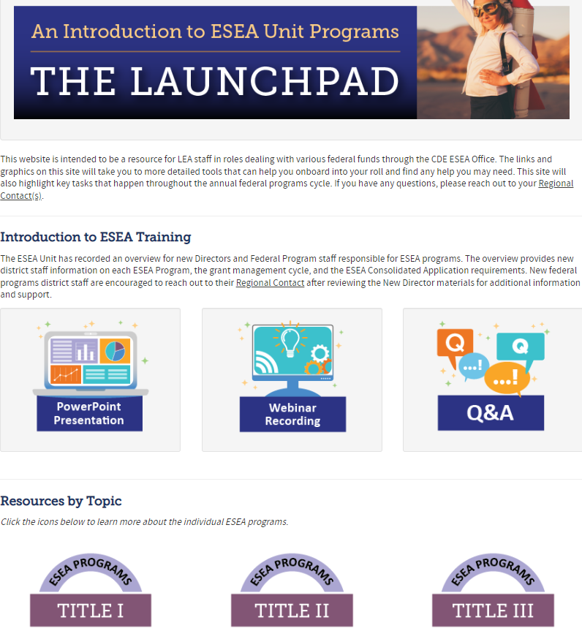
What is the Launchpad?
Starting point for new and current LEA staff to learn about ESEA Programs.
Highly encouraged to share this resource with new teammates in your LEAs.

Slide 11
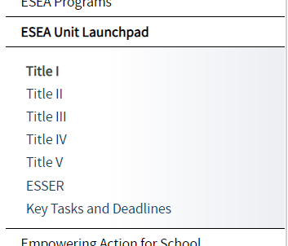
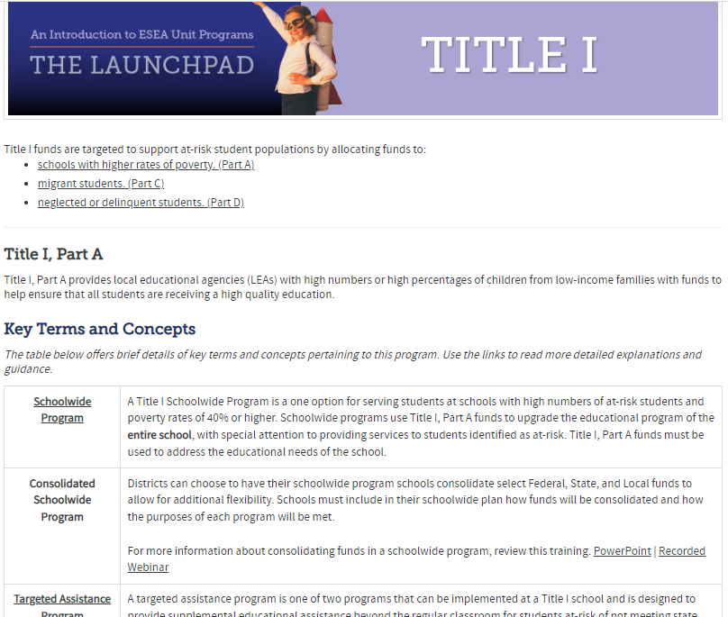
Program Introductions
All ESEA Title Programs & ESSER have independent Training Pages containing:
  Key Terms & Concepts
  Program Eligibility
  Allowable Uses of Funds
  Key Tasks & Deadlines
  Resources
Use the links on the pages for a more detailed explanation of topics/terms.

Slide 12
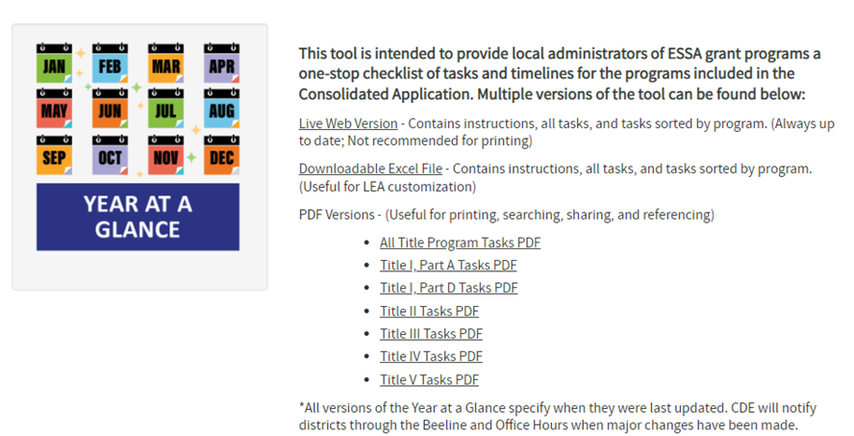
Year at a Glance
The Year at a Glance is a timeline for managing federal programs
Include dates and resources for tasks throughout the year
Sortable by program
Available as a live web version, editable Excel file, and printable PDF

Slide 13
Grants Fiscal Management Unit
RFF Signature Authority Updates

Slide 14
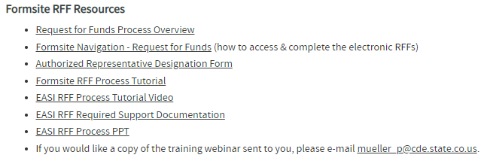
GFMU – RFF Signature Authority Updates
RFF Information is located on the Grants Fiscal Web Page
http://www.cde.state.co.us/cdefisgrant
Request for Funds Forms (RFF)

Slide 15
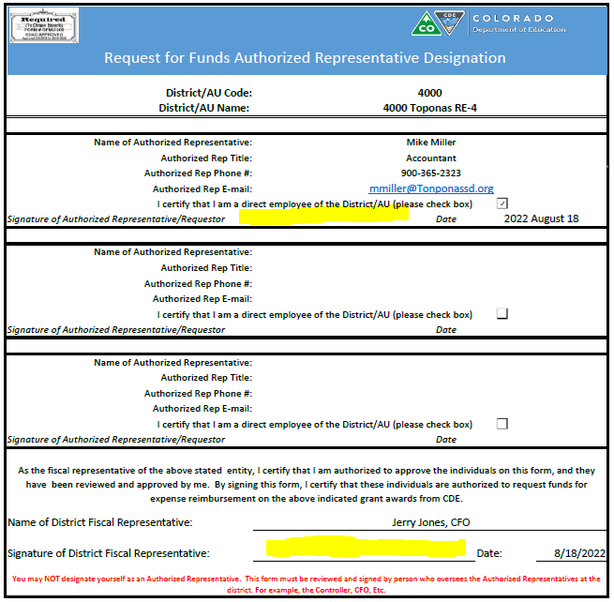
Authority Code
The Authority Code is an electronic signature.
The four-digit code is assigned by GFMU to represent the signature that CDE maintains on file for designated fiscal representatives of an organization.
This code is used to validate Request for Funds reimbursements.
The code is not transferable to any other individual.
The code cannot be used for the designated individual in any other organization.

Slide 16
RFF Approval Process
Grant Accountant gathers supporting Documentation to prepare for RFF Submission
Logs into Formsite and completes the appropriate RFF form and data fields
Updates RFF with the individual holding signature authority and the individual’s email address – clicks ‘submit’
Individual with Signature Authority review the RFF and approves the document with their four-digit electronic signature code
RFF exports to Grants Fiscal’s payment rules engine
RFF routes to individual with Signature Authority
Payment Rules Engine validates four-digit electronic signature code against Authorized Signatures on file
Signature Code Validates
Request is processed for payment
Signature code Fails Validation
Request is moved to Error Holding

Slide 17
Signature Authority Continuity
To avoid delays in reimbursements, continuity plans should include establishment of new signature authority prior to the departure of any designated fiscal representative.
  There are currently 6 School Districts, 1 Administrative Unit and 3 501C organizations with no designated fiscal representative actively employed.
  Authority validation errors cannot be released for payment until valid authority is re-established.
  Notice of held payments will be emailed to the designated fiscal representatives or the organization requesting funds.
    Having those mailboxes migrated to active users will aid an organization in resolving errored requests in a timely manner.

Slide 18
CDC Update

Slide 19
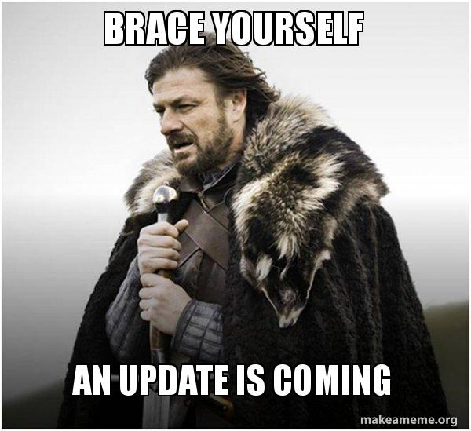
CDC Update as of August 10, 2022
No new requirements
Schools will work directly with their local public health partners to make decisions that align with their local communities and conditions
The Safe Return to In-Person Plan is still an ARP ESSER III requirement
  Please ensure this is being reviewed and updated if needed at least every 6 months.
Link to practical guide for operationalizing CDC’s school guidance

Slide 20
Public Service Loan Forgiveness (PSLF) Program

Slide 21
PSLF Guidelines
If you are employed by a government or not-for-profit organization, you may be able to receive student loan forgiveness under the Public Service Loan Forgiveness (PSLF) Program.
PSLF forgives the remaining balance on your Direct Loans after you have made 120 qualifying monthly payments under a qualifying repayment plan while working full-time for a qualifying employer.

Slide 22
Qualifying for PSLF
To qualify for PSLF, you must
be employed by a U.S. federal, state, local, or tribal government or not-for-profit organization (federal service includes U.S. military service);
work full-time for that agency or organization;
have Direct Loans (or consolidate other federal student loans into a Direct Loan);
repay your loans under an income-driven repayment plan (this provision will be waived through October 31, 2022 as part of the limited PSLF waiver); and
make 120 qualifying payments.

Slide 23
Qualifying Employer
Qualifying employment for the PSLF Program isn’t about the specific job that you do for your employer. Instead, it’s about who your employer is.
Employment with the following types of organizations qualifies for PSLF:
Government organizations at any level (U.S. federal, state, local, or tribal) – this includes the U.S. military
Not-for-profit organizations that are tax-exempt under Section 501(c)(3) of the Internal Revenue Code
Serving as a full-time AmeriCorps or Peace Corps volunteer also counts as qualifying employment for the PSLF Program.

Slide 24
Full-Time Employment
For PSLF, you’re generally considered to work full-time if you meet your employer’s definition of full-time or work at least 30 hours per week, whichever is greater.
If you are employed in more than one qualifying part-time job at the same time, you will be considered full-time if you work a combined average of at least 30 hours per week with your employers.

Slide 25
Eligible Loans
Eligible loans:
Any loan received under the William D. Ford Federal Direct Loan (Direct Loan) Program qualifies for PSLF.
Ineligible loans:
The Federal Family Education Loan (FFEL) Program and the Federal Perkins Loan (Perkins Loan) Program. However, they may become eligible if you consolidate them into a Direct Consolidation Loan.
Student loans from private lenders do not qualify for PSLF.
Under normal PSLF Program rules, if you consolidate your loans, only qualifying payments that you make on the new Direct Consolidation Loan can be counted toward the 120 payments required for PSLF. Any payments you made on the loans before you consolidated them don’t count. However, if you consolidate these loans into a Direct Loan before October 31, 2022, you may be able to receive qualifying credit for payments made on those loans through the limited PSLF waiver.

Slide 26
Qualifying Payments
A qualifying monthly payment is a payment that you make
after Oct. 1, 2007;
under a qualifying repayment plan;
for the full amount due as shown on your bill;
no later than 15 days after your due date; and
while you are employed full-time by a qualifying employer.
You can make qualifying monthly payments only during periods when you’re required to make a payment. Therefore, you can’t make a qualifying monthly payment while your loans are in
an in-school status,
the grace period,
a deferment, or
a forbearance.
If you want to make qualifying payments, but you’re in a deferment or forbearance, contact your federal student loan servicer to waive the deferment or forbearance. However, you can still receive credit toward PSLF during the COVID-19 national emergency administrative forbearance period, which extends from March 13, 2020 through August 31, 2022.
Your 120 qualifying monthly payments don’t need to be consecutive. For example, if you have a period of employment with a nonqualifying employer, you will not lose credit for prior qualifying payments you made.

Slide 27
Qualifying Repayment Plans
Qualifying repayment plans include all of the income-driven repayment (IDR) plans (plans that base your monthly payment on your income).
While payments made under the 10-year Standard Repayment Plan are qualifying payments, you would have to change to an IDR plan to benefit from PSLF. Under the 10-year Standard Repayment Plan, generally your loans will be paid in full once you have made the 120 qualifying PSLF payments and there will be no balance to forgive. Before you change to an IDR plan, however, you should understand that your payment may increase under these plans depending on your income and the amount that you owe. If this is the case for you, and you do not wish to pay this higher amount, then the PSLF Program may not benefit you.

Slide 28
How to Apply for PSLF
Use the PSLF Help Tool for all of the following:
Check to see if your employer qualifies.
Certify your employment each year.
Apply for forgiveness once you’ve met all the requirements.
Generate your PSLF form for signing and submitting to the PSLF servicer.
Top tip: Certify your employment each year as you work toward PSLF. That’ll save you time and effort later, when you’re ready to apply for forgiveness.

Slide 29
PSLF Annual Certification Form
To benefit from PSLF, you should complete and submit the PSLF form every year while you’re making progress toward PSLF. The USDE will use the information you provide on the form to inform you if your employment qualifies and to confirm if you’re making qualifying PSLF payments.

Slide 30
PSLF Time-Limited Waiver
Time-limited changes to PSLF Program rules allow borrowers to receive credit for past periods of repayment that would otherwise not qualify for PSLF (with many of the requirements previously stated waived). The changes end on Oct. 31, 2022.
To qualify for the limited PSLF waiver, you need to have at least one Direct Loan and at least one approved PSLF form.

Slide 31
Debrief of Washington, D.C. Conferences

Slide 32
Conferences
Council of Chief State School Officers (CCSSO): Federal Liaison Network
  State representatives
  Meeting with the U.S. Department of Education
  Congressional Representatives
National Association of ESEA Program Administrators (NAESPA): Summer Member Meeting
  State representatives
  Several Panels from U.S. Department of Education
  Congressional Representatives
  Presentations by Brustein and Manasevit Attorneys (BruMan)

Slide 33
ESSER

Slide 34
Congressional Concern
Concerns with not spending funds fast enough
Concerns with learning loss not being addressed
Not a lot of interest on the Hill for extending obligation timelines
Congressional reps and USDE frequently visit SEA websites looking for how LEAs are spending funds
To do: Tell Your Story Far and Wide!
  Website, newsletter, other communications to your communities
    Success stories; especially from ESSER I for now, but include any data that is available
      Have LEAs also share their innovative, effective, concrete examples of how funds are being used
    Amounts budgets / Amounts spent
    Type of activities being funded
    Evidence of impact of funds
    Innovative solutions to pandemic issues
  Share/disseminate data, evaluation reports, and innovative/effective uses with Colorado Congressional Representatives (by SEA and LEAs) – make sure our Senators and House Representatives know how our LEAs are using funds
Questions:
What have ESSER funds achieved/accomplished?
How has learning loss been addressed?

Slide 35
Monitoring Interests!
Capital Expenditures
  Construction, buses, cleaning robots!
  Prior written approval
Multi-year subscriptions, licenses
  Pay prior to end of obligation period
  Use during liquidation period
  The longer the use lasts post obligation, the greater the risk of being considered not allocable!
    HERF monitoring finding – subscriptions beyond the liquidation period!
Will monitor for not violating MOE of other programs! ESEA and IDEA
Pull and review actual receipts (OK finding for just reviewing expenditure ledgers and spreadsheets – no actual receipts)
Must follow local procurement policy and procedures
EQS under ESSER I
  Timing of calculations matters! LEAs should track how calculations changed and when. Show before and after calculations. Show dates of consultation.
Relationship to COVID will be checked!!!!

Slide 36
Davis-Bacon Act
BruMan session at NAESPA
DBA Requirements
  Pay prevailing wages – must be included in the contract with vendor that prevailing wages will be paid for all contracts over $2,000, even for renovations, repairs, etc.
  Collect weekly certification of vendors
    May require amending contracts if did not include paying prevailing wages
    If have not been collecting, may need to do a retroactive cert and start the process for weekly collection moving forward
CDE Will Do:
  Present DBA requirements, in collaboration with DoL
Fun Fact:
Construction Use Life = 50 Years
Requires 15 years of data reporting
Wisconsin audit finding – LEA did not pay prevailing wages! Having to pay money back. Under negotiation to:
1. Pay workers the right amount; 2. Pay funds back to USDE; or
3. Breakdown costs of equipment v. wages and only pay wages back.

Slide 37
Bipartisan Safer Communities Act (BSCA)

Slide 38
Prohibition
On June 25, 2022, President Biden signed into law S. 2938, the Bipartisan Safer Communities Act. Section 13401 of the Act amends section 8526 of the ESEA to add a prohibition that no funds under the ESEA may be used for the provision to any person of a dangerous weapon, as defined in section 930(g)(2) of title 18, United States Code, or training in the use of a dangerous weapon. (Dangerous weapon is defined in section 930(g)(2) as a weapon, device, instrument, material, or substance, animate or inanimate, that is used for, or is readily capable of, causing death or serious bodily injury, except that such term does not include a pocket knife with a blade of less than 2 1/2 inches in length.)
As noted above, this prohibition applies to all ESEA funds. The prohibition went into effect immediately on June 25, 2022, and applies to all existing and future awards under all ESEA programs, including [Title IV-A].

Slide 39
Additional Title IV Funds ~ Coming Soon
The Bipartisan Safer Communities Act (BSCA) passed on June 25.
  The Act provides much-needed support for safe and healthy students, including support for mental health services.
  BSCA includes $1 billion for activities under Title IV-A, section 4108 for supporting safe and healthy students.
  These funds will be distributed to states, and states will award grants on a competitive basis to high-need local educational agencies (LEAs).
There is $50 million in additional support for the Title IV-B, 21st Century Community Learning Center program, with the direction to increase support for the implementation of evidence-based practices intended to increase attendance and engagement of students in middle grades and high school community learning centers.
In addition, BSCA provides $1 billion for two discretionary grant programs designed to increase the number of mental health providers in schools. Notices inviting applications for the School-Based Mental Health Services Grant and the Mental Health Services Professional Development Grant will be available in early fall. Information about these programs as they currently exist can be found at Safe & Supportive Schools - Office of Elementary and Secondary Education.

Slide 40
Waivers
U.S. Department of Education

Slide 41
Tydings and Carryover Caps
USDE will not be doing any of the simplified waiver requests that were available during the pandemic…not on a systemwide basis!
However, SEAs can use any of the waivers from last year, to submit individual waiver requests under ESSA Section VIII, including requests to extend tydings periods and allow for more than once every 3-year carryover caps!
CDE working on submitting a request

Slide 42
Late Liquidation Requests
Requests have to be processed during the automatic liquidation period
Plan to use lessons learned from ESSER I requests to improve ESSER II and III request processes
Not planning to do blanket waivers and will consider requests on a case-by-case basis

Slide 43
USDE Requests and Reminders

Slide 44
USDE Requests and Reminders Based on Recent Monitoring and Audit Findings
OCR requirements apply to LEAs, even those without Title III allocations!!!
Title IX rules are available for public comment until 9/12/2022.
  Requires several Title IX roles within each LEA – can be the same person – but must have a contact per role.
    This might be burdensome for LEAs with less than 1,000.
Segregation of duties for program and fiscal ~ balance for internal controls.

Slide 45
USDE Requests and Reminders Based on Recent Monitoring and Audit Findings
ESSA reporting must include:
  PPE for 20-21 OR 19-20
  Educator qualifications
  Student group data
  Assessment participation
  Accountability and other indicator results
  1003 uses and services
  Chronic absenteeism
Adjusted Cohort Graduation Rates cannot include diplomas aligned with IEP; only diplomas awarded to a preponderance of students. Must track students included or not in analyses (e.g., students who left the country).
CDE must post a link to all LEAs’ public ESSA Report Cards. So, CDE posts all required data on behalf of our LEAs. You have the option of posting your own ESSA Report Cards or pointing to CDE’s ESSA Local Reports website.

Slide 46
Resources
Effective Personnel for ALL: Attract, Prepare, Retain
Comp Centers and RELs
  Resources:
    Educator workforce, equity, planning and evaluation, summer and out of school time, teaching and learning, trauma informed practices, social emotional learning
Student Engagement and Attendance Technical Assistance Center
  Reduce chronic absenteeism and increase student engagement
Equity Assistance Centers - Training and Advisory Services at the request of school boards

Slide 47
Upcoming Meetings

Slide 48

Any Requests for Upcoming Topics or Questions!
Upcoming Office Hours
September 1
September 15

Slide 49
CDE Contacts!
Emails: Lastname_Firstinitial@cde.state.co.us
(e.g., Smith_a@cde.state.co.us)
Federal Programs & Supports (ESEA/ESSER Program Supports) | School Finance & Operations (Fiscal and Systems Supports)
Nazie Mohajeri-Nelson, Federal Programs & Supports Unit ESEA Programs Specialists and ESEA Regional Contacts (assigned by district) Title I: Laura Meushaw, Kathryn Wisner, Evita Byrd, Nathan Hickman Title II: Karen Bixler Title III: Kathryn Wisner, Rachel Temple Title IV: Tammy Giessinger, Nathan Hickman Title V: TBD ESEA and ESSER: Shannon Wilson ESSER Program Monitoring Specialists Kristin Crumley Jonathan Schelke Kim Boylan ESEA and ESSER Data and Reporting Specialists Tina Negley Mary Shen Mackenzie Owens | Kate Bartlett, Executive Director of School District Operations Unit Fiscal Specialists Jennifer Austin, Director of Grants Fiscal Management ESEA Robert Hawkins, Grants Fiscal Analyst Steven Kaleda, Grants Fiscal Analyst ESSER Fiscal Specialist Steven Kaleda Grants Fiscal Analyst ESSER Monitoring Bill Parsley, ESSER Fiscal Monitoring Supervisor Hilery Morris, ESSER Fiscal Monitoring Application Systems Specialists DeLilah Collins, Director of Grants Program Administration Online Applications Systems Technical Support Michelle Prael

