Slide 1
CDE Office Hours
July 21, 2022

Slide 2
ESSER Office Hours
Topics
Updates and Reminders
  Consolidated Application Updates
  ESSER Upcoming Deadlines
  Committee of Practitioners Membership
  Upcoming CS UIP Trainings
  Equitable Distribution of Teachers
Federal Programs Monitoring Updates
Late Liquidation Waiver from the U.S. Department of Education
Expanded Learning Opportunity Stakeholder Engagement

Slide 3
Updates, Reminders, and Clarifications

Slide 4
Consolidated Application Updates
The 22-23 application is the last year of a three-year plan therefore, CDE will need to update the Consolidated Application for the 2023-24 funding year. In our efforts to continuously improve our systems and resources to meet the needs of Local Education Agencies (LEA) we invite you to complete the 2023-2024 Consolidated Application Platform Input survey. The survey will inform CDE on how to improve the application for the next 3 year application.
Notes:
DeLilah/Michelle?

Slide 5
Upcoming ESSER Deadlines
Important Dates
ESSER III Supplemental budgets due - September 2
Deadline to spend ESSER I Funds - September 30 ~ Statutory Deadline! No Extensions Possible!
Deadline to draw down ESSER I funds - October 31
Resources
ESSER launchpad page- includes deadlines and resources
ESSER I distribution report
Request for funds webpage
ESSER Lead Reviewer list - CDE staff to contact with questions on ESSER applications
Notes:
Shannon

Slide 6
Committee of Practitioners (CoP)
Notes:
Shannon

Slide 7
Members Needed for Committee of Practitioners (CoP)
The Committee of Practitioners (CoP) is a critical stakeholder group for the Federal Programs & Supports Unit at the Colorado Department of Education (CDE).
  Primary purpose is to advise CDE regarding its implementation of the Elementary and Secondary Education Act (ESEA), reauthorized as the Every Student Succeeds Act (ESSA) and the Elementary and Secondary School Emergency Relief (ESSER) grants
  Operates to identify issues across regions of the state and facilitate two-way communication between CDE and the preK-12 education community throughout Colorado
Committee members serve for an initial three-year term with the opportunity to extend.
A minimum of four meetings will be held per year.
Notes:
Shannon

Slide 8
Representation Status by Role as of May 2022
Role | Representation Met | Notes
Representatives from LEAs | Yes
Administrators (school leaders) | No
Teachers, including vocational educators, paraprofessionals | Somewhat | No paras
Parents | Yes
Members of local school boards | No
Representatives of private schools | No
Charter school personnel | Yes
Pupil services personnel | Yes
Representation of above from 8 regions | No | No representation from SW region. Not all regions have a Title I administrator representative
Title I, II, IV, and V and fiscal | Somewhat | Mostly met, missing Title V representation
Exceptional Student Services | Yes
Notes:
Shannon

Slide 9
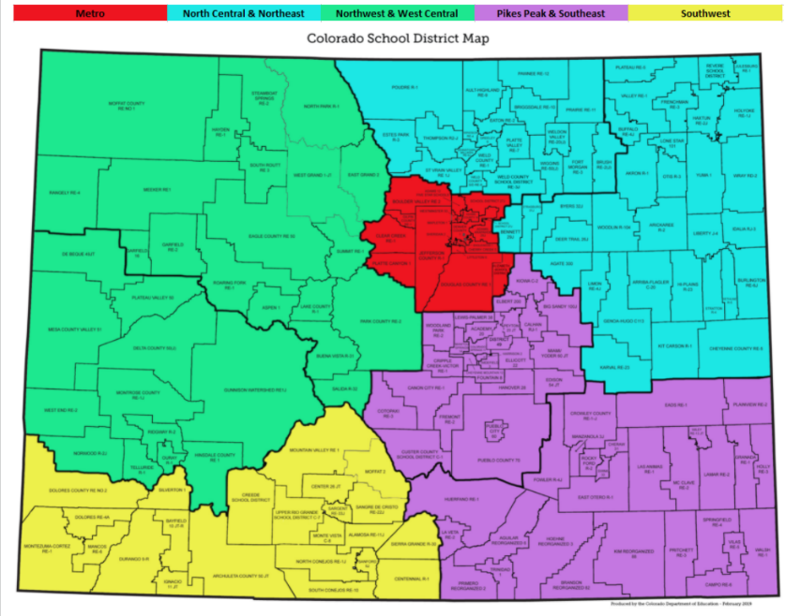
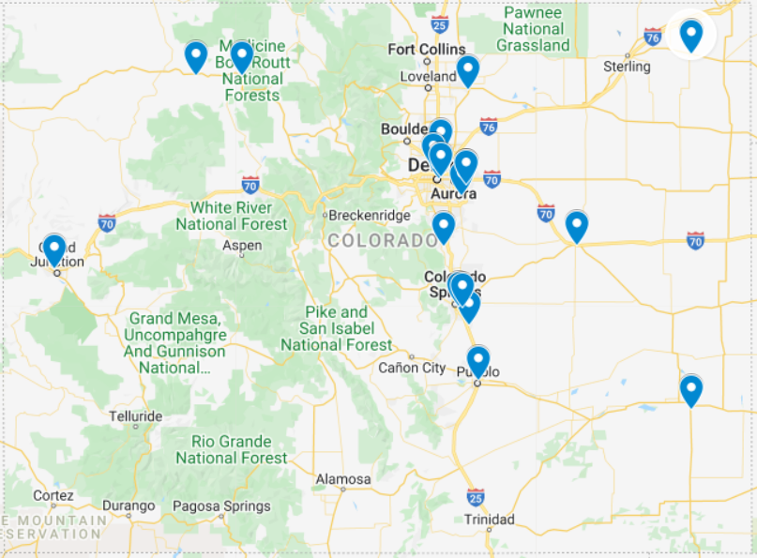
Representation by Geography
Southwest and Southeast are severely underrepresented, as well as central mountains.
Notes:
Shannon

Slide 10
Join us!
To apply for a position, fill out the 2022-23 Application(PDF) and submit to Emily Owen.
For additional information, please reach out to Rachel Temple or Shannon Wilson.
Notes:
Shannon

Slide 11
Comprehensive Support Plans/ CS UIP
Notes:
Karen

Slide 12
Upcoming Virtual Training: CS UIP Requirements
Content: CDE will provide and overview of the improvement planning requirements for schools identified for Comprehensive Support and Improvement under ESSA.
Target Audience: LEA staff who oversee the UIP process for CS schools and school leaders from identified schools
Date and Time: August 2nd, 10:00- 12:00
Register HERE
Notes:
Karen

Slide 13
CS UIP Planning
September Virtual Workshop Offerings
Additional Opportunity Coming in September: Workshop sessions for each identification type where CDE staff will assist with question and help LEA and school staff complete the CS UIP requirements.
Thursday, September 1, 2022 from 8:00-11:00 - Comprehensive Support Plan for CS Identified Schools/UIP: Low Graduation Rate Register HERE
Thursday, September 1, 2022 from 12:00-3:00 - Comprehensive Support Plan/UIP for CS Identified Schools: Low Participation Register HERE
Thursday, September 8, 2022 from 8:00-11:00 - Comprehensive Support Plan/UIP for CS Identified Schools: Lowest 5% Elementary/ Secondary Register HERE
Thursday, September 8, 2022 from 12:00- 3:00 - Comprehensive Support Plan/UIP for CS Identified Schools: Lowest 5% Elementary K-2 Register HERE

Slide 14
Equitable Distribution of Teachers (EDT)
Notes:
Karen

Slide 15
Equitable Distribution of Teachers: Aligning Data Years
Data Year | 19-20 | 20-21 | 21-22 | 22-23
Planning Year | 20-21 | 21-22 | 22-23 | 23-24
EDT Plan Due Date | 6/30/21 | 6/30/22 | 6/30/23 | 6/30/24
Implementation Year (Also ConsApp Year) | 21-22 | 22-23 | 23-24 | 24-25
Currently: Using 21-22 HR data, LEAs will spend 22-23 reviewing that data and planning with stakeholders to identify strategies to address gaps. If there are medium or large gaps, EDT plans are submitted by June 30, 2023 in the 23-24 Cons App and after approval, will be implemented over the course of that 23-24 school year.
Notes:
Karen

Slide 16
Equitable Distribution of Teachers: Next Steps
Syncplicity: On Monday, July 18, 2022, access to the 21-22 EDT data in Syncplicity was shared with LEA contacts listed as Authorized Representative, Title I, and Title II in the Consolidated Application.
Notification: An EDT data notification email was sent, which explains the purpose of EDT, plan requirements, and important reminders.
Resources: The CDE EDT website, which includes training videos and FAQs, is a helpful resource as you review the 21-22 data. http://www.cde.state.co.us/fedprograms/equitabledistributionofteachers
Please contact Evita Byrd [byrd_e@cde.state.co.us] for general EDT questions and Tina Negley [negley_t@cde.state.co.us] for questions about EDT data calculations.
Notes:
Karen

Slide 17
Federal Programs Monitoring Updates
Notes:
Tammy

Slide 18

2021-2022 Monitoring Reflections
Successes: Revised process to include both ESEA and ESSER monitoring Made real-time changes based on observations and feedback Provided training and support to LEAs, Tribal Nations, facility schools, and AUs Internal and external collaboration Reports are being finalized Challenges: Made real-time changes to the process Needed to extend timelines

Slide 19

Next Steps
Implement Improvements: Make adjustments to risk assessment Incorporate a more robust self-assessment Provide targeted training for LEAs based on lessons learned and monitoring findings Update resources and timelines

Slide 20

Coming Soon!
Final Reports from 21-22 Monitoring
  Feedback survey will accompany report
    Monitoring Process
    Support, Resources, and Training
Notification letters will be sent by end of August (82 LEAs)
Training will be provided following notification
    22-23 Timeline
    Self-assessment

Slide 21
Updates and Clarifications about the Late Liquidation Waiver from the U.S. Department of Education
Notes:
Nazie

Slide 22
What is the Difference Between Obligation and Liquidation?
Obligate - make a binding, written commitment to obtain services, work, or products (often compared to using a credit card for a purchase)
Liquidate - draw down and expenditure of funds
Program | Obligation Deadline | Colorado LEA’s Liquidation Period | SEA (CDE) Liquidation Deadline (without extension)
CARES ESSER I | September 30, 2022 | November 1, 2022 | January 30, 2023
CRSSA ESSER II | September 30, 2023 | November 1, 2023 | January 29, 2024
ARP ESSER III | September 30, 2024 | November 1, 2024 | January 28, 2025

Slide 23
Obligation Date by Activity Type [34 CFR §76.707]
If the obligation is for - | The obligation is made -
(a) Acquisition of real or personal property | On the date on which the State or subgrantee makes a binding written commitment to acquire the property.
(b) Personal services by an employee of the State or subgrantee | When the services are performed.
(c) Personal services by a contractor who is not an employee of the State or subgrantee | On the date on which the State or subgrantee makes a binding written commitment to obtain the services.
(d) Performance of work other than personal services | On the date on which the State or subgrantee makes a binding written commitment to obtain the work.
(e) Public utility services | When the State or subgrantee receives the services.
(f) Travel | When the travel is taken.
(g) Rental of real or personal property | When the State or subgrantee uses the property.
(h) A pre-agreement cost that was properly approved by the Secretary under the cost principles in 2 CFR part 200, Subpart E - Cost Principles | On the first day of the grant or subgrant performance period.

Slide 24
Late Liquidation - USDE Communication
May 13, 2022 USDE Letter to the School Superintendents Association
  Response to request seeking flexibility on timeline for use of funds, particularly pertaining to construction projects
Reminders in the USDE letter
  Discourages use of funds for new construction
  Encourages addressing needs arising from the pandemic and using funds for pressing needs and with the sense of urgency as intended
  All uses of funds must meet the overall purpose of the ESSER grants: “to prevent, prepare for, and respond to to COVID-19”
    Includes matters that have been exasperated by the pandemic
  ESSER obligation and liquidation deadlines are set in statute and regulations
    USDE does NOT have the authority to waive or extend the obligation periods
    USDE does have the authority to extend the liquidation period, on a grant by grant basis, for activities that have been properly and timely obligated [timely and valid obligation pursuant to 34 CFR §76.707]

Slide 25
Clarifications
Extension must be requested by the SEA - granted on a case by case basis
USDE has not yet released a process for requesting late liquidation extensions - ESSER I first/this summer
At this time, they are not pre-determining what scenarios constitute the circumstances under which an extension will be granted; urge SEAs and LEAs to continue to spend and draw down funds as quickly as feasible
USDE can only extend the liquidation (NOT the obligation) period up to 18 months after the obligation deadline (or up to 14 months after the liquidation period)
Program | Obligation Deadline | Colorado LEA’s Liquidation Period | SEA (CDE) Liquidation Deadline (without extension) | (Up to) 14-months Liquidation Extension
CARES ESSER I | September 30, 2022 | November 1, 2022 | January 30, 2023 | April 1, 2024
CRSSA ESSER II | September 30, 2023 | November 1, 2023 | January 29, 2024 | March 31, 2025
ARP ESSER III | September 30, 2024 | November 1, 2024 | January 28, 2025 | March 31, 2026

Slide 26
Google Survey
In order for CDE to get a better sense of potential extension requests needed, please complete a Google survey indicating the following:
Please indicate if you feel that you may be in a situation of needing an extension request for
  ESSER I?
  ESSER II?
  ESSER III?
  Do not anticipate needing an extension for any of the ESSER funds
If anticipating needing an extension, for what type/buckets activities?

Slide 27


ESSER Update & Community Engagement
ESSER Update & Community Engagement
July 2022
Notes:
Robert Beauchamp

Slide 28
ESSER Overview

Slide 29

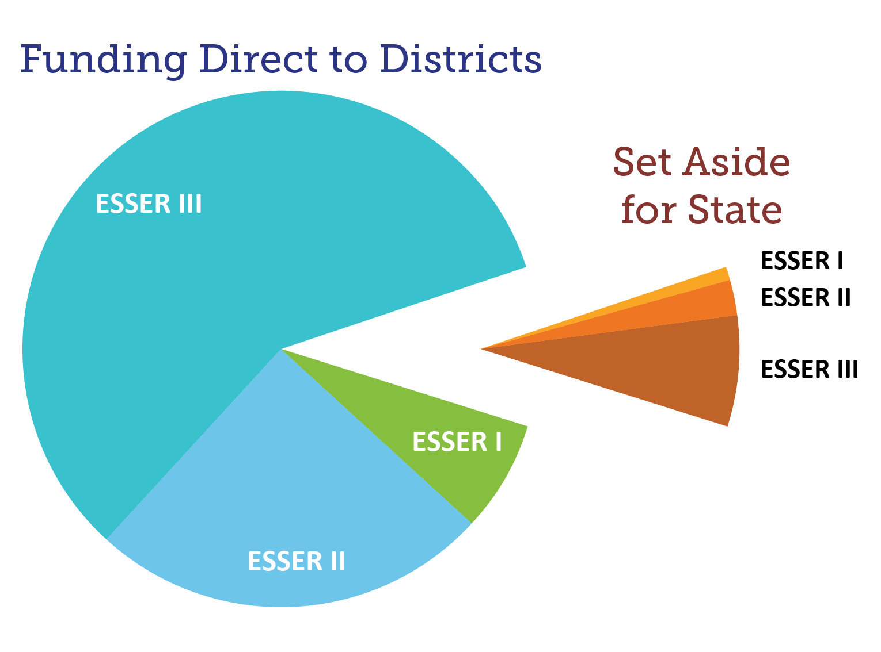

Colorado Pandemic Relief Funding
Colorado ESSER Funds
LEA ESSER Funding $1.6 Billion
State ESSER Funding
$180 Million
Total ESSER Funding
$1.8 Billion
Notes:
Following federal statute, 90% – or $1.6 billion of the $1.8 billion – of all ESSER funding is allocated directly to the districts following the Title I allocation. The remaining 10% is made available to CDE in order to carry out state-level activities to support the broader education community and to fund the costs necessary to administer these programs.

Slide 30
ESSER State Reserve Funds

Slide 31
ESSER State Reserve Funds
Focus Areas
ACADEMIC ACCELERATION
ENGAGE & EXPAND LEARNING
STRENGTHEN
STATE CAPACITY
Tutoring / Before & After School Programs
Supplemental Funding
EASI Grant
Curricular/Instructional Materials
Ed Workforce
Professional Learning
Before & After School Programs
Academic Enrichment
Rural Coaction
Technical Assistance
Integrated Data Systems
Blended Learning
Data & Evaluation
Evolving Needs
$91 Million
$29 Million
$12 Million

Slide 32
ESSER State Reserve Funds
Closed Programs w/ ESSER Funding Allocations
Empowering Action for School Improvement Grants
High Impact Tutoring Program
Learning & Transparency Technical Assistance Program
Educator Workforce Support Grants
Peer Mentoring Program
Rural Coaction – Cohort 1
$6 M
$7 M
$786 K
$3 M
$10 M
$6 M
CLOSED

Slide 33
ESSER State Reserve Funds
Closed Programs w/ ESSER Funding Allocations
K-8 Mathematics Curricula / K-3 READ Act Programs
Rural Coaction – Cohort 2
ESSER Transportation Assistance Grant Program
Expanded Learning Opportunities Grant
$10 M
$15 M
$3 M
$10 M
CLOSED

Slide 34
ESSER State Reserve Funds
Open Programs w/ ESSER Funding Allocations
Supplemental Funding
$25 M
9/2/22
Rural Program Development Grants
$525K
9/30/22

Slide 35
ESSER State Reserve Funds
Coming Soon
Programs In Development
Ongoing Programs & Work
Expanded Learning Opportunities
Professional Learning
Tutoring Corp
Blended Learning Initiative
Technical Assistance
Integrated Data Systems
Data & Evaluation
Monitoring

Slide 36
Expanded Learning Opportunities

Slide 37
Expanded Learning Opportunities
What Are We Talking About?
Programs and initiatives that offer students the opportunity to accelerate, enrich, or strengthen engagement in their learning beyond their normal school program. Examples include, but are not limited to:
Before and after school programs
5th Day Academies
Summer Programs
Extended school days
High-Impact/High Dosage Tutoring

Slide 38
Expanded Learning Opportunities
What will be the goals of the conversations?
Understand what is working in the realm of ELOs in Colorado
Explore potential barriers to success
Identify potential supports for expanding success of ELO programs

Slide 39
Expanded Learning Opportunities
What are the parameters?
Allowability under ESSER, for example:
  Evidence-based interventions
  Connected to addressing needs from the pandemic
Within the allocated use of state ESSER funds by the State Board of Education
State capacity to implement, for example:
  Staffing capacities
  Direct payments to families not feasible

Slide 40
Small Group Discussions
Discussion Questions
Over the past two years, what have your successes been in expanding learning opportunities for your students during and as we emerge from the pandemic?
What did it take to accomplish that?
What did you learn that was surprising or that you needed to change?
What, if anything, has kept you from achieving your goals with that program?
Do you have any suggestions for how CDE could support you in achieving your goals?
Notes:
Do you have any other experiences? Are you hearing from families or students that we need to hear about?
Recognize the importance of K-12 work. How do we engage with families?

Slide 41
Thank you!

Slide 42
Upcoming Meetings

Slide 43

Any Requests for Upcoming Topics or Questions!
Upcoming Office Hours
August 4
August 18

Slide 44
CDE Contacts!
Emails: Lastname_Firstinitial@cde.state.co.us
(e.g., Smith_a@cde.state.co.us)
Federal Programs & Supports (ESEA/ESSER Program Supports) | School Finance & Operations (Fiscal and Systems Supports)
Nazie Mohajeri-Nelson, Federal Programs & Supports Unit ESEA Programs Specialists and ESEA Regional Contacts (assigned by district) Title I: Laura Meushaw, Kathryn Wisner, Evita Byrd Title II: Karen Bixler Title III: Kathryn Wisner, Rachel Temple Title IV: Tammy Giessinger Title V: TBD ESEA and ESSER: Shannon Wilson ESSER Program Monitoring Specialists Kristin Crumley Jonathan Schelke Kim Boylan ESEA and ESSER Data and Reporting Specialists Tina Negley Mary Shen Mackenzie Owens | Kate Bartlett, Executive Director of School District Operations Unit Fiscal Specialists Jennifer Austin, Director of Grants Fiscal Management ESEA Robert Hawkins, Grants Fiscal Analyst Steven Kaleda, Grants Fiscal Analyst ESSER Fiscal Specialist Steven Kaleda Grants Fiscal Analyst ESSER Monitoring Bill Parsley, ESSER Fiscal Monitoring Supervisor Hilery Morris, ESSER Fiscal Monitoring Application Systems Specialists DeLilah Collins, Director of Grants Program Administration Online Applications Systems Technical Support Michelle Prael

