Slide 1
CDE Office Hours
June 23, 2022

Slide 2
ESSER Office Hours
Topics
Updates and Reminders
  Consolidated Application Deadlines
  Reporting Survey Reminder
  ESSER I PAR Deadline
CDCs Updated Operational Guidance
ESEA Launchpad
TIII Allowable Uses

Slide 3
Updates, Reminders, and Clarifications

Slide 4
Consolidated Application Updates
The 22-23 Consolidated Application is now open!
  Online application
  Requires a login username and password through the CDE Identity Management System; work with your Local Access Manager (LAM)
  Applications are due June 30, 2022!
For questions or assistance, please contact your ESEA Regional Contact.

Slide 5
Reporting Reminder
All LEAs received an ESSER survey with a question about student engagement, and if you allocated ESSER funds in 2020-2021 to schools, including charters, you also received a survey question about what method you used to determine school level allocations. Please contact Mackenzie Owens at owens_m@cde.state.co.us to determine which survey you need to complete.
Thank you so much to those of you who have already submitted your ESSER data on student engagement and school level allocations. This data is very important for reporting to the USDE.
If you have not yet submitted, please submit your data as soon as possible before the final deadline! The report is due to the USDE in full by July 1st.
Notes:
Tina

Slide 6
ESSER I PAR Deadline
The Carryover (PAR) application for ESSER I closes June 30, 2022
Any needed revisions must be submitted by this date
Other Important Dates
All ESSER I funds must be spent by September 30, 2022
All funds must be drawn down by October 31, 2022
Resources
ESSER launchpad page- includes deadlines and resources
ESSER I distribution report
Request for funds webpage
ESSER Lead Reviewer list- CDE staff to contact with questions
Notes:
Shannon

Slide 7
CDCs Operational Guidance to Support Safe In-Person Learning
Notes:
Kristen

Slide 8
Updates to CDC Guidance
Notable Changes:
“Layered Prevention Strategies” is now “Strategies for Everyday Operations”
Physical distancing removed (cohorting still a recommendation)
Considering local context
  Age of population served
  Availability of resources
  Communities served
  Pediatric-specific healthcare capacity
  Equity
  Students with disabilities
Link to CDC Guidance
Notes:
“Layered Prevention Strategies” is now “Strategies for Everyday Operations”: Verbiage
Physical distancing removed (cohorting still a recommendation)
Considering local context: Schools should balance risk of COVID-19 with educational, social, and mental health outcomes when deciding which strategies to put in place.

Slide 9
ESEA Launchpad
Notes:
Niko/Shannon

Slide 10
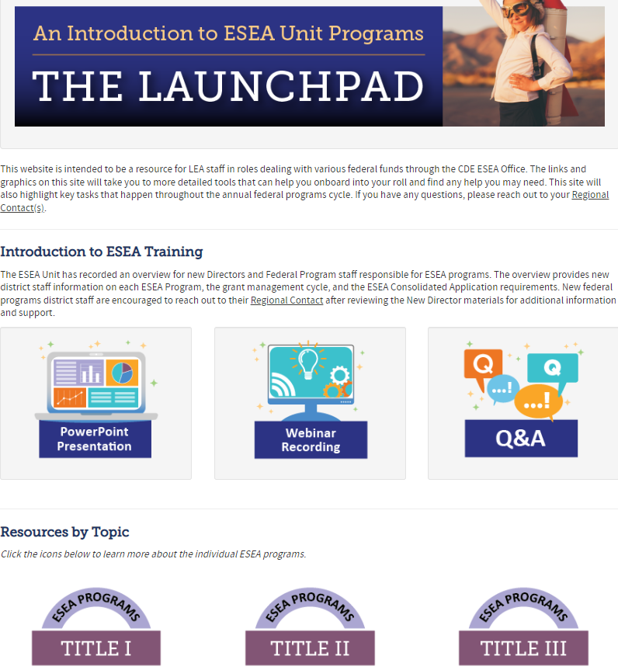
What is the Launchpad?
Starting point for new and current LEA staff to learn about ESEA Programs.
Highly encouraged to share this resource with new teammates in your LEAs.
Notes:
Niko/Shannon The Launchpad is a “one stop shop” geared towards LEA staff that may be new to ESEA programs or just wanting to learn about programs/processes in our office.
We are hoping that it becomes an intuitive first step in learning about our programs.

Slide 11
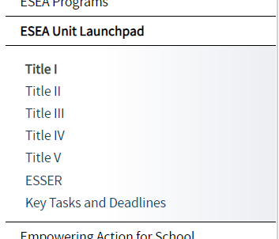
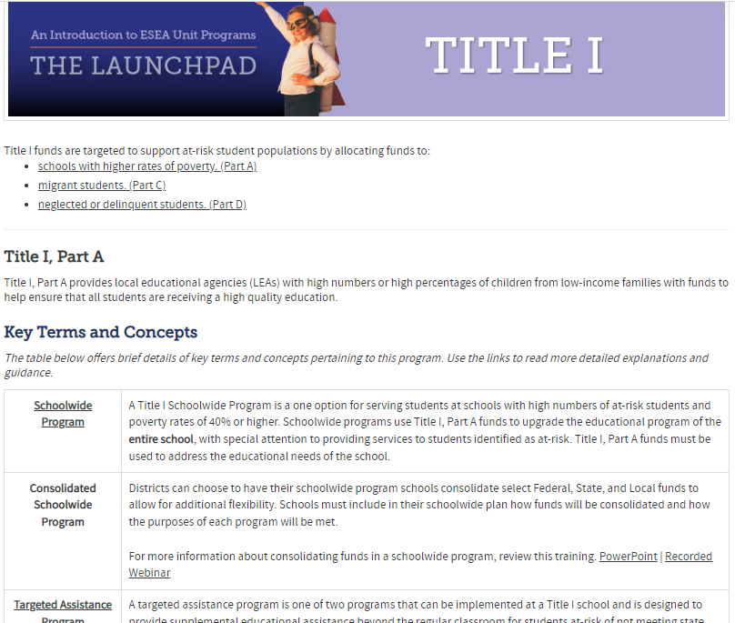
Phase II Complete
All ESEA Title Programs & ESSER now have independent Training Pages containing:
  Key Terms & Concepts
  Program Eligibility
  Allowable Uses of Funds
  Key Tasks & Deadlines
  Resources
Use the links on the pages for a more detailed explanation of topics/terms.
Notes:
[show the pages live and how many links there are]

Slide 12
Title III, Part A
Rachel Temple, ESEA Title III Specialist

Slide 13

Title III
Don’t be afraid of Title III, it’s not that scary

Slide 14

Common acronyms
LEP = Limited English Proficient
ESL = English as a Second Language
ELL = English Language Learner
EL = English Learner
MLL = Multilingual Learner
ELA = English Language Acquisition
ELD = English Language Development
SIFE = Students with Interrupted/Inconsistent Formal Education
LIEP = Language Instruction Educational Program

Slide 15


It’s like a salad…
Above and Beyond
Title III funds
Title I funds
state/local funds

Slide 16
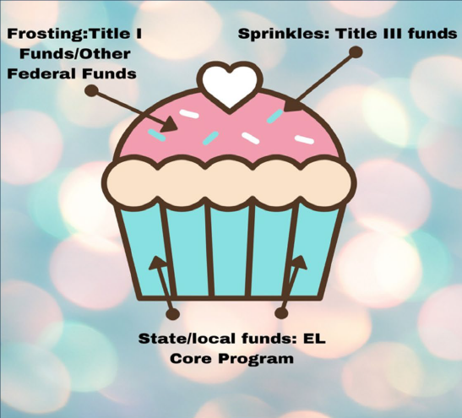
Or a cupcake!

Slide 17
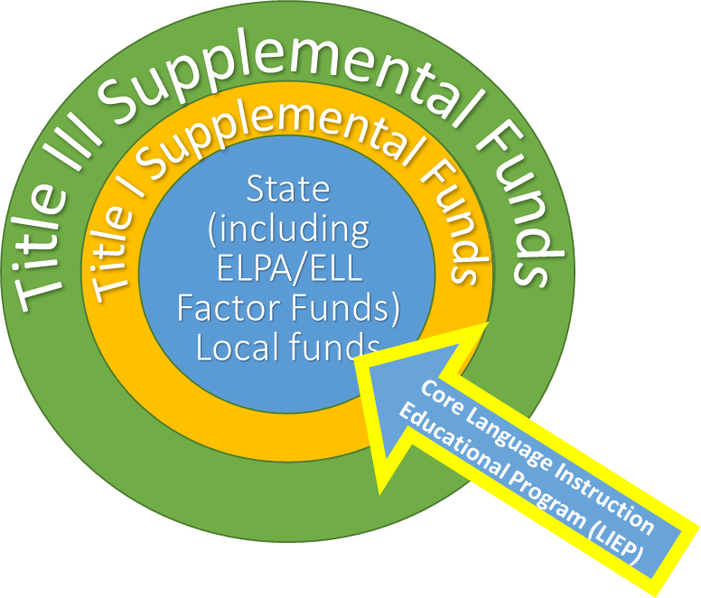
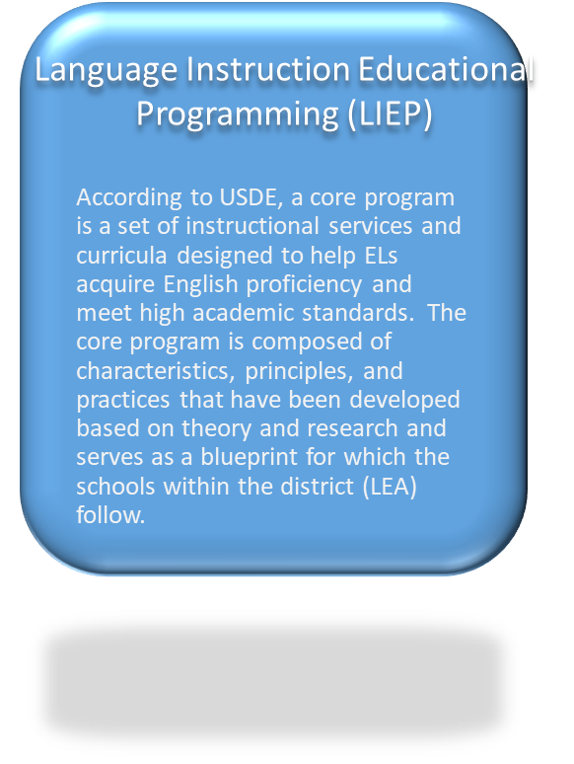
Title III, Part A: Programming

Slide 18
Purpose of Title III, Part A
•Ensure ELs and immigrant children and youth attain English proficiency and develop high levels of academic achievement
•Assist all ELs in meeting Colorado Academic Standards (CAS)
•Establish, implement, and sustain effective English language development (ELD) programs designed to assist in teaching ELs
•Develop and enhance the capacity of teachers, principals, and other school and district leaders to provide effective instructional programs for ELs
•Promote parental, family, and community participation in ELD programs

Slide 19
Required Activities
Increase English proficiency by providing effective language instructional educational programs
Provide effective professional development
Family & community engagement

Slide 20

What can you do with Title III?
• Supplementary educational programs that work to increase English language proficiency and academic achievement of ELLs/MLLs
• Providing effective supplemental language instruction educational programs that meet the needs of ELLs/MLLs, including early childhood education programs that demonstrate success in increasing (A) English language proficiency; and (B) student academic achievement (ESEA Section 3115(c)(1))
• Providing professional development that is: (B) sustained (not stand-alone, 1-day, or short-term workshops), intensive, collaborative, job-embedded, data-driven, and classroom-focused.
• Promoting parent, family, and community engagement through community participation programs, family literacy services, and parent outreach and training activities to ELLs/MLLs and their families.

Slide 21
What can you do with Title III?
• Upgrading ELL/MLL programs’ objectives and effective instruction strategies.
• Improving the instruction program for ELLs/MLLs by identifying, acquiring, and upgrading curricula, instructional materials, educational software, and assessment procedures.
• Tutorials and supplemental materials (including home language) for ELLs/MLLs
• Early college high school or dual enrollment programs for ELLs/MLLs. This new provision presents a valuable opportunity to promote college and career readiness for ELLs/MLLs and to bridge their transition to postsecondary education. Title III funds cannot, however, be used to fulfill an LEA’s obligations under Title VI and the EEOA, including an LEA’s basic obligation to provide a Language Instruction Educational Program to all ELLs/MLLs in the district that is educationally sound and has been proven successful.
• Improving instruction, including the provision of educational technology, for all ELL/MLL subgroups: Newcomers, Developing ELLs/MLLs, Long Term ELLs/MLLs, ELLs/MLLs with disabilities, Students with Interrupted/Inconsistent Formal Education (SIFE), and Former ELLs/MLLs.

Slide 22
Supplement, Not Supplant (SNS)
ABOVE & BEYOND
Title III funds can only be used to provide ADDITIONAL:
  Staff
  Programs
  Materials
Federal funds cannot pay for resources that would otherwise be purchased with State/local funds
Supplanting occurs when the LEA provides services that:
  are required under other federal, state, or local laws, or
  were provided with non-federal funds in prior years

Slide 23

Supplement, Not Supplant: Fiscal
Title III funds cannot be used for an activity (supplies, curricular resources, FTE, stipends, etc.) that was previously paid for with another funding source
How was it funded in the past?
Other federal or state and local funds?

Slide 24
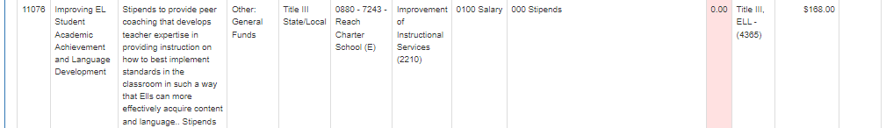
Supplement, Not Supplant: Fiscal

Slide 25
Supplement, Not Supplant: Programming
Title III funds cannot be used for an activity (supplies, curricular resources, FTE, stipends, etc.) that is required for local ELD programming per Civil Rights, DoJ, and State laws or required by local policies, Consent Decrees, or agreements.
How is this activity supplemental to the core ELD program? (Above & beyond)
How is the program specifically designed for ELs?
It is required through ELPA? READ Act?

Slide 26
Uses of Funds
ADMINISTRATION
2% of total allocation for administration of grant
Any funds reserved for administration costs may be used only for direct administrative costs

Slide 27
Examples of ALLOWABLE Title III Activities
Classroom instructional assistants
Teacher preparation for effective EL instruction for all educators
Implement:
  Family education programs
  Parent outreach
  Training activities designed to assist only parents of Title III served students
Translation for only Title III related documents and services

Slide 28

Title III Activities: CAUTION
Curriculum
  Expand curriculum/purchasing supplemental
  Don’t purchase new core curr
Additional computers in the EL classroom
  The computers purchased must be beyond what is already available for teachers and/or required by district and state
Translation/interpreting
  Is it a core EL program requirement/

Slide 29

Title III Activities: NON-ALLOWABLE
Expenses related to the administration of the WIDA assessments
Salary for EL teacher providing core instruction
Translating and interpreting for required events, forms, and documents
Technology costs not directly related to supporting ELs

Slide 30

RED FLAGS
•W-APT, WIDA Screener, or ACCESS 2.0
•ELPA requires LEAs to identify, provide services, and annually evaluate ELs.
LEAs cannot use Title III to purchase these materials, train teachers, or provide FTE/subs/release time to administer assessments.
•Core resources
•Curricular resources for ELD or content blocks
•ELD Resources - EL Achieve, Pearson Language Central, NatGeo Edge, Reach, Inside the USA
•READ Act approved programming
•Required FTE for core ELD Program
•FTE for core content programming
•Using TIII to pay for ELs to participate in an activity paid for with local funds for other students

Slide 31
RED FLAGS, continued
•Translation/Interpretation Services
•Translation/interpretation can only be used for activities non-essential to the students’ education or personal well-being.
Anything that needs to be communicated regarding the student’s academic successes or challenges or the health and safety of the student needs to be translated or interpreted with general funds
(i.e., parent conferences, parent requests for information, IEP meetings/plans, communications after an incident at school, PTA meetings, etc.)

Slide 32
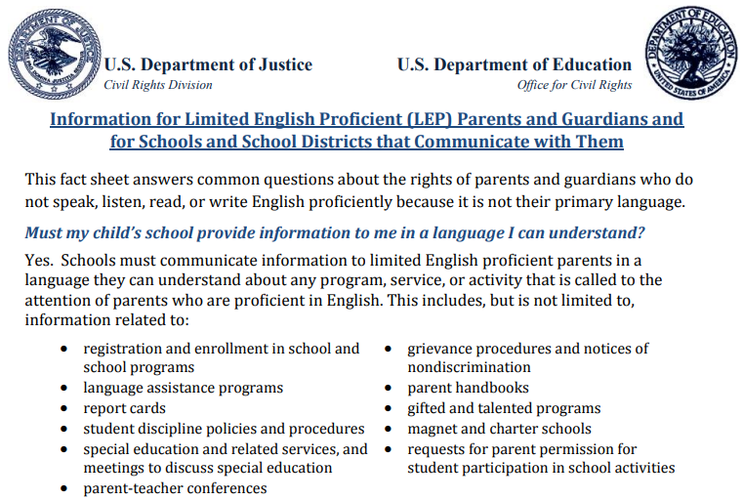
Additional Guidance: Meaningful Communication with Parents

Slide 33
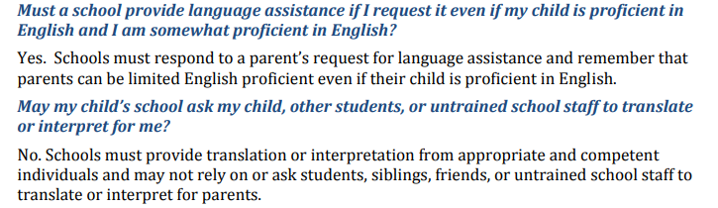
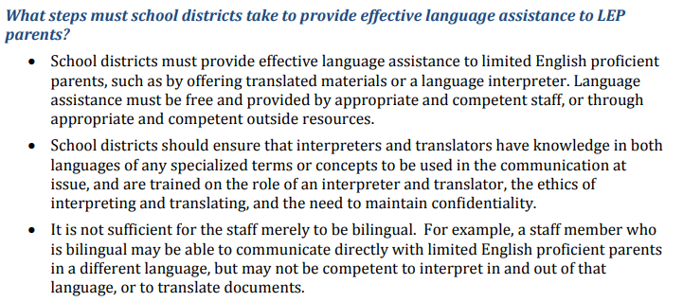
Additional Guidance: Meaningful Communication with Parents

Slide 34
Other Reminders: Private school consultation
Who is eligible?
  An LEA that receives Title III funds must provide Title III services to eligible non-profit private school PK-12 students, teachers, and other educational personnel according to the number of eligible students enrolled at the private school.
Consultation
  Must engage in timely and meaningful consultation with private school officials. The consultation must be ongoing throughout the school year.

Slide 35
Private school: Title III Equitable Services
Which students are eligible?
  EL private school students that attend a private school in the LEA geographic location
How to determine how many students:
  Students must be identified the same way LEA ELs are identified
    Home Language Questionnaire/Home Language Survey, screener
What if current private school does not identify EL students?
  Through the consultation, it may be determined that the LEA will assist the private school with the identification process.

Slide 36
Private school: Title III Equitable Services
To ensure equitable participation, a school district must:
  Consult promptly and in a meaningful way with private school officials to assess, address, and evaluate the needs of private school ELs, teachers, and other personnel
  Spend funds per-pupil equal to the funds it expends for public students
  Offer private school students, teachers, and other personnel to take part in professional development opportunities it offers

Slide 37
Private school: Title III Equitable Services
EXAMPLE SERVICES:
  Tutoring for ELs before, during, and after school hours
  Professional development
  Summer school programs to provide English language instruction
  Supplemental instructional materials and supplies

Slide 38
Private school: Title III Equitable Services
SCHOOL DISTRICTS MUST HAVE DOCUMENTATION OF THE FOLLOWING:
  Evidence of consultation
    Record that student lives within district boundaries
  Evidence of non-public school’s process to identify English learners
  Fiscal records aligned with allowable activities
  Compliance with supplement, not supplant provision

Slide 39

Information for Limited English Proficient (LEP) Parents and Guardians and
for Schools and School Districts that Communicate with Them
https://www2.ed.gov/about/offices/list/ocr/docs/dcl-factsheet-lep-parents-201501.pdf
US Dept of Ed: English Learner Toolkit
https://ncela.ed.gov/files/english_learner_toolkit/OELA_2017_ELsToolkit_508C.pdf
CLDE ELD Guidebook
http://www.cde.state.co.us/cde_english/eldguidebook
English Language Proficiency Act (ELPA)
http://www.cde.state.co.us/cde_english/elpa
CDE: Title III, Part A - Supplemental Supports for English Learners
http://www.cde.state.co.us/fedprograms/tiii/index
CDE’s Title III Quick Reference Guide
http://www.cde.state.co.us/fedprograms/tiiipaquickref
Resources

Slide 40

Contact us
Kathryn Wisner
wisner_k@cde.state.co.us
720-595-7689
Rachel Temple
temple_r@cde.state.co.us
720-202-6135

Slide 41
What questions do you have?

Slide 42

Thank you

Slide 43
Upcoming Meetings

Slide 44

Any Requests for Upcoming Topics or Questions!
Upcoming Office Hours
July 7:
  Expanded Learning Opportunity Stakeholder Engagement

Slide 45
CDE Contacts!
Emails: Lastname_Firstinitial@cde.state.co.us
(e.g., Smith_a@cde.state.co.us)
Federal Programs & Supports (ESEA/ESSER Program Supports) | School Finance & Operations (Fiscal and Systems Supports)
Nazie Mohajeri-Nelson, Federal Programs & Supports Unit ESEA Programs Specialists and ESEA Regional Contacts (assigned by district) Title I: Laura Meushaw, Kathryn Wisner, Niko Kaloudis, Evita Byrd Title II: Niko Kaloudis, Karen Bixler Title III: Kathryn Wisner, Rachel Temple Title IV: Tammy Giessinger Title V: TBD ESEA and ESSER: Shannon Wilson ESSER Program Monitoring Specialists Kristin Crumley Jonathan Schelke Kim Boylan ESEA and ESSER Data and Reporting Specialists Tina Negley Alan Shimmin Mary Shen Mackenzie Owens | Kate Bartlett, Executive Director of School District Operations Unit Fiscal Specialists Jennifer Austin, Director of Grants Fiscal Management ESEA Robert Hawkins, Grants Fiscal Analyst Steven Kaleda, Grants Fiscal Analyst ESSER Fiscal Specialist Steven Kaleda Grants Fiscal Analyst ESSER Monitoring Bill Parsley, ESSER Fiscal Monitoring Supervisor Hilery Morris, ESSER Fiscal Monitoring Application Systems Specialists DeLilah Collins, Director of Grants Program Administration Online Applications Systems Technical Support Michelle Prael

