Slide 1
CDE Office Hours
May 25, 2023

Slide 2
ESSER Office Hours
Topics
Updates and Reminders
  Cons App reminders and ESEA Requirements
  Allowable Uses of ESSER and ESSER Requirements
National Convening on English Learners’ Civil Rights
ESSER Reporting Reminders and Clarifications
Monitoring – Lessons Learned Share-out
Stronger Connections Grant Intent to Apply
Q&A time for the 2023-2024 Consolidated Application

Slide 3
Updates and Reminders

Slide 4

Consolidated Application Questions?
The Consolidated Application for ESEA funds is now open! The application is due on June 30th.
This time has been reserved for LEAs to ask questions about the application.
Sign in to the application system HERE
Notes:
Rachel E

Slide 5
Consolidated Application Reminders
The Year at a Glance indicates the following should be happening right now (Note: Some tasks listed should be close to completion):
  Declare participation in Community Eligibility Provision to School Nutrition, if applicable. CEP is an optional poverty measure used for serving Title I schools.
    Program Eligibility for Nutrition Programs and all the forms needed, including for CEP
  Evaluate English learner redesignation status including Els with disabilities.
  Have LEA budget discussions that include staff assignments to ensure compliance with Title I, Part A comparability and EDT requirements for the following school year.
  Plan and collaborate with local neglected or delinquent facilities to plan activities for Consolidated Application, if applicable.
  All public school code changes for the 2023-24 school year must be submitted to CDE no later than June 30. The forms for making changes can be found under “School Code Change Request Forms” on CDE’s Directory Webpage.
Non-Public Consultation form and the School Improvement Retention of Funds form are both available on the website and are due on May 31st.
  These will need to be uploaded in the application.
Notes:
Nazie

Slide 6
Reminders of ESEA Requirements

Slide 7
ESEA Requirements
Constitutionally Protected Prayer
  Updated guidance (May 15, 2023)
  Each local educational agency (LEA) must continue to file annually the statutorily required certification with their state educational agency (SEA) that no policy of the LEA prevents, or otherwise denies participation in, constitutionally protected prayer in public elementary and secondary schools
    Part of the General Assurances
      Annually certified
        ARAC
        Approval & Transmittal form (required for substantial and final approval each year)
Notes:
Nazie
https://www2.ed.gov/policy/gen/guid/religionandschools/prayer_guidance.html

Slide 8
Reminders of Allowable Uses of ESSER

Slide 9
Uses of ESSER Funds
USDE Guidance
C-21. May ESSER and GEER funds be used to serve adults, including English learners, who are eligible to be served under the Adult Education and Family Literacy Act?
Yes. An LEA may use ESSER and GEER funds for any activity authorized by the Adult Education and Family Literacy Act (AEFLA), which is Title II of the Workforce Innovation and Opportunity Act. These activities could include:
Conducting outreach activities to re-enroll eligible adults who may have discontinued their attendance due to the COVID-19 pandemic;
Providing career counseling for eligible adults who suffered job loss as a result of the COVID-19 pandemic;
Purchasing technology (including laptops, Wi-Fi hotspots, or tablets) that enable adult learners to access virtual instruction;
Professional development for adult education instructors in the effective implementation of online learning;
Providing instruction to improve digital literacy of adult learners, including English learners, to improve digital access and inclusion;
Assessing the skills and educational progress of adult learners using virtual assessment tools; and
Accessing PPE and cleaning and disinfecting classrooms used during the regular school day so that they may be used for adult education and literacy activities in the evening.
Notes:
Nazie

Slide 10
Uses of ESSER Funds Cont’d
USDE Guidance
C-22. May ESSER and GEER funds be used for career and technical education?
Yes. An LEA may use ESSER and GEER funds for any activity authorized by Perkins V. These activities could include, for example:
Updating the comprehensive local needs assessment required by section 134(c) of Perkins V to reflect changes in the labor market caused by the COVID-19 pandemic;
Providing ridesharing services to transport students to shared-time area career and technical education centers or work-based learning opportunities;
Adjusting curriculum to account for the academic impact of lost instructional time or to cover technical skills that could not be addressed during remote instruction;
Providing professional development on the delivery of remote classroom instruction and virtual or remote work-based learning opportunities;
Purchasing remote test-proctoring services so that students can participate remotely in assessments for industry-recognized credentials;
Implementing simulated work-based learning or school-based enterprises to replace work-based learning opportunities that are no longer available in the community due to the COVID-19 pandemic;
Providing support to low-income students for college application fees; and
Supporting students who graduated high school in the class of 2020 and students who will graduate in the class of 2021 (i.e., during the pandemic) but have not yet successfully transitioned to college or careers by providing, for example, college or career counseling, assistance with college applications, entry into job training programs, and financial literacy.
Notes:
Nazie

Slide 11
ESSER Requirements

Slide 12
ARP ESSER III - 20% Learning Loss Set Aside
ARP ESSER III - had some additional requirements
  LEA use of funds plans
  Safe In-Person plans that need to be updated every 6-months until 9/30/24
    Ensure that we have a link to your plan and that you are reviewing every 6-months to see if any changes are needed
  Maintenance of Equity
  20% Learning Loss Set Aside
    Resources for ….
      USDE document on strategies for using ESSER III funds to address the impact of lost instructional time
    Ensuring that budgets have a minimum of 20% allocated to learning loss - otherwise will trigger a monitoring finding

Slide 13
Federally Funded Construction!

Slide 14
ESSER Funded Construction
Using federal funds for construction triggers several additional requirements!!
If you have used ESSER funds for construction, remember to check our guidance document to ensure you are complying with these additional requirements and the Construction attachment on Grant Award Letters.
Davis-Bacon Act
Protecting the federal interest:
  The LEA must record the notice of federal interest in the official real property records for the jurisdiction in which the facility is located as soon as it receives approval from the SEA to construct or renovate the facility.
As a reminder, the LEA is subject to the annual reporting requirements in 2 C.F.R. § 200.330 and the disposition rules in 2 C.F.R. § 200.311.
CDE has transferred the oversight responsibility of construction projects and contracts to the LEA. It is therefore the LEA’s responsibility to ensure all federal requirements are being met, including making sure contractors and subcontractors are complying with Davis Bacon weekly payroll certification, collecting and storing those certifications, making sure contractors are not debarred, protecting the federal interest in construction projects, and periodically conducting site visits. CDE will periodically check through monitoring!
Notes:
CCSSO webinar on 5/25/23
Generally, local agencies must send certified payrolls to the federal awarding agency, but federal agencies typically delegate this responsibility to states.
States can delegate to LEAs but should verify LEAs are spot checking certified payrolls.
States can delegate the storage of certified payrolls to LEAs but should verify LEAs have good maintenance procedures.

Slide 15
Davis-Bacon Act & Other Construction Requirements - Trainings & Guidance
CDE Guidance Document
The US. Department of Education has recently released guidance and training on construction funded with federal funds that have flown from the U.S. Department of Education.
Davis Bacon Fact Sheet
Davis Bacon training by the Department of Labor [very helpful training if you have used ESSER funds for construction projects] ~ April 27, 2023
DOL Presentations on Prevailing Wages
CDE Office Hours: Training provided by the BruMan Group:
January 26, 2023
April 27, 2023

Slide 16
National Convening on
English Learners’ Civil Rights
Notes:
Rachel T.

Slide 17

National Convening on English Learners’ Civil Rights
June 22-23, 2023
This event will:
  Focus on laws and policies relevant to the civil rights of English learners
  Highlight guidance and resources to equip state and local education agencies with tools to meet their obligations to English learner students and families
Please register by June 12, 2023
Notes:
The U.S. Department of Education's Office of English Language Acquisition (OELA) and Office for Civil Rights (OCR) are hosting a virtual convening on Thursday, June 22 and Friday, June 23, 2023. The event will focus on statutes, regulations, and case law relevant to the civil rights of English learners and will highlight guidance and resources to ensure that state and local education agencies are equipped with tools to meet their obligations to English learner students and families. Please join us if you are interested and share this with your LEAs and stakeholders. https://registration.socio.events/e/elcivilrights2023

Slide 18
ESSER Reporting -
Reminders and Clarifications
Notes:
Mackenzie

Slide 19
Data Elements We Pull From the Applications
The U.S. Department of Education (USDE) has been authorized by Congress to collect data from all ESSER I, II, and III (and other ESSER award) grantees, including but not limited to the uses and impact of funds.
CDE is able to use the ESSER I, II, and III applications to provide the vast majority of the requested data (809 data elements total) on behalf of our LEAs.
Data requested includes information on all LEAs’ expenditures and planned activities in the following four main activity types:
  Addressing Physical Health and Safety
  Meeting Students’ Academic, Social, Emotional, and Other Needs (Excluding Mental Health Supports)
  Mental Health Supports for Students and Staff
  Operational Continuity and Other Allowed Uses
Next year, we will be reporting on more specific categories within each of the main activity types.

Slide 20
Other Data Elements Pulled from the Applications
We also report on ESSER funds used for:
  Maintaining safe-in person instruction
  Internet access
  The 20% set-aside for learning loss
  FTE (including total FTE in LEA)
Please note that CDE reports our LEAs’ uses of funds and is able to respond to majority of the data from LEA applications and without adding any additional collections to LEAs, with the exception of the three data elements described on next few slides.
Please see the USDE reporting template for all of the data elements in the collection.

Slide 21
Data Elements We Collect from You
Data elements we collect from you:
  How students with poor attendance or participation have been re-engaged (submitted for this year)
  How school level allocations were determined (submitted for this year)
  LEA and school-level participation in ESSER activities (due in September for this year)
We collect these three data elements from you because we cannot get this data from the ESSER applications.

Slide 22
Importance of Accuracy and Completeness of ESSER Applications
We pull our reporting data from the ESSER application budgets.
Please ensure that your budgets accurately reflect your planned and/or expended uses of activities.
We understand that budgets change, which is why it is important to submit a PAR whenever an activity change is larger than 10% of the activity amount.

Slide 23
Monitoring –
Lessons Learned Share-out
Notes:
Nazie

Slide 24
Connecting Uses of Funds in All Processes
Application and Budget
General Ledger
Annual Financial Report
As part of our data reporting work, we compare across LEA plans/applications, budgets, AFRs, and General Ledgers submitted in the monitoring process.
We are checking for alignment to make sure that the activities approved in the application and budget, match those submitted in the AFR, and those recorded in the LEA’s general ledger. It is good practice for the LEA to also conduct this type of comparison to ensure that federal funds are being used as approved and in compliance with statutory and regulatory requirements.
Notes:
Nazie

Slide 25
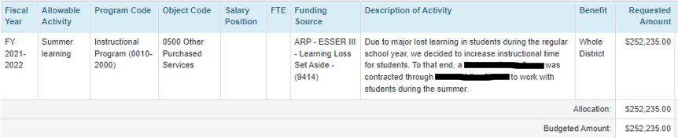
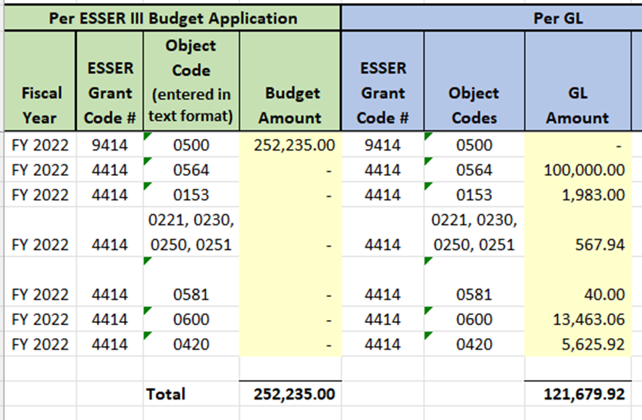
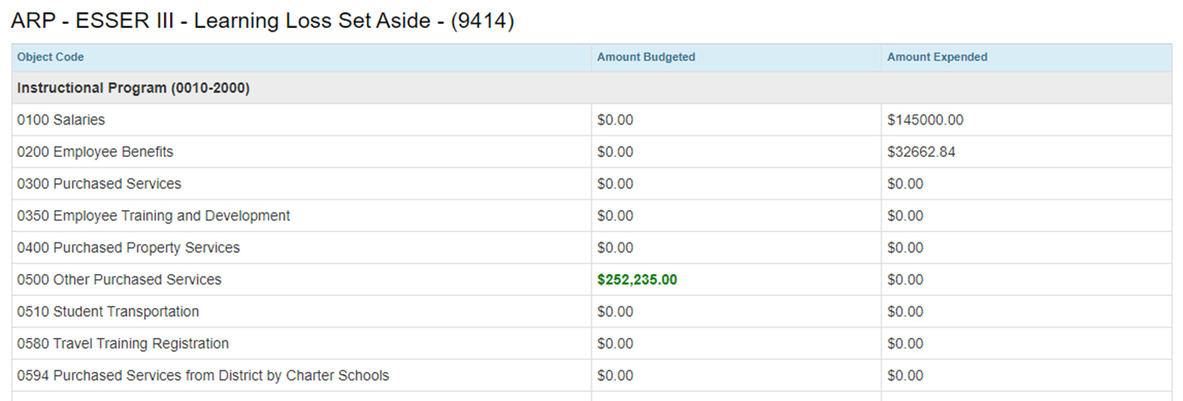
Budget App >= General Ledger (GL) = Annual Financial Report (AFR)
Budget App
The Budgeted amount should always be equal to or greater than the amounts in the AFR and GL.
The AFR and GL should match in grant code, object code and amount
Example of a three-way mismatch
GL
AFR
Notes:
Bill/Hilery

Slide 26
Stronger Connections Grant
Notes:
Evita

Slide 27
SCG Updates
A few clarifications:
Awards of up to $200,000 per applicant; may have more than one applicant per LEA
Submit applications based on identified needs; may have multiple needs
Refer to Appendix A in the RFA to confirm LEA’s “high-need” status
Need for non-public school consultations will depend on the activities being implemented and the schools that will be participating
Status Update:
39 Intent to Apply submissions
Applications are due June 7, 2023
Reach out to Stronger_Connections@cde.state.co.us with questions
Notes:
Evita

Slide 28
Call for Reviewers
The Colorado Department of Education (CDE) is seeking volunteer peer reviewers for Stronger Connections Grant (SCG) applications. More information about this grant is available on CDE’s Stronger Connections Grant website.
It is preferred that reviewers have knowledge of physical education; mental health; social emotional wellness; sexual health; drug or violence prevention; chronic absenteeism; counseling services; promotion of a healthy school environment; health education; health services; and/or parent and community involvement.
If you are available and interested in participating in this virtual review process, please complete a brief survey regarding your experience and areas of expertise as soon as possible, but no later than Wednesday, June 7, 2023.
This review will be completed virtually, and there is no in-person review component. Reviewers should have a reliable internet connection.
Review Timeline:
Thursday, June 15, 2023: Readers receive review materials
Participants review approximately 4-6 applications.
Thursday, June 15 – Monday, July 10, 2023: Individual and Team Reviews
Reviewers will read and assess their assigned applications individually and then collaborate with their team members to determine consensus scores and feedback for each of their assigned applications.
Monday, July 10, 2023: Scores due to CDE by 12 pm
Team consensus scores and feedback for each assigned application are due to CDE. CDE staff will review team feedback and contact readers within the following week if any clarification is needed.

Slide 29
Consolidated Application Q & A
Notes:
Rachel E

Slide 30
23-24 Consolidated Application
The 2023-2024 Consolidated Application is now open!
  Non-Public Consultation form and the School Improvement Retention of Funds form are due by May 31st.
The deadline for a complete application and all applicable documents is June 30, 2023.
For questions or assistance, please contact your ESEA Regional Contact.
Notes:
Rachel E

Slide 31
Consolidated Application Questions?
The Consolidated Application for ESEA funds is now open! The application is due on June 30th.
This time has been reserved for LEAs to ask questions about the application.
Sign in to the application system HERE
Notes:
Rachel E

Slide 32
Upcoming Meetings

Slide 33

Looking Ahead…
Any requests for topics or questions?
Upcoming Office Hours:
  June 8 Office Hours rescheduled to June 15
  June 22 Office Hours
  July Office Hours are cancelled

Slide 34
CDE Contacts!
Emails: Lastname_Firstinitial@cde.state.co.us
(e.g., Smith_a@cde.state.co.us)
Federal Programs & Supports (ESEA/ESSER Program Supports) | School Finance & Operations (Fiscal and Systems Supports)
Nazie Mohajeri-Nelson, Executive Director of Federal Programs & Supports Unit Program Specialists Program Implementation Supervisor: Laura Meushaw Program Implementation Coordinator: Christina Adeboye Sullivan Program Monitoring Supervisor: Tammy Giessinger ESEA/ESSER Monitoring Coordinator: Kristin Crumley Program Effectiveness Supervisor: Tina Negley ESEA Programs Specialists and ESEA Regional Contacts (assigned by district) Title I: Laura Meushaw, Evita Byrd, Rachel Echsner Title II: Karen Bixler Title III: Rachel Temple Title IV: Tammy Giessinger, Nathan Hickman Title V: Melissa Chaffin ESSER Program Specialists Jonathan Schelke Kim Boylan ESEA and ESSER Data and Reporting Specialists Tina Negley Mary Shen Mackenzie Owens Melissa Chaffin | Amy Carman, Executive Director of School District Operations Unit Fiscal Specialists Jennifer Austin, Director of Grants Fiscal Management ESEA Robert Hawkins, Grants Fiscal Analyst Steven Kaleda, Grants Fiscal Analyst ESSER Fiscal Specialist Steven Kaleda Grants Fiscal Analyst ESSER Monitoring Bill Parsley, ESSER Fiscal Monitoring Supervisor Hilery Morris, ESSER Fiscal Monitoring Kristina Jones, Federal Fiscal Monitoring and Reporting Specialist Werner Hagemann, ESSER Fiscal Monitoring Specialist Application Systems Specialists DeLilah Collins, Director of Grants Program Administration Online Applications Systems Technical Support Michelle Prael

