Slide 1
CDE Office Hours
May 9, 2024

Slide 2
ESSER Office Hours
Topics
Updates and Reminders
  State Level Activities under Stronger Connections Grant
  Spring 2024 Grant Opportunities
  ESSER Countdown to Closeout
ESSER III Rapid Request
Streamlined UIP: Information for Federal Programs
Title III
Notes:
Nazie

Slide 3
Updates and Reminders
Spring 2024 Grant Opportunities
Notes:
Nazie

Slide 4
Stronger Connection Grant State Level Activities
Enhancing School Safety: Integrating Prevention and School Climate Improvement Efforts.
  This training will explore the fundamentals of preventing school violence by emphasizing the creation of systems and structures essential for positive school environments.
  District and school-level educators, administrators, mental health staff, school resource offices, family liaisons, and other community partners involved in school safety and violence prevention efforts (e.g., discipline, social-emotional and behavioral development, climate and culture, multi-tiered system of supports) are invited to attend. Registration will be open soon for the following dates and locations:
  Dates and locations:
    June 20, 2024: Front Range Community College, Westminster REGISTRATION LINK
    August 2, 2024: Adams State University, Alamosa REGISTRATION LINK
    August 21, 2024: 5-R High School, Grand Junction REGISTRATION LINK
    September 20, 2024: Northeastern Junior College, Sterling REGISTRATION LINK
We also plan to offer Learning Cohorts centered on problems of practice related to school safety during the 2024-25 school year. More to come!
Non-public Schools are eligible to participate in any of the SCG State Level activities. Please extend the invite to any NPS in your LEAs that may be interested.

Slide 5
ESSA Reduction in Funds for FY 2024-2025
The State’s Title I allocation has gone down by $5 million!
ESSER funds are sunsetting!
How to strategize and which funding streams to consider:
Any remaining ARP ESSER III funds - PAR
ESSA Carryover Funds
Title I Reallocated
ARP ESSER III Rapid Request
If ESSA identified schools, EASI grants: Diagnostic Review or Targeted Grant for costs associated with an evidence-based interventions
Use above funding to free up general and/or ESSA funds for FY24-25
Which funding stream is going to best help meet your needs? None will make up for the full reductions!

Slide 6
Title I Reallocated Grant
Who? Any LEAs that have seen a significant reduction in their ESEA Allocations!
How Much? Total Available: $670,000
By when? Expiring ESEA Funds: Must be obligated by 9/30/24
For What? Allowable Uses of Funds: Title I allowable supplemental activities, aligned with CNA, reasonable and necessary to meet program intent.
Deadline | Description
Friday, May 31, 2024 | Applications due to CDE by 11:59 pm.
May 31 - June 13, 2024 | Review of Applications.
Friday, June 14, 2024 | Applicants will be notified of application status.
Monday, September 30, 2024 | All funds must be obligated (i.e. A contract with a provider must be executed).
Wednesday, October 30, 2024 | Funds must be requested for reimbursement from CDE.
Notes:
Nazie

Slide 7
ARP ESSER III Rapid Request - More Details in a Few Minutes
Who? Any LEAs that have spent their own ESSER III allocations but have remaining costs associated with the pandemic!
How much? Total Available to be determined!
By When? ARP ESSER III State Reserve Funds: Must be obligated 9/30/24
For what? Allowable Uses of Funds: Any activity that is allowable under ESSER, is reasonable in cost, and necessary to respond to, prepare for, prevent the spread of, or recover / emerge stronger from the pandemic.
Deadline | Description
Thursday, June 13, 2024 | Applications due to CDE by 11:59 pm.
June 13 - July 1, 2024 | Review of Applications.
Friday, July 1, 2024 | Applicants will be notified of application status.
Monday, September 30, 2024 | All funds must be obligated
Wednesday, October 30, 2024 | Funds must be requested for reimbursement from CDE.
Notes:
Nazie

Slide 8
EASI Grant for ESSA Identified Schools
If an LEA has any ESSA Identified Schools (i.e., CS, TS, or ATS), there are 2 grant opportunities for this spring:
Diagnostic Reviews to be conducted in September or October of 2024
EASI Targeted - Costs associated with evidence-based interventions / strategies being implemented this summer
  Both applications will be due in May 24, 2024
  Funds must be obligated by September 30, 2024
    Obligated activities can be implemented in October
  Funds must be requested by November 15, 2024
Notes:
Nazie

Slide 9
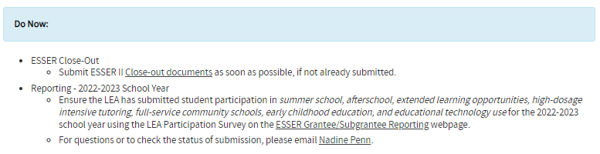
Countdown to Closeout
Website where updates and outline of remaining tasks on ESSERs will be posted!
Please bookmark the Countdown to Closeout website!
ESSER Reporting: 2021-2022 Activities - Final report due in July
ESSER Reporting: 2022-2023 Activities - Preliminary report in June
Notes:
Nazie

Slide 10
ESSER III Rapid Request
Notes:
Matt Koziol

Slide 11
ESSER III Rapid Request
ESSER State Reserve Competitive Grant
ESSER III Rapid Request is a competitive grant funded with ARP ESSER III State Reserve funds. It will open on Monday, May 13, 2024, in GAINS (the CDE grant application system).
Grant Purpose: Allows eligible LEPs to apply to submit ESSER-eligible expenses to be reimbursed with ESSER grant funds, including:
  ESSER-eligible activities completed in FY2023-24 (July 1, 2023 - June 30, 2024) funded with a non-ESSER funding source (ex. General Fund)
  Intended future ESSER-eligible expenses in FY2024-25 (July 1, 2024 - September 30, 2024).
    Note - all funds must be obligated or expended by September 30, 2024
Eligible Applicants include:
  School Districts, BOCES, Charter Schools (authorized by either CSI or a school district), Administrative Units, Facility Schools, and Native Tribes.
*Application is pending EDAC approval. All statements are subject to modification based on EDAC review.
Notes:
Nazie

Slide 12
ESSER III Rapid Request, con’t
ESSER State Reserve Competitive Grant
Priority Areas: Grant funds will be prioritized for submitted budget line items that are:
Previously incurred expenses from FY2023-24 that will be moved to this ESSER award,
Activities for evidence-based student learning loss from the pandemic,
Activities with the purpose of serving underserved students disproportionately impacted by the pandemic,
Activities to strengthen student engagement, attendance, or SEL initiatives,
Expenses for LEPs with a reduction in ESEA Titles I-V funds, prioritized by greatest percentage reduction.
Important Dates:
Monday, May 13: Grant Opens in GAINS
Friday, May 17, 10am: Informational webinar for applicants
Thursday, June 13: Application closes
Monday, July 1: Award notifications
*Application is pending EDAC approval. All statements are subject to modification based on EDAC review.

Slide 13
Streamlined UIP Template:
Information for Federal Programs
May 9, 2024
FPSU Office Hours
Sue Miller-Curley, ESEA Monitoring and Title II Specialist, Federal Programs
miller-curley_s@cde.state.co.us
Erin Loften, School Improvement and Planning
Loften_e@cde.state.co.us
Notes:
Welcome- Thank you for being here. We know this is a season of change w/ Consolidated Application. There is another change happening in that there is new streamlined UIP. Today we want to give you a high level overview

Slide 14
Outcomes
Review ESSA-Identification and Planning Requirements
  Comprehensive Support (CS)
  Targeted Support (TS)
  Additional Targeted Support (ATS)
Introduce Streamlined UIP Template w/Structural Shifts
Share updated Quality Criteria Rubric for Streamlined UIP
  Meeting ESSA Planning requirements
Provide resources for support and questions in planning for 2024-2025 school year

Slide 15
Review ESSA Identification and Planning Requirements

Slide 16
Review: ESSA Identification
Any school currently identified as comprehensive support and improvement must submit to both their district and the SEA an approvable plan
A plan that meets the statutory required elements to help LEAs ensure they are working towards rectifying the reasons for identification
In Colorado, the UIP can serve as the CS Improvement Plan and requires review and approval by the school, district, and CDE. CDE periodically reviews UIPs from CS schools to ensure they meet ESSA requirements.
  Schools that have been identified for Targeted Support and Improvement must also develop a plan that addresses the reasons for identification, which must be reviewed and approved by the school and district. CDE does not approve these plans; however, they are reviewed during monitoring.

Slide 17
Identification of Schools
Annual identification of Schools for Support and Improvement under ESSA
Comprehensive Support and Improvement (CS)
  CS - Lowest 5% of Title I Schools
  CS - Low Graduation Rate
  CS - Former ATS (first year of identification will be Fall 2022)
Targeted Support and Improvement (TS)
  TS - based on disaggregated group(s); any school with at least one consistently underperforming student group
  Additional Targeted Support (ATS) - based on disaggregated group(s) that on their own meet the criteria for Lowest 5%
Possible to be identified due to participation only

Slide 18

Improvement Planning Requirements for ESSA Identified Schools
CS plans must:
Be developed by the LEA in partnership with stakeholders, including the principal, other school leaders, teacher and parents of the school.
Be informed by student performance on accountability indicators. In Colorado, this currently refers to performance indicators on the School Performance Frameworks.
Include evidence-based interventions.
Be based on a school-level needs assessment.
Address resource inequities.
Be approved by the school, LEA, and CDE
CDE uses the ESSA CS plan requirements embedded within the
Quality Criteria to approve plans, and provide feedback if not yet approved.

Slide 19
Considerations- ESSA Improvement Planning Requirements
Planning Requirements:
Comprehensive Support (CS)
Targeted Support (TS)*
Additional Targeted Support (ATS)*
* LEA review
UIP Traditional Template
UIP Pilot Template
LEA Consolidated Application for ESEA Funds
2023-24
UIP Traditional Template
UIP Streamlined Template
(Optional)
New
LEA Consolidated Application for ESEA Funds
in GAINS
New
2024-25
UIP Streamlined Template
LEA Consolidated Application for ESEA Funds
in GAINS
2025-26
Notes:
This slide is intended to communication the sequence of change in these related processes.

Slide 20
Introduce Streamlined UIP with Structural Shifts
Notes:
Be sure to note why they are “anticipated” and not confirmed what we are actually doing at this point.
More work with our development team that is ongoing.
We still have some formatting changes taking place
Still have some structure pieces we are working on

Slide 21
Goals of Template Change and Evaluation Focus
01
Adding specificity to collections to ensure users know what to fill out
Reorganize layout to align better with school and district planning processes
Ease of Use
02
Shorten and consolidate sections
Remove components not specified in rule or law
Completion Time Reduction
03
New look and feel to form
Improved final report to increase readability
Improved Visual and Public Reporting
Notes:
Again- started a few years ago with some of our current and former colleagues.

Slide 22

Development Process
Working Group- Spring 2021
Input- ACEE, PPRSAC, EDAC, AWG
Piloting group- Google version- Spring 2022
Salesforce Development-Winter 2022
Salesforce Pilot and Evaluation- Fall 2023
Notes:
Pilot Participants
8 district leaders engaged in the pilot
Weld, RFSD, MCVSD, Morgan, BVSD, North Park, DPS, and CSI
27 schools
2 charter schools
In the pilot we had participation from Colorado’s largest school districts to more rural school districts with a wide-range of demographic representation and socio-economic status.
In most cases, we had schools start and submit the new UIP with a couple that reverted back to the original

Slide 23

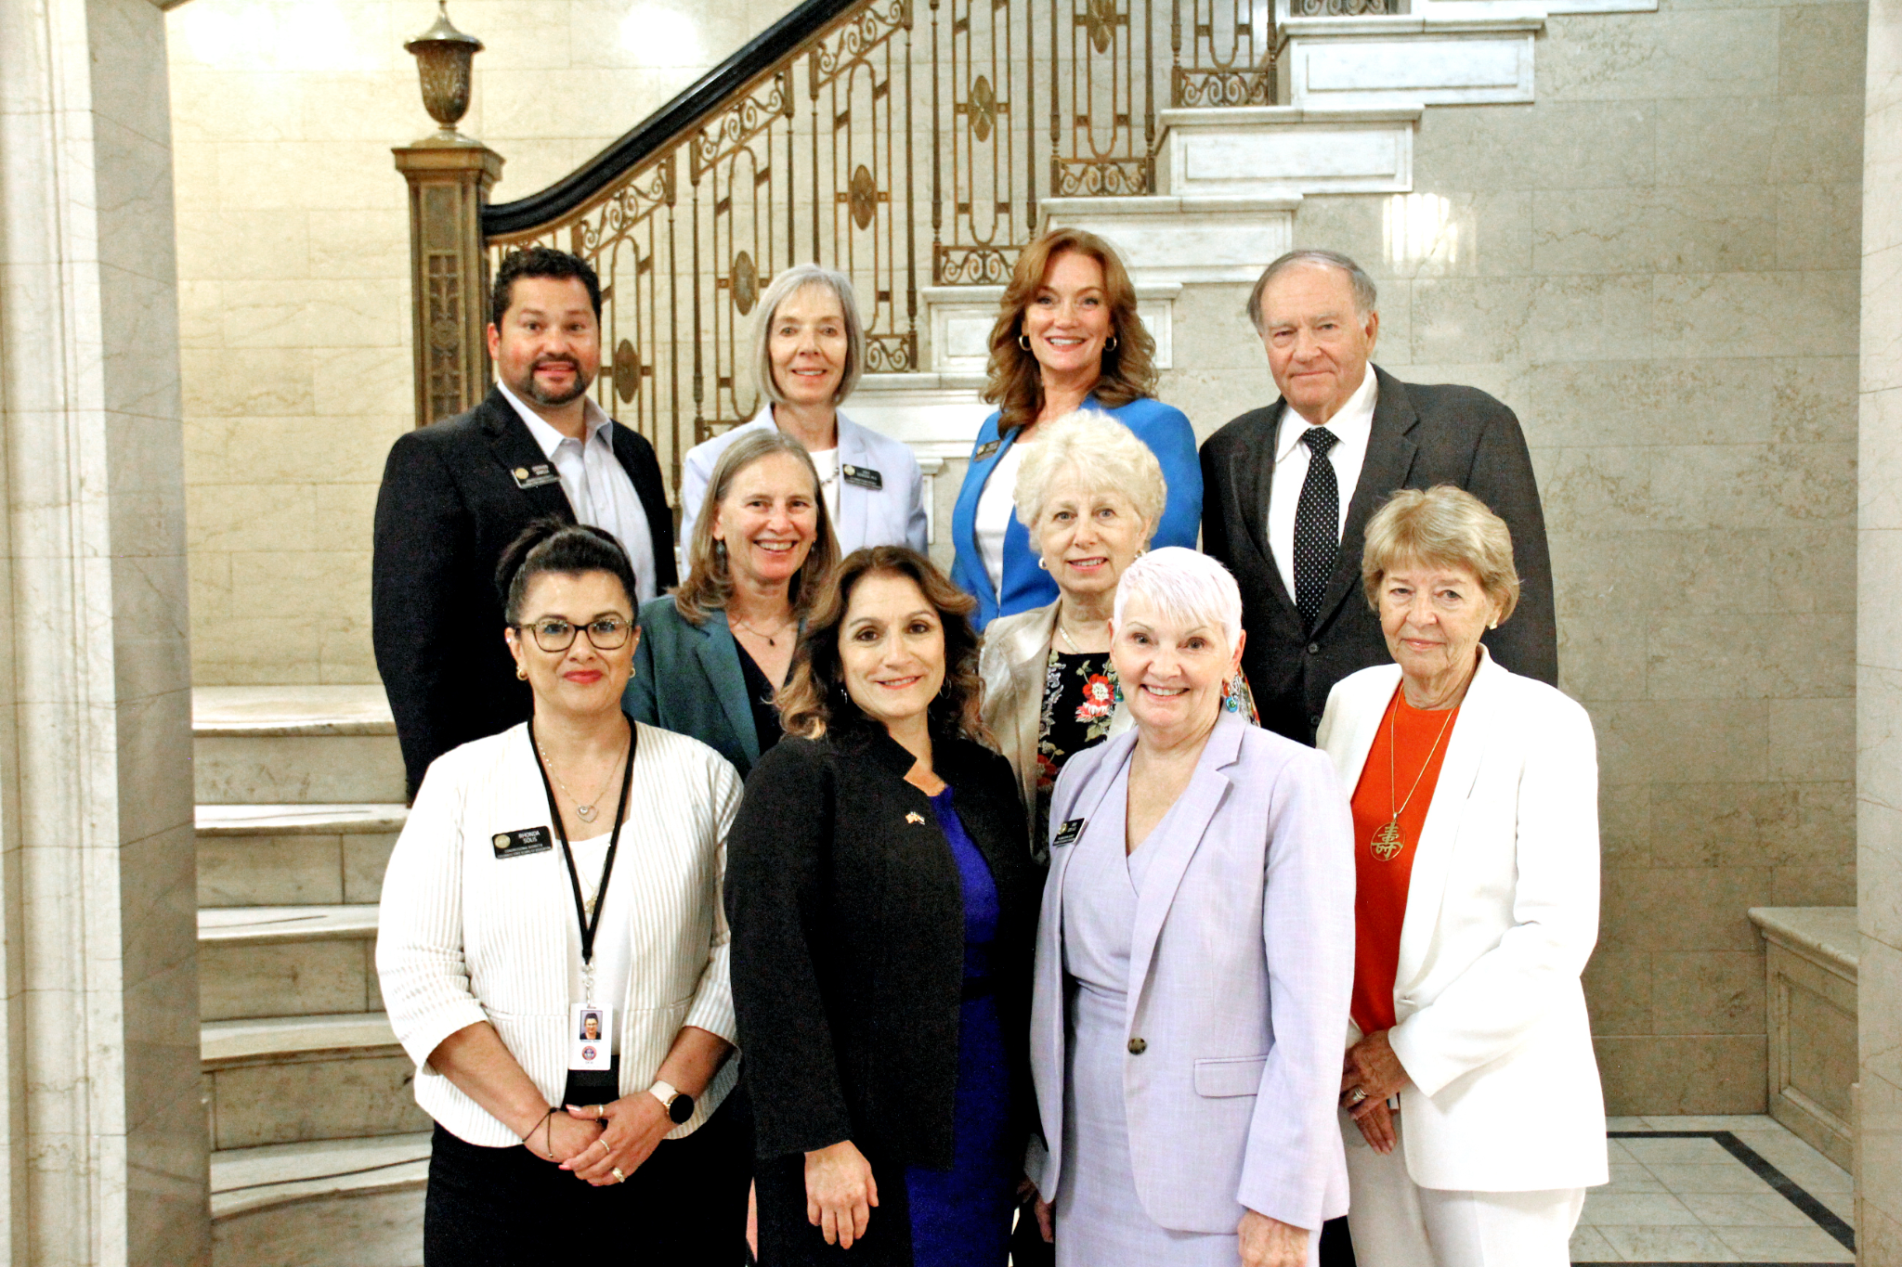

Context for Planning Requirements
Policy Development Structures | General Description | Examples in 2022 Accountability Processes
State Legislature & Governor | Legislature passes statute and Governor signs into law. | SB 22-137: Provides broader overview for adjustments to accountability
State Board of Education | Board provides additional detail on statute through rule process. | State Board Rules: Framework cut scores, request to reconsider process
CDE Documentation and Guidance | Department provides documentation, logistics and parameters for implementation. Guidance includes requirements and recommendations. | Documentation: Frameworks Calculation Guidebook Guidance: Request to Reconsider Guidance, UIP Handbook
Notes:
Although it seem like it all falls on the UIP
It is an intersection of all of the legislation merged into one process and document
It is this instead of having 6-12 different documents that accomplish the same thing.

Slide 24

Terminology Changes
Some of the terms have changed to offer more clarity and purpose.
Traditional UIP | Streamlined UIP
Priority Performance Challenges | Student Performance Priorities
Implementation Benchmarks | Implementation Milestones
Notes:
After talking with numerous different stakeholders (internal and external, programs, former leaders of this work)
PP/SPP- Confusion with Benchmarks and also shifting thinking from deficit thinking
Making terminology
More clear
More specific

Slide 25
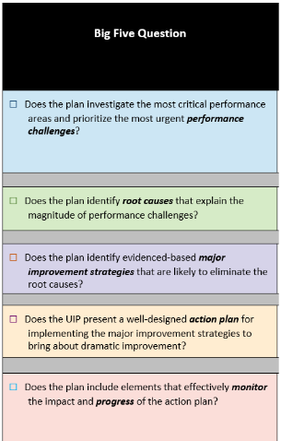
Big Five to Top Three Questions
The Streamlined UIP organized into three sections instead of five.
Does the plan identify high-leverage performance priorities and targets? | Does the plan focus on evidence-based strategies to resolve systemic root causes and drive improvement on identified priorities? | Does the plan outline a coherent approach to implementation and adjustment of the identified strategies?
Student Performance Priorities Annual Target Setting Interim Targets | Root Causes with validation Major Improvement Strategies (including Evidence Base) Associated Resources | Implementation Milestones Action steps

Slide 26

Assurances and Brief Description
For 24/25, the “Brief Description” has been removed and many of the expectations of the data narrative will be moved to assurances.
Last year, assurances were added to the UIP to reduce some of the reporting
  Assurances were used for federal and state accountability as well as READ and Math data analysis.
  Assurances are customized based on school characteristics- identifications, k-3 serving, etc.
Notes:
One of the biggest changes and workload burdens removed
Some of the data narrative and section 1 components moved to assurances

Slide 27

Improved Workflow
The Streamlined UIP Sections:
Assurances
Priorities and Targets
Root Causes and Strategies
Implementation and Actions
Removed use of Sub-Tabs
Notes:
Less is more as the mantra
Customized assurances for your school, accreditation, Ed level, etc.

Slide 28

Quick Clicks!
The streamlined template has a collection of high leverage options to help build context and detail to the improvement plan:
Assurances: checkboxes for activities rather than trying to convey in narrative, particularly helpful for some specific requirements (READ/Math, ESSA CS)
Student Performance Priorities: Select Demographics (e.g., grade, group)
Targets: Provide specific metrics and measures
Milestones: select metrics, measures, and dates
By adding specific dropdowns and checkboxes, we reduce demand of having to craft the narrative while improving specificity and transparency.
Notes:
Checkboxes and dropdown categories are options
Disaggregated groups, grades, programs, strategies, root causes and SPPs
good practice
create better reporting.

Slide 29
Shift in Sequencing- Data Analysis
Current template sequences steps as they occur in in planning process
Prior Year Targets
Current Performance
Trend Analysis
Priority Performance Challenge
New template asks for a synthesis of work for more succinct reading and coherence among elements.
Student Performance Priority (previously PPC) Also the “Claim”
Evidence (may include current progress, trend analysis, etc.)
Reasoning (may include identifications, relative performance, district priorities, etc.)
Notes:
Looking back, reflecting on targets, trends and how they relate to current performance before PPC
Now, is still similar but more of an assurance you start directly from SPP with the Claim, providing evidence and reasoning for your organisations decisions regarding performance priorities.

Slide 30
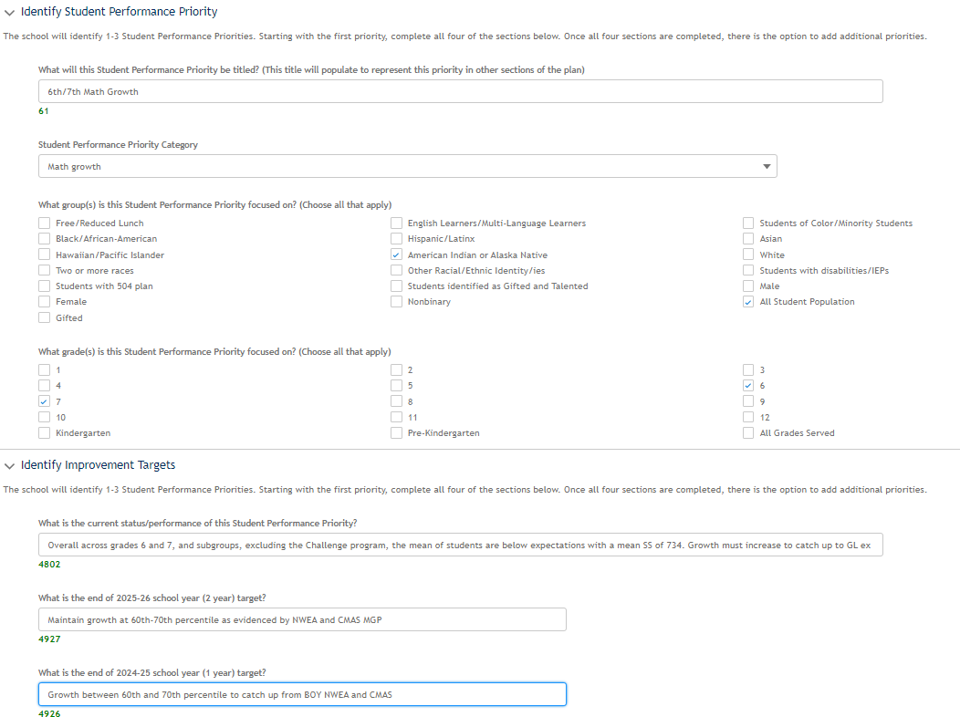
Student Performance Priority to Target Setting
Where are we now? Where do we want to be?
Notes:
One significant shift is to set targets immediately after prioritizing.
Our developer is still working on moving the SPP title to the top just above the performance category.
All of our text boxes will have counters so you can wordsmith appropriately.

Slide 31
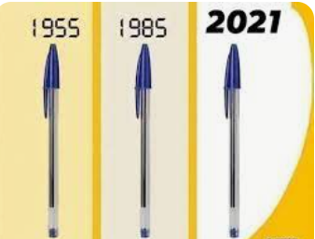
What is staying the same
Root Cause Analysis
Prioritizing
Target Setting
Major Improvement Strategy
Implementation Milestones (Benchmarks)
Action Steps
Notes:
The idea being, if it has been working and is good practice holding up over the years, let’s not do away with it.
Process for Root Causes
Attainable Targets
Evidence based Strategies that have proven effective with solid implementation
Making sure you have a plan to implement well.

Slide 32
Summary- Differences between UIP and Streamlined UIP Template
Location | Traditional Template | New Streamlined Template
Overall | Clunky web page design, many pages and clicks to associate items, work through tasks | More intuitive page design, new web page components, faster, cleaner pages, fewer boxes, less “showing” work pages
Priority Performance Challenges > Student Performance Priorities | ‘Show your work’ to develop your priority performance challenges - 1. Reflect on prior year 2. Review current performance 3. Write over-time trend statements 4. Prioritize to PPC 5. Describe prioritization of PPC | ‘Share your results’ of your student performance priorities Select who (grade, demo), focus area, and give a short title to SPP Describe evidence and reasoning SPP
Targets | Draft plan and the last step is to set Targets for improvement | Draft Student Performance Priorities (identified student improvement areas) and associated Targets (improvement in identified areas)
Root Cause | Draft root causes, one box to describe how they were selected and validated | Each Root Cause, describe the root cause and the verification process

Slide 33
Continued
Location | Traditional Template | New Streamlined Template
Strategies | Multiple clicks to associate root causes, fill out | Same components, less clicks, moved ‘resources’ from action step level to ‘strategy’ level
Implementation Benchmarks /Implementation Milestones | Drafted similar to action steps Name Description Start End Frequency Key Personnel | Written as Milestone Plans What do you expect to see Evidence (data source) Who will monitor Goal, By when (Up to 6 goals)
Action Steps | Action Step Description Start End Responsible Resources | Shortened Step Responsible (Individual/Role) Start End
Notes:
When IBs looked almost like action steps, many were written as if they were action steps. Today, we make it more clear that they are about the implementation process across the system.

Slide 34


Considerations for moving to the streamlined template
· To prepare for the transition to the new template, the Copy from Last Year feature will not be available the first year of streamlined template usage.
· With any new process, there is a probability of bugs or system issues. Many issues have been resolved through the 2023-24 pilot.
· With any system change, there are new training responsibilities and a learning curve. This may not be the year your system has time to engage with this change.

Slide 35
Updated Quality Criteria Rubric
Meeting CS, TS, ATS Requirements
Notes:
Now what I would like to do is share with you where you can find the CS, TS and ATS requirements in the new streamlined UIP.

Slide 36
ESSA-Identified Schools may use either template to meet planning requirements in 2024-2025.
Traditional Template:
Quality Criteria Traditional Template
NEW Streamlined Template:
Quality Criteria Streamlined Template
“Big Five” Guiding Question | Plan Elements within Traditional UIP Template
Does the plan investigate the most critical performance areas and prioritize the most urgent performance challenges? | Brief Description Prior Year Targets Current Performance Trend Analysis Priority Performance Challenges
Does the plan identify root causes that explain the magnitude of performance challenges? | Root Causes
Does the plan identify evidenced-based major improvement strategies that are likely to eliminate the root causes? | Major Improvement Strategies Planning Form
Does the UIP present a well-designed action plan for implementing the major improvement strategies to bring about dramatic improvement? | Major Improvement Strategies Planning Form
Does the plan include elements that effectively monitor the impact and progress of the action plan? | Target Setting Planning Form
“Top Three” Guiding Question | Does the plan identify high-leverage performance priorities and targets? | Does the plan focus on evidence-based strategies to resolve systemic root causes and drive improvement on identified priorities? | Does the plan outline a coherent approach to implementation and adjustment of the identified strategies?
Plan Elements within Streamlined Template | Student Performance Priorities Annual Target Setting Interim Targets | Root Causes with validation Major Improvement Strategies (including Evidence Base) Associated Resources | Implementation Milestones Action steps
Notes:
Either template can be used to meet the federal requirements. The structure is different, but requirements are indicated in both versions, and both are provided on the UIP website.

Slide 37




Meeting Federal Requirements – Symbols
ALL, CS, TS and ATS
SEA
Review
All Schools
Schools identified for Comprehensive Support through Every Student Succeeds Act (ESSA)
Schools identified for Targeted Support through ESSA
Schools identified for Additional Targeted Support through ESSA
LEA Review

Slide 38
Resources and Support
Notes:
Be sure to note why they are “anticipated” and not confirmed what we are actually doing at this point.
More work with our development team that is ongoing.
We still have some formatting changes taking place
Still have some structure pieces we are working on

Slide 39

Current Resources
Streamlined Template Resources- In additional to updates on the “Announcements” header, there are two primary places within the UIP website structure which will address information regarding the template:
  UIP Online System
  UIP Resources
Streamlined Template Overview Document Overview of the new template, including key features, major changes, timeline and accessing the template.
Streamlined Template Overview Webinar (3/22/24) Webinar and slides provide an overview of the new template, rationale for changes, summarizes difference between templates and considerations for template use.
Streamlined UIP Template Navigation This video is a selection from the UIP 101 video series specific to the new UIP layout.
Streamlined UIP School Level Quality Criteria- In keeping with the drivers for changes in the template, we revised and reformatted criteria to be simplified, easier to navigate and aligned to the new UIP streamlined template structure.

Slide 40

Resources Under Construction
Small Bite Videos for CS, TS, and ATS
Resources and Support for CS Y3+ Schools
Updated Website: Meeting ESSA Requirements Streamlined UIP
Resources: Addressing Resource Inequities for CS and ATS Schools
Notes:
Sue

Slide 41
LEAs with Title III Allocations
Less than $10,000
Notes:
Rachel T/Kim

Slide 42

Title III, Part A: Program Requirements and Eligibility
Colorado’s Title III allocation is based on the number of multilingual learners (MLs) reported through the American Community Survey and U.S. Census data. Annual local education agency (LEA), including district or consortia, allocations are based on the number of Multilingual learners reported through the annual Student October Count. The previous Student October count informs the subsequent school year Title III allocation.
An LEA or consortium allocation must meet or exceed $10,000 in order to apply for a Title III grant.

Slide 43
Acronyms
ESEA = Elementary and Secondary Education Act
ESSA = Every Student Succeeds Act
LEA = Local Education Agency
ML = Multilingual Learner
EL = English Learner
Please note:
The next few slides reference “EL” since the wording comes directly from the Non-Regulatory Guidance: English Learners and Title III of the Elementary and Secondary Education Act (ESEA), as amended by the Every Student Succeeds Act (ESSA) document.

Slide 44
Non-Regulatory Guidance: English Learners and Title III of the Elementary and Secondary Education Act (ESEA), as amended by the Every Student Succeeds Act (ESSA)
A-15. How can LEAs form a consortium to receive a Title III EL formula subgrant?
An LEA may join with other LEAs to form a consortium of LEAs to receive Title III formula funds under the ESEA. Under this arrangement, one of the LEAs must serve as the fiscal agent for the consortium, and is legally responsible to the Department for the grant.
Notes:
https://www2.ed.gov/policy/elsec/leg/essa/essatitleiiiguidenglishlearners92016.pdf

Slide 45
Non-Regulatory Guidance: English Learners and Title III of the Elementary and Secondary Education Act (ESEA), as amended by the Every Student Succeeds Act (ESSA), continued
The option of joining a consortium may be especially relevant to a small LEA that does not, on its own, have a sufficient number of ELs to meet the requirement in ESEA Section 3114(b) that a Title III subgrant be at least $10,000.
Such a small LEA could, for example, form a consortium with other small LEAs to receive Title III funds or enter into an agreement with a neighboring larger LEA to receive services provided by the larger LEA.
Some examples of consortia models in place in various States include:
• The LEA fiscal agent provides consortium-wide services, such as professional development and supplemental instructional materials, directly to all LEAs in the consortium.
• The LEA fiscal agent enters into a contract with another entity to provide services to all of the member LEAs.
• The LEA fiscal agent distributes a portion of the consortium’s allocation to each member LEA based on the number of ELs in each LEA.
(In Colorado: LEA to LEA and LEA to BOCES)

Slide 46
Title III, Part A Allocations
As a reminder, Title III allocations must remain with the LEA in which the funds are assigned to. An LEA cannot give their Title III funds to another LEA for their use since the allocation was based on the number of ML students identified in the October Student Count.
Mentioned earlier: The LEA fiscal agent provides consortium-wide services, such as professional development and supplemental instructional materials, directly to all LEAs in the consortium.

Slide 47
Best Practices
Memorandum of Understanding
Due dates
Timing - responses for Consolidated Application
Post-Award Revision (PAR) process
Request funds, timing (quarterly)
Draw down funds
Plan a mid-year check-in/quarterly check-ins
Review and understand assurances - what are you agreeing to when you do this
Contacts, backup contacts

Slide 48
Process
Allocations are available
Internal discussion whether to transfer or decline Title III funds
Establish working relationship with LEA or BOCES
  Develop Memorandum of Understanding
  Needs assessment
    Families, students, EL/ML staff members, community
  Plan for use of funds
2024-25 Consolidated Application Cycle
  Complete ARAC (Acceptance, Relinquishment, Assignment and Certification) form
  Complete Title III narratives
  Complete Title III budget items
Guiding question: Is this realistic for my LEA for the 2024-25 Consolidated Application or would this be a better discussion for next year?
Notes:
May or may not be realistic right now; future conversation; we can help you do this now or we can help you now to do it next year

Slide 49
Common uses of Title III Funds for LEAs with smaller allocations
Professional development
Family/community engagement
Supplemental materials and supplies
  Supplemental books/periodicals
  Online programs
  Manipulatives, vocabulary cards, bilingual dictionaries
Notes:
Locally controlled State - LEAs’ decision; open up - if you have some great ways you’ve used a smaller allocation with big impact - share in the chat - you are the experts

Slide 50
Next Steps
If you’re interested in accepting Title III funds, please reach out!
Rachel Temple: temple_r@cde.state.co.us
Kim Boylan: boylan_k@cde.state.co.us

Slide 51
Title III Immigrant Set-Aside
Notes:
Rachel T/Kim

Slide 52

Intent and Purpose
The Title III Immigrant Set-Aside grant:
Is designed to support school districts that have experienced a significant increase in immigrant students over the past two years.
Provides enhanced instructional and supplemental support opportunities for immigrant students and their families.
Will discuss the definition of immigrant children and youth
Will discuss how Title III, Immigrant Set-Aside is determined.
Will explain the use of the word “migrant” in the news, etc. vs. how it’s used at the State level
How T3 ISA allocation is determined

Slide 53
How Title III, Immigrant Set-Aside is determined
Title III Immigrant Set-Aside determination:
Based on increase in Immigrant Student counts, as compared to the average of the prior two years.
Allocation Process
  States are required to set aside a portion of their Title III grant (Colorado currently sets aside 5% of the state’s Title III allocation) to provide funding to school districts impacted by increased immigrant student enrollment and to help ensure that immigrant children and youth receive enhanced instructional opportunities to help them meet State academic achievement standards.
  To be eligible for Title III Immigrant Set-Aside funding, LEAs must have experienced:
    An increase in the number of immigrant children and youth enrolled in the district in comparing the most recent October immigrant count with the average immigrant count reported to CDE in the previous two years.
If the most recent October immigrant count (2023 for FY 24-25 allocations) is greater than the preceding two-year average (October count 2021 and October 2022), an LEA receives a Title III Immigrant Set-aside allocation.

Slide 54
Definition of Immigrant Children and Youth
Important: The term “immigrant” as used in Title I is NOT related to an individual’s legal status.
Are aged 3 - 21
Were not born in any U.S. State
Have not been attending one or more schools in any one or more states than 3 full academic years
  States are defined as the 50 states, the District of Columbia, and the Commonwealth of Puerto Rico

Slide 55
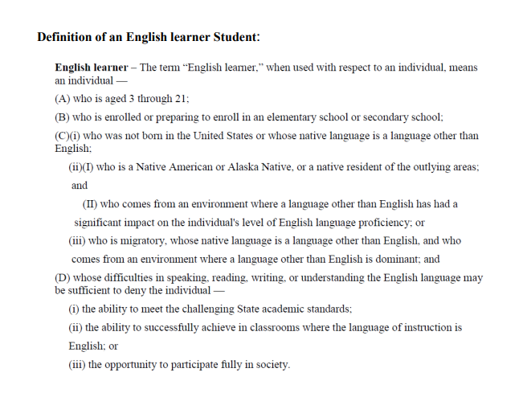
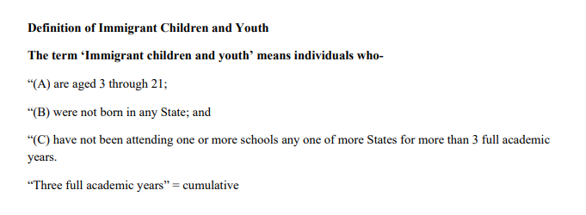
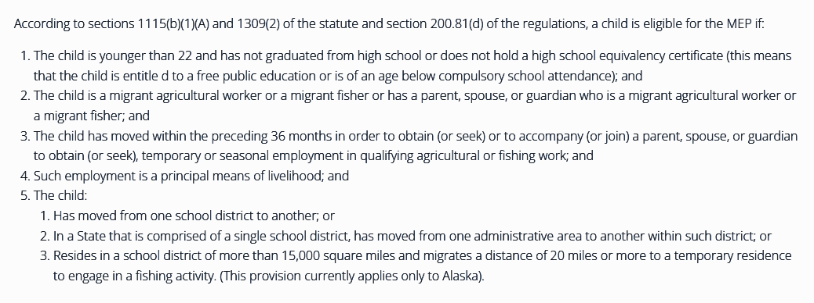
Different experiences, different needs:
More than one definition may apply, but they are not one in the same
MAY SPEAK ENGLISH FLUENTLY
NOT TIED TO COUNTRY OF BIRTH OR LANGUAGE
Notes:
(Federal definitions) This slide illustrates the differences between students identified as Immigrants, Migrants and English Learners

Slide 56
Program Eligibility
Colorado's Title III allocation is based on the number of English learners/Multilingual Learners (ELs/MLs) reported through the American Community Survey and U.S. Census data.
Before determining local allocations, CDE reserves 5% of its Title III allocation for the Title III Immigrant Set-Aside (ISA) grant.
CDE determines local allocations based on the number and average number of immigrant students reported through the annual Student October Count in three school years prior to the current school year.
Reminder: not all immigrant children and youth are ELs/MLs

Slide 57

Details
Title III Immigrant Set-Aside
These funds can be accepted at any allocation amount. It does not require the same $10,000 minimum as Title III, Part A.
Smaller allocation ideas and considerations:
Professional development for all staff members, including leadership
  Supporting Immigrant students and their families
  Culturally responsive teaching
  Book study
    Exploring different ways to make the school district welcoming

Slide 58
New to Title III - Immigrant Set-Aside Cohort
Purpose:
Support LEAs new to receiving Title III, Immigrant Set Aside Funds
Establishing a working group to support each other
Share thoughts, ideas, processes
If you’re interested, please contact:
Rachel Temple, temple_r@cde.state.co.us
Kim Boylan, boylan_k@cde.state.co.us
Next steps: once interested parties have reached out,
we will establish a day and time to meet virtually and plan from there.

Slide 59
Upcoming Meetings
Notes:
Nazie

Slide 60

Looking Ahead…
Any requests for topics or questions?
Upcoming Office Hours
  May 23
    BOCES Cons App Training
  June 6
    Cons App Q&A

Slide 61
CDE Contacts!
Emails: Lastname_Firstinitial@cde.state.co.us (e.g., Smith_a@cde.state.co.us)
Federal Programs & Supports (ESEA/ESSER Program Supports) | School Finance & Operations (Fiscal and Systems Supports)
Nazie Mohajeri-Nelson, Executive Director of Federal Programs & Supports Unit Program Specialists Program Implementation Supervisor: Laura Meushaw Program Implementation Coordinator: Christina Adeboye Sullivan Program Monitoring Supervisor: Tammy Giessinger ESEA/ESSER Monitoring Coordinator: Kristin Crumley Program Effectiveness Supervisor: Tina Negley Program Evaluation & Research Coordinator: Mary Shen ESEA Programs Specialists and ESEA Regional Contacts (assigned by district) Title I: Laura Meushaw, Evita Byrd, Rachel Echsner, Kim Boylan Title II: Rachel Echsner, Sue Miller-Curley Title III: Rachel Temple, Kim Boylan Title IV & Stronger Connections Grant: Nathan Hickman, Evita Byrd Title V: Christina Adeboye-Sullivan, Rachel Echsner ESSER Program Specialists Jonathan Schelke Kim Boylan Kriselda Craven Nadine Penn ESEA and ESSER Data and Reporting Specialists Melissa Chaffin (ESEA) Jerry Ring (ESEA) | Amy Carman, Executive Director of School District Operations Unit Fiscal Specialists Jennifer Austin, Director of Grants Fiscal Management ESEA Robert Hawkins, Grants Fiscal Analyst Steven Kaleda, Grants Fiscal Analyst ESSER Fiscal Specialist Steven Kaleda Grants Fiscal Analyst ESSER Monitoring Hilery Morris, ESSER Fiscal Monitoring Kristina Jones, Federal Fiscal Monitoring and Reporting Specialist Werner Hagemann, ESSER Fiscal Monitoring Specialist Application Systems Specialists DeLilah Collins, Director of Grants Program Administration Online Applications Systems Technical Support Jessica Hollingshead

