Slide 1
CDE Office Hours
April 15, 2021

Slide 2
CDE Team Introductions!
ESSER/ESEA
Nazie Mohajeri-Nelson, Director of ESEA Office (mohajeri-nelson_n@cde.state.co.us)
DeLilah Collins, Assistant Director of ESEA Office (collins_d@cde.state.co.us)
Mary Ann Caterina, ESSER Monitoring & Reporting Specialist (caterina_m@cde.state.co.us)
Kristin Crumley, ESSER Monitoring & Reporting Specialist (Crumley_k@cde.state.co.us)
ESEA Regional Contacts assigned to your district
Fiscal Experts
Jennifer Okes, Chief Operating Officer (okes_j@cde.state.co.us)
Kate Bartlett, Executive Director of School District Operations (Bartlett_k@cde.state.co.us)
Jennifer Austin, Director of Grants Fiscal Management (Austin_j@cde.state.co.us)
Robert Hawkins, Grants Fiscal Analyst (Hawkins_s@cde.state.co.us)
Steven Kaleda, Grants Fiscal Analyst (Kaleda_s@cde.state.co.us)
Adam Williams, Financial Data Coordinator (Williams_a@cde.state.co.us)

Slide 3
ESSER Office Hours
Topics
ESEA Updates – Allocations and Cons App
ESSER Updates and Clarifications
Questions
No Office Hours on April 22, 2021!
Notes:
Nazie

Slide 4
ESEA Updates

Slide 5
Allocations & Cons App
2021-2022 preliminary allocations are posted: https://www.cde.state.co.us/cdefisgrant/essa_download
2021-2022 Cons App
  Now live: https://www.cde.state.co.us/fedprograms/consapp/index
  NPS carryover – added functionality
Overview of allocation calculations
Questions?

Slide 6
How USDE Allocates Title I To CDE
Allocated through four statutory formulas, each with their own criteria, that are based primarily on population, census poverty estimates, and the cost of education in each state
  Basic, Concentration, Targeted and Education Finance Incentive Grant (EFIG)
  Each have individual criteria for eligibility
Allocated based on US Census Bureau poverty estimates – 3 years in arrears
  E.G., 2017 data used for 2020 allocations – data is 3 years in arrears
USDE applies the first Hold-Harmless Provision
USDE sends allocation figures by individual LEAs to CDE

Slide 7
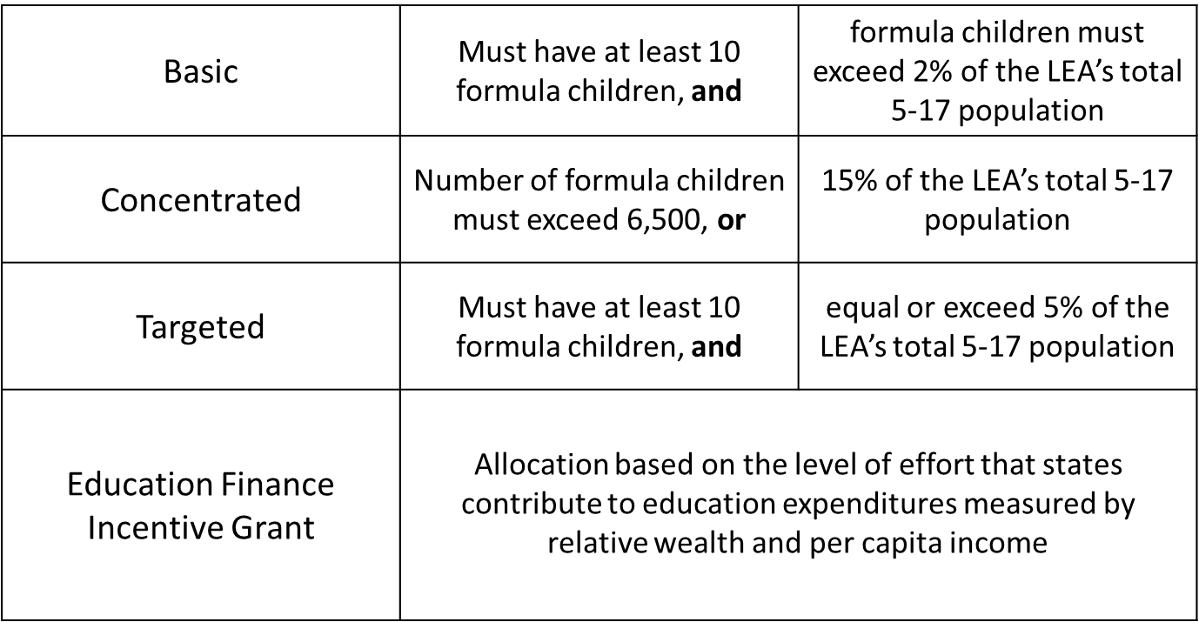
Title I, Part A Components

Slide 8
Updates, Clarifications, and Follow-Ups

Slide 9
Clarifications
Oh! So many different funding sources, applications, and rules!
  ESSER I: http://www.cde.state.co.us/caresact/esser1
  ESSER II: http://www.cde.state.co.us/caresact/esser2
  ARP ESSER III: http://www.cde.state.co.us/caresact/esser3
Allowable Uses Matrix: http://www.cde.state.co.us/caresact/crf-allowableexpenditures

Slide 10
Timelines Associated with ESSER I, II, and III
 | ESSER I (CARES Act) | ESSER II (CRSSA Act) | ARP ESSER III (ARP Act)
Award Period | 03/13/20 – 09/30/21 | 03/13/20 – 09/30/22 | 03/13/20 – 09/30/23
Tydings Period - will end and funds must be spent by | 9/30/22 | 9/30/23 | 9/30/24
USDE Award to CDE | 05/07/20 | 01/06/21 | 3/24/21
CDE Must Make Subgrants to LEAs (90%) – LEAs must have final approval on ESSER I and II and substantial approval on ESSER III | 05/07/21 Final Approval | 01/06/22 Final Approval | 05/23/21 Substantial Approval
Application must have final approval | 05/07/21 | 01/06/22 | 03/24/22
CDE Must Make Subgrants via Contract or Grants (10%) | 05/07/21 | 01/06/22 | 03/24/22
CDE Application Opened | 05/31/20 | 02/12/21 | ???
CDE Application Closed/Closes | 12/31/20 | 09/30/21 | 03/24/22
PAR Open – Rolling Basis | Date of Final Approval | Date of Final Approval | Date of Final Approval
PAR Closes | 06/30/21 | 06/30/22 | 06/30/23
Carryover Application Will Open (Unexpended Funds Carried Over to Next Year) | 07/01/21 | 07/01/22 | 06/30/23
Carryover Application Will Close | 06/30/22 | 06/30/23 | 06/30/24
Monthly Deadline for Requesting Funds (LEA’s Request for Funds, RFF) | First Day of Each Month | First Day of Each Month | First Day of Each Month
Deadline for Final Spending | 09/30/22 | 09/30/23 | 9/30/24
Deadline for Final Draw Down of Funds (RFF) | October/November 2022 | October/November 2023 | October/November 2024

Slide 11
Upcoming Due Dates
ESSER I
  Facility Schools Apps – 5/7/21
  PAR Revisions – 6/30/21
ESSER II
  You have a few months – Application due on 9/30/21
ESSER III
  Acceptance and Transmittal, Assurances, and GEPA – due 5/23/21
  Budget – you have until 3/24/22

Slide 12
Allowable Uses of Funds
Activities | ESSER I CARES Act | ESSER II CRSSA Act | ESSER III ARP Act
Allowable Activities | Any activity related to preventing, preparing for, and responding to COVID-19. | Same | Same
Reservations | None | None | 20% for addressing learning loss through the implementation of EBI, such as summer learning or summer enrichment, extended day, comprehensive afterschool programs, or extended year programs in response to students’ academic, social, and emotional needs and address disproportionate impact on student groups
Called Out Activities: Permitted under all 3 but just called out | Any activity necessary to maintain operation of or continuity of services, including hiring new staff or avoiding layoffs. | Addressing learning loss, preparing for reopening, testing, repairing, and upgrading projects to improve air quality in school buildings. | Develop strategies and implement public health protocols including, to the greatest extent practicable, policies in line with guidance from the CDC for the reopening and operation of school facilities to effectively maintain the health and safety of students, educators, and other staff.

Slide 13
Clarifications
Salary and benefits – yes, if reasonable and necessary to respond to, prepare for, or prevent the spread of COVID-19
Hazard pay or stipends – yes, if reasonable and necessary to respond to, prepare for, or prevent the spread of COVID-19
  Update HR and accounting protocols, processes, or policies to include how hazard pay is calculated, when paid, to whom, under what circumstances

Slide 14
ESSER State Reserve (10%)
ESSER I Supplemental Funds are in the application; ESSER II will be added soon!
Grantees | ESSER I | ESSER II | ESSER III
Formula grants to BOCES with gaps in their special education funding: Any activity allowable under ESSER in support of students w disabilities | X | X | TBD
Formula grants BOCES with brick-and-mortar schools: Any activity allowable under ESSER to support the operation of the school | X | X | TBD
Formula grants to Colorado Tribes: any activity allowable under ESSER | X | X | TBD
Formula grants to Districts with small or no allocation: any activity allowable under ESSER | X | X | TBD
Competitive grants for connectivity to districts, BOCES, and Tribes: connectivity | X |  | TBD
Formula grant to Colorado Digital BOCES for online courses: online courses | X |  | TBD
Formula grants to facility schools: any activity allowable under ESSER | X |  | TBD
Formula grants to districts with Native American students: any activity allowable under ESSER in support of Native American students | X | X | TBD
All ESSER-funded activities, including the above, must be reasonable and necessary to respond to, prepare for, or prevent the spread of COVID-19

Slide 15
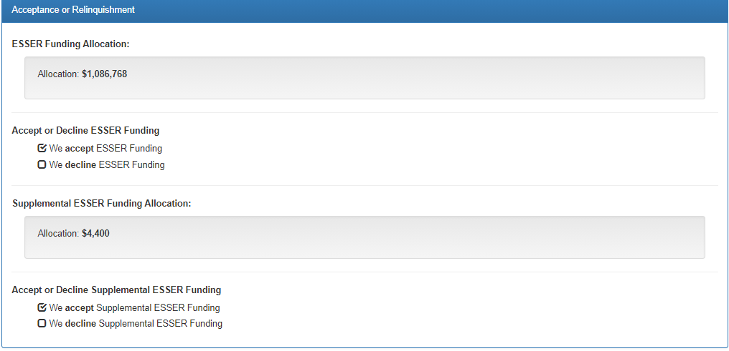
Application View for Districts

Slide 16
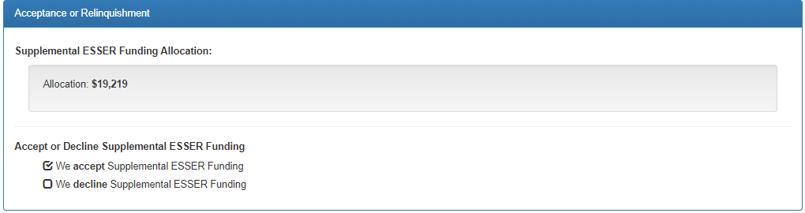
Application for Facility Schools, AUs, and BOCES

Slide 17
Describing Reasonableness
Reviewers need sufficient information to be able to ascertain:
  Allowability – activities listed in statutes as allowable (see funding matrix)
  Allocability – activities must be necessary in order to respond to, prepare for, or prevent the spread of COVID-19
  Reasonableness – a prudent person would be able to explain how the item is reasonable (e.g., is priced at fair market value, is the most cost-effective way of conducting/implementing the activity, is in line with how similar activities are paid from other funding sources)
    Sufficient detail ~ allows reviewers to be able to understand how the total was reached; includes the unit expense, how many units, and for how long.
    Example – salary
      2 teachers, 4 months, $4,500 average per month = $36,000
      2 teacher, 2 years, $54,000 average per year = $216,000

Slide 18
Seeking Examples to Share
Updated HR or accounting policies to address impact of a pandemic
  Hazard Pay for increased exposure/risk
  Salaries and benefits during school closures
Plans for “…safe return to in-person instruction and continuity of services” and links to websites.

Slide 19
Questions?
Future Topics?

Slide 20
Reminder!
No Office Hours next week due to a schedule conflict
  We will resume on April 29th
  In the meantime, please do not hesitate to contact any of us on the contact list (next slide)

Slide 21
CDE Team Contact Information
ESSER/ESEA
Nazie Mohajeri-Nelson, Director of ESEA Office (mohajeri-nelson_n@cde.state.co.us)
DeLilah Collins, Assistant Director of ESEA Office (collins_d@cde.state.co.us)
Mary Ann Caterina, ESSER Monitoring & Reporting Specialist (caterina_m@cde.state.co.us)
Kristin Crumley, ESSER Monitoring & Reporting Specialist (Crumley_k@cde.state.co.us)
ESEA Regional Contacts assigned to your district
Fiscal Experts
Jennifer Okes, Chief Operating Officer (okes_j@cde.state.co.us)
Kate Bartlett, Executive Director of School District Operations (Bartlett_k@cde.state.co.us)
Jennifer Austin, Director of Grants Fiscal Management (Austin_j@cde.state.co.us)
Robert Hawkins, Grants Fiscal Analyst (Hawkins_s@cde.state.co.us)
Steven Kaleda, Grants Fiscal Analyst (Kaleda_s@cde.state.co.us)
Adam Williams, Financial Data Coordinator (Williams_a@cde.state.co.us)

