Slide 1
CDE Office Hours
March 14, 2024

Slide 2
ESSER Office Hours
Topics
Updates and Reminders
  ARP ESSER III
  Consolidated Application Work Sessions
Utilizing Title III for Newcomers
Schoolwide vs Targeted Assistance
CCNetwork: The Grid
Listening Segment

Slide 3
Updates and Reminders

Slide 4
Reminders!
ARP ESSER III -
Please submit requests for funds at your earliest opportunity!
  We need to assess what funds remain unspent.
All Post Award Revisions must be submitted prior to June 30, 2024.
Funds must be obligated prior to September 30, 2024…even if requesting a late liquidation.
Please email mohajeri-nelson_n@cde.state.co.us if you believe you may need a late liquidation.

Slide 5
Consolidated Application Trainings
Consolidated Application Narratives Training
Tuesday, April 9th 9:00-11:00 am
Register for the zoom meeting here
Will be recorded
GAINS Training for Consolidated Application
Thursday, April 25th time TBD
Will be recorded

Slide 6
Spring Work Sessions
In person work sessions for support with the 2024-25 Consolidated Application
Metro
  Highlands Ranch - May 2nd 12:00-3:00pm
Pikes Peak/Southeast
  Pueblo - May 6th 1:00-4:00pm
North Central/Northeast
  Greeley - May 15th 12:30-3:30pm
Northwest/West Central
  Delta - May 14th 10:00am-1:00pm
  Craig - May 15th 11:00am-2:00pm
Southwest
  Alamosa - May 15th 12:30-3:30pm
  Durango - May 16th 9:00am- 12:00pm
See more information and sign up for a session on the RNM webpage.

Slide 7
Utilizing Title III for Newcomers

Slide 8
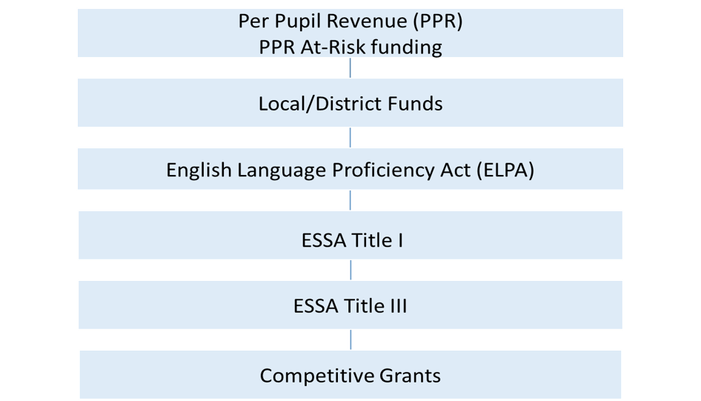
Leveraging Fiscal Resources for MLs

Slide 9

Intent and Purpose of Title III
Title III is a supplemental grant under the ESEA that is designed to improve and enhance the education of Multilingual learners (MLs) in becoming proficient in English, as well as meeting the Colorado Academic Content standards.

Slide 10

Program Requirements and Eligibility
Colorado’s Title III allocation is based on the number of MLs reported through the
American Community Survey and U.S. Census data. Annual local education agency (LEA), including district or consortia, allocations are based on the number of Multilingual learners reported through the annual Student October Count. The previous Student October count informs the subsequent school year Title III allocation. An LEA or consortium allocation must meet or exceed $10,000 in order to apply for a Title III grant.

Slide 11

Required Activities
Increasing the English language proficiency of MLs by providing effective language instructional education programs (LIEPs)/English language development (ELD) programs that have successfully demonstrated increasing English language proficiency and academic achievement.
Providing effective professional development to classroom teachers, principals and other school leaders, administrators, and other school or community-based organizational personnel that relates directly to the instruction of MLs that support their linguistic, academic, and social-emotional challenges and opportunities of MLs.
Providing and implementing other effective activities and strategies that enhance or supplement LIEPS/ELD programs for MLs. These activities and strategies must include parent, family, and community engagement activities, but may also include strategies that coordinate and align related programs.

Slide 12

Supporting Newcomers
“Schools are often the very first places to welcome newcomer students and families into the United States. ‘Newcomers’ refers to K-12 students born outside the U.S. who have arrived in the country in the last three years and are still learning English. These students and their families may have experienced trauma on their journey to the U.S., they may be unfamiliar with the U.S. school system, and may need myriad supports to feel comfortable starting their educational experiences in a new country.”

Slide 13

Allowable Activities
Upgrading ELD program objectives and effective instructional activities
Improving ELD programs for MLs by supplementing curricula, instruction materials, and educational software and technology that improve content and language acquisition
Providing community participation programs, family literacy services, and parent outreach and training activities to ML students and their families
Providing tutoring and intensified instruction for ML students
Offering early college high school or dual/concurrent enrollment programs or courses designed to help MLs achieve in postsecondary education
Developing and implementing effective preschool, elementary or secondary school ELD programs that are coordinated with other relevant programs and services
Improving instruction for ML students, including ML students with a disability or identified as gifted in a specific area

Slide 14
Allowable Activities: Ideas for Supporting Newcomer Students and Their Families
Allowable Activities | Examples
Upgrading ELD program objectives and effective instructional activities | Training and theory-based (adult-focused): Culturally responsive teaching; language acquisition scaffolding
Improving ELD programs for MLs by supplementing curricula, instruction materials, and educational software and technology that improve content and language acquisition | Physical materials: Visual aides, classroom posters, vocabulary picture cards, picture dictionaries, manipulatives,
Providing community participation programs, family literacy services, and parent outreach and training activities to ML students and their families | Parent/family university Newcomer activity nights Home visits

Slide 15
Allowable Activities: Ideas for Supporting Newcomer Students and Their Families, Continued
Allowable Activities | Examples
Providing tutoring and intensified instruction for ML students | Before or after school tutoring for newcomers
Developing and implementing effective preschool, elementary or secondary school ELD programs that are coordinated with other relevant programs and services | Collaboration with local community providers to support newcomers
Improving instruction for ML students, including ML students with a disability or identified as gifted in a specific area | Supplies and materials to support newcomers identified with disabilities or gifted

Slide 16

Keep in Mind
Title III allocation is based on student October count
  Ensure MLs are correctly identified in your student data system
Consider your district’s current use of Title III funds
  Funds being utilized for staffing purposes
  Supplies/materials
  Professional development
Planning cycle for 2024-25 Consolidated Application Cycle
  Needs assessment
  Conversations around allocation of funds
    District-level
    School-level
Supplement, not supplant provision
  The U.S. Department of Education assumes that supplanting exists if an LEA uses Title III funds to provide services it provided in prior years with State, local, or other federal funds

Slide 17
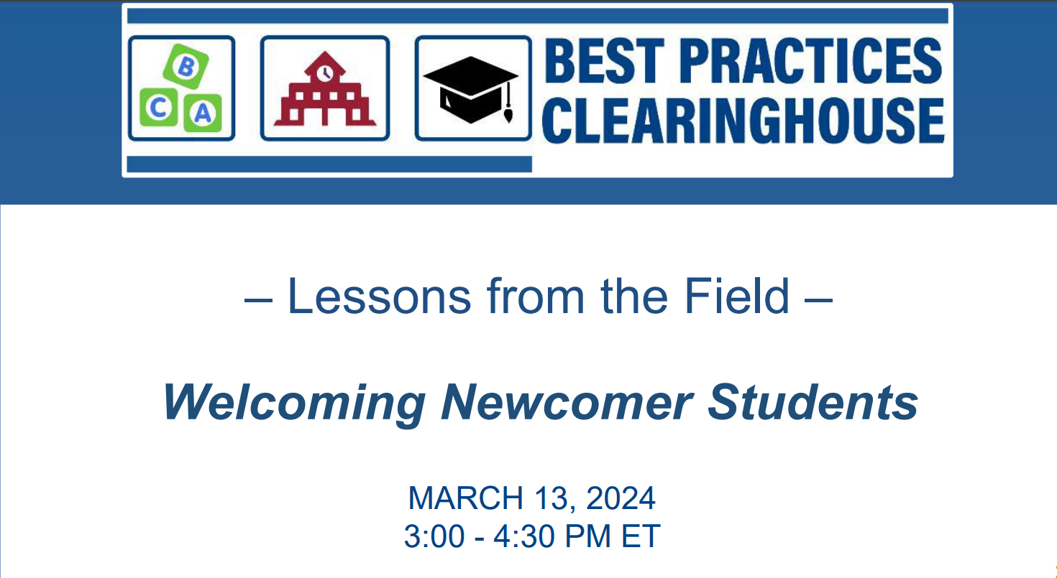
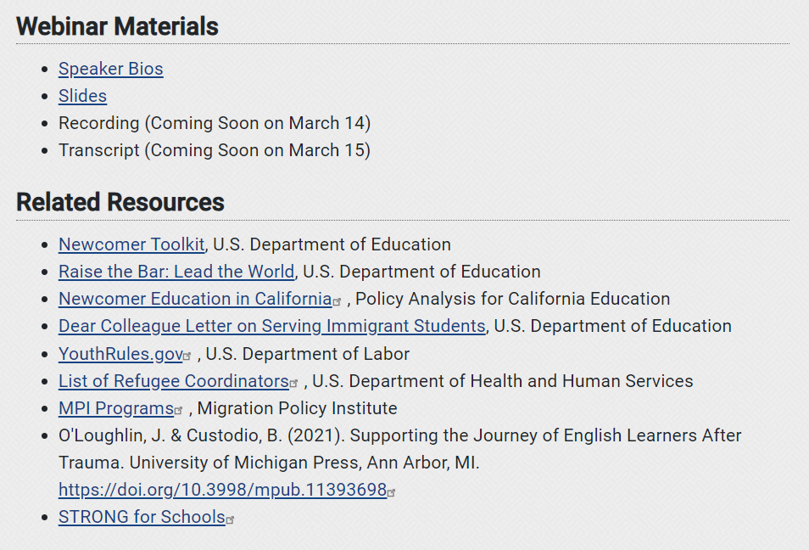
Resources
This webinar builds on the September 6, 2023, webinar, Supporting Newcomer Students. In this webinar, experts will provide resources to help educators welcome and fully engage newcomers and their families in and out of the classroom including providing trauma-informed care and social emotional developmental practices. Panelists from schools around the country will discuss the tools, strategies, and best practice examples they use to meet the needs of newcomers and their families to build community, support mental health, and help them thrive.
Supporting Immigrants with Trauma Backgrounds (starting on slide 24)
  Types of trauma that immigrants commonly experience
  How can trauma impact learning?
  Is school the proper place to address issues related to trauma and if so, how can we best do this?
  The use of the “I Have, I Am, and I Can Model” to build resilience.

Slide 18
Rachel Temple
ESEA Title III Specialist
temple_r@cde.state.co.us
720-202-6135
Kim Boylan
ESEA/ESSER Monitoring Specialist
boylan_k@cde.state.co.us
720-354-7031

Slide 19
Schoolwide vs Targeted Assistance

Slide 20
Purpose
The purpose of this session is to:
Define Schoolwide (SW) and Targeted Assistance (TA)
Discuss the key components of each program
Provide considerations when determining which program is best for your schools
Explain Consolidated Schoolwide Programs
Logistics
  Waivers
  GAINS System

Slide 21
Purpose of Title I
The purpose of Title I is to provide all children significant opportunity to receive a fair, equitable, and high-quality education, and to close educational achievement gaps. Title I, Part A of the Elementary and Secondary Education Act (ESEA), as amended by the Every Student Succeeds Act (ESSA) provides financial assistance to local educational agencies (LEAs) and schools with high numbers or high percentages of children from low-income families to help ensure that all children meet challenging academic standards.
Title I, Part A provides supplemental funding to support LEAs in
Providing high quality academic support to students at risk of not meeting state standards
Improving teaching by promoting effective instruction for at-risk children and for enriched and accelerated programs
Expanding eligibility of schools for schoolwide programs that serve all children
Establishing school-based improvement planning based on a needs assessment
Establishing accountability based on results
Promoting meaningful stakeholder engagement
Coordinating with health and social services agencies
Focusing resources on the schools with the highest percentage of students living in poverty
Addressing any disparities that result in low-income and minority students being taught at disproportionate rates by ineffective, inexperienced, or out-of-field teachers

Slide 22

Targeted Assistance Programs
A Title I, Part A targeted assistance program is designed to help eligible children meet the Colorado English Language Proficiency (CELP) and Colorado Academic standards (CAS) which may include programs, activities, and academic courses necessary to provide a well-rounded education.
A targeted assistance program is designed to provide extra educational assistance beyond the regular classroom to at-risk students, identified as having the greatest need for special assistance.
CDE Targeted Assistance

Slide 23

Schoolwide Programs
A Title I, Part A schoolwide program is a comprehensive reform strategy designed to upgrade the entire educational program in a Title I school with a poverty percentage of 40% or more in order to improve the achievement of the lowest-achieving students.
The use of funds is driven by the school’s comprehensive needs assessment and schoolwide plan
CDE Schoolwide (Guidance, Small Bite, Schoolwide Plan Requirements)

Slide 24
Programmatic Summary
Targeted Assistance Programs
Designed to provide extra educational assistance beyond the regular classroom to at-risk students, identified as having the greatest need for special assistance.
Eligible students are those identified by the school as not meeting academic standards. Requires tracking and reporting supports and serves at the student level.
Funds may only be used to meet the needs of eligible and served Title I students.
Progress of eligible children must be reviewed on an ongoing basis and the program should be adjusted as necessary.
Schoolwide Programs
Comprehensive reform strategy designed to upgrade the entire educational program in order to improve the achievement of the lowest-achieving students.
● Use the school’s comprehensive needs assessment to drive the use of funds ● Regularly monitor and revise the schoolwide plan, as necessary, based on student needs
Funds may be used to upgrade the educational program of the entire school, with particular attention to providing services to students identified as at-risk
Does not need to identify particular students as eligible.
Option for schools with a minimum of 40% poverty, or the school has applied for a waiver.

Slide 25
Expenditures in Targeted Assistance vs. Schoolwide
Targeted Assistance | Schoolwide
Guiding Questions Will this use of funds: Address the needs of students at risk of not meeting State academic standards? Increase the amount of quality learning time for Title I students? Provide an enriched or accelerated curriculum contributing to a well-rounded education for Title I students? | Guiding Questions Will this use of funds: Address the needs of all students in the school, particularly students at risk of not meeting State academic standards? Increase the amount of quality learning time for students? Provide an enriched or accelerated curriculum contributing to a well-rounded education?
Common Allowable Uses of Funds Teaching assistant or interventionist salary for students at risk of not meeting state standards Extended learning opportunities (i.e., tutoring, summer school) for students at risk of not meeting state standards Intervention materials or software to be used by students at risk of not meeting state standards | Common Allowable Uses of Funds Instructional coach salary Whole school parent and family engagement Classroom books aligned with READ Act Professional development for all staff to support Tier II.
Notes:
There are some budget considerations depending on the program a school selects. Strategies and expenditures in a Targeted Assistance school must target the needs of “eligible students” - those students most at risk of not meeting state standards as determined by objective criteria established by the school and/or district. Some of the common uses of funds are interventionist to work directly with eligible students and intervention materials. Schoolwide programming offers greater flexibility since all students are in essence eligible students. Some common uses of funds are interventionist with the opportunity for flexible grouping, coaching support for teachers, professional development and coaching support that ensures all classroom staff are able to provide Tier II instruction in the classroom.

Slide 26
Expenditures in Targeted Assistance Programs vs. Schoolwide Programs- Example
Requirements/ Considerations | Targeted Assistance Program Activity | Need (as identified in the CNA) | Schoolwide Program Activity | Requirements/ Considerations
LEA must track and review progress of after-school program participants (i.e. progress monitoring of the individual students on an ongoing basis) Opportunity costs (i.e. network capability and infrastructure; security) | Chromebook Cart for use in an intervention program to provide additional math support to students identified as at-risk (Title I). | Challenge: Low Achievement in Math Root Cause: Lack of effective Math interventions Need: Effective interventions for students in Math | 1:1 Chromebook program for all students grades 3-5 to be used throughout the day at school or in the evening at home to access Math intervention program | Need must be identified in CNA Cost to Impact Ratio Opportunity costs (i.e. network capability and infrastructure; security) Annual evaluation of programming

Slide 27
Things to Consider When Deciding on TA or SW
Is the school’s poverty rate above 40%?
How much funding will the school receive?
What does the data suggest about the school’s at risk student population?
  Are the challenges and/or barriers across the school system or the need of a particular group of students?
What are the overall needs of staff and students?
Would a particular program model provide a greater likelihood of improving the achievement of students with the greatest needs?
Would the added flexibility of the schoolwide model benefit students?
What is the most effective use of these supplemental funds to meet the needs of our students most in need?

Slide 28

Consolidated Schoolwide
A Title I school that is implementing a schoolwide program may choose to consolidate federal, state, and local funds to design and implement a comprehensive plan for the purpose of upgrading the school’s entire educational program based on the school's comprehensive needs assessment.
Can only be enacted in schools that are served schoolwide and whose schoolwide plans reflect consolidation.

Slide 29
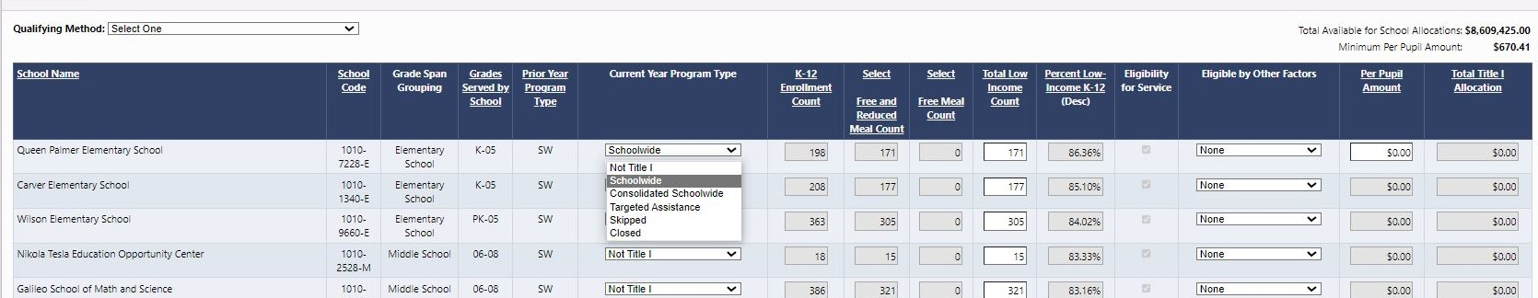
Program Identification in GAINS
Identify Current Year Program Type (previous year will be prepopulated).
Eligibility by Other Factors - for schoolwide schools with less than 40% poverty, indicate that a waiver has been submitted and/or approved.

Slide 30
School-wide versus Targeted Assistance
Resources
Title I Launch Pad
CDE Schoolwide (Guidance, Small Bite)
CDE Targeted Assistance
Evita Byrd (byrd_e@cde.state.co.us)
Rachel Echsner (echsner_r@cde.state.co.us)
Laura Meushaw (meushaw_l@cde.state.co.us)

Slide 31
Questions?

Slide 32
Danielle Crain and Laura Anderson
Office Hours with Colorado Department of Education
March 14, 2024

Slide 33
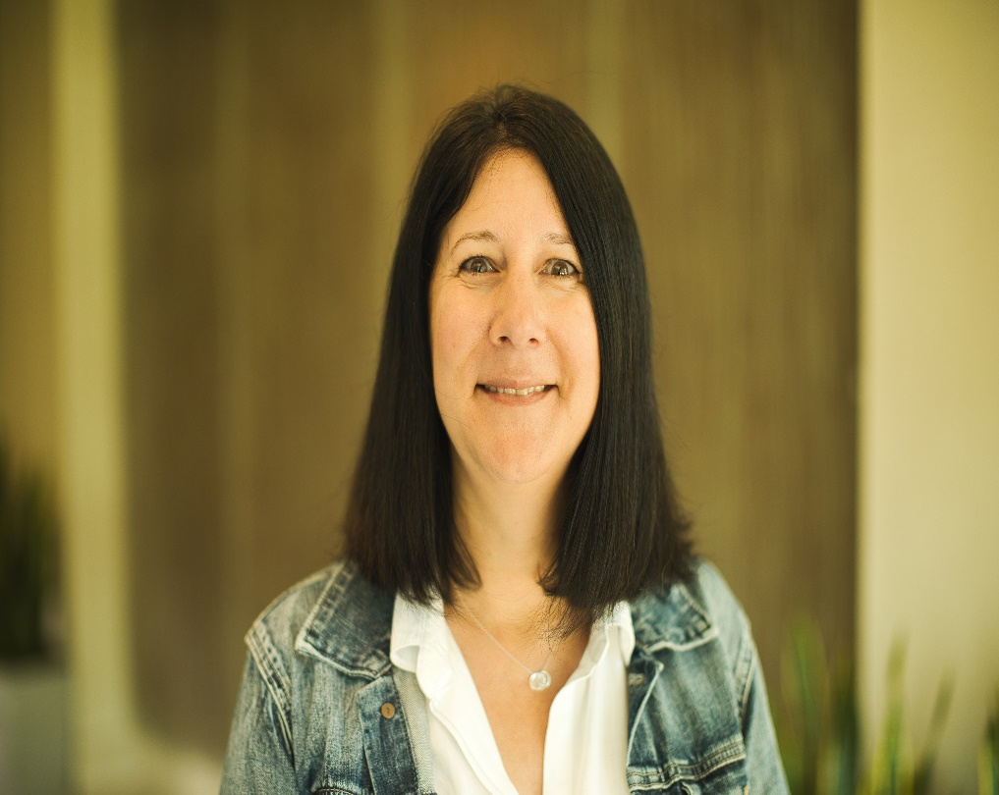
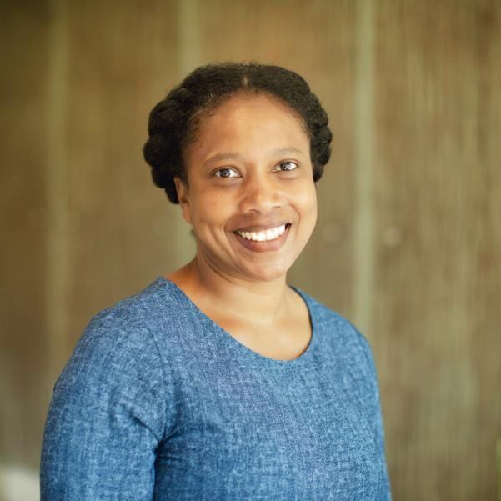
Presenters
Laura Anderson
Edunomics Lab, NCC Partner
Danielle Crain
SPCR Project Lead, NCC

Slide 34
Agenda
Overview of the Comprehensive Center Network
Introduction to Strategic Planning for Continued Recovery Initiative
Using the Investment Grid: Planning Post-ESSER
Wrap Up
Contact Information

Slide 35
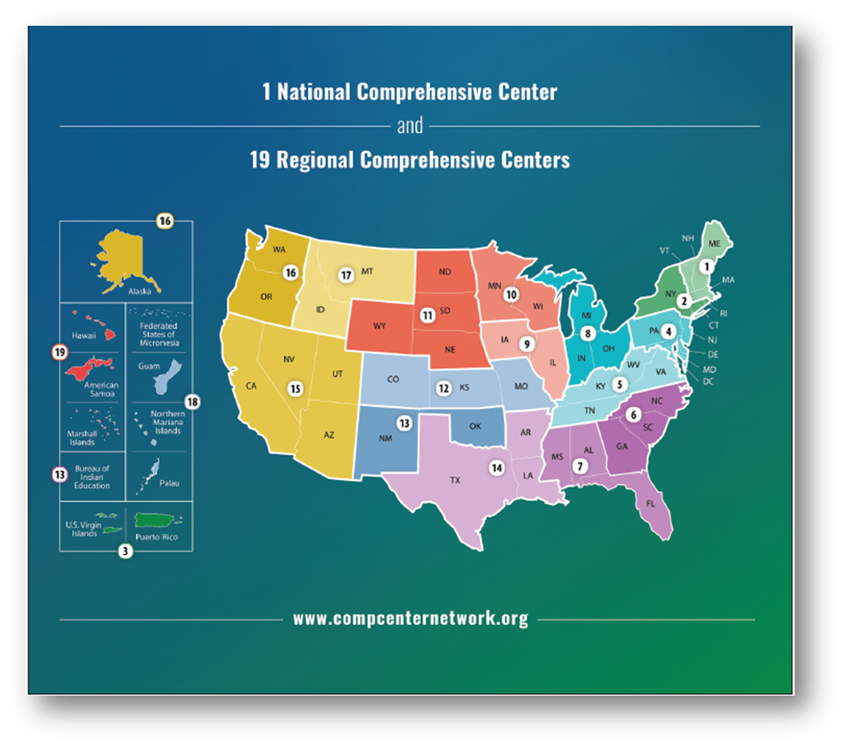

The National Comprehensive Center and the CCNetwork work with SEAs and LEAs to...
Improve education opportunities
and outcomes for disadvantaged
and low-income students
Increase awareness and use of evidence-based practices related
to school improvement
Enhance human, organizational, policy, and resource capacity
Check out the CCNetwork website!
http://compcenternetwork.org

Slide 36


Overview
We focus on six strategies:
Within each strategy, we discuss how SEAs might use five levers to support LEAs
  Grantmaking, policy, monitoring, technical assistance, and partners
Determine impact of investments
Prioritize efforts for ongoing recovery & transformation
Achieve sustainability through financial planning
Ensure access & opportunity for all
Communicate impact of investments
Support/sustain systemic capacity building

Slide 37
Opportunities to get involved:
November | December | January | February | April | May
Universal Webinars &
Resource Portfolios
Determine impact of investments
Prioritize efforts for ongoing recovery & transformation
Achieve sustainability through financial planning
Ensure access & opportunity for all
Communicate impact of investments
Support/sustain systemic capacity building
Individualized Supports
Individual SEA Coaching
Individual SEA Consultations
Targeted Supports
Cross-SEA Collaboration Series

Slide 38
Using the Investment Grid: Planning Post-ESSER

Slide 39
Three big questions LEAs are asking this budget season:
ESSER obligation deadline!
How can we determine which ESSER investments are bringing value?
How can LEAs fund ESSER investments post September 2024?
SEPT | OCT | NOV | DEC | JAN | FEB | MAR | APR | MAY | JUNE | JULY | AUG | SEPT
2023 |  |  |  |  |  |  |  |  |  |  |  | 2024
State legislative sessions
SEA
Which, if any, ESSER investments are important to continue?
1st board budget work session
Examine data, Set priorities
2nd board budget work session
Quantify and narrow options
Final board vote on 2024–25 budget
2024–25 School Year Begins
LEA
Source: Adapted from Edunomics Lab, Wild Ride Ahead, 2023
Notes:
Laura

Slide 40

The Investment Grid
 | Investment | Major cost factors | Estimated # Students Served | Cost per participating student | Desired Outcomes - Estimated Effectiveness (High/Med/Low) | Risks
A | Tutoring: 4-to-1 student-teacher ratio 3/week, 36 weeks $1.3 million | Tutors = $30/hour | 400 | $3,250 per tutored student | Boost achievement among lowest-performing students ----- Promising | Some students may not attend; difficulty hiring tutors
B | Counselors and social workers $1.6 million | $100,000 per FTE = 2 per school | 4,000 | $400 | SEL needs are met, so students attend and learn | Difficulty hiring; uneven access across schools
C | Reading coaches $800,000 | $100,000 per FTE per school | 4,000 | $200 | Reading scores increase ----- Promising | Difficulty hiring; uneven effects
D | Class size reduction $2.4 million | $100,000 per FTE 24 teachers across district | 4,000 | $600 | Achievement? | Difficulty hiring; uneven effects
E | PD & planning time: Teachers paid 1 week before school starts + 10 half days $1.5 million | $3,600 stipend for all certified staff | 4,000 | $375 | Better instruction, more customized approaches? | PD not always effective
F | Expanded extracurriculars $120,000 | $2,500 stipends, 6 per school | 1,000 | $120 per participating student | Increased engagement and attendance | Lower participation among chronically absent
G | Summer school $160,000 | $10,000 stipend per teacher | 320 | $500 per summer school student | Boost achievement in math and reading | Some students may not attend
Communicating desired outcomes can help everyone stay focused (which can drive outcomes).
Recognize risks to find ways to mitigate them or ensure early detection.
Notes:
Laura

Slide 41
The Investment Grid – Checking Data for Desired Outcomes
 | Investment | Major cost factors | Estimated # Students Served | Cost per participating student | Desired Outcomes - Estimated Effectiveness (High/Med/Low) | Risks
A | Tutoring: 4-to-1 student-teacher ratio 3/week, 36 weeks $1.3 million | Tutors = $30/hour | 400 | $3,250 per tutored student | Boost achievement among lowest-performing students ----- Promising | Some students may not attend; difficulty hiring tutors
B | Counselors and social workers $1.6 million | $100,000 per FTE = 2 per school | 4,000 | $400 | SEL needs are met, so students attend and learn | Difficulty hiring; uneven access across schools
C | Reading coaches $800,000 | $100,000 per FTE per school | 4,000 | $200 | Reading scores increase ----- Promising | Difficulty hiring; uneven effects
D | Class size reduction $2.4 million | $100,000 per FTE 24 teachers across district | 4,000 | $600 | Achievement? | Difficulty hiring; uneven effects
E | PD & planning time: Teachers paid 1 week before school starts + 10 half days $1.5 million | $3,600 stipend for all certified staff | 4,000 | $375 | Better instruction, more customized approaches? | PD not always effective
F | Expanded extracurriculars $120,000 | $2,500 stipends, 6 per school | 1,000 | $120 per participating student | Increased engagement and attendance | Lower participation among chronically absent
G | Summer school $160,000 | $10,000 stipend per teacher | 320 | $500 per summer school student | Boost achievement in math and reading | Some students may not attend
Check data for desired outcomes
More evidence of effectiveness in math
Chronic absenteeism remains high
Some improvement in elementary grades
? Teachers give it high reviews
? Teachers give it mixed reviews
Signs of improved engagement among those participants
Modest improvement among those participating
Don’t forget to check the data!
This was an expensive program. Was it high value?
Notes:
Laura

Slide 42
The Investment Grid – Post ESSER funding sources
 | Investment | Major cost factors | Estimated # Students Served | Cost per participating student | Desired Outcomes - Estimated Effectiveness (High/Med/Low) | Risks | Check data for desired outcomes
A | Tutoring: 4-to-1 student-teacher ratio 3/week, 36 weeks $1.3 million | Tutors = $30/hour | 400 | $3,250 per tutored student | Boost achievement among lowest-performing students ----- Promising | Some students may not attend; difficulty hiring tutors | More evidence of effectiveness in math
B | Counselors and social workers $1.6 million | $100,000 per FTE = 2 per school | 4,000 | $400 | SEL needs are met, so students attend and learn | Difficulty hiring; uneven access across schools | Chronic absenteeism remains high
C | Reading coaches $800,000 | $100,000 per FTE per school | 4,000 | $200 | Reading scores increase ----- Promising | Difficulty hiring; uneven effects | Some improvement in elementary grades
D | Class size reduction $2.4 million | $100,000 per FTE 24 teachers across district | 4,000 | $600 | Achievement? | Difficulty hiring; uneven effects | ? Teachers give it high reviews
E | PD & planning time: Teachers paid 1 week before school starts + 10 half days $1.5 million | $3,600 stipend for all certified staff | 4,000 | $375 | Better instruction, more customized approaches? | PD not always effective | ? Teachers give it mixed reviews
F | Expanded extracurriculars $120,000 | $2,500 stipends, 6 per school | 1,000 | $120 per participating student | Increased engagement and attendance | Lower participation among chronically absent | Signs of improved engagement among those participants
G | Summer school $160,000 | $10,000 stipend per teacher | 320 | $500 per summer school student | Boost achievement in math and reading | Some students may not attend | Modest improvement among those participating
Post – ESSER funding sources
If we want to keep this program what non- ESSER funding sources are available?
What are the possible trade-offs to maintain these successful ESSER investments?
Notes:
Laura

Slide 43
Colorado Funding Matrix -
Updated Version Coming Soon
Funding Matrix (state.co.us)
Notes:
Laura

Slide 44
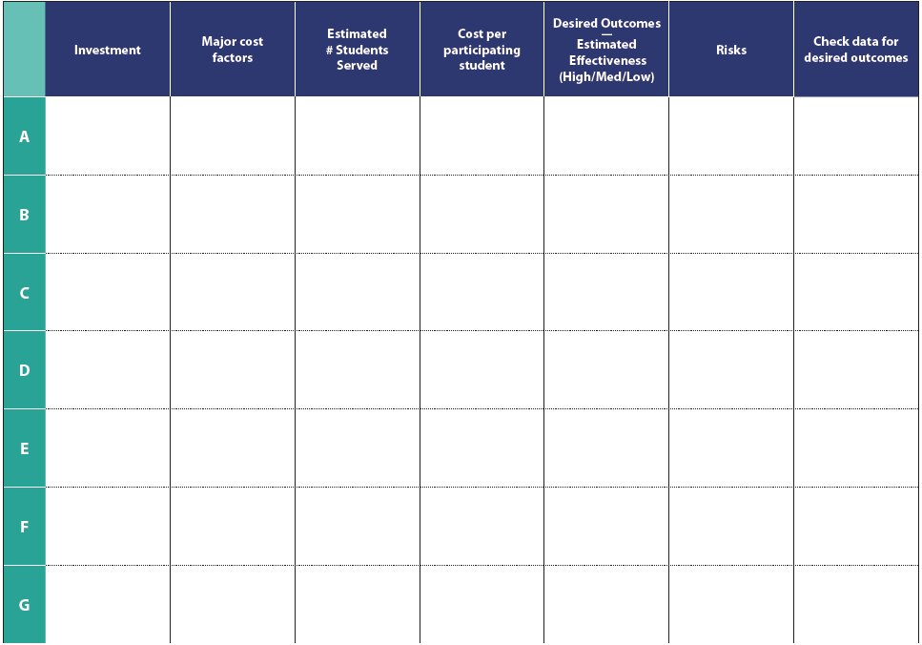
How to use the Investment Grid
What’s your “North Star” goal for kids?
  Raise math scores
  Close achievement gap
  Reduce absenteeism
2. Use the Investment Grid to weigh trade-offs between investment options.
3. Communicate trade-offs and what investments will do for students.
The LEA may need to stop doing something it has traditionally done, if it choses to do something new or maintain an ESSER investment.
Notes:
Laura

Slide 45
Using the Investment Grid with…
Principals
  What’s working in your schools?
  How do you know?
  What trade-off would you make?
School board
  What value did ESSER investments bring?
  What trade-offs in the proposed budget sustain what’s working?
School communities
  Explain ESSER investments
  Describe trade-offs and investment decisions
LEA leadership (CSI/TSI)
  Investments have not been bringing value for some schools/students
  Examine and weight trade-offs
Notes:
Laura

Slide 46

CCNetwork Presentation
Questions?

Slide 47
Wrap Up

Slide 48
Take advantage of these no-cost supports!
Next sessions in the webinar series
  April 4, 2024, 4 p.m. ET: Webinar #5: Communicating Impact: Making the Case for Sustaining What Works Register here
  May 2, 2024, 4 p.m. ET: Webinar #6: Support/Sustain Systemic Capacity Building
SPCR SEA Sustainability Planning Template | Comprehensive Center Network (compcenternetwork.org)
Notes:
Danielle
You can also mark your calendars for the next sessions in this webinar series, we will be sending invitations with zoom registration in advance of each session.

Slide 49
Contact Information
Laura Anderson, Edunomics Lab, NCC Partner
lma86@georgetown.edu
206-276-3172
Danielle Crain, SPCR Lead, National Comprehensive Center
daniellecrain@westat.com
301-610-8805

Slide 50
Presentation Content Note
The presentation is prepared by the National Comprehensive Center under Award #S283B190028 for the Office of Program and Grantee Support Services (PGSS) within the Office of Elementary and Secondary Education (OESE) of the U.S. Department of Education and is administered by Westat. The content of the presentation does not necessarily reflect the views or policies of the Office of Program and Grantee Support Services (PGSS), the Office of Elementary and Secondary Education (OESE), or the U.S. Department of Education nor does mention of trade names, commercial products, or organizations imply endorsement by the U.S. Government.

Slide 51
Listening Segment
Each Office Hours will have a listening segment, wherein we would like to hear from LEAs regarding:
Current hot topics/matters in your LEAs and in your roles
How CDE can support you with ESSA and/or ESSER implementation
What TA or guidance would be helpful for your roles
Any questions you may have

Slide 52
Upcoming Meetings

Slide 53

Looking Ahead…
Any requests for topics or questions?
Upcoming Office Hours:
  March 28
    Construction Training and FAQ

Slide 54
CDE Contacts!
Emails: Lastname_Firstinitial@cde.state.co.us (e.g., Smith_a@cde.state.co.us)
Federal Programs & Supports (ESEA/ESSER Program Supports) | School Finance & Operations (Fiscal and Systems Supports)
Nazie Mohajeri-Nelson, Executive Director of Federal Programs & Supports Unit Program Specialists Program Implementation Supervisor: Laura Meushaw Program Implementation Coordinator: Christina Adeboye Sullivan Program Monitoring Supervisor: Tammy Giessinger ESEA/ESSER Monitoring Coordinator: Kristin Crumley Program Effectiveness Supervisor: Tina Negley Program Evaluation & Research Coordinator: Mary Shen ESEA Programs Specialists and ESEA Regional Contacts (assigned by district) Title I: Laura Meushaw, Evita Byrd, Rachel Echsner, Kim Boylan Title II: Rachel Echsner, Sue Miller-Curley Title III: Rachel Temple, Kim Boylan Title IV & Stronger Connections Grant: Nathan Hickman, Evita Byrd Title V: Christina Adeboye-Sullivan, Rachel Echsner ESSER Program Specialists Jonathan Schelke Kim Boylan Kriselda Craven Nadine Penn ESEA and ESSER Data and Reporting Specialists Mackenzie Owens (ESSER) Melissa Chaffin (ESEA) Jerry Ring (ESEA) | Amy Carman, Executive Director of School District Operations Unit Fiscal Specialists Jennifer Austin, Director of Grants Fiscal Management ESEA Robert Hawkins, Grants Fiscal Analyst Steven Kaleda, Grants Fiscal Analyst ESSER Fiscal Specialist Steven Kaleda Grants Fiscal Analyst ESSER Monitoring Hilery Morris, ESSER Fiscal Monitoring Kristina Jones, Federal Fiscal Monitoring and Reporting Specialist Werner Hagemann, ESSER Fiscal Monitoring Specialist Application Systems Specialists DeLilah Collins, Director of Grants Program Administration Online Applications Systems Technical Support Michelle Prael

