Slide 1
CDE ESEA and ESSER Office Hours
February 13, 2025

Slide 2
ESEA/ESSER Office Hours
Topics:
Overview of the Process for ESEA Funding and Resource for Tracking the Process
Upcoming TNTP Western Slope Sessions
Title II 23-24 District Uses of Funds

Slide 3
ESEA & ESSER Reminders and Updates

Slide 4

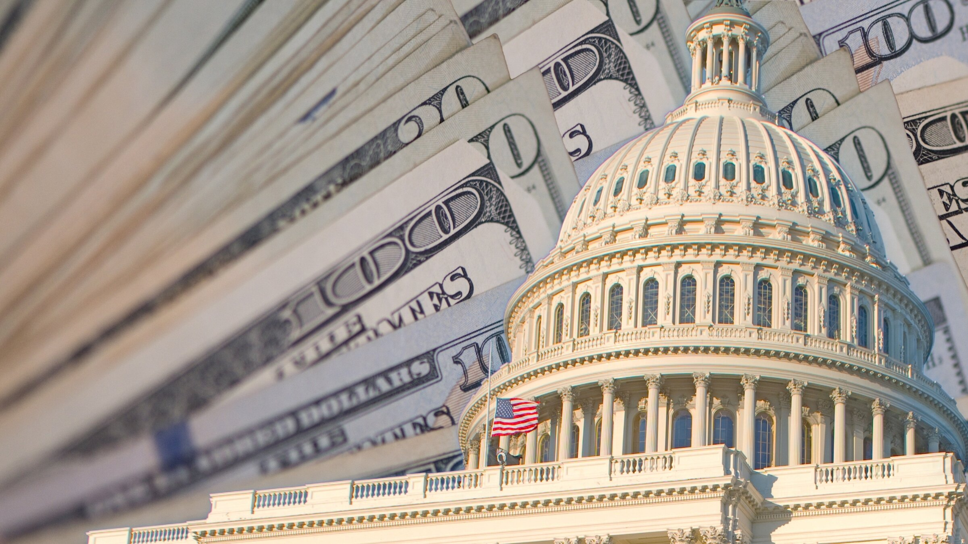
Overview of the Process for ESEA Funding
Authorization Legislation V. Appropriation Legislation
Statutory provisions that define the authority of the government to establish or continue a federal agency, program, project, or activity.
Reauthorized every five years.
Statutory provisions that provide the budget authority for a federal agency to incur obligations and make payments from the Treasury for specific purposes for a specific period of time.
Reauthorized annually - in practice.
Source: Congressional Research Service: Authorizations and the Appropriations Process (2023)
Notes:
Nazie
The Elementary and Secondary Education Act (ESEA), reauthorized as the Every Student Succeeds Act (ESSA), enacted in December 2025, is an authorization bill, and defines the programs to be implemented to ensure all students have equitable access to high quality education and educators.
The funding for implementation comes from Appropriations Legislation.

Slide 5
Overview of the Process for ESEA Funding Cont’d
Congress has the Constitutional authority for both types of Legislation (Authorization and Appropriations); but process is established by Congress.
  12 parallel Appropriations Subcommittees in the House and Senate
  The Subcommittee on Labor, Health and Human Services, Education, and Related Agencies establishes the appropriation for ESEA.

Slide 6
Overview of the Process for ESEA Funding Continued
Source: Congressional Research Service: The Appropriations Process: A Brief Overview
President Proposes a Budget
House
Senate
Amendments
President Signature
1st Monday of February
Federal Agencies / Departments submit justifications
Both House & Senate Subcommittees Analyze
Hold Hearings
Get input from other Members of Congress
House drafts an Appropriation Bill
Goes through amendments
House Floor Vote
If approved, goes to Senate
If approves House Bill, goes to President
If not, can create a Senate Appropriations Bill
Both Chambers must agree to an Appropriations Bill
If not, goes through Amendments and negotiations until reach an agreement
An Appropriation Bill approved by both Chambers goes to the President to sign
After President signs, Federal Agencies and Departments receive their allocations

Slide 7
Allocations Timeline~
Varies by Year! Highly Dependent on Appropriations Process!
U.S. Department of Education
Awards Allocations to State Educational Agencies ( e.g., CDE) based on Census poverty data for Titles I and II (also includes total population). Title III is calculated based on number of Multilingual Learners and immigrant students and youth in the state. Title IV is based on prior year’s Title I.
SEA: Colorado Department of Education
CDE distributes 90-95% to LEAs (depending on the program) by formula and reserves funds at the State for administration and state level activities.
Local Educational Agencies
LEAs apply for the funds through the Consolidated Application.

Slide 8
Current Status and Tracking Resource
Fiscal Year ending on September 30, 2025
  Under a Continuing Resolution that ends on March 14, 2025
Fiscal Year ending on September 30, 2026
  Delayed during administration transition years
Resource for Tracking Appropriations Bills
Congressional Research Service: Appropriations Status Table
  Choose year from dropdown
  Regular Appropriations - Scroll down to “Labor-HHS-Education”
  Continuing Resolutions Tab - Scroll down to the bottom

Slide 9
How to Prepare for 2025-2026
Notes:
Nazie

Slide 10
Upcoming Regional Network Meetings
Content: The Winter RNMs will focus on building understanding of Comprehensive Needs Assessments and how to use a Comprehensive Needs Assessment to plan ESEA funds. The RNM will also share updated guidance from the Family, School and Community Partnerships and USDE. Lastly, the RNM will provide time to network with other LEAs to learn more about the Consolidated Application process and implementation.
Target Audience: LEA staff or school leaders who support the development of the Consolidated Application or manage federal programs.
Dates and Locations:
Thursday, February 27th 1:30-3:30 pm (join using Office Hours Zoom link)
Tuesday, March 4th 8:30-10:30 am (Sign up HERE)
See full details and registration links at the RNM webpage

Slide 11

CDE + TNTP: Building a Championship Team:
Proactive and Reactive Talent Strategies to Accelerate Learning
What:
Leaders will be able to articulate what matters most for teacher retention and create a year-long plan to retain their irreplaceables.
Leaders will be able to identify components of the hiring process that are critical to building a championship team, review exemplar documents and tools, and create an action plan to support proactive retention and recruitment, selection, and onboarding.
More info in our flyer
Who:
This session is open to to anyone looking to improve their retention and recruitment practices within schools and districts. Especially those on the Western Slope!
We’d also encourage you to bring along a member of your HR/Talent team to support coherence in your strategy and planning you’ll do in the session.
When: March 7th, 9:00 - 2:30
Where: R-5 High School (Grand Junction, CO)
Register here! Or email Karen Beisel at beisel_k@cde.state.co.us
Notes:
Sam

Slide 12
Title II, Part A—Supporting Effective Instruction
LEA Use of Funds
SY 2023-24
Notes:
Sue and Jerry

Slide 13
Title II Purpose
Increase student academic achievement consistent with state academic standards
Improve the quality and effectiveness of educators
Increase the number of educators who are effective in improving student academic achievement in schools
Provide low-income and minority students greater access to effective educators
https://www.cde.state.co.us/fedprograms/tii/index
Notes:
Jerry

Slide 14
Title II Requirements
Activities must be planned through consultation with teachers, school leaders, special service providers, parents, and community partners.
Each LEA accepting Title II, Part A funds must also:
  Implement a system of professional growth and improvement for educators, including opportunities to develop meaningful teacher leadership
  Prioritize Title II, Part A funds to schools that have been identified for comprehensive and targeted support and improvement
  Provide equitable services to eligible non-public school teachers;
  Coordinate professional development activities with activities provided through other Federal, State and local programs
  Ensure activities address the learning needs of all students
https://www.cde.state.co.us/fedprograms/tii/index

Slide 15
Title II Allowable Uses
High-quality, personalized, evidence-based professional development
Rigorous, transparent, and fair evaluation and support system for teachers, principals
Initiatives to assist in recruiting, hiring, and retaining effective teachers
Recruiting qualified individuals from other fields to become teachers, principals
Reducing class size to a level that is evidence-based
Programs and activities that increase the ability of teachers to effectively teach children with disabilities and English learners
Activities to increase the ability of principals or other school leaders to support teachers meet the needs of students through age 8
Instructional services provided by effective school library programs
https://www.cde.state.co.us/fedprograms/tii/index

Slide 16
Colorado Data
State Use of Title II, Part A Funds in 2023–24
Analysis based on Consolidated Applications

Slide 17
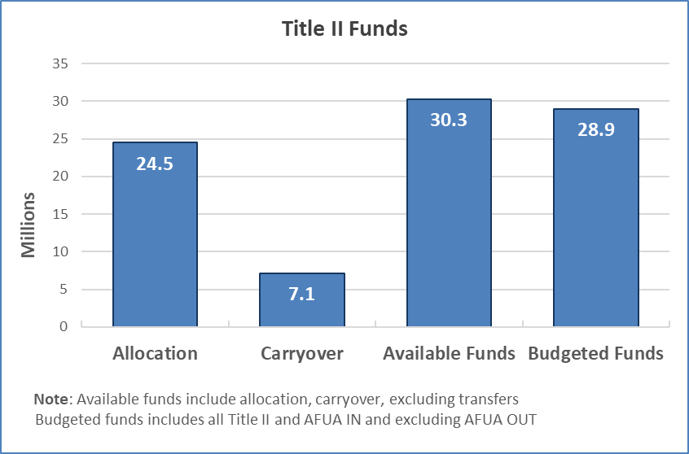
Title II Funds SY 2023-24
Table 1: Title II Funds
Allocation | Carryover | Available Funds | Budgeted Funds
$24,505,897.00 | $7,122,811.85 | $30,256,708.85 | $28,944,205.00

Slide 18
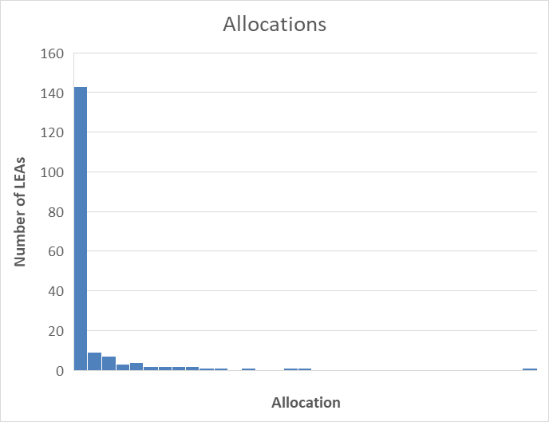
Title II Allocations
Table 2: Title II Allocations

Slide 19
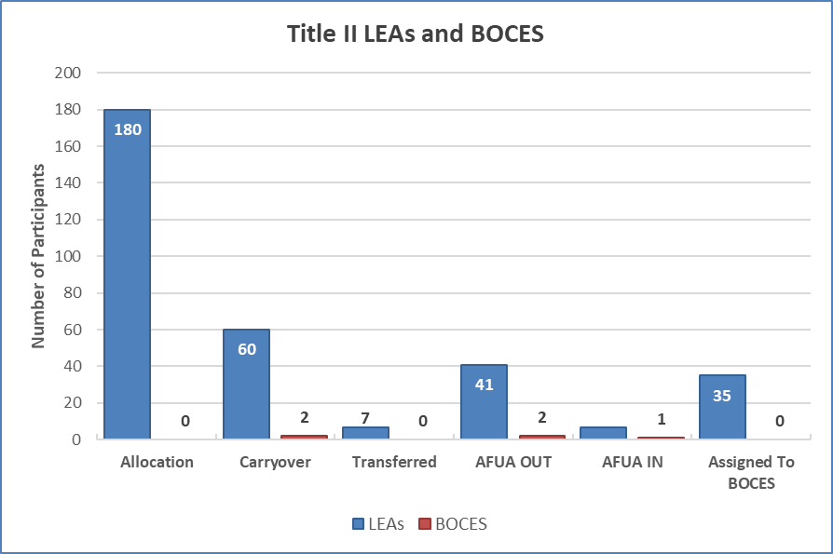
Title II Funding Availability
Table 4: Funding Numbers by LEAs and BOCES

Slide 20
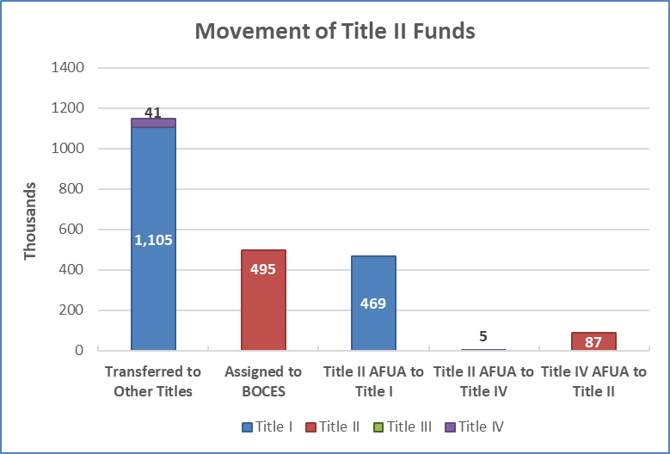
Title II Movement of Funds
Seven LEAs transferred Title II funds, majority to Title I
Thirty-five LEAs assigned Title II funds to BOCES
Forty LEAs moved funds to Title I with AFUA
Table 6: Movement of Title II Funding
 | Title I | Title II | Title III | Title IV
Transferred to Other Titles | 1105368 | 0 | 0 | 40500
Assigned to BOCES | 0 | 495336 | 0 | 0
Title II AFUA to Title I | 468522 | 0 | 0 | 0
Title II AFUA to Title IV | 0 | 0 | 0 | 5196
Title IV AFUA to Title II | 0 | 86983 | 0 | 0

Slide 21
Title II Activities from 2023-24 ConsApp
Professional Development
Indicators and Object Codes
Instructional Planning
Indicators
Class Size Reduction
Budget narratives text search
Recruitment and Retention
Budget narratives text search

Slide 22
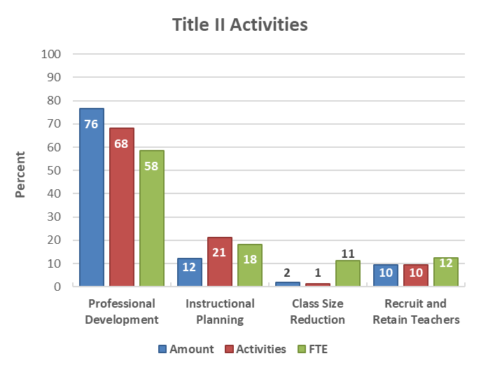
Title II Activities
Majority of Title II funds, activities and FTEs used for professional development
Class size reduction was least frequently funded activity
Note that categories are not exclusive
Table 8: Title II Activities

Slide 23
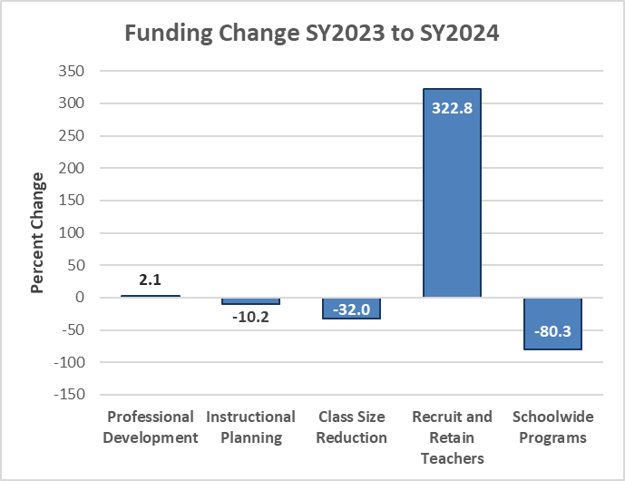
Title II Change in Funding Activities SY23-24
Title II Change in Funding Activities SY2023 to SY2024
Table 9: Change in Title II Activities

Slide 24
Title II LEA Use of Funds Summary
Total available funds SY 2023-24 approximately $30M
  $1.6M (5%) moved out of Title II-A
  Transfers were down and AFUA increased in SY2023-24
  Majority of transfer/AFUA went to Title I (99%)
Most of budgeted funds (74%), activities (66%), and FTEs (58%) were for professional development
Significant increase in funding for recruiting, hiring, and retaining educators

Slide 25
Colorado and National Trends
State and District Use of Title II, Part A Funds in 2023–24
U.S. Department of Education, Office of Elementary and Secondary Education
American Institutes of Research 2025

Slide 26
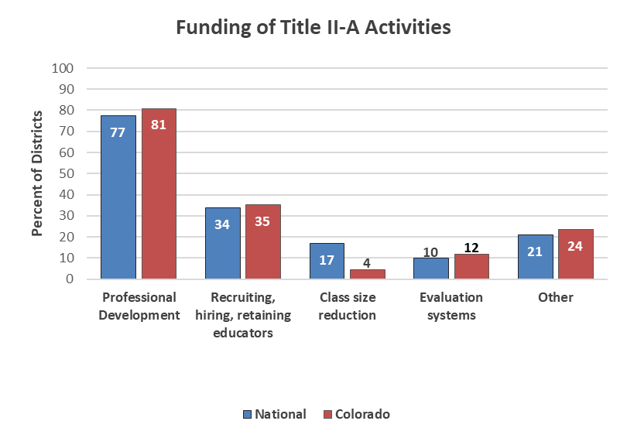
Title II Activities Funding
Most districts funded professional development
Colorado followed national trends
Class size reduction not frequently used in Colorado
Table 10: Percent Districts Funding Types of Title II Activities
State and District Use of Title II, Part A Funds in 2023–24, Washington, DC, 2025. Exhibit B.7

Slide 27
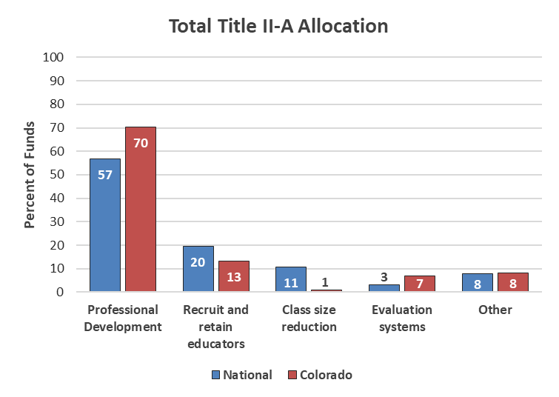
Title II Budgeted ($) Funds
Most Title II funding was for professional development
Relatively little funding for class size reduction in Colorado
Evaluation systems higher priority in Colorado
Table 11: Percent of Funds for Types of Title II Activities
State and District Use of Title II, Part A Funds in 2023–24, Washington, DC, 2025. Exhibit B.8

Slide 28
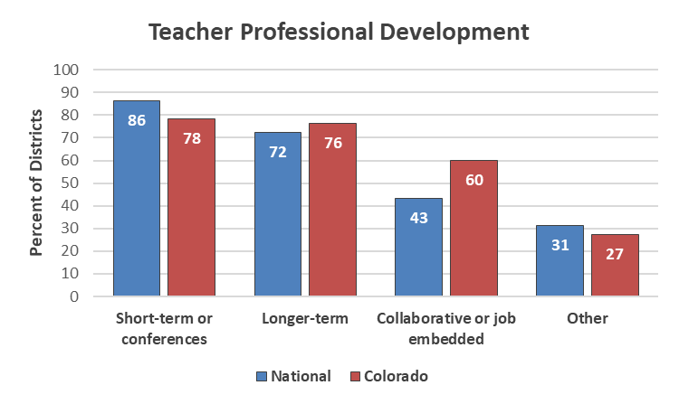
Title II Teacher Professional Development Types
National trend was short term professional development for teachers
More Colorado LEAs invested in longer-term or collaborative activities
Table 12: Districts Funding Types of Professional Development
State and District Use of Title II, Part A Funds in 2023–24, Washington, DC, 2025. Exhibit B.15

Slide 29
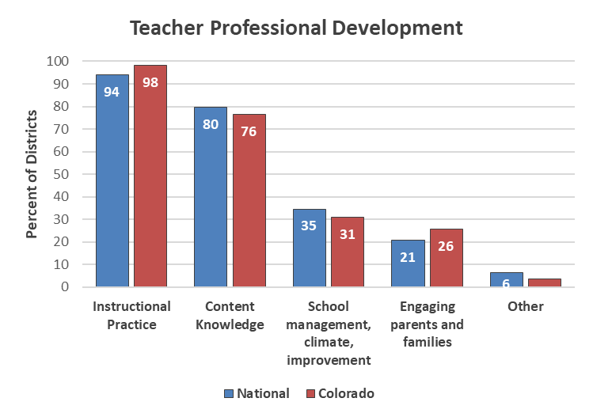
Title II Teacher Professional Development Activities
Primary topics for teachers were instructional practice and content knowledge
Almost all Colorado LEAs invested in instructional practice activities
Table 13: Percent of Districts by Teacher Professional Development Activity
State and District Use of Title II, Part A Funds in 2023–24, Washington, DC, 2025. Exhibit B.21

Slide 30
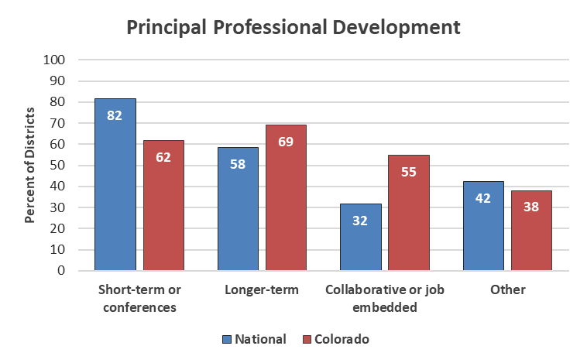
Title II Principal Professional Development Types
Like teacher professional development, national trend for principals was more short term (3 days or less)
Again, Colorado LEAs invested in more longer-term or collaborative activities for principals
Table 14: Districts Funding Types of Professional Development
State and District Use of Title II, Part A Funds in 2023–24, Washington, DC, 2025. Exhibit B.16

Slide 31
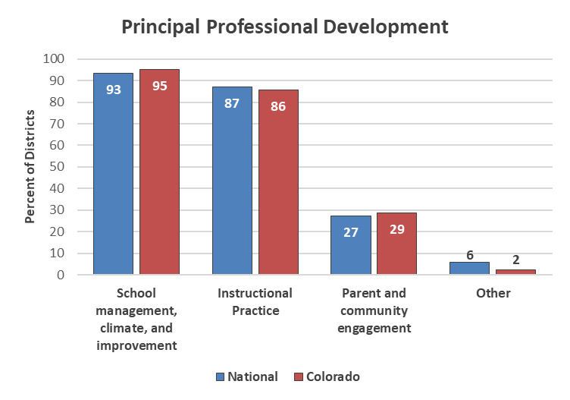
Title II Principal Professional Development Activities
Primary professional development topics for principals were school management and instructional practice
Colorado LEAs emphasized more community engagement than national trends
Table 15: Percent of Districts by Principal Professional Development Activity
State and District Use of Title II, Part A Funds in 2023–24, Washington, DC, 2025. B.26

Slide 32
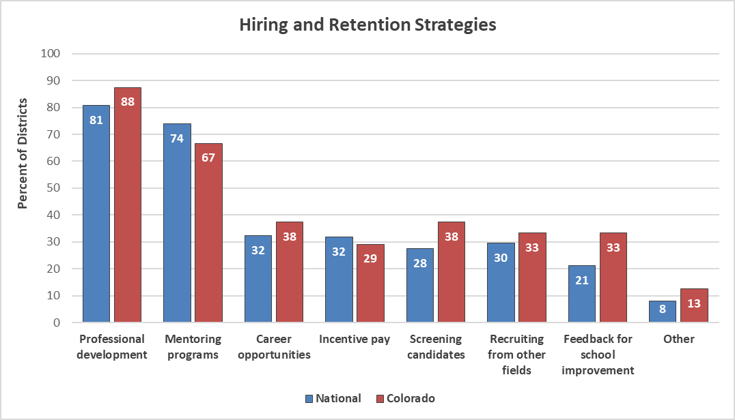
Title II District Hiring and Retention Strategies
Table 16: District Hiring and Retention Strategies
State and District Use of Title II, Part A Funds in 2023–24, Washington, DC, 2025. Exhibit B.33

Slide 33
Title II Colorado Survey Summary
Percentages of CO LEAs funding Title II-A activities followed national trends
Professional development (PD) was most funded activity
Colorado LEAs budgeted far less for class size reduction and more for evaluation systems than national average
More CO LEAs funded long-term or collaborative/job embedded PD than national trends for both principals and teachers
Teachers’ PD mostly focused on instructional practice and content knowledge
Principals’ PD mostly focused on school management and instructional practice

Slide 34
Title II Use of Funds: Questions to Consider
How do you make decisions regarding AFUA and transfer out of Title II based on district needs?
Most Title II funds in Colorado are dedicated to professional development and Colorado provides more long-term professional development opportunities than the national trend.
  How will your district go about measuring the effectiveness of the 2024-2025 professional development?
  What initiatives needs multiple years?
  Have needs changed in professional development for 2025-2026 planning?
How can your district leverage Title II funds to supplement district recruitment and retention initiatives?

Slide 35
Title II Regional Network Meetings
Meetings: February 27 and March 4
We will be discussing uses of Title II funds and providing examples from Colorado and across the US
Support LEAs in planning their use of Title II funds for the SY2025-2026
Deepen our understanding of allowable uses of Title II funds to support student achievement

Slide 36
Upcoming Meetings

Slide 37
2025 Elevating Excellence Conference: Strengthening Equitable Systems
Purpose: Attendees from diverse professional backgrounds to learn and share ideas, strategies, and plans for how to strengthen equitable systems. Highlight and elevate effective and exemplary practices in Colorado.
September 22-23, 2025
Adams 12 Conference Center
Free!
Strands:
  Increase Student Engagement
  Accelerate Student Outcomes
  Strengthen the Educator Workforce
  LEA Operational Excellence
Accepting proposals for sessions until May 30, 2025
Conference website

Slide 38

Looking Ahead…
Any requests for topics or questions?
Upcoming Office Hours
  February 27 and March 4
    Winter RNM
  March 13
    Waiver Overview
    EBI Training

Slide 39
CDE Contacts!
Emails: Lastname_Firstinitial@cde.state.co.us (e.g., Smith_a@cde.state.co.us)
Federal Programs & Supports (ESEA/ESSER Program Supports) | School Finance & Operations (Fiscal and Systems Supports)
Nazie Mohajeri-Nelson, Executive Director of Federal Programs & Supports Unit Program Specialists Program Implementation Supervisor: Laura Meushaw Program Implementation Coordinator: Christina Adeboye Sullivan Program Monitoring Supervisor: Tammy Giessinger ESEA/ESSER Monitoring Coordinator: Kristin Crumley Program Effectiveness Supervisor: Tina Negley Program Evaluation & Research Coordinator: Anna Rowan Strategic Recovery Office (ESSER State Reserve): Matt Koziol ESEA Programs Specialists and ESEA Regional Contacts (assigned by district) Title I: Laura Meushaw, Evita Byrd, Rachel Echsner, Kim Boylan Title II: Rachel Echsner, Sue Miller-Curley Title III: Rachel Temple, Kim Boylan Title IV & Stronger Connections Grant: Nathan Hickman, Evita Byrd Title V: Christina Adeboye-Sullivan, Rachel Echsner ESEA and ESSER Data and Reporting Specialists Melissa Chaffin (ESEA) Jerry Ring (ESEA) Anna Rowan (ESEA) | Vacant, Executive Director of School District Operations Unit Fiscal Specialists Jennifer Austin, Director of Grants Fiscal Management ESEA Robert Hawkins, Grants Fiscal Analyst Steven Kaleda, Grants Fiscal Analyst ESSER Fiscal Specialist Steven Kaleda Grants Fiscal Analyst ESSER Monitoring Bill Parsley, ESSER Fiscal Monitoring Supervisor Hilery Morris, ESSER Fiscal Monitoring Application Systems Specialists DeLilah Collins, Director of Grants Program Administration Online Applications Systems Technical Support Jessica Hollingshead Michelle Prael

