Slide 1
CDE Office Hours
February 9, 2023

Slide 2
ESSER Office Hours
Topics
Updates and Reminders
Stronger Connections Grant
Close-Out Documents
ESSER Grantee/Subgrantee Reporting Requirements
Follow-up to BruMan Training/Open Q&A

Slide 3
Updates and Reminders

Slide 4
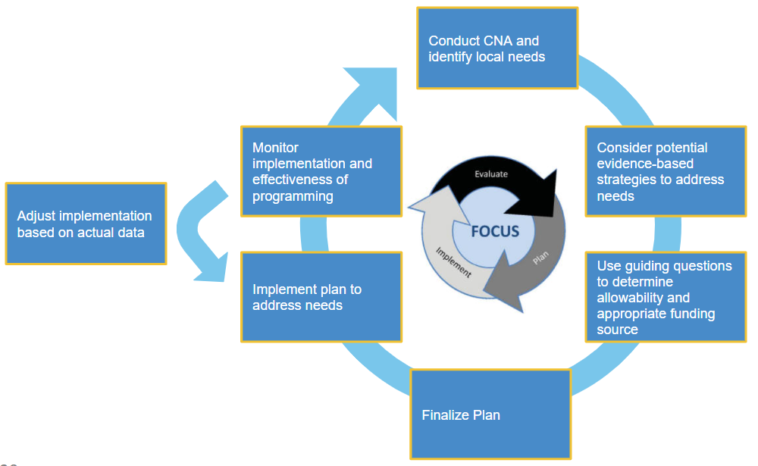
Upcoming Regional Network Meetings
Content: The Winter RNMs will focus on supporting LEAs in creating a Consolidated Application that is driven by student needs and will result in improved student outcomes.
Target Audience: LEA staff or school leaders who support the development of the Consolidated Application or manage federal programs. This training will be specifically helpful for anyone new to managing the Consolidated Application or wanting to learn more about allowable uses of federal funds.
RNM Objectives:
Understand important updates from FPSU, including the 23-24 Consolidated Application
Know the steps to plan for and implement activities that respond to student needs using federal funds
Build knowledge of allowable uses of federal funds
Identify evidence-based interventions to meet student needs
Reflect on past programming and plan for future activities using federal funds

Slide 5
Upcoming Regional Network Meetings
Dates and Locations:
Douglas County Board Room: Wednesday, February 22nd, 2023, 12:30-3:30pm
Greeley-Evans Family Center: Tuesday, February 28th, 2023, 12:30-3:30pm
Summit RE-1 Professional Development Building: Wednesday, March 1st 2023, 12:30-3:30pm
Pueblo 60 Board Room at the Administration Office: Tuesday, March 7th, 2023, 12:30-3:30pm
Virtual Session: Thursday, March 9th, 2023, 12:30-3:30 pm
See full details and registration links at the RNM webpage

Slide 6
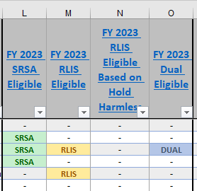
Rural Education Achievement Program Updates
The 2023 Master Eligibility Spreadsheet for Rural Education Achievement Program (REAP) programs is available on the USDE’s SRSA Eligibility and RLIS Eligibility webpages
The spreadsheet shows LEAs’ estimated allocations for The Small, Rural School Achievement Program and The Rural and Low-Income School Program funding
Please check the programs that you are eligible for and your allocations. These may have changed from last year
Dual-Eligible LEAs can only apply for one of the programs
If there are any errors in your LEA’s information, email Shannon Wilson
The contacts are especially important!

Slide 7
SRSA Application
The SRSA application opened yesterday
Due Date: April 14, 2023
The application will be emailed to the contacts listed on the Master Eligibility Spreadsheet
Email will come from no-reply.survey@max.gov
To apply, you must have a Unique Entity Identifier (UEI) through SAM.gov
Instructions and support for setting up your UEI can be found on the UEI and SAM support webpage.
Note that setting up the UEI is a two-part process: an LEA must first request a UEI from SAM.gov and then go through the registration process. UEI registrations must be renewed annually.
USDE has released a new REAP Use of Funds guide to help LEAs determine how to use SRSA or REAP funds
The first FY 2023 SRSA application webinar will be held on Tuesday, February 14 at 11 a.m. An invitation to the webinar will be included in the application email.
Questions about the application can be sent to REAP@ed.gov or Shannon Wilson

Slide 8
Colorado Education Recruitment Fair

Slide 9
Stronger Connections Grant

Slide 10
Stronger Connections Grant
CDE is currently seeking public comment on using the following criteria to define a “high-need” LEA
Percentage of students eligible for Free and Reduced Lunch (FRL),
A high student-to-mental health professional ratio, and
High rates of chronic absenteeism.
To determine eligibility, CDE is proposing to
Separate LEAs into quartiles for each of the proposed criteria
Award points based on where each LEA falls within the indicator quartiles and calculate a total score
Determine which LEAs have the most points in order to identify who will be automatically eligible to apply for the Stronger Connections Grant
CDE is also proposing an alternative eligibility option that would allow LEAs that are not automatically eligible to apply using their own data to demonstrate an identified need that aligns with the intent of the Stronger Connections Grant.

Slide 11
Feedback Requested
Please review the information on the Stronger Connections Grant website and submit a feedback form by March 8, 2023.
Questions can be sent to stronger_connections@cde.state.co.us

Slide 12
Close-Out Documents

Slide 13
Close-out Procedures - Fiscal and Program Checklist
Document can be found on the GFMU Webinars, Trainings and Guidance Page
Here is a link to the actual form
Final AFR submissions should follow the standard submission process

Slide 14
ESSER Grantee/Subgrantee
Reporting Requirements

Slide 15
ESSER Data Reporting
The U.S. Department of Education has been authorized by Congress to collect data from all ESSER I, II, and III grantees, including but not limited to the uses and impact of funds. CDE is able to use the ESSER I, II, and III applications to provide the vast majority of the requested data on behalf of our grantees, with the exception of the following data points:
How students with poor attendance or participation have been re-engaged;
How school level allocations were determined; and
LEA participation in ESSER activities.

Slide 16
Student Re-Engagement Survey
All LEAs that received ESSER I, II, or III funds must report on whether the LEA sought to re-engage students with poor attendance or participation (regardless of whether ESSER funds were used for this purpose).
Applies to districts only.
SY 2021-22 survey will be due March 31st, 2023 (SY July 1st, 2021 - June 30th, 2022)
Annual survey (Google Form) consisting of two questions:
Did the LEA seek to re-engage students with poor attendance or participation?
If so, how? (check all that apply)
LEAs previously submitted the SY 2020-21 survey in Spring 2022.
SY 2022-23 survey will be due September 30, 2023.

Slide 17
School-Level Allocation Survey
All LEAs allocating at least a portion of ESSER funds to schools in the reporting period must report on the criteria used to allocate funds to schools within the LEA.
Applies to districts that budgeted funds at the school-level only.
SY 2021-22 survey will be due March 31st, 2023 (SY July 1st, 2021 - June 30th, 2022)
Annual survey (Google Form) consisting of one question:
What criteria was used to allocate ESSER funds to schools? (check all that apply)
LEAs previously submitted the SY 2020-21 survey in Spring 2022.
SY 2022-23 survey will be due September 30, 2023.

Slide 18
NEW - LEA Participation in ESSER Activities
All LEAs that received ESSER I, II, or III funds must report on how ESSER funds were used to support learning recovery or acceleration for student groups who were disproportionately impacted by the COVID-19 pandemic.
Includes all grantees of ESSER I, II, or III funds, including districts, BOCES, Administrative Units (AUs), facility schools, and tribal nations.
Data collection template to be submitted via Syncplicity.
SY 2022-23 (July 1st, 2022 - June 30th, 2023) template will be due September 30, 2023.
Extended learning time definition for this reporting:
Using a longer school day, week, or year schedule to significantly increase the total number of school hours to include additional time for a)instruction in core academic subjects; and b) instruction in other subjects and enrichment activities that contribute to a well-rounded education. Participation is considered mandatory.

Slide 19
Data Collection Templates
Stakeholders indicated that, for some LEAs, reporting student level data would be more convenient, while for others it would be easier to report aggregated data. To best meet the needs of all LEAs and create options that meet varying needs, LEAs can choose to submit either LEA-level or student-level data. LEAs should submit one of the following templates:
LEA-Level Survey
Multiple spreadsheets to report aggregate data for each student group.
Student-Level (Combined) Survey
Single spreadsheet for reporting each student’s participation in a variety of programs.
Student-Level (Separate) Survey
Multiple spreadsheets to report student participation for each program separately.

Slide 20
Resources
CDE has created an ESSER Grantee/Subgrantee Reporting webpage to share resources, trainings, and data collection templates/surveys, to support grantees in successfully meeting these reporting requirements.
A recorded training, instructional manual, and links to surveys and data collection templates are available now on the website.
CDE will also continue to dedicate time during upcoming Office Hours to provide updates and host Q&A sessions concerning these reporting requirements:
March 23, 2023
April 13, 2023
Contact:
Tina Negley (negley_t@cde.state.co.us)
or
Mackenzie Owens (owens_m@cde.state.co.us)

Slide 21
Follow-up to BruMan Training/
Open Q&A

Slide 22
Construction Projects
01
Is your LEA using ESSER funds for construction?
Did CDE provide prior written approval for the project(s)?
Is it clear how the construction is allocable to ESSER (intended to “prevent, prepare for, or respond to” COVID-19)?
02
Have construction projects been completed?
Were 2020-2021 and 2021-2022 projects completed?
Will projects in 2022-2023 be completed on time?
03
Are Davis-Bacon Act requirements being met?
Are any projects over $2,000?
Has the LEA ensured that any contracts include Davis-Bacon provisions and that the Davis-Bacon poster is visible on any work sites?
04
Can the LEA demonstrate that other construction regulations are being met?
Refer to CDE’s construction guidance and the Brustein & Manasevit materials for additional information.
05
Have the plans for the use of any ESSER funds changed?
If funds are not being used as budgeted and approved by CDE, the LEA should submit a post-award revision (PAR) request for approval.

Slide 23
Open Q & A

Slide 24
Upcoming Meetings

Slide 25
Looking Ahead…
Upcoming Office Hours
Any requests for topics or questions?
February Changes!
February 23

Slide 26
CDE Contacts!
Emails: Lastname_Firstinitial@cde.state.co.us
(e.g., Smith_a@cde.state.co.us)
Federal Programs & Supports (ESEA/ESSER Program Supports) | School Finance & Operations (Fiscal and Systems Supports)
Nazie Mohajeri-Nelson, Executive Director of Federal Programs & Supports Unit Program Specialists Program Implementation Supervisor: Laura Meushaw Program Implementation Coordinator: Christina Adeboye Sullivan Program Monitoring Supervisor: Tammy Giessinger ESEA/ESSER Monitoring Coordinator: Kristin Crumley Program Effectiveness Supervisor: Tina Negley ESEA Programs Specialists and ESEA Regional Contacts (assigned by district) Title I: Laura Meushaw, Evita Byrd, Rachel Echsner Title II: Karen Bixler Title III: Rachel Temple Title IV: Tammy Giessinger, Nathan Hickman Title V: Shannon Wilson ESSER Program Specialists Jonathan Schelke Kim Boylan Shannon Wilson ESEA and ESSER Data and Reporting Specialists Tina Negley Mary Shen Mackenzie Owens Melissa Chaffin | Amy Carman, Executive Director of School District Operations Unit Fiscal Specialists Jennifer Austin, Director of Grants Fiscal Management ESEA Robert Hawkins, Grants Fiscal Analyst Steven Kaleda, Grants Fiscal Analyst ESSER Fiscal Specialist Steven Kaleda Grants Fiscal Analyst ESSER Monitoring Bill Parsley, ESSER Fiscal Monitoring Supervisor Hilery Morris, ESSER Fiscal Monitoring Kristina Jones, Federal Fiscal Monitoring and Reporting Specialist Werner Hagemann, ESSER Fiscal Monitoring Specialist Application Systems Specialists DeLilah Collins, Director of Grants Program Administration Online Applications Systems Technical Support Michelle Prael

