Slide 1
Emergency Assistance to Non-public Schools Grant
Application training

Slide 2
EANS Overview
The Coronavirus Response and Relief Supplemental Appropriations Act, which passed in December 2020, created the Emergency Assistance to Non-Public Schools (EANS) grant within the Governor’s Emergency Education Relief (GEER) II Fund. The $2.75 billion program will provide funding for emergency assistance to nonpublic.
Colorado was awarded $28,433,931
Nonpublic schools can apply for these funds for “secular, neutral, and non ideological” services and assistance, including sanitization, personal protective equipment, COVID testing, educational technology, and connectivity.
Application due: Monday April 12, 2021

Slide 3
Eligibility
Funds are available to non-public schools that meet the following definitions below:
K-12 Non-profit non-public school. Standalone Pre-K schools are not eligible to apply for funding.
School that is accredited, licensed, or otherwise approved to operate in accordance with State law.
School that existed and operated prior to March 13, 2020.
Consortium of eligible non-public schools - An organization that represents a group of non-public schools and has governing authority over the schools listed in the application.
Non-governing Consortium of eligible non-public schools - an organization that is aggregating support for a group of non-public schools.
The school requesting services or assistance did not and will not apply for and receive a loan under the Small Business Administration’s Paycheck Protection Program (PPP) (15 U.S.C. 636(a)(37)) that is made on or after December 27, 2020.

Slide 4
Non-Governing Consortia Applicants
Applications will be accepted from non-profit organizations that aggregate support for a group of non-public schools but do not have governing authority over the schools it represents. A non-public school within that consortium must be named as the applicant/fiscal agent, and the consortium lead must collect Consortia Sign-Over agreement from each participating school to work on behalf of the schools included in the application.
The Consortia Sign-Over agreement must be submitted to eansapplications@cde.state.co.us by April 12, 2021.

Slide 5
Application Components
Online webform submission:
Provider Information
Funding Information
Assurances
Narrative
Supplemental Attachments
Certification, Approval, and Transmittal form
Preliminary Electronic Budget
EANS Consortia Enrollment and Low-Income Data Sheet (if applicable)

Slide 6
Provider Information
Type of Education Provider
K-12 non-profit non-public school that is accredited, licensed or otherwise approved to operate in accordance with State law and existed and operated prior to March 13, 2020.
Consortium of non-profit non-public schools that meet the criteria above
School demographics
Contact information

Slide 7
Funding Information
Indicate what you will request to be reimbursed for or ask to be purchased
List of allowable uses of these funds
Items not listed are not allowable
Note: Based on new guidance received from the U.S. Department of Education, funding for replacement of windows, air ventilation systems or capital expenses that cannot be removed from a non-public school without remodeling the non-public school are not permissible under this grant.
Amount of funding request
CDE will calculate a per pupil allocation to determine final award amounts for each school/applicant.
Applicants will use the following ranges to determine the amount of their request:
Per Pupil Base Amount | Low-income student (Base + Supplemental)
$500-700 | $1000-1400

Slide 8
Funding… cont.
So exactly what amount do I ask for?
For the base calculation, the non-public school will multiply the total enrollment of the school by an amount within the range provided ($500-700)
250 x $700 = $175,000
If the school has no low-income students, STOP. This is the amount you add to the application.
If the non-public school has low-income students attending the non-public school, calculate the amount by doing the following:
250 x $700 + 9 (low-income students) x $1400
$175,000 + $12,600 = $187,600

Slide 9
Funding FAQ
Q. Since the amount we are adding to the application is based on a range, when will we know exactly what will be available to us?
CDE does not collect data from all non-public schools which makes it difficult to determine the exact amount of each award. Once all applications are received, CDE will use the information collected and re-calculate the base and supplemental amounts.
CDE will work with schools once we know what the base and supplemental amounts are finalized.

Slide 10
Assurances
The assurances in the application are your positive declaration of adherence to the program rules and requirements. Additionally, the assurances inform you of your role, responsibility, and the role and responsibility of CDE.

Slide 11
Application Narrative
Enrollment and Low-Income Data
Student enrollment
Total student enrollment
#K-12 low-income students in the 2019-2020 school year
% of total low-income students (actual or estimate)
Consortia applicants
Complete the EANS Consortia Enrollment and Low-Income Data, PPP and Equitable Services data worksheet

Slide 12
Data Sources
Options:
Free or reduced-price lunch data
Resources: Income Eligibility Guidelines
Scholarship or financial assistance data
Internal data
E-Rate data
If the non-public school participates in the E-rate program, use the same information provided for that program (based on NSLP data)
American Community Survey (ACS) data
Resources: County Maps
U.S. Census Bureau Small Area Income and Poverty Estimates (SAIPE) program data
Proportionality Data
Other relevant data, such as data that the non-public school has provided to the State for purposes of State or local programs.

Slide 13
Application Narrative
Paycheck Protection Program
Indicate if the school participated in the PPP program
Include the amount
Equitable Services under the CARES Act
Provide the name of the district
Consortia will provide this information on the EANS Consortia Enrollment and Low-Income Data, PPP and Equitable Services data worksheet

Slide 14
Application Narrative
Impact of Covid
Loss of tuition revenue
Decrease in enrollment
Increase in enrollment
Lack of capacity to provide remote learning due to insufficient technological support
Learning loss attributed to the education disruptions caused by COVID-19
Other

Slide 15
Expenditure Requests
Each applicant will complete a Preliminary Budget Workbook
Cover page
Budget and Actual Detail
Budget summary
Allowable Activity
AFR Summary

Slide 16
Preliminary Budget - Cover Page
Complete the editable cells only. Any cells that are greyed out cannot be edited.

Slide 17
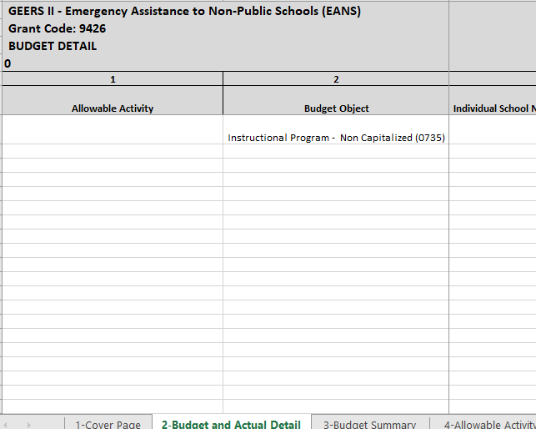
Preliminary Budget – Budget and Actual Detail
Allowable activity pre-populated
Budget Object: Object codes describe the service or commodity obtained as a result of the specific expenditure.
Individual School Name

Slide 18
More on Budget Object – Program Codes
The budget object options in the drop down represent the Program and Object codes.
Program Codes allow applicants to charge costs, instructional and support, directly to the benefiting program.
Instructional Program refers to direct instructional services to students. These can be provided by a classroom teacher, interventionist, etc.
Support Program refers to services that facilitate and enhance the instructional programs. Examples are school counselors, parent liaisons, transportation, community services, curriculum design, assessment, etc.

Slide 19
Object Codes
Object codes describe the service or commodity obtained as a result of the specific expenditure.
0100 Salaries - Amounts paid for personal services to both permanent and temporary school district employees, including personnel substituting for those in permanent positions.
0200 Employee Benefits - Amounts paid by the school district on behalf of employees; generally, these amounts are not included in the gross salary, but are in addition to that amount.
0300 Purchased Professional and Technical Services - Services which by their nature can be performed only by persons or firms with specialized skills and knowledge.
0500 Other Purchased Services - Amounts paid for services rendered by organizations or personnel not on the payroll of the school district (separate from Professional and Technical Services or Property Services).

Slide 20
Object Codes, cont.
0600 Supplies - Amounts paid for items that are consumed, worn out, or deteriorated through use; or items that lose their identity through fabrication or incorporation into different or more complex units or substances.
0735 Non-Capital Equipment - Expenditures for items classified as equipment but cost less than the district policy for capital assets inventory.
0730 Equipment - Expenditures for the initial and replacement items of equipment, such as machinery, furniture, fixtures, instruments, and vehicles.

Slide 21
Budget and Actual Detail
Identify the amount of the request that will be used to support students, staff and the administration of the organization.
You will need to break the costs out even if the amount of the item requested is to cover all three.

Slide 22
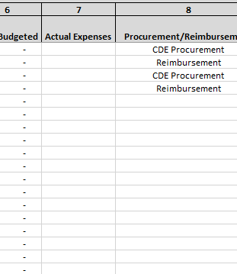
Budget and Actual Detail
Total Budgeted and Actual Expenses will auto calculate based on the amount entered columns 3, 4 & 5.
For each line, indicate if CDE will procure/purchase on the school's behalf or if the school will request to be reimbursed for allowable expenses already purchased.

Slide 23
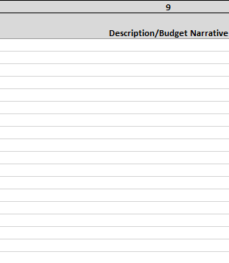
Budget and Actual Detail
Description/Budget Narrative must be completed
Description and Narrative must include the following
Quantity
Amount
Provider/Vendor name (if known)
Date purchased (if already purchased)
Product number (if known)
Quote number (if applicable)
If requesting purchase from Amazon, include link to product from the Amazon website

Slide 24
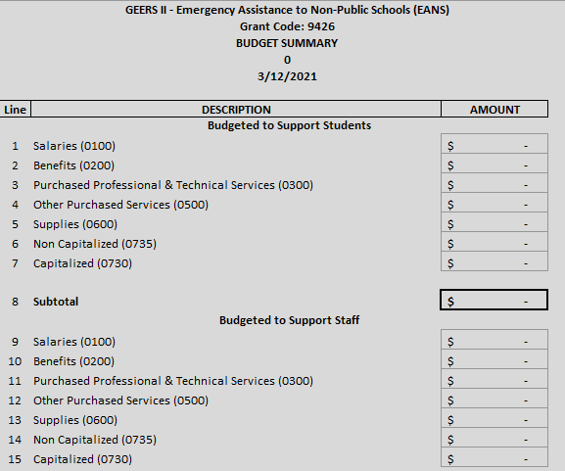
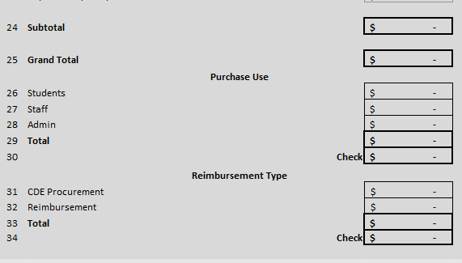
Preliminary Budget – Budget Summary
This tab is pre-populated based on the information added to the Budget and Actual Detail tab
Red text = ERROR

Slide 25
Preliminary Budget – Allowable Activity
This table summarizes the amount allocated to the activities selected on the Budget and Actual Detail tab

Slide 26
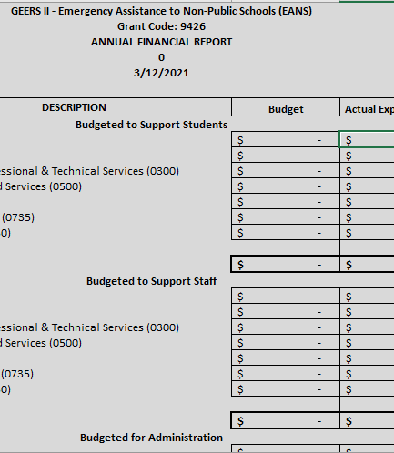
Preliminary Budget – AFR Summary
At the end of the grant, CDE will collect an Annual Financial report where the school will report the actual amount spent in each category. Applicants cannot edit this page.

Slide 27
Summary
Successful single school applicants will have completed and submitted the following:
Submitted the Online Application web form
Emailed the signed Certification, Approval and Transmittal signature form and Preliminary EANS budget workbook to eansapplications@cde.state.co.us
Successful consortia applicants will have completed and submitted the following:
Submitted the Online Application web form
Emailed the signed Certification, Approval and Transmittal signature form, EANS Consortia Enrollment and Low-Income Data, PPP and Equitable Services data worksheet and Preliminary EANS Budget workbook to eansapplications@cde.state.co.us

Slide 28
Submission Process and Deadline
Applications must be completed and submitted through the online application by Monday, April 12, 2021 5:00 pm.
A preliminary electronic budget form must also be submitted and emailed to eansapplications@cde.state.co.us by Monday, April 12, 2021.
Note: Incomplete or late applications will not be considered. Applicants should receive an automated confirmation email from the online system upon submission. If you do not, please email eansapplications@cde.state.co.us.

Slide 29
Procurement Process - First Look
Any request that is greater than $25,000 will require a formal procurement process.
Competitive bidding
Longer process
Request less than $25,000 will not require a formal procurement process.
NPS can chose provider/vendor, however, must follow internal procurement requirements
CDE can pay the provider/vendor directly
More to come!

Slide 30
Reimbursement Process – First Look
Non-public school will provide the necessary paperwork prior to being reimbursed.
Receipt of payment
Proof of delivery

Slide 31
Any Questions??

Slide 32
Contacts
Program Questions:
DeLilah Collins (collins_d@cde.state.co.us)
Budget/Fiscal Questions:
Robert Hawkins (hawkins_r@cde.state.co.us)
Application Process Questions:
Kim Burnham (burnham_k@cde.state.co.us)
Website: EANS

