Slide 1
Neglected and Delinquent
CSPR Data Collection

Slide 2
Overview
Reporting requirements
Walkthrough of Facility-Level data collection template
Submission process

Slide 3
Reporting requirements
Data must be submitted for all facilities that received FY 2022-23 funding
  Title I, Part D
    Subpart 1 – State agencies
    Subpart 2 – Delinquent
  Title I, Part A Neglected Set-Aside
    Neglected Facilities
Complete CDE’s Facility-Level data collection template
  Separately for each facility
  Facilities running more than one program must submit a separate template for each program

Slide 4
Data Collection Template –
Layout
Instructions
Required elements:
  Contact Info (person completing template)
  Programs and Facilities
  Students Served
  Academic & Vocational Outcomes
  Academic Performance

Slide 5
Data Collection Template –
Instructions
Only include facilities/programs that received funding, and students that directly benefited
  Students who are housed in facilities that received funding, but did not benefit from those funds during the reporting year should not be included
July 1, 2022 – June 30, 2023
Complete tabs in order
Zero values vs. missing data
  Type “Missing” in any fields for which a data element is not collected or is missing, and provide an explanation in the Comments field as to why the information is not available
  If the number of students to be reported for a data element is zero, insert the number zero (0)

Slide 6
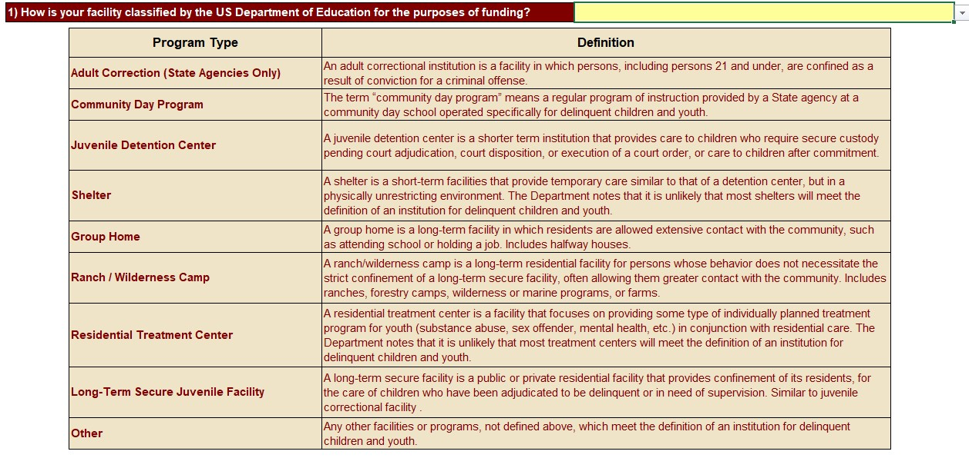
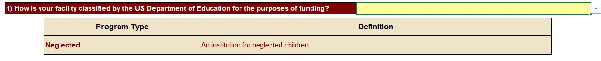
Data Collection Template –
Programs and Facilities
Delinquent Facilities: Choose a program type
Neglected Facilities: Select neglected from the dropdown

Slide 7
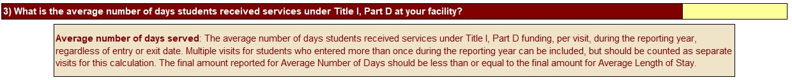
Data Collection Template –
Programs and Facilities, Cont.
Provide average length of stay for each program
Provide average number of days served

Slide 8
Data Collection Template –
Students Served
Unduplicated count
  Students are counted only once, even if they were admitted to a facility or program multiple times within the reporting year
Duplicated count
  Multiple admissions counted each time (e.g. a student in the facility who exits, then is entered back into the program at a later date, would be counted twice)

Slide 9
Data Collection Template –
Students Served, Cont.
Based on unduplicated counts only:
Long-term students
  Students enrolled for 90 or more consecutive days
Students with disabilities (IDEA)
Limited-English proficient (LEP) students
  Federal definition, includes NEP and LEP
Race/ethnicity
Gender
Age
NOTE: Each subtotal should equal the number of unduplicated students reported, otherwise provide explanation in comments

Slide 10
Data Collection Template –
Program Outcomes
*NOTE: All outcomes, except for enrollment in local school district, are reported for students while in facility, and again for students within 90 days after exiting. If a student attained an outcome once in the facility, and again after exiting, that student may be counted once in each column.
Based on unduplicated counts only:
Enrolled in local school district
  Only reported after exiting
Earned high school course credits
Enrolled in GED program
Earned a GED
Obtained high school diploma
Accepted and/or enrolled in post-secondary education
Enrolled in job training courses/programs
Obtained employment

Slide 11
Data Collection Template –
Academic Achievement
Only report academic performance of long-term students
Students who took both initial and follow-up tests
For students taking both an initial and follow-up, report the change in grade-level performance:
  Negative change
  No change
  Improvement up to one grade-level
  Improvement more than one grade-level
NOTE: Students who took an initial test prior to July 1 of the reporting year may be included if their follow-up test occurred during the reporting year. Students who completed the follow-up test after the reporting year ended should be counted in the following year CSPR.

Slide 12
Data Collection Template –
State Assessment
Report the total number of students, served by Title I, Part D, who took a state assessment.
Total number of students who took the State Assessment in Reading Language Arts and Math
  Number of students considered proficient
  Number of students considered non-proficient
Note: This is a new data element that will be required beginning in SY 2023-2024. Requirements are being presented for informational purposes only – data is not being collected for SY 2022-23.

Slide 13
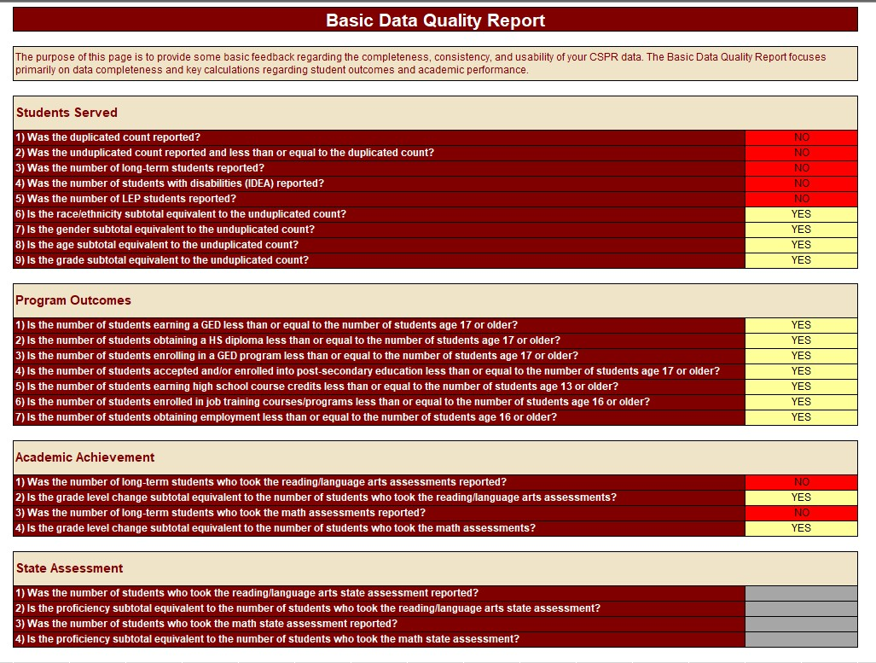
Data Collection Template –
Validation Checking
Review the “Basic Data Quality Report” tab to ensure accuracy and consistency:

Slide 14
Submit Data Template
Do not send the template via e-mail!
You will receive a link to register with and submit your template through Syncplicity
Templates are due November 3, 2023

Slide 15
Questions?
Questions regarding data collection and program evaluation of Title I, Part D:
  Tina Negley
    Negley_t@cde.state.co.us
  Melissa Chaffin
    Chaffin_m@cde.state.co.us
Questions regarding Title I, Part D program:
  Nathan Hickman
    Hickman_n@cde.state.co.us

Slide 16
Thank you!

