Slide 1
2021-2022 Consolidated Application Functionality
Notes:
Michelle
Good morning,
Before we get started, please be sure to change your name in the Participants Panel to include your district name. We will have a breakout session later on by your Region

Slide 2
Agenda For Today
Timeline
Application Updates
Additional Training Opportunities
Cons App Walk Through
Breakout Session by Region
Questions
Notes:
Michelle
We are going to go over
The timeline, upcoming due dates, and substantial approval
The new updates and changes for the 21-22 application
We will complete a walk through of the application
Provide information around additional training opportunities
Give some time for questions as a group
And last but not least, have breakout sessions by region for you to ask your regional contact questions about the application

Slide 3
Timeline: Substantial Approval
Substantial Approval allows applicants to obligate funds for activities outlined in the Consolidated Application budget.
In order to receive Substantial Approval on the 2021-2022 Consolidated Application, the applicant will need to submit the following:
Activity | Due Date | Submission Location
Non-Public School Consultation Forms | May 30 | Non-Public Schools page
School Improvement Retention of Funds Form | May 30 | Documents Upload page
Approval and Transmittal Form | June 30 | Documents Upload page
BOCES Member District ARAC Form | June 30 | Sign Over Info & Uploads
Native American Education Tribal Consultation Form | June 30 | Submit to the Consolidatedapplications@cde.state.co.us or Georgina Owen
Online Application | June 30 | http://www.cde.state.co.us/apps/consapp2021/login
Notes:
Michelle
Substantial approval allows the applicant to obligate funds.
In order to receive Substantial Approval, you will need to submit the online application, along with a few documents that may pertain to your district. Almost all the forms need to be submitted through the consolidated application, except for the tribal forms. Those districts that it applies to, Georgina Owen (Title Program Manager), submits them on behalf of the district. So work with her to make sure that gets submitted on time.

Slide 4
Timeline: Upcoming Due Dates
Many documents required for substantial approval are due prior to submission of the application platform, including:
Non-public school consultation forms (if applicable)
School Improvement Retention of Funds Request Form (if applicable)
These forms are due no later than May 30, 2021 and should be uploaded into the Consolidated Application
Note: Failure to submit forms timely may impact the applicant’s receipt of substantial and/or final approval.
Notes:
Michelle
One thing to draw your attention to, as you probably saw on the previous slide, two forms are due earlier than the June 30th deadline. The NPS and 1003 form are both due May 30, 2021.
We typically have to check a lot for these forms to ensure we have all of them and that they are filled out correctly. This is helpful to turn in early so that when the June 30th date comes around, we are not scrambling to get the forms in and that way, it won’t impact your substantial approval date.

Slide 5
Extension Requests
If the LEA/BOCES is unable to submit all the requirements for Substantial Approval by June 30 the LEA or BOCES may request an extension by submitting a completed extension request form. The extension request form is available online: www.cde.state.co.us/fedprograms/consapp/index
The LEA/BOCES may not encumber funds until a complete application has been submitted to CDE and granted Substantial Approval. Once the extension request has been submitted and approved, the LEA/BOCES has until the last business day in July to submit requirements for Substantial Approval.
Notes:
Michelle
If you are looking at the upcoming dates and you aren’t sure if you can complete everything on time, we do have an extension request form. This form lets us know at CDE that your application will be turned in late. However, you can not encumber funds until everything is turned in. So if you want another month to turn everything in, you wouldn’t get that substantial approval date until July 30th or August 1st. We can’t backdate it to July 1^{st.}

Slide 6
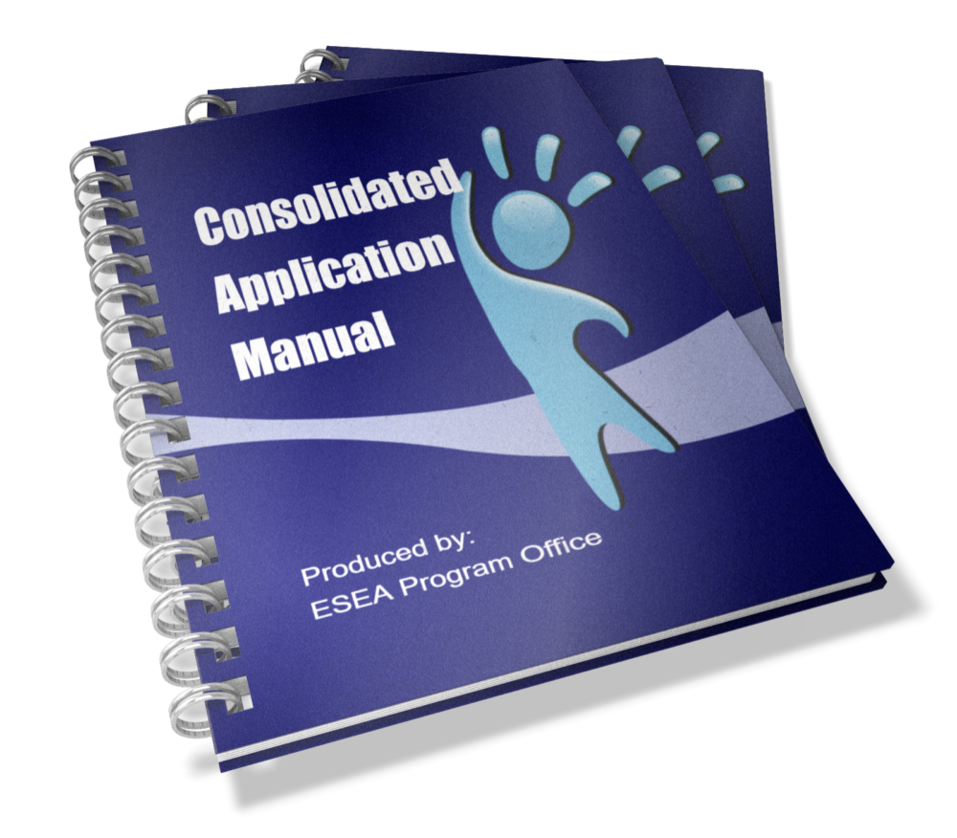
Consolidated Application Manual
The Consolidated Application Manual assists applicants with the completion and submission of the application. The Consolidated Application Manual:
Follows the workflow of the application platform
Provides a description and definition of all parts of the application
Provides screen shots of areas in the application platform
Incorporates all narrative questions, assurances, additional resources and requirements in one document
Notes:
Michelle
We are currently updating our Consolidated Application Manual to reflect the new changes. Once it is ready, you will find the manual at the link on this slide. This will be a great resource for anyone who is new or needs a quick refresher on requirements. The manual follows the workflow of the platform so your team can easily find the sections needed to complete the application. It is also helpful if you have multiple people working on different sections of the application, those individuals can jump to the section they need to learn about it and they can ensure they are including everything.

Slide 7
Updates/Changes to the 2021-2022 Consolidated Application
Login
Now under the Identity Management System
Funding year designations
LEA profile includes the option to choose between 2019-2020 and 2020-2021 student October data
Non-public schools
Moved to a separate page
Add an upload function for the consultation forms
Neglected Facilities
Reduced to one question in the Title I Narrative
Title I, Part A - Targeted Support and Assistance
Combined questions
Added progressive disclosure
Title I, Part D - Delinquent Facilities
Reduce/clarified questions
Set-Aside and Title IV Content Categories Summary
New section to track Title IV budget items by purpose area (Well-rounded, Safe and Healthy, Education technology)
20-21 Narrative Response will carryover to the 21-22 application
Notes:
Michelle
The top three are probably the biggest changes to this year’s application and we will go more in depth with those in the next couple of slides.

Slide 8
21-22 Consolidated Application Login
The application access is through the Identify Management system (IdM), using the same login and password details used for Data Pipeline and the Unified Improvement Plan.
A good first step, if you have used IdM before, is to check with your District Local Access Management (LAM) Group to grant you access to the CONSAPP application in IdM.
If you haven’t used the IdM system before or are having trouble logging in with it, please use the access assistance form to find your district’s LAM Group.
If you have used IdM before and have confirmed you have access to the Consolidated Application, please contact us at consolidatedapplications@cde.state.co.us for additional technical assistance
Here are some additional resources to assist you:
Reset Your IdM Password
Local Access Manager Quick Access Guide (DOCX)
Identity Management Quick Reference Guide (PDF)
The previous applications will use the old login. If you need access to those applications, please reach out to consolidatedapplications@cde.state.co.us
Notes:
Michelle
Just because you have had access to the past applications, you won’t have access to this year’s application.
Request access from your LAM ASAP

Slide 9
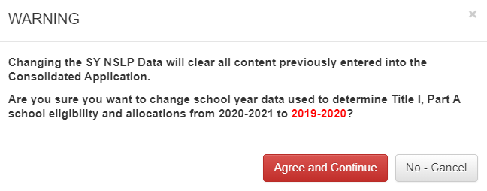
Funding Year Designation
Notes:
Michelle
We have added functionality to the LEA Profile page. As you can see, we added a section where you can select the data you wish to use for the 21-22 application. It is important to note that you should decide which data year to use prior to filling out the application. We will mention this multiple times today but if you fill out your entire application and then decide to see what 2019-2020 data might look like, this will completely wipe the data from your application.

Slide 10
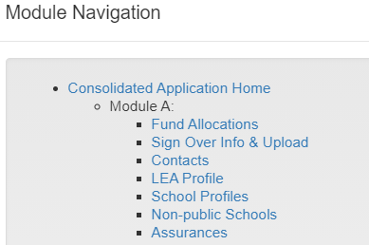
Non-Public Schools Page
Notes:
Michelle
Another exciting part of the application is the NPS page. As some of you know, in the past, you would submit each consultation form to the consolidatedapplication email. That is no longer the case as we have now added an upload function for you to use. You will now be able to upload each consultation form for each school in the same line you use to fill out what programs they will participate in.
As a reminder, you will need to submit a consultation form for those who are participating, as well as, those who are not participating.

Slide 11
2021-2022 Consolidated Application Walk Through
https://sitespubdev.cde.state.co.us/apps/consapp2021/
Notes:
Kristen
LEA Profile:
Funding year designations: LEA profile includes the option to choose between 2019-2020 and 2020-2021 student October data
School Profile:
When you modify a school, the word “Modified” in red will pop up and that is just letting CDE know that you change the data.
If you use 2019-2020 data and you had a new school, you will have to add that school’s data to the page.
Non-Public Schools:
Moved to a separate page
Add an upload function for the consultation forms
Assurances:
Neglected Facilities: Reduced to one question in the Title I Narrative
Title I, Part A - Targeted Support and Assistance (Tina)
Combined questions
Added progressive disclosure
Title I, Part D - Delinquent Facilities
Reduce/clarified questions
Title III and Title III
The narrative questions from 20-21 will not carryover into this application.
Title IV
We have added grant codes to last year’s funding sources for the content areas.
Set-Aside and Title IV Content Categories Summary
New section to track Title IV budget items by purpose area (Well-rounded, Safe and Healthy, Education technology)
20-21 Narrative Response will carryover from the 21-22 application

Slide 12
Past Webinars
Title I, Part A:
PowerPoint | Recorded Webinar
Title I Part D:
PowerPoint | Program Recorded Webinar | Budget Recorded Webinar
Title II, Part A
PowerPoint | Recorded Webinar
Title III
PowerPoint | Recorded Webinar
Title IV, Part A
PowerPoint | Recorded Webinar
Title V, Part B
PowerPoint | Recorded Webinar
Notes:
Michelle
Last year, we did present on and record the training for each program. On this slide, that will be sent out after this meeting, we have included links to the powerpoint presentation and the recorded webinars. You can use them to learn the programs or to give yourself a quick refresher!

Slide 13
Additional Training Opportunities:
Reach out to your Regional Contacts
Technical Assistance Request
Dedicate time during existing Thursday afternoon office hours
Notes:
Michelle
We have a Technical Assistance Request form that you can fill out to set up technical assistance time. A lot of people used the form last year and you can designate which sections of the applications you need help with. It will ask for days and times that work best for you and our team will set up a meeting with you and the appropriate individuals to provide you with support. As always, if you have questions, you can reach out to your Regional Contact for assistance.
We will also host office hours.

Slide 14
Questions??
Notes:
Michelle
Before we jump into our breakout sessions, does anyone have any questions?

Slide 15
ESEA Team
ESEA Office | Position | E-mail
Nazie Mohajeri-Nelson | Director of ESEA Office | Mohajeri-nelson_n@cde.state.co.us
DeLilah Collins | Assistant Director of ESEA Office | Collins_d@cde.state.co.us
Emily Owen | Program Support | Owen_e@cde.state.co.us
Marissa Gonzales | Program Support | Gonzales_m@cde.state.co.us
ESEA Team | Position | E-mail
Kathryn Wisner | ESEA Senior Consultant: Titles I and III | Wisner_k@cde.state.co.us
Kristen Collins | ESEA Senior Consultant: Parent and Family Engagement & Title V | collins_k@cde.state.co.us
Tammy Giessinger | ESEA Senior Consultant: Title IV | giessinger_t@cde.state.co.us
Jeremy Meredith | ESEA Senior Consultant: Title II | meredith_j@cde.state.co.us
Laura Meushaw | Titles I School Improvement Coordinator | meushaw_l@cde.state.co.us
Niko Kaloudis | ESEA Senior Consultant: Titles I and II | Kaloudis_n@cde.state.co.us
Shannon Allen | ESEA Senior Consultant: Title I | allen_s@cde.state.co.us
Michelle Prael | ESEA Consultant: Titles ID and IV | prael_m@cde.state.co.us
Notes:
Michelle
We have included on our team’s information. Feel free to reach out to any of us if you have any additional questions.

Slide 16
ESEA Office
ESEA Office | Position | E-mail
Nazie Mohajeri-Nelson | Director of ESEA Office | Mohajeri-nelson_n@cde.state.co.us
DeLilah Collins | Asst. Director of ESEA Office | Collins_d@cde.state.co.us
CGA Team | Program Expertise | E-mail
Kim Burnham | Competitive, Grants & Awards Supervisor | Burnham_K@cde.state.co.us
Patricia Gleason | Senior Consultant, Grants & Awards | Gleason_P@cde.state.co.us
Mandy Christensen | Senior Consultant, Grants & Awards | Christensen_m@cde.state.co.us
Brittany Jimenez | Program Support | Jimenez_B@cde.state.co.us
DARE Team | Expertise | Email
Tina Negley | ESSA Accountability, Program Evaluation, and Reporting | negley_t@cde.state.co.us
Alan Shimmin | ESEA Reporting and Data Collections | shimmin_a@cde.state.co.us
Mary Shen | ESEA Program Evaluation, Research, and Accountability | shen_m@cde.state.co.us
Notes:
Michelle
We do have two other team’s and we have included those team member’s contact info as well.

Slide 17
Grants Fiscal Contacts
Grants Fiscal Staff | Program Expertise | E-mail
Jennifer Austin | Director of Grants Fiscal | Austin_j@cde.state.co.us
Robert Hawkins | Grants Fiscal Analyst | Hawkins_r@cde.state.co.us
Steven Kaleda | Grants Fiscal Analyst | kaleda_s@cde.state.co.us
Notes:
Michelle
As well as our Grant Fiscal Partners.

Slide 18
Breakout Session By Region
North Central & Northeast Region – Shannon Allen, Niko Kaloudis, & DeLilah Collins
Northwest and West Central Region – Kristen Collins
Pikes Peak and Southeast Region – Tammy Giessinger
Southwest Region – Jeremy Meredith & Kathryn Wisner
Floater: Michelle Prael
Notes:
Michelle
We save the best for last! If you’d like, stick around and we can break you out by Region. You can talk to your Regional Contact and ask questions about the application or whatever other questions you may have. But if you are all set and you don’t have any questions, that is all the content we have for today. Thank you for joining us. For those who would like to join their Regional session, hang tight and we will get you in the right breakout session!

