Slide 1
October 20, 2016

Slide 2
Advance organizer
Minutes
Decision-making process for the group
1202 Task Force Summary
ESSA Template Review
Innovative Assessment Demonstration Authority
ESSA Listening Tour Feedback
Assessment Reports
Next Steps: October 25th Meeting
2

Slide 3
HB14-1202
Dan Snowberger, Superintendent, Durango School District 9-R Chairman of the 1202 Task Force – July 2014-January 2015

Slide 4
Hb14-1202 task force
Adele Bravo, Colorado Education Association (CEA), Broomfield, Public School Teacher Representative
Jay Cerny, Cherry Creek Academy, Englewood, Charter School Representative
John Creighton, St. Vrain Valley Schools, Longmont, School Board Director Representative
Bethany Drosendahl, Cheyenne Mountain School District 12, CO Springs, Parent Representative
Lisa Escárcega, Aurora Public Schools, Aurora, District Administrator Representative
Bill Jaeger, Colorado Children's Campaign, Denver, Organization that represents low performing students
Tony Lewis, Donnell-Kay Foundation, CSI Board, Denver, Charter School Institute Representative
Donna Lynne, Chair, Denver Metro Chamber of Commerce, Business Representative
Syna Morgan, Jefferson County Schools, District Administrator Representative
Luke Ragland, Colorado Succeeds, Denver, Business Representative
Dan Snowberger, Durango School District, Durango, District Administrator Representative
Ilana Spiegel, Supportive Parents, Educators and Students (SPEAK), Centennial, Parent Representative
Dane Stickney, Strive Prep Charter School, Denver, School Teacher Representative
Nancy Tellez, Poudre School District Board of Education, Fort Collins, School Board Director
Representative
Susan Van Gundy, Golden, Eduvate, PARCC Representative

Slide 5
Role of task force
The Colorado Standards and Assessments Task Force was established by the Colorado General Assembly in 2014 (HB14-1202) and charged with studying the implications of Colorado’s State and local assessment system for school districts, public schools, charter schools, educators and students. State assessments refer to tests that are mandated by the State or Federal governments. Local assessments refer to all other assessments administered by districts, charters, schools, or classrooms at the discretion of local authorities.

Slide 6
Findings
Early on in Task Force deliberations, members agreed that assessments provide valuable data for the purposes of holding schools and districts accountable for student performance, comparing groups of students to one another, improving instruction, and measuring student growth and proficiency.
Current system has created far too many demands on time, logistics, and finances that are impacting the teaching and learning process in schools and undermining public support for the assessment system as a whole.
Consensus of the Task Force is that, where possible, changes must be made to the type, frequency, and use of various assessments.

Slide 7
Findings contd
In addition, the Task Force recognizes that the State’s ability to change the current assessment system is severely restricted by the current Federal testing requirements under the Elementary and Secondary Education Act (ESEA). There was consensus that, in the short term, the State must adhere to these Federal requirements in order to avoid the fiscal and other consequences of non-compliance.

Slide 8
State assessments
Statewide assessments hold policymakers, districts and schools accountable for growth and achievement of students and provide information about the effectiveness of schools and districts.
Statewide assessments ensure that there is an infrastructure in place to inform all stakeholders of how students achieve compared to their peers, how school and district achievement compare to one another, and how specific subgroups compare to one another.
Statewide assessments provide a way to measure academic growth.
Statewide assessments provide a set of data points that can be included in a comprehensive body of evidence about student achievement to inform district and school programming.
State and local assessments have both unique and overlapping purposes. Both levels of assessment add to a comprehensive body of evidence that can be used to inform school and district programming and policymakers.
Public input and surveys made it clear that something must be done to reduce the financial, time, and logistical burden of our statewide assessment system.

Slide 9
Local assessments
Local assessments can provide comparative information at the local level (classroom, students, schools).
State and local assessments have both unique and overlapping purposes. Both levels of assessment add to a comprehensive body of evidence that can be used to inform school and district programming and policymakers.
Local assessments are used to improve instruction for individual student achievement and growth as well as to improve programming and building design.
Local assessments provide timely results that can be used to inform instruction.
Public input and surveys indicated that local assessments are a part of the overall testing burden and we encourage local districts to examine the purpose and use of their local assessments.
The State should not legislate what districts/charters should do in terms of local assessments. The Task Force supports using the mechanisms in place to provide resources and technical assistance to help districts analyze their use of local and State assessment data to improve instruction.

Slide 10
Work needed
The Task Force identified difficult tensions that need to be resolved by continued work of an Advisory Board.
To what extent should emphasis be given to State assessments relative to locally chosen/designed assessments? What’s the appropriate balance?
To what extent should State assessments focus on district and school accountability? To what extent should State assessments be used to identify individual student growth and proficiency? To what extent are local assessments and processes able to achieve this task?
How much flexibility can districts and schools have to choose their own assessments and still retain the principles of accountability, comparability, growth and equity?
When a parent or guardian exercises his or her right to refuse to have their student participate in an assessment, how should this be managed by districts and schools? How should this be factored into district and school accountability?
In light of concerns about technology-based tests including equity, access, and developmental appropriateness, to what extent should future assessment systems be technology-based versus administered through paper and pencil?

Slide 11
Recommendations
Eliminate State-mandated tests in 12th grade.
Eliminate State-mandated tests in 11th grade except for a college entrance exam and offer state- funded CMAS English Language Arts (ELA) and Math exams as an option for districts and schools.
Fulfill high school Science assessment requirements with an augmented college entrance exam, such as the ACT.
Consider whether to continue State-mandated ELA and Math exams at 9th grade. This is an area in which Task Force members were evenly split and could not reach a consensus. Some believe the State should fund optional testing for 9th grade ELA and Math exams. Others believe the State should continue to fund and mandate 9th grade ELA and Math assessments.
Consider whether to continue State-funded Social Studies tests in 4th and 7th grades. This is another area in which Task Force members were evenly split and could not reach a consensus. Some believe the State should fund optional testing for 4th and 7th grade Social Studies exams. Others believe the State should continue to fund and mandate 4th and 7th grade Social Studies exams.
Administer ELA and Math CMAS assessments at 10th grade to fulfill State and Federal requirements.
Hold all schools and districts harmless from the consequences associated with School and District Performance accountability frameworks (including for low participation rates) through 2015- 2016 school year.
Provide paper and pencil options for all tests.
Proactively address parent and student opt outs.

Slide 12
HB 15-1323
Instituted a bulk of the recommendations of HB 14-1202 Task Force

Slide 13
ESSA template
13

Slide 14
A. Student Academic Assessments
Student Academic Assessments. Identify the student academic assessments that the State is implementing under section 1111(b)(2) of the ESEA, including the following:
High-quality student academic assessments in mathematics, reading or language arts, and science consistent with the requirements under section 1111(b)(2)(B);

Slide 15
Implementation TImeline
2014
2015
2016
2017
2018
2019
2020
-
-
-
-
-
-
-
2015
2016
2017
2018
2019
2020
2021
Standards Adopted
Standards Implemented
CMAS: Science/SS | 2nd admin | 3rd admin | 4th admin | 5th admin New contract | 6th admin Dev new | 7th admin FT new | Revised
CMAS: ELA/Math | 1st admin | 2nd admin | 3rd admin | ? | ? Dev new | ? FT new | Revised
PSAT 10 SAT |  | 1st admin | 2nd admin 1st admin | 3rd admin 2nd admin | 4th admin 3rd admin | 5th admin 4th admin | New Contract

Slide 16
Procurement
Required for science/social studies: New contract in 17 - 18.
Option A for ELA/Math: Procure with science and social studies.
Transfer administration activities in 17-18.
Maintain current administration contractor in 17-18. Transfer to new administration contract in 18-19.
Option B for ELA/Math: Procure next year separately from science/social studies.
Implement in 18-19.
With other PARCC states
Colorado only

Slide 17
Timeline
2014
2015
2016
2017
2018
2019
2020
-
-
-
-
-
-
-
2015
2016
2017
2018
2019
2020
2021
CMAS: ELA/Math Option 1 | 1st admin | 2nd admin | 3rd admin | 4th admin | 5th admin New contract Dev new | 6th admin FT new | Revised
CMAS: ELA/Math Option 2 | 1st admin | 2nd admin | 3rd admin | 4th admin (abb.?) New contract? | 5th admin (abb.) New contract? Dev new | 6th admin (abb.) FT new | Revised
CMAS: ELA/Math Option 3 | 1st admin | 2nd admin | 3rd admin | Off-the- shelf 1st admin New contract | Off-the- shelf 2nd admin (Dev new) | Off-the- shelf 3rd admin (FT new) | Off-the- shelf 4th admin (Revised)

Slide 18
9th Grade Procurement
Aligned to CAS
Clear and explicit connection to college entrance exam
Single administration
Testing time considerations

Slide 19
A. Student Academic Assessments 1
Student Academic Assessments. Identify the student academic assessments that the State is implementing under section 1111(b)(2) of the ESEA, including the following:
Any assessments used under the exception for advanced middle school mathematics under section 1111(b)(2)(C)(iii) of the Act;

Slide 20
A. Student Academic Assessments 2
Student Academic Assessments. Identify the student academic assessments that the State is implementing under section 1111(b)(2) of the ESEA, including the following:
Alternate assessments aligned with the challenging State academic standards and alternate academic achievement standards for students with the most significant cognitive disabilities;

Slide 21
A. Student Academic Assessments 3
Student Academic Assessments. Identify the student academic assessments that the State is implementing under section 1111(b)(2) of the ESEA, including the following:
The uniform statewide assessment of English language proficiency, including reading, writing, speaking, and listing skills consistent with
§200.6(f)(3);

Slide 22
A. Student Academic Assessments 4
Student Academic Assessments. Identify the student academic assessments that the State is implementing under section 1111(b)(2) of the ESEA, including the following:
Any approved locally selected nationally recognized high school assessments consistent with §200.3.

Slide 23
B. State Assessment Requirements
Provide evidence at such time and in such manner specified by the Secretary that the State’s assessments identified above in section 3.2.A. meet the requirements of section 1111(b)(2) of the ESEA.

Slide 24
C. Advanced Mathematics Coursework
Describe the SEA’s strategies to provide all students in the State the opportunity to be prepared for and to take advanced mathematics coursework in middle school consistent with section 1111(b)(2)(C) and §200.5.

Slide 25
Advance Math
The districts and the CDE will benefit from the annual collection of student IDs (Sasid) for those middle school students that complete, or are enrolled in, Algebra I or Geometry courses. These data will allow the state, and districts, to monitor the equitable participation of diverse students within these important advanced mathematics trajectories.

Slide 26
Advanced Math Contd
Additionally, given this new data collection, the CDE will be able to monitor the coursework-assessment alignment in middle school mathematics. The alignment being referred to is the alignment of students who take Algebra I course content being provided the Algebra I state test in the same year as the content was encountered. Similarly, the state and districts have a vested interest in knowing how many middle school students that took a Geometry course also took the state Geometry test. Without these data, the CDE and the districts may be unsure how many once-accelerated or twice- accelerated students are taking the state test designed for grade level content associated with the standard 7th grade
math or 8th grade math curriculum.
26

Slide 27
Advanced Math Contd 2
Given that Advanced Mathematics Coursework assessment data are used in the CDE accountability processes and supports the identification and sharing of best practices, any process inequities (such as testing accelerated students on grade level assessments) can systematically influence resulting score distributions thereby reducing the interpretability and usefulness of our middle school advanced mathematics assessment data. There may be a perverse incentive built into the current system since middle school Algebra or Geometry students that take the standard 7th or 8th grade math assessments will put upward pressure on the resulting score distributions and the mean outcomes that are judged in the
accountability system.
27

Slide 28
Advanced Math Contd 3
▪
Perhaps most importantly, for student who are not accelerated or twice accelerated, their score distributions become less able to support best practices research because the aggregate scores and associated distributions no longer really reflect the learning and gains of only this very important group. The districts and the CDE will benefit from some processes and assurances that each middle school student is taking the state assessment that is most aligned with the content they were exposed to.

Slide 29
Waiver Language
See document

Slide 30
Universal design
Describe the steps the SEA has taken to incorporate the principles of universal design for learning, to the extent feasible, in the development of its assessments, including any alternate assessments aligned with alternate academic achievement standards that the State administers consistent with sections 1111(b)(2)(B)(xiii) and 1111(b)(2)(D)(i)(IV) of the Act.

Slide 31
Accommodations
Consistent with §200.6, describe how the SEA will ensure that the use of appropriate accommodations, if applicable, do not deny an English learner (a) the opportunity to participate in the assessment and (b) any of the benefits from participation in the assessment that are afforded to students who are not English Learners.

Slide 32
Languages

Slide 33
Proposed Regulations
33

Slide 34
Proposed Regulations:
Innovative Assessment Demonstration Authority
New opportunity for states or consortia of states to pilot innovative
approaches to assessments (limited to 7 states)
Gives states time and space to try out, and learn from the implementation of novel testing approaches as they scale the innovative assessment system statewide
Innovative assessment demonstration authority is only needed if a state is seeking to:
Develop a new approach for assessing students against the
standards
Start small, piloting in a limited number of representative districts and schools before implementing statewide
Use the approach for accountability and reporting during the
piloting phase

Slide 35
Innovative Assessment Demonstration Authority
Variety of models, including:
Performance tasks and simulations
Competency-based assessments
Multiple assessments
All models must produce an annual summative determination of grade-level achievement aligned to state standards

Slide 36
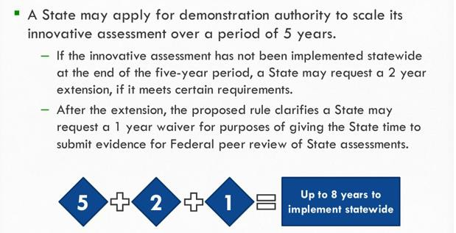
Proposed Regulations:
Innovative Assessment Demonstration Authority Time to Thoughtfully Scale

Slide 37
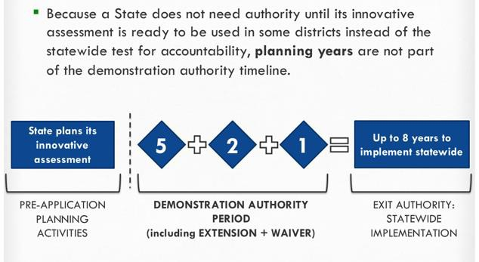
Proposed Regulations:
Innovative Assessment Demonstration Authority Time to Thoughtfully Scale Contd

Slide 38
Proposed Regulations:
Innovative Assessment Demonstration
Authority
Comparability
ESSA requires that the innovative and statewide assessments generate results during the authority period that are valid, reliable, and comparable for all students and subgroups of students.
The proposed regulations include options for states regarding how they can annually demonstrate comparability:
Assessing all students using the statewide tests at least once in
each grade span for which there is an innovative assessment.
Assessing a representative sample of students in the same school year on both the innovative and corresponding statewide test at least once in each span.
Incorporating, as a significant portion of the assessment, common items across both statewide and innovative tests.
Another state-determined method that will provide an equally rigorous, statistically valid comparison for all students and subgroups.
38

Slide 39
Proposed regulations contd
Proposed Regulations:
Innovative Assessment Demonstration Authority Application Requirements
A demonstration that the innovative assessment system meets statutory requirements for assessments: alignment, quality, fairness, comparability between the innovative and statewide assessment (depth and breadth of content, academic achievement standards and results) to maintain consistent and unbiased annual accountability and reporting
Provide for the participation and be accessible to all students (95% participation of all students and all subgroups)
Provide disaggregated results for all students and subgroups

Slide 40
Assessment priorities
What can we prioritize and do without demonstration authority?
Move to single new assessment that meet state and federal requirements
What can we prioritize and do with demonstration authority?
Have 2 comparable assessments being administered at the same time while scaling up to a single system
What doesn’t appear to be allowed?
Multiple assessments long term, outside of high school
Off-grade level without a grade level determination

Slide 41
Options 1
Options that don’t require demonstration authority:
Is there a way to increase perceived student relevance of 9th grade assessments?
Is there a way to shorten current CMAS assessments?
Social studies? (especially high school)

Slide 42
Options 2
Allow for waivers from CMAS high school science assessments for students taking AP/IB/Cambridge/SAT Content tests
(violates proposed regulations)
Move to a single statewide administered series of interim/benchmark assessments
Advantages: reduction in testing
Challenges: potential intrusion on local control
Develop common performance-based assessments that can be used by themselves at some grade levels and in conjunction
with administration of current assessment at other grade
levels
Fits also with graduation guidelines work
Increase flexibility of off-grade level use of current assessments
42

Slide 43
Feedback
43

Slide 44
Reports
44

Slide 45
General info
Sample reports do not contain real data.
Generated for training purposes only
45

Slide 46
Score Types
ELA, math, and CSLA have five performance levels; science and
social studies have four performance levels¹
Performance Levels:
Exceeded Expectations²
Met Expectations²
Approached Expectations
Partially Met Expectations
Does Not Yet Meet Expectations (ELA, Math, CSLA only)
¹CMAS science and social studies performance level names updated in 2015- 2016 to be more aligned to PARCC performance levels
²The top two levels are indicators of being on track for college and career in
46
the content area

Slide 47
Performance levels
CMAS ELA and Math (PARCC), CSLA | CMAS Science and Social Studies
Level 5: Exceeded expectations | Level 4: Exceeded expectations
Level 4: Met expectations | Level 3: Met expectations
Level 3: Approached expectations | Level 2: Approached expectations
Level 2: Partially met expectations | Level 1: Partially met expectations
Level 1: Did not yet meet expectations

Slide 48
Claims
Students who exceeded or met expectations are considered on track for college and career in the assessed content area.
Exceeded Expectations | Students performing at this level demonstrate a distinguished command of the concepts, skills, and practices embodied by the Colorado Academic Standards assessed at their grade level. They are academically well prepared to engage successfully in further studies in this content area.
Met Expectations | Students performing at this level demonstrate a strong command of the concepts, skills, and practices embodied by the Colorado Academic Standards assessed at their grade level. They are academically prepared to engage successfully in further studies in this content area.

Slide 49
Claims contd
Approached Expectations | Students performing at this level demonstrate a moderate command of the concepts, skills, and practices embodied by the Colorado Academic Standards assessed at their grade level. They will likely need academic support to engage successfully in further studies in this content area.
Partially Met Expectations | Students performing at this level demonstrate a limited command of the concepts, skills, and practices embodied by the Colorado Academic Standards assessed at their grade level. They will likely need extensive academic support to engage successfully in further studies in this content area.
Did Not Yet Meet Expectations (ELA, Math, CSLA only) | Students performing at this level do not yet meet academic expectations for the concepts, skills, and practices embodied by the Colorado Academic Standards assessed at their grade level. They will need academic support to engage successfully in further studies in this content area.
49

Slide 50
Score types contd
Scale scores put student performance on a common scale
Overall scale score
Comparisons can be made within the current assessment year and across years
Subscale score
Comparisons can be made within the current assessment year and across years
Percent correct
Comparisons can be made within the current assessment year

Slide 51
Levels
State
District
School
Subgroups
Individual student
Total Test (Overall Performance
Level)
ELA and math
Reporting Category
Subclaim Category
Evidence Statement
Science and social studies
Standard Level (Reporting Category)
Prepared Graduate Competency (PGC)
Grade Level Expectation (GLE)
Item Type

Slide 52
Scale score, overall
Overall scale score for the assessment
Range is displayed (650-850 for ELA and math, 300-900 for science and social studies)
Arrows (↔) around student scores represent the standard error of
measurement (SEM)
The SEM is the estimated range of scores that the student might receive if they took the test multiple times
State, district, and school level information is provided in relevant sections of the report to help understand how the student’s performance compares to other students.
Cross-state average included on ELA and math reports
Data suppressed if less than 16 students in a category

Slide 53
Percentile rank
The percentile rank shows how well the student performed in comparison to other students who took the same assessment across the state.
Example: A student in the 70th percentile performed better than 70
percent of students in the state.

Slide 54
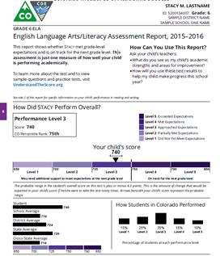
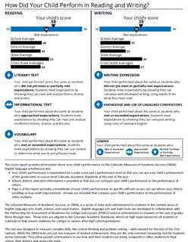
Individual Reports
54

Slide 55
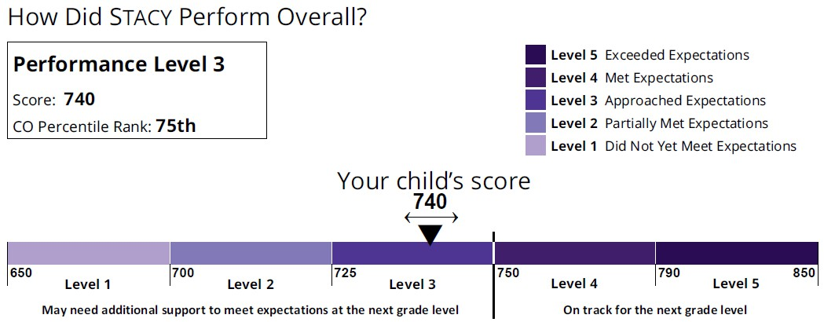
Overall performance level
Overall scale score range is 650-850
This student :
Approached expectations
Performed better than 75 percent of students across the state
May need additional support to meet expectations at the next grade level
55

Slide 56
Overall level contd
This student:
Performed better than school, district, state, and cross-state averages
Percentage of students at each performance level
The percentage of students within the state who performed at each of
56
the five performance levels

Slide 57
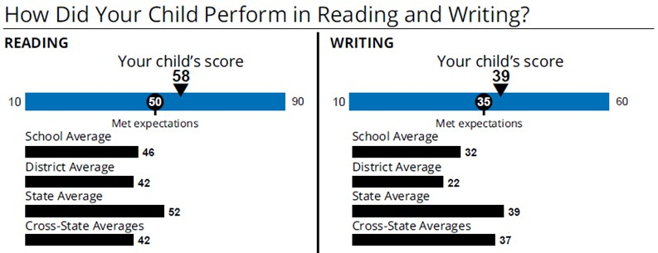
PARCC category
Reporting Categories for ELA
The reporting category is provided as a scale score (i.e., 10–90 for Reading and 10–60 for Writing), which is different from the overall scale score. The sum of the scale scores for each reporting category will not equal the overall scale score.
This student:
Performed better than school, district, state, and cross-state averages
57

Slide 58
PARCC subclaim
Subclaims describe specific skill sets
Arrow icons on ISRs represent student performance in the subclaim categories
Met or Exceeded Expectations
Students are likely academically well prepared to engage successfully in further studies in the subclaim area and may need instructional enrichment.
Approached Expectations
Students likely need academic support to engage successfully in further studies in the subclaim area.
Did Not Yet Meet or Partially Met Expectations
Students are likely not academically well prepared to engage successfully in further studies in the subclaim area. Such students likely need instructional interventions to increase achievement in the subclaim area.
An explanation of whether the student has met the expectations of the subclaim is provided
⁵E⁸ LA subclaims are divided by reporting category (i.e., Reading and Writing)

Slide 59
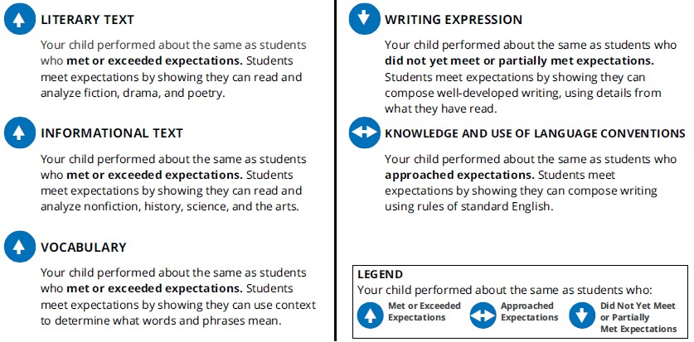
Subclaim performance
Divides Reading and Writing Reporting Categories

Slide 60
Math subclaim

Slide 61
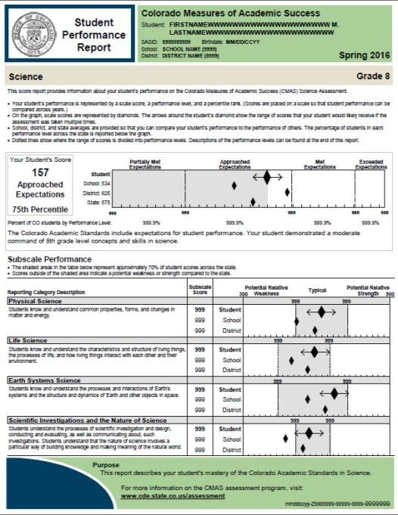
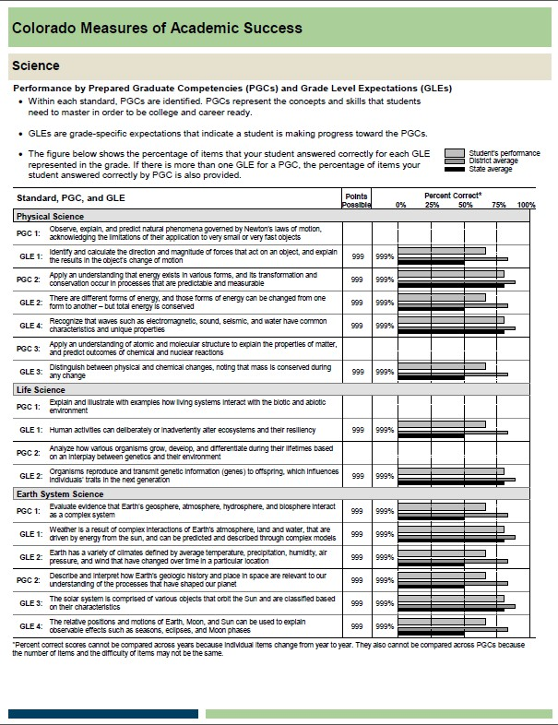
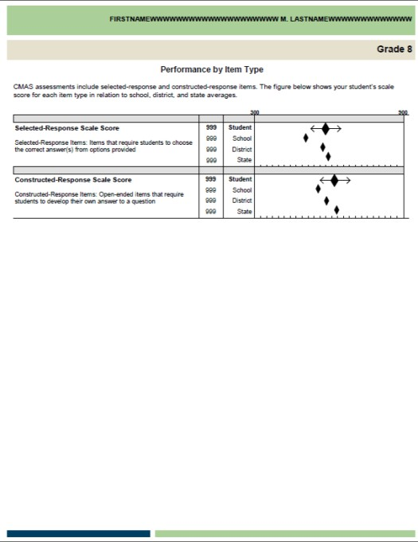
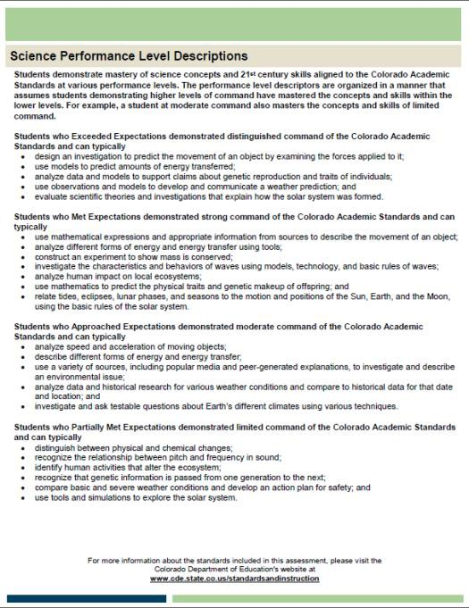
Student reports
61

Slide 62
Science performance
Overall scale score range is 300-900
This student:
Approached expectations
Performed better than the school and state, but not as well as the district
Performed better than 75 percent of students across the state

Slide 63
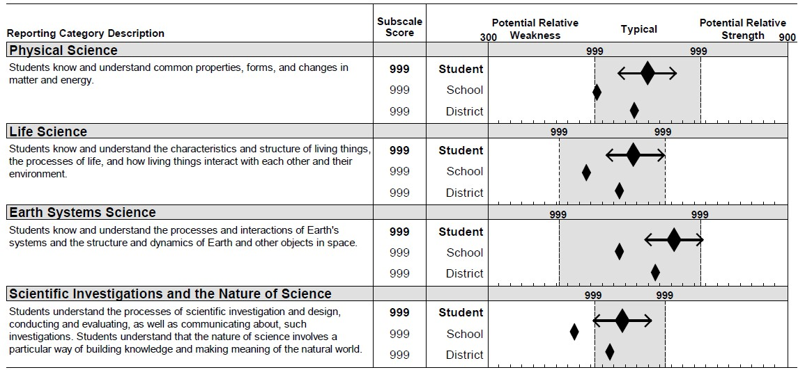
Subscale
Reporting Category scores are displayed as Subscale Scores
On the same scale as the Overall Scale Score (300-900)
To help with interpretation, the scale is split into three “Performance Indicators”
Potential Relative Weakness
Typical (shaded area)
Potential Relative Strength
Performance Indicators are set one standard deviation above and below
the state average
The standard deviation is a measure of the spread of the scores
Around 70% of students will perform within one standard deviation of the state average

Slide 64
1 SD Around State Average
64

Slide 65
Science & social studies
Prepared Graduate Competencies and Grade Level Expectations
The percent correct for the student, district, and state are given for the PGCs and GLEs.
GLE numbering is taken directly from the standards. PGCs are not numbered in the standards and do not always line up in order with the GLEs. The text from the standards is included.
PCG information not shown if there is only one GLE in a PG
Standards text for PGCs and GLEs
C.
65

Slide 66
Science and social student scores
Percent correct scores are based on the particular items that
appeared on that year’s test
Cannot be compared across years
Can be compared to District and State to spot trends*
Based on a small number of items (between 6 and 20)
Do not necessarily cover the entirety of a topic
Should not be the sole basis for instructional adjustments
*If a school performed worse than the previous year (percent correct went down by a small amount), but a school goes from being below the district average to above the district average, it could be an indication that there was improvement.

Slide 67
Selected and constructed response
Nearly half the points on the science and social studies
assessments come from constructed-response items
This is a scale score and can be compared across years (uses the same 300-900 scale)

Slide 68
District/School reports

Slide 69
School roster
District level only
Available for each grade and content area assessed at each school
Provides data aggregated at the state, district, and school levels by
overall performance level and average scale score
reporting category performance and average scale score
PGC/GLE (science and social studies only)
Percent correct for each GLE is presented.
If there is more than one GLE within a PGC then percent correct by PGC is also provided.
Information also provided for each school

Slide 70
CSLA student roster
School level only
Available for each grade and content area assessed at each school
Provides aggregated data at the cross-state, state, district, and school levels including
overall scale score
overall performance level
reporting category (ELA only)
subclaim category performance

Slide 71
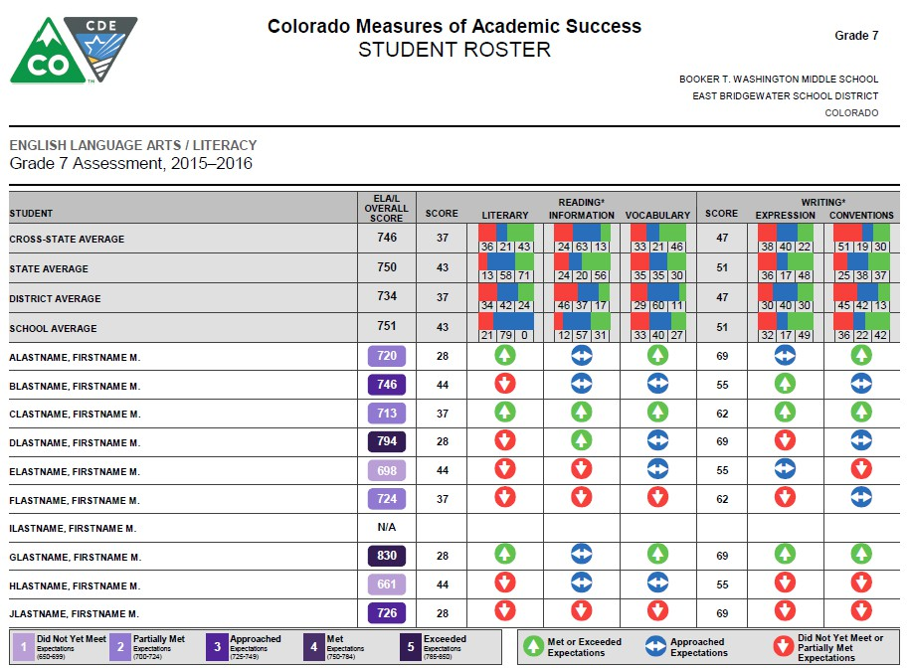
Student roster

Slide 72
CMAS standards roster
School level only
Available for each grade assessed at each school
Lists every student for whom a test book/answer document or online record was submitted
For each student, provides performance on
overall performance level
reporting category/content standards
subclaim percent correct (ELA and math only)
PGC/GLE data (science and social studies only)
Provides the same information aggregated at the state, district, and school levels

Slide 73
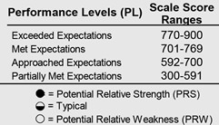
Roster Pg 1
Key:
Lists performance levels with scale score ranges
Explains Content Standards Performance
Symbols
School Summary
# and % of Students in school at each Standards Performance Indicator

Slide 74
Roster Pg 1 contd
Scale Scores by State, District , and School
Individual Student Performance
Overall test
Content standards

Slide 75
Roster Pg 2
Page 2 reports the PGC and GLE Performance
The header includes the points possible and the average % for State, District, and School
PGC and GLE numbering is the same as on the SPR
The language and numbering on the SPR will be included in the
Interpretive Guide for easy reference
PGC percent correct provided if more than one GLE within a PGC

Slide 76
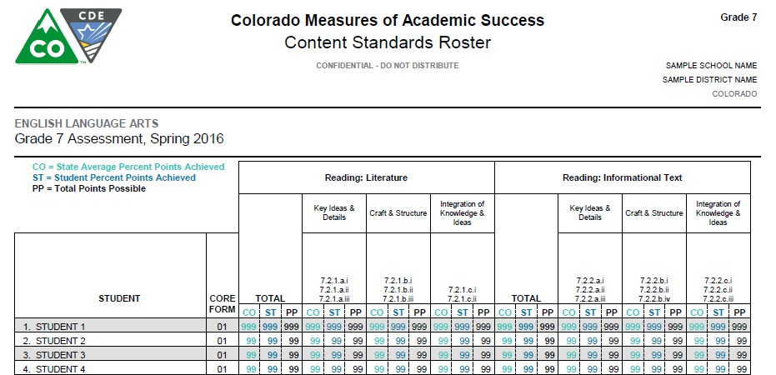
ELA/MATH Roster

Slide 77
Level summary
District and School level
Available for each assessed content area at each grade
Contains aggregated performance level information across the school, district, and state (percent of students meeting each performance level)
Contains disaggregated performance level data by student demographic and program categories and subgroups for either the school or the district
Gender, Race/Ethnicity, Language Proficiency, Disability, etc.
Results for students for whom no demographic or program information was coded are included in the “not indicated” subgroups
No Scores are NOT included in the denominator for the % in each level

Slide 78
Level summary contd
Includes data for the state on the district level report; data for
the state and district on school level reports
Cross- state data included on ELA and math reports
Average Scale Scores
Performance Levels Distribution

Slide 79
Evidence statement analysis
District and School level
Available for each grade assessed at each school
Only if the number of students is greater than 15
Performance on individual items
1 point items: % of students answering correctly
Multi-point items: average points earned divided by the number of possible points
Includes item information

Slide 80
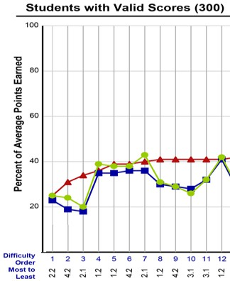
Statement analysis pg 1
Graph:
Average percent correct by item for State, District, and School
Ordered by difficulty from most to least difficult (based on State level data)
Label on the bottom
Science and social studies – Standard and GLE
ELA and math – Evidence Statement

Slide 81
Statement analysis pg 2
Item Information
Ordered by Difficulty – matches the order on Page 1
Location on the test – section and item number
Related PGC and GLE
Item type
SR – Selected Response
CR – Constructed Response (includes point value)

Slide 82
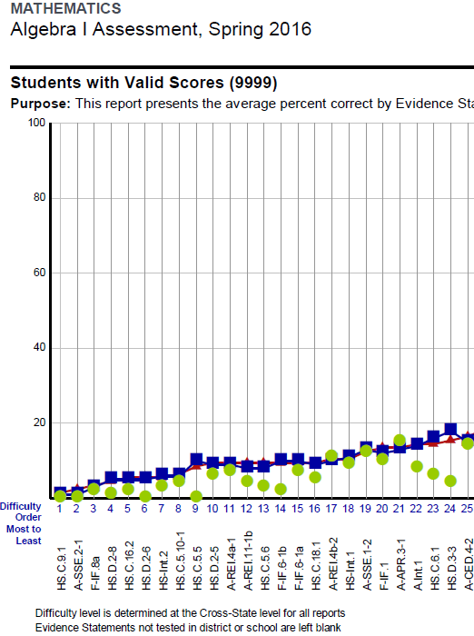
PARCC Statement analysis
Report summarizes district and school performance by evidence statement.
Evidence statements describe the knowledge and skills that an item or task assesses.
The most specific level of information on student achievement.
Due to the number of PARCC test forms, aggregate item level data is not available.

Slide 83
Evidence Statement analysis pg 2
Item Information
Ordered by difficulty – matches the order on Page 1
Evidence Statement
Colorado Academic Standard
Domain

Slide 84
State reports are posted publicly

Slide 85
State Level Results
State results available by
Overall by grade and content area
Gender
Race/ethnicity
Free-reduced lunch status
Special programs
Language proficiency
School and district results available by
Overall by grade and content area
These data are posted to the CDE Assessment webpage on the “Data and Results” subcategory under each assessment

Slide 86
State Level Results Contd
CMAS ELA and Math (PARCC)
http://www.cde.state.co.us/assessment/cmas-englishmath- dataandresults
CSLA
http://www.cde.state.co.us/assessment/csla
CMAS Science and Social Studies
http://www.cde.state.co.us/assessment/cmas-sciencesocial- dataandresults
CoAlt Science and Social Studies
http://www.cde.state.co.us/assessment/coalt-sciencesocial- dataandresults

Slide 87
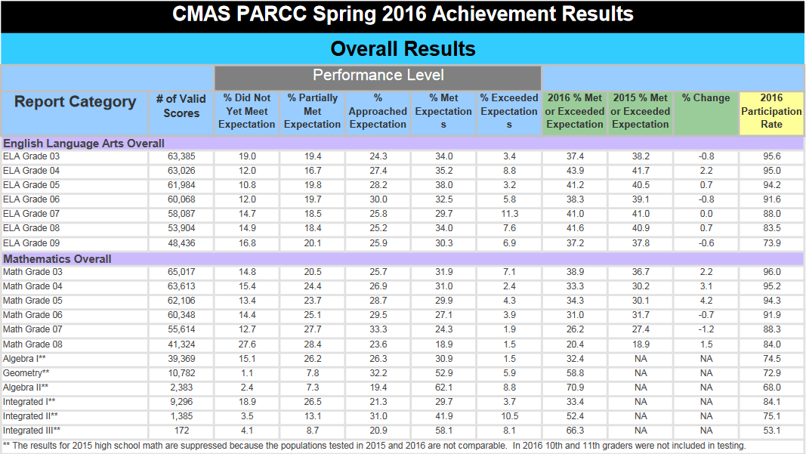
Sample Report

Slide 88
Additional Info
88

Slide 89
Format of Results
Electronic Files – available through PearsonAccess^{next}
Summative File/Student Data File
Summary Data File
Electronic PDF reports – available through PearsonAccess^{next}
District School Roster/District Summary of Schools
Student Roster Report (PARCC, CSLA)
Performance Level Summary Reports
Content Standards Roster Reports
Item Analysis Reports/Evidence Statement Analysis
Individual Student Reports/Student Performance Reports
Hard copy reports – Sent to DACs
Individual Student Reports/Student Performance Reports (two copies)
One copy for parents/guardians, one copy to be kept on file locally
Distribute to parents/guardians as soon as possible
89

Slide 90
Resources
90

Slide 91
Interpretive Guide
CMAS and CoAlt Science and Social Studies
English – Full Guide
Spanish – Guide for Parents
PARCC ELA and Math
English – Full Guide
English – Guide for Parents
Spanish – Guide for Parents
CSLA
English – Full Guide
Spanish – Guide for Parents

Slide 92
Comm Resources
Resources Page
Parent’s Guide to Understanding the New Score Reports (PARCC)
How to Use the Test Results to Support Your Student (PARCC)
Sample score reports available to help educators and parents know what to expect
Algebra II http://www.cde.state.co.us/communications/parcc- mockscorecardmath
English language arts, Grade 6 http://www.cde.state.co.us/communications/parcc- mockscorecardenglish
CMAS Tests Results & School/District Accountability

