Slide 1
Chapter 6: Students with Disabilities
May 2020

Slide 2
Introduction
Students with disabilities are defined as those “children having intellectual disabilities, hearing impairment (including deafness), speech or language impairment, visual impairment (including blindness), serious emotional disturbance, orthopedic impairment, autism, traumatic brain injury, developmental delay, other health impairment, a specific learning disability, deaf-blindness, or multiple disabilities, and who, as a result, receive special education and related services under the Individual with Disabilities Education Act (IDEA) according to an Individualized Education Program (IEP), Individual Family Service Plan (IFSP), or services plan” (Section 602(3) of IDEA). For additional information, visit the CDE Office of Special Education webpage (www.cde.state.co.us/cdesped). To the extent possible, the tables and figures include data on all students with disabilities, and separately by disability category. For definitions and additional information regarding each disability category, please visit the CDE Office of Special Education’s webpage on Disabilities Categories (www.cde.state.co.us/cdesped/sd-main). For comparison purposes, the tables and figures also include data on all Colorado students, as well as data on students with a 504 plan. Section 504 is part of the Americans with Disabilities Act Amendments Act of 2008 that guarantees specific rights in federally funded programs and activities to people who qualify as disabled.

Slide 3
Characteristics

Slide 4
Student October
Information in this section reflects student demographics at the time of the Student October Snapshot only. The Colorado Department of Education (CDE) annually collects student demographic data from districts. When districts submit the data to CDE in October of each year, it is referred to as the Student October Snapshot. The “purpose of the Student October Snapshot is to determine funding for districts and schools by taking a count of students in attendance on the Pupil Enrollment Date” (Student October Data Elements and Definitions [http://www.cde.state.co.us/datapipeline/studentoctoberdata]). Additional information is available on the CDE Pupil Membership webpage (www.cde.state.co.us/cdereval/pupilcurrent). To protect student privacy, Colorado suppresses any cells that do not meet minimum number requirements. "N/A" indicates a cell contains fewer than 16 students, or that complementary suppression rules were applied.

Slide 5
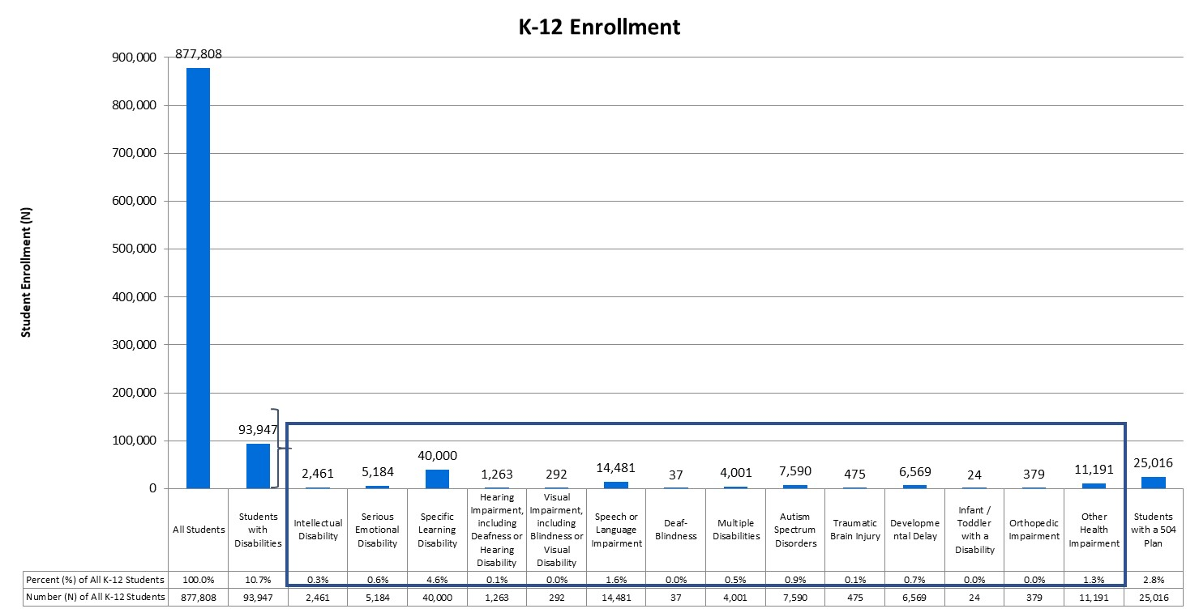
K-12 Enrollment
During the 2018-19 school year, there were 93,947 students with disabilities in Kindergarten through 12th grade, representing 10.7% of the total K-12 population (Number or N = 877,808).

Slide 6
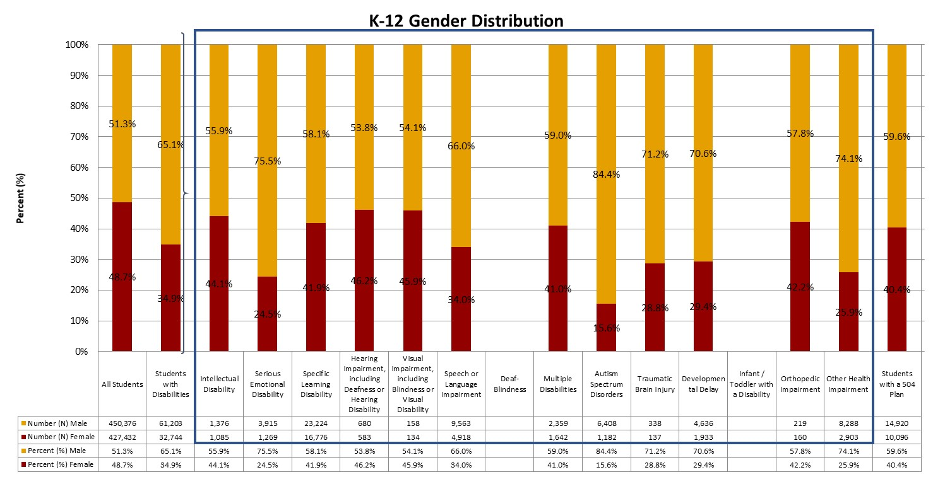
Gender
Statewide, the gender distribution of all K-12 students was 51.3% male students and 48.7% female students. The distribution for students with disabilities was 65.1% male students.

Slide 7
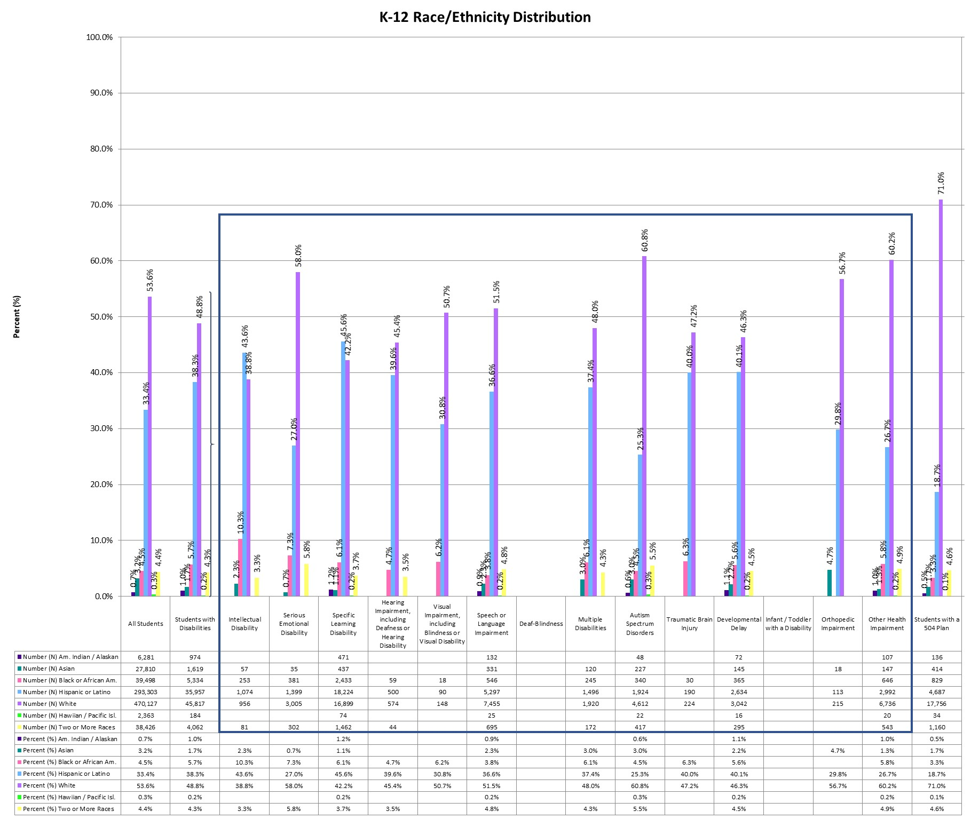
Race/Ethnicity
During the 2018-19 school year, 53.6% of Colorado students were White and 33.4% were Hispanic or Latino. Of students with disabilities, 48.8% were White and 38.3% were Hispanic or Latino.
Notes:
To align with federal reporting requirements, changes were made to the collection of racial and ethnic data beginning with the 2010-11 school year. Under this system, identification is based on the responses to a two-part question. The first part determines whether a student is of Hispanic/Latino origin, while the second part determines which of the following groups define a student’s race: American Indian or Alaska Native, Asian, black or African American, white, or Native Hawaiian or other Pacific Islander. Students who identify as Hispanic or Latino are counted in the Hispanic category regardless of the race(s) indicated. The remaining students are categorized based on the race(s) indicated, with students who select more than one race counted in the two or more races category.

Slide 8
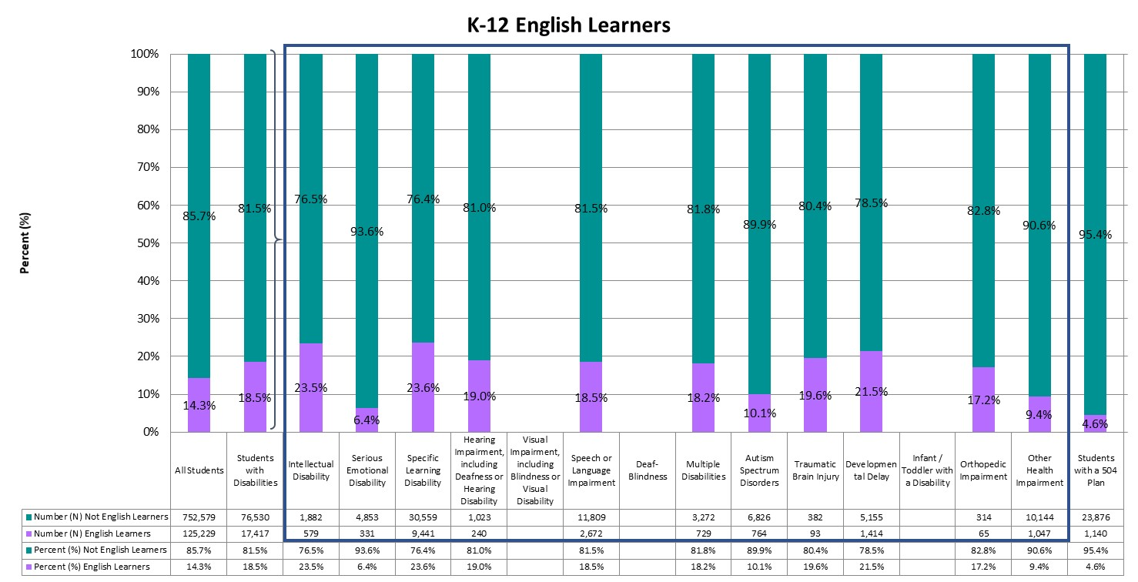
English Learners
Approximately 14.3% of students in the total K-12 population were identified as English learners. Of students with disabilities, 18.5% were English learners.
Notes:
English learners (ELs) are those students who are linguistically diverse and identified as having a level of English language proficiency that requires language support to achieve standards in grade-level content in English (Colorado Revised Statutes under the English Language Proficiency Act 22-24-103). Although federal reporting for English learners (see Chapter 2 for more information) typically refers to students who are non-English proficient (NEP) and limited English proficient (LEP), Colorado also includes students monitored for two years following redesignation as fluent English proficient (FEP M1/M2).

Slide 9
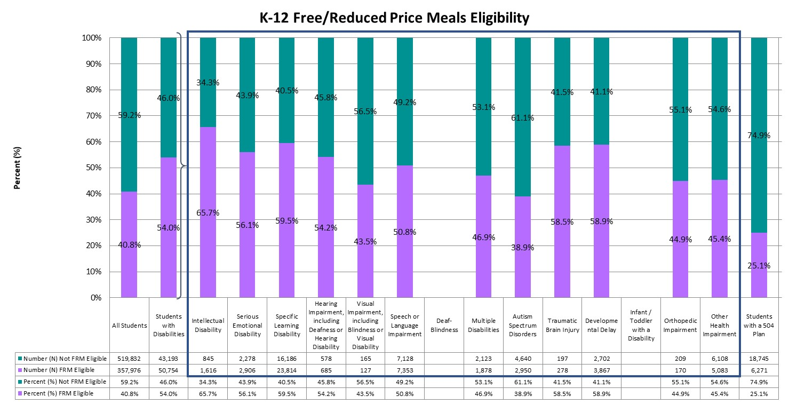
Free/Reduced Meals Eligibility
Across Colorado, 40.8% of all Colorado students were eligible for free/reduced meals (FRM) and 54.0% of students with disabilities were eligible for FRM.
Notes:
Students may be eligible to receive free or reduced price meals (FRM) based on household income eligibility requirements (Eligibility Manual for School Meals [fns-prod.azureedge.net/sites/default/files/cn/SP36_CACFP15_SFSP11-2017a1.pdf]). Students from households with an income at or below 130 percent of the poverty income threshold were eligible for free meals, and students from households with an income between 130 percent and 185 percent of the poverty income threshold were eligible for reduced meals. Students from households participating in the Supplemental Nutrition Assistance Program (SNAP), Food Distribution Program on Indian Reservations (FDPIR), or Temporary Assistance for Needy Families (TANF) were also eligible for free lunch. In addition, children may also be eligible if they are designated as homeless, migrant, runaway, or a foster child. Given these requirements, free or reduced price meal eligibility is used as a proxy to determine students who are economically disadvantaged. For more information, visit the CDE Office of School Nutrition’s webpage on Free and Reduced Price Processes (www.cde.state.co.us/nutrition/nutrifreeandreducedprocesses).

Slide 10
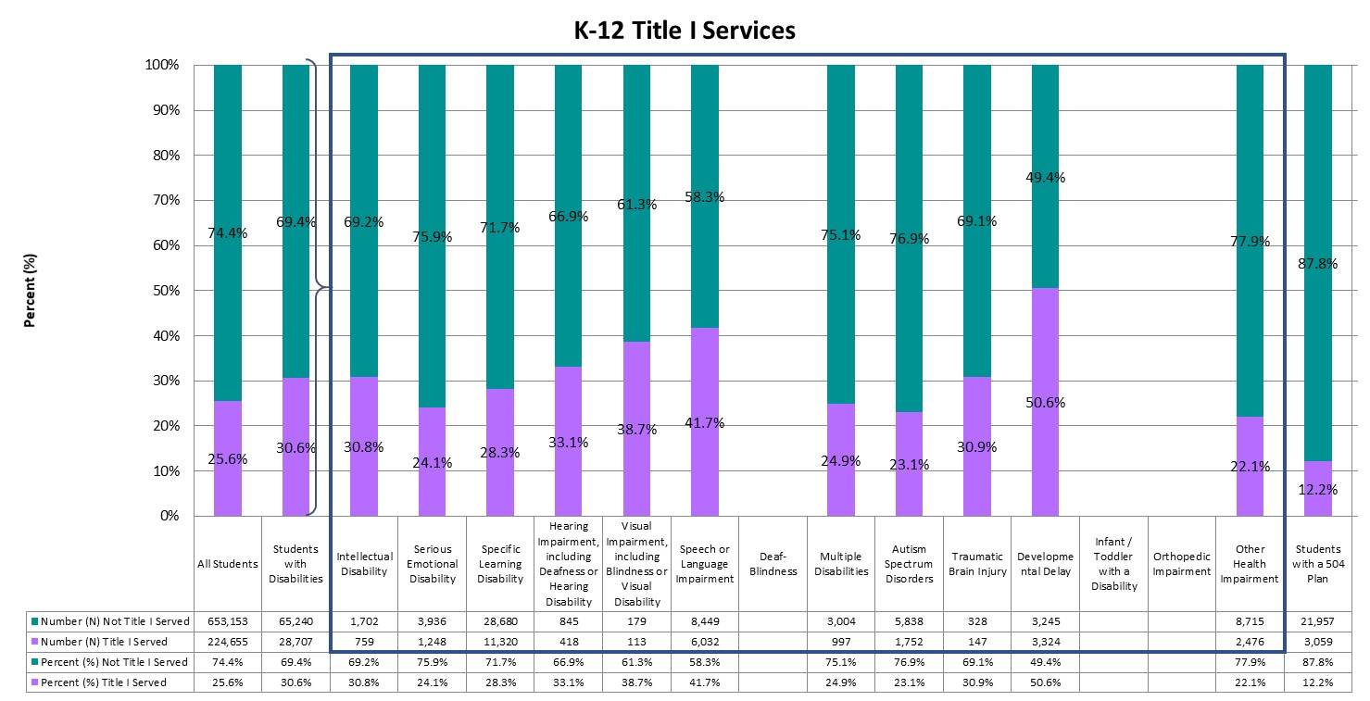
Title I Services
Approximately 30.6% of all students with disabilities were identified as receiving Title I services, compared to 25.6% of all K-12 students in the state.
Notes:
The purpose of Title I, Part A is to provide resources to schools and districts to “ensure that all children have a fair, equitable, and high-quality education, and to close educational achievement gaps” (Every Student Succeeds Act). For additional information regarding Title I services, visit the CDE Federal Programs Unit’s webpage on Title I, Part A (www.cde.state.co.us/fedprograms/ti/a), or refer to Chapter 5.

Slide 11
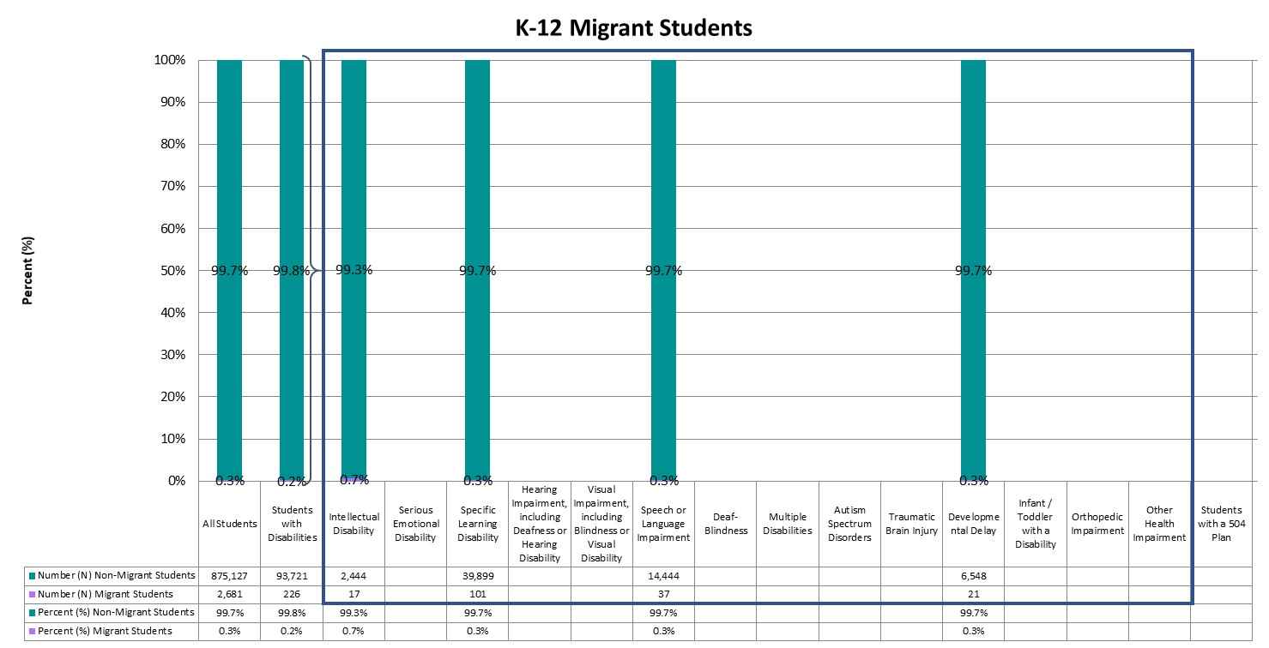
Migrant Students
Statewide, less than one percent (0.3%) of K-12 students were identified as migrant students. The percent of students with disabilities identified as migrant students was 0.2%.
Notes:
Students identified as migrant students are children of migratory agricultural workers and others who are determined eligible on Certificates of Eligibility (COEs). Supplementary services are provided to these students to help reduce the educational disruption and other problems that result from repeated moves, and to ensure that migratory children are provided with appropriate educational services that address their special needs. For additional information regarding the education of migratory children, please visit the CDE Office of Migrant Education’s webpage on the Migrant Education Program (www.cde.state.co.us/migrant).

Slide 12
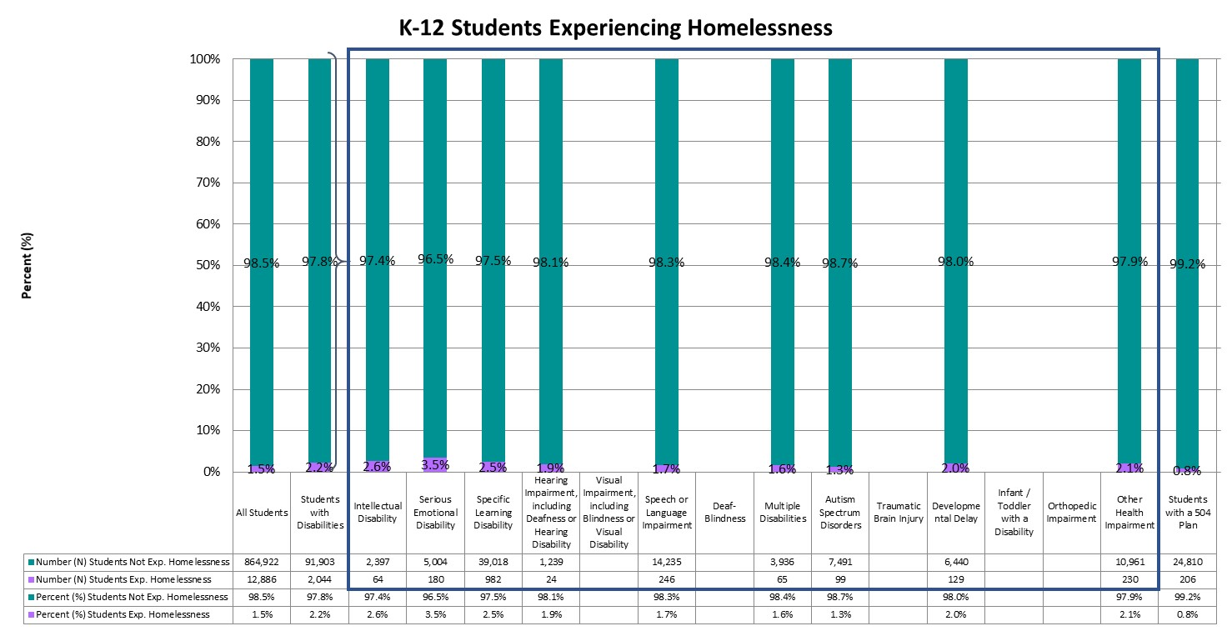
Students Experiencing Homelessness
Across the state, 1.5% of all K-12 students were experiencing homelessness based on the Student October Snapshot. Similarly, 2.2% of students with disabilities were experiencing homelessness.
Notes:
Any displaced child or youth who is living in a shelter, motel, inadequate trailer or house, is staying temporarily with relatives or friends due to economic hardship or loss of housing, or is living in any other homeless situation has educational rights under the McKinney-Vento Act. These services are designed to assist students experiencing homelessness in enrolling in and attending school, completing their high school education, and continuing on to higher education. Additional information regarding homeless education and the McKinney-Vento Act can be found on the CDE Office of Dropout Prevention and Student Re-Engagement’s webpage on McKinney-Vento Homeless Education (www.cde.state.co.us/dropoutprevention/homeless_index).

Slide 13
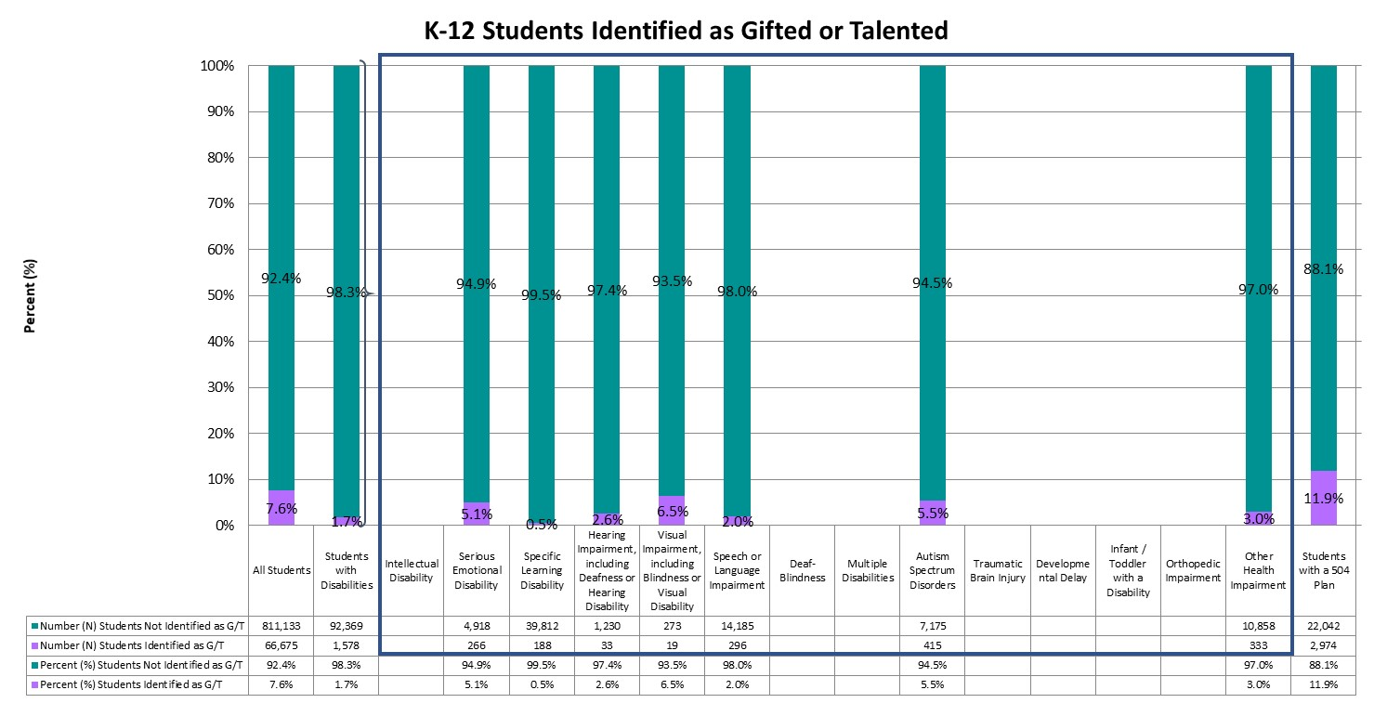
Students Identified as Gifted/Talented
Approximately 7.6% of all K-12 students and 1.7% of students with disabilities were identified as gifted or talented.
Notes:
The Exceptional Children’s Educational Act (ECEA) defines gifted students as those students whose aptitude or competence in abilities, talents, and potential for accomplishment in one or more domains are so exceptional or developmentally advanced that they require special provisions to meet their educational programming needs. For additional information regarding gifted education, visit the CDE Office of Gifted Education’s webpage (www.cde.state.co.us/gt), or refer to Chapter 7.

Slide 14
Location and Context

Slide 15
Districts with Highest Number of students with disabilities
Students with disabilities are located throughout the state, with 184 districts having at least one student with a disability enrolled during the Student October Snapshot in the 2018-19 school year. Twenty-four districts had more than 1,000 K-12 students with disabilities enrolled at the time of the Snapshot, with the top 10 districts each having enrolled more than 2,300 students with disabilities. Denver County 1 had the highest number of students with disabilities enrolled (N = 9,845), followed by Jefferson County R-1 (N = 8,043) and Douglas County Re 1 (N = 6,637).
District Number | District Name | Number (N) All Students | Number (N) Students with Disabilities | Percent (%) Students with Disabilities
0880 | DENVER COUNTY 1 | 86,928 | 9,845 | 11.3%
1420 | JEFFERSON COUNTY R-1 | 81,714 | 8,043 | 9.8%
0900 | DOUGLAS COUNTY RE 1 | 65,671 | 6,637 | 10.1%
0130 | CHERRY CREEK 5 | 54,275 | 6,467 | 11.9%
0180 | ADAMS-ARAPAHOE 28J | 38,010 | 4,523 | 11.9%
0020 | ADAMS 12 FIVE STAR SCHOOLS | 38,095 | 3,920 | 10.3%
0470 | ST VRAIN VALLEY RE 1J | 31,100 | 3,465 | 11.1%
0480 | BOULDER VALLEY RE 2 | 30,313 | 3,444 | 11.4%
1010 | COLORADO SPRINGS 11 | 25,624 | 2,478 | 9.7%
1550 | POUDRE R-1 | 29,686 | 2,396 | 8.1%

Slide 16
Districts with Highest Percentage of students with disabilities
For one district, students with disabilities represented at least one-quarter of their K-12 student population. The top 10 districts had student populations composed of at least 17.6 percent students with disabilities. Colorado School For The Deaf And Blind had the highest percent of students with disabilities (100.0%). Zero districts were in the top 10 for both number and percent of students with disabilities. To protect student privacy, two districts with fewer than 16 students with disabilities were excluded.
District Number | District Name | Number (N) All Students | Number (N) Students with Disabilities | Percent (%) Students with Disabilities
9000 | COLORADO SCHOOL FOR THE DEAF AND BLIND | 205 | 205 | 100.0%
1620 | AGUILAR REORGANIZED 6 | 104 | 23 | 22.1%
1450 | ARRIBA-FLAGLER C-20 | 149 | 32 | 21.5%
1780 | GENOA-HUGO C113 | 188 | 39 | 20.7%
2865 | REVERE SCHOOL DISTRICT | 136 | 28 | 20.6%
3030 | AKRON R-1 | 363 | 65 | 17.9%
1480 | STRATTON R-4 | 214 | 38 | 17.8%
1390 | HUERFANO RE-1 | 489 | 86 | 17.6%

Slide 17
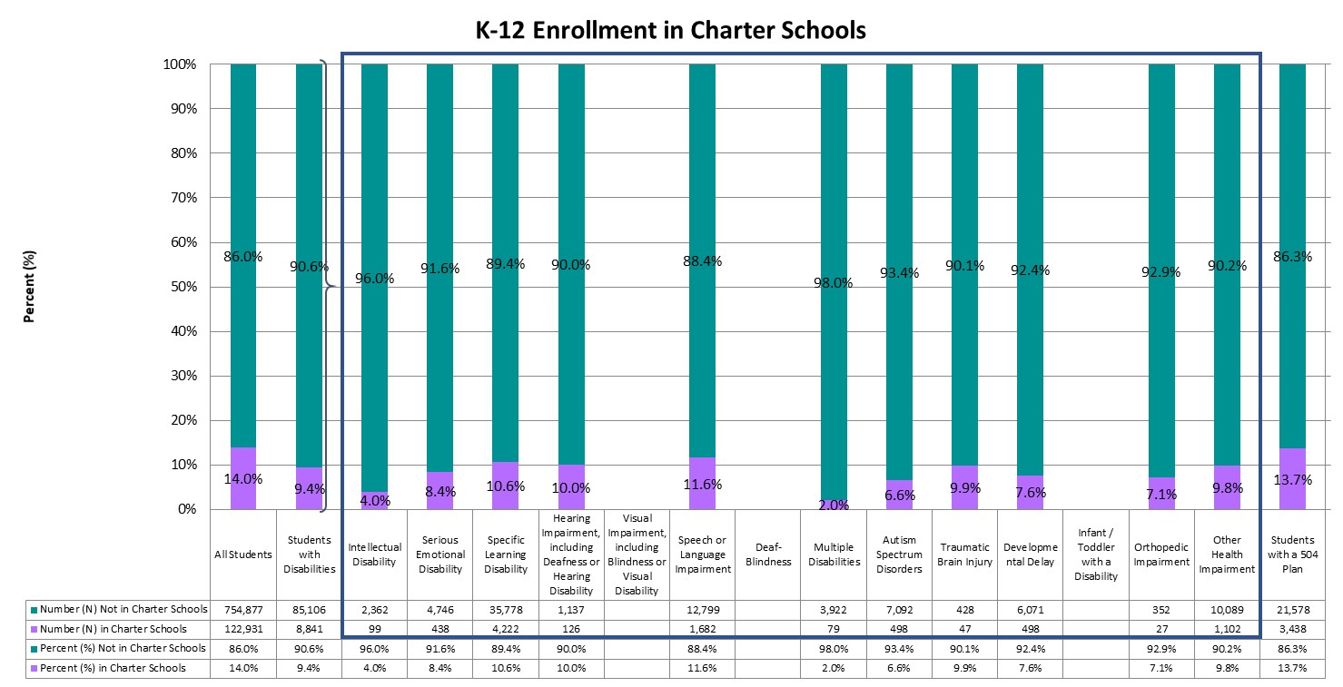
Enrolled in Charter Schools
Statewide, approximately 14.0% of all K-12 students and 9.4% of students with disabilities were enrolled in a Charter school.
Notes:
Charter schools operate under a charter (or contract) between the charter school and its authorizer, which is either a local school district or the Colorado Charter School Institute. Parents must apply to charter schools if they choose to enroll their children in a charter school. Additional information is available on the CDE Schools of Choice Office’s webpage on Colorado Charter Schools (www.cde.state.co.us/cdechart).

Slide 18
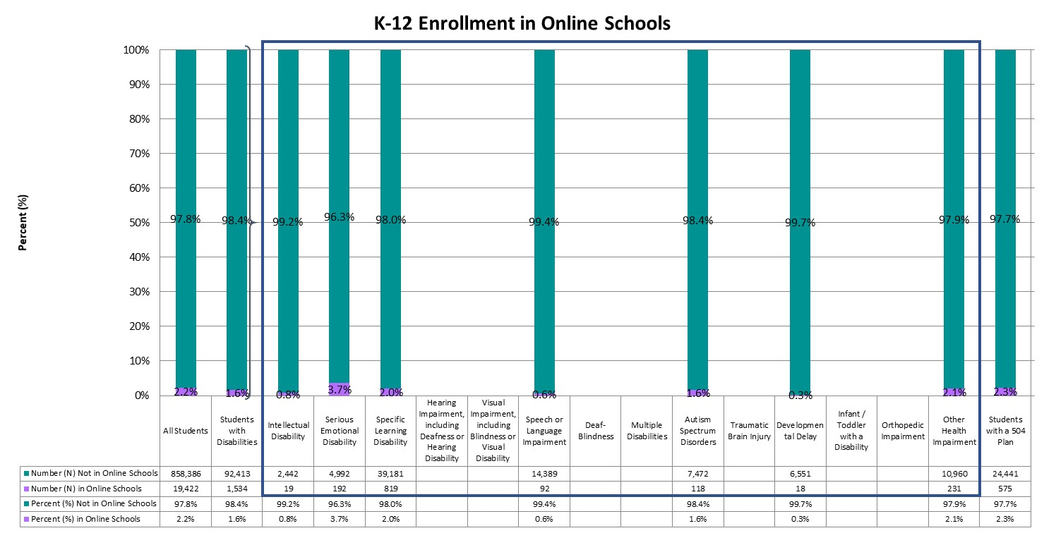
Enrolled in Online Schools
Only 2.2% of all K-12 students and 1.6% of students with disabilities were enrolled in online schools.
Notes:
An online school or program is a full-time education school/program that delivers a sequential program of instruction directed by a teacher, primarily through online digital learning strategies that provide students choice over time, place, and path, and teacher-guided modality of learning. For additional information, please visit the CDE Office of Blended & Online Learning webpage (www.cde.state.co.us/onlinelearning).

Slide 19
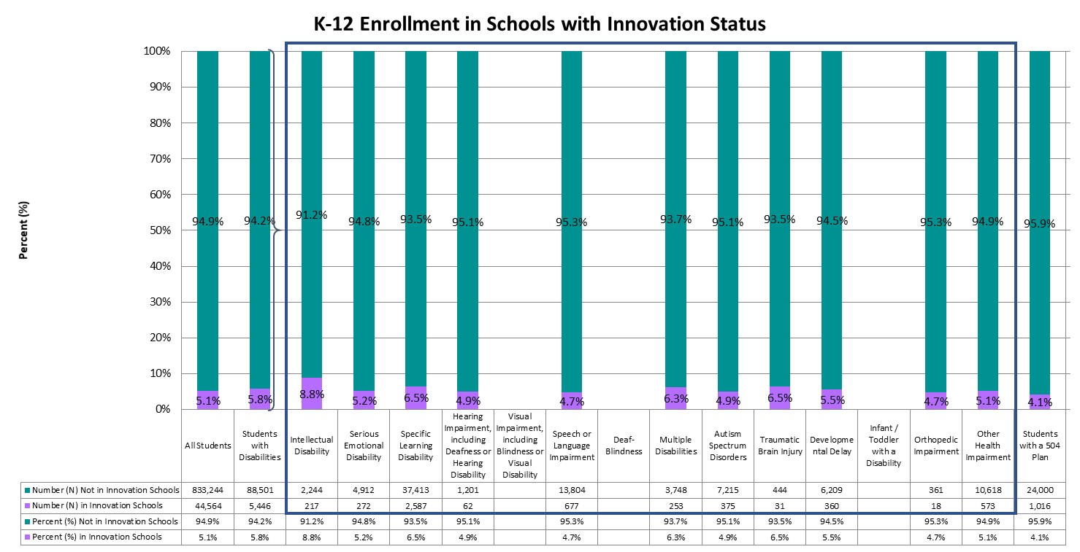
Enrolled in Schools with Innovation Status
Statewide, 5.1% of all K-12 students were enrolled in schools with Innovation status, whereas 5.8% of students with disabilities were enrolled in schools with Innovation status.
Notes:
The Innovation Schools Act provides a pathway for schools and districts to obtain greater individual school autonomy and managerial flexibility in order to implement diverse approaches to learning. Schools receiving Innovation status gain greater control over issues such as educational programming, personnel selection and evaluation, calendars and scheduling, and budgeting. Additional information can be found on the CDE Schools of Choice Office’s webpage on Innovation Schools (www.cde.state.co.us/choice/innovationschools).

Slide 20
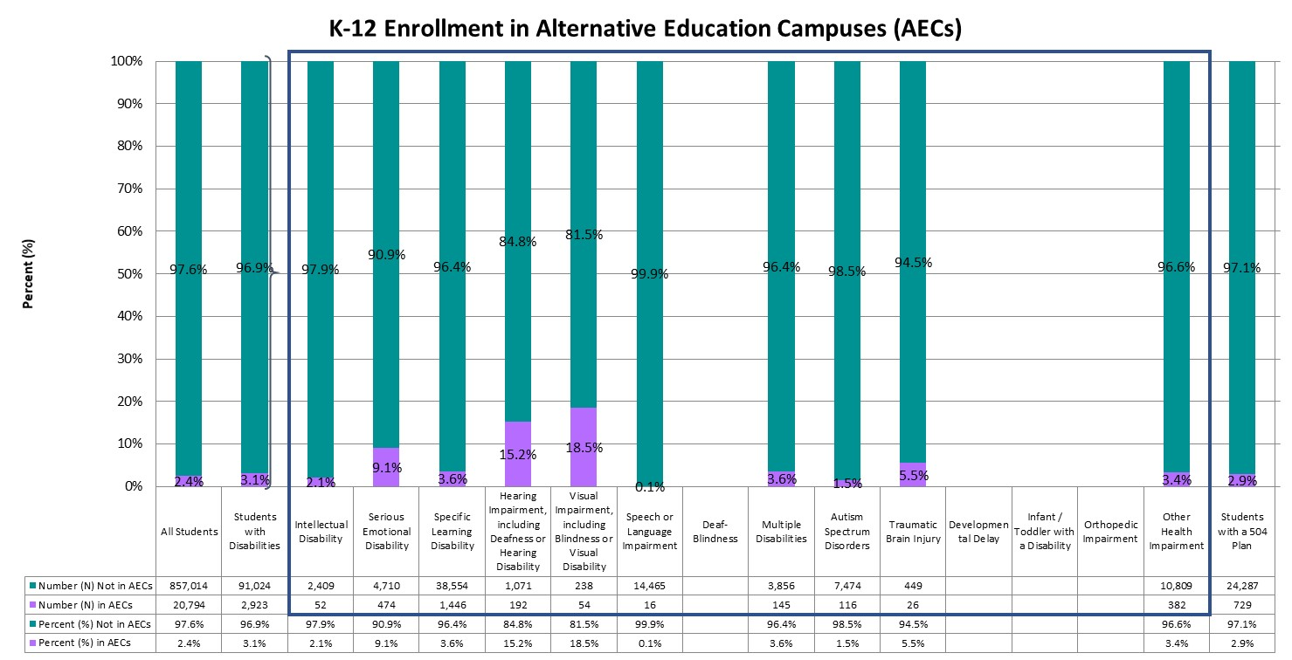
Enrolled in Alternative Education Campuses (AECs)
Approximately 2.4% of all K-12 students and 3.1% of students with disabilities were enrolled in Alternative Education Campuses (AECs).
Notes:
Schools may be designated as Alternative Education Campuses (AECs) if at least 90% of students meet criteria that classify them as high-risk, if they serve students who have severe limitations precluding appropriate administration of state assessments, or if they serve students who attend on a part-time basis, coming from other public schools. High-risk students include those students with one of more of the following conditions: juvenile delinquent, dropped out of school, expelled from school, history of drug or alcohol use, history of street gang involvement, history of child abuse or neglect, has a parent or guardian in prison, has an IEP, family history of domestic violence, repeated school suspensions, parent or pregnant woman, migrant child, homeless child, history of a serious psychiatric or behavioral disorder, or is over traditional school age for his or her grade level and lacks adequate credit hours. Additional information regarding AECs can be found on the CDE Accountability and Data Analysis Unit’s webpage for State Accountability – Alternative Education Campuses (www.cde.state.co.us/accountability/stateaccountabilityaecs).

Slide 21
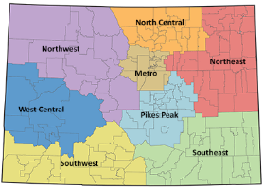
Colorado Regions
Colorado is divided into eight regions in which districts are located: Metro, North Central, Northeast, Northwest, Pikes Peak, Southeast, Southwest, and West Central. Charter School Institute and Colorado Digital BOCES serve students throughout the state, and therefore are not assigned to a particular region.

Slide 22
Enrollment Across Regions
Category | Metro | North Central | Northeast | Northwest | Pikes Peak | Southeast | Southwest | West Central | Charter School Institute | Colorado Reenvisioned BOCES | Colorado Detention Centers
Percent (%) of All Students | 52.3% | 14.4% | 1.6% | 4.0% | 17.4% | 1.4% | 2.4% | 4.1% | 2.0% | 0.3% | 0.0%
Percent (%) of Students with Disabilities | 53.1% | 13.5% | 2.0% | 4.0% | 17.8% | 1.4% | 2.2% | 4.4% | 1.3% | 0.3% | 0.0%
Percent (%) of Intellectual Disability | 51.6% | 12.5% | 2.0% | 2.8% | 22.0% | 1.7% | 1.9% | 4.6% | * | * | *
Percent (%) of Serious Emotional Disability | 57.6% | 12.7% | 1.8% | 3.6% | 15.4% | 0.7% | 2.5% | 3.9% | 0.8% | * | *
Percent (%) of Specific Learning Disability | 53.8% | 13.1% | 2.0% | 4.6% | 16.4% | 1.5% | 2.2% | 4.5% | 1.3% | 0.4% | 0.0%
Percent (%) of Hearing Impairment, including Deafness or Hearing Disability | 53.9% | 11.3% | 1.3% | 3.4% | 23.5% | * | 1.9% | 3.2% | * | * | *
Percent (%) of Visual Impairment, including Blindness or Visual Disability | 46.6% | * | * | * | 33.2% | * | * | * | * | * | *
Percent (%) of Speech or Language Impairment | 49.1% | 14.5% | 2.5% | 3.7% | 20.0% | 1.6% | 1.9% | 4.3% | 2.3% | * | *
Percent (%) of Deaf-Blindness | * | * | * | * | * | * | * | * | * | * | *
Percent (%) of Multiple Disabilities | 56.2% | 12.6% | 2.0% | 3.4% | 19.4% | * | 2.6% | 3.1% | * | * | *
Percent (%) of Autism Spectrum Disorders | 53.2% | 15.7% | 1.4% | 2.6% | 19.3% | 0.9% | 1.6% | 4.0% | 0.9% | * | *
Percent (%) of Traumatic Brain Injury | 51.4% | 15.8% | * | * | 16.8% | * | * | * | * | * | *
Percent (%) of Developmental Delay | 55.5% | 11.7% | 1.6% | 4.0% | 15.5% | * | 2.9% | 5.5% | 0.7% | * | *
Percent (%) of Infant / Toddler with a Disability | * | * | * | * | * | * | * | * | * | * | *
Percent (%) of Orthopedic Impairment | 44.9% | 14.5% | * | 7.4% | * | * | * | 6.9% | * | * | *
Percent (%) of Other Health Impairment | 52.0% | 14.4% | 1.8% | 3.7% | 18.9% | 1.0% | 2.1% | 4.3% | 1.3% | * | *
Percent (%) of Students with a 504 Plan | 57.6% | 14.7% | 1.0% | 3.0% | 16.0% | 0.4% | 1.5% | 3.2% | 2.4% | * | *
The majority of K-12 students (52.3%) were enrolled in the Metro region, followed by Pikes Peak (17.4%) and North Central (14.4%) regions. The majority of students with disabilities were enrolled in the Metro region (53.1%), followed by Pikes Peak (17.8%) and North Central (13.5%) regions.

Slide 23
Enrollment Within Regions
The Northeast region had the highest proportion of students with disabilities (12.9%), whereas the Charter School Institute region had the lowest proportion of students with disabilities (6.6%). Approximately 13.2% of students enrolled in a school within the Charter School Institute were students with disabilities.
Region | Number (N) All Students | Number (N) Students with Disabilities | Percent (%) Students with Disabilities
Metro | 459,455 | 49,921 | 10.9%
North Central | 126,627 | 12,683 | 10.0%
Northeast | 14,288 | 1,842 | 12.9%
Northwest | 35,332 | 3,733 | 10.6%
Pikes Peak | 152,509 | 16,716 | 11.0%
Southeast | 11,932 | 1319 | 11.1%
Southwest | 20,642 | 2,060 | 10.0%
West Central | 36,274 | 4,117 | 11.3%
Charter School Institute | 17,986 | 1,187 | 6.6%
Colorado Reenvisioned BOCES | 2,475 | 327 | 13.2%
Colorado Detention Centers | 288 | 42 | 14.6%

Slide 24
Colorado Settings
Districts are classified into one of six settings: Denver Metro, Urban-Suburban (population center over 30,000 residents, but outside the Denver Metro area), Outlying City (population center of 7,000 to 30,000), Outlying Town (population center of 1,000 to 7,000), Remote (population center of less than 1,000), or BOCES (Data Pipeline Frequently Requested Codes [www.cde.state.co.us/datapipeline/org_orgcodes]).

Slide 25
Enrollment Across Settings
Category | Denver Metro | Outlying City | Outlying Town | Remote | Urban-Suburban | Colorado BOCES | Colorado Detention Centers
Percent (%) of All Students | 55.4% | 4.4% | 8.1% | 3.5% | 28.2% | 0.4% | 0.0%
Percent (%) of Students with Disabilities | 56.3% | 5.0% | 8.0% | 3.5% | 26.8% | 0.4% | 0.0%
Percent (%) of Intellectual Disability | 54.5% | 4.8% | 7.1% | * | 30.7% | * | *
Percent (%) of Serious Emotional Disability | 60.4% | 4.2% | 6.8% | 3.5% | 23.8% | * | *
Percent (%) of Specific Learning Disability | 56.7% | 5.4% | 8.5% | 3.7% | 25.2% | 0.5% | 0.0%
Percent (%) of Hearing Impairment, including Deafness or Hearing Disability | 56.6% | 3.6% | 6.3% | * | 30.2% | * | *
Percent (%) of Visual Impairment, including Blindness or Visual Disability | 47.6% | * | * | * | * | * | *
Percent (%) of Speech or Language Impairment | 51.5% | 4.6% | 8.8% | 4.2% | 30.9% | * | *
Percent (%) of Deaf-Blindness | * | * | * | * | * | * | *
Percent (%) of Multiple Disabilities | 58.9% | 4.9% | 7.4% | * | 26.1% | * | *
Percent (%) of Autism Spectrum Disorders | 58.9% | 3.3% | 6.1% | 2.7% | 28.6% | * | *
Percent (%) of Traumatic Brain Injury | 51.6% | 6.5% | 9.9% | * | 27.6% | * | *
Percent (%) of Developmental Delay | 58.9% | 7.2% | 9.1% | * | 21.3% | * | *
Percent (%) of Infant / Toddler with a Disability | * | * | * | * | * | * | *
Percent (%) of Orthopedic Impairment | 46.4% | * | 11.9% | * | 33.8% | * | *
Percent (%) of Other Health Impairment | 55.8% | 4.3% | 6.6% | 3.2% | 29.3% | * | *
Percent (%) of Students with a 504 Plan | 61.7% | 2.2% | 5.8% | 2.3% | 27.7% | * | *
The majority of K-12 students (55.4%) were enrolled in Denver Metro settings, followed by Urban-Suburban settings (28.2%). The majority of students with disabilities were enrolled in Denver Metro settings (56.3%), followed by Urban-Suburban settings (26.8%).

Slide 26
Enrollment Within Regions
The Outlying City setting had the highest proportion of students with disabilities (12.0%), whereas the Urban-Suburban setting had the lowest proportion of students with disabilities (10.2%).
Setting | Number (N) All Students | Number (N) Students with Disabilities | Percent (%) Students with Disabilities
Denver Metro | 485,960 | 52,872 | 10.9%
Outlying City | 38,921 | 4,673 | 12.0%
Outlying Town | 70,973 | 7,476 | 10.5%
Remote | 30,655 | 3,276 | 10.7%
Urban-Suburban | 247,841 | 25,200 | 10.2%
Colorado BOCES | 3,170 | 408 | 12.9%
Colorado Detention Centers | 288 | 42 | 14.6%

Slide 27
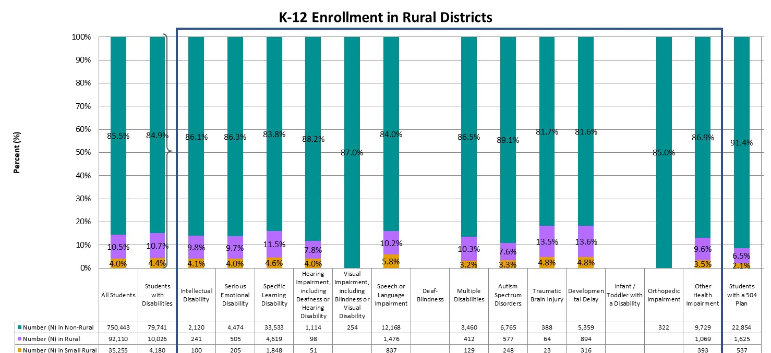
Enrolled in Rural Districts
Statewide, 10.5% of all K-12 students were enrolled in rural districts and 4.0% were enrolled in small rural districts. In comparison, 10.7% of students with disabilities were enrolled in rural and 4.4% in small rural districts.
Notes:
A Colorado school district is determined to be rural based on the size of the district, the distance from the nearest large urban/urbanized area, and having a student enrollment of approximately 6,500 students or fewer. Small rural districts are those districts meeting these same criteria and having a student population of fewer than 1,000 students. For more information, and for a list of districts considered rural or small rural, please visit the CDE Rural Education Council webpage (www.cde.state.co.us/ruraledcouncil).

Slide 28
Academic Achievement

Slide 29
Academic Achievement
Students in grades 3 through 8 were administered the Colorado Measures of Academic Success (CMAS) assessments in mathematics and English language arts, and students in grade 11 were administered the SAT assessment in mathematics and evidence-based reading and writing. In addition, students in grades 5, 8, and 11 were administered the CMAS assessment in science. Students with significant cognitive disabilities were eligible to take the Colorado Alternate (CoAlt) assessments instead. For more information on the state assessments, and for school- and district-level results, please visit the CDE Assessment Unit webpage (www.cde.state.co.us/assessment). To protect student privacy, Colorado suppresses any cells that do not meet minimum number requirements. Data omitted from the following graphs indicates fewer than 16 students, or that complementary suppression rules were applied.

Slide 30
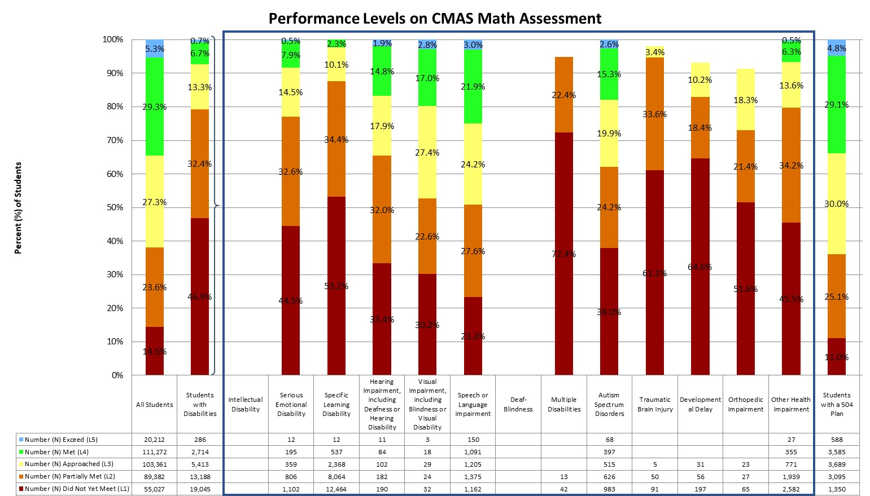
Performance on CMAS Math Assessment (Grades 3-8)
Statewide, the majority of students scored in level 4 (Met Expectations, 29.3%) and level 3 (Approached Expectations, 27.3%). The majority of students with disabilities scored in level 1 (Did Not Yet Meet Expectations, 46.9%) and level 2 (Partially Met Expectations, 32.4%).
Notes:
The CMAS math assessment has five performance levels, ranging from Did Not Yet Meet Expectations (Level 1) to Exceed Expectations (Level 5).

Slide 31
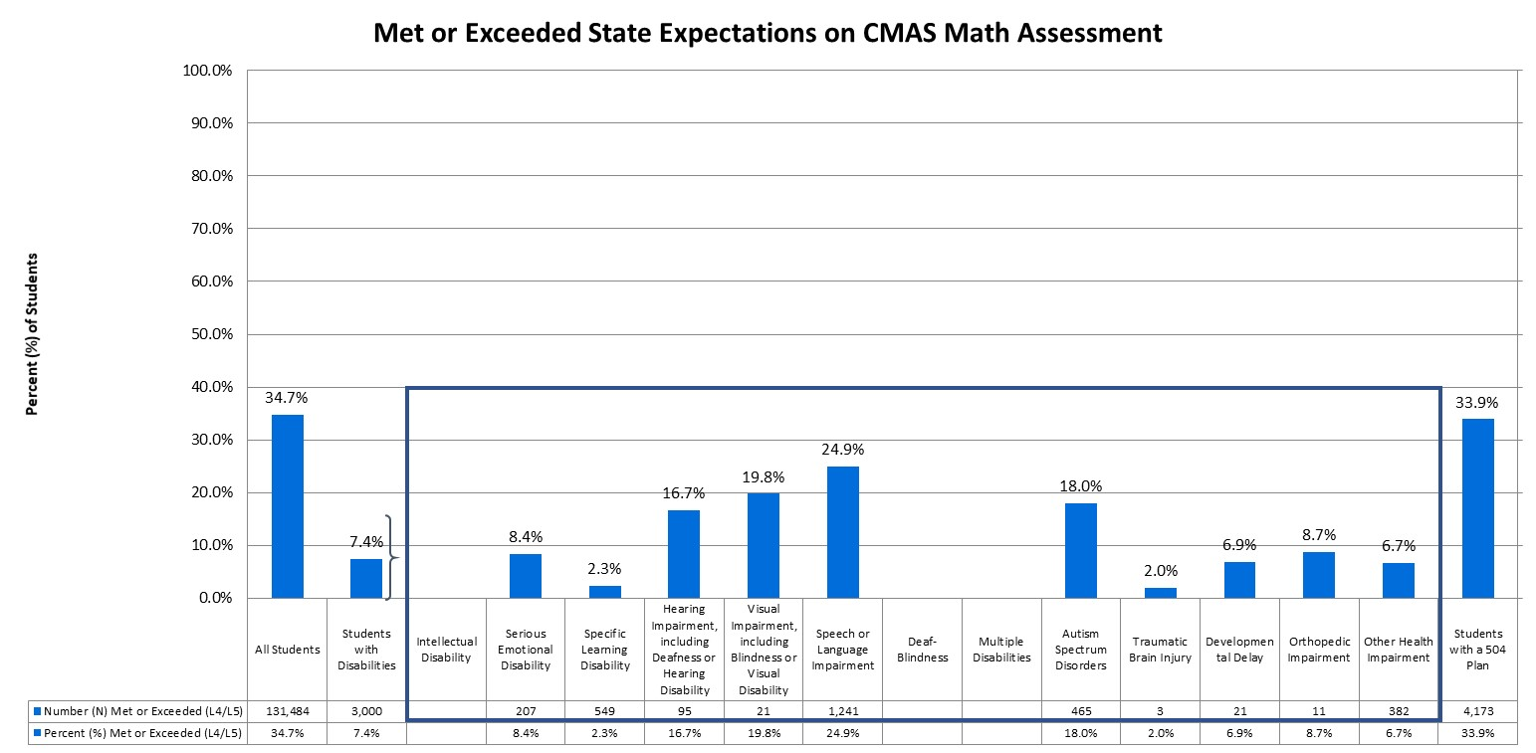
Students Meeting/Exceeding Expectations on CMAS Math Assessment (Grades 3-8)
Statewide, approximately 34.7% of students in grades 3 through 8 met or exceeded state expectations, compared to 7.4% of students with disabilities.
Notes:
In addition to the percent of students scoring within each performance level, it is important to consider how many students are meeting state expectations, reaching level 4 or higher.

Slide 32
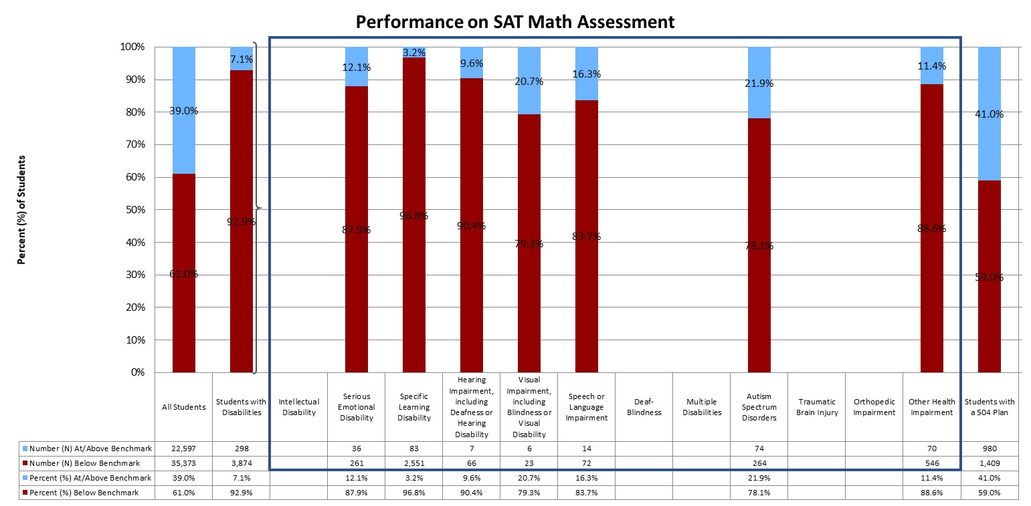
Performance on SAT Math Assessment (Grade 11)
Statewide, 39.0% of students were at or above benchmark on the SAT math assessment, compared to 7.1% of students with disabilities.

Slide 33
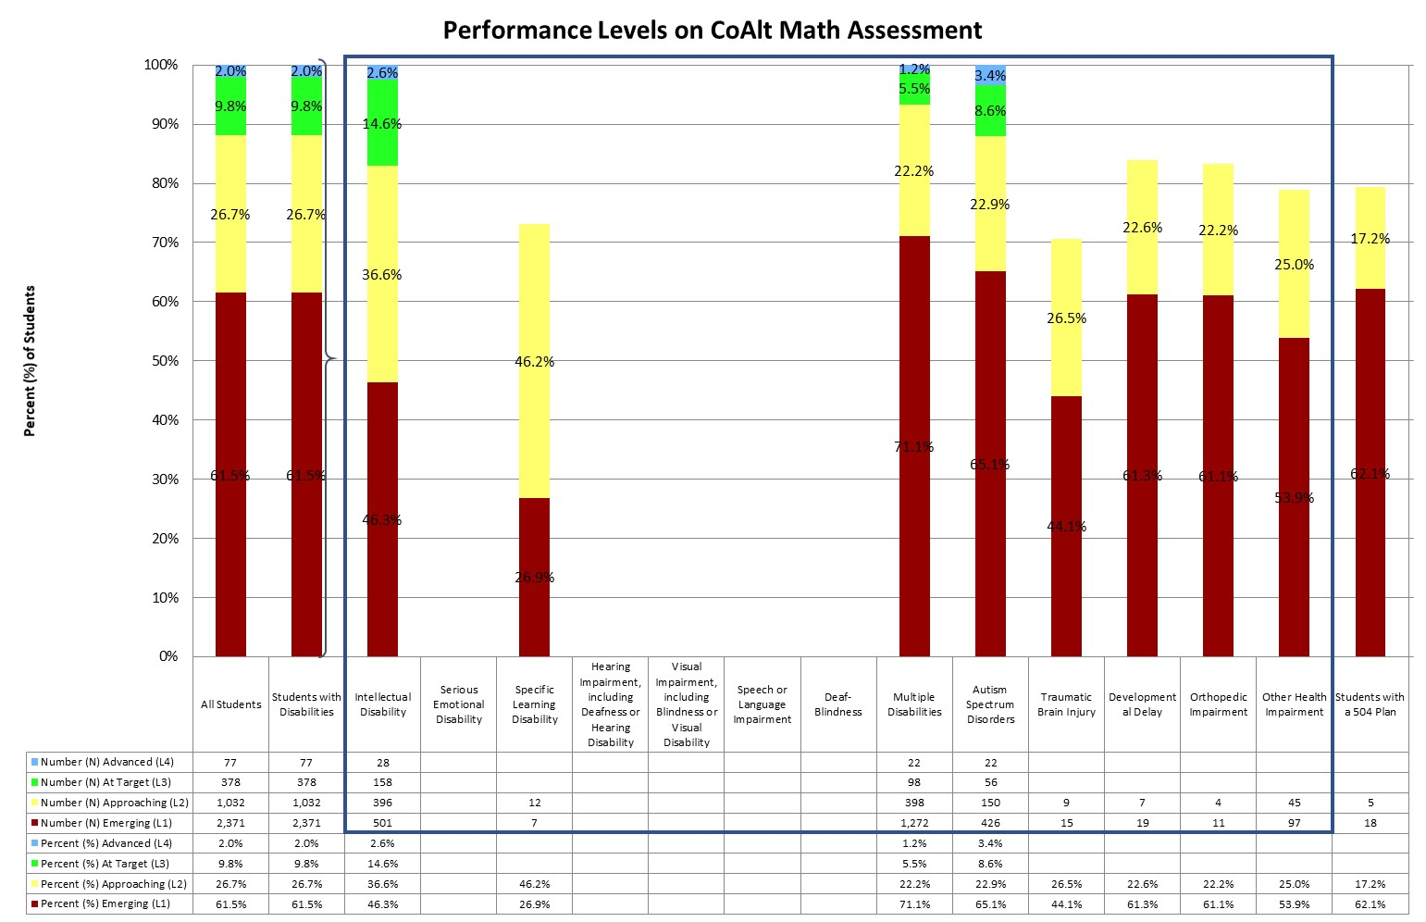
Performance on COALT Math Assessment (Grades 3-8 and 11)
Statewide, the majority of students with disabilities scored in level 1 (Emerging, 61.5%) and level 2 (Approaching Target, 26.7%).
Notes:
The CoAlt math assessment has four performance levels, ranging from Emerging (Level 1) to Advanced (Level 4).

Slide 34
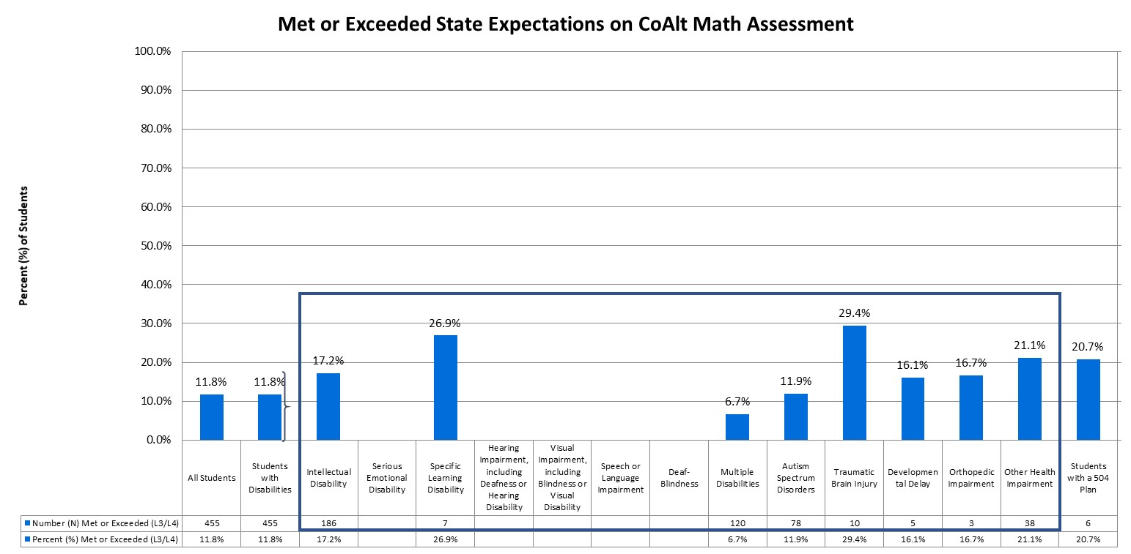
Students Meeting/Exceeding Expectations on COALT Math Assessment (Grades 3-8 and 11)
Statewide, approximately 11.8% of students in grades 3 through 8 and grade 11 met or exceeded state expectations, compared to 11.8% of students with disabilities.
Notes:
In addition to the percent of students scoring within each performance level, it is important to consider how many students are meeting state expectations, reaching level 3 or higher.

Slide 35
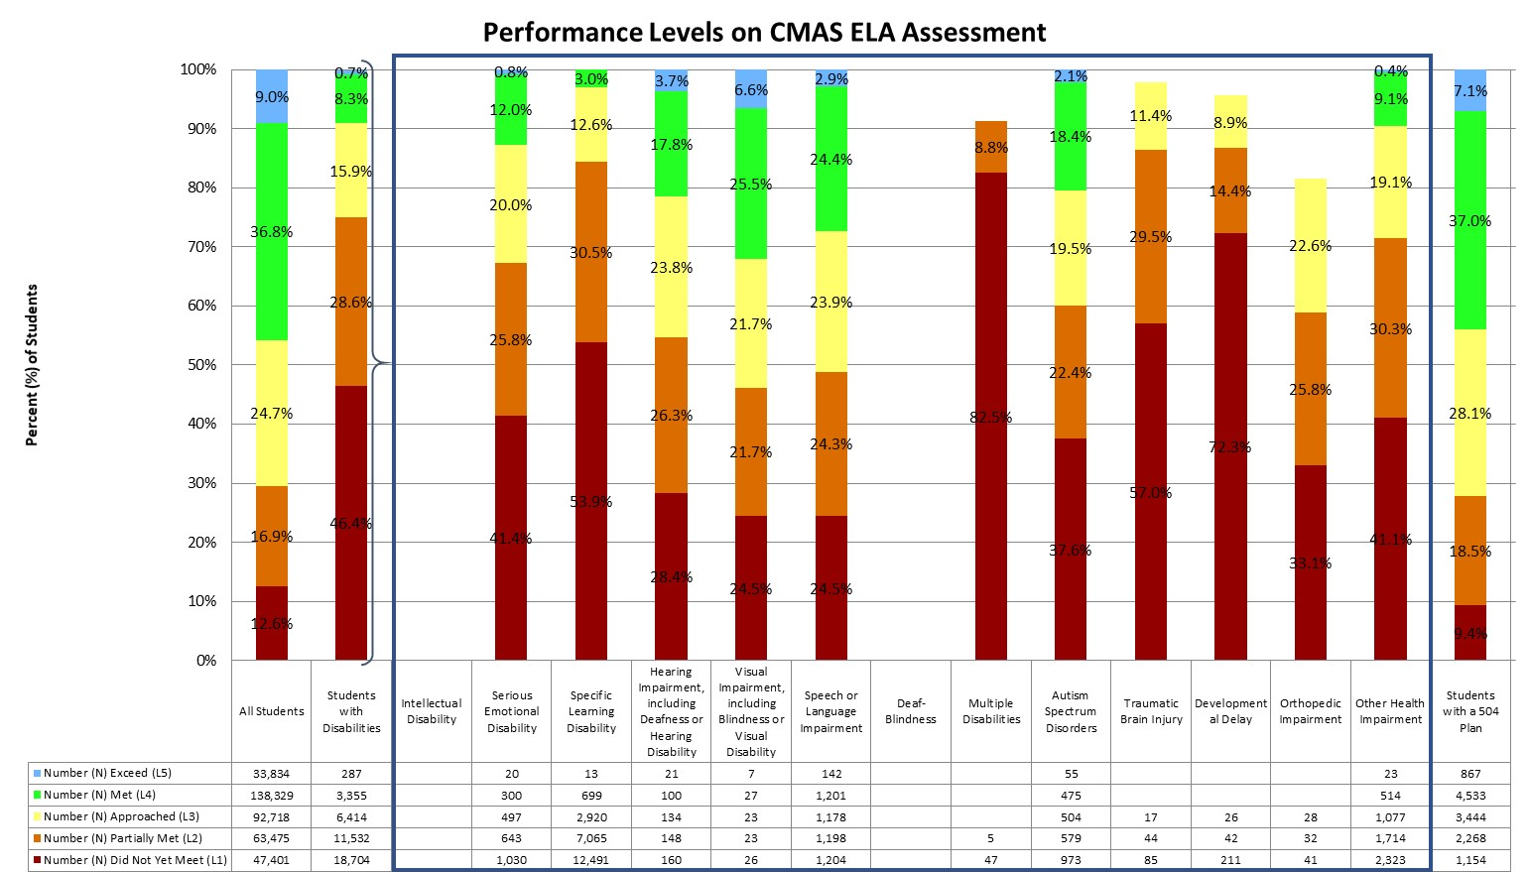
Performance on CMAS ELA Assessment (Grades 3-8)
Statewide, the majority of students scored in level 4 (Met Expectations, 36.8%) and level 3 (Approached Expectations, 24.7%). The majority of students with disabilities scored in level 1 (Did Not Yet Meet Expectations, 46.4%) and level 2 (Partially Met Expectations, 28.6%).
Notes:
Like the math assessment, the CMAS ELA assessment has five performance levels.

Slide 36
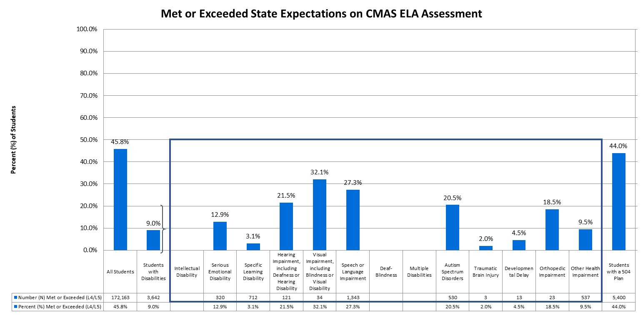
Students Meeting/Exceeding Expectations on CMAS ELA Assessment (Grades 3-8)
Statewide, approximately 45.8% of students in grades 3 through 8 met or exceeded state expectations, compared to 9.0% of students with disabilities.
Notes:
In addition to the percent of students scoring within each performance level, it is important to consider how many students are meeting state expectations, reaching level 4 or higher.

Slide 37
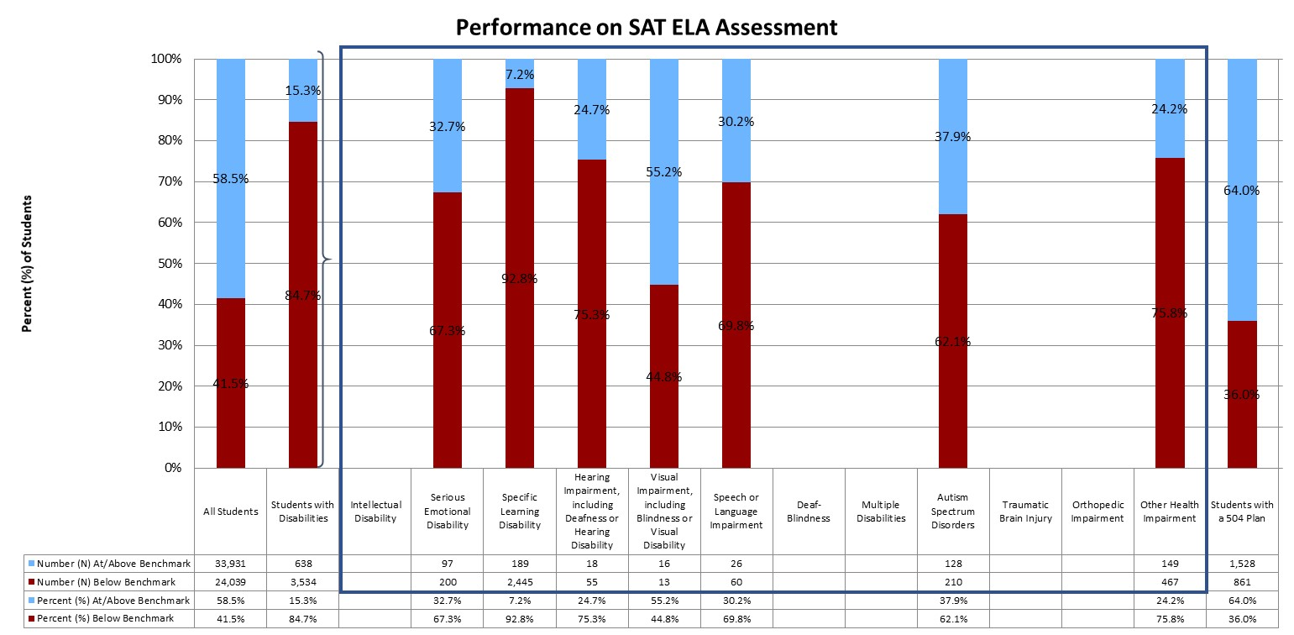
Performance on SAT ELA Assessment (Grade 11)
Statewide, 58.5% of students were at or above benchmark on the SAT math assessment, compared to 15.3% of students with disabilities.

Slide 38
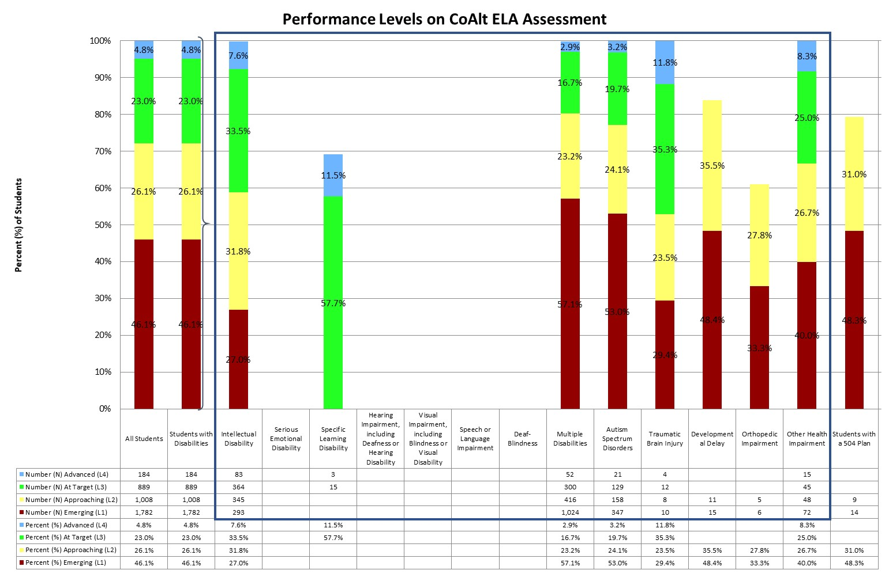
Performance on COALT ELA Assessment (Grades 3-8 and 11)
Statewide, the majority of students with disabilities scored in level 1 (Emerging, 46.1%) and level 2 (Approaching Target, 26.1%).
Notes:
The CoAlt ELA assessment has four performance levels, ranging from Emerging (Level 1) to Advanced (Level 4).

Slide 39
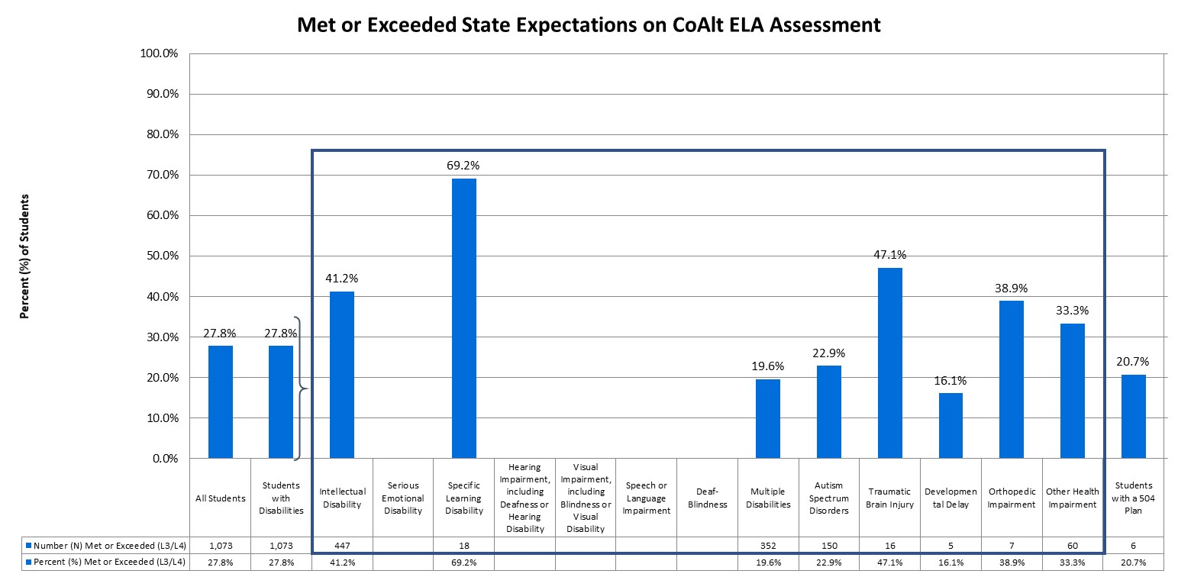
Students Meeting/Exceeding Expectations on COALT ELA Assessment (Grades 3-8 and 11)
Statewide, approximately 27.8% of students with disabilities in grades 3 through 8 and grade 11 met or exceeded state expectations.
Notes:
In addition to the percent of students scoring within each performance level, it is important to consider how many students are meeting state expectations, reaching level 3 or higher.

Slide 40
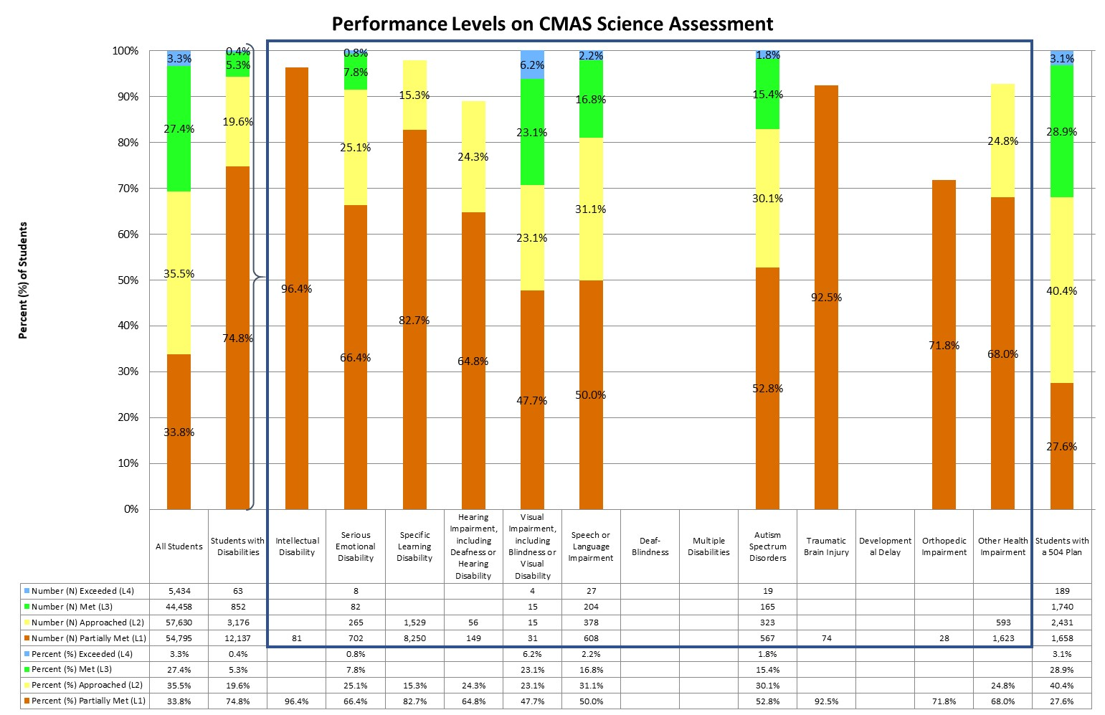
Performance on CMAS science Assessment (Grades 5, 8, and 11)
Statewide, the majority of students scored in level 2 (Approached Expectations, 35.5%) and level 1 (Partially Met Expectations, 33.8%). The majority of students with disabilities scored in level 1 (Partially Met Expectations, 74.8%) and level 2 (Approached Expectations, 19.6%).
Notes:
The CMAS science assessment has four performance levels, ranging from Partially Met Expectations (Level 1) to Exceeded Expectations (Level 4).

Slide 41
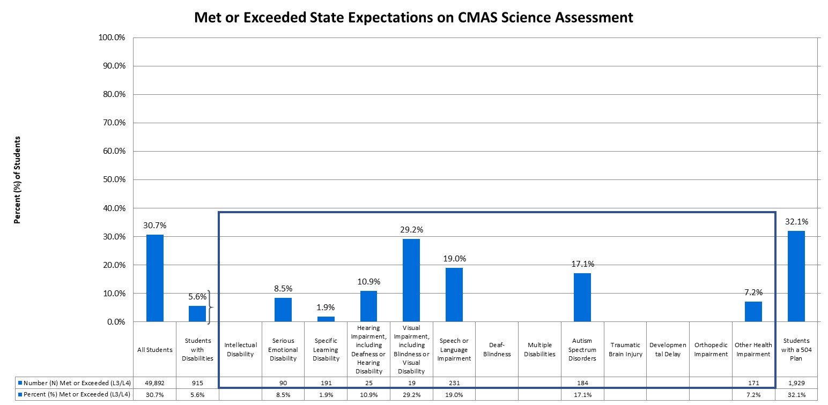
Students Meeting/Exceeding Expectations on CMAS science Assessment (Grades 5, 8, and 11)
Statewide, approximately 30.7% of students met or exceeded state expectations, compared to 5.6% of students with disabilities.
Notes:
In addition to the percent of students scoring within each performance level, it is important to consider how many students are meeting state expectations, reaching level 3 or higher.

Slide 42
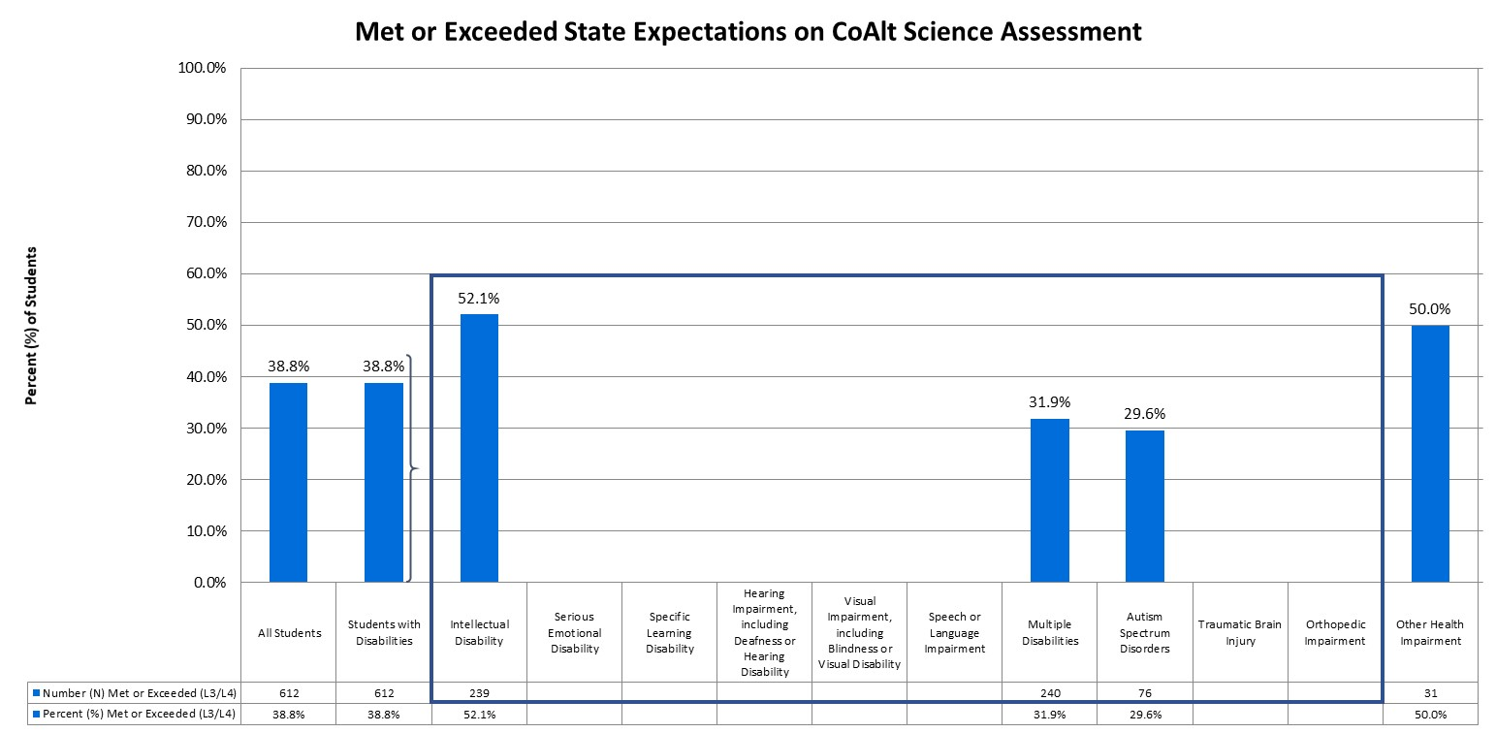
Students Meeting/Exceeding Expectations on COALT science Assessment (Grades 5, 8, and 11)
Statewide, approximately 38.8% of students with disabilities in grades 3 through 8 and grade 11 met or exceeded state expectations.
Notes:
In addition to the percent of students scoring within each performance level, it is important to consider how many students are meeting state expectations, reaching level 3 or higher.

Slide 43
Academic Growth

Slide 44
Academic Growth
Colorado calculates student growth for the CMAS and SAT math and English language arts assessments. A student growth percentile (SGP) defines how much relative growth a student made, compared to that student’s academic peers. The Colorado Growth Model essentially compares each student’s current achievement to students in the same grade throughout the state who had similar scores in past years. A student growth percentile of 60, for example, indicates a student grew as well as or better than 60% of his/her academic peers. The median is then calculated by taking the individual student growth percentiles of all the students in the group being analyzed, ranking them from lowest to highest, and identifying the middle score. Medians are more appropriate to use than averages when summarizing a collection of percentile scores. For more information regarding median growth percentiles (MGPs), please visit the Colorado Growth Model FAQs (www.cde.state.co.us/schoolview/generalgrowthmodelfaq#q22).

Slide 45
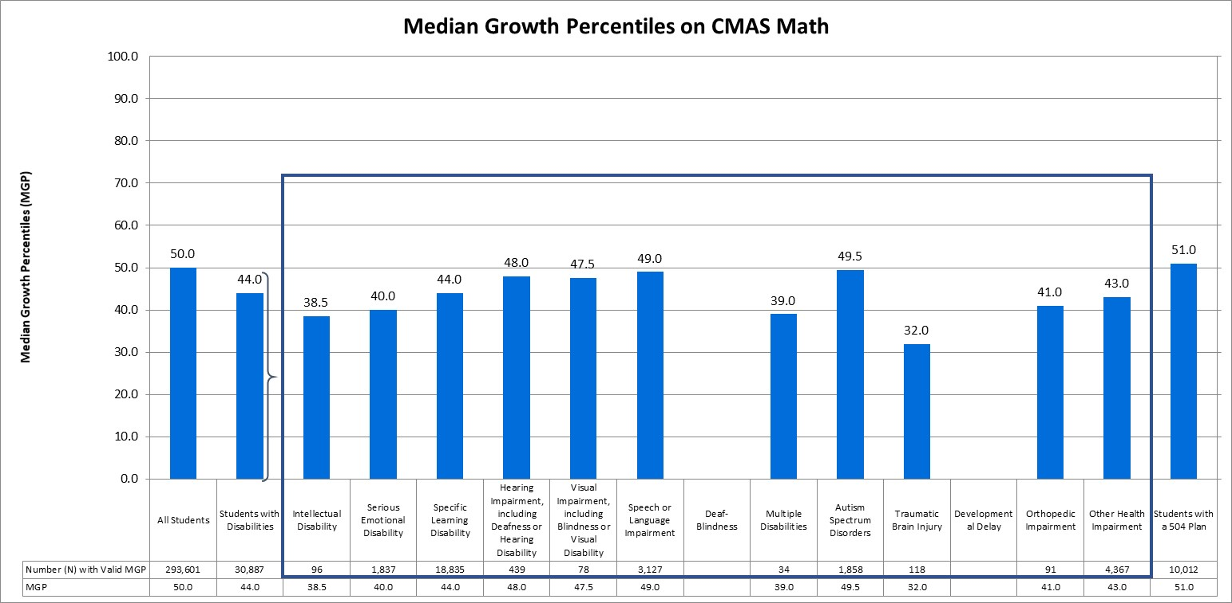
Median Growth Percentiles on CMAS math assessment
The median growth percentile (MGP) for all Colorado students (grades 4 through 8) on the CMAS math assessment was 50.0, compared to an MGP of 44.0 for students with disabilities.

Slide 46
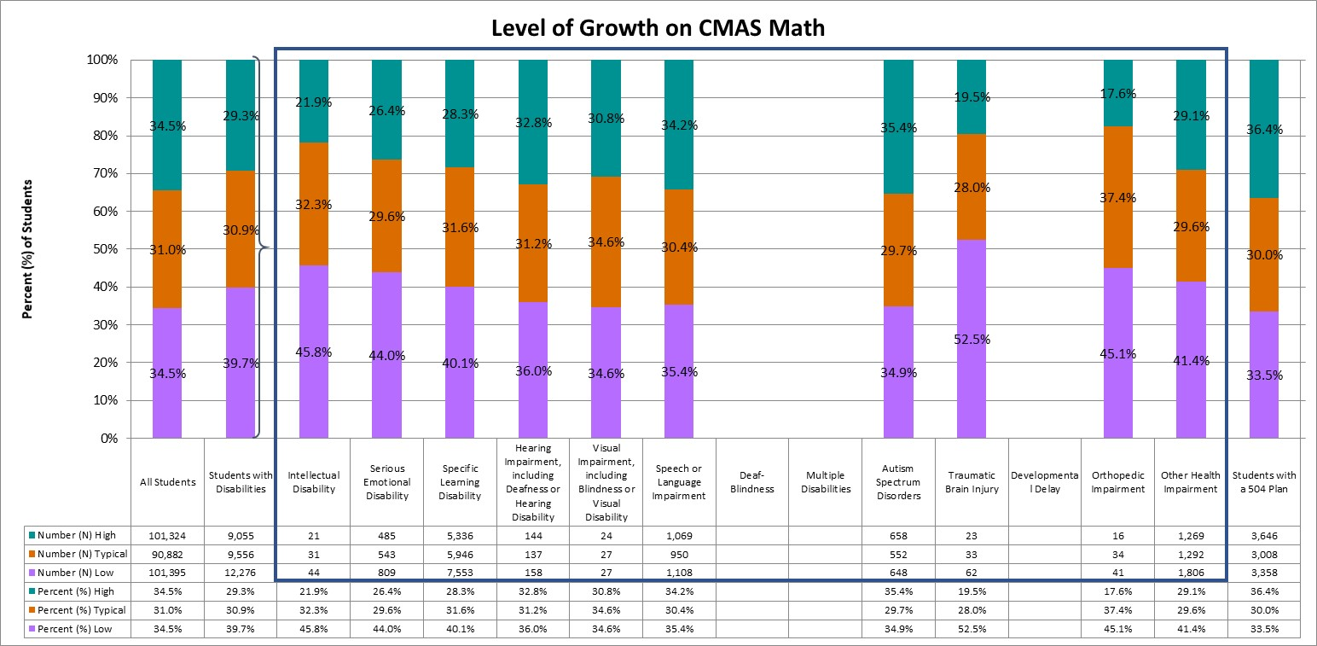
Levels of growth on CMAS math assessment
Statewide, on the CMAS math assessment, 34.5% of all students demonstrated high growth, 31.0% demonstrated typical growth, and 34.5% demonstrated low growth. In comparison, 29.3% of students with disabilities had high growth and 39.7% had low growth.
Notes:
A student growth percentile that falls below the 35th percentile reflects low growth, while a student growth percentile that falls above the 65th percentile reflects high growth (Colorado Growth Model FAQs [www.cde.state.co.us/schoolview/generalgrowthmodelfaq#q22]). Student growth percentiles between the 35th and 65th percentile represent typical growth.

Slide 47
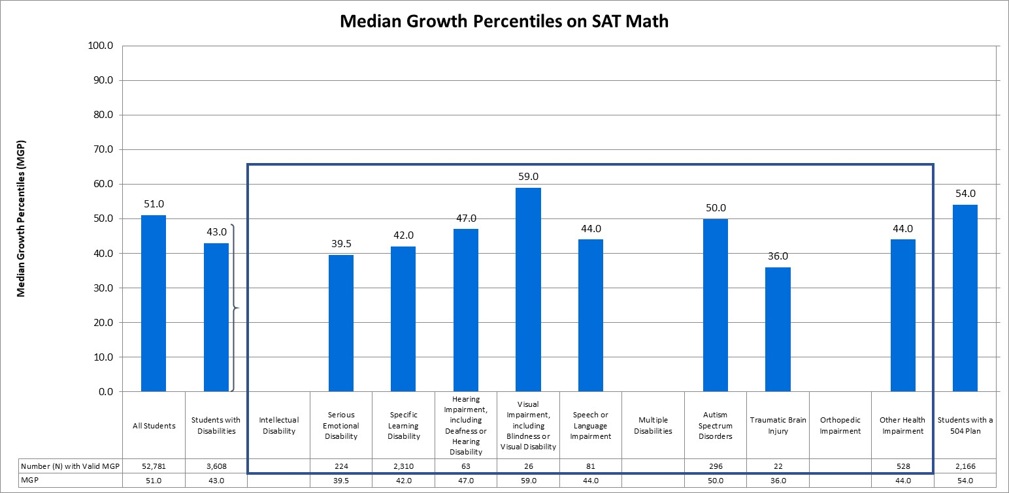
Median Growth Percentiles on SAT math assessment
The median growth percentile (MGP) for all Colorado students (grade 11) on the SAT math assessment was 51.0, compared to an MGP of 43.0 for students with disabilities.

Slide 48
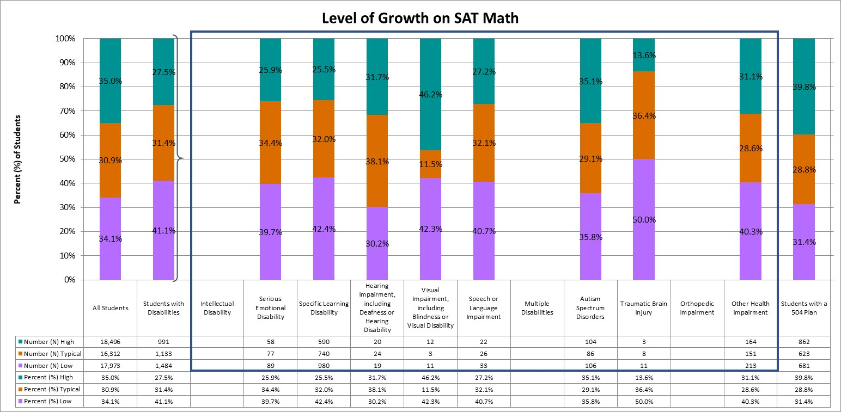
Levels of growth on SAT math assessment
Statewide, on the SAT math assessment, 35.0% of all students demonstrated high growth, 30.9% demonstrated typical growth, and 34.1% demonstrated low growth. In comparison, 27.5% of students with disabilities had high growth and 41.1% had low growth.
Notes:
A student growth percentile that falls below the 35th percentile reflects low growth, while a student growth percentile that falls above the 65th percentile reflects high growth (Colorado Growth Model FAQs [www.cde.state.co.us/schoolview/generalgrowthmodelfaq#q22]). Student growth percentiles between the 35th and 65th percentile represent typical growth.

Slide 49
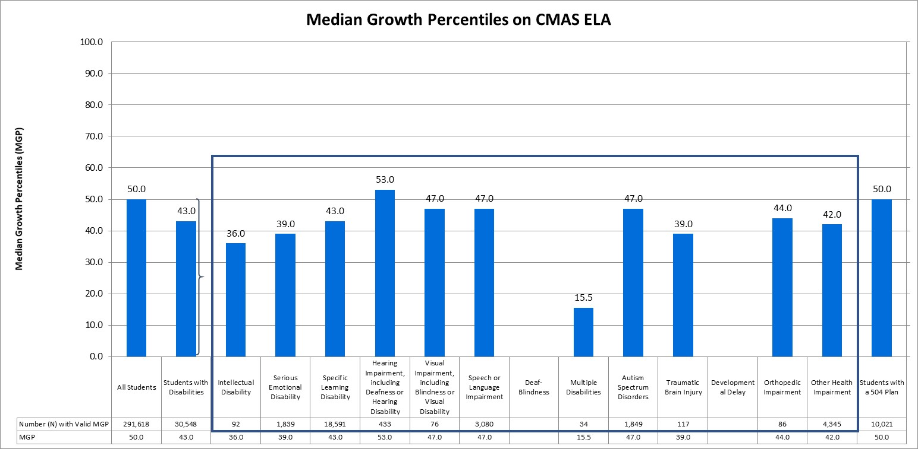
Median Growth Percentiles on CMAS ELA assessment
The median growth percentile (MGP) for all Colorado students (grades 4 through 8) on the CMAS ELA assessment was 50.0, compared to an MGP of 43.0 for students with disabilities.

Slide 50
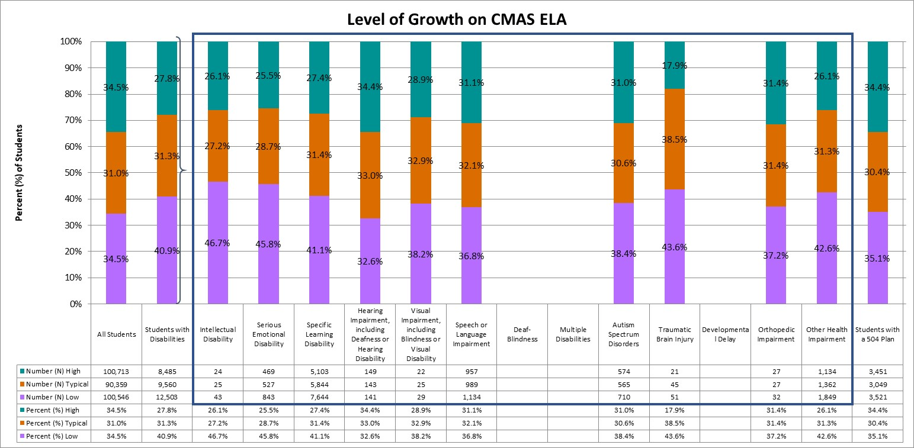
Levels of growth on CMAS ELA assessment
Statewide, on the CMAS ELA assessment, 34.5% of all students demonstrated high growth, 31.0% demonstrated typical growth, and 34.5% demonstrated low growth. In comparison, 27.8% of students with disabilities had high growth and 40.9% had low growth.
Notes:
A student growth percentile that falls below the 35th percentile reflects low growth, while a student growth percentile that falls above the 65th percentile reflects high growth (Colorado Growth Model FAQs [www.cde.state.co.us/schoolview/generalgrowthmodelfaq#q22]). Student growth percentiles between the 35th and 65th percentile represent typical growth.

Slide 51
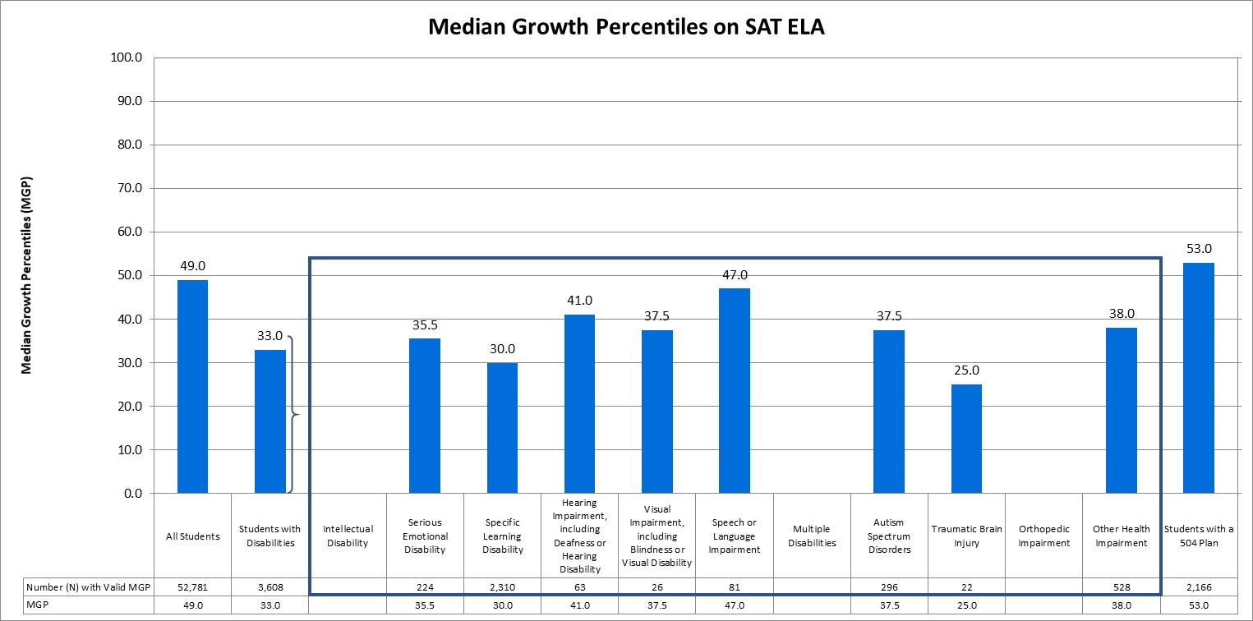
Median Growth Percentiles on SAT ELA assessment
The median growth percentile (MGP) for all Colorado students (grade 11) on the SAT ELA assessment was 49.0, compared to an MGP of 33.0 for students with disabilities.

Slide 52
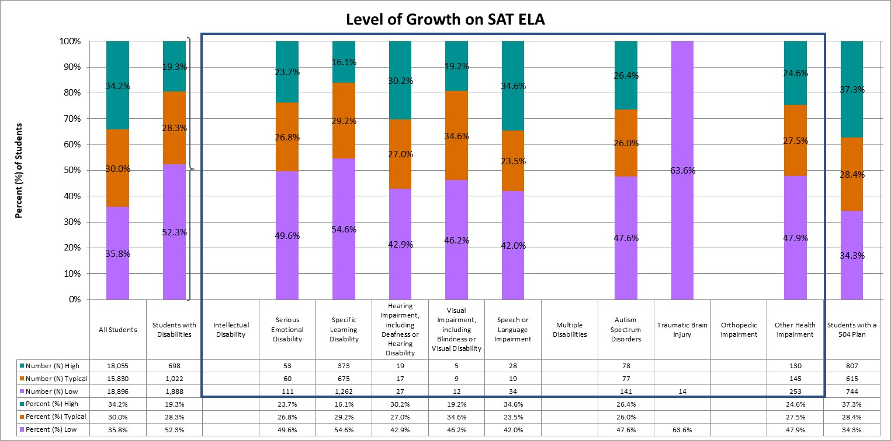
Levels of growth on SAT ELA assessment
Statewide, on the SAT ELA assessment, 34.2% of all students demonstrated high growth, 30.0% demonstrated typical growth, and 35.8% demonstrated low growth. In comparison, 19.3% of students with disabilities had high growth and 52.3% had low growth.
Notes:
A student growth percentile that falls below the 35th percentile reflects low growth, while a student growth percentile that falls above the 65th percentile reflects high growth (Colorado Growth Model FAQs [www.cde.state.co.us/schoolview/generalgrowthmodelfaq#q22]). Student growth percentiles between the 35th and 65th percentile represent typical growth.

Slide 53
Graduation Rates

Slide 54
Graduation Rates
ESSA requires states to present the four-year adjusted cohort graduation rates, but also gives states the discretion to include extended-year adjusted cohort graduation rates as well. Extended-year rates account for students who may require additional time to complete high school, such as those in five-year programs (e.g., ASCENT: Accelerating Students through Concurrent Enrollment, a state program that allows a limited number of students to attend a post-secondary education after completion of 12th grade, while still in the K-12 system), those who started below grade-level, and students whose coursework is interrupted for a semester or more. For more information on graduation rates, and for school- and district-level results, please visit the CDE Graduation Statistics webpage (www.cde.state.co.us/cdereval/gradratecurrent).

Slide 55
4-Year Graduation Rate
Student Group | Number (N) of Students in Graduation Base | Number (N) of Graduates | Graduation Rate (%)
All Students | 65,933 | 53,240 | 80.7%
Students with Disabilities | 6,625 | 3,883 | 58.6%
The 4-year adjusted cohort graduation rate for the class of 2018 shows that 80.7% of all students in the 2017-18 cohort graduated within four years, compared to 58.6% for students with disabilities.

Slide 56
7-Year Graduation Rate
Student Group | Number (N) of Students in Graduation Base | Number (N) of Graduates | Graduation Rate (%)
All Students | 61,111 | 52,314 | 85.6%
Students with Disabilities | 6,025 | 4,466 | 74.1%
The 7-year adjusted cohort graduation rate for the class of 2015 shows that 85.6% of all students in the 2014-15 cohort graduated within seven years, compared to 74.1% for students with disabilities.

Slide 57
School Quality or Student Success (SQSS)

Slide 58
School Quality or Student Success (SQSS) Indicator
Under ESSA, states are required to select at least one indicator of school quality or student success. For elementary and middle grade spans, Colorado is using mean scale scores on the 5th and 8th grade CMAS science assessment, as well as change in chronic absenteeism rates. For high school grade spans, Colorado is using mean scale scores on the 11th grade CMAS science assessment, as well as dropout rates. Mean scale scores on the CMAS science assessment and dropout rates are presented. Colorado is continuing to evaluate the data quality of chronic absenteeism rates; therefore, change in chronic absenteeism is not currently reported.

Slide 59
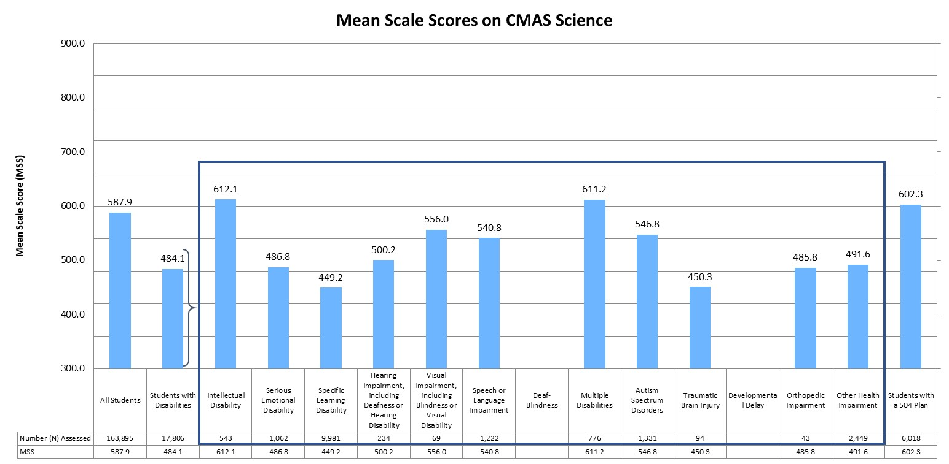
Mean Scale Scores (MSS) on CMAS science Assessment
The mean scale score (MSS) on the CMAS science assessment was 587.9 for all students in grades 5, 8, and 11, compared to an MSS of 484.1 for students with disabilities.

Slide 60
Dropout Rate
Student Group | Number (N) of Total Students | Number (N) of Dropouts | Dropout Rate (%)
All Students | 309,736 | 9,769 | 3.2%
Students with Disabilities | 30,729 | 1,199 | 3.9%
Statewide, 3.2% of all students discontinued their educational services without receiving credentials or providing adequate documentation of a transfer to another educational setting. In comparison, 3.9% of students with disabilities were considered dropouts.

Slide 61
Long-Term Goals

Slide 62
Long-Term Goals Under ESSA
Under ESSA, states are required to establish long-term goals and measures of interim progress. Colorado uses mean scale scores (MSS) on the ELA and math assessments to measure progress towards long-term goals in academic achievement.

Slide 63
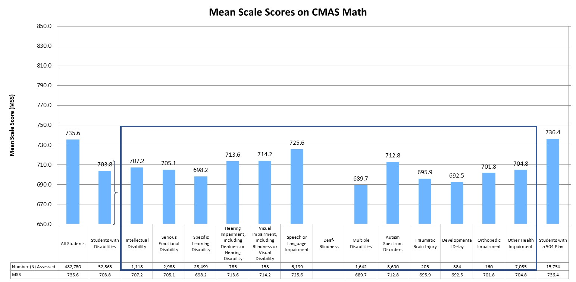
Mean Scale Scores (MSS) on CMAS math Assessment
The mean scale score (MSS) for all students in grades 3 through 8 was 735.6 on the CMAS math assessment. In comparison, the MSS for students with disabilities was 703.8.
Notes:
On the CMAS math and English language arts assessments, scale scores range from 650 to 850.

Slide 64
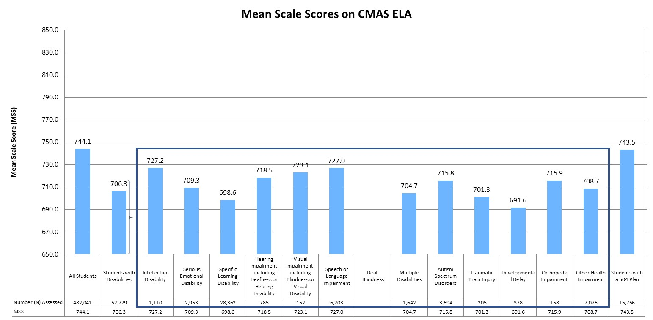
Mean Scale Scores (MSS) on CMAS ELA Assessment
The mean scale score (MSS) for all students in grades 3 through 8 was 744.1 on the CMAS ELA assessment. In comparison, the MSS for students with disabilities was 706.3.
Notes:
On the CMAS math and English language arts assessments, scale scores range from 650 to 850.

Slide 65
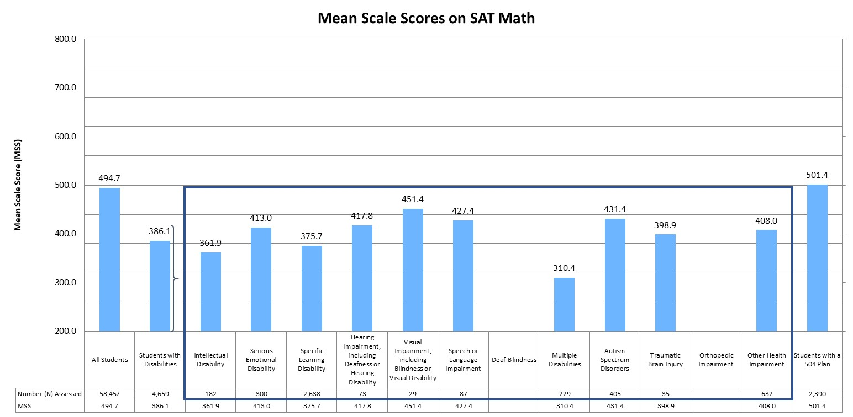
Mean Scale Scores (MSS) on SAT math Assessment
The mean scale score (MSS) for all students in grade 11 was 494.7 on the SAT math assessment. In comparison, the MSS for students with disabilities was 386.1.
Notes:
On the SAT math and evidence-based reading and writing assessments, scale scores range from 200 to 800.

Slide 66
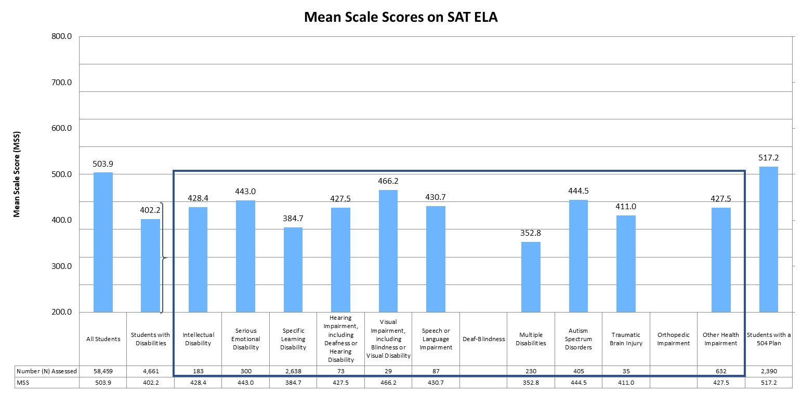
Mean Scale Scores (MSS) on SAT ELA Assessment
The mean scale score (MSS) for all students in grade 11 was 503.9 on the SAT ELA assessment. In comparison, the MSS for students with disabilities was 402.2.
Notes:
On the SAT math and evidence-based reading and writing assessments, scale scores range from 200 to 800.

Slide 67
Participation Rates

Slide 68
Participation Rates
Students in grades 3 through 8 were administered the Colorado Measures of Academic Success (CMAS) assessments in mathematics and English language arts, and students in grade 11 were administered the SAT. In addition, students in grades 5, 8, and 11 were administered the CMAS assessment in science. Students with significant cognitive disabilities were eligible to take the Colorado Alternate (CoAlt) assessments instead. For more information on the state assessments, and for school- and district-level results, please visit the CDE Assessment Unit webpage (www.cde.state.co.us/assessment).

Slide 69
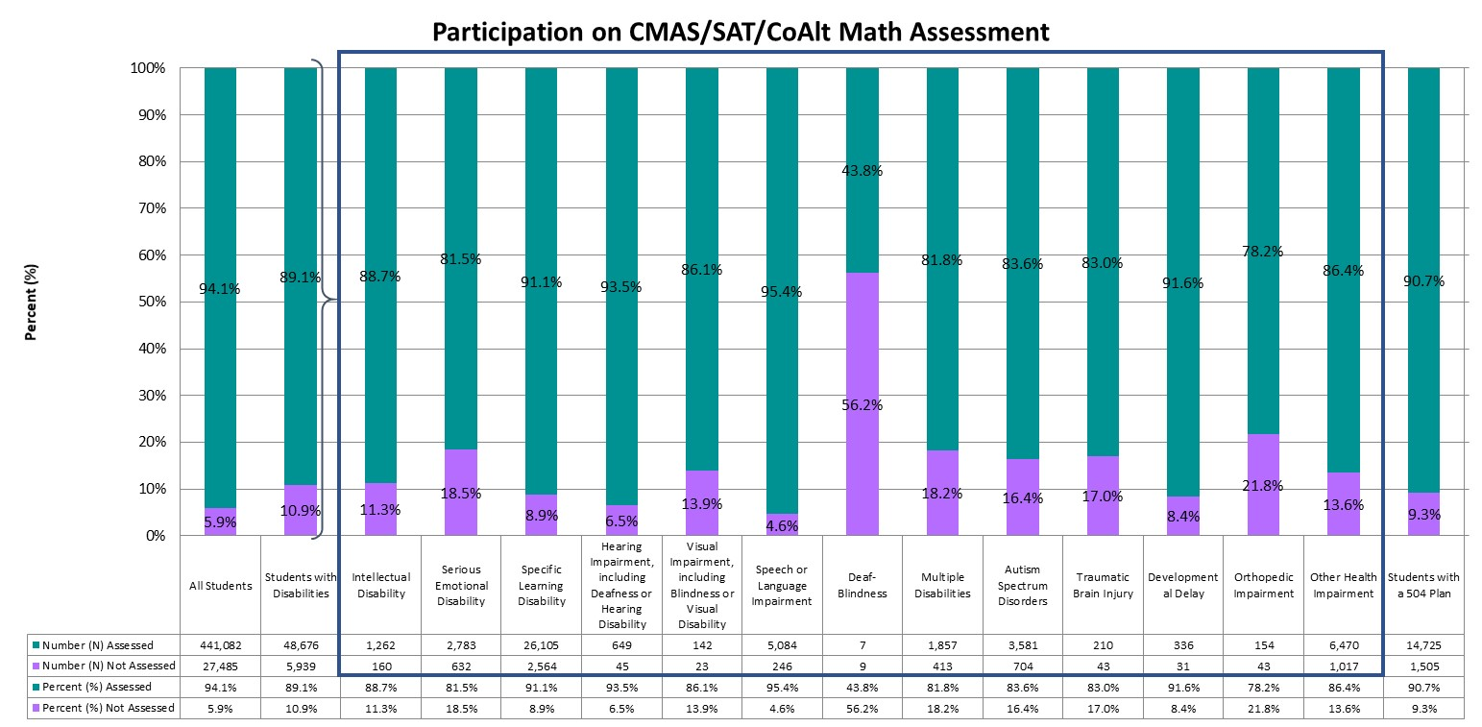
Participation on the Math Assessments (Grades 3-8 and 11)
Statewide, approximately 94.1% of students in grades 3 through 8 and grade 11 were assessed, compared to 89.1% of students with disabilities.
Notes:
Graph represents the total number assessed (taking either the CMAS, SAT, or CoAlt assessment).

Slide 70
Participation on the ELA Assessments (Grades 3-8 and 11)
Statewide, approximately 94.2% of students in grades 3 through 8 and grade 11 were assessed, compared to 89.0% of students with disabilities.
Notes:
Graph represents the total number assessed (taking either the CMAS, SAT, or CoAlt assessment).

Slide 71
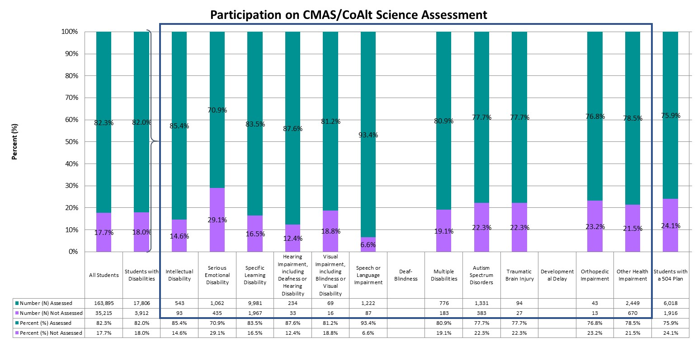
Participation on the science Assessments (Grades 5, 8, and 11)
Statewide, approximately 82.3% of students in grades 5, 8, and 11 were assessed, compared to 82.0% of students with disabilities.
Notes:
Graph represents the total number assessed (taking either the CMAS, SAT, or CoAlt assessment).

Slide 72
National Assessment of Educational Progress (NAEP)

Slide 73
NAEP
Students in grades 4 and 8 participate in reading and mathematics assessments of the National Assessment of Educational Progress (NAEP), which are administered at least once every two years. Results from 2018-19 are included, along with the national average.

Slide 74
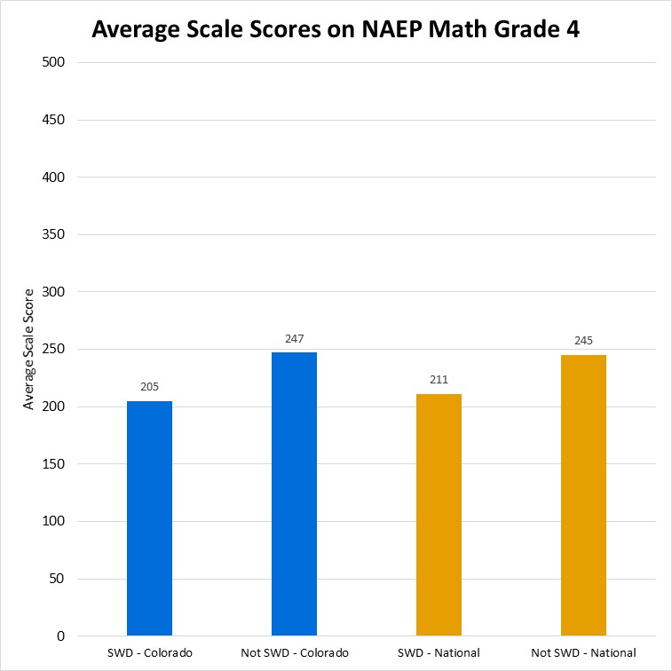
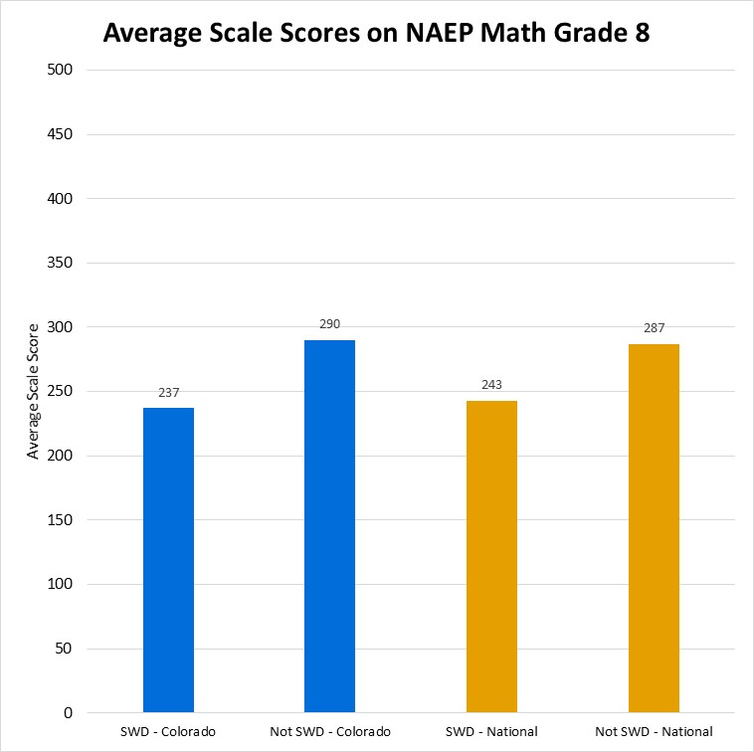
Average scale scores on NAEP Math Assessment
In 4th grade, Colorado students with disabilities had an average scale score of 205, compared to the national average for students with disabilities of 211. Students not identified as students with disabilities receied an average scale score of 247 in Colorado and 245 nationally. In 8th grade, Colorado students with disabilities had an average scale score of 237, compared to the national average for students with disabilities of 243. Students not identified as students with disabilities receied an average scale score of 290 in Colorado and 287 nationally.

Slide 75
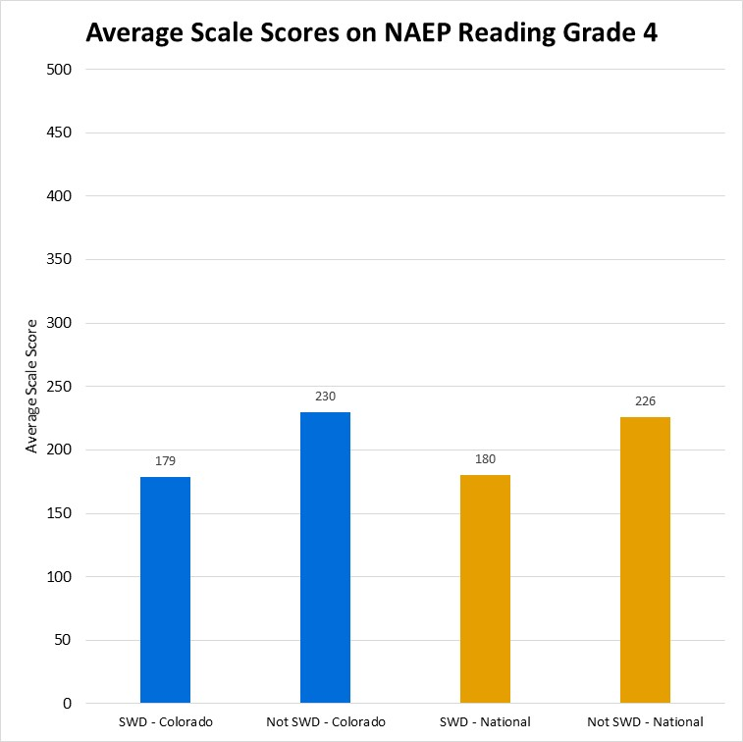
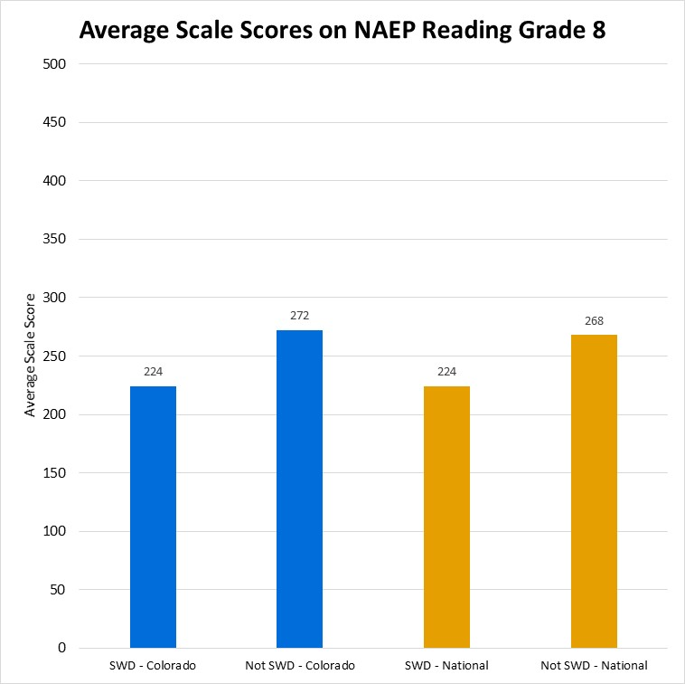
Average scale scores on NAEP Reading Assessment
In 4th grade, Colorado students with disabilities had an average scale score of 179, compared to the national average for students with disabilities of 180. Students not identified as students with disabilities receied an average scale score of 230 in Colorado and 226 nationally. In 8th grade, Colorado students with disabilities had an average scale score of 224, compared to the national average for students with disabilities of 224. Students not identified as students with disabilities receied an average scale score of 272 in Colorado and 268 nationally.

