Slide 1
Chapter 4: English Learners
May 2020

Slide 2
Introduction
English learners (ELs) are those students who are linguistically diverse and identified as having a level of English language proficiency that requires language support to achieve standards in grade-level content in English (Colorado Revised Statutes under the English Language Proficiency Act 22-24-103). Although federal reporting for English learners (see Chapter 2 for more information) typically refers to students who are non-English proficient (NEP) and limited English proficient (LEP), Colorado also includes students monitored for two years following redesignation as fluent English proficient (FEP M1/M2) when analyzing the performance of English learners. Data is also disaggregated separately, when possible, by each of those language proficiency levels (NEP, LEP, and FEP M1/M2). Colorado also disaggregates student data by former English learners (FELL) and students who exit from the ELD program after demonstrating English language proficiency and grade-level proficiency in reading, writing, and other content areas (FEP Exited) when possible.
For comparison purposes, tables and figures include data on all Colorado students, as well as data for students not identified as English learners (those not identified as NEP, LEP, FEP, or FELL).

Slide 3
Characteristics

Slide 4
Student October
Information in this section reflects student demographics at the time of the Student October Snapshot only. The Colorado Department of Education (CDE) annually collects student demographic data from districts. When districts submit the data to CDE in October of each year, it is referred to as the Student October Snapshot. The “purpose of the Student October Snapshot is to determine funding for districts and schools by taking a count of students in attendance on the Pupil Enrollment Date” (Student October Data Elements and Definitions [http://www.cde.state.co.us/datapipeline/studentoctoberdata]). Additional information is available on the CDE Pupil Membership webpage (www.cde.state.co.us/cdereval/pupilcurrent). To protect student privacy, Colorado suppresses any cells that do not meet minimum number requirements. "N/A" indicates a cell contains fewer than 16 students, or that complementary suppression rules were applied.

Slide 5
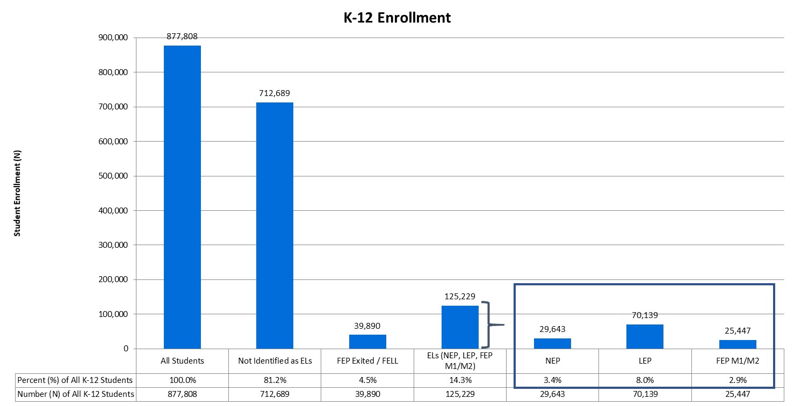
K-12 Enrollment
During the 2018-19 school year, there were 125,229 English learners in Kindergarten through 12th grade, representing 14.3% of the total K-12 population (Number or N = 877,808).

Slide 6
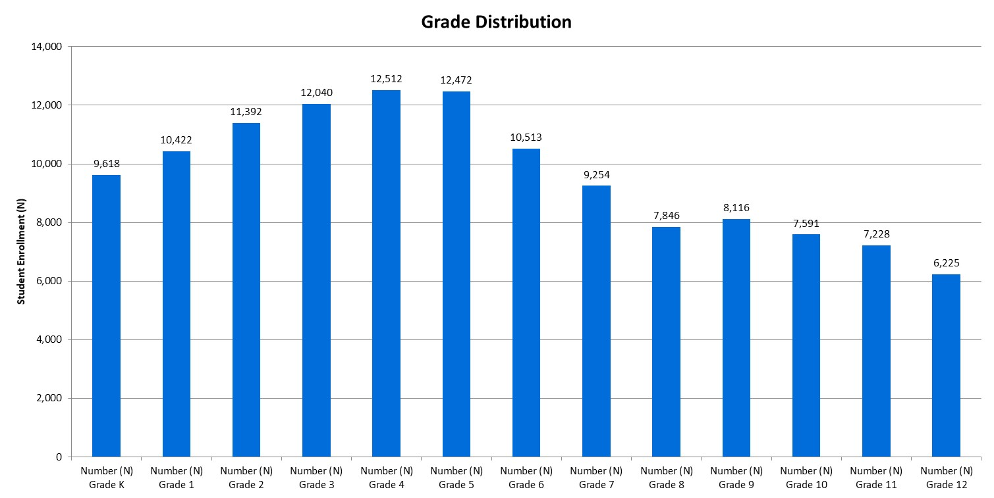
Grade Distribution
The distribution of English learners was highest at the elementary-level (grades K-5), with the highest number of English learners in grade 4 (N = 12,512). The distribution of English learners was lowest at the high-level (grades 9-12), with the lowest number of English learners in grade 12 (N = 6,225).

Slide 7
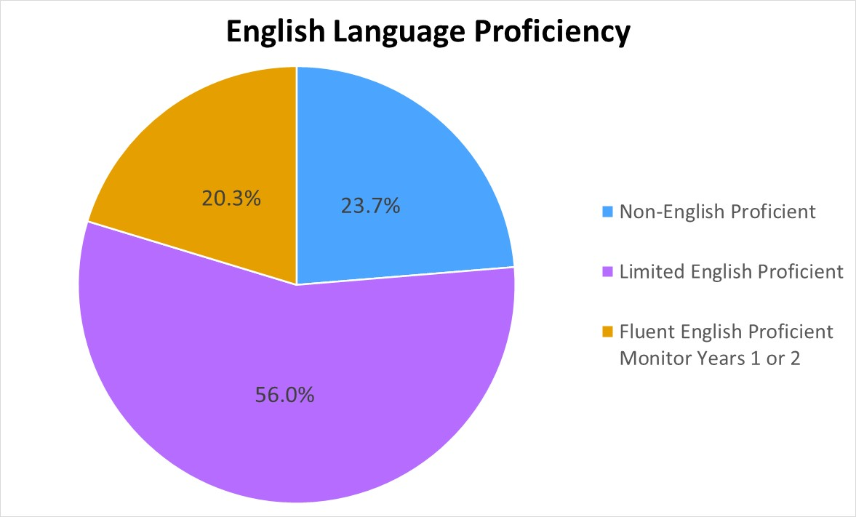
English Language Proficiency
Of the 125,229 English learners in K-12, 23.7% were non-English proficient, 56.0% were limited English proficient, and 20.3% were fluent English proficient in monitor years 1 or 2.

Slide 8
Top 20 Language Backgrounds
Language | Number (N) ELs (NEP, LEP, FEP M1/M2) | Percent (%) ELs (NEP, LEP, FEP M1/M2)
Spanish | 102,796 | 82.1%
Arabic | 2,326 | 1.9%
Vietnamese | 1,944 | 1.6%
Chinese, Mandarin | 1,349 | 1.1%
Russian | 1,306 | 1.0%
Amharic | 1,261 | 1.0%
Somali | 1,117 | 0.9%
Nepali | 858 | 0.7%
French | 665 | 0.5%
Korean | 632 | 0.5%
Burmese | 503 | 0.4%
Hmong | 411 | 0.3%
Tigrigna | 399 | 0.3%
Swahili | 398 | 0.3%
Telugu | 353 | 0.3%
Hindi | 337 | 0.3%
Tagalog | 310 | 0.2%
Karen, Pa'o | 308 | 0.2%
Chinese, Yue | 301 | 0.2%
Portuguese | 283 | 0.2%
Most English learners (82.1%) reported their language background as Spanish, followed by Arabic (1.9%), Vietnamese (1.6%), and Chinese, Mandarin (1.1%).

Slide 9
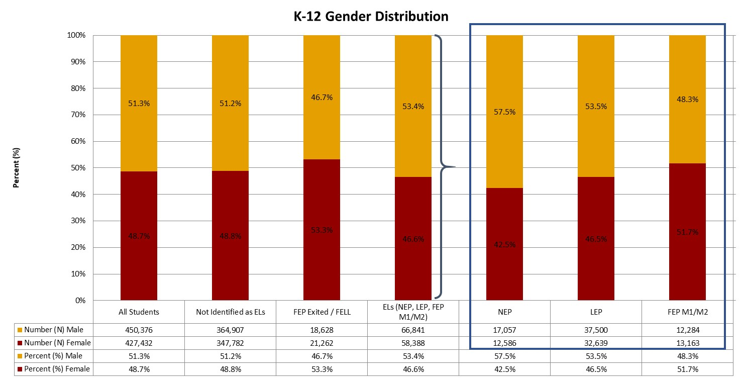
Gender
Statewide, the gender distribution of all K-12 students was 51.3% male students and 48.7% female students. The distribution for English learners was 53.4% male students.

Slide 10
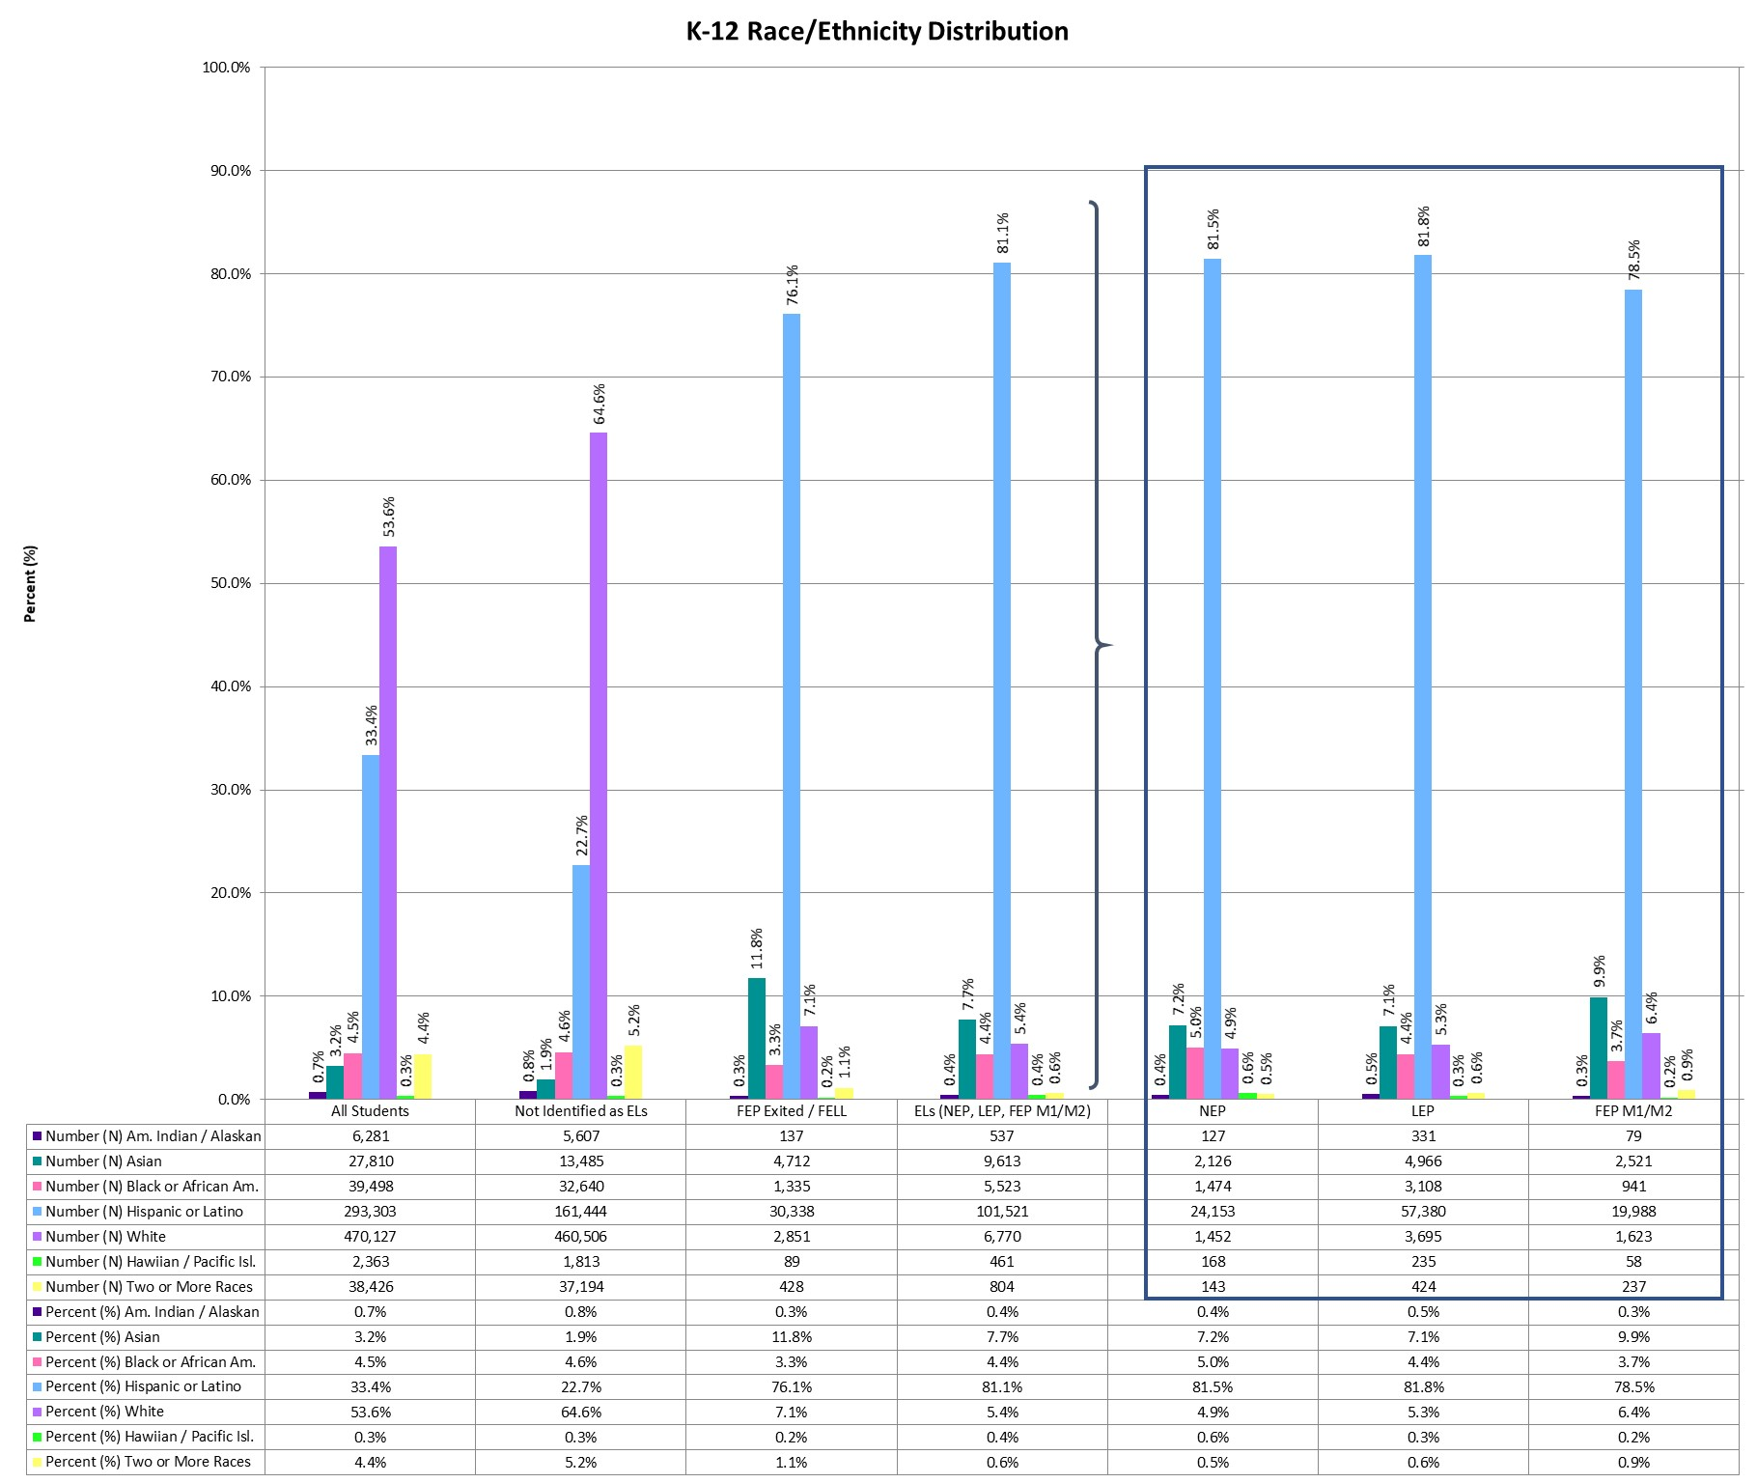
Race/Ethnicity
During the 2018-19 school year, 53.6% of Colorado students were White and 33.4% were Hispanic or Latino. Of English learners, 81.1% were Hispanic or Latino and 7.7% were Asian.
Notes:
To align with federal reporting requirements, changes were made to the collection of racial and ethnic data beginning with the 2010-11 school year. Under this system, identification is based on the responses to a two-part question. The first part determines whether a student is of Hispanic/Latino origin, while the second part determines which of the following groups define a student’s race: American Indian or Alaska Native, Asian, black or African American, white, or Native Hawaiian or other Pacific Islander. Students who identify as Hispanic or Latino are counted in the Hispanic category regardless of the race(s) indicated. The remaining students are categorized based on the race(s) indicated, with students who select more than one race counted in the two or more races category.

Slide 11
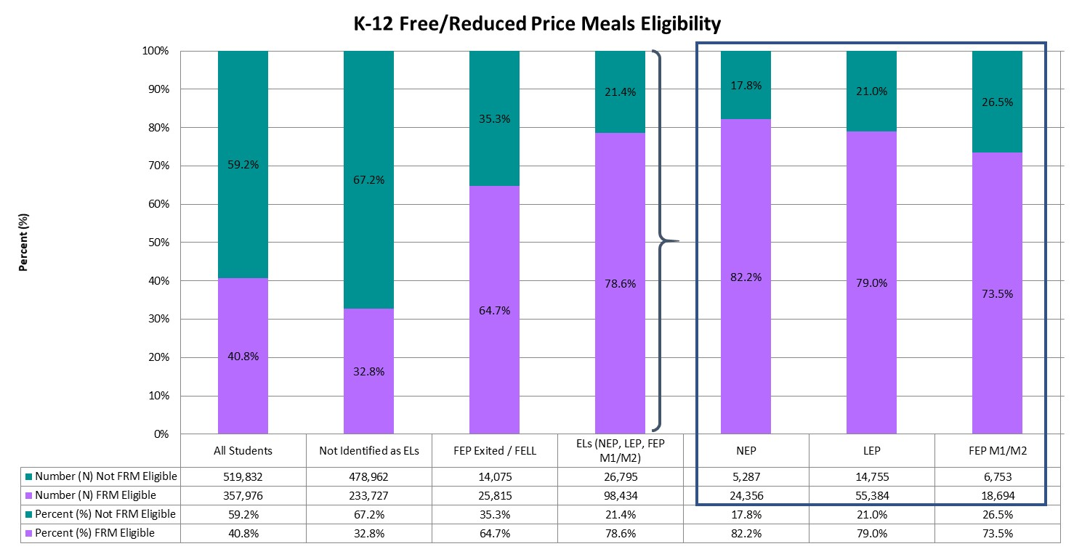
Free/Reduced Meals Eligibility
Across Colorado, 40.8% of all Colorado students were eligible for free/reduced meals (FRM) and 78.6% of English learners were eligible for FRM.
Notes:
Students may be eligible to receive free or reduced price meals (FRM) based on household income eligibility requirements (Eligibility Manual for School Meals [fns-prod.azureedge.net/sites/default/files/cn/SP36_CACFP15_SFSP11-2017a1.pdf]). Students from households with an income at or below 130 percent of the poverty income threshold were eligible for free meals, and students from households with an income between 130 percent and 185 percent of the poverty income threshold were eligible for reduced meals. Students from households participating in the Supplemental Nutrition Assistance Program (SNAP), Food Distribution Program on Indian Reservations (FDPIR), or Temporary Assistance for Needy Families (TANF) were also eligible for free lunch. In addition, children may also be eligible if they are designated as homeless, migrant, runaway, or a foster child. Given these requirements, free or reduced price meal eligibility is used as a proxy to determine students who are economically disadvantaged. For more information, visit the CDE Office of School Nutrition’s webpage on Free and Reduced Price Processes (www.cde.state.co.us/nutrition/nutrifreeandreducedprocesses).

Slide 12
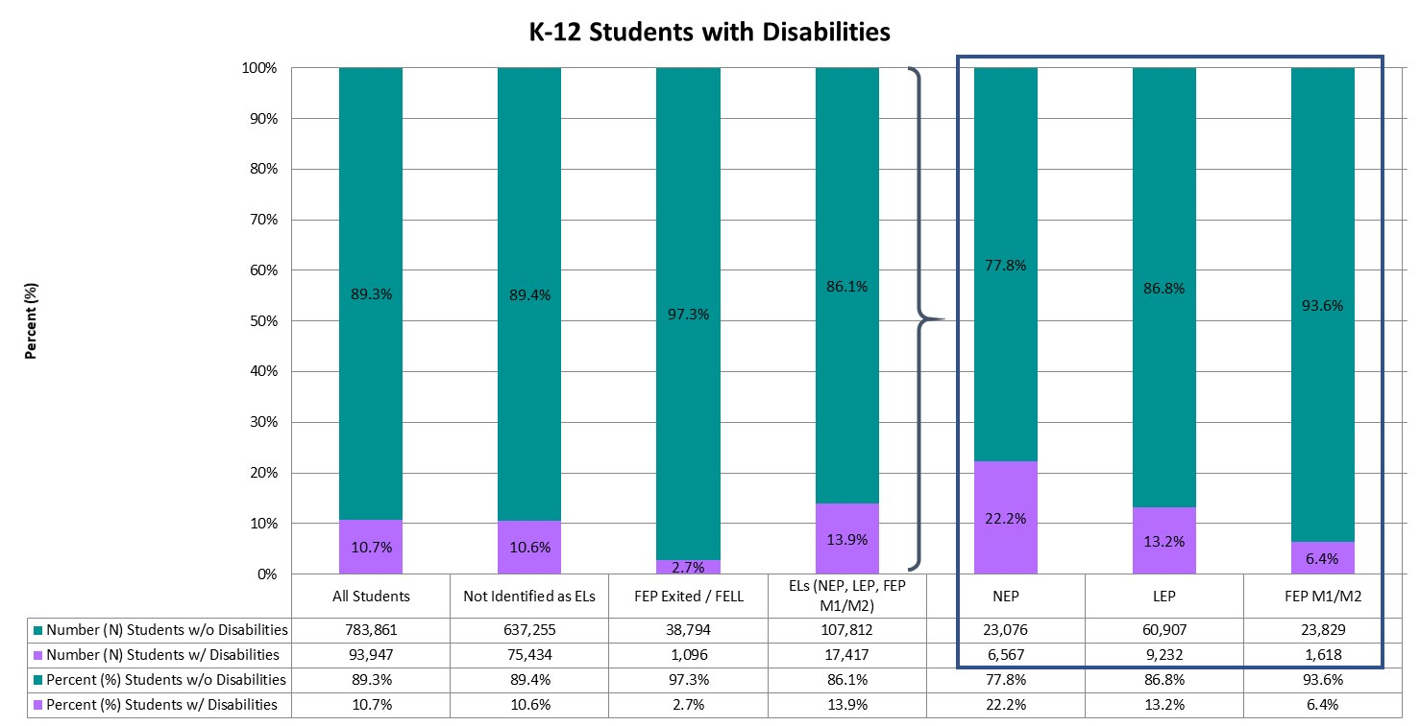
Students with Disabilities
Approximately 10.7% of all K-12 students were identified as students with disabilities (those with an Individualized Education Plan or IEP). In comparison, 13.9% of English learners were students with disabilities.
Notes:
Per federal reporting requirements, students with disabilities are defined as those “children having intellectual disabilities, hearing impairment (including deafness), speech or language impairment, visual impairment (including blindness), serious emotional disturbance, orthopedic impairment, autism, traumatic brain injury, developmental delay, other health impairment, a specific learning disability, deaf-blindness, or multiple disabilities, and who, as a result, receive special education and related services under the Individual with Disabilities Education Act (IDEA) according to an Individualized Education Program (IEP), Individual Family Service Plan (IFSP), or services plan” (Section 602(3) of IDEA). For additional information, visit the CDE Office of Special Education webpage (www.cde.state.co.us/cdesped), or refer to Chapter 6.

Slide 13
Disability Category
Disability Category | All Students | Not Identified as ELs | FEP Exited / FELL | ELs (NEP, LEP, FEP M1/M2) | NEP | LEP | FEP M1/M2
Intellectual Disability | 2.6% | 2.5% | 3.0% | 3.3% | 6.6% | 0.9% | 3.5%
Serious Emotional Disability | 5.5% | 6.4% | 4.9% | 1.9% | 1.6% | 1.8% | 3.6%
Specific Learning Disability | 42.6% | 39.7% | 54.9% | 54.2% | 35.6% | 66.2% | 61.5%
Hearing Impairment, Incl. Deafness | 1.3% | 1.3% | 4.5% | 1.4% | 1.3% | 1.4% | 1.4%
Visual Impairment, Incl. Blindness | 0.3% | 0.3% | * | * | * | * | *
Speech / Language Disability | 15.4% | 15.5% | 7.4% | 15.3% | 16.4% | 15.2% | 11.6%
Deaf-Blindness | 0.0% | * | * | * | * | * | *
Multiple Disabilities | 4.3% | 4.2% | 6.7% | 4.2% | 8.7% | 0.7% | 5.5%
Autism Spectrum Disorders | 8.1% | 9.0% | 5.8% | 4.4% | 6.9% | 2.6% | 4.6%
Traumatic Brain Injury | 0.5% | * | * | 0.5% | * | * | *
Developmental Delay | 7.0% | * | * | 8.1% | * | * | *
Infant/Toddler with a Disability | 0.0% | * | * | * | * | * | *
Orthopedic Impairment | 0.4% | * | * | 0.4% | * | * | *
Other Health Impairment | 11.9% | 13.3% | 10.3% | 6.0% | 5.8% | 6.1% | 6.2%
Statewide, of the K-12 students identified with a disability, 42.6% were identified as having a Specific Learning Disability, followed by 15.4% of students identified as having a Speech / Language Disability. In comparison, 54.2% of English learners with a disability were identified as having a Specific Learning Disability, followed by 15.3% identified as having a Speech / Language Disability.
Notes:
For definitions and additional information regarding each disability category, please visit the CDE Office of Special Education’s webpage on Disabilities Categories (www.cde.state.co.us/cdesped/sd-main).

Slide 14
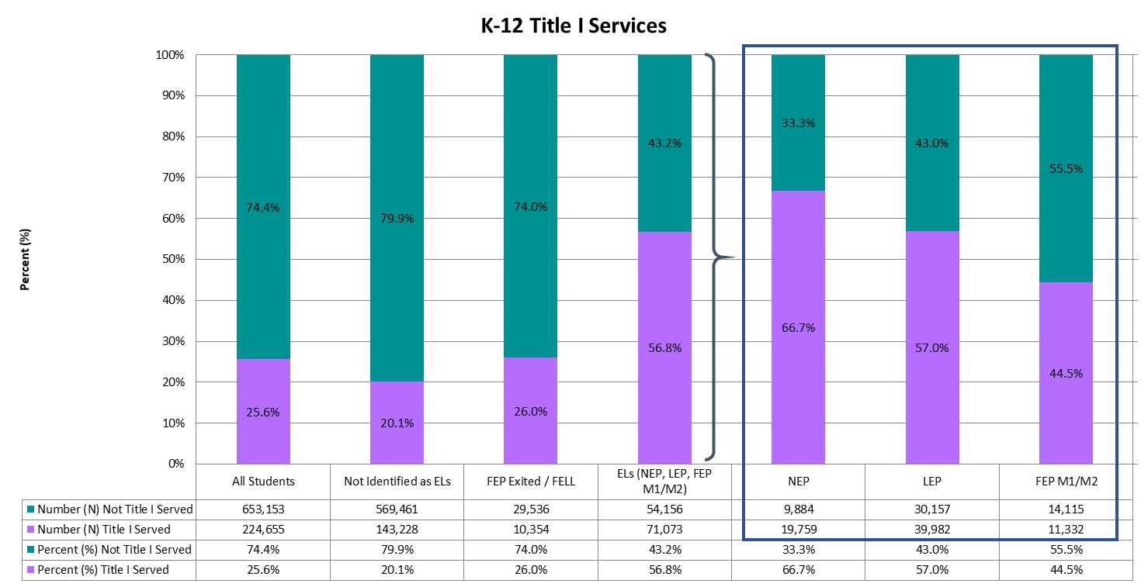
Title I Services
Over half (56.8%) of all English learners were identified as receiving Title I services, compared to 25.6% of all K-12 students in the state.
Notes:
The purpose of Title I, Part A is to provide resources to schools and districts to “ensure that all children have a fair, equitable, and high-quality education, and to close educational achievement gaps” (Every Student Succeeds Act). For additional information regarding Title I services, visit the CDE Federal Programs Unit’s webpage on Title I, Part A (www.cde.state.co.us/fedprograms/ti/a), or refer to Chapter 5.

Slide 15
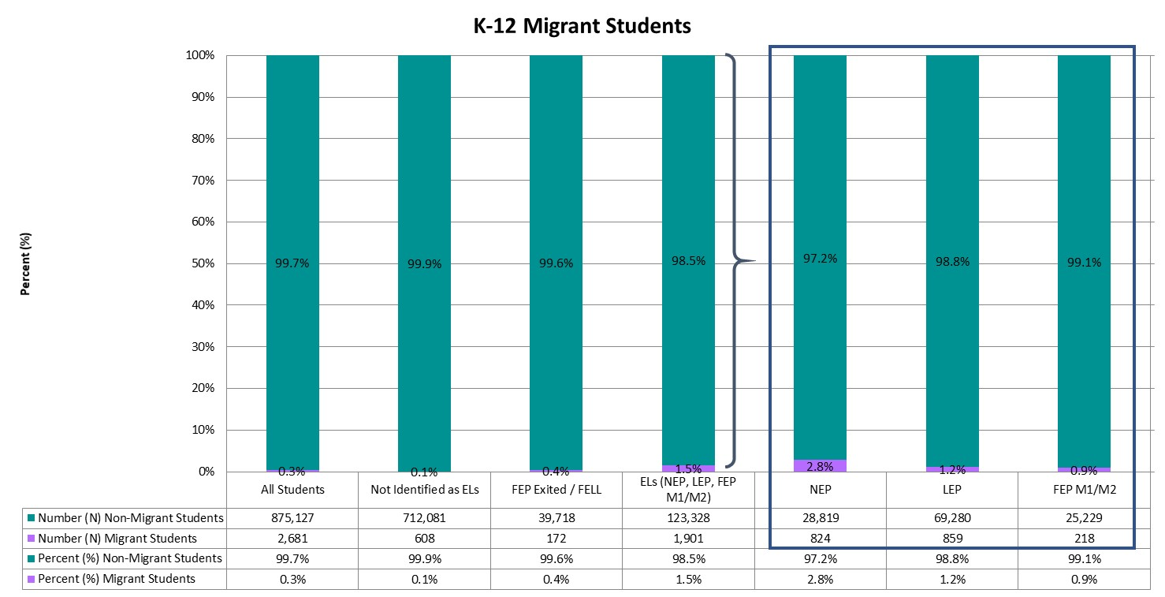
Migrant Students
Statewide, less than one percent (0.3%) of K-12 students were identified as migrant students. The percent of English learners identified as migrant students was 1.5%.
Notes:
Students identified as migrant students are children of migratory agricultural workers and others who are determined eligible on Certificates of Eligibility (COEs). Supplementary services are provided to these students to help reduce the educational disruption and other problems that result from repeated moves, and to ensure that migratory children are provided with appropriate educational services that address their special needs. For additional information regarding the education of migratory children, please visit the CDE Office of Migrant Education’s webpage on the Migrant Education Program (www.cde.state.co.us/migrant).

Slide 16
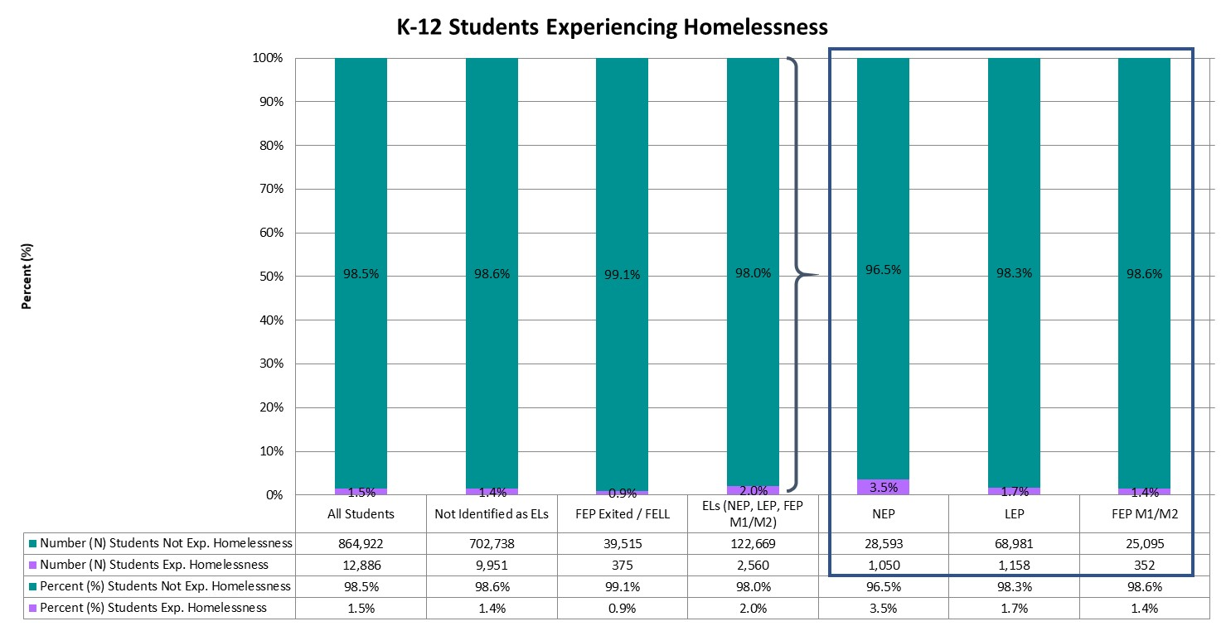
Students Experiencing Homelessness
Across the state, 1.5% of all K-12 students were experiencing homelessness based on the Student October Snapshot. Similarly, 2.0% of English learners were experiencing homelessness.
Notes:
Any displaced child or youth who is living in a shelter, motel, inadequate trailer or house, is staying temporarily with relatives or friends due to economic hardship or loss of housing, or is living in any other homeless situation has educational rights under the McKinney-Vento Act. These services are designed to assist students experiencing homelessness in enrolling in and attending school, completing their high school education, and continuing on to higher education. Additional information regarding homeless education and the McKinney-Vento Act can be found on the CDE Office of Dropout Prevention and Student Re-Engagement’s webpage on McKinney-Vento Homeless Education (www.cde.state.co.us/dropoutprevention/homeless_index).

Slide 17
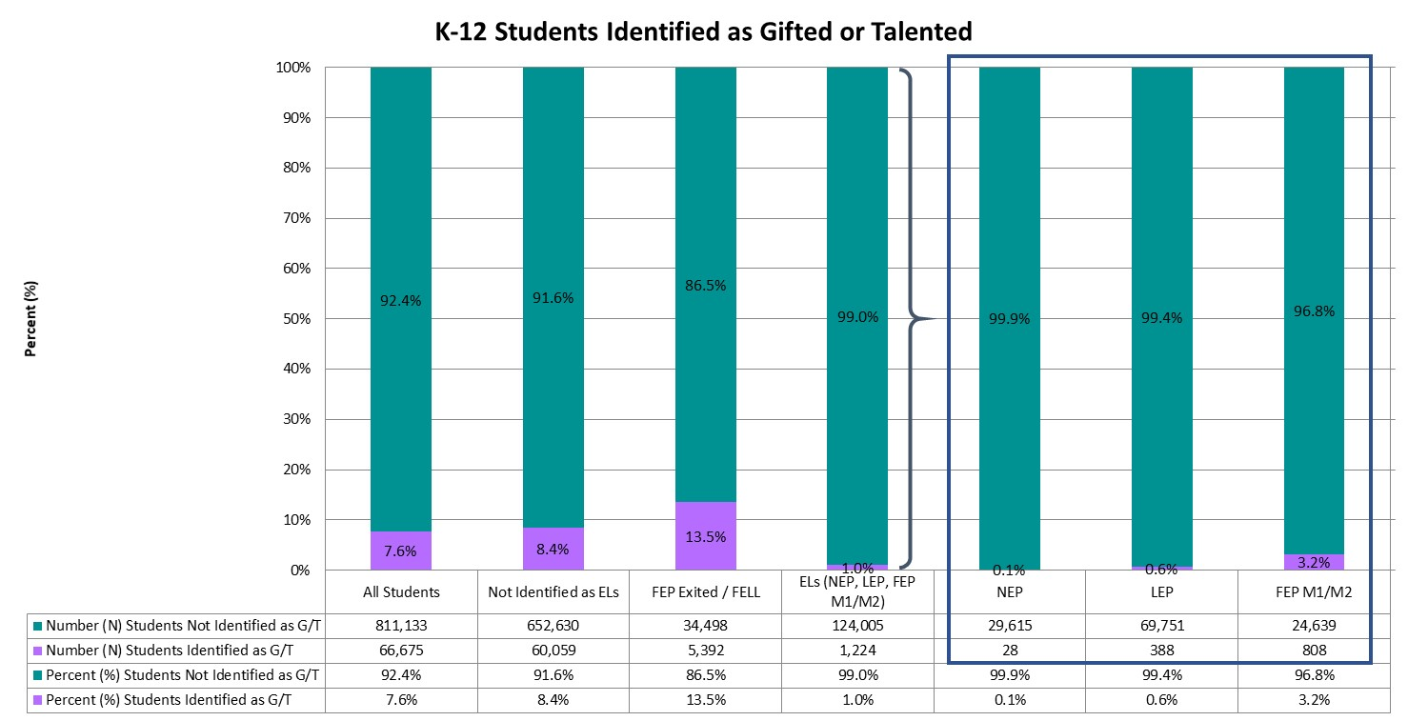
Students Identified as Gifted/Talented
Approximately 7.6% of all K-12 students and 1.0% of English learners were identified as gifted or talented.
Notes:
The Exceptional Children’s Educational Act (ECEA) defines gifted students as those students whose aptitude or competence in abilities, talents, and potential for accomplishment in one or more domains are so exceptional or developmentally advanced that they require special provisions to meet their educational programming needs. For additional information regarding gifted education, visit the CDE Office of Gifted Education’s webpage (www.cde.state.co.us/gt), or refer to Chapter 7.

Slide 18
Location and Context

Slide 19
Districts with Highest Number of English learners
English learners are located throughout the state, with 157 districts having at least one English learner enrolled during the Student October Snapshot in the 2018-19 school year. Twenty-one districts had more than 1,000 K-12 English learners enrolled at the time of the Snapshot, with the top 10 districts each having enrolled more than 3,100 English learners. Denver County 1 had the highest number of English learners enrolled (N = 30,173), followed by Adams-Arapahoe 28J (N = 15,641) and Adams 12 Five Star Schools (N = 7,196).
District Number | District Name | Number (N) All Students | Number (N) ELs (NEP, LEP, FEP M1/M2) | Percent (%) ELs (NEP, LEP, FEP M1/M2)
0880 | DENVER COUNTY 1 | 86,928 | 30,173 | 34.7%
0180 | ADAMS-ARAPAHOE 28J | 38,010 | 15,641 | 41.1%
0020 | ADAMS 12 FIVE STAR SCHOOLS | 38,095 | 7,196 | 18.9%
1420 | JEFFERSON COUNTY R-1 | 81,714 | 6,387 | 7.8%
0130 | CHERRY CREEK 5 | 54,275 | 6,218 | 11.5%
3120 | GREELEY 6 | 22,419 | 5,264 | 23.5%
0470 | ST VRAIN VALLEY RE 1J | 31,100 | 4,253 | 13.7%
0900 | DOUGLAS COUNTY RE 1 | 65,671 | 3,824 | 5.8%
0070 | WESTMINSTER PUBLIC SCHOOLS | 8,593 | 3,204 | 37.3%
0030 | ADAMS COUNTY 14 | 6,507 | 3,199 | 49.2%

Slide 20
Districts with Highest Percentage of English learners
For seventeen districts, English learners represented at least one-quarter of their K-12 student population. The top 10 districts had student populations composed of at least 32.8 percent English learners. Adams County 14 had the highest percent of English learners (49.2%). Four districts were in the top 10 for both number and percent of English learners: Adams County 14, Adams-Arapahoe 28J, Denver County 1, Westminster Public Schools.
District Number | District Name | Number (N) All Students | Number (N) ELs (NEP, LEP, FEP M1/M2) | Percent (%) ELs (NEP, LEP, FEP M1/M2)
0030 | ADAMS COUNTY 14 | 6,507 | 3,199 | 49.2%
0180 | ADAMS-ARAPAHOE 28J | 38,010 | 15,641 | 41.1%
2810 | CENTER 26 JT | 598 | 237 | 39.6%
0070 | WESTMINSTER PUBLIC SCHOOLS | 8,593 | 3,204 | 37.3%
0123 | SHERIDAN 2 | 1,248 | 450 | 36.1%
1510 | LAKE COUNTY R-1 | 983 | 350 | 35.6%
0880 | DENVER COUNTY 1 | 86,928 | 30,173 | 34.7%
3200 | YUMA 1 | 801 | 269 | 33.6%
1180 | ROARING FORK RE-1 | 5,455 | 1,827 | 33.5%
0910 | EAGLE COUNTY RE 50 | 6,605 | 2,164 | 32.8%

Slide 21
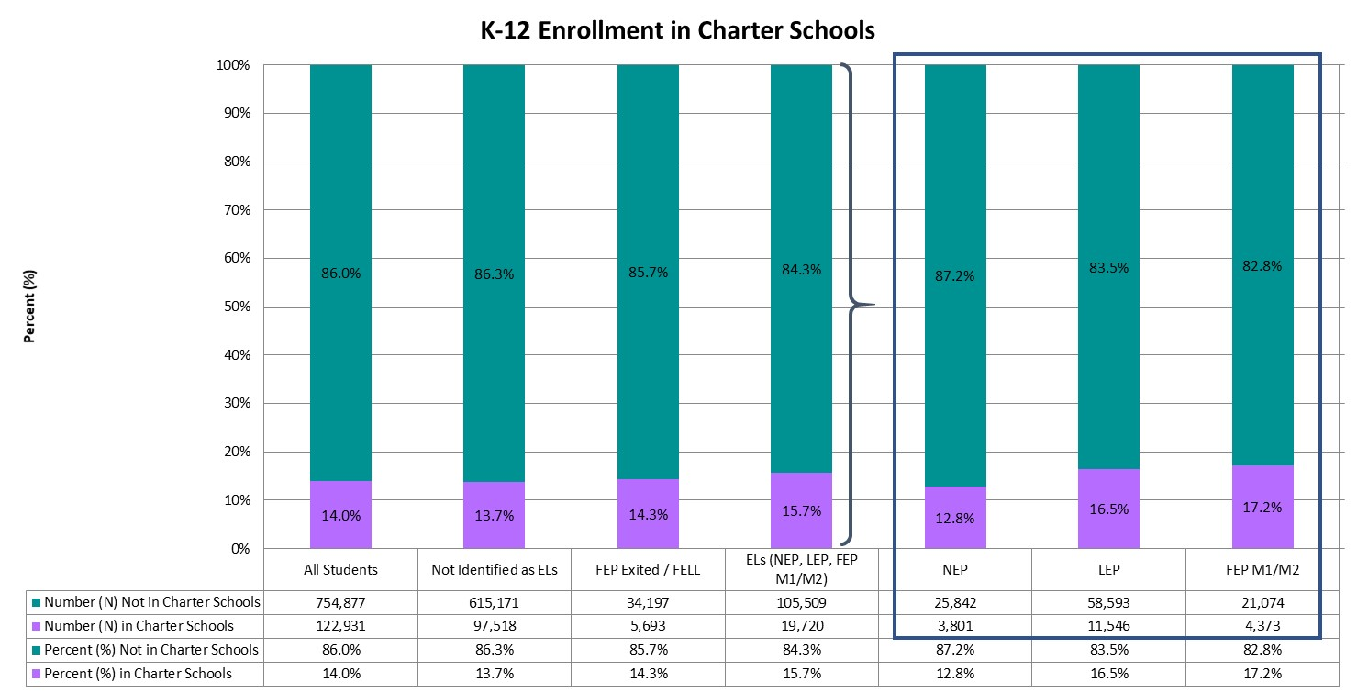
Enrolled in Charter Schools
Statewide, approximately 14.0% of all K-12 students and 15.7% of English learners were enrolled in a Charter school.
Notes:
Charter schools operate under a charter (or contract) between the charter school and its authorizer, which is either a local school district or the Colorado Charter School Institute. Parents must apply to charter schools if they choose to enroll their children in a charter school. Additional information is available on the CDE Schools of Choice Office’s webpage on Colorado Charter Schools (www.cde.state.co.us/cdechart).

Slide 22
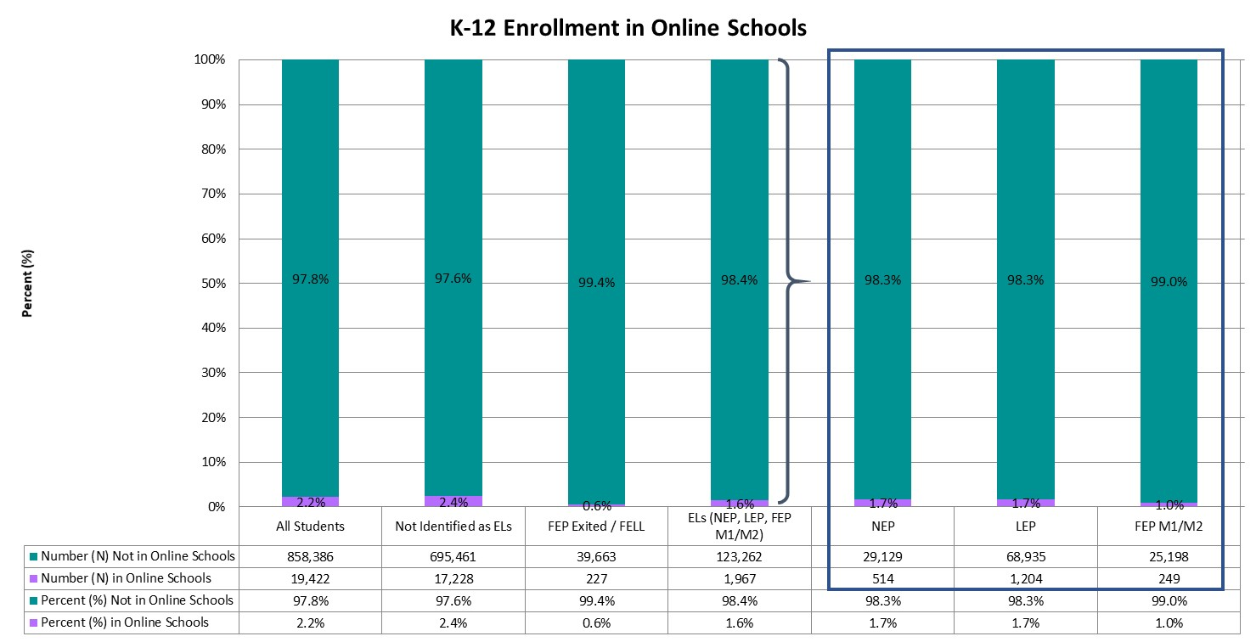
Enrolled in Online Schools
Only 2.2% of all K-12 students and 1.6% of English learners were enrolled in online schools.
Notes:
An online school or program is a full-time education school/program that delivers a sequential program of instruction directed by a teacher, primarily through online digital learning strategies that provide students choice over time, place, and path, and teacher-guided modality of learning. For additional information, please visit the CDE Office of Blended & Online Learning webpage (www.cde.state.co.us/onlinelearning).

Slide 23
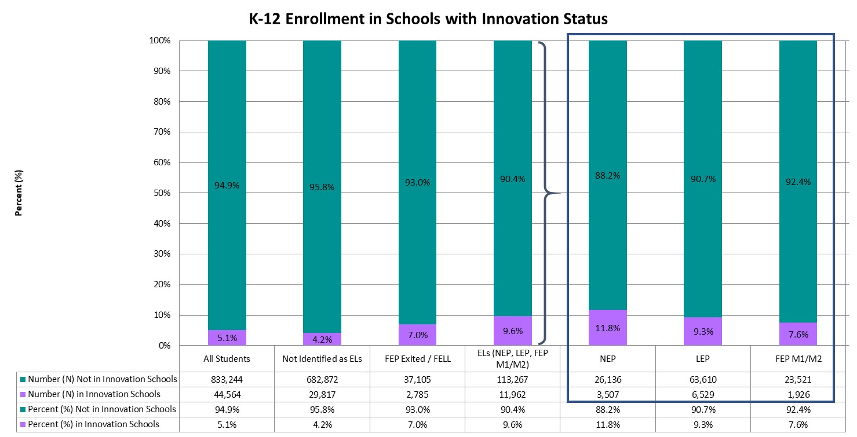
Enrolled in Schools with Innovation Status
Statewide, 5.1% of all K-12 students were enrolled in schools with Innovation status, whereas 9.6% of English learners were enrolled in schools with Innovation status.
Notes:
The Innovation Schools Act provides a pathway for schools and districts to obtain greater individual school autonomy and managerial flexibility in order to implement diverse approaches to learning. Schools receiving Innovation status gain greater control over issues such as educational programming, personnel selection and evaluation, calendars and scheduling, and budgeting. Additional information can be found on the CDE Schools of Choice Office’s webpage on Innovation Schools (www.cde.state.co.us/choice/innovationschools).

Slide 24
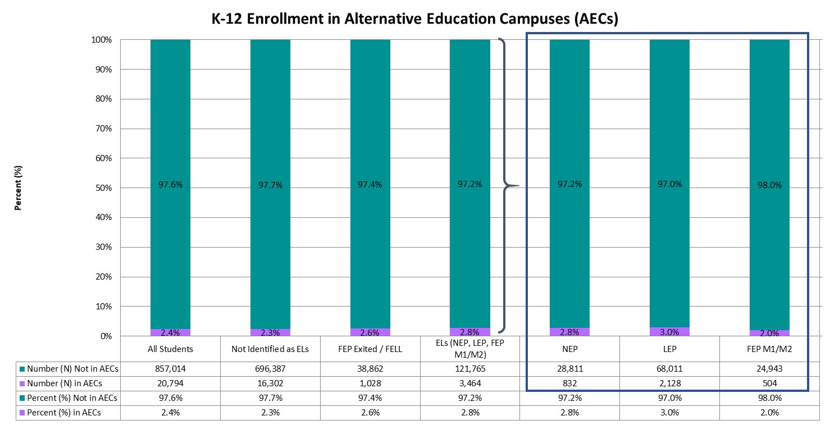
Enrolled in Alternative Education Campuses (AECs)
Approximately 2.4% of all K-12 students and 2.8% of English learners were enrolled in Alternative Education Campuses (AECs).
Notes:
Schools may be designated as Alternative Education Campuses (AECs) if at least 90% of students meet criteria that classify them as high-risk, if they serve students who have severe limitations precluding appropriate administration of state assessments, or if they serve students who attend on a part-time basis, coming from other public schools. High-risk students include those students with one of more of the following conditions: juvenile delinquent, dropped out of school, expelled from school, history of drug or alcohol use, history of street gang involvement, history of child abuse or neglect, has a parent or guardian in prison, has an IEP, family history of domestic violence, repeated school suspensions, parent or pregnant woman, migrant child, homeless child, history of a serious psychiatric or behavioral disorder, or is over traditional school age for his or her grade level and lacks adequate credit hours. Additional information regarding AECs can be found on the CDE Accountability and Data Analysis Unit’s webpage for State Accountability – Alternative Education Campuses (www.cde.state.co.us/accountability/stateaccountabilityaecs).

Slide 25
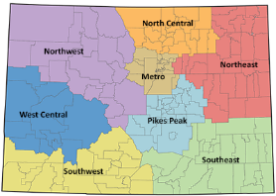
Colorado Regions
Colorado is divided into eight regions in which districts are located: Metro, North Central, Northeast, Northwest, Pikes Peak, Southeast, Southwest, and West Central. Charter School Institute and Colorado Digital BOCES serve students throughout the state, and therefore are not assigned to a particular region.

Slide 26
Enrollment Across Regions
Category | Metro | North Central | Northeast | Northwest | Pikes Peak | Southeast | Southwest | West Central | Charter School Institute | Colorado Reenvisioned BOCES | Colorado Detention Centers
Percent (%) of All Students | 52.3% | 14.4% | 1.6% | 4.0% | 17.4% | 1.4% | 2.4% | 4.1% | 2.0% | 0.3% | 0.0%
Percent (%) of Not Identified as ELs | 49.2% | 14.7% | 1.7% | 3.5% | 19.7% | 1.6% | 2.6% | 4.6% | 2.0% | 0.3% | 0.0%
Percent (%) of FEP Exited / FELL | 60.6% | 16.3% | 1.1% | 6.6% | 8.5% | 0.6% | 1.2% | 2.7% | 2.4% | * | *
Percent (%) of ELs (NEP, LEP, FEP M1/M2) | 67.8% | 12.4% | 1.3% | 6.0% | 6.8% | 0.3% | 1.1% | 1.7% | 2.5% | * | *
Percent (%) of NEP | 68.5% | 12.5% | 1.2% | 6.9% | 6.3% | 0.3% | 0.8% | 1.3% | 2.0% | * | *
Percent (%) of LEP | 69.0% | 11.6% | 1.3% | 5.6% | 6.4% | 0.4% | 1.3% | 1.9% | 2.6% | * | *
Percent (%) of FEP M1/M2 | 63.9% | 14.4% | 1.3% | 5.9% | 8.6% | 0.2% | 0.8% | 1.8% | 2.9% | * | *
The majority of K-12 students (52.3%) were enrolled in the Metro region, followed by Pikes Peak (17.4%) and North Central (14.4%) regions. The majority of English learners were enrolled in the Metro region (67.8%), followed by North Central (12.4%) and Pikes Peak (6.8%) regions.

Slide 27
Enrollment Within Regions
The Northwest region had the highest proportion of English learners (21.2%), whereas the Southeast region had the lowest proportion of English learners (3.6%).
Region | Number (N) All Students | Number (N) ELs (NEP, LEP, FEP M1/M2) | Percent (%) ELs (NEP, LEP, FEP M1/M2)
Metro | 459,455 | 84,948 | 18.5%
North Central | 126,627 | 15,493 | 12.2%
Northeast | 14,288 | 1,578 | 11.0%
Northwest | 35,332 | 7,475 | 21.2%
Pikes Peak | 152,509 | 8,556 | 5.6%
Southeast | 11,932 | 425 | 3.6%
Southwest | 20,642 | 1,343 | 6.5%
West Central | 36,274 | 2,180 | 6.0%
Charter School Institute | 17,986 | 3,128 | 17.4%
Colorado Reenvisioned BOCES | 2,475 | * | *
Colorado Detention Centers | 288 | * | *

Slide 28
Colorado Settings
Districts are classified into one of six settings: Denver Metro, Urban-Suburban (population center over 30,000 residents, but outside the Denver Metro area), Outlying City (population center of 7,000 to 30,000), Outlying Town (population center of 1,000 to 7,000), Remote (population center of less than 1,000), or BOCES (Data Pipeline Frequently Requested Codes [www.cde.state.co.us/datapipeline/org_orgcodes]).

Slide 29
Enrollment Across Settings
Category | Denver Metro | Outlying City | Outlying Town | Remote | Urban-Suburban | Colorado BOCES | Colorado Detention Centers
Percent (%) of All Students | 55.4% | 4.4% | 8.1% | 3.5% | 28.2% | 0.4% | 0.0%
Percent (%) of Not Identified as ELs | 52.1% | 4.5% | 8.2% | 3.9% | 30.9% | 0.4% | 0.0%
Percent (%) of FEP Exited / FELL | 64.7% | 4.4% | 8.6% | 1.9% | 20.4% | * | *
Percent (%) of ELs (NEP, LEP, FEP M1/M2) | 71.2% | 4.1% | 7.2% | 1.5% | 15.8% | * | *
Percent (%) of NEP | 71.3% | 5.1% | 6.8% | 1.3% | 15.3% | * | *
Percent (%) of LEP | 72.5% | 3.6% | 7.6% | 1.7% | 14.5% | * | *
Percent (%) of FEP M1/M2 | 67.5% | 4.4% | 6.7% | 1.4% | 19.8% | * | *
The majority of K-12 students (55.4%) were enrolled in Denver Metro settings, followed by Urban-Suburban settings (28.2%). The majority of English learners were enrolled in Denver Metro settings (71.2%), followed by Urban-Suburban settings (15.8%).

Slide 30
Enrollment Within Regions
The Denver Metro setting had the highest proportion of English learners (18.3%), whereas the Remote setting had the lowest proportion of English learners (6.3%).
Setting | Number (N) All Students | Number (N) ELs (NEP, LEP, FEP M1/M2) | Percent (%) ELs (NEP, LEP, FEP M1/M2)
Denver Metro | 485,960 | 89,149 | 18.3%
Outlying City | 38,921 | 5,172 | 13.3%
Outlying Town | 70,973 | 9,075 | 12.8%
Remote | 30,655 | 1,929 | 6.3%
Urban-Suburban | 247,841 | 19,771 | 8.0%
Colorado BOCES | 3,170 | * | *
Colorado Detention Centers | 288 | * | *

Slide 31
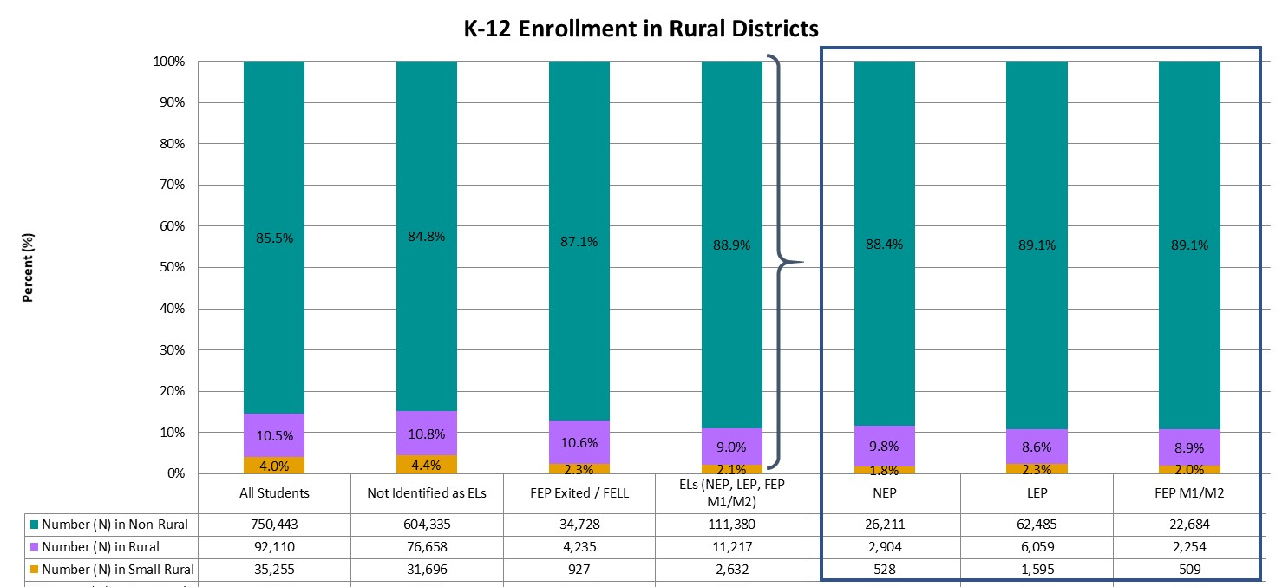
Enrolled in Rural Districts
Statewide, 10.5% of all K-12 students were enrolled in rural districts and 4.0% were enrolled in small rural districts. In comparison, 9.0% of English learners were enrolled in rural and 2.1% in small rural districts.
Notes:
A Colorado school district is determined to be rural based on the size of the district, the distance from the nearest large urban/urbanized area, and having a student enrollment of approximately 6,500 students or fewer. Small rural districts are those districts meeting these same criteria and having a student population of fewer than 1,000 students. For more information, and for a list of districts considered rural or small rural, please visit the CDE Rural Education Council webpage (www.cde.state.co.us/ruraledcouncil).

Slide 32
Academic Achievement

Slide 33
Academic Achievement
Students in grades 3 through 8 were administered the Colorado Measures of Academic Success (CMAS) assessments in mathematics and English language arts, and students in grade 11 were administered the SAT assessment in mathematics and evidence-based reading and writing. In addition, students in grades 5, 8, and 11 were administered the CMAS assessment in science. Students with significant cognitive disabilities were eligible to take the Colorado Alternate (CoAlt) assessments instead. For more information on the state assessments, and for school- and district-level results, please visit the CDE Assessment Unit webpage (www.cde.state.co.us/assessment). To protect student privacy, Colorado suppresses any cells that do not meet minimum number requirements. Data omitted from the following graphs indicates fewer than 16 students, or that complementary suppression rules were applied.

Slide 34
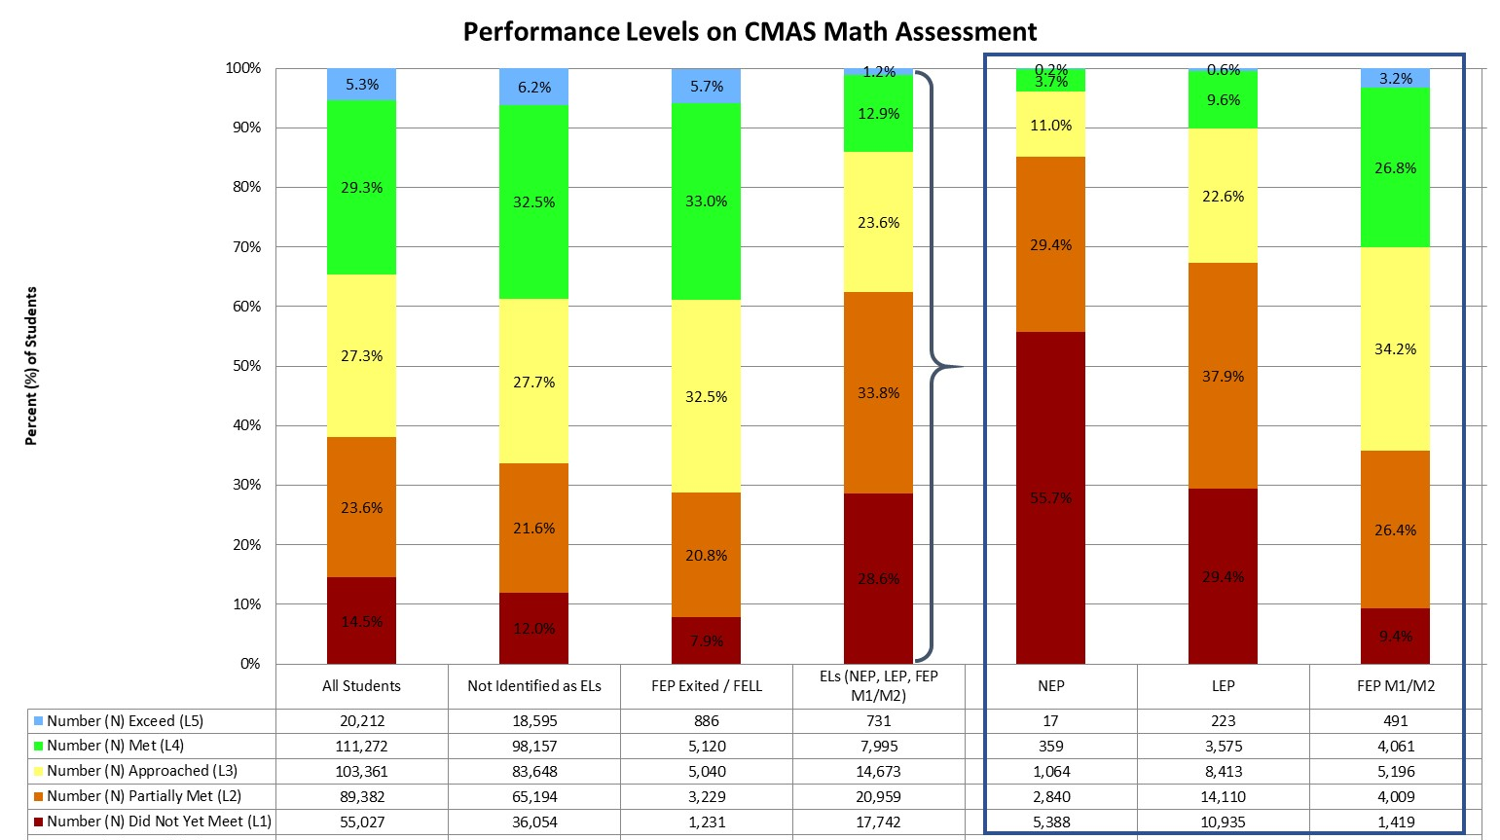
Performance on CMAS Math Assessment (Grades 3-8)
Statewide, the majority of students scored in level 4 (Met Expectations, 29.3%) and level 3 (Approached Expectations, 27.3%). The majority of English learners scored in level 2 (Partially Met Expectations, 33.8%) and level 1 (Did Not Yet Meet Expectations, 28.6%).
Notes:
The CMAS math assessment has five performance levels, ranging from Did Not Yet Meet Expectations (Level 1) to Exceed Expectations (Level 5).

Slide 35
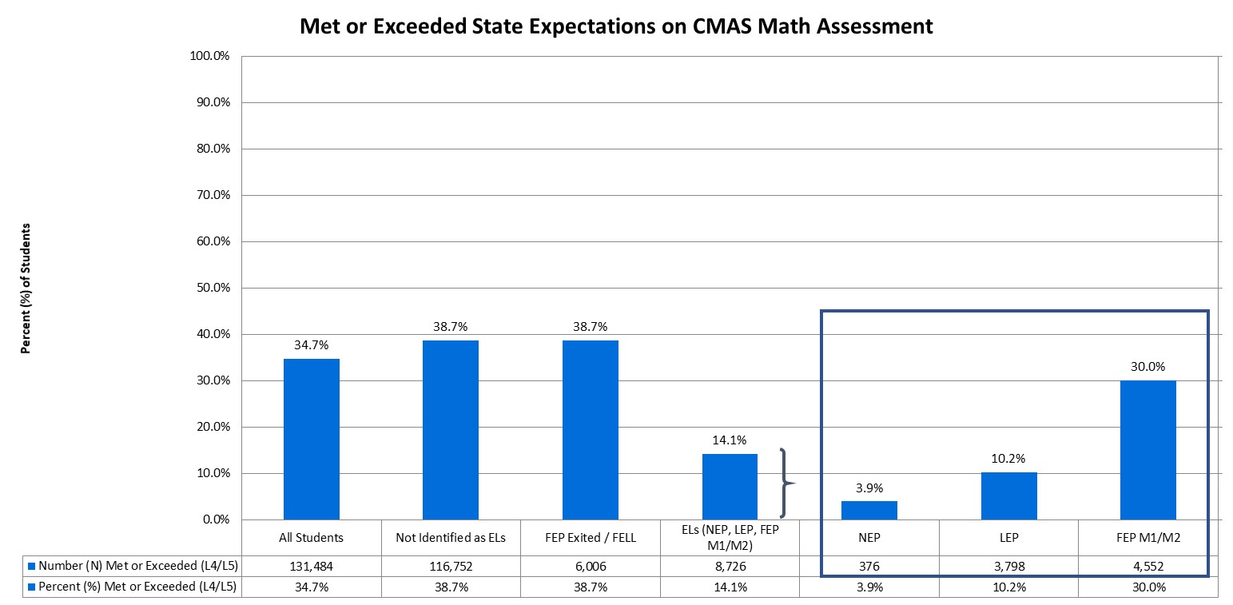
Students Meeting/Exceeding Expectations on CMAS Math Assessment (Grades 3-8)
Statewide, approximately 34.7% of students in grades 3 through 8 met or exceeded state expectations, compared to 14.1% of English learners.
Notes:
In addition to the percent of students scoring within each performance level, it is important to consider how many students are meeting state expectations, reaching level 4 or higher.

Slide 36
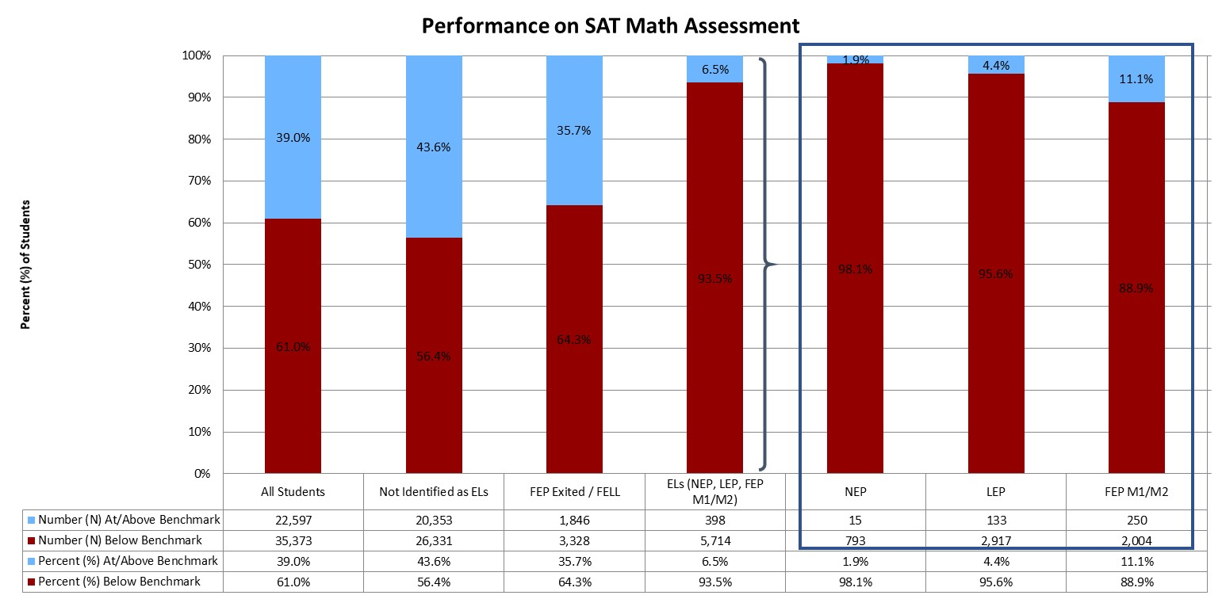
Performance on SAT Math Assessment (Grade 11)
Statewide, 39.0% of students were at or above benchmark on the SAT math assessment, compared to 6.5% of English learners.

Slide 37
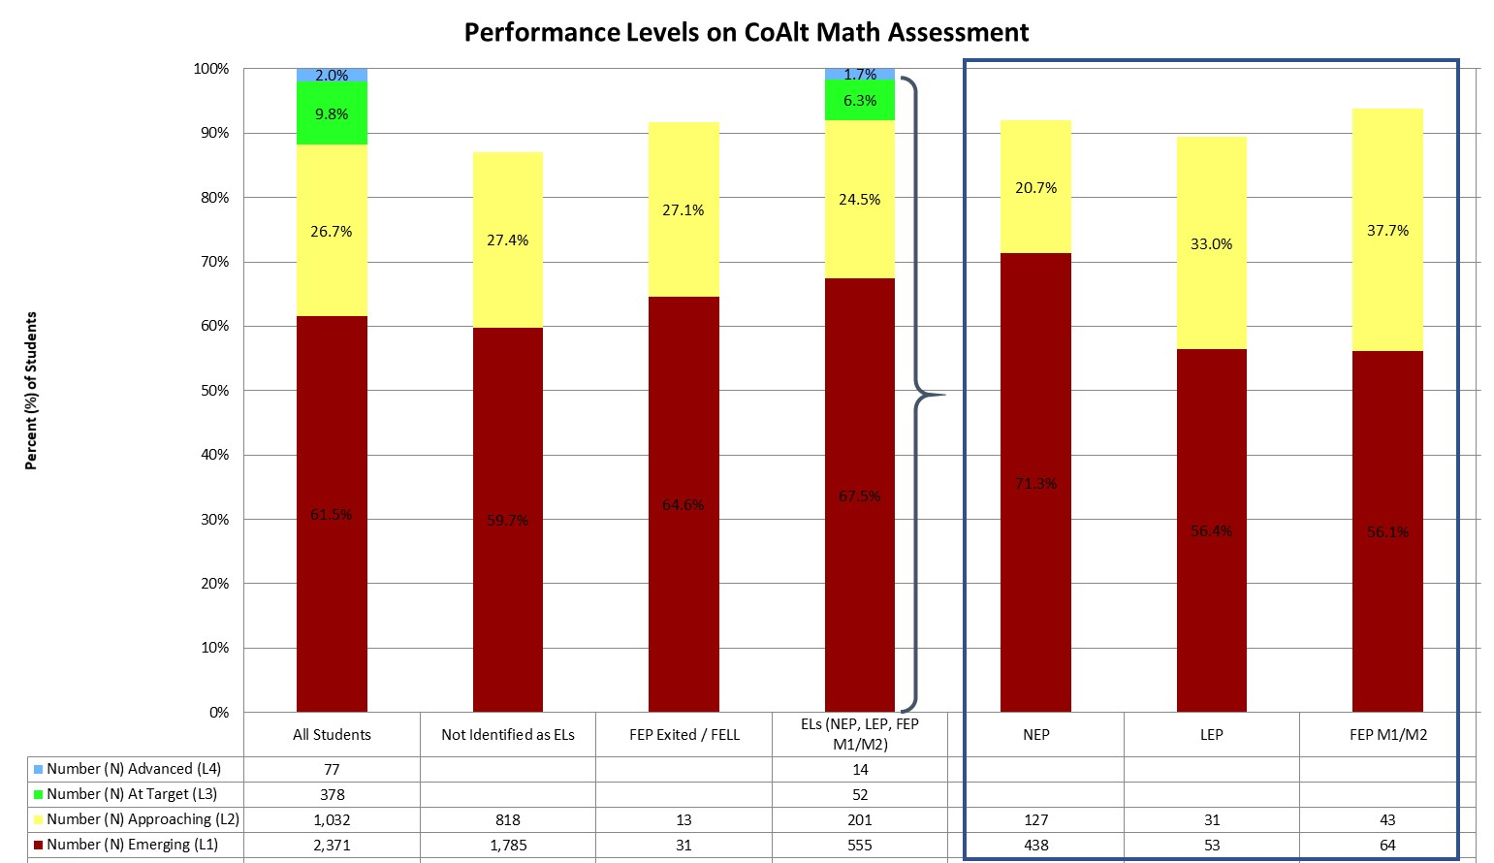
Performance on COALT Math Assessment (Grades 3-8 and 11)
Statewide, the majority of students scored in level 1 (Emerging, 61.5%) and level 2 (Approaching Target, 26.7%). The majority of English learners scored in level 1 (Emerging, 67.5%) and level 2 (Approaching Target, 24.5%).
Notes:
The CoAlt math assessment has four performance levels, ranging from Emerging (Level 1) to Advanced (Level 4).

Slide 38
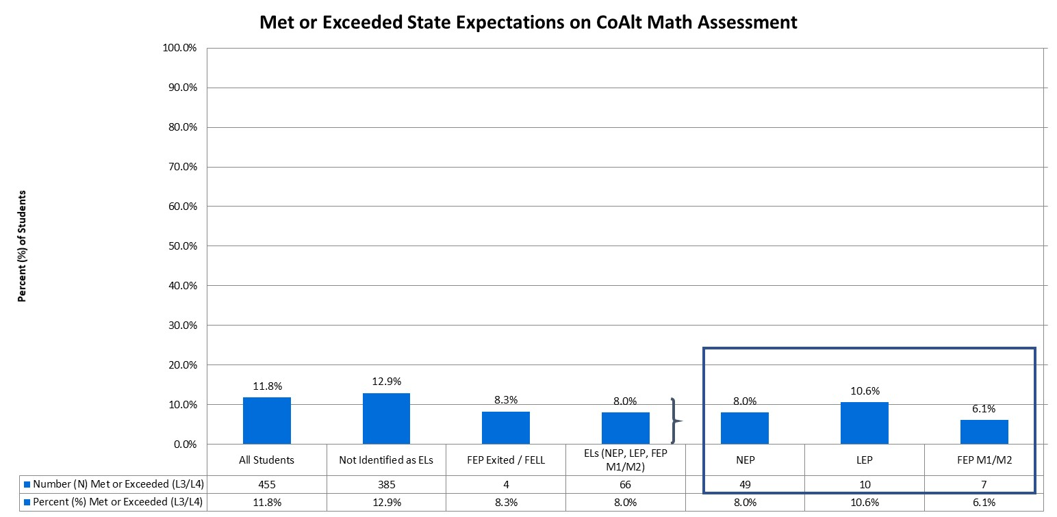
Students Meeting/Exceeding Expectations on COALT Math Assessment (Grades 3-8 and 11)
Statewide, approximately 11.8% of students in grades 3 through 8 and grade 11 met or exceeded state expectations, compared to 8.0% of English learners.
Notes:
In addition to the percent of students scoring within each performance level, it is important to consider how many students are meeting state expectations, reaching level 3 or higher.

Slide 39
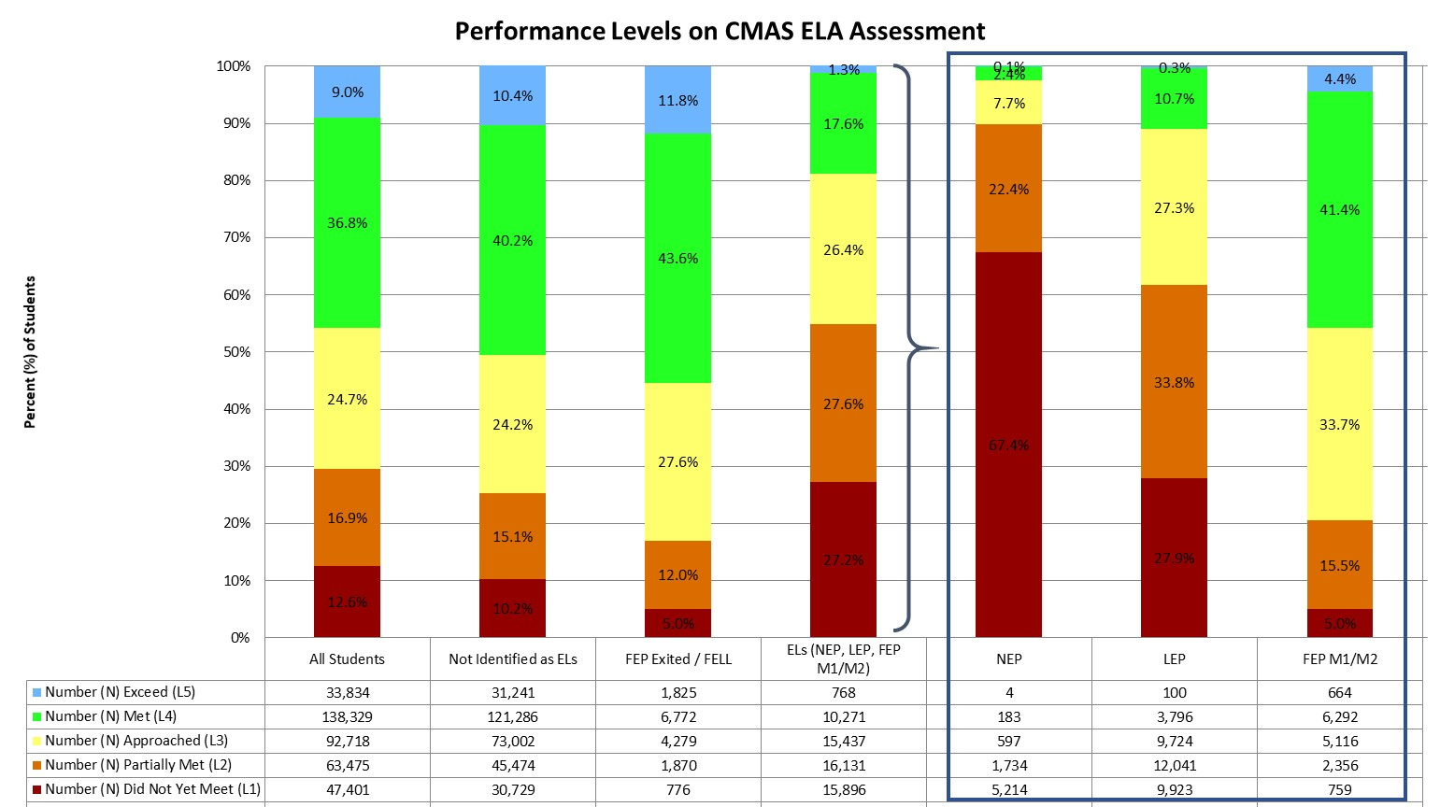
Performance on CMAS ELA Assessment (Grades 3-8)
Statewide, the majority of students scored in level 4 (Met Expectations, 36.8%) and level 3 (Approached Expectations, 24.7%). The majority of English learners scored in level 2 (Partially Met Expectations, 27.6%) and level 1 (Did Not Yet Meet Expectations, 27.2%).
Notes:
Like the math assessment, the CMAS ELA assessment has five performance levels.

Slide 40
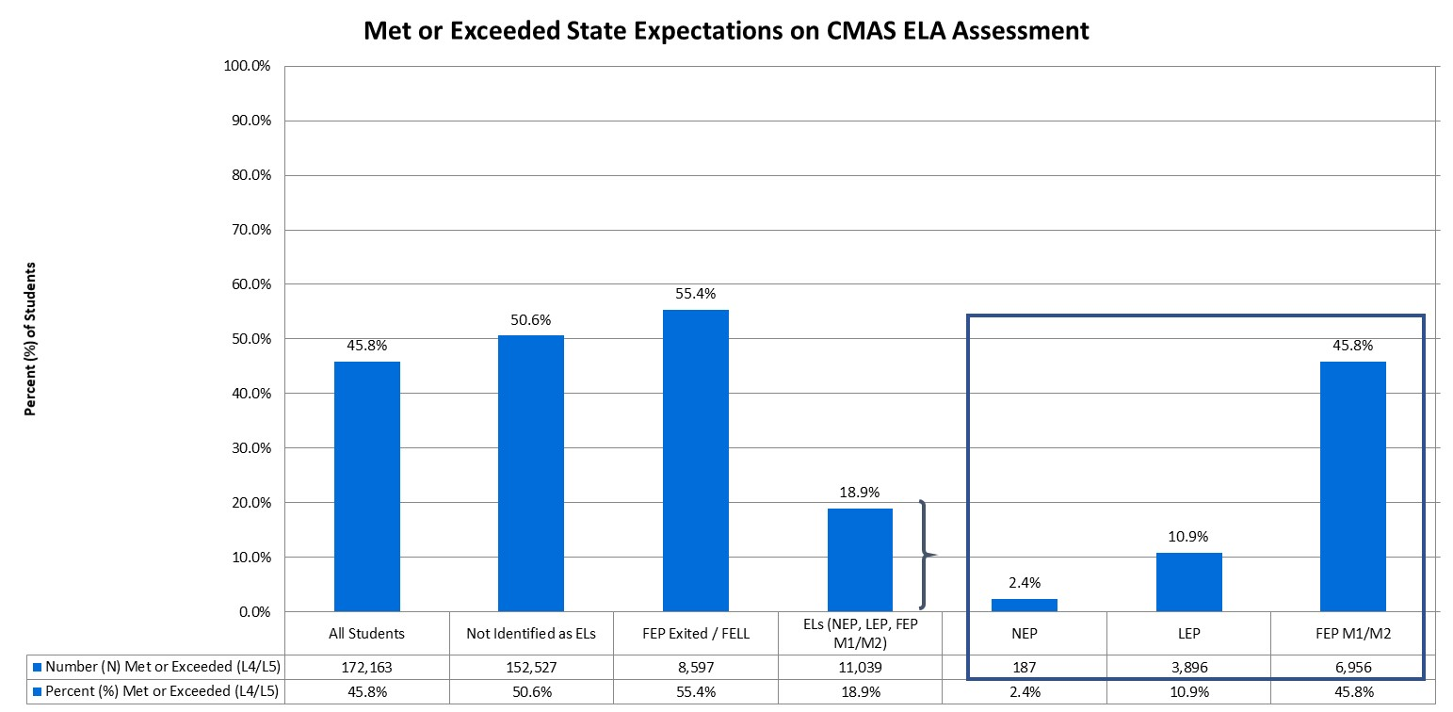
Students Meeting/Exceeding Expectations on CMAS ELA Assessment (Grades 3-8)
Statewide, approximately 45.8% of students in grades 3 through 8 met or exceeded state expectations, compared to 18.9% of English learners.
Notes:
In addition to the percent of students scoring within each performance level, it is important to consider how many students are meeting state expectations, reaching level 4 or higher.

Slide 41
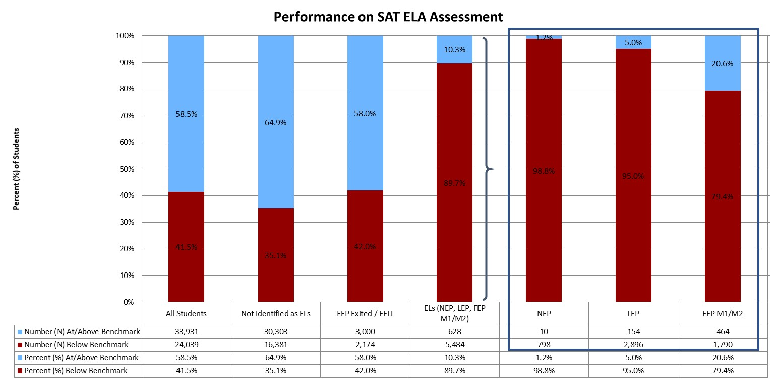
Performance on SAT ELA Assessment (Grade 11)
Statewide, 58.5% of students were at or above benchmark on the SAT math assessment, compared to 10.3% of English learners.

Slide 42
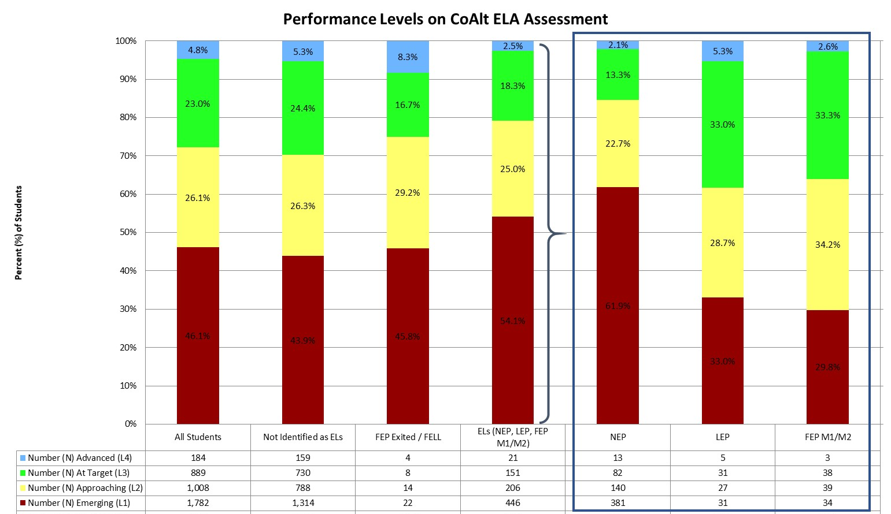
Performance on COALT ELA Assessment (Grades 3-8 and 11)
Statewide, the majority of students scored in level 1 (Emerging, 46.1%) and level 2 (Approaching Target, 26.1%). The majority of English learners scored in level 1 (Emerging, 54.1%) and level 2 (Approaching Target, 25.0%).
Notes:
The CoAlt ELA assessment has four performance levels, ranging from Emerging (Level 1) to Advanced (Level 4).

Slide 43
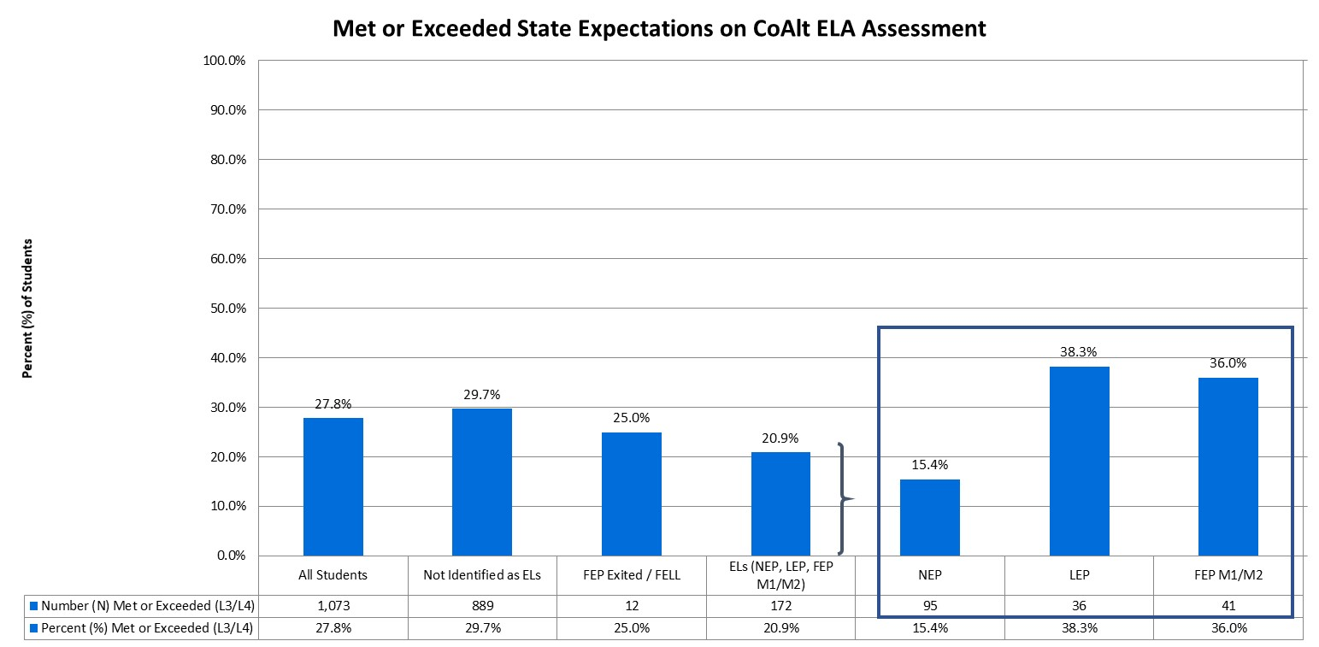
Students Meeting/Exceeding Expectations on COALT ELA Assessment (Grades 3-8 and 11)
Statewide, approximately 27.8% of students in grades 3 through 8 and grade 11 met or exceeded state expectations, compared to 20.9% of English learners.
Notes:
In addition to the percent of students scoring within each performance level, it is important to consider how many students are meeting state expectations, reaching level 3 or higher.

Slide 44
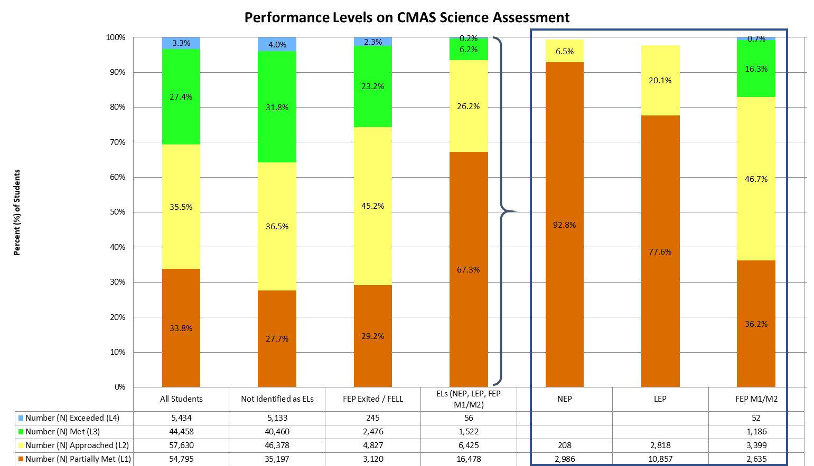
Performance on CMAS science Assessment (Grades 5, 8, and 11)
Statewide, the majority of students scored in level 2 (Approached Expectations, 35.5%) and level 1 (Partially Met Expectations, 33.8%). The majority of English learners scored in level 1 (Partially Met Expectations, 67.3%) and level 2 (Approached Expectations, 26.2%).
Notes:
The CMAS science assessment has four performance levels, ranging from Partially Met Expectations (Level 1) to Exceeded Expectations (Level 4).

Slide 45
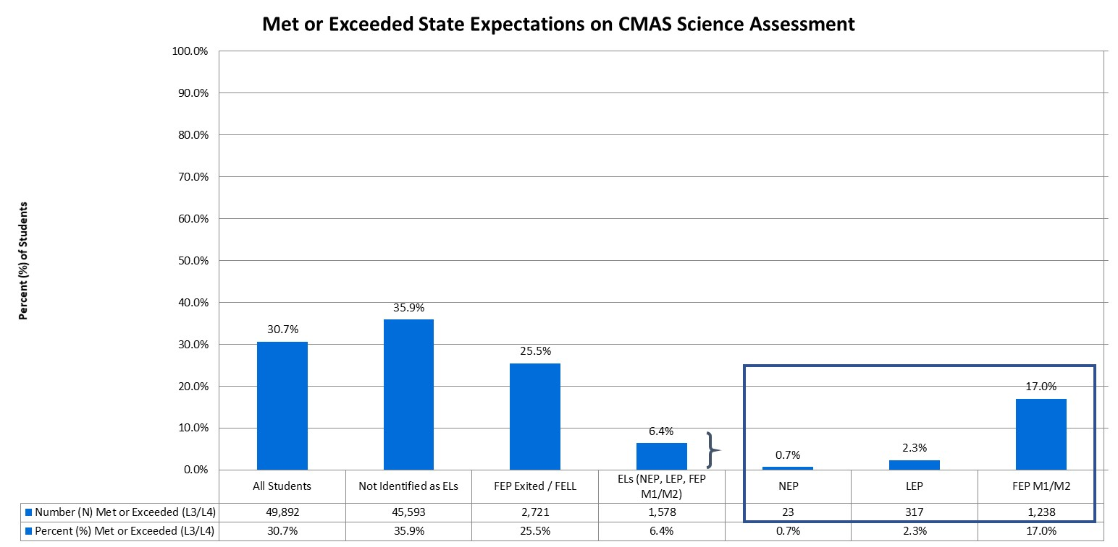
Students Meeting/Exceeding Expectations on CMAS science Assessment (Grades 5, 8, and 11)
Statewide, approximately 30.7% of students met or exceeded state expectations, compared to 6.4% of English learners.
Notes:
In addition to the percent of students scoring within each performance level, it is important to consider how many students are meeting state expectations, reaching level 3 or higher.

Slide 46
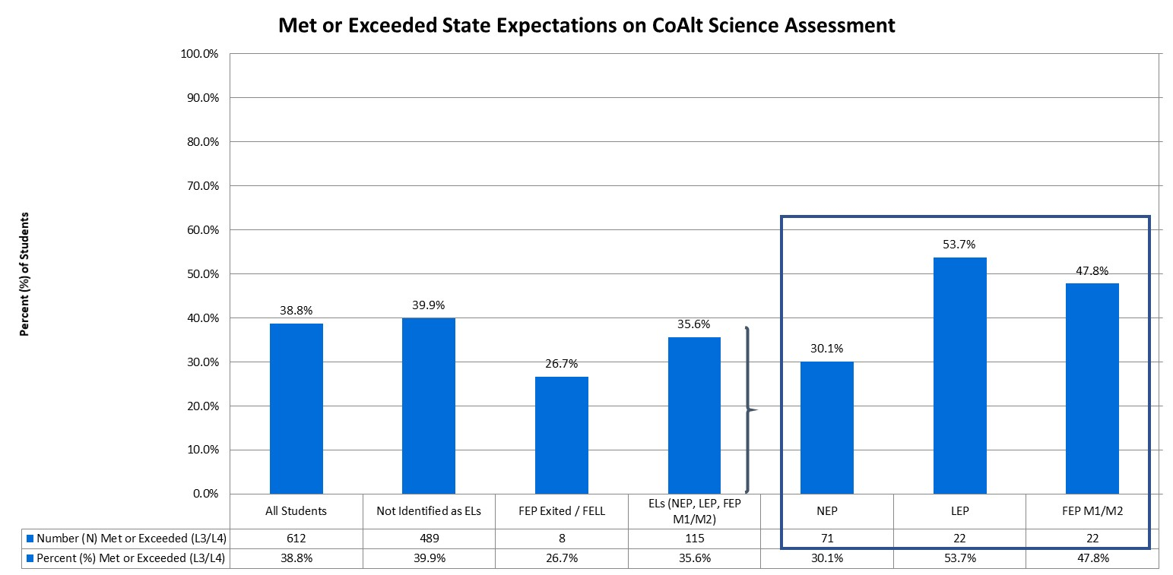
Students Meeting/Exceeding Expectations on COALT science Assessment (Grades 5, 8, and 11)
Statewide, approximately 38.8% of students in grades 3 through 8 and grade 11 met or exceeded state expectations, compared to 35.6% of English learners.
Notes:
In addition to the percent of students scoring within each performance level, it is important to consider how many students are meeting state expectations, reaching level 3 or higher.

Slide 47
Academic Growth

Slide 48
Academic Growth
Colorado calculates student growth for the CMAS and SAT math and English language arts assessments. A student growth percentile (SGP) defines how much relative growth a student made, compared to that student’s academic peers. The Colorado Growth Model essentially compares each student’s current achievement to students in the same grade throughout the state who had similar scores in past years. A student growth percentile of 60, for example, indicates a student grew as well as or better than 60% of his/her academic peers. The median is then calculated by taking the individual student growth percentiles of all the students in the group being analyzed, ranking them from lowest to highest, and identifying the middle score. Medians are more appropriate to use than averages when summarizing a collection of percentile scores. For more information regarding median growth percentiles (MGPs), please visit the Colorado Growth Model FAQs (www.cde.state.co.us/schoolview/generalgrowthmodelfaq#q22).

Slide 49
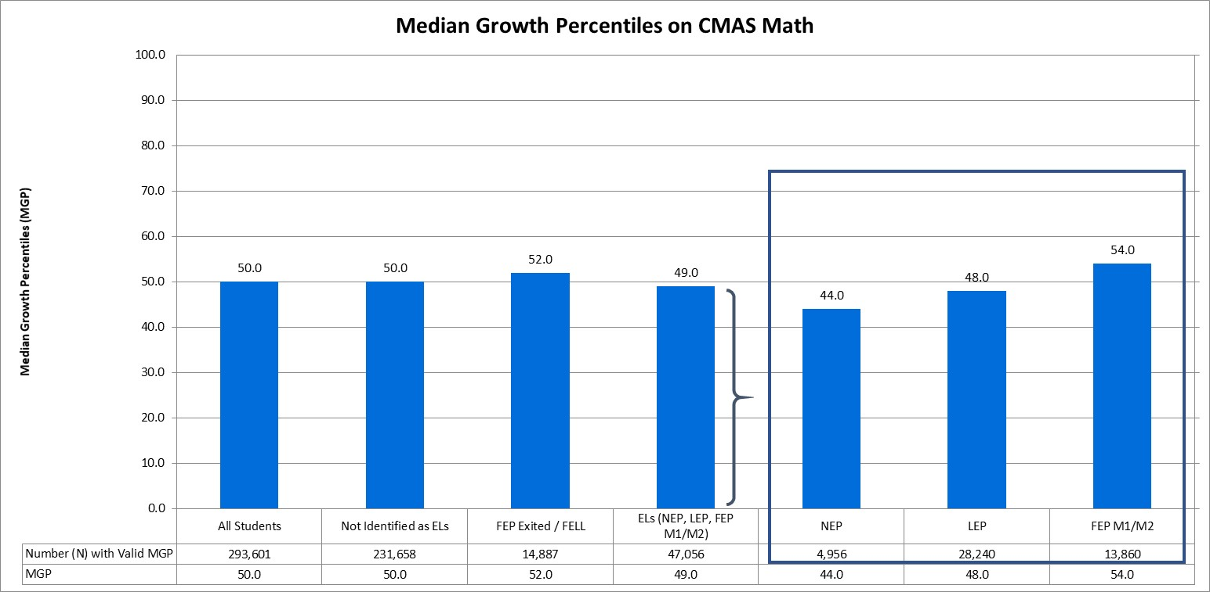
Median Growth Percentiles on CMAS math assessment
The median growth percentile (MGP) for all Colorado students (grades 4 through 8) on the CMAS math assessment was 50.0, compared to an MGP of 49.0 for English learners.

Slide 50
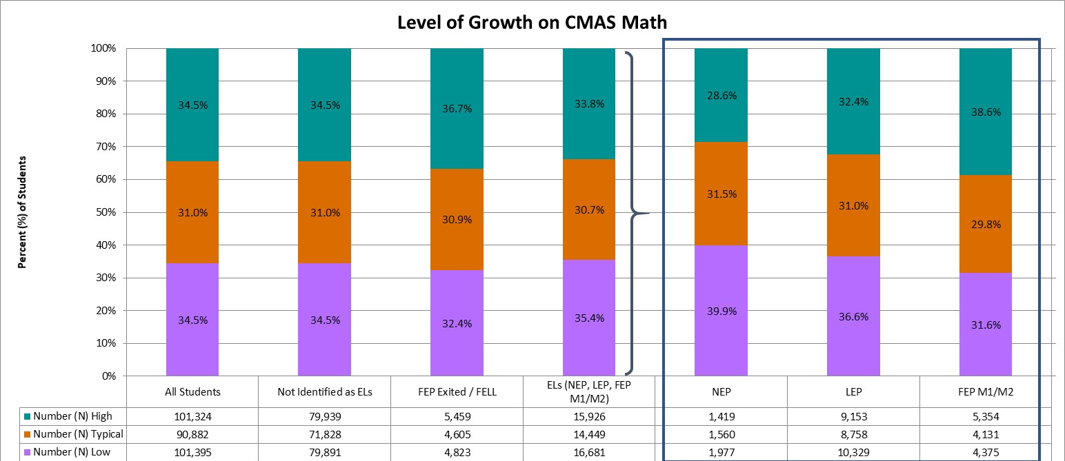
Levels of growth on CMAS math assessment
Statewide, on the CMAS math assessment, 34.5% of all students demonstrated high growth, 31.0% demonstrated typical growth, and 34.5% demonstrated low growth. In comparison, 33.8% of English learners had high growth and 35.4% had low growth.
Notes:
A student growth percentile that falls below the 35th percentile reflects low growth, while a student growth percentile that falls above the 65th percentile reflects high growth (Colorado Growth Model FAQs [www.cde.state.co.us/schoolview/generalgrowthmodelfaq#q22]). Student growth percentiles between the 35th and 65th percentile represent typical growth.

Slide 51
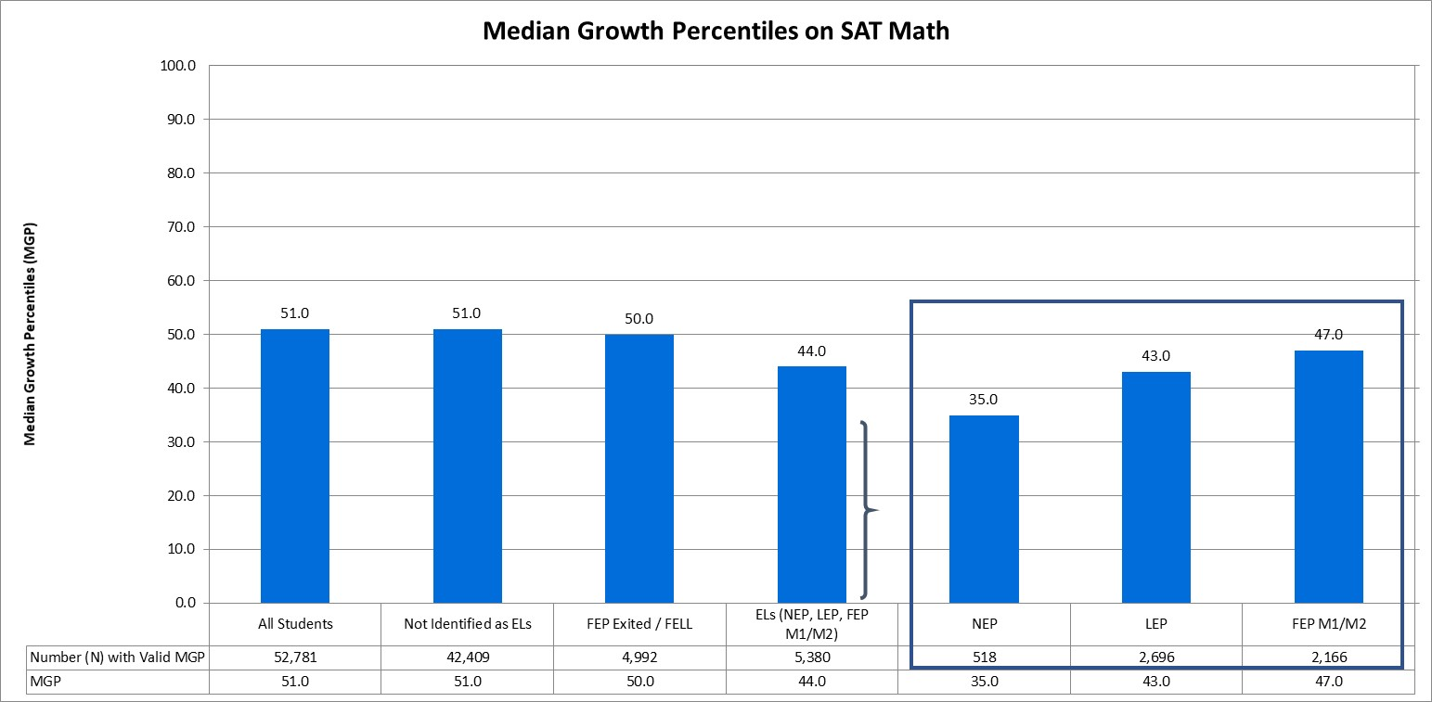
Median Growth Percentiles on SAT math assessment
The median growth percentile (MGP) for all Colorado students (grade 11) on the SAT math assessment was 51.0, compared to an MGP of 44.0 for English learners.

Slide 52
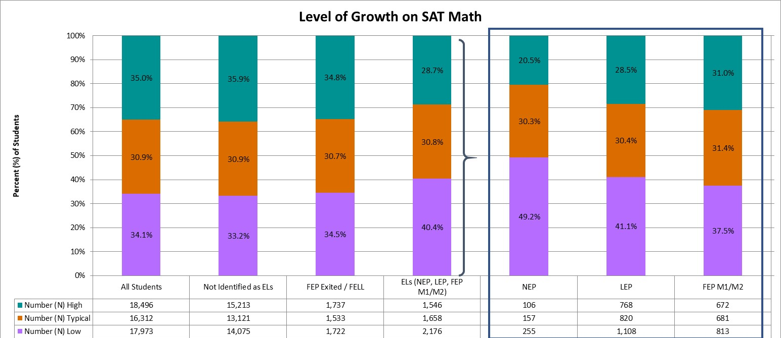
Levels of growth on SAT math assessment
Statewide, on the SAT math assessment, 35.0% of all students demonstrated high growth, 30.9% demonstrated typical growth, and 34.1% demonstrated low growth. In comparison, 28.7% of English learners had high growth and 40.4% had low growth.
Notes:
A student growth percentile that falls below the 35th percentile reflects low growth, while a student growth percentile that falls above the 65th percentile reflects high growth (Colorado Growth Model FAQs [www.cde.state.co.us/schoolview/generalgrowthmodelfaq#q22]). Student growth percentiles between the 35th and 65th percentile represent typical growth.

Slide 53
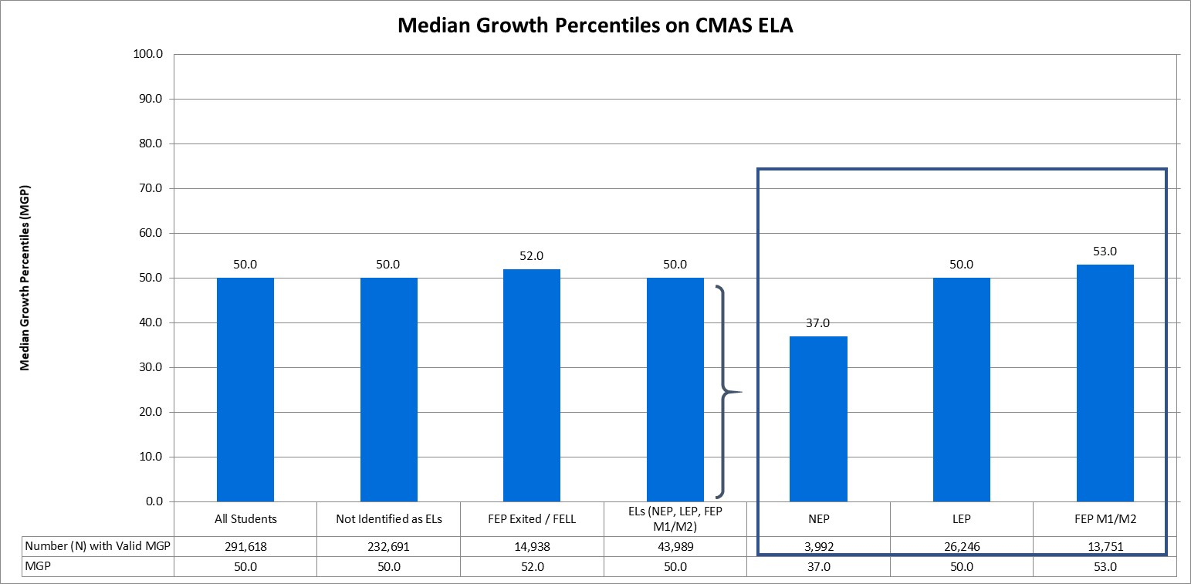
Median Growth Percentiles on CMAS ELA assessment
The median growth percentile (MGP) for all Colorado students (grades 4 through 8) on the CMAS ELA assessment was 50.0, compared to an MGP of 50.0 for English learners.

Slide 54

Levels of growth on CMAS ELA assessment
Statewide, on the CMAS ELA assessment, 34.5% of all students demonstrated high growth, 31.0% demonstrated typical growth, and 34.5% demonstrated low growth. In comparison, 34.0% of English learners had high growth and 34.4% had low growth.
Notes:
A student growth percentile that falls below the 35th percentile reflects low growth, while a student growth percentile that falls above the 65th percentile reflects high growth (Colorado Growth Model FAQs [www.cde.state.co.us/schoolview/generalgrowthmodelfaq#q22]). Student growth percentiles between the 35th and 65th percentile represent typical growth.

Slide 55
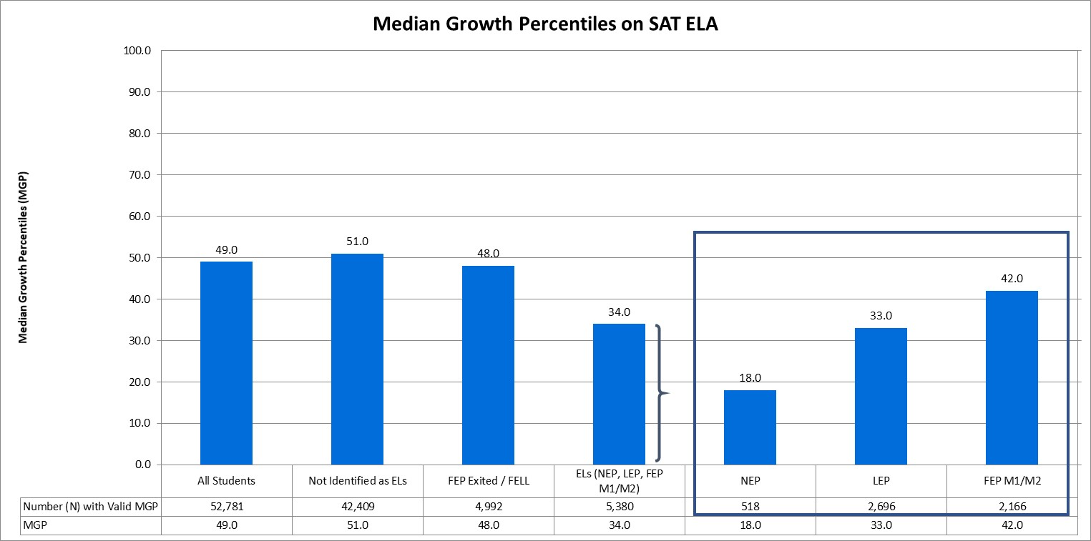
Median Growth Percentiles on SAT ELA assessment
The median growth percentile (MGP) for all Colorado students (grade 11) on the SAT ELA assessment was 49.0, compared to an MGP of 34.0 for English learners.

Slide 56
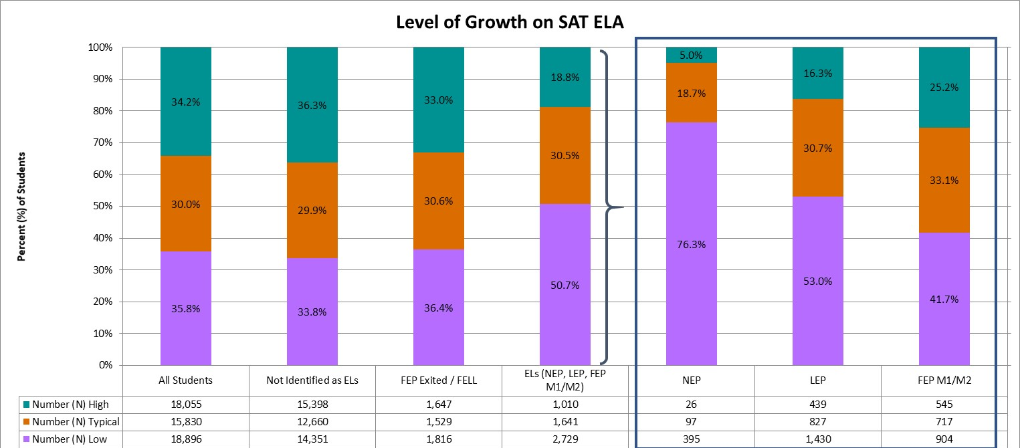
Levels of growth on SAT ELA assessment
Statewide, on the SAT ELA assessment, 34.2% of all students demonstrated high growth, 30.0% demonstrated typical growth, and 35.8% demonstrated low growth. In comparison, 18.8% of English learners had high growth and 50.7% had low growth.
Notes:
A student growth percentile that falls below the 35th percentile reflects low growth, while a student growth percentile that falls above the 65th percentile reflects high growth (Colorado Growth Model FAQs [www.cde.state.co.us/schoolview/generalgrowthmodelfaq#q22]). Student growth percentiles between the 35th and 65th percentile represent typical growth.

Slide 57
Graduation Rates

Slide 58
Graduation Rates
ESSA requires states to present the four-year adjusted cohort graduation rates, but also gives states the discretion to include extended-year adjusted cohort graduation rates as well. Extended-year rates account for students who may require additional time to complete high school, such as those in five-year programs (e.g., ASCENT: Accelerating Students through Concurrent Enrollment, a state program that allows a limited number of students to attend a post-secondary education after completion of 12th grade, while still in the K-12 system), those who started below grade-level, and students whose coursework is interrupted for a semester or more. For more information on graduation rates, and for school- and district-level results, please visit the CDE Graduation Statistics webpage (www.cde.state.co.us/cdereval/gradratecurrent).

Slide 59
4-Year Graduation Rate
Student Group | Number (N) of Students in Graduation Base | Number (N) of Graduates | Graduation Rate (%)
All Students | 65,933 | 53,240 | 80.7%
ELs (NEP, LEP) | 8,445 | 5,654 | 67.0%
The 4-year adjusted cohort graduation rate for the class of 2018 shows that 80.7% of all students in the 2017-18 cohort graduated within four years, compared to 67.0% for English learners.

Slide 60
7-Year Graduation Rate
Student Group | Number (N) of Students in Graduation Base | Number (N) of Graduates | Graduation Rate (%)
All Students | 61,111 | 52,314 | 85.6%
ELs (NEP, LEP) | 6,934 | 5,278 | 76.1%
The 7-year adjusted cohort graduation rate for the class of 2015 shows that 85.6% of all students in the 2014-15 cohort graduated within seven years, compared to 76.1% for English learners.

Slide 61
English Language Proficiency Assessments

Slide 62
Graduation Rates
English learners (NEP and LEP) in grades K-12 were administered the Assessing Comprehension and Communication in English (ACCESS for ELLs®), in order to measure students’ progress in acquiring academic English. Students with significant cognitive disabilities were eligible to take the alternate ACCESS assessment instead. For more information on the state assessments, and for school- and district-level results, please visit the CDE Assessment Unit webpage (www.cde.state.co.us/assessment).

Slide 63
Performance on ACCESS
Student Group | Level 1 - Entering | Level 2 - Emerging | Level 3 - Developing | Level 4 - Expanding | Level 5 - Bridging | Level 6 - Reaching
Number (N) ELs (NEP, LEP, FEP M1/M2) | 11,613 | 16,130 | 37,964 | 25,746 | 4,180 | 299
Percent (%) ELs (NEP, LEP, FEP M1/M2) | 12.1% | 16.8% | 39.6% | 26.8% | 4.4% | 0.3%
Number (N) NEP | 8,714 | 8,840 | 8,923 | 1,676 | 168 | 15
Percent (%) NEP | 30.8% | 31.2% | 31.5% | 5.9% | 0.6% | 0.1%
Number (N) LEP | 2,871 | 7,268 | 28,992 | 24,042 | 4,010 | 284
Percent (%) LEP | 4.3% | 10.8% | 43.0% | 35.6% | 5.9% | 0.4%
Statewide, 12.1% of English learners were at Level 1, 16.8% at Level 2, 39.6% at Level 3, 26.8% at Level 4, 4.4% at Level 5, and 0.3% at Level 6.

Slide 64
Performance on ACCESS Alternate
Student Group | A1 - Initiating | A2 - Exploring | A3 - Engaging | P1 - Entering | P2 - Emerging
Number (N) ELs (NEP, LEP, FEP M1/M2) | 158 | 108 | 280 | 285 | 294
Percent (%) ELs (NEP, LEP, FEP M1/M2) | 14.0% | 9.6% | 24.9% | 25.3% | 26.1%
Number (N) NEP | 149 | 101 | 259 | 259 | 228
Percent (%) NEP | 15.0% | 10.1% | 26.0% | 26.0% | 22.9%
Number (N) LEP | 9 | 7 | 21 | 26 | 66
Percent (%) LEP | 7.0% | 5.4% | 16.3% | 20.2% | 51.2%
Statewide, 14.0% of English learners were at Level A1, 9.6% at Level A2, 24.9% at Level A3, 25.3% at Level P1, and 26.1% at Level P2.

Slide 65
Achieving English Language Proficiency
Student Group | Total Records | Number (N) Proficient | Percent (%) Proficient
ELs (NEP, LEP, FEP M1/M2) | 97,057 | 24,135 | 24.9%
NEP | 29,332 | 1,678 | 5.7%
LEP | 67,596 | 22,435 | 33.2%
Students are eligible for redesignation if they meet English language proficiency criteria, having both an overall proficiency level and a literacy proficiency level of at least 4.0 on the ACCESS for ELLs assessment, or having both an overall proficiency level and a literacy proficiency level of at least P1 on the alternate ACCESS assessment. A total of 24.9% of English learners achieved English language proficiency on the ACCESS assessments.

Slide 66
School Quality or Student Success (SQSS)

Slide 67
School Quality or Student Success (SQSS) Indicator
Under ESSA, states are required to select at least one indicator of school quality or student success. For elementary and middle grade spans, Colorado is using mean scale scores on the 5th and 8th grade CMAS science assessment, as well as change in chronic absenteeism rates. For high school grade spans, Colorado is using mean scale scores on the 11th grade CMAS science assessment, as well as dropout rates. Mean scale scores on the CMAS science assessment and dropout rates are presented. Colorado is continuing to evaluate the data quality of chronic absenteeism rates; therefore, change in chronic absenteeism is not currently reported.

Slide 68
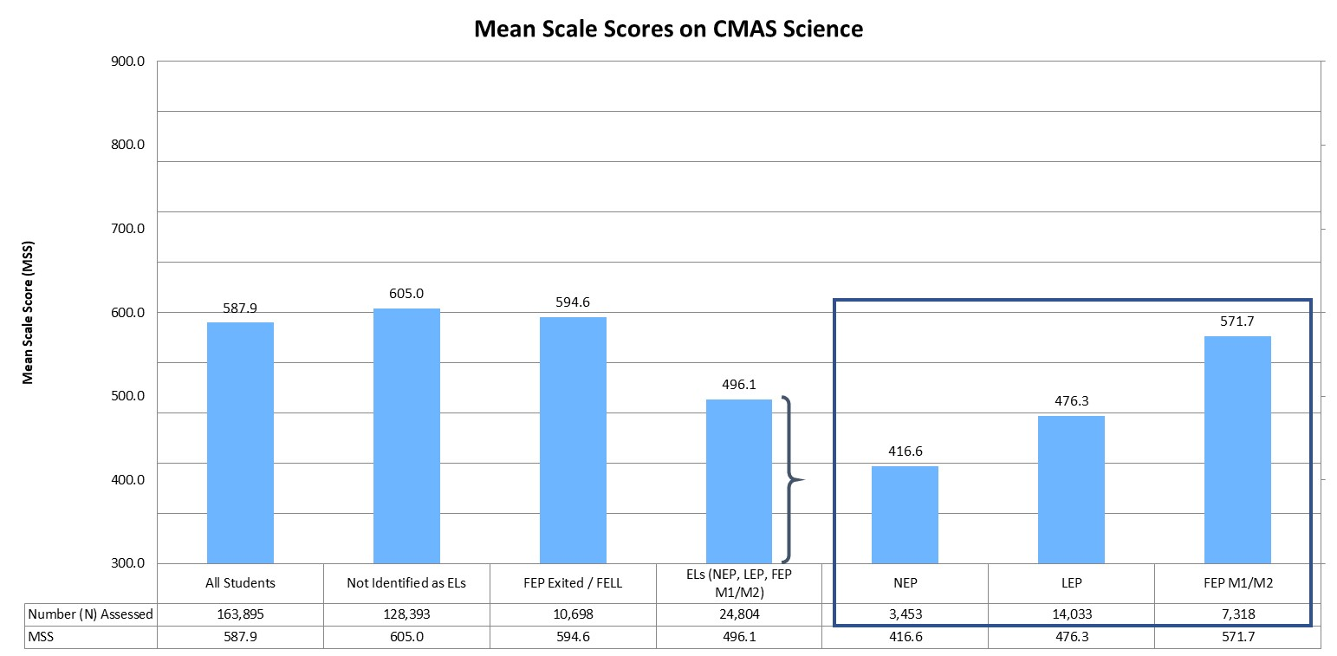
Mean Scale Scores (MSS) on CMAS science Assessment
The mean scale score (MSS) on the CMAS science assessment was 587.9 for all students in grades 5, 8, and 11, compared to an MSS of 496.1 for English learners.

Slide 69
Dropout Rate
Student Group | Number (N) of Total Students | Number (N) of Dropouts | Dropout Rate (%)
All Students | 309,736 | 9,769 | 3.2%
ELs (NEP, LEP) | 34,158 | 1,988 | 5.8%
Statewide, 3.2% of all students discontinued their educational services without receiving credentials or providing adequate documentation of a transfer to another educational setting. In comparison, 5.8% of English learners were considered dropouts.

Slide 70
Long-Term Goals

Slide 71
Long-Term Goals Under ESSA
Under ESSA, states are required to establish long-term goals and measures of interim progress. Colorado uses mean scale scores (MSS) on the ELA and math assessments to measure progress towards long-term goals in academic achievement.

Slide 72
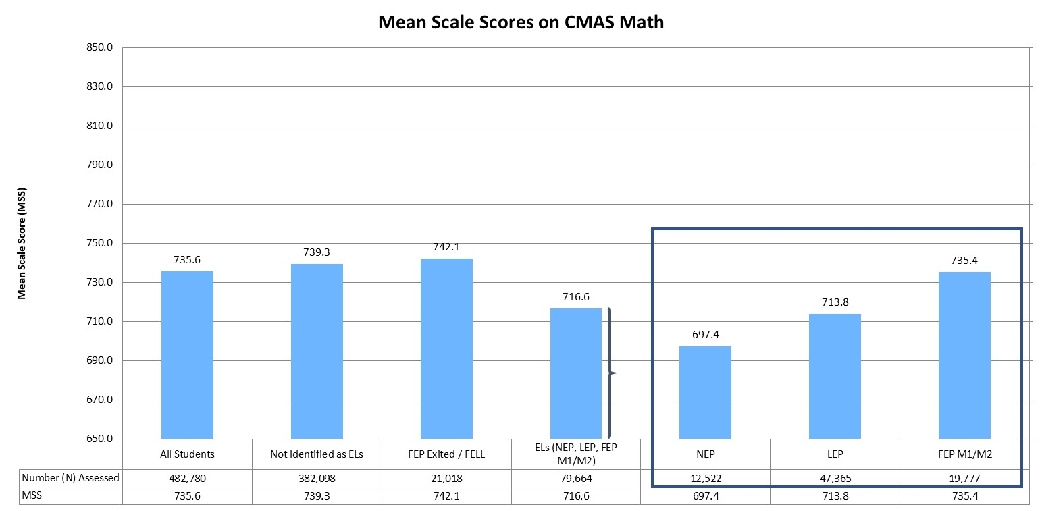
Mean Scale Scores (MSS) on CMAS math Assessment
The mean scale score (MSS) for all students in grades 3 through 8 was 735.6 on the CMAS math assessment. In comparison, the MSS for English learners was 716.6.
Notes:
On the CMAS math and English language arts assessments, scale scores range from 650 to 850.

Slide 73
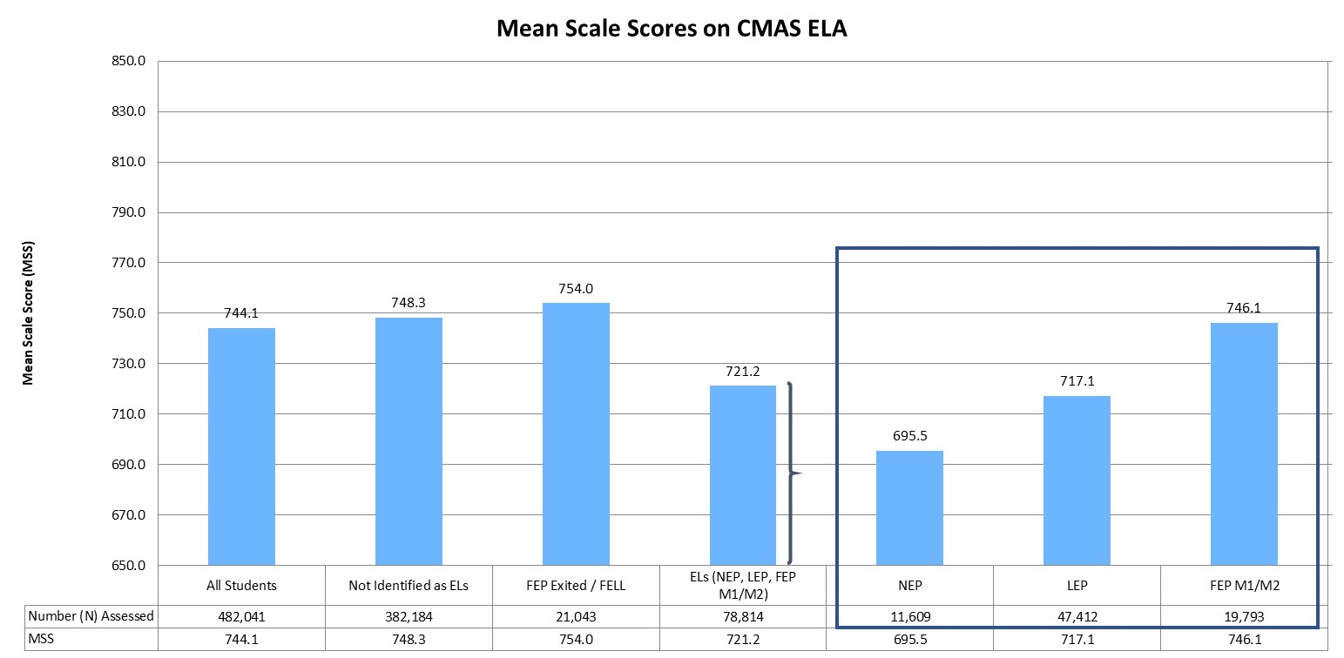
Mean Scale Scores (MSS) on CMAS ELA Assessment
The mean scale score (MSS) for all students in grades 3 through 8 was 744.1 on the CMAS ELA assessment. In comparison, the MSS for English learners was 721.2.
Notes:
On the CMAS math and English language arts assessments, scale scores range from 650 to 850.

Slide 74
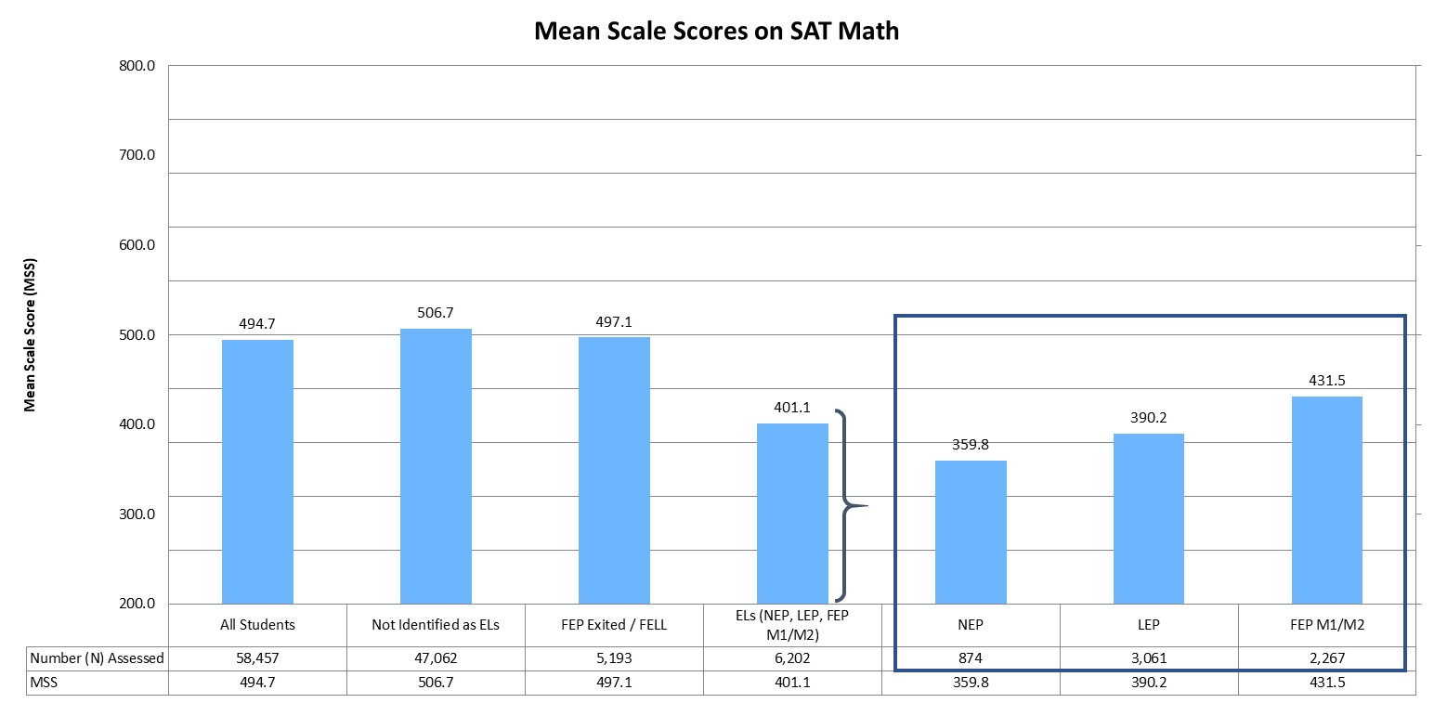
Mean Scale Scores (MSS) on SAT math Assessment
The mean scale score (MSS) for all students in grade 11 was 494.7 on the SAT math assessment. In comparison, the MSS for English learners was 401.1.
Notes:
On the SAT math and evidence-based reading and writing assessments, scale scores range from 200 to 800.

Slide 75
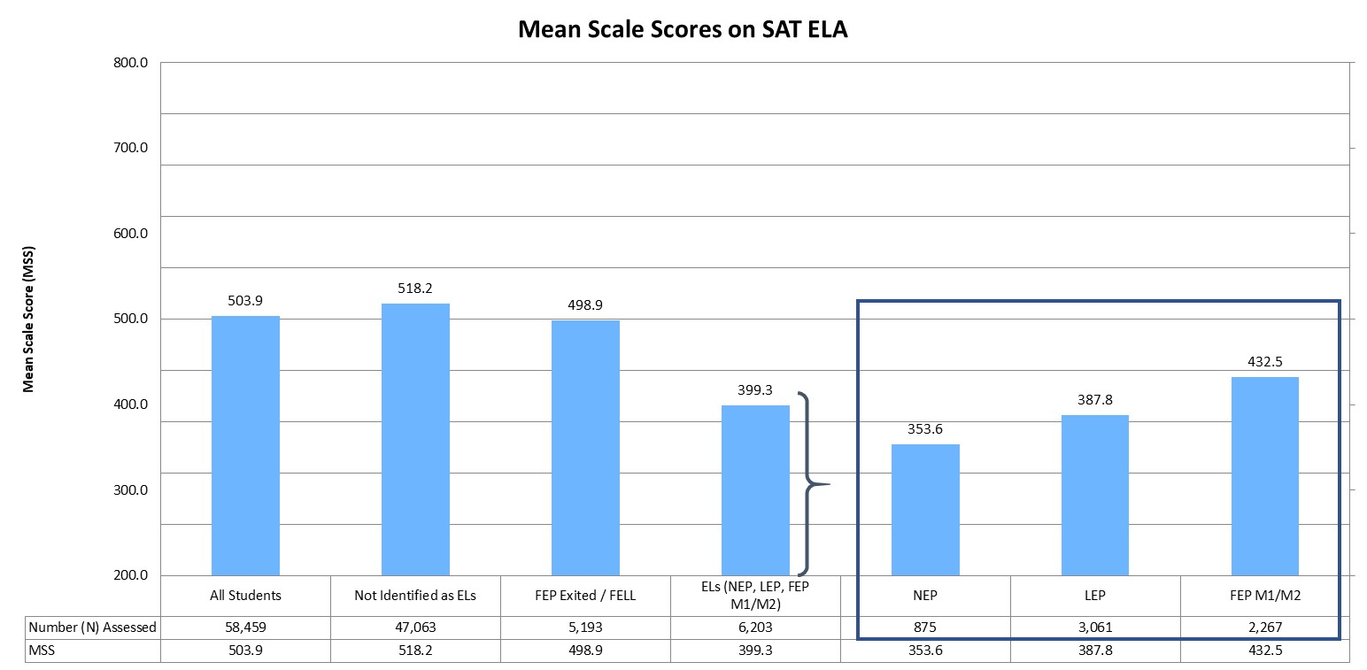
Mean Scale Scores (MSS) on SAT ELA Assessment
The mean scale score (MSS) for all students in grade 11 was 503.9 on the SAT ELA assessment. In comparison, the MSS for English learners was 399.3.
Notes:
On the SAT math and evidence-based reading and writing assessments, scale scores range from 200 to 800.

Slide 76
Participation Rates

Slide 77
Participation Rates
Students in grades 3 through 8 were administered the Colorado Measures of Academic Success (CMAS) assessments in mathematics and English language arts, and students in grade 11 were administered the SAT. In addition, students in grades 5, 8, and 11 were administered the CMAS assessment in science. Students with significant cognitive disabilities were eligible to take the Colorado Alternate (CoAlt) assessments instead. For more information on the state assessments, and for school- and district-level results, please visit the CDE Assessment Unit webpage (www.cde.state.co.us/assessment).

Slide 78
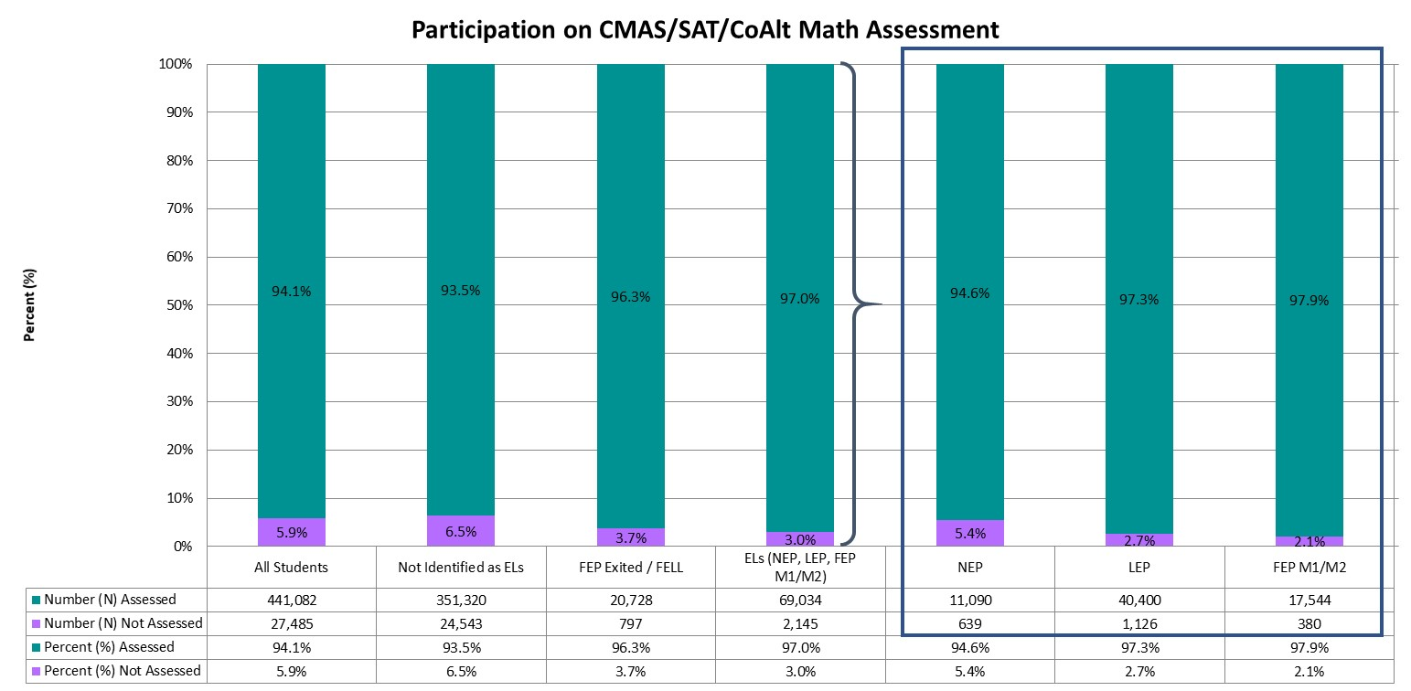
Participation on the Math Assessments (Grades 3-8 and 11)
Statewide, approximately 94.1% of students in grades 3 through 8 and grade 11 were assessed, compared to 97.0% of English learners.
Notes:
Graph represents the total number assessed (taking either the CMAS, SAT, or CoAlt assessment).

Slide 79
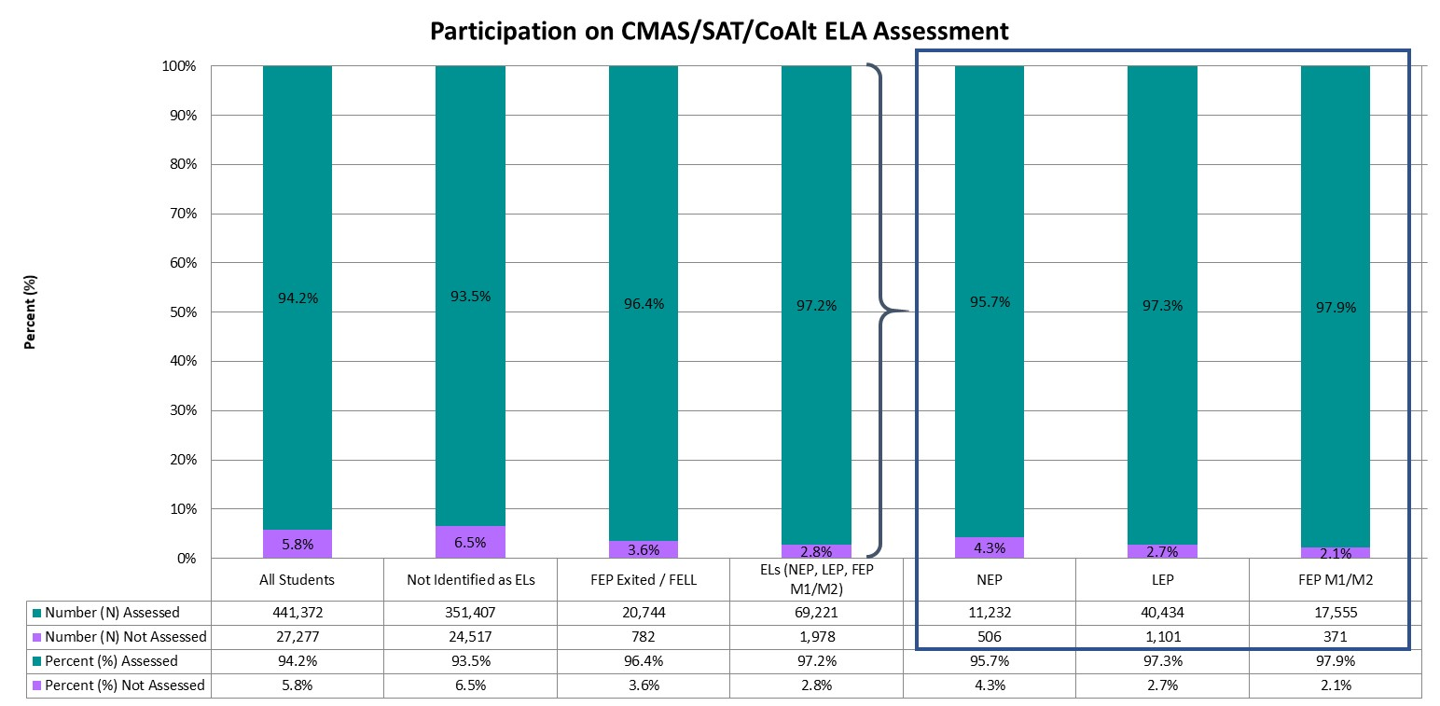
Participation on the ELA Assessments (Grades 3-8 and 11)
Statewide, approximately 94.2% of students in grades 3 through 8 and grade 11 were assessed, compared to 97.2% of English learners.
Notes:
Graph represents the total number assessed (taking either the CMAS, SAT, or CoAlt assessment).

Slide 80
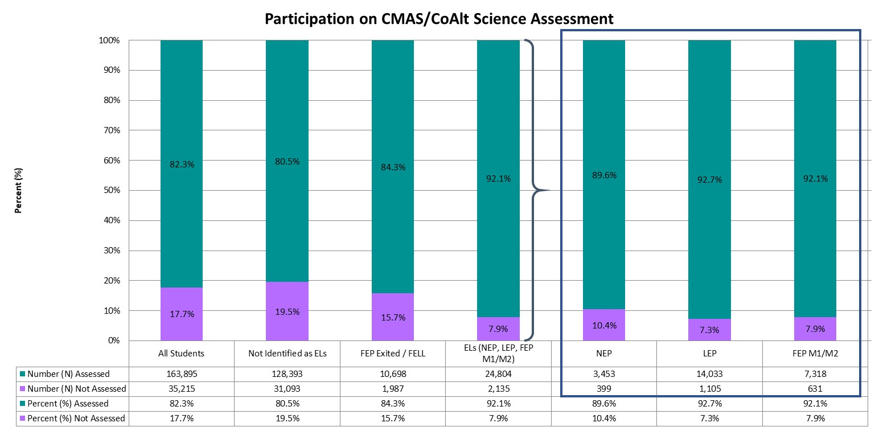
Participation on the science Assessments (Grades 5, 8, and 11)
Statewide, approximately 82.3% of students in grades 5, 8, and 11 were assessed, compared to 92.1% of English learners.
Notes:
Graph represents the total number assessed (taking either the CMAS, SAT, or CoAlt assessment).

Slide 81
National Assessment of Educational Progress (NAEP)

Slide 82
NAEP
Students in grades 4 and 8 participate in reading and mathematics assessments of the National Assessment of Educational Progress (NAEP), which are administered at least once every two years. Results from 2018-19 are included, along with the national average.

Slide 83
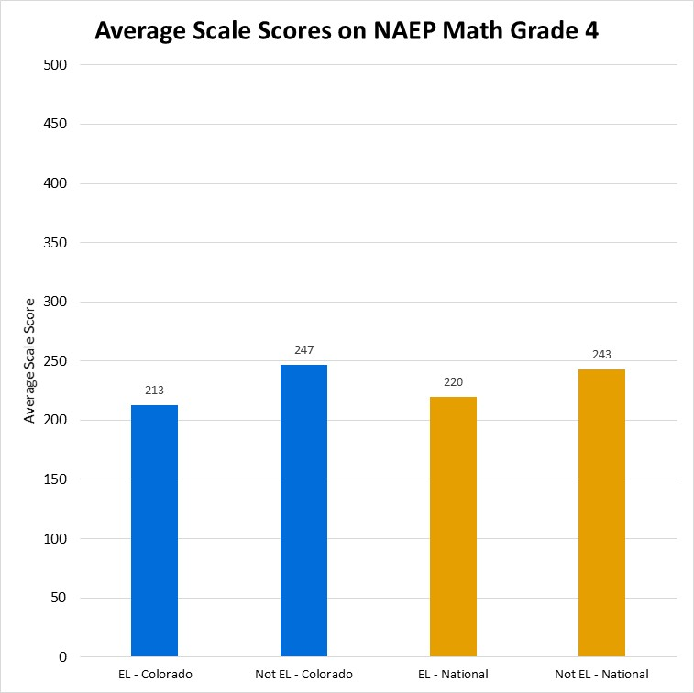
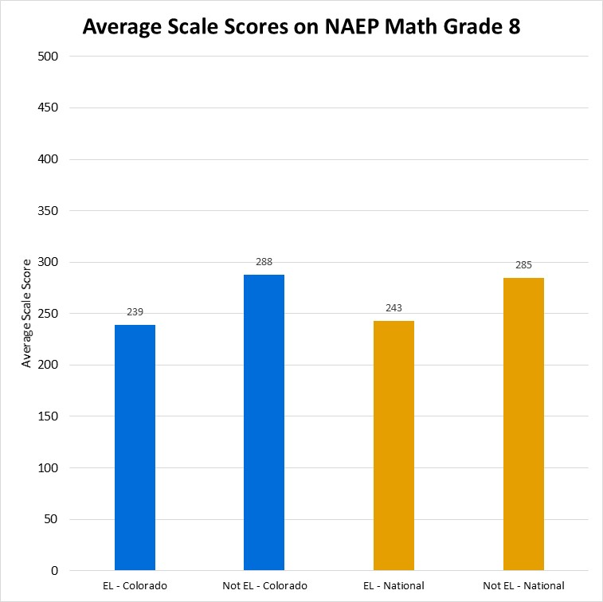
Average scale scores on NAEP Math Assessment
In 4th grade, Colorado English learners had an average scale score of 213, compared to the national average for English learners of 220. Students not identified as English learners receied an average scale score of 247 in Colorado and 243 nationally. In 8th grade, Colorado English learners had an average scale score of 239, compared to the national average for English learners of 243. Students not identified as English learners receied an average scale score of 288 in Colorado and 285 nationally.

Slide 84
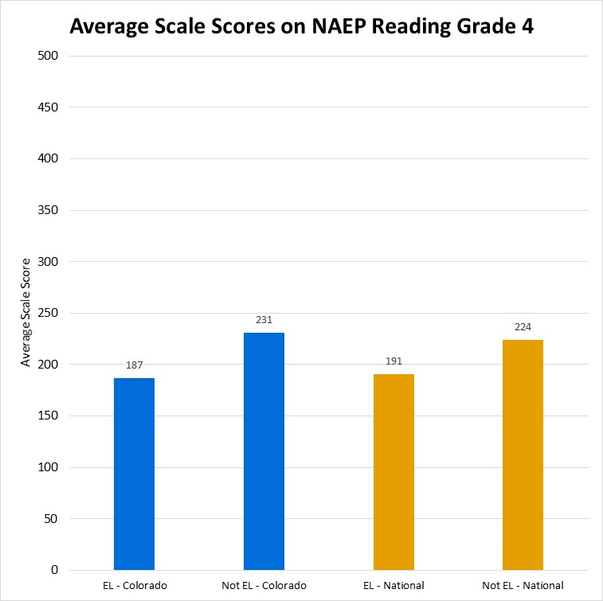
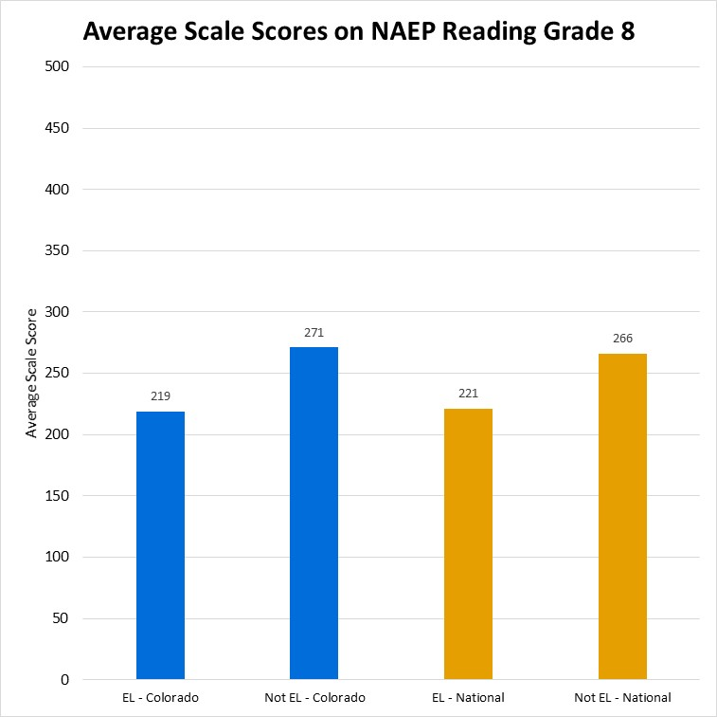
Average scale scores on NAEP Reading Assessment
In 4th grade, Colorado English learners had an average scale score of 187, compared to the national average for English learners of 191. Students not identified as English learners receied an average scale score of 231 in Colorado and 224 nationally. In 8th grade, Colorado English learners had an average scale score of 219, compared to the national average for English learners of 221. Students not identified as English learners receied an average scale score of 271 in Colorado and 266 nationally.

