Slide 1
Chapter 8: American Indian or Alaska Native & Native Hawaiian or Other Pacific Islander
May 2020

Slide 2
Introduction
Title VI of the Every Student Succeeds Act (ESSA) is designed to ensure the unique cultural, linguistic, and educational needs of American Indian, Alaska Native, and Native Hawaiian students are met so that they can meet challenging State academic standards and gain an understanding of Native communities, tribal histories, and traditions.
Aligning with federal reporting requirements, racial and ethnic identification is based on the responses to a two-part question. The first part determines whether a student is of Hispanic/Latino origin, while the second part determines which of the following groups define a student’s race: American Indian or Alaska Native, Asian, black or African American, white, or Native Hawaiian or other Pacific Islander. Students who identify as Hispanic or Latino are counted in the Hispanic category regardless of the race(s) indicated. The remaining students are categorized based on the race(s) indicated, with students who select more than one race counted in the two or more races category.
Because of this methodology, the majority of students who indicate they are American Indian or Alaska Native, or Native Hawaiian or other Pacific Islander are coded as either Hispanic or two or more races. Although federal reporting refers only to those students solely identified as American Indian or Alaska Native, or Native Hawaiian or other Pacific Islander, Colorado also analyses the performance of all students (regardless of federal reporting identification) who identify with those racial categories. For comparison purposes, the tables and figures also include data on all Colorado students.

Slide 3
Characteristics

Slide 4
Student October
Information in this section reflects student demographics at the time of the Student October Snapshot only. The Colorado Department of Education (CDE) annually collects student demographic data from districts. When districts submit the data to CDE in October of each year, it is referred to as the Student October Snapshot. The “purpose of the Student October Snapshot is to determine funding for districts and schools by taking a count of students in attendance on the Pupil Enrollment Date” (Student October Data Elements and Definitions [http://www.cde.state.co.us/datapipeline/studentoctoberdata]). Additional information is available on the CDE Pupil Membership webpage (www.cde.state.co.us/cdereval/pupilcurrent). To protect student privacy, Colorado suppresses any cells that do not meet minimum number requirements. "N/A" indicates a cell contains fewer than 16 students, or that complementary suppression rules were applied.

Slide 5
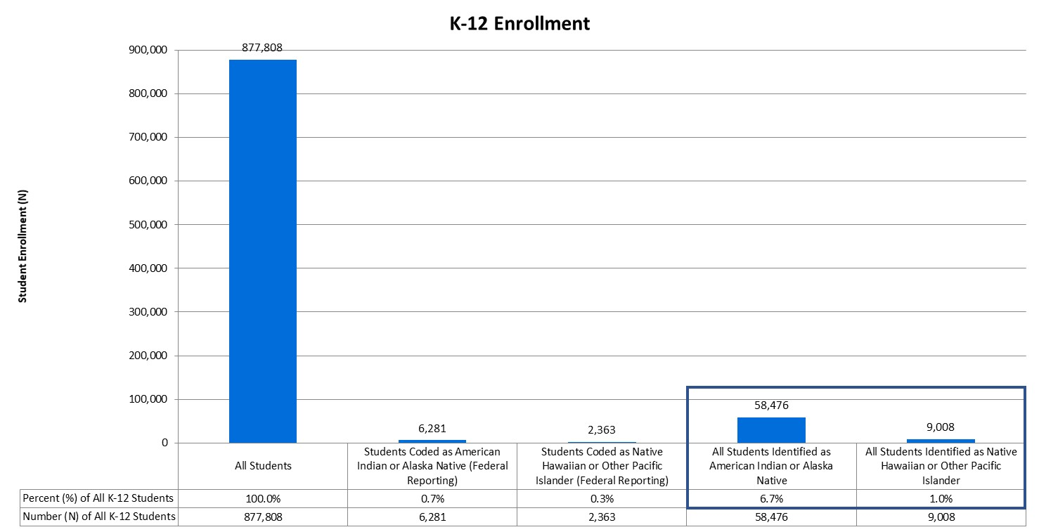
K-12 Enrollment
During the 2018-19 school year, 58,476 total students in Kindergarten through 12th grade indicated they were American Indian or Alaska Native, but only 6,281 (10.7%) of those students were classified in that racial/ethnic group based on federal reporting methodology. The majority (75.2%; N = 43,986) were federally identified as Hispanic or Latino because they indicated they were of Hispanic/Latino origin. Approximately 14.0% (N = 8,209) were federally identified as Two or More Races because they indicated more than one racial category. Based on federal identification, American Indian or Alaska Native students represent 0.7% of the total student population, although 6.7% of all students in the state indicated they were American Indian or Alaska Native.
There were 9,008 total students in K-12 who indicated they were Native Hawaiian or other Pacific Islander, and 2,363 (26.2%) were classified in that racial/ethnic group using the federal reporting methodology. The majority of students were federally identified as Two or More Races (38.8%; N = 3,497) or Hispanic or Latino (34.9%; N = 3,148). Based on federal identification, Native Hawaiian or other Pacific Islander students represent 0.3% of the total student population, although 1.0% of all students in the state indicated they were Native Hawaiian or other Pacific Islander.

Slide 6
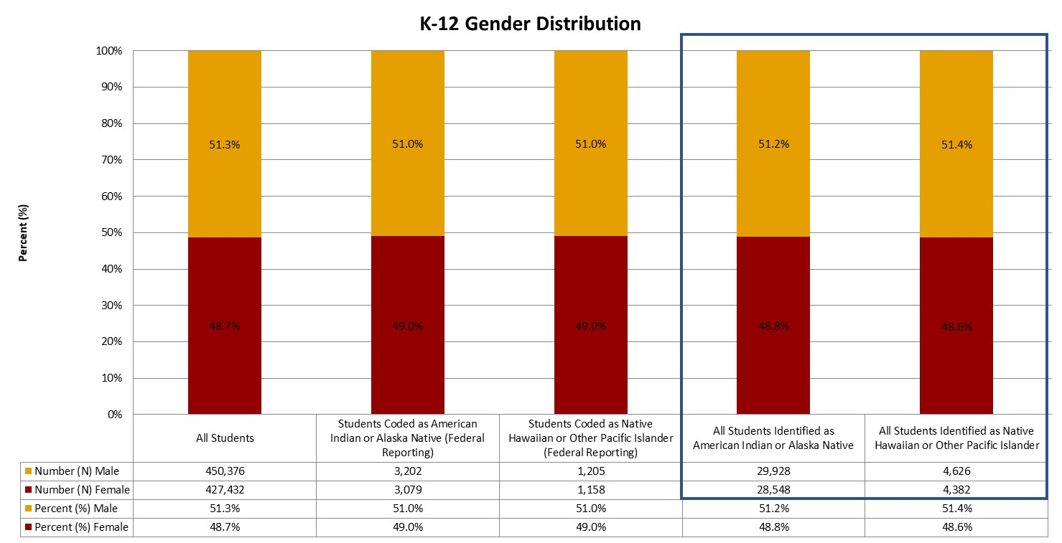
Gender
Statewide, the gender distribution of all K-12 students was 51.3% male students and 48.7% female students. The distribution for American Indian or Alaska Native students was 51.0% male students. The distribution for Native Hawaiian or other Pacific Islander students was 51.0% male students.

Slide 7
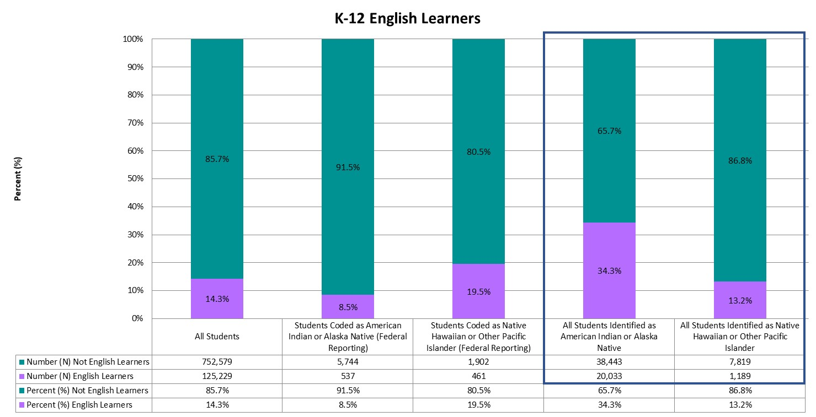
English Learners
Approximately 14.3% of students in the total K-12 population were identified as English learners. Of American Indian or Alaska Native students, 8.5% were English learners. Of Native Hawaiian or other Pacific Islander students, 19.5% were English learners.
Notes:
English learners (ELs) are those students who are linguistically diverse and identified as having a level of English language proficiency that requires language support to achieve standards in grade-level content in English (Colorado Revised Statutes under the English Language Proficiency Act 22-24-103). Although federal reporting for English learners (see Chapter 2 for more information) typically refers to students who are non-English proficient (NEP) and limited English proficient (LEP), Colorado also includes students monitored for two years following redesignation as fluent English proficient (FEP M1/M2).

Slide 8
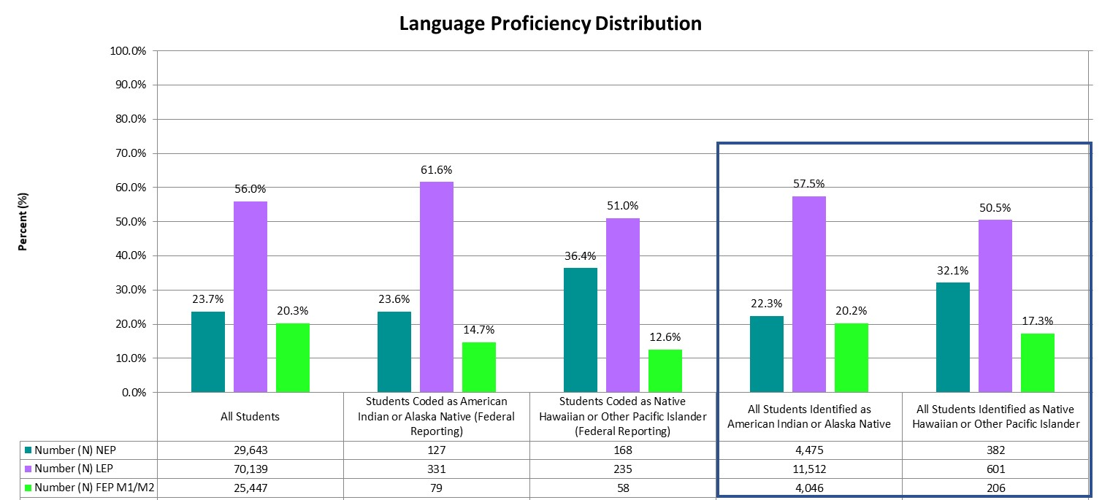
English Language Proficiency
Of the 6,281 American Indian or Alaska Native students that were also identified as English learners in K-12, 23.6% were non-English proficient, 61.6% were limited English proficient, and 14.7% were fluent English proficient in monitor years 1 or 2.
Of the 2,363 Native Hawaiian or other Pacific Islander students that were also identified as English learners in K-12, 36.4% were non-English proficient, 51.0% were limited English proficient, and 12.6% were fluent English proficient in monitor years 1 or 2.

Slide 9
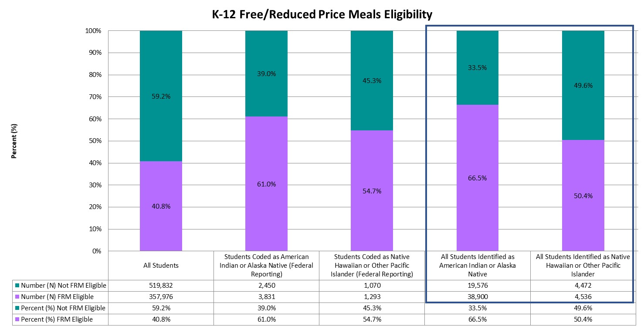
Free/Reduced Meals Eligibility
Across Colorado, 40.8% of all Colorado students were eligible for free/reduced meals (FRM), 61.0% of American Indian or Alaska Native students were eligible for FRM, and 54.7% of Native Hawaiian or other Pacific Islander students were eligible for FRM.
Notes:
Students may be eligible to receive free or reduced price meals (FRM) based on household income eligibility requirements (Eligibility Manual for School Meals [fns-prod.azureedge.net/sites/default/files/cn/SP36_CACFP15_SFSP11-2017a1.pdf]). Students from households with an income at or below 130 percent of the poverty income threshold were eligible for free meals, and students from households with an income between 130 percent and 185 percent of the poverty income threshold were eligible for reduced meals. Students from households participating in the Supplemental Nutrition Assistance Program (SNAP), Food Distribution Program on Indian Reservations (FDPIR), or Temporary Assistance for Needy Families (TANF) were also eligible for free lunch. In addition, children may also be eligible if they are designated as homeless, migrant, runaway, or a foster child. Given these requirements, free or reduced price meal eligibility is used as a proxy to determine students who are economically disadvantaged. For more information, visit the CDE Office of School Nutrition’s webpage on Free and Reduced Price Processes (www.cde.state.co.us/nutrition/nutrifreeandreducedprocesses).

Slide 10
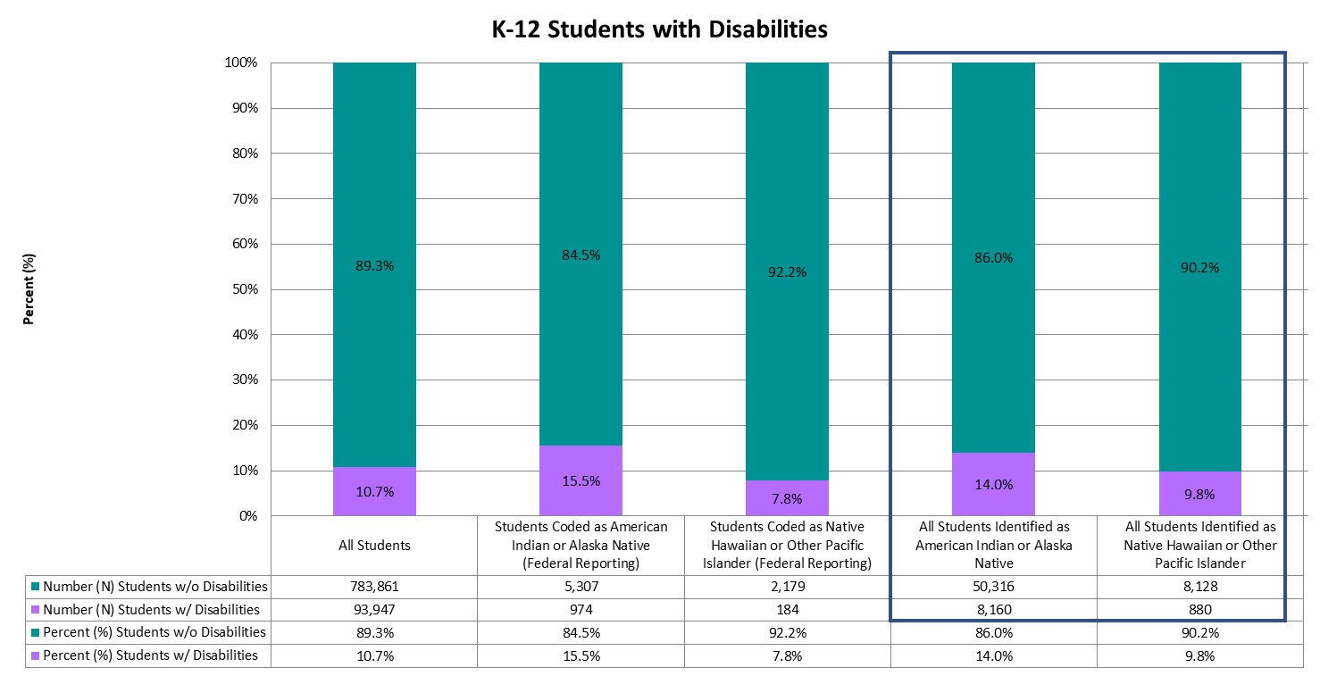
Students with Disabilities
Approximately 10.7% of all K-12 students were identified as students with disabilities (those with an Individualized Education Plan or IEP). In comparison, 15.5% of American Indian or Alaska Native students and 7.8% of Native Hawaiian or other Pacific Islander students were students with disabilities.
Notes:
Per federal reporting requirements, students with disabilities are defined as those “children having intellectual disabilities, hearing impairment (including deafness), speech or language impairment, visual impairment (including blindness), serious emotional disturbance, orthopedic impairment, autism, traumatic brain injury, developmental delay, other health impairment, a specific learning disability, deaf-blindness, or multiple disabilities, and who, as a result, receive special education and related services under the Individual with Disabilities Education Act (IDEA) according to an Individualized Education Program (IEP), Individual Family Service Plan (IFSP), or services plan” (Section 602(3) of IDEA). For additional information, visit the CDE Office of Special Education webpage (www.cde.state.co.us/cdesped), or refer to Chapter 6.

Slide 11
Disability Category
Disability Category | All Students | Students Coded as American Indian or Alaska Native (Federal Reporting) | Students Coded as Native Hawaiian or Other Pacific Islander (Federal Reporting) | All Students Identified as American Indian or Alaska Native | All Students Identified as Native Hawaiian or Other Pacific Islander
Intellectual Disability | 2.6% | * | * | 3.6% | 3.5%
Serious Emotional Disability | 5.5% | 6.0% | * | 4.5% | 5.8%
Specific Learning Disability | 42.6% | 48.4% | 40.2% | 53.9% | 39.4%
Hearing Impairment, Incl. Deafness | 1.3% | * | * | 1.4% | *
Visual Impairment, Incl. Blindness | 0.3% | * | * | * | *
Speech / Language Disability | 15.4% | 13.6% | 13.6% | 12.6% | 15.9%
Deaf-Blindness | 0.0% | * | * | * | *
Multiple Disabilities | 4.3% | * | * | 4.2% | 4.3%
Autism Spectrum Disorders | 8.1% | 4.9% | 12.0% | 4.8% | 9.2%
Traumatic Brain Injury | 0.5% | * | * | 0.5% | *
Developmental Delay | 7.0% | 7.4% | 8.7% | 5.2% | 9.1%
Infant/Toddler with a Disability | 0.0% | * | * | * | *
Orthopedic Impairment | 0.4% | * | * | 0.3% | *
Other Health Impairment | 11.9% | 11.0% | 10.9% | 8.7% | 9.8%
Statewide, of the K-12 students identified with a disability, 42.6% were identified as having a Specific Learning Disability, followed by 15.4% of students identified as having a Speech / Language Disability. In comparison, 48.4% of American Indian or Alaska Native students with a disability were identified as having a Specific Learning Disability, followed by 13.6% identified as having a Speech / Language Disability.
In addition, 40.2% of Native Hawaiian or other Pacific Islander students with a disability were identified as having a Specific Learning Disability, followed by 13.6% identified as having a Speech / Language Disability.
Notes:
For definitions and additional information regarding each disability category, please visit the CDE Office of Special Education’s webpage on Disabilities Categories (www.cde.state.co.us/cdesped/sd-main).

Slide 12
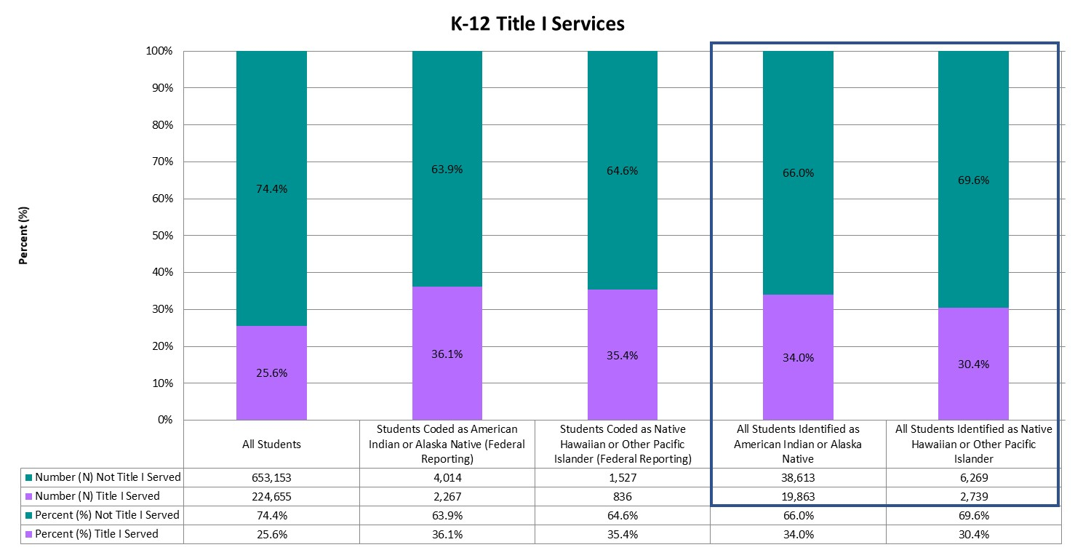
Title I Services
Approximately 36.1% of all American Indian or Alaska Native students and 35.4% of all Native Hawaiian or other Pacific Islander students were identified as receiving Title I services, compared to 25.6% of all K-12 students in the state.
Notes:
The purpose of Title I, Part A is to provide resources to schools and districts to “ensure that all children have a fair, equitable, and high-quality education, and to close educational achievement gaps” (Every Student Succeeds Act). For additional information regarding Title I services, visit the CDE Federal Programs Unit’s webpage on Title I, Part A (www.cde.state.co.us/fedprograms/ti/a), or refer to Chapter 5.

Slide 13
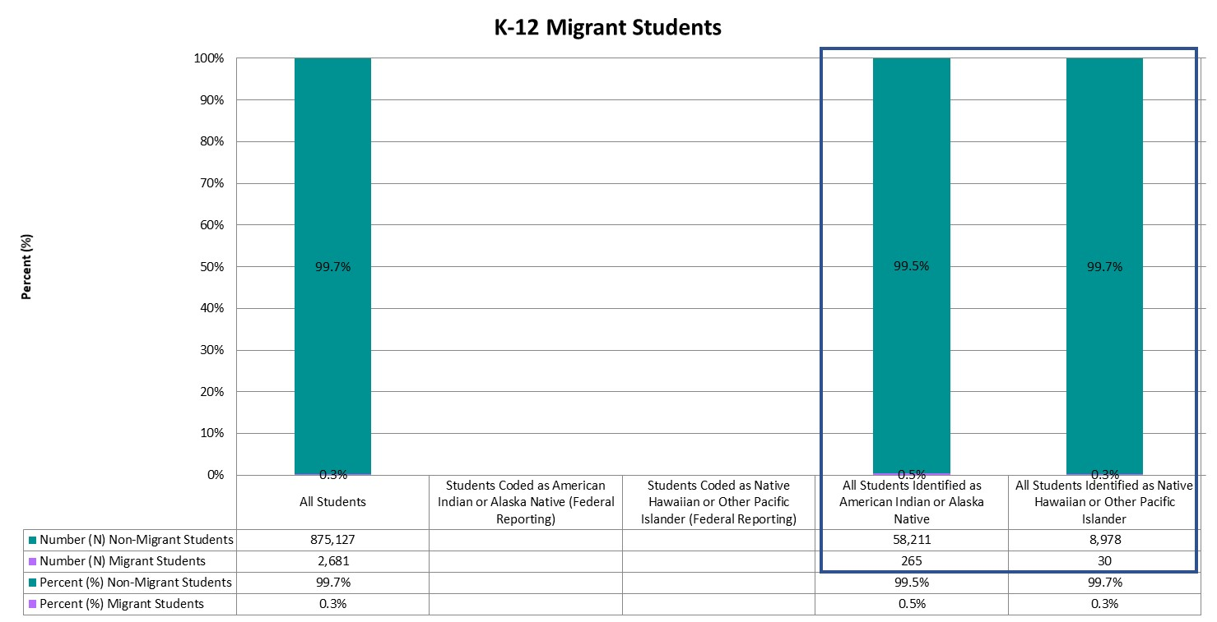
Migrant Students
Statewide, less than one percent (0.3%) of K-12 students were identified as migrant students. Fewer than 16 American Indian or Alaska Native students were identified as migrant students and fewer than 16 Native Hawaiian or other Pacific Islander students were identified as migrant students.
Notes:
Students identified as migrant students are children of migratory agricultural workers and others who are determined eligible on Certificates of Eligibility (COEs). Supplementary services are provided to these students to help reduce the educational disruption and other problems that result from repeated moves, and to ensure that migratory children are provided with appropriate educational services that address their special needs. For additional information regarding the education of migratory children, please visit the CDE Office of Migrant Education’s webpage on the Migrant Education Program (www.cde.state.co.us/migrant).

Slide 14
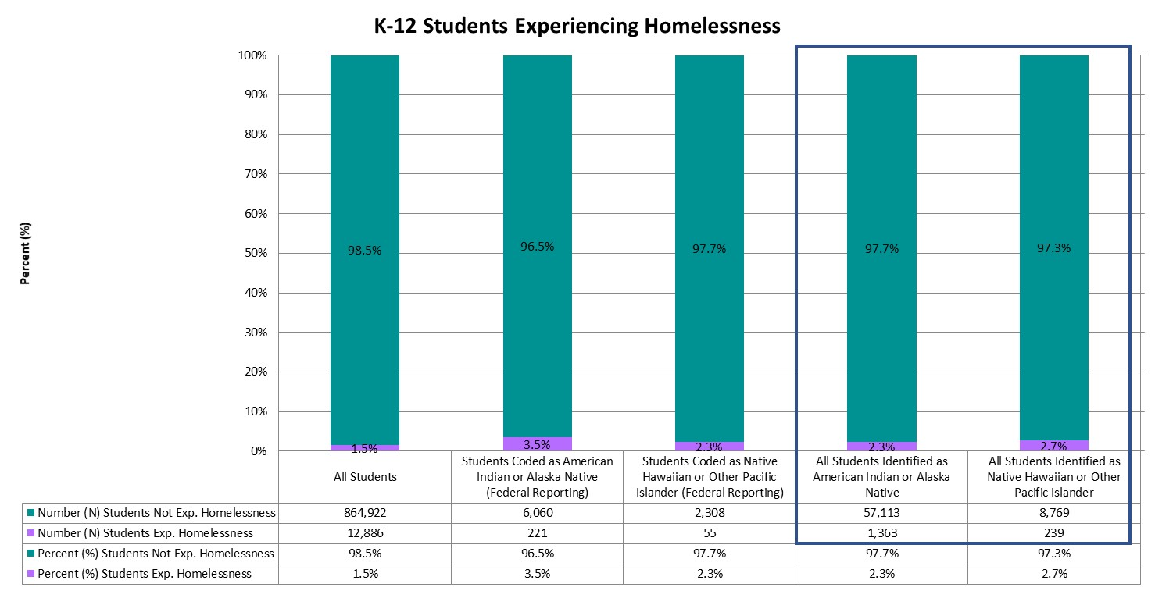
Students Experiencing Homelessness
Across the state, 1.5% of all K-12 students were experiencing homelessness based on the Student October Snapshot. Similarly, 3.5% of American Indian or Alaska Native students and 3.5% of American Indian or Alaska Native students were experiencing homelessness.
Notes:
Any displaced child or youth who is living in a shelter, motel, inadequate trailer or house, is staying temporarily with relatives or friends due to economic hardship or loss of housing, or is living in any other homeless situation has educational rights under the McKinney-Vento Act. These services are designed to assist students experiencing homelessness in enrolling in and attending school, completing their high school education, and continuing on to higher education. Additional information regarding homeless education and the McKinney-Vento Act can be found on the CDE Office of Dropout Prevention and Student Re-Engagement’s webpage on McKinney-Vento Homeless Education (www.cde.state.co.us/dropoutprevention/homeless_index).

Slide 15
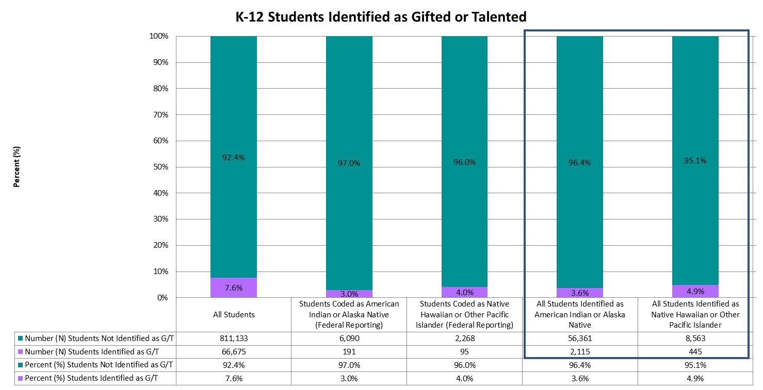
Students Identified as Gifted/Talented
Approximately 7.6% of all K-12 students, and 3.0% of American Indian or Alaska Native students and 4.0% of Native Hawaiian or other Pacific Islander students were identified as gifted or talented.
Notes:
The Exceptional Children’s Educational Act (ECEA) defines gifted students as those students whose aptitude or competence in abilities, talents, and potential for accomplishment in one or more domains are so exceptional or developmentally advanced that they require special provisions to meet their educational programming needs. For additional information regarding gifted education, visit the CDE Office of Gifted Education’s webpage (www.cde.state.co.us/gt), or refer to Chapter 7.

Slide 16
Location and Context

Slide 17
Districts with Highest Number of American Indian or Alaska Native students
American Indian or Alaska Native students are located throughout the state, with 141 districts having at least one American Indian or Alaska Native student enrolled during the Student October Snapshot in the 2018-19 school year. Zero districts had more than 1,000 K-12 American Indian or Alaska Native students enrolled at the time of the Snapshot, with the top 10 districts each having enrolled more than 100 American Indian or Alaska Native students. Montezuma-Cortez Re-1 had the highest number of American Indian or Alaska Native students enrolled (N = 746), followed by Denver County 1 (N = 570) and Jefferson County R-1 (N = 548).
District Number | District Name | Number (N) All Students | Number (N) Students Coded as American Indian or Alaska Native (Federal Reporting) | Percent (%) Students Coded as American Indian or Alaska Native (Federal Reporting)
2035 | MONTEZUMA-CORTEZ RE-1 | 2,686 | 746 | 27.8%
0880 | DENVER COUNTY 1 | 86,928 | 570 | 0.7%
1420 | JEFFERSON COUNTY R-1 | 81,714 | 548 | 0.7%
0130 | CHERRY CREEK 5 | 54,275 | 310 | 0.6%
0900 | DOUGLAS COUNTY RE 1 | 65,671 | 300 | 0.5%
0180 | ADAMS-ARAPAHOE 28J | 38,010 | 252 | 0.7%
1520 | DURANGO 9-R | 5,228 | 238 | 4.6%
1540 | IGNACIO 11 JT | 730 | 227 | 31.1%
0020 | ADAMS 12 FIVE STAR SCHOOLS | 38,095 | 214 | 0.6%
1110 | DISTRICT 49 | 22,079 | 190 | 0.9%

Slide 18
Districts with Highest Number of Native Hawaiian or other Pacific Islander students
Native Hawaiian or other Pacific Islander students are located throughout the state, with 89 districts having at least one Native Hawaiian or other Pacific Islander student enrolled during the Student October Snapshot in the 2018-19 school year. Zero districts had more than 1,000 K-12 Native Hawaiian or other Pacific Islander students enrolled at the time of the Snapshot, with the top 10 districts each having enrolled more than 70 Native Hawaiian or other Pacific Islander students. Denver County 1 had the highest number of Native Hawaiian or other Pacific Islander students enrolled (N = 330), followed by Adams-Arapahoe 28J (N = 303) and Cherry Creek 5 (N = 182).
District Number | District Name | Number (N) All Students | Number (N) Students Coded as Native Hawaiian or Other Pacific Islander (Federal Reporting) | Percent (%) Students Coded as Native Hawaiian or Other Pacific Islander (Federal Reporting)
0880 | DENVER COUNTY 1 | 86,928 | 330 | 0.4%
0180 | ADAMS-ARAPAHOE 28J | 38,010 | 303 | 0.8%
0130 | CHERRY CREEK 5 | 54,275 | 182 | 0.3%
1000 | FOUNTAIN 8 | 7,861 | 156 | 2.0%
1420 | JEFFERSON COUNTY R-1 | 81,714 | 136 | 0.2%
1010 | COLORADO SPRINGS 11 | 25,624 | 133 | 0.5%
0990 | WIDEFIELD 3 | 9,150 | 129 | 1.4%
0980 | HARRISON 2 | 11,735 | 101 | 0.9%
1110 | DISTRICT 49 | 22,079 | 93 | 0.4%
1040 | ACADEMY 20 | 25,807 | 72 | 0.3%

Slide 19
Districts with Highest Percentage of American Indian or Alaska Native students
For two districts, American Indian or Alaska Native students represented at least one-quarter of their K-12 student population. The top 10 districts had student populations composed of at least 3.3 percent American Indian or Alaska Native students. Ignacio 11 Jt had the highest percent of American Indian or Alaska Native students (31.1%). Three districts were in the top 10 for both number and percent of American Indian or Alaska Native students: Durango 9-R, Ignacio 11 Jt, Montezuma-Cortez Re-1. To protect student privacy, three districts with fewer than 16 American Indian or Alaska Native students were excluded.
District Number | District Name | Number (N) All Students | Number (N) Students Coded as American Indian or Alaska Native (Federal Reporting) | Percent (%) Students Coded as American Indian or Alaska Native (Federal Reporting)
1540 | IGNACIO 11 JT | 730 | 227 | 31.1%
2035 | MONTEZUMA-CORTEZ RE-1 | 2,686 | 746 | 27.8%
0220 | ARCHULETA COUNTY 50 JT | 1,706 | 125 | 7.3%
2070 | MANCOS RE-6 | 451 | 26 | 5.8%
2055 | DOLORES RE-4A | 655 | 35 | 5.3%
1520 | DURANGO 9-R | 5,228 | 238 | 4.6%
1390 | HUERFANO RE-1 | 489 | 16 | 3.3%

Slide 20
Districts with Highest Percentage of Native Hawaiian or other Pacific Islander students
The top 10 districts had student populations composed of at least 0.8 percent Native Hawaiian or other Pacific Islander students. Fountain 8 had the highest percent of Native Hawaiian or other Pacific Islander students (2.0%). Four districts were in the top 10 for both number and percent of Native Hawaiian or other Pacific Islander students: Durango 9-R, Ignacio 11 Jt, Montezuma-Cortez Re-1. To protect student privacy, six districts with fewer than 16 Native Hawaiian or other Pacific Islander students were excluded.
District Number | District Name | Number (N) All Students | Number (N) Students Coded as Native Hawaiian or Other Pacific Islander (Federal Reporting) | Percent (%) Students Coded as Native Hawaiian or Other Pacific Islander (Federal Reporting)
1000 | FOUNTAIN 8 | 7,861 | 156 | 2.0%
0990 | WIDEFIELD 3 | 9,150 | 129 | 1.4%
0980 | HARRISON 2 | 11,735 | 101 | 0.9%
0180 | ADAMS-ARAPAHOE 28J | 38,010 | 303 | 0.8%

Slide 21
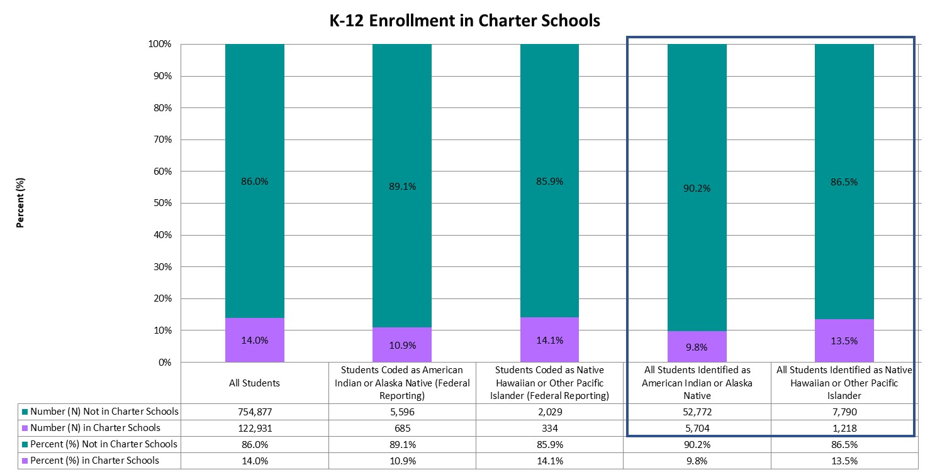
Enrolled in Charter Schools
Statewide, approximately 14.0% of all K-12 students, 10.9% of American Indian or Alaska Native students, and 14.1% of Native Hawaiian or other Pacific Islander students were enrolled in a Charter school.
Notes:
Charter schools operate under a charter (or contract) between the charter school and its authorizer, which is either a local school district or the Colorado Charter School Institute. Parents must apply to charter schools if they choose to enroll their children in a charter school. Additional information is available on the CDE Schools of Choice Office’s webpage on Colorado Charter Schools (www.cde.state.co.us/cdechart).

Slide 22
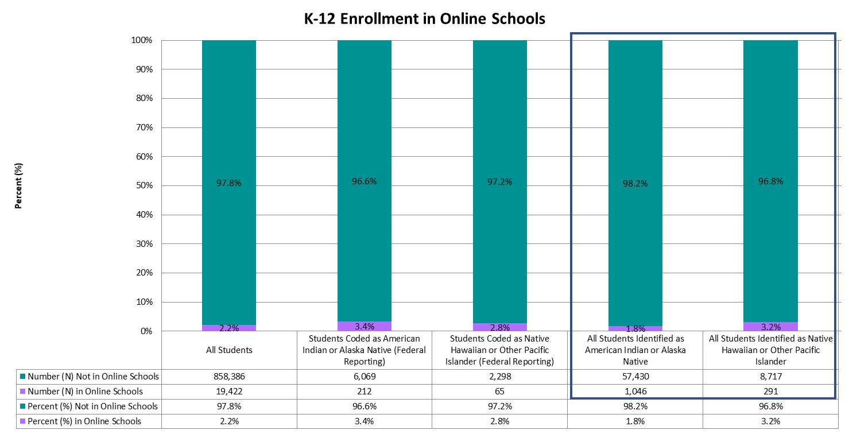
Enrolled in Online Schools
Only 2.2% of all K-12 students, 3.4% of American Indian or Alaska Native students, and 2.8% of Native Hawaiian or other Pacific Islander students were enrolled in online schools.
Notes:
An online school or program is a full-time education school/program that delivers a sequential program of instruction directed by a teacher, primarily through online digital learning strategies that provide students choice over time, place, and path, and teacher-guided modality of learning. For additional information, please visit the CDE Office of Blended & Online Learning webpage (www.cde.state.co.us/onlinelearning).

Slide 23
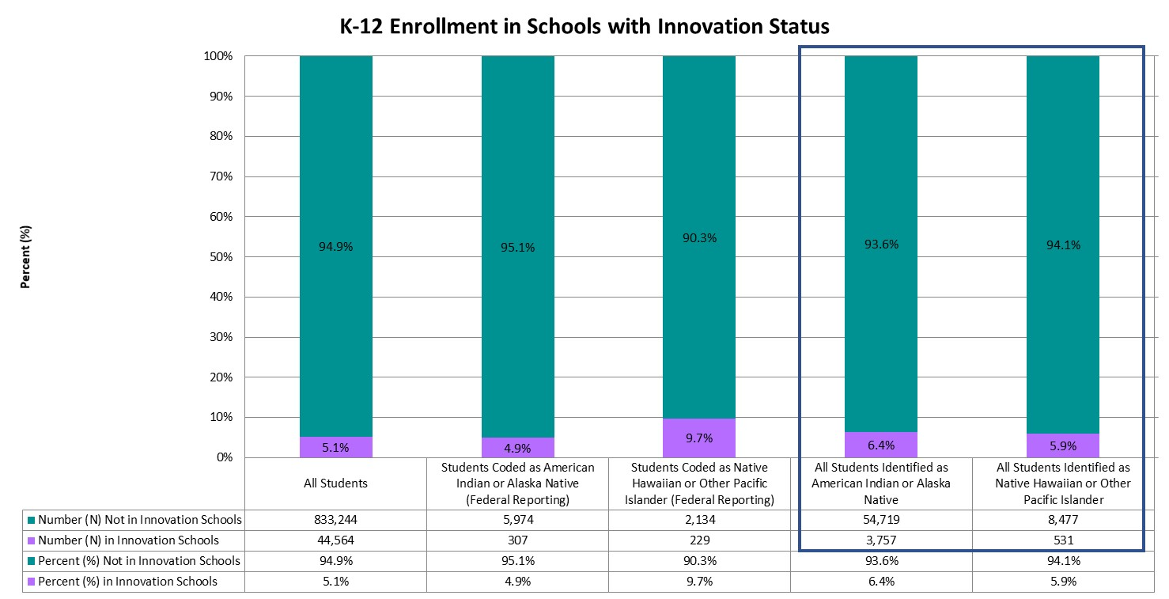
Enrolled in Schools with Innovation Status
Statewide, 5.1% of all K-12 students were enrolled in schools with Innovation status, whereas 4.9% of American Indian or Alaska Native students and 9.7% of Native Hawaiian or other Pacific Islander students were enrolled in schools with Innovation status.
Notes:
The Innovation Schools Act provides a pathway for schools and districts to obtain greater individual school autonomy and managerial flexibility in order to implement diverse approaches to learning. Schools receiving Innovation status gain greater control over issues such as educational programming, personnel selection and evaluation, calendars and scheduling, and budgeting. Additional information can be found on the CDE Schools of Choice Office’s webpage on Innovation Schools (www.cde.state.co.us/choice/innovationschools).

Slide 24
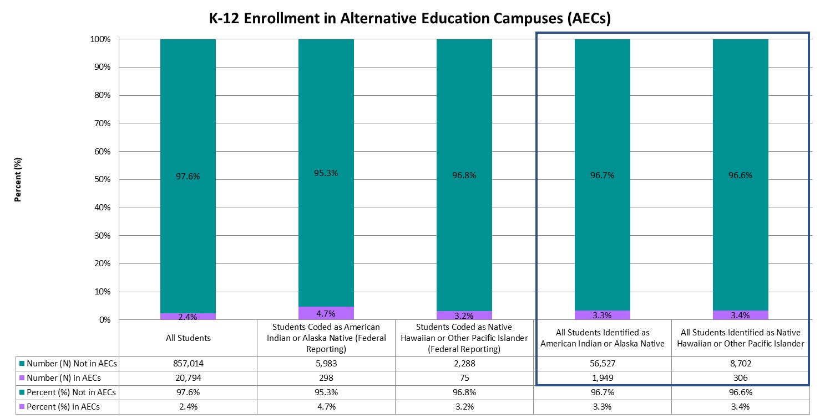
Enrolled in Alternative Education Campuses (AECs)
Approximately 2.4% of all K-12 students, 4.7% of American Indian or Alaska Native students, and 3.2% of Native Hawaiian or other Pacific Islander students were enrolled in Alternative Education Campuses (AECs).
Notes:
Schools may be designated as Alternative Education Campuses (AECs) if at least 90% of students meet criteria that classify them as high-risk, if they serve students who have severe limitations precluding appropriate administration of state assessments, or if they serve students who attend on a part-time basis, coming from other public schools. High-risk students include those students with one of more of the following conditions: juvenile delinquent, dropped out of school, expelled from school, history of drug or alcohol use, history of street gang involvement, history of child abuse or neglect, has a parent or guardian in prison, has an IEP, family history of domestic violence, repeated school suspensions, parent or pregnant woman, migrant child, homeless child, history of a serious psychiatric or behavioral disorder, or is over traditional school age for his or her grade level and lacks adequate credit hours. Additional information regarding AECs can be found on the CDE Accountability and Data Analysis Unit’s webpage for State Accountability – Alternative Education Campuses (www.cde.state.co.us/accountability/stateaccountabilityaecs).

Slide 25
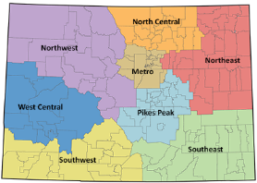
Colorado Regions
Colorado is divided into eight regions in which districts are located: Metro, North Central, Northeast, Northwest, Pikes Peak, Southeast, Southwest, and West Central. Charter School Institute and Colorado Digital BOCES serve students throughout the state, and therefore are not assigned to a particular region.

Slide 26
Enrollment Across Regions
Category | Metro | North Central | Northeast | Northwest | Pikes Peak | Southeast | Southwest | West Central | Charter School Institute | Colorado Reenvisioned BOCES | Colorado Detention Centers
Percent (%) of All Students | 52.3% | 14.4% | 1.6% | 4.0% | 17.4% | 1.4% | 2.4% | 4.1% | 2.0% | 0.3% | 0.0%
Percent (%) of Students Coded as American Indian or Alaska Native (Federal Reporting) | 41.5% | 8.4% | 1.7% | 2.4% | 15.4% | 1.4% | 24.1% | 3.4% | 1.3% | * | *
Percent (%) of Students Coded as Native Hawaiian or Other Pacific Islander (Federal Reporting) | 52.0% | 7.4% | 1.1% | 1.5% | 31.7% | * | 1.1% | 2.0% | 2.1% | * | *
Percent (%) of All Students Identified as American Indian or Alaska Native | 58.8% | 8.1% | 0.8% | 9.2% | 10.6% | 1.4% | 4.6% | 4.4% | 1.7% | * | *
Percent (%) of All Students Identified as Native Hawaiian or Other Pacific Islander | 50.7% | 7.7% | 1.1% | 4.0% | 28.9% | 0.5% | 1.4% | 3.4% | 1.9% | * | *
The majority of K-12 students (52.3%) were enrolled in the Metro region, followed by Pikes Peak (17.4%) and North Central (14.4%) regions. The majority of American Indian or Alaska Native students were enrolled in the Metro region (41.5%), followed by Southwest (24.1%) and Pikes Peak (15.4%) regions.
The majority of Native Hawaiian or other Pacific Islander students were enrolled in the Metro region (52.0%), followed by Pikes Peak (31.7%) and North Central (7.4%) regions.

Slide 27
Enrollment Within Regions
The Southwest region had the highest proportion of American Indian or Alaska Native students (7.3%), whereas the North Central region had the lowest proportion of American Indian or Alaska Native students (0.4%).
The Pikes Peak region had the highest proportion of Native Hawaiian or other Pacific Islander students (0.5%), whereas the North Central region had the lowest proportion of Native Hawaiian or other Pacific Islander students (0.1%).
Region | Number (N) All Students | Number (N) Students Coded as American Indian or Alaska Native (Federal Reporting) | Percent (%) Students Coded as American Indian or Alaska Native (Federal Reporting) | Number (N) Students Coded as Native Hawaiian or Other Pacific Islander (Federal Reporting) | Percent (%) Students Coded as Native Hawaiian or Other Pacific Islander (Federal Reporting)
Metro | 459,455 | 2,604 | 0.6% | 1,229 | 0.3%
North Central | 126,627 | 527 | 0.4% | 174 | 0.1%
Northeast | 14,288 | 107 | 0.7% | 27 | 0.2%
Northwest | 35,332 | 148 | 0.4% | 35 | 0.1%
Pikes Peak | 152,509 | 969 | 0.6% | 750 | 0.5%
Southeast | 11,932 | 90 | 0.8% | * | *
Southwest | 20,642 | 1,514 | 7.3% | 27 | 0.1%
West Central | 36,274 | 211 | 0.6% | 47 | 0.1%
Charter School Institute | 17,986 | 84 | 0.5% | 49 | 0.3%
Colorado Reenvisioned BOCES | 2,475 | * | * | * | *
Colorado Detention Centers | 288 | * | * | * | *

Slide 28
Colorado Settings
Districts are classified into one of six settings: Denver Metro, Urban-Suburban (population center over 30,000 residents, but outside the Denver Metro area), Outlying City (population center of 7,000 to 30,000), Outlying Town (population center of 1,000 to 7,000), Remote (population center of less than 1,000), or BOCES (Data Pipeline Frequently Requested Codes [www.cde.state.co.us/datapipeline/org_orgcodes]).

Slide 29
Enrollment Across Settings
Category | Denver Metro | Outlying City | Outlying Town | Remote | Urban-Suburban | Colorado BOCES | Colorado Detention Centers
Percent (%) of All Students | 55.4% | 4.4% | 8.1% | 3.5% | 28.2% | 0.4% | 0.0%
Percent (%) of Students Coded as American Indian or Alaska Native (Federal Reporting) | 42.8% | 18.5% | 7.7% | 7.9% | 22.7% | * | *
Percent (%) of Students Coded as Native Hawaiian or Other Pacific Islander (Federal Reporting) | 53.6% | 2.1% | 3.0% | * | 39.0% | * | *
Percent (%) of All Students Identified as American Indian or Alaska Native | 59.4% | 7.8% | 11.4% | 3.3% | 17.7% | * | *
Percent (%) of All Students Identified as Native Hawaiian or Other Pacific Islander | 52.7% | 3.8% | 4.2% | 2.0% | 36.9% | * | *
The majority of K-12 students (55.4%) were enrolled in Denver Metro settings, followed by Urban-Suburban settings (28.2%). The majority of American Indian or Alaska Native students were enrolled in Denver Metro settings (42.8%), followed by Urban-Suburban settings (22.7%).
The majority of Native Hawaiian or other Pacific Islander students were enrolled in Denver Metro settings (53.6%), followed by Urban-Suburban settings (39.0%).

Slide 30
Enrollment Within Regions
The Outlying City setting had the highest proportion of American Indian or Alaska Native students (3.0%), whereas the Denver Metro setting had the lowest proportion of American Indian or Alaska Native students (0.6%).
The Urban-Suburban setting had the highest proportion of Native Hawaiian or other Pacific Islander students (0.4%), whereas the Outlying City setting had the lowest proportion of Native Hawaiian or other Pacific Islander students (0.1%).
Setting | Number (N) All Students | Number (N) Students Coded as American Indian or Alaska Native (Federal Reporting) | Percent (%) Students Coded as American Indian or Alaska Native (Federal Reporting) | Number (N) Students Coded as Native Hawaiian or Other Pacific Islander (Federal Reporting) | Percent (%) Students Coded as Native Hawaiian or Other Pacific Islander (Federal Reporting)
Denver Metro | 485,960 | 2,686 | 0.6% | 1,266 | 0.3%
Outlying City | 38,921 | 1,162 | 3.0% | 50 | 0.1%
Outlying Town | 70,973 | 482 | 0.7% | 70 | 0.1%
Remote | 30,655 | 496 | 1.6% | * | *
Urban-Suburban | 247,841 | 1,424 | 0.6% | 922 | 0.4%
Colorado BOCES | 3,170 | * | * | * | *
Colorado Detention Centers | 288 | * | * | * | *

Slide 31
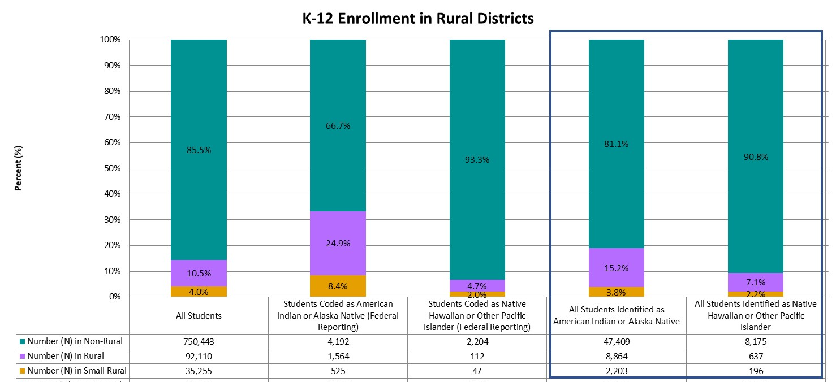
Enrolled in Rural Districts
Statewide, 10.5% of all K-12 students were enrolled in rural districts and 4.0% were enrolled in small rural districts. In comparison, 24.9% of American Indian or Alaska Native students were enrolled in rural and 8.4% in small rural districts, and 4.7% of Native Hawaiian or other Pacific Islander students were enrolled in rural and 2.0% in small rural districts.
Notes:
A Colorado school district is determined to be rural based on the size of the district, the distance from the nearest large urban/urbanized area, and having a student enrollment of approximately 6,500 students or fewer. Small rural districts are those districts meeting these same criteria and having a student population of fewer than 1,000 students. For more information, and for a list of districts considered rural or small rural, please visit the CDE Rural Education Council webpage (www.cde.state.co.us/ruraledcouncil).

Slide 32
Academic Achievement

Slide 33
Academic Achievement
Students in grades 3 through 8 were administered the Colorado Measures of Academic Success (CMAS) assessments in mathematics and English language arts, and students in grade 11 were administered the SAT assessment in mathematics and evidence-based reading and writing. In addition, students in grades 5, 8, and 11 were administered the CMAS assessment in science. Students with significant cognitive disabilities were eligible to take the Colorado Alternate (CoAlt) assessments instead. For more information on the state assessments, and for school- and district-level results, please visit the CDE Assessment Unit webpage (www.cde.state.co.us/assessment). To protect student privacy, Colorado suppresses any cells that do not meet minimum number requirements. Data omitted from the following graphs indicates fewer than 16 students, or that complementary suppression rules were applied.

Slide 34
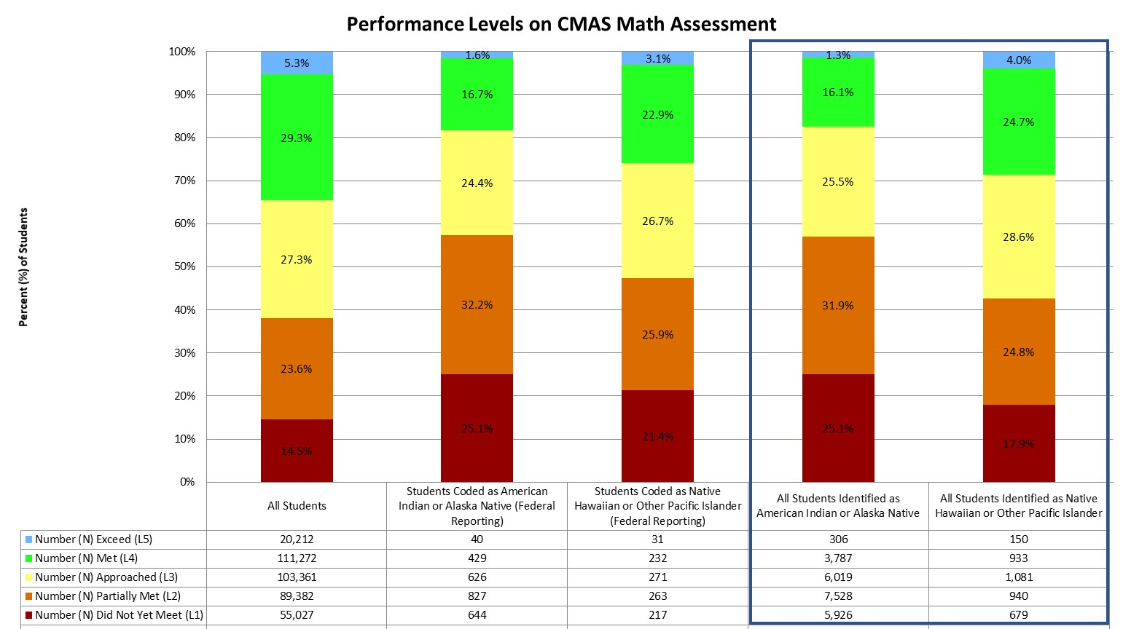
Performance on CMAS Math Assessment (Grades 3-8)
Statewide, the majority of students scored in level 4 (Met Expectations, 29.3%) and level 3 (Approached Expectations, 27.3%). The majority of American Indian or Alaska Native students scored in level 2 (Partially Met Expectations, 32.2%) and level 1 (Did Not Yet Meet Expectations, 25.1%).
The majority of Native Hawaiian or other Pacific Islander students scored in level 3 (Approached Expectations, 26.7%) and level 2 (Partially Met Expectations, 25.9%).
Notes:
The CMAS math assessment has five performance levels, ranging from Did Not Yet Meet Expectations (Level 1) to Exceed Expectations (Level 5).

Slide 35
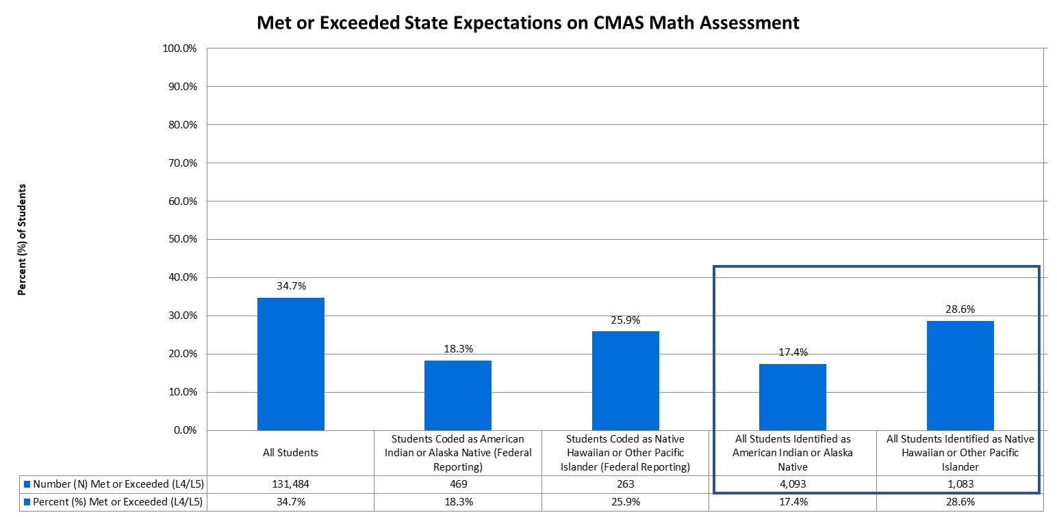
Students Meeting/Exceeding Expectations on CMAS Math Assessment (Grades 3-8)
Statewide, approximately 34.7% of students in grades 3 through 8 met or exceeded state expectations, compared to 18.3% of American Indian or Alaska Native students and 25.9% of Native Hawaiian or other Pacific Islander students.
Notes:
In addition to the percent of students scoring within each performance level, it is important to consider how many students are meeting state expectations, reaching level 4 or higher.

Slide 36
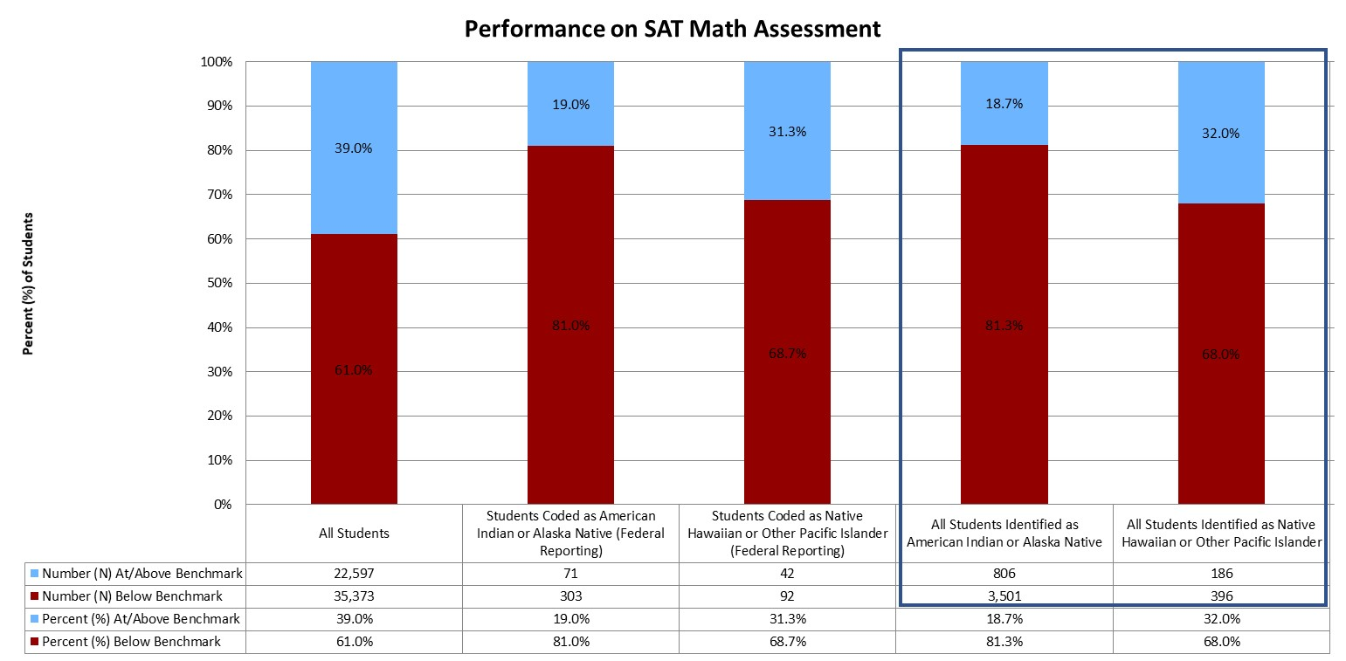
Performance on SAT Math Assessment (Grade 11)
Statewide, 39.0% of students were at or above benchmark on the SAT math assessment, compared to 19.0% of American Indian or Alaska Native students and 31.3% of Native Hawaiian or other Pacific Islander students.

Slide 37
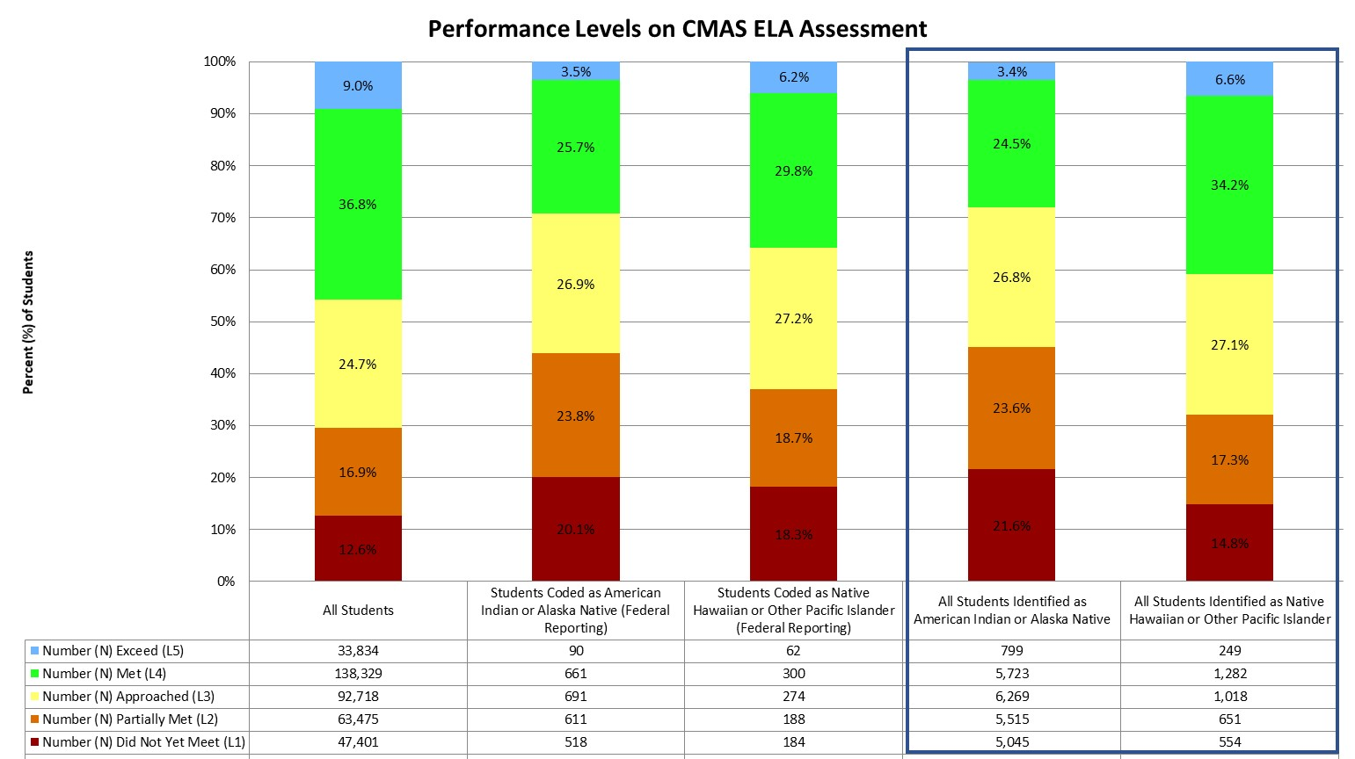
Performance on CMAS ELA Assessment (Grades 3-8)
Statewide, the majority of students scored in level 4 (Met Expectations, 36.8%) and level 3 (Approached Expectations, 24.7%). The majority of American Indian or Alaska Native students scored in level 3 (Approached Expectations, 26.9%) and level 4 (Met Expectations, 25.7%).
The majority of Native Hawaiian or other Pacific Islander students scored in level 4 (Met Expectations, 29.8%) and level 3 (Approached Expectations, 27.2%).
Notes:
Like the math assessment, the CMAS ELA assessment has five performance levels.

Slide 38
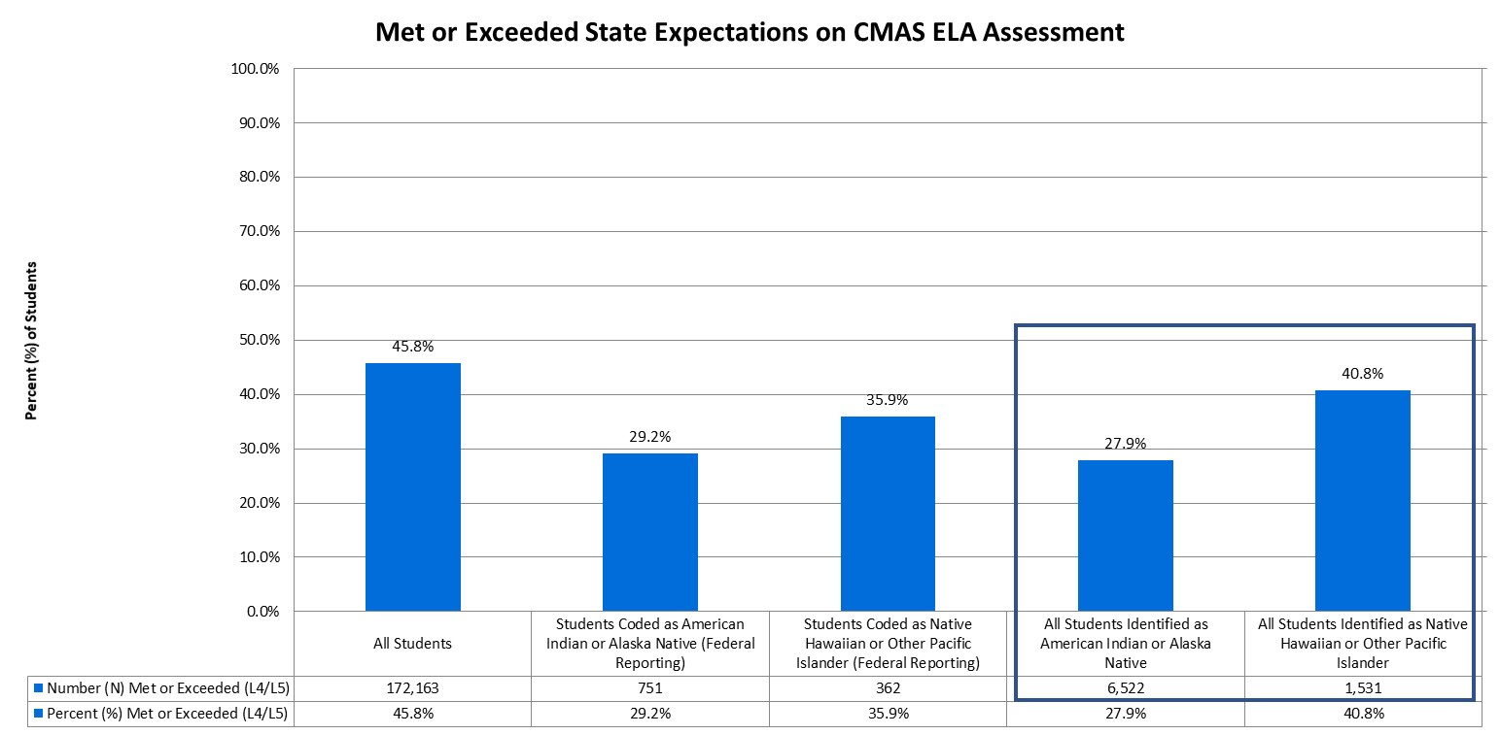
Students Meeting/Exceeding Expectations on CMAS ELA Assessment (Grades 3-8)
Statewide, approximately 45.8% of students in grades 3 through 8 met or exceeded state expectations, compared to 29.2% of American Indian or Alaska Native students and 35.9% of Native Hawaiian or other Pacific Islander students.
Notes:
In addition to the percent of students scoring within each performance level, it is important to consider how many students are meeting state expectations, reaching level 4 or higher.

Slide 39
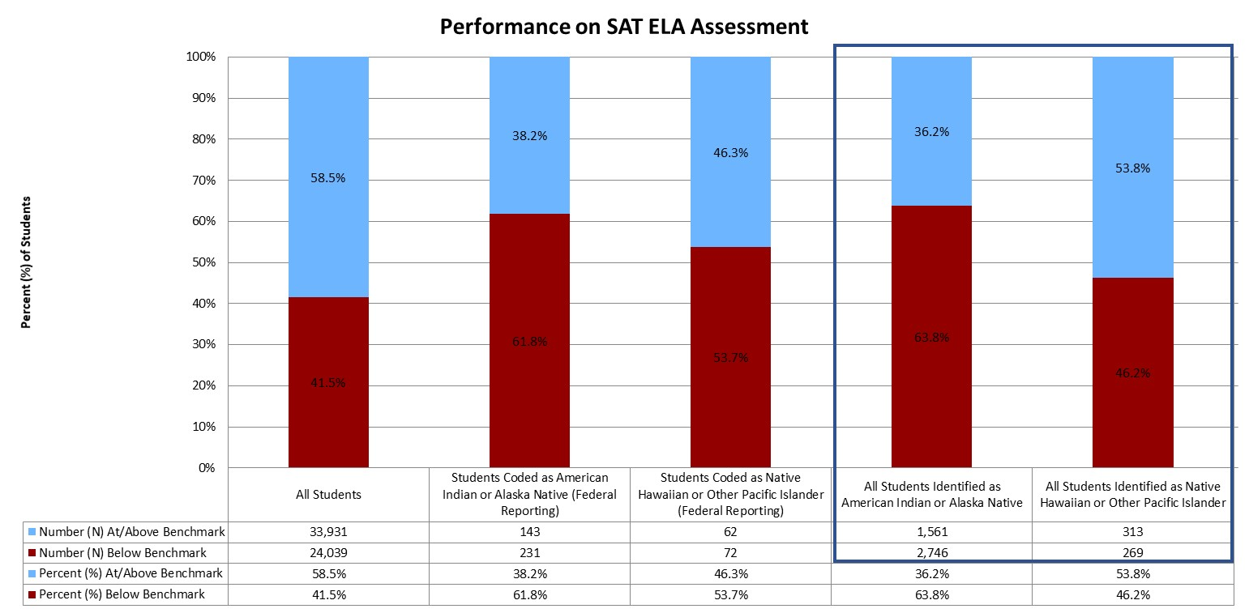
Performance on SAT ELA Assessment (Grade 11)
Statewide, 58.5% of students were at or above benchmark on the SAT math assessment, compared to 38.2% of American Indian or Alaska Native students and 46.3% of Native Hawaiian or other Pacific Islander students.

Slide 40
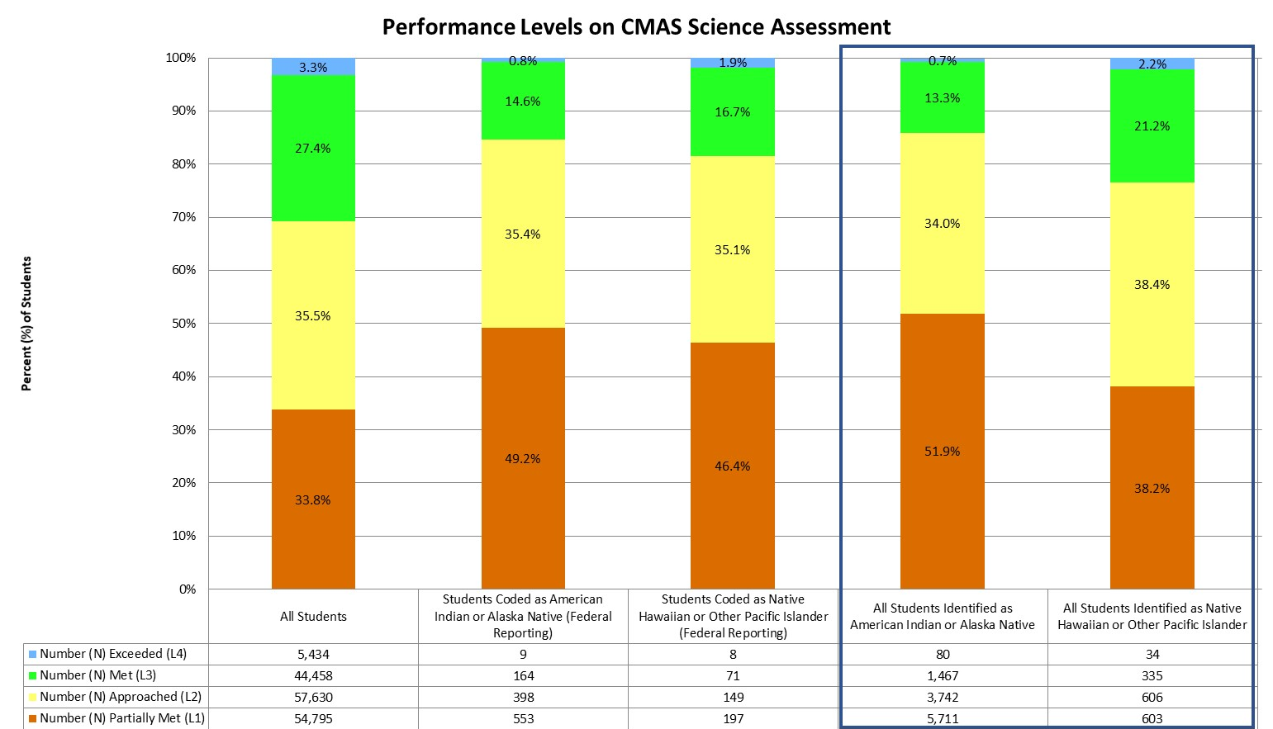
Performance on CMAS science Assessment (Grades 5, 8, and 11)
Statewide, the majority of students scored in level 2 (Approached Expectations, 35.5%) and level 1 (Partially Met Expectations, 33.8%). The majority of American Indian or Alaska Native students scored in level 1 (Partially Met Expectations, 49.2%) and level 2 (Approached Expectations, 35.4%).
The majority of Native Hawaiian or other Pacific Islander students scored in level 1 (Partially Met Expectations, 46.4%) and level 2 (Approached Expectations, 35.1%).
Notes:
The CMAS science assessment has four performance levels, ranging from Partially Met Expectations (Level 1) to Exceeded Expectations (Level 4).

Slide 41
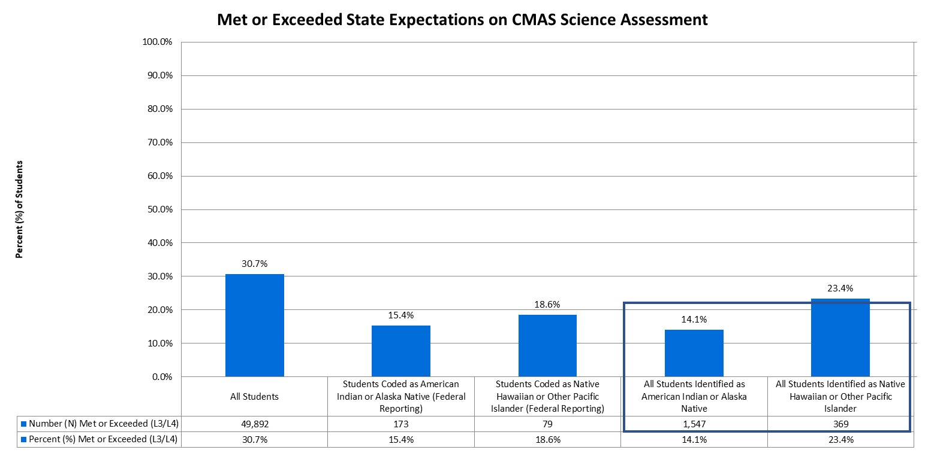
Students Meeting/Exceeding Expectations on CMAS science Assessment (Grades 5, 8, and 11)
Statewide, approximately 30.7% of students met or exceeded state expectations, compared to 15.4% of American Indian or Alaska Native students and 18.6% of Native Hawaiian or other Pacific Islander students.
Notes:
In addition to the percent of students scoring within each performance level, it is important to consider how many students are meeting state expectations, reaching level 3 or higher.

Slide 42
Academic Growth

Slide 43
Academic Growth
Colorado calculates student growth for the CMAS and SAT math and English language arts assessments. A student growth percentile (SGP) defines how much relative growth a student made, compared to that student’s academic peers. The Colorado Growth Model essentially compares each student’s current achievement to students in the same grade throughout the state who had similar scores in past years. A student growth percentile of 60, for example, indicates a student grew as well as or better than 60% of his/her academic peers. The median is then calculated by taking the individual student growth percentiles of all the students in the group being analyzed, ranking them from lowest to highest, and identifying the middle score. Medians are more appropriate to use than averages when summarizing a collection of percentile scores. For more information regarding median growth percentiles (MGPs), please visit the Colorado Growth Model FAQs (www.cde.state.co.us/schoolview/generalgrowthmodelfaq#q22).

Slide 44
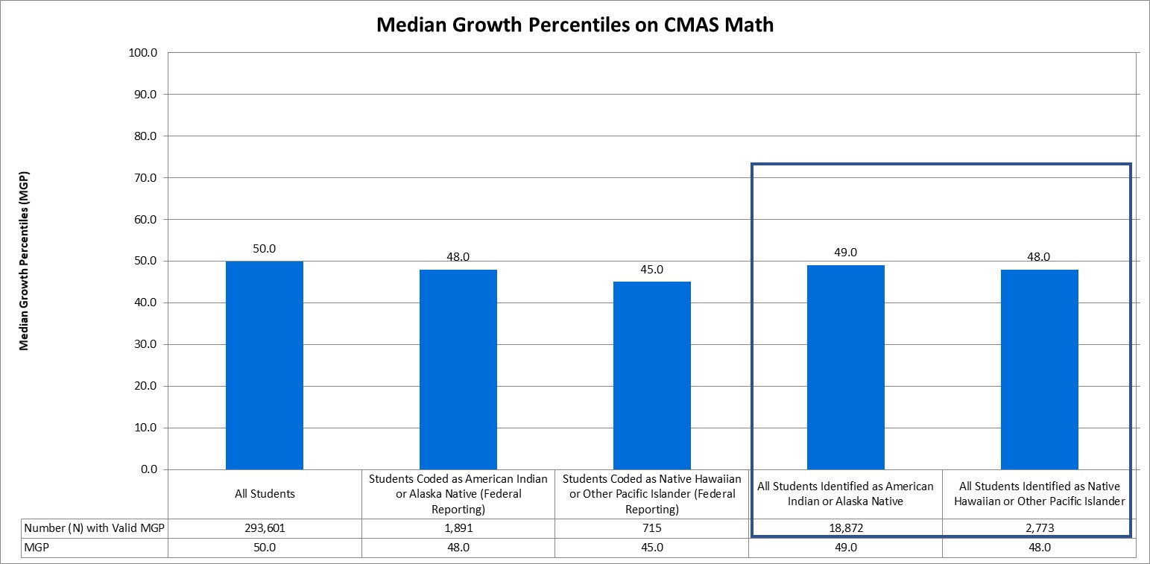
Median Growth Percentiles on CMAS math assessment
The median growth percentile (MGP) for all Colorado students (grades 4 through 8) on the CMAS math assessment was 50.0, compared to an MGP of 48.0 for American Indian or Alaska Native students and 45.0 for Native Hawaiian or other Pacific Islander students.

Slide 45
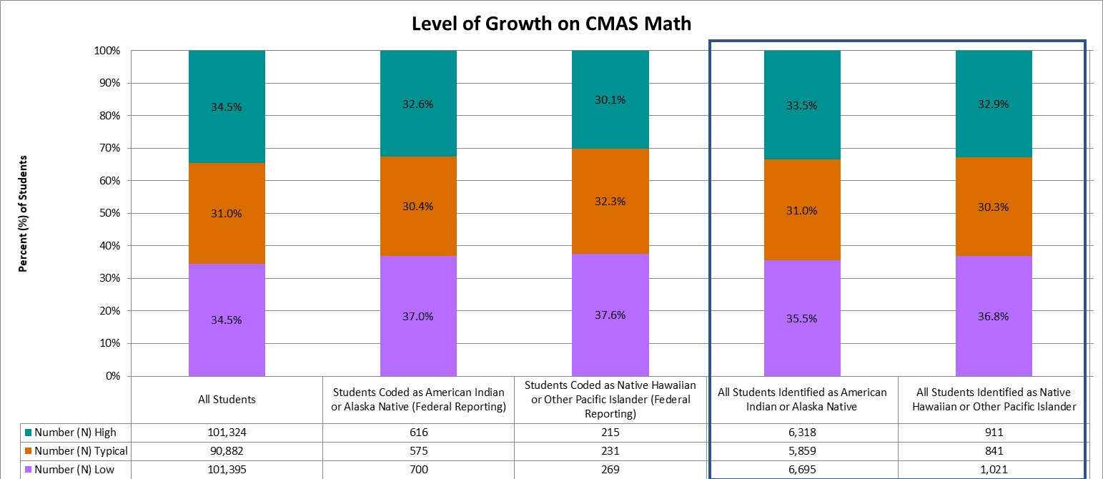
Levels of growth on CMAS math assessment
Statewide, on the CMAS math assessment, 34.5% of all students demonstrated high growth, 31.0% demonstrated typical growth, and 34.5% demonstrated low growth. In comparison, 32.6% of American Indian or Alaska Native students had high growth and 37.0% had low growth, while 30.1% of Native Hawaiian or other Pacific Islander students had high growth and 37.6% had low growth.
Notes:
A student growth percentile that falls below the 35th percentile reflects low growth, while a student growth percentile that falls above the 65th percentile reflects high growth (Colorado Growth Model FAQs [www.cde.state.co.us/schoolview/generalgrowthmodelfaq#q22]). Student growth percentiles between the 35th and 65th percentile represent typical growth.

Slide 46
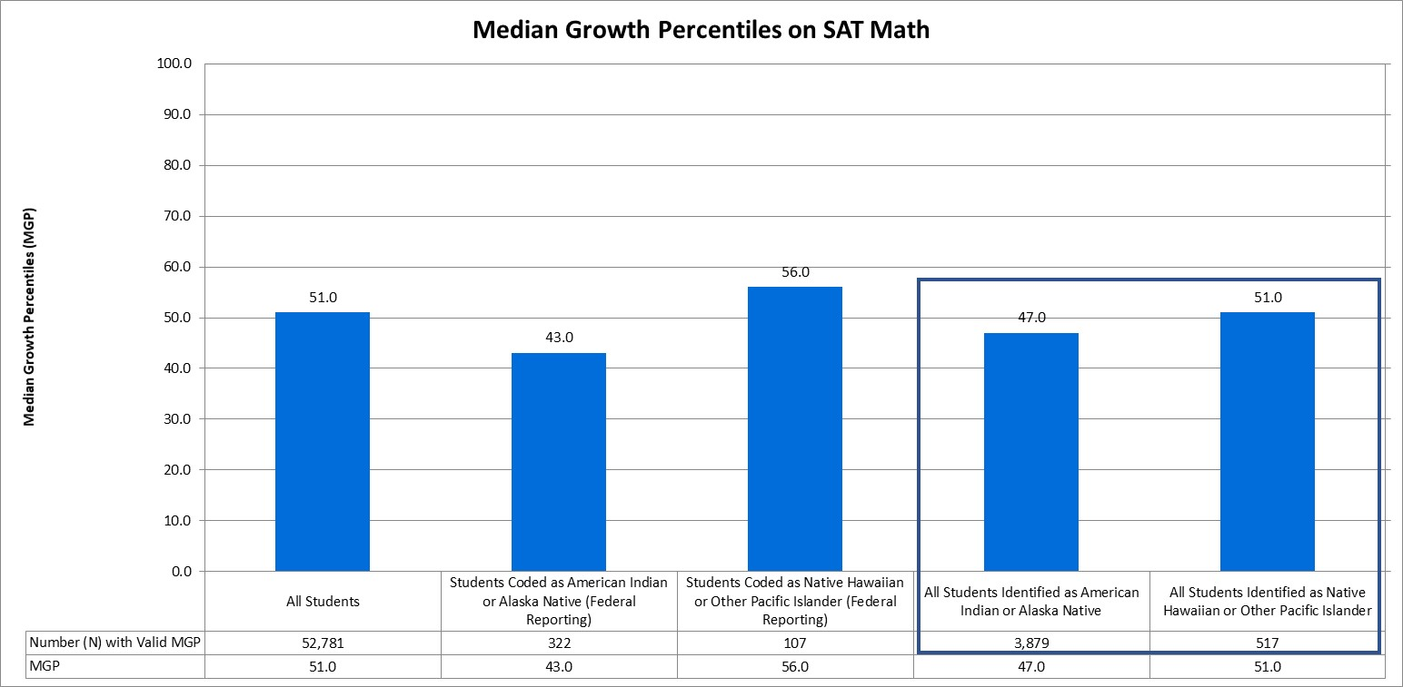
Median Growth Percentiles on SAT math assessment
The median growth percentile (MGP) for all Colorado students (grade 11) on the SAT math assessment was 51.0, compared to an MGP of 43.0 for American Indian or Alaska Native students and 56.0 for Native Hawaiian or other Pacific Islander students.

Slide 47
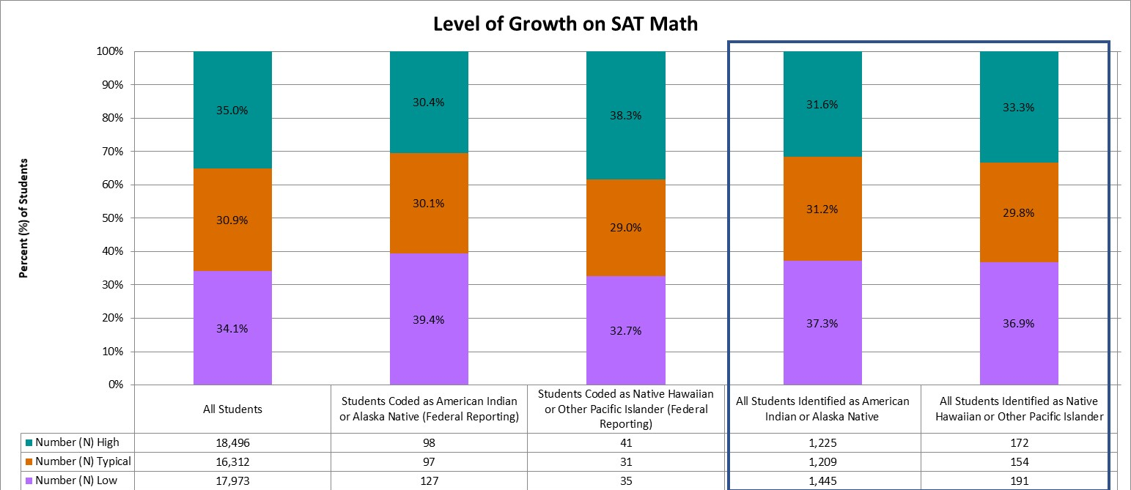
Levels of growth on SAT math assessment
Statewide, on the SAT math assessment, 35.0% of all students demonstrated high growth, 30.9% demonstrated typical growth, and 34.1% demonstrated low growth. In comparison, 30.4% of American Indian or Alaska Native students had high growth and 39.4% had low growth, while 38.3% of Native Hawaiian or other Pacific Islander students had high growth and 32.7% had low growth.
Notes:
A student growth percentile that falls below the 35th percentile reflects low growth, while a student growth percentile that falls above the 65th percentile reflects high growth (Colorado Growth Model FAQs [www.cde.state.co.us/schoolview/generalgrowthmodelfaq#q22]). Student growth percentiles between the 35th and 65th percentile represent typical growth.

Slide 48
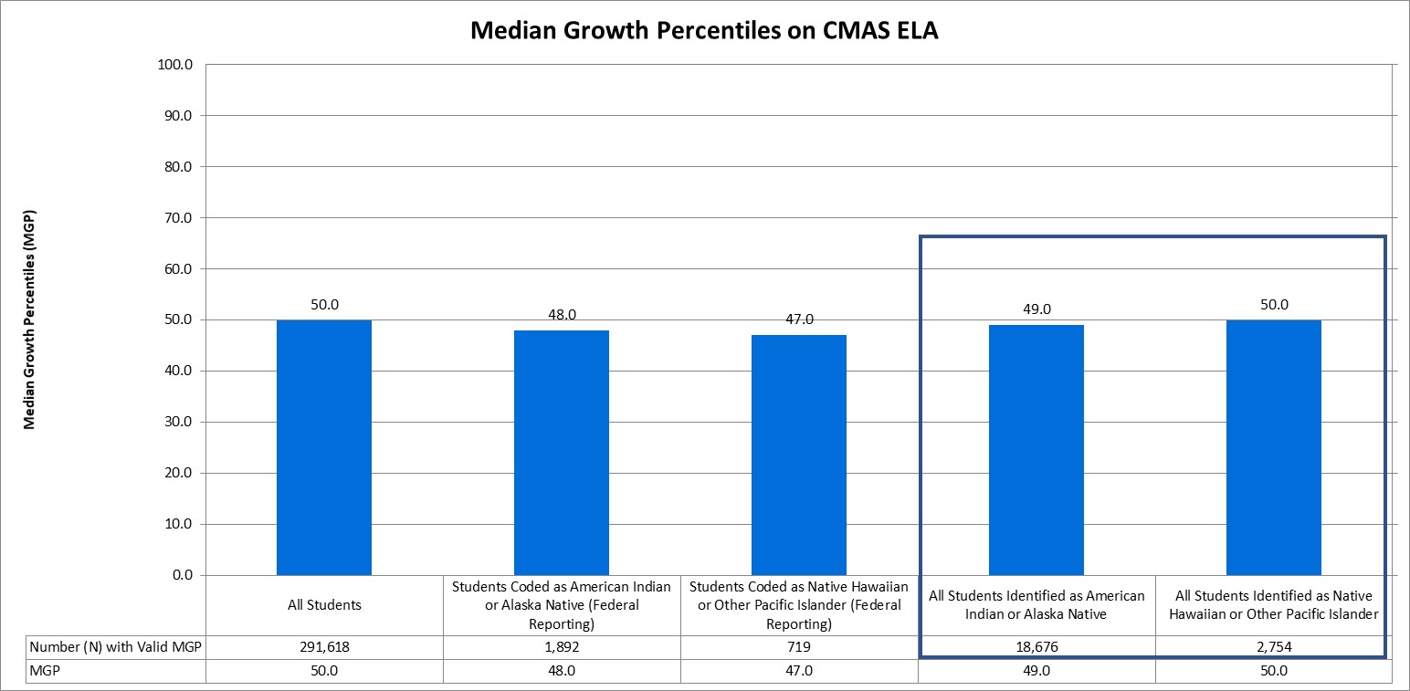
Median Growth Percentiles on CMAS ELA assessment
The median growth percentile (MGP) for all Colorado students (grades 4 through 8) on the CMAS ELA assessment was 50.0, compared to an MGP of 48.0 for American Indian or Alaska Native students and 47.0 for Native Hawaiian or other Pacific Islander students.

Slide 49
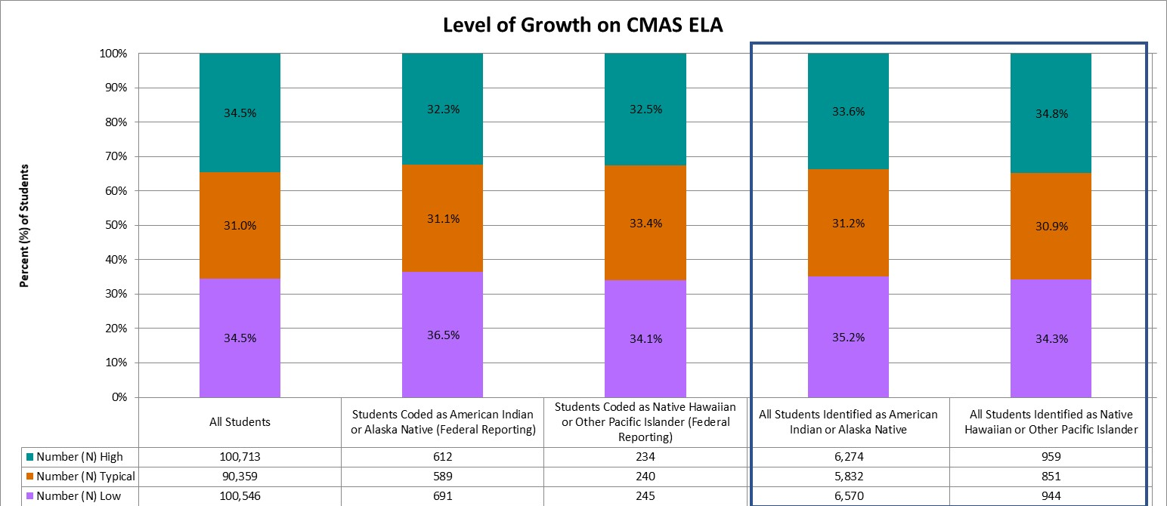
Levels of growth on CMAS ELA assessment
Statewide, on the CMAS ELA assessment, 34.5% of all students demonstrated high growth, 31.0% demonstrated typical growth, and 34.5% demonstrated low growth. In comparison, 32.3% of American Indian or Alaska Native students had high growth and 36.5% had low growth, while 32.5% of Native Hawaiian or other Pacific Islander students had high growth and 34.1% had low growth.
Notes:
A student growth percentile that falls below the 35th percentile reflects low growth, while a student growth percentile that falls above the 65th percentile reflects high growth (Colorado Growth Model FAQs [www.cde.state.co.us/schoolview/generalgrowthmodelfaq#q22]). Student growth percentiles between the 35th and 65th percentile represent typical growth.

Slide 50
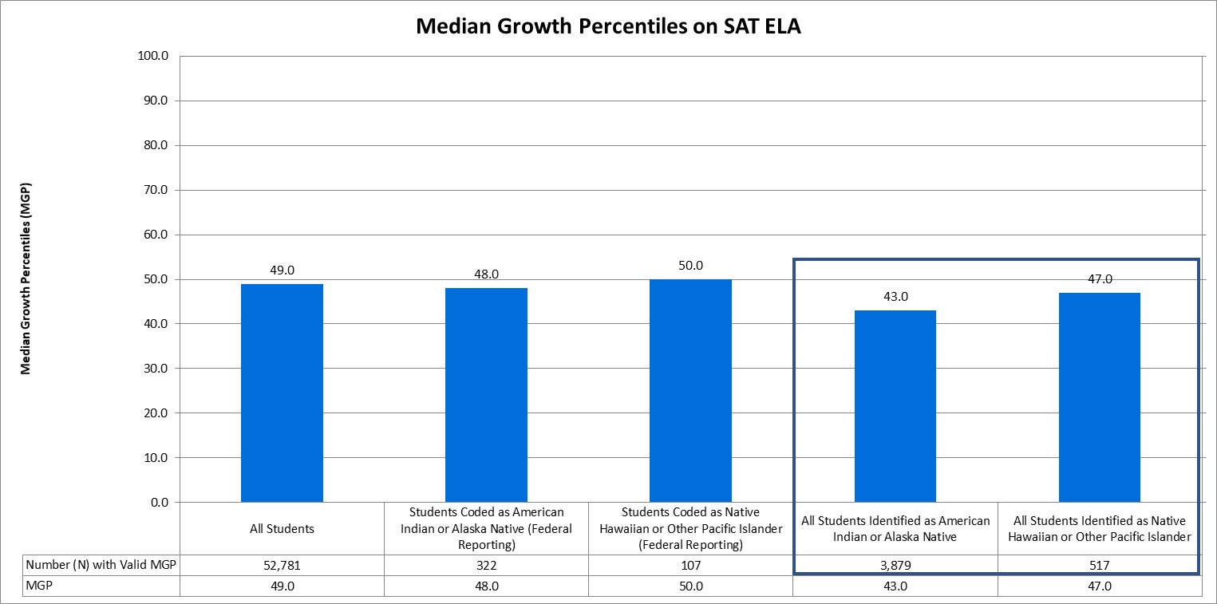
Median Growth Percentiles on SAT ELA assessment
The median growth percentile (MGP) for all Colorado students (grade 11) on the SAT ELA assessment was 49.0, compared to an MGP of 48.0 for American Indian or Alaska Native students and 50.0 for Native Hawaiian or other Pacific Islander students.

Slide 51
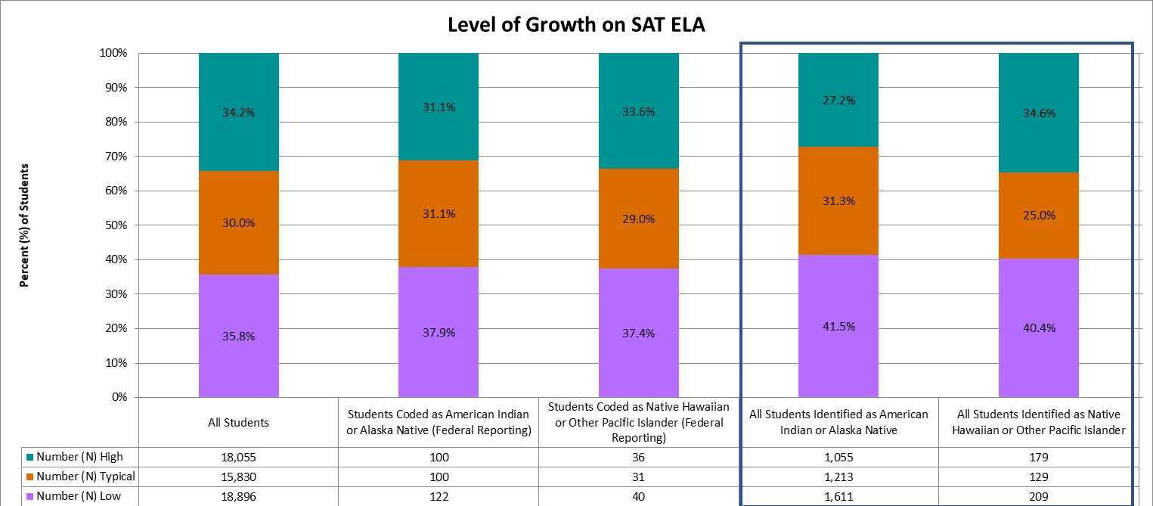
Levels of growth on SAT ELA assessment
Statewide, on the SAT ELA assessment, 34.2% of all students demonstrated high growth, 30.0% demonstrated typical growth, and 35.8% demonstrated low growth. In comparison, 31.1% of American Indian or Alaska Native students had high growth and 37.9% had low growth, while 33.6% of Native Hawaiian or other Pacific Islander students had high growth and 37.4% had low growth.
Notes:
A student growth percentile that falls below the 35th percentile reflects low growth, while a student growth percentile that falls above the 65th percentile reflects high growth (Colorado Growth Model FAQs [www.cde.state.co.us/schoolview/generalgrowthmodelfaq#q22]). Student growth percentiles between the 35th and 65th percentile represent typical growth.

Slide 52
Graduation Rates

Slide 53
Graduation Rates
ESSA requires states to present the four-year adjusted cohort graduation rates, but also gives states the discretion to include extended-year adjusted cohort graduation rates as well. Extended-year rates account for students who may require additional time to complete high school, such as those in five-year programs (e.g., ASCENT: Accelerating Students through Concurrent Enrollment, a state program that allows a limited number of students to attend a post-secondary education after completion of 12th grade, while still in the K-12 system), those who started below grade-level, and students whose coursework is interrupted for a semester or more. For more information on graduation rates, and for school- and district-level results, please visit the CDE Graduation Statistics webpage (www.cde.state.co.us/cdereval/gradratecurrent).

Slide 54
4-Year Graduation Rate
Student Group | Number (N) of Students in Graduation Base | Number (N) of Graduates | Graduation Rate (%)
All Students | 65,933 | 53,240 | 80.7%
Students Coded as American Indian or Alaska Native (Federal Reporting) | 552 | 378 | 68.5%
Students Coded as Native Hawaiian or Other Pacific Islander (Federal Reporting) | 165 | 122 | 73.9%
The 4-year adjusted cohort graduation rate for the class of 2018 shows that 80.7% of all students in the 2017-18 cohort graduated within four years, compared to 68.5% for American Indian or Alaska Native students and 73.9% for Native Hawaiian or other Pacific Islander students.

Slide 55
7-Year Graduation Rate
Student Group | Number (N) of Students in Graduation Base | Number (N) of Graduates | Graduation Rate (%)
All Students | 61,111 | 52,314 | 85.6%
Students Coded as American Indian or Alaska Native (Federal Reporting) | 503 | 379 | 75.3%
Students Coded as Native Hawaiian or Other Pacific Islander (Federal Reporting) | 162 | 137 | 84.6%
The 7-year adjusted cohort graduation rate for the class of 2015 shows that 85.6% of all students in the 2014-15 cohort graduated within seven years, compared to 75.3% for American Indian or Alaska Native students and 84.6% for Native Hawaiian or other Pacific Islander students.

Slide 56
School Quality or Student Success (SQSS)

Slide 57
School Quality or Student Success (SQSS) Indicator
Under ESSA, states are required to select at least one indicator of school quality or student success. For elementary and middle grade spans, Colorado is using mean scale scores on the 5th and 8th grade CMAS science assessment, as well as change in chronic absenteeism rates. For high school grade spans, Colorado is using mean scale scores on the 11th grade CMAS science assessment, as well as dropout rates. Mean scale scores on the CMAS science assessment and dropout rates are presented. Colorado is continuing to evaluate the data quality of chronic absenteeism rates; therefore, change in chronic absenteeism is not currently reported.

Slide 58
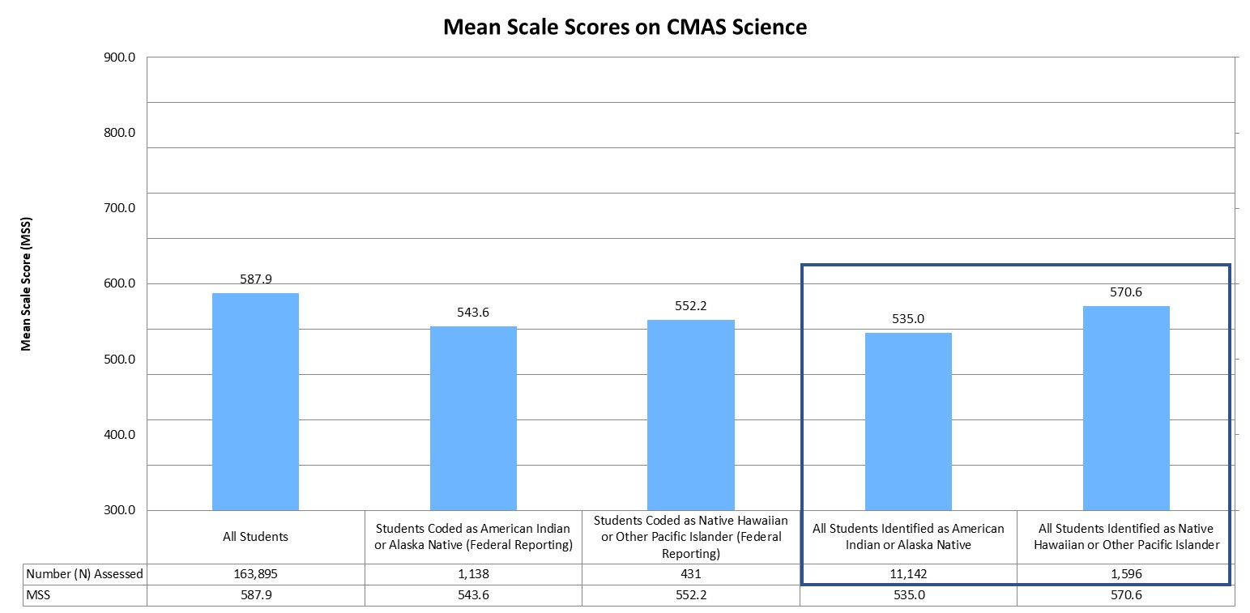
Mean Scale Scores (MSS) on CMAS science Assessment
The mean scale score (MSS) on the CMAS science assessment was 587.9 for all students in grades 5, 8, and 11, compared to an MSS of 543.6 for American Indian or Alaska Native students and 552.2 for Native Hawaiian or other Pacific Islander students.

Slide 59
Dropout Rate
Student Group | Number (N) of Total Students | Number (N) of Dropouts | Dropout Rate (%)
All Students | 309,736 | 9,769 | 3.2%
Students Coded as American Indian or Alaska Native (Federal Reporting) | 2,551 | 151 | 5.9%
Students Coded as Native Hawaiian or Other Pacific Islander (Federal Reporting) | 857 | 37 | 4.3%
Statewide, 3.2% of all students discontinued their educational services without receiving credentials or providing adequate documentation of a transfer to another educational setting. In comparison, 5.9% of American Indian or Alaska Native students and 4.3% of Native Hawaiian or other Pacific Islander students were considered dropouts.

Slide 60
Long-Term Goals

Slide 61
Long-Term Goals Under ESSA
Under ESSA, states are required to establish long-term goals and measures of interim progress. Colorado uses mean scale scores (MSS) on the ELA and math assessments to measure progress towards long-term goals in academic achievement.

Slide 62
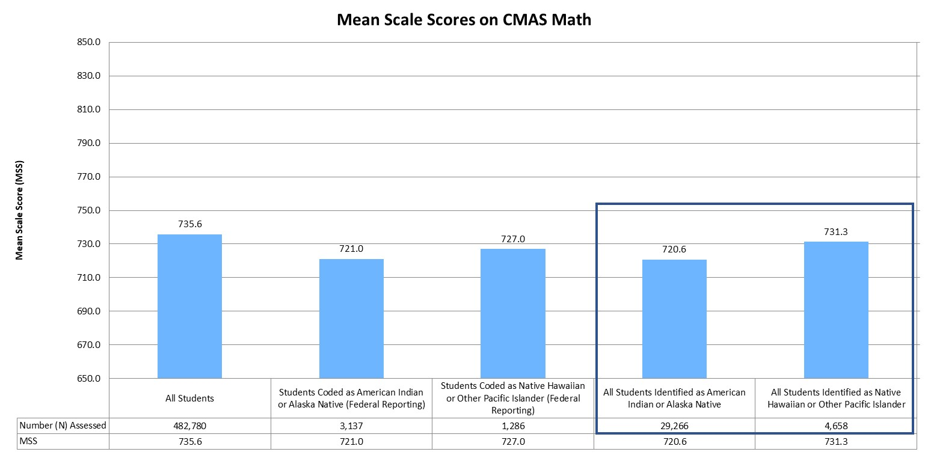
Mean Scale Scores (MSS) on CMAS math Assessment
The mean scale score (MSS) for all students in grades 3 through 8 was 735.6 on the CMAS math assessment. In comparison, the MSS for American Indian or Alaska Native students was 721.0 and the MSS for Native Hawaiian or other Pacific Islander students was 727.0.
Notes:
On the CMAS math and English language arts assessments, scale scores range from 650 to 850.

Slide 63

Mean Scale Scores (MSS) on CMAS ELA Assessment
The mean scale score (MSS) for all students in grades 3 through 8 was 744.1 on the CMAS ELA assessment. In comparison, the MSS for American Indian or Alaska Native students was 730.6 and the MSS for Native Hawaiian or other Pacific Islander students was 734.9.
Notes:
On the CMAS math and English language arts assessments, scale scores range from 650 to 850.

Slide 64
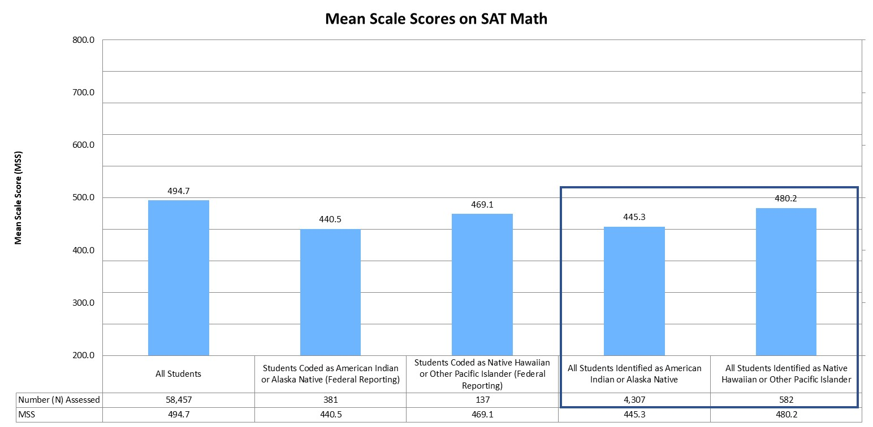
Mean Scale Scores (MSS) on SAT math Assessment
The mean scale score (MSS) for all students in grade 11 was 494.7 on the SAT math assessment. In comparison, the MSS for American Indian or Alaska Native students was 440.5 and the MSS for Native Hawaiian or other Pacific Islander students was 469.1.
Notes:
On the SAT math and evidence-based reading and writing assessments, scale scores range from 200 to 800.

Slide 65
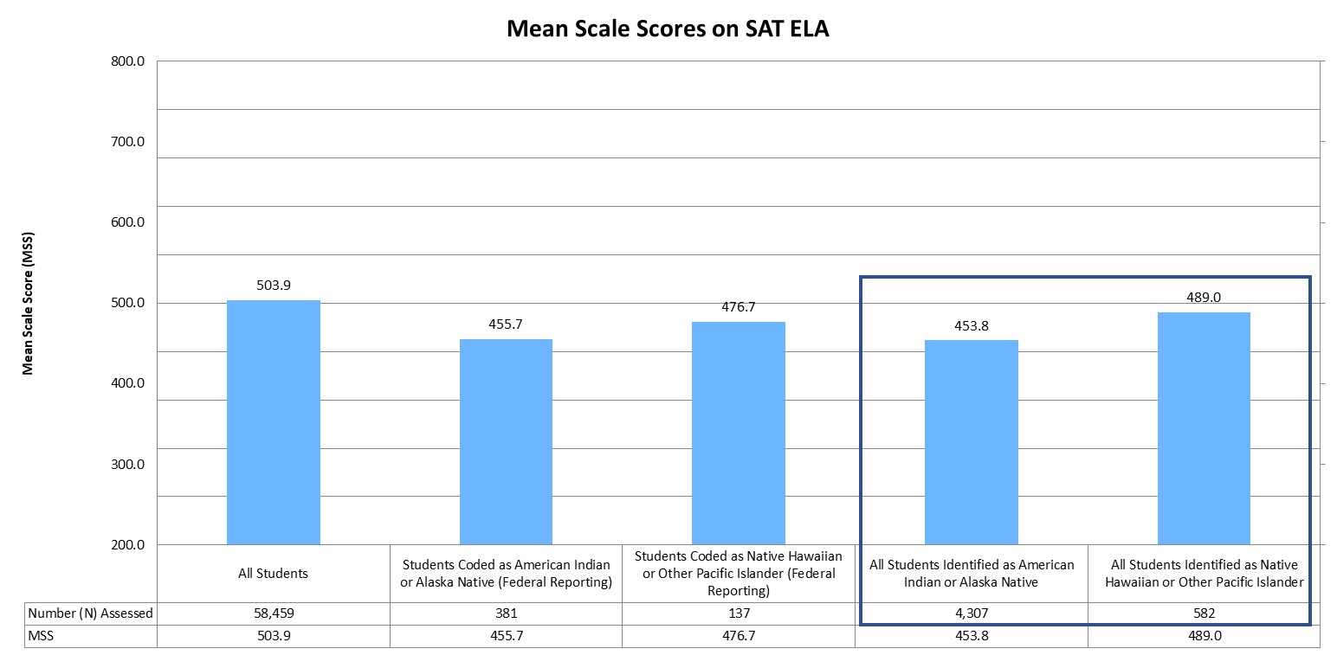
Mean Scale Scores (MSS) on SAT ELA Assessment
The mean scale score (MSS) for all students in grade 11 was 503.9 on the SAT ELA assessment. In comparison, the MSS for American Indian or Alaska Native students was 455.7 and the MSS for Native Hawaiian or other Pacific Islander students was 476.7.
Notes:
On the SAT math and evidence-based reading and writing assessments, scale scores range from 200 to 800.

Slide 66
Participation Rates

Slide 67
Participation Rates
Students in grades 3 through 8 were administered the Colorado Measures of Academic Success (CMAS) assessments in mathematics and English language arts, and students in grade 11 were administered the SAT. In addition, students in grades 5, 8, and 11 were administered the CMAS assessment in science. Students with significant cognitive disabilities were eligible to take the Colorado Alternate (CoAlt) assessments instead. For more information on the state assessments, and for school- and district-level results, please visit the CDE Assessment Unit webpage (www.cde.state.co.us/assessment).

Slide 68
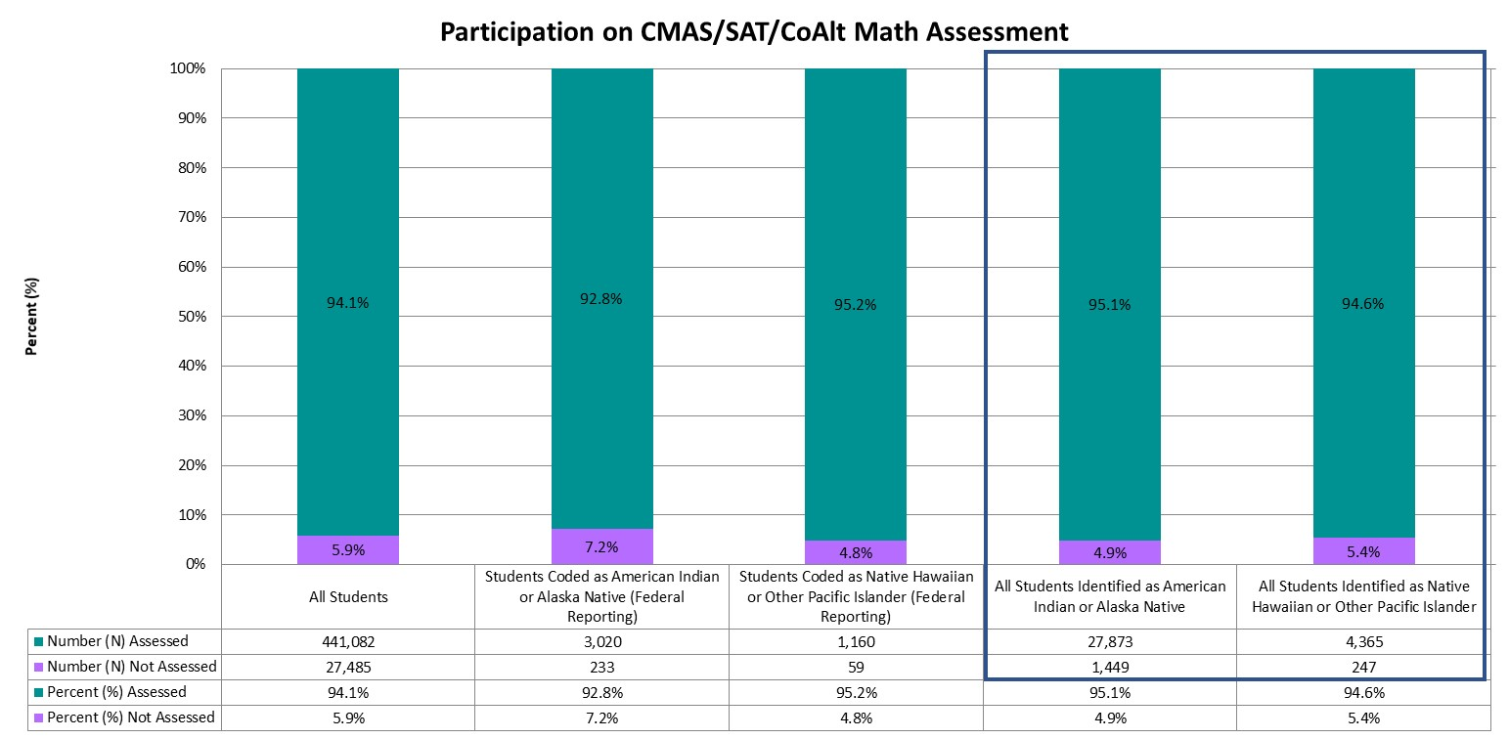
Participation on the Math Assessments (Grades 3-8 and 11)
Statewide, approximately 94.1% of students in grades 3 through 8 and grade 11 were assessed, compared to 92.8% of American Indian or Alaska Native students and 95.2% of Native Hawaiian or other Pacific Islander students.
Notes:
Graph represents the total number assessed (taking either the CMAS, SAT, or CoAlt assessment).

Slide 69

Participation on the ELA Assessments (Grades 3-8 and 11)
Statewide, approximately 94.2% of students in grades 3 through 8 and grade 11 were assessed, compared to 93.0% of American Indian or Alaska Native students and 94.8% of Native Hawaiian or other Pacific Islander students.
Notes:
Graph represents the total number assessed (taking either the CMAS, SAT, or CoAlt assessment).

Slide 70
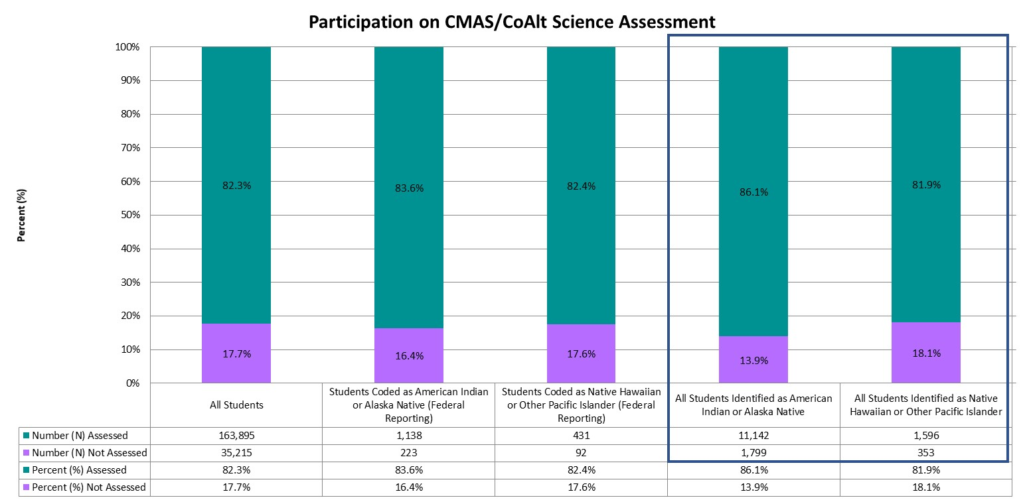
Participation on the science Assessments (Grades 5, 8, and 11)
Statewide, approximately 82.3% of students in grades 5, 8, and 11 were assessed, compared to 83.6% of American Indian or Alaska Native students and 82.4% of Native Hawaiian or other Pacific Islander students.
Notes:
Graph represents the total number assessed (taking either the CMAS, SAT, or CoAlt assessment).

