Slide 1
Orientation to Revisions
in the Colorado State Model Evaluation System
2017-18 School Year
Educator Effectiveness Office

Slide 2
Friendly Reminders
All districts are required to evaluate all educators on all professional practice standards, I-V for teachers and specialized service professionals and I-VI for principals
Measures of Student Learning/Outcomes must account for 50% of an educator’s annual evaluation (Teacher, Principal, SSP)
  House Bill 15-1323, states that, “If a local board does not receive the results of state assessments in time to use them in the written evaluation report prepared for the school year in which the assessments are administered, the local board shall use the results of the state assessments as measures of student academic growth for educator evaluations and professional development in the school year following the school year in which the assessments are administered” (22-9-106).
All educators must be given a written evaluation report upon the completion of an evaluation
  Teachers must receive the report no later than two weeks before the end of the school year.
Notes:
First, a few quick reminders - all professionals are to be evaluated on all standards to determine an overall effectiveness rating. This includes teachers, principals, and specialized service professionals.
MSL/O’s must account for 50% of an educator’s evaluation. Districts should also be mindful of the requirements outlined in House Bill 15-1323, which states that, “If a local board does not receive the results of state assessments in time to use them in the written evaluation report prepared for the school year in which the assessments are administered, the local board shall use the results of the state assessments as measures of student academic growth for educator evaluations and professional development in the school year following the school year in which the assessments are administered” (22-9-106). When districts use prior year results, it means that state assessment results are the “first data point in” to an educator’s evaluation at the beginning of the year, rather than the “last data point in” at the end of the year.
Also, all educators must be given a written evaluation report no later than two weeks before the end of the school year.

Slide 3
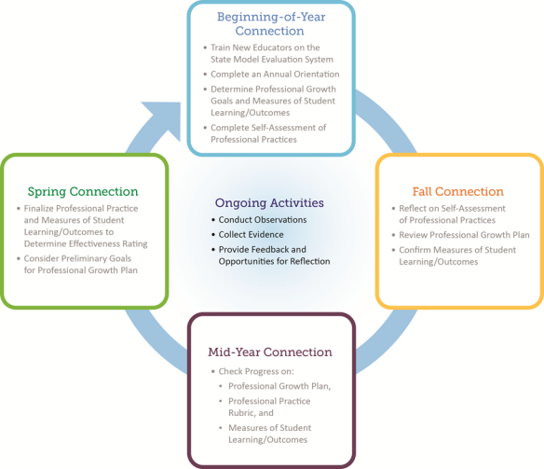
Evaluation Process Connections
Notes:
As an additional reminder, the evaluation process underwent a revision last school year and now highlights points of connection between evaluator and person being evaluated. You see that there are 4 key times in the annual evaluation cycle for connecting evaluators with educators. This includes the 50% professional practice and the 50% measures of student learning/outcomes. These connections will help in planning your evaluation cycle throughout the school year.

Slide 4

Teacher, Principal and Specialized Service Professionals Rubrics
Notes:
As we enter the 2017-18 school year, the State Model Evaluation System rubrics for evaluating teachers, principals and specialized service professionals remain unchanged.

Slide 5

Support Tools and Resources
Notes:
We also wanted to share with you some other important resources and tools that will be available to you this year.

Slide 6
Colorado State Model
Performance Management System
For districts/BOCES/charter schools using the Colorado Performance Management System (RANDA), enhancements will be added throughout the fall.
  All updates can be found by visiting the Help tab and clicking on Release Notes.
  The EE team will send emails outlining these updates to district level staff as they are added to the system.
Notes:
For those districts using the Colorado Performance Management System (COPMS), updates will be available this fall. We will let you know when they are released and you can also find them using the Help tab and clicking on Release Notes.

Slide 7
Supporting Resources
Training resources for teachers, principals, and SSPs have also been updated to reflect changes to the evaluation system.
Guidance for selecting Measures of Student Learning/Outcomes for teachers, principals, and SSPs have been updated to support districts in their continued implementation.
Notes:
We also wanted to remind you that general training resources and guidance documents have been updated for the 2017-18 school year.

Slide 8

Practical Ideas Guides
Developed by educators about how to effectively evaluate professionals in unique positions
  Focused on what evaluators could look for during observations and other evidence related to their specific roles
Practical Ideas Guides for SSPs
  School Counselors
  School Nurses
  School Psychologists
  Speech Language Pathologists
For access to all Practical Ideas Guides, visit:
  http://www.cde.state.co.us/educatoreffectiveness/implementationguidance#practicalideasguides
Notes:
CDE has worked with Colorado Educators to develop a set of “practical guides” for evaluating a variety of professionals in their specific positions within the requirements of the state model evaluation system. The practical ideas guides are heavily focused on what evaluators could look for during observations. They also provide other evidence related to these unique roles in order to support the ratings of the educators being evaluated. These new Practical Ideas Guides for the Specialized Service Professional groups listed are currently available and serve as a great companion to the SSP rubrics themselves.
Watch the Educator Talent newsletter and the SCOOP for more information on the release of additional resources.

Slide 9
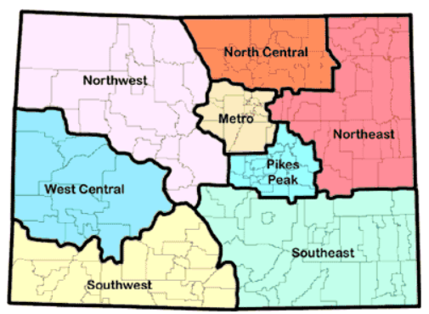
A New Way to Work
Educator Effectiveness Regional Specialist | Assigned Region | Email | Phone
Curtis Garcia | Southwest | garcia_c@cde.state.co.us | 303-981-8950
Lynn Kintz | West Central and Ute Pass BOCES | kintz_l@cde.state.co.us | 303-913-7767
Ann Pearce | Metro and North Central | pearce_a@cde.state.co.us | 303-981-8979
Rachel Paul | Northeast, Pikes Peak, Southeast | paul_r@cde.state.co.us | 303-917-8410
Karin Reynolds | Northwest | reynolds_k@cde.state.co.us | 303-981-2804
Notes:
The Educator Effectiveness (EE) Office is shifting how it will provide support to the field. Based on feedback, new regional specialists have been added to the EE team and will be deployed to support districts/BOCES as they work to enhance their evaluation practices. The regional specialist model will aid districts/BOCES as they continue supporting educator practice and building an integrated, systematic approach to educator evaluation.
This transition provides an opportunity for districts/BOCES to engage with Educator Effectiveness Regional Specialists to create or refine an evaluation system that honors their local values. These regional specialists are invested in forming a unique partnership with districts/BOCES and supporting continuous improvement in the evaluation system and technical assistance.
As the 2017-18 school year begins, members of the team will be available to meet with districts/BOCES to discuss local needs. Please use the chart below to help identify your Educator Effectiveness Regional Specialist. You can also refer to the contact us page which contains a detailed region map to ensure you are contacting the correct regional specialist. Feel free to contact your specialist with any questions you may have or support you may need!
Curtis Garcia
Southwest
garcia_c@cde.state.co.us
303-981-8950
Lynn Kintz
West Central and Ute Pass BOCES
kintz_l@cde.state.co.us
303-913-7767
Ann Pearce
Metro and North Central
pearce_a@cde.state.co.us
303-981-8979
Rachel Paul
Northeast, Pikes Peak, Southeast
paul_r@cde.state.co.us
303-917-8410
Karin Reynolds
Northwest
reynolds_k@cde.state.co.us
303-981-2804

Slide 10

State Model Evaluation System 2017-18 Pilot
An Overview of Changes to the System
Notes:
The following slides will provide an overview of the changes to the State Model Evaluation System to be piloted during the 2017-18 school year by your district or BOCES. Changes include:
Significant revisions to rubric expectations, including a reduction in the number of Standards, Elements, and Professional Practices
Changes to category labels
Scoring at the Standard level for professional practice
Overall scoring when determining a final effectiveness rating

Slide 11
Pilot Highlights
More than 30 districts, BOCES, and charter schools will be participating in piloting all the changes to the State Model Evaluation System
  All school districts, BOCES, and charter schools were given the opportunity to participate
  Pilot participants are geographically and physically diverse
  Pilot participants have specific evaluation activity deadlines to meet in order to support data collection and analysis
  All pilot participants will be asked to complete a survey at the start of the school year and again at the end of the school year
  Analysis of both qualitative and quantitative data will be conducted to continuously improve the State Model Evaluation System
Visit our State Model Evaluation System Pilot website!
Notes:
More than 30 districts, BOCES, and charter schools will be participating in piloting all the changes to the State Model Evaluation System
All school districts, BOCES, and charter schools were given the opportunity to participate
Pilot participants are geographically and physically diverse
Pilot participants have specific evaluation activity deadlines to meet in order to support data collection and analysis
All pilot participants will be asked to complete a survey at the start of the school year and again at the end of the school year
Analysis of both qualitative and quantitative data will be conducted to continuously improve the State Model Evaluation System
State Model Evaluation System Pilot website!

Slide 12
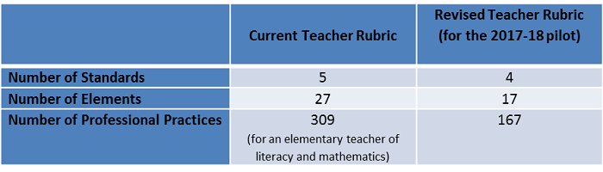
Rubric Revisions
Notes:
This graphic highlights the major changes in the State Model Evaluation System teacher rubric. In attempting to reduce the length of the rubric, a primary goal of this revision was to maintain the rubric’s conceptual integrity. To do that, the group determined to reduce redundancies of similar practices by focusing on the high leverage practices identified in quantitative and qualitative data from the initial State Model Evaluation System teacher pilot and incorporating feedback from educators. In addition, the team focused on clarifying language, ensuring that practices appeared in the appropriate rating levels and considered current research on best practices to modify, add, or delete professional practices. Thus similar elements were combined and rewritten to reflect changes made to professional practices. As a result, major shifts in the location of elements and professional practices occurred. In addition, Quality Standards IV and V were combined to expand the concept of professionalism and now includes elements of ethical conduct, reflection, and leadership.

Slide 13
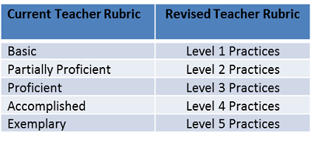
Category Labels Change
Notes:
In addition to reducing and changing rubric content, feedback from the field also indicated a negative impression of the label “Basic” on the rubric. With the help of focus group and Technical Working Group feedback, the five rubric categories that indicate the level of professional practices from the most foundational to the more complex have been changed to better reflect a focus on educator instructional practice and allow evaluators to better focus feedback conversations on instructional practices. The current teacher rubric rating levels of Basic, Partially Proficient, Proficient, Accomplished, and Exemplary, will still be utilized to determine element, standard, and overall professional practice ratings, but within the professional practices the educator will move from Level One to Level Five as they move left to right.

Slide 14
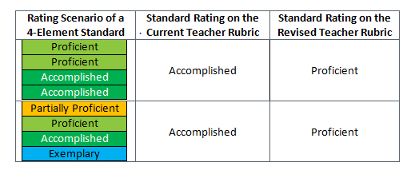
Professional Practice Scoring Revisions
Notes:
In the current professional practice rubric, the scoring reflects a “rounding up” approach in that half of the elements need to be of a certain rating in order to earn that rating. In the revised professional practice rubric there must be a “preponderance of evidence” in order for an educator to receive the higher of two ratings within a standard. If there are 4 elements in a standard, then the educator must receive 3 out of 4 elements at the higher rating in order to earn the higher rating. Previously only 2 of the 4 elements would have to be scored at the higher rating to earn that rating on the standard. This example is illustrated in the table above.
The preponderance of evidence approach will be used for scoring at the standard level and the Overall Professional Practice Score. At the standard level, the educator will need to earn the higher rating on more than half of the elements to earn the higher rating on that standard. At the overall professional practice level, the educator will need to earn the higher rating on 3 of the 4 standards to earn the higher rating on the Overall Professional Practice Score. Note that the rating cut points were established based on the standards being weighted equally. Districts and BOCES may still choose their own custom weights in order to emphasize specific standards based on local values and context.

Slide 15
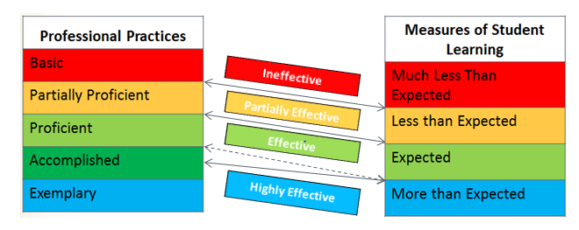
Final Effectiveness Rating Scoring Revisions
Notes:
The revised State Model Evaluation System also involves an adjustment of cut points at the Final Effectiveness Rating level in order to set a higher expectation to earn a Highly Effective rating. Previously, the minimum cut point for Highly Effective was determined by adding the minimum score for Accomplished (on Overall Professional Practice) to the minimum score for More than Expected (on Measures of Student Learning). The minimum cut point for Highly Effective is now determined by adding the midpoint score for Accomplished to the minimum score for More than Expected. The current cut point is represented with the dashed line in the image below. The solid lines represent the cut points that are being used in the pilot.
In the current system, the highly effective category had the largest possible range of scores, making it easier to achieve. Additionally, school and district leaders found that it was more difficult to have effective feedback conversations around growth with teachers rated Highly Effective. Thus, the pilot system sets a higher expectation for earning a Highly Effective rating in order to make the rating more accurate and to facilitate educator growth.

Slide 16
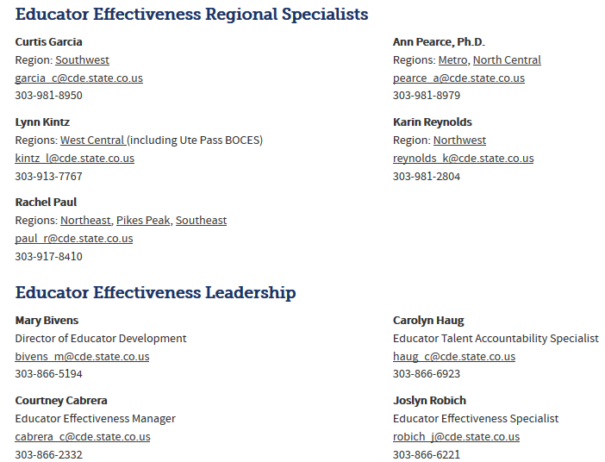
Contact Us
http://www.cde.state.co.us/educatoreffectiveness/contactus
Notes:
We hope this power point has provided you with valuable information when implementing the Colorado State Model Evaluation System pilot. Please contact any of the staff in the Educator Effectiveness Office if you have any questions.

