Slide 1
CO Comprehensive Literacy State Development Grant – PD Cohort
Stacey Smith, CLSD Program Grant Manager | smith_s@cde.state.co.us
Anna Friedman, Grants Fiscal | friedman_a@cde.state.co.us
Mandy Christensen, Competitive Grants | christensen_m@cde.state.co.us
Trish Malik, Principal Leadership Institute | malik_t@cde.state.co.us
Notes:
Welcome
Introduction to staff on call
Housekeeping: All participants muted, hold questions until the end of each section, questions can be typed into the chat box (staff are moderating)
Recording and slides will be available on the CLSD webpage after today’s webinar

Slide 2
Webinar objectives
Review the program purpose, objectives and intended outcomes
Review eligibility criteria and priority considerations
Review funding and the grant cycle
Review allowable activities, project narrative pieces and attachments (including the budget)
Review project evaluation and reporting requirements
Review how applications will be scored and the scoring rubric
Notes:
I will be providing a high-level overview of the program and components of the grant application today.
Detailed information is available in the RFA and I am more than happy to provide support throughout the application process.

Slide 3
CLSD Overview
The Colorado Comprehensive Literacy State Development (CLSD) Grant is a federally supported grant (CFDA Number: 84.371C) intended to expand the use of evidence-based reading practices and interventions that advance literacy skills for children from birth through grade 12 with an emphasis on historically underserved students including children in poverty, English learners (ELs), and children with disabilities.
CLSD Website
Age/Grade Ranges Supported
Grant funds are intended to support literacy efforts in the following ranges:
Birth-5 years including preschool
Kindergarten-5th grade
6th-12th grade
Notes:
Used to be the “Striving Readers” grant
CLSD is more heavily focused on comprehensive literacy and across all ages birth to graduation

Slide 4
Program purpose – PD Cohort
Expand early reading risk identification
Increase knowledge and implementation of evidence-based practices for early learners Birth-5 years, including Pre-K
Professional development and coaching for teachers and administrators that supports implementation of evidence-based literacy practices in classrooms
Expanding literacy leadership capacity in schools through the Principal Leadership Institute – Literacy Leader Track
Limited funds for district/school wide Literacy Instructional Coaches
Expanding community and family engagement in literacy efforts

Slide 5
Intended Outcomes
Increase teacher and administrator knowledge on the science of reading and language development
Support transfer of professional learning into teacher practice
Increase oral language skills for 4-year-olds
Increase the percentage of 5th graders, 8th graders and high school students who meet or exceed proficiency on Colorado reading/language arts assessments
Increase ELA proficiency in underserved populations such as students receiving free and reduced lunch, English learners, and students with disabilities

Slide 6
Applicant eligibility
Local Education Providers (LEPs) are eligible to apply for this opportunity. Eligible LEPs include:
A school district.
A Board of Cooperative Services (BOCES).
A Charter School authorized by a school district; or
A Charter School authorized by the Charter School Institute.
Must be in compliance with the Colorado READ Act
Must already be implementing evidence-based or scientifically-based universal instruction
Must agree to include early childhood providers as active partners in grant activities
Notes:
-Individual schools are not eligible to apply.
-Primary goal is for this to be a district wide effort. We are willing to consider an application within a district’s department so long as they can demonstrate in the application their plan and capacity to manage the project in a way that is collaborative across the entire district, age and grade bands, and that meets the needs of ALL students, not just those supported by their department
-Participating schools selected for CLSD participation must be in compliance with the READ Act, not all schools in the district.

Slide 7
Priority Considerations
Available grant funding will be distributed to LEPs with participating schools demonstrating high need based on certain Priority Eligibility Criteria:
serving a high percentage of students eligible for free and reduced lunch
serving a high percentage of ELs
serving a high percentage of students with an IEP serving a high percentage of students with SRDs
located in a Qualified Opportunity Zone (QOZ)
applying as a district-wide effort
including early childhood providers (birth-3 years) and preschool (3-5 years) in system-wide literacy efforts.
Notes:
Again, schools selected to participate in the CLSD program should meet these priority considerations. We are not looking at district wide numbers here.

Slide 8
Funding
Approximately $1,425,000 is available over 2 years.
The following percentages must apply to each age and grade range for all grant related activities and expenditures:
Birth-5 years (15%)
Kindergarten-5th grade (40%)
Grades 6-12 (40%)
Administrative (5%)
Notes:
-All administrative costs must be directly related to the CLSD project and pre-approved.
-Indirect costs cannot exceed 5%, including combined with admin costs. Indirect costs cannot exceed an applicant’s indirect cost rate agreement.
-Percentage breakdowns are a federal requirement. Applications that don’t meet this breakdown will be asked to modify their application or could be denied.

Slide 9
Grant Cycle
2-year grant cycle supporting ONE cohort of applicants
Year 1 (2023-2024 SY)
Year 2 (2024-2025 SY)
Grant cycle will run October 1-September 30 each year

Slide 10
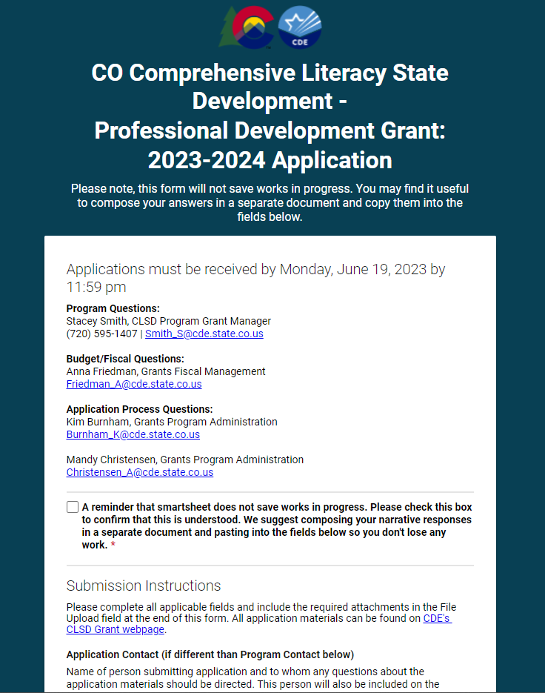
Smartsheet – Application Portal
Applications are due by Monday, June 19, 2023 by 11:59pm MST
Each section limited to 200 words each
Smartsheet DOES NOT save works in progress
Original signatures required
Budget + budget narrative
Attachments: “Applicant Name – CLSD File Name_Date”

Slide 11
Application timeline
Application window open until June 19, 2023*
June 19th is a state holiday. Questions received during this time may not be answered.
Review committee will review and score applications June 20-July 14, 2023
Applications that are missing information or not meeting application requirements may be contacted to make changes or submit missing pieces
Award and denial notices will be sent to applicants by August 1, 2023
The grant will start on October 1, 2023
Funds will be available for drawdown on October 1, 2023

Slide 12
QUESTIONS – Eligibility, priority criteria, application portal

Slide 13
CLSD Grant – PD Cohort Allowable Use of Funds
Notes:
-There are some specific breakdowns of allowable activities that we are going to cover and are important for applicants to understand.

Slide 14
Birth-5 years old
Professional development on language development and the science reading for early education providers, support staff and administrators
Sustainability planning by partnering with Local Coordinating Organizations (LCOs), Family Resource Centers, Community Centered Boards (CCB), Child Find, childcare providers in the community, etc.
Parent, family, caregiver, and community partner engagement activities
Support expansion of early reading risk identification (i.e., dyslexia, speech disorders, auditory processing, autism, sensory, other disabilities that affect reading, speaking, and writing development, social factors)
Notes:
-Early risk ID: dyslexia, speech disorders, auditory processing, autism, sensory, other disabilities that affect reading, speaking, and writing development, social factors).

Slide 15
Kindergarten-12th grade activities
Professional development for teachers, administrators, instructional coaches, and support staff in the science of reading, writing, and language development.
Participation in the 2-year Principal Leadership Institute: Literacy Leader Track * (Year one- identifies principal mentors. Year two-principal mentors work with mentees)
District or school-wide literacy instructional coach
Please note: All K-3 activities must be aligned with the READ Act
Notes:
-All K-3 activities must be aligned with the READ Act

Slide 16
Principal Leadership Institute- Year One
CDE’s Elementary Literacy and School Readiness Office and the CLSD Team have partnered with the Educator and Leadership Development team to support school leaders’ participation in the Principal Leadership Institute: Literacy Leader Track.
Two Year Commitment for Coaches
Year One- Identify Principal Coaches
Year Two- Principal Coaches support mentees
For Principal Coaches: To be considered for and participate in the PLI, the following elements are required:
Brief online application
A letter of recommendation from an external literacy consultant or principal’s supervisor if not currently working with a consultant
Complete a brief 30-minute interview with CDE staff
Commitment to fully participate in required PLI activities for 2 years
Be a principal in a K-12 school that is approved in your CLSD application
Notes:
-All K-3 activities must be aligned with the READ Act

Slide 17
Principal Leadership Institute- Year One
Covered costs Principal Coaches:
$2500/year stipend
Mileage, per diem, and hotel for in-person activities associated with the PLI
For questions related specifically to the content and requirements of the CLSD PLI: Literacy Leader Track, please contact Trish Malik | malik_t@cde.state.co.us
Notes:
-All K-3 activities must be aligned with the READ Act

Slide 18
Admin + Indirect costs
Administrative costs must be directly related to the support and implementation of the CLSD grant and pre-approved by CDE.
Administrative costs cannot exceed 5% of the funding request. If you don’t need admin funds, you can allocate this 5% anywhere in the age and grade bands of your project.
Amount charged to indirect cannot exceed an applicant’s Indirect Cost Rate.
Uses that will not be funded include:
Curriculum, capital needs, technology equipment (including tablets, laptops, bookshelves, other furniture, etc.), software, construction costs, food or alcohol costs, and gift certificates.
Direct instructional staff.
Out-of-state travel that is not directly related to the critical components of the CLSD Program.
Professional development, assessments, and instructional practices that are not aligned with the science of reading and any non-instructional activity not listed in the allowable costs.
Notes:
-It is a federal requirement that 95% of funds be used towards program implementation.
-ALL EXPENDITURES MUST BE PRE-APPROVED BY CDE

Slide 19
QUESTIONS – Allowable Use of
Funds

Slide 20
CLSD Grant – PD Cohort Application Critical Components

Slide 21
Section A: Grant Proposal Summary
Applicants must provide a high-level overview of the literacy landscape within their jurisdiction and the need for further funding to enhance and improve oral language and ELA proficiency scores.
It is important to highlight how grant activities will focus on meeting the needs of targeted student populations such as those receiving free and reduced lunch, multilingual learners, migrant children, students with disabilities, students with a Significant Reading Deficiency (SRD), students in foster care, students experiencing homelessness, etc.
Looking for a cohesive plan that meets the needs of gaps in literacy systems and structures identified through some sort of needs assessment/data analysis process. Activities should be clearly correlated to the gaps.

Slide 22
Section B: Detailed Project Propsal
This is an opportunity to dive a little deeper into how your proposed activities will meet the needs of gaps in your literacy systems and structures.
Types of PD planned
Participants in these PD sessions
Non-PLI PD
PLI Principal Names
Describe measurable student outcomes and tools used to determine effectiveness of PD
Brief plan for meaningful engagement of ECE educators, family and community partners.
Instructional coaching
If requesting funds for instructional coach, describe need and how this coach will be used.
If not requesting funds for instructional coach, describe existing or planned structures for job-embedded coaching
Program Sustainability Plan

Slide 23
Underserved students
CLSD applicant plans must specifically address how they will meet the needs of underserved students across all age and grade bands for students including but not limited to:
Students receiving free and reduced lunch
English learners
students with disabilities
students with a Significant Reading Deficiency (SRD)
migrant children
students in foster care
students experiencing homelessness

Slide 24
Section C: Budget & Budget Narrative
Applicants must provide a Budget Narrative outlining the components below and explaining the cost of the proposed CLSD project plan.
Describe how all expenditures in the budget workbook connect to the project objectives and that expenditures are reasonable and sufficient and will not supplant any federal, state, local or non-federal funds.
Develop a budget workbook aligned to the narrative and is within the 15/40/40/5 formula requirements.
Notes:
-CDE understands that there are not clear guidelines on what this looks like in 4th-12th grade like we have in the K-3 space. This is something we are looking to develop at some point in the future. For now, applicants can provide documentation on curriculum used from a variety of spaces such as the What Works Clearinghouse, ESSA evidence, found on another state’s approved list, IES, etc. CDE may consider evidence submitted that shows promising practices as evidence.
-You can also look at the CDE Advisory List of approved vendors for the READ Act. Link is found on page 8 of the RFA.

Slide 25
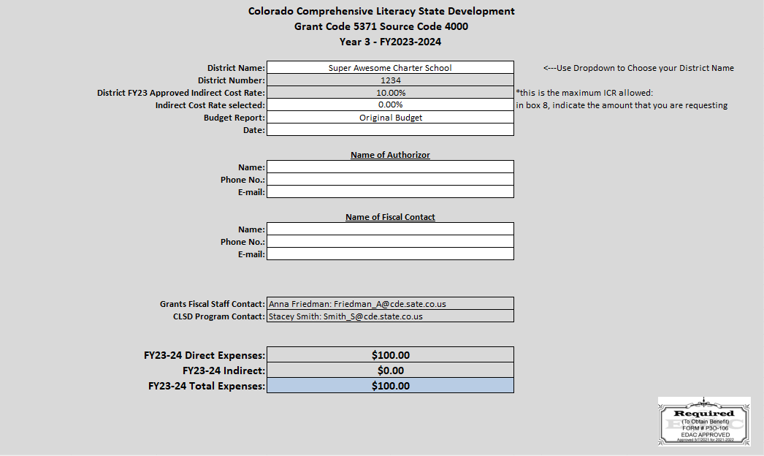
Budget cover page

Slide 26
Budget and Actual Detail
Notes:
-This is where you will enter each line-item expense for the project
-Only enter expenses you expect to incur for October 1, 2021-September 30, 2022
-A brief narrative of each line item is required in column 9. This is IN ADDITION TO the budget narrative document uploaded as a separate attachment
-The template is broken down into the B-5, K-5, 6-12, and Admin/Indirect categories. Embedded formulas will help ensure you don’t spend outside the federally required 15/40/40/5 formula

Slide 27
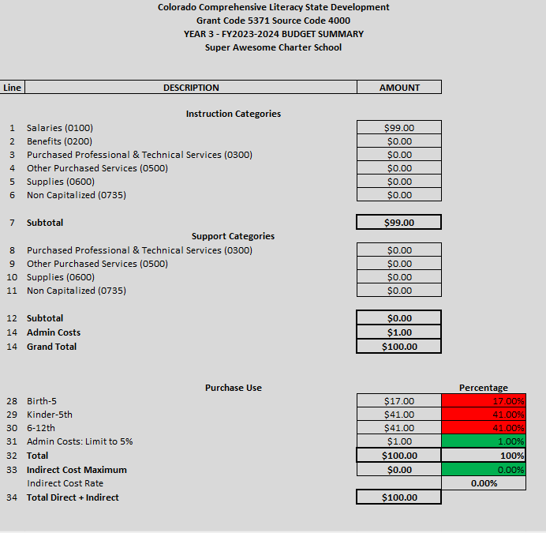
Budget Summary Page
Notes:
-This is where you will enter each line-item expense for the project
-Only enter expenses you expect to incur for October 1, 2021-September 30, 2022
-A brief narrative of each line item is required in column 9. This is IN ADDITION TO the budget narrative document uploaded as a separate attachment
-The template is broken down into the B-5, K-5, 6-12, and Admin/Indirect categories. Embedded formulas will help ensure you don’t spend outside the federally required 15/40/40/5 formula

Slide 28
Annual budget submission + project changes
An updated budget must be submitted each year
Budget with carryover template will be provided in May of the current grant year
Due no later than July 31st of each year
Carryover funds
Project and/or budget modifications – 2 per year allowed and not in the months of April or September

Slide 29
QUESTIONS – Application Critical Components

Slide 30
CLSD Grant – PD Cohort Attachments

Slide 31
Attachments in Smartsheet Application
Notes:
-Review that ALL attachments must be uploaded into the same attachment area.

Slide 32
Program Assurances
Notes:
-Note: If grant application is approved, funding will not be awarded until all signatures are in place. Please attempt to obtain all signatures before submitting the application.
-Signatures must be original signatures and NOT digital images of signatures

Slide 33
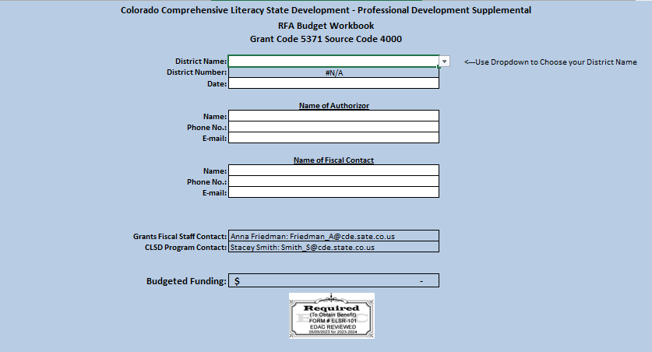
Budget Template in Excel

Slide 34
Financial Risk Assessment
Notes:
-Note: If grant application is approved, funding will not be awarded until all signatures are in place. Please attempt to obtain all signatures before submitting the application.
-Signatures must be original signatures and NOT digital images of signatures

Slide 35
QUESTIONS – Attachments and Budget

Slide 36
CLSD Grant – PD Cohort Scoring + Rubric

Slide 37
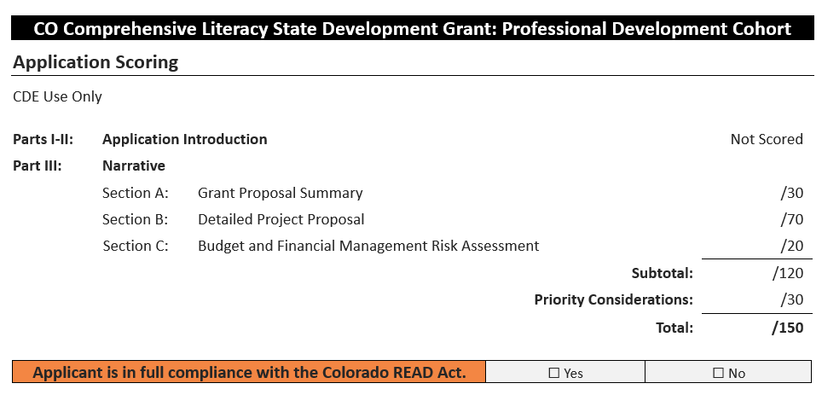
Application scoring guide
Notes:
-CDE will form a review committee that will score each application on the rubric
-For details on what we are looking for under each section and attachment, look back to the critical components part of the RFA

Slide 38
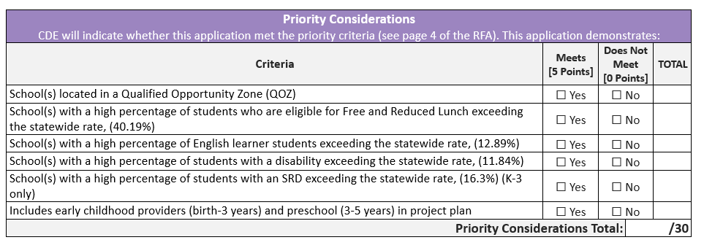
Priority considerations

Slide 39
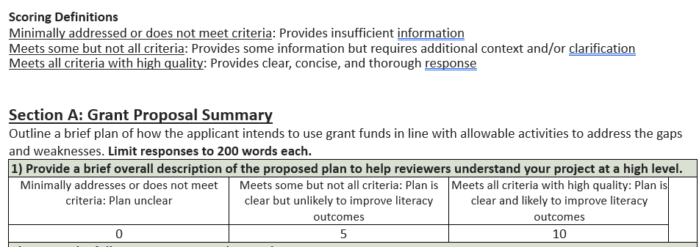
Scoring definitions
Notes:
-Review scoring definitions
-Each section of the project narrative and attachments has their own scored section
-We may ask applicants to go back and edit or change parts of the application or budget to increase probability of being funded

Slide 40
QUESTIONS – Scoring and Rubric

Slide 41
Thank you for joining us today!

