Slide 1
McKinney-Vento Liaisons Training
September 20, 2018

Slide 2
Agenda
Welcome and Connections Activity
CDE Strategic Plan
Education Milestones Activity
The Importance of Early Childhood Education
Lunch on your own
Unaccompanied Youth
Wrap-up

Slide 3
Connections Activity
Yellow/Green Post-it:
A highlight or success you’ve experienced since the beginning of the academic year
Red Post-it:
One struggle you’ve experienced since the beginning of the academic year

Slide 4
Connections Activity- Table Topics
What does your intake/re-verification process look like?
How do you ensure immediate enrollment?
How does your district remove the barrier of fees?
Reflection Question: What is something new that you could implement within your district?

Slide 7
Divider slide maximum Mueso Slab 500 / 54 pt. or smaller

Slide 8
Prevalence of homelessness by age
Of children experiencing homelessness under the age of 18, what percentage are:
Under 1
1-5
6-12
13-18

Slide 9
Ages of Children Experiencing Homelessness
18%
33%
39%
10%
< 1
1-5
6-12
13-17
Notes:
Unfortunately, homelessness has a disproportionate impact on the youngest children, which often surprises people. You can see here that prevalence of homelessness is concentrated in the earlier years.
HUD data shows that about half of all children living in federally-funded homeless shelters are age 5 and under.

Slide 10
Most incidents of homelessness occur during the most critical period of development in the entire human lifespan

Slide 11
Homelessness harms children
Lower birth weights
More likely to have moderate to severe acute or chronic health problems
Three times the rate of emotional and behavioral problems
Four times the rate of developmental delays
Twice as likely to go hungry
Twice as likely as others to repeat a school grade, be expelled or suspended, or drop out of high school
More likely to experience a traumatic event
Compromised brain development
Notes:
Research also tells us that homelessness harms children in all sorts of ways. Homeless kids are sicker more often, more likely to experience developmental delays, are more likely to have severe emotional and behavioral problems, more likely to experience traumatic events, and little ones are more likely to experience stressed attachments to their caregivers.
Homelessness can also compromise brain development.

Slide 12
As we know, The early years matter!
The first three years represent the most critical period of development
Relationships, experiences, and environments shape development
Early experiences lay the foundation for later success…or challenges
Notes:
It’s becoming increasingly important to consider everything that we know about how homelessness impacts young children in the context of brain development and the importance of the early years.
I think everyone in this room knows that the first three years of life is the most rapid, critical, and vulnerable, period of development in the entire human lifespan and that all development happens in the context of relationships and experiences. We know that the quality of relationships and experiences matter a lot for small children, as do the environments in which they live.
In the homeless services world, there is a dominant service philosophy called housing first, which basically says we should focus first and foremost on getting homeless people into their own housing and then provide supportive services to help them stay there, which is a change from years ago where we would provide services on the front end while people were in shelter or transitional housing so that we could get people “housing ready.”
What this means is that in recent years, the homeless system is investing less and less in shelters, and more in interventions like rapid rehousing and permanent supportive housing. There has also been an increasing focus on changing how the extremely limited homeless services resources are allocated with efforts to first house the most vulnerable people first, which is often defined as those most likely to die on the streets.
Overall, I think housing first and prioritizing resources makes a lot of sense, but in my view, an unintended consequence of this movement has been less attention on the unique needs of children for the weeks and months that a family is waiting for housing in a shelter situation or if the family is in a homeless living situation that does not allow them access to homeless services resources.
For children, we know that it isn’t just the roof over their head that is important, but also what life is like under that roof. So I want to turn now to homeless living situations and take a closer look at how these environments can shape child development for better or worse.

Slide 13
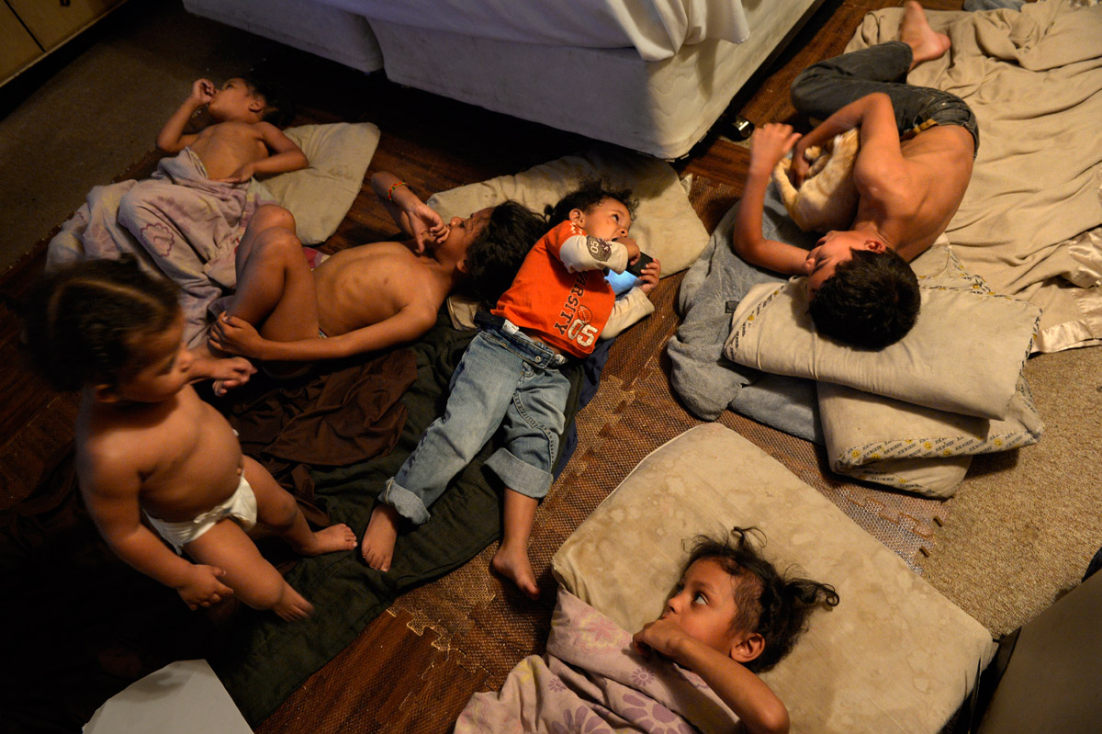
“Trying to Live, Trying to Learn” Denver Post, http://extras.denverpost.com/homelessstudents/
Notes:
These last two come from a Denver Post story about a family living in a doubled up situation. In these situations it’s pretty common for a family to sleep like this on the floor in one room or sometimes on a back porch, basement, or a common space.

Slide 14
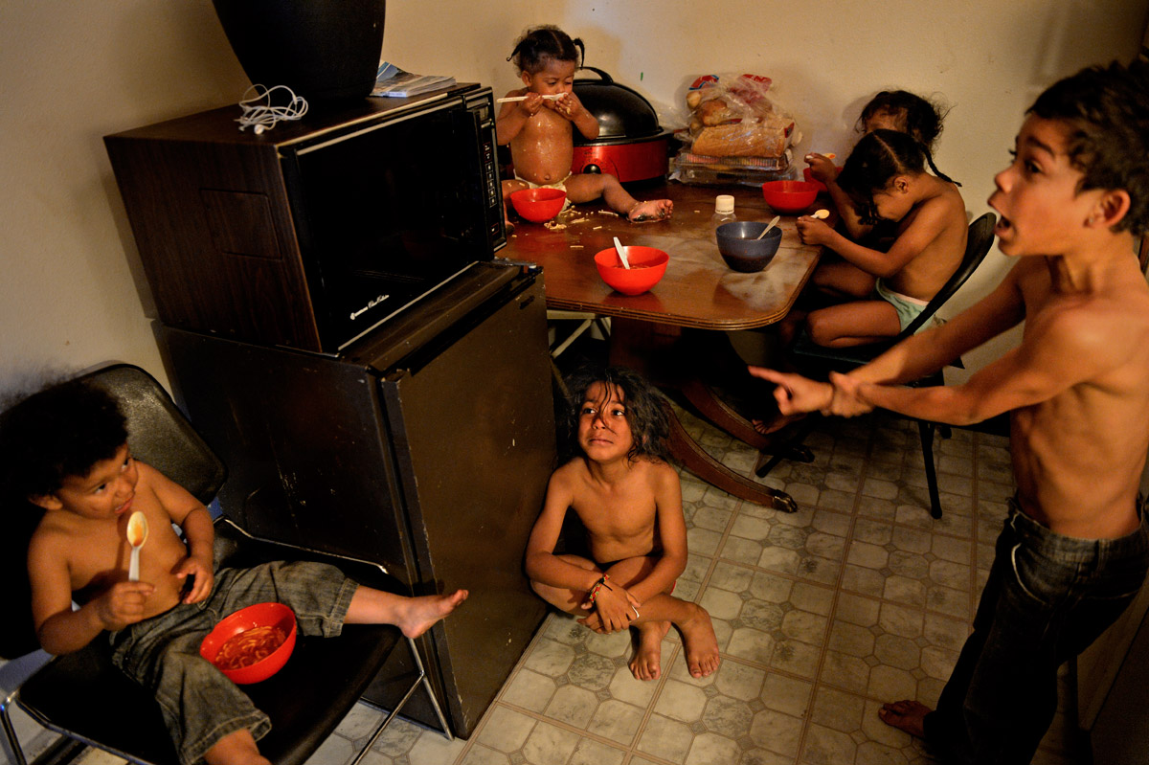
“Trying to Live, Trying to Learn” Denver Post, http://extras.denverpost.com/homelessstudents/
Notes:
Here’s the same family at mealtime.

Slide 15
Cramped
Compromised health and development
Crowded
Chaotic
Noisy
Lack of child-friendly spaces/policies
Dirty
Dangerous
Notes:
Even at their best, homeless living situations are cramped and crowded and probably chaotic and noisy. At their worst, they are dirty and dangerous—even some shelters lack resources for basic child proofing or safe sleep practices, and many don’t have child-friendly spaces or policies that create a child-friendly environment.
Anyone who works in early childhood knows that these are not the kind of environments that are conducive to healthy growth and development, and sadly, thousands of homeless infants, toddlers, and preschoolers are spending the majority of their time in places like these.

Slide 16
What do you think the role of early care and education is here?
Notes:
What can we do? What role can early care and education play?

Slide 17
High-quality early care and education makes the difference!
Developmentally stimulating and supportive environment for children
Healthy meals
Build resilience and strengths in children and caregivers
Protect and support brain development during critical period
Protect and support health
Comprehensive supports for parents and caregivers
Sense of normalcy
Stability and routines
Positive relationships
End homelessness!
Support parents in addressing health, mental heath, other needs that contribute to persistent homelessness
Support parents in finding employment or furthering education
Support families in finding safe, stable housing
Notes:
They can’t necessarily put a family in housing, but high-quality early childhood programs can ameliorate or prevent the types of deficits and challenges that contribute to homeless children growing up to be homeless adults.
From home visiting to Head Start to child care, your programs can provide a stimulating and supportive environment, healthy meals, connections to health and other services, parenting support, and more. They also can provide children and families with positive relationships, a sense of normalcy, and in some cases, may be the only stable thing in a family’s life.
For homeless parents, access to safe and stable care for their children means having the ability to attend to the issues that contribute to their homelessness. It can allow them the time and space they need to address health and mental health issues, further their education, obtain employment, and search for housing.
We also have research that backs this up. The office of Planning, Research, and Evaluation out of ACF recently examined data from the U.S. Department of Housing and Urban Development’s Family Options Study, to learn more about the well-being of young children 20 months after staying in emergency homeless shelters with their families. Among the findings were that children who had more stable recent housing situations and more stable child care arrangements displayed fewer behavior problems and children who were enrolled in Head Start or other early education and center-based care displayed stronger pre-math and pre-reading skills.

Slide 18
Access to early care and education for homeless children means the difference between spending your day here…
Notes:
At the most basic level…

Slide 20
Or here…

Slide 21
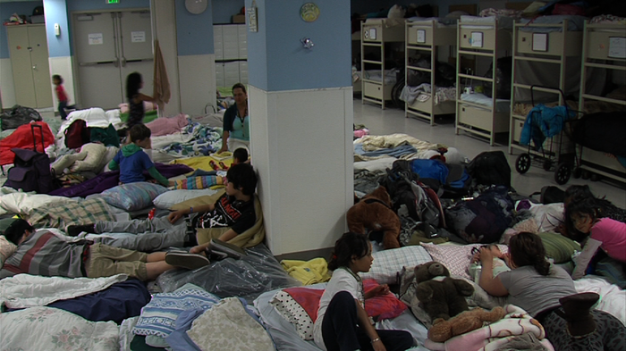
“Homeless Babies and Toddlers Endure Tough, Long Days on San Diego Streets” KPBS, San Diego Rescue Mission, http://www.kpbs.org/news/2013/may/30/preschool-aged-homeless-children-endure-tough-time/

Slide 22
Why aren’t we serving more children and families?

Slide 23
Why aren’t we serving more children and families?
Families are highly mobile
Families lack documentation required to apply/enroll (birth certificates, health records, etc.)
Families have chaotic lives
Families have histories of negative experiences with service providers
Families don’t believe they are eligible or don’t’ know about available programs
Lack of awareness and understanding of homelessness
Lack of outreach to/identification of homeless families
Lack of program availability/capacity
Rigid program requirements and structures
Complicated program application/enrollment procedures
Lack of transportation
Lack of meaningful data on homeless families
Notes:
There are a lot of reasons we aren’t enrolling more homeless children in programs.
Some of that has to do with the tremendous barriers that homelessness creates for families, like high mobility, lack of required documentation, competing priorities, and distrust of service providers based on past negative experiences.
But at the same time, our system, like most service systems, isn’t really built with homeless families in mind and therefore presents some systemic barriers that tend to keep homeless families out.
I already mentioned the issue of under-identification and under-reporting. A lot of programs have pretty rigid enrollment and attendance requirements or multi-step, complicated enrollment procedures that make it hard for homeless families to navigate the process. Not enough programs are intentionally targeting outreach efforts to homeless families.
Most programs are unable to offer transportation, which is a key support that homeless families often need, and certainly there aren’t enough programs slots available in the first place to meet the demand, and those that are available might not be accessible for homeless families, perhaps because they are only part day or not available during the hours families need them.

Slide 24
Recent policy changes pave the way for improvement
Child Care and Development Block Grant
Head Start Performance Standards
Every Student Succeeds Act
Notes:
Good news! Recent updates to federal policies provide opportunities to greatly improve our impact on children and families experiencing homelessness.
Many of the changes I’m going to talk to you about are meant to align early childhood programs with federal requirements that support school enrollment and participation among school-age children who experience homelessness.

Slide 25
Child Care Development Block Grant (CCDBG)
Reauthorization: In 2014, on a bipartisan basis, Congress reauthorized the Child Care and Development Block Grant (CCDBG) Act and made sweeping changes.
Final Rule: HHS published a final rule on September 30, 2016 to update Child Care and Development Fund (CCDF) regulations to follow the Act.
CCDF is the largest source of federal funding to help pay for child care for low-income working parents.
Notes:
In 2014, CCDBG was reauthorized for the first time in 18 years, making major changes to the program. The most significant changes included improvements to health and safety protections for children in child care, more eligibility practices that promote access to stable care, more funds to enhance quality of care, and increases to consumer education available to parents, providers, and the public.
A little more than a year ago, HHS published a final rule that updated the regulations for the Child Care and Development Fund program, which is the largest source of federal funding to help pay for child care for low-income working parents and serves about 1.4 million children under age 13 each month.
The latest reauthorization of the law represents a paradigm shift that many states are challenged to make, so I can’t underscore enough how significant these changes have been.

Slide 26
CCDF and homeless children
States are required to:
Provide training and TA on identifying and serving homeless children and their families
Conduct specific outreach to families experiencing homelessness
Coordinate with early childhood programs serving children experiencing homelessness, McKinney-Vento liaisons, and homeless service providers
Collect & submit data on children experiencing homelessness who receive child care assistance
Use the McKinney-Vento definition
Prioritize children experiencing homelessness
Establish a grace period for providing required documentation (birth certificates, immunization records, etc.)
Provide support to families in obtaining required documentation
Notes:
For the first time ever, the law includes a number of provisions that directly target children and families experiencing homelessness.
States are now required to:
Establish a grace period that allows children experiencing homelessness to receive child care while their families obtain any required documentation, like immunization records or birth certificates
States must fund activities that remove barriers to enrollment in child care, including training and TA on identifying and serving homeless children and specific outreach to homeless families
And states must also collect and submit data on the number of homeless children who receive child care assistance monthly

Slide 27
Head Start Performance Standards
On September 1, 2016, ACF published a final rule revising the Head Start Performance Standards
First comprehensive revision since 1975
Major changes included moving more programs to full-day and full-year, limiting suspension and prohibiting expulsion, more attention on attendance, more local flexibility to innovate, and streamlined requirements
Also included some new provisions related to serving children and families experiencing homelessness
Notes:
ACF published another final rule in September 2016, this time revising the Head Start Performance Standards. This was the first comprehensive revision of the standards in more than 35 years.
Some of the changes to the standards included efforts to move more programs to a full-day and full-year schedule, putting limits on suspension and prohibiting expulsion, focusing more attention on program attendance, providing more local flexibility to innovate, and streamlining requirements.
The revised standards also included some new provisions related to homelessness.

Slide 28
Head Start Performance Standards and homeless children
McKinney-Vento definition
Categorically eligible
Must be prioritized for enrollment
Programs can reserve up to 3% of slots for children experiencing homelessness
Children can attend for up to 90 days while records are obtained
Community needs assessments must include data on homelessness
Programs must make efforts to help families
maintain enrollment or transition to other programs
if they move, arrange for transportation if needed, and
Develop relationships with housing/ homelessness partners.
Notes:
Probably the most significant opportunity presented by the standards is the option for Head Start programs to reserve up to 3% of slots specifically for children experiencing homelessness.
The revised standards also clarified that children can attend programs for up to 90 days without birth certificates or immunization records, as long as local licensing allows.
The standards also don’t specifically require but do ask programs to make efforts to maintain enrollment in the program when homeless children move or to help them transition to other programs if needed, to make efforts to provide transportation, and to develop relationships with relevant housing partners.
Not new but worth mentioning is that Head Start uses the McKinney-Vento definition of homelessness and children experiencing homelessness are categorically eligible for Head Start and must be prioritized for enrollment.

Slide 29
ESSA Reauthorization and early childhood homelessness
States must ensure that homeless children have access to public preschool programs
McKinney-Vento State Coordinators must collaborate with early childhood community
LEA homeless liaisons must ensure that homeless children have access to Head Start and Early Head Start programs, early intervention services under the Individuals with Disabilities Education Act (Part C), and other preschool programs administered by the LEA.
Added preschool to the definition of “school of origin” thus ensuring preschool age homeless students can continue in their school if they move due to homelessness
LEAs must provide transportation to and from preschool of origin
Notes:
States have long had to ensure that homeless children have access to public preschool programs and there has almost always been some mandate around collaboration among McKinney-Vento state coordinators and the early childhood community.
What is new is that preschool is now considered a school of origin, which means that preschool age children must now be allowed to remain enrolled in their LEA administered preschool programs even if they move outside of the attendance barriers and schools must provide transportation to and from that school of origin.
Another new item is that local school-based homeless liaisons must ensure that children have access to IDEA Part C or Early Intervention services, in addition to Head Start and preschool. This one is more of a heavy lift for liaisons because most of them already have very little experience with early childhood programs and services, so asking them to connect infants and toddlers to programs is new to a lot of folks.
****************
Homeless children have the right to continue their education in their “school of origin” for the duration of homelessness, and until the end of the academic year in which they become permanently housed, if it is determined to be in their best interest.
“School of origin” is defined as the school attended when permanently housed or school in which last enrolled, including a preschool.
In determining a child’s best interest, LEAs must: presume that keeping the child in the school of origin is in the child’s best interest, unless contrary to the request of the parent or guardian; consider student-centered factors, including the impact of mobility on achievement, education, health, safety, the child’s attachment to preschool staff, and the availability and quality of services; and give priority to the parent/guardian’s request.
LEAs must provide transportation to and from the preschool of origin, including until the end of the year when the student obtains permanent housing, at a parent/guardian’s request. In addition to preschool of origin transportation, LEAs also must provide children in homeless situations with transportation services comparable to those provided to other children.

Slide 30
Resources
Colorado Early Childhood Council: https://ecclacolorado.org/what-are-early-childhood-councils/
National Center for Homeless Education: www.serve.org/nche
National Association for the Education of Homeless Children and Youth (NAEHCY): www.naehcy.org
ACF Early Childhood Homelessness resource page: http://www.acf.hhs.gov/programs/ecd/interagency-projects/ece-services-for-homeless-children

Slide 31
Enjoy lunch!

Slide 32
Unaccompanied Homeless Youth
Definition: child or youth who meets the McKinney-Vento definition and is not in the physical custody of a parent or guardian.
Many youth become separated from parents due to lack of space in living situations or shelter policies.
Many flee abuse: 20-50% sexual; 40-60% physical.
Many flee family dysfunction: Over 2/3 Hotline callers report at least one parent abuses drugs or alcohol.
Roughly 1/3 homeless youth identify as LGBTQ.
10% of currently homeless female teens are pregnant.
Many are not enrolled in school.
Notes:
Training Opportunities

Slide 33
Enrollment of Unaccompanied Youth
Immediate enrollment applies, even without parent or guardian.
Youth self-enrollment; Caregiver forms
NCHE Brief: When Legal Guardians Re Not Present: Enrolling Students on Their Own
Liaisons must help unaccompanied youth choose and enroll in a school, give priority to the youth’s wishes, and inform the youth of his or her appeal rights.
School personnel (administrators, teachers, attendance officers, enrollment personnel) must be made aware of the specific needs of runaway and homeless youth.

Slide 34
Full Participation
The McKinney-Vento Act requires schools to enroll children and youth experiencing homelessness in school immediately, even if the student is unable to produce records normally required for enrollment, or has missed application or enrollment deadlines during any period of homelessness [42 U.S.C. § 11432(g)(3)(C)(i)]. The Act defines enroll and enrollment as "attending classes and participating fully in school activities” [42 U.S.C. § 11434a(1)]. Therefore, students experiencing homelessness must be able to enroll in school immediately, including attending classes and participating in extracurricular school activities, such as sports, performing arts, and clubs.
In addition, the McKinney-Vento Act requires State educational agencies (SEAs) and local educational agencies (LEAs; hereafter school districts) to develop, review, and revise policies to remove barriers to the identification, enrollment, and retention in school of children and youth experiencing homelessness [42 U.S.C. § 11432(g)(1)(I)]. Further, the Act requires schools to ensure that children and youth experiencing homelessness who meet the relevant eligibility criteria do not face barriers to accessing academic and extracurricular activities [42 U.S.C. § 11432(g)(1)(F)(iii)]. By proactively reviewing, revising, developing, and implementing policies to eliminate barriers to full school participation for McKinney-Vento students, States and school districts ensure that these students are able to participate in extracurricular activities, and provide these students with an added motivation for continued school engagement.
Notes:
What about sports?

Slide 35
Support for Academic Success
Liaisons must ensure that—
Unaccompanied youth are enrolled in school and that procedures are implemented to identify and remove barriers that prevent them from receiving credit for full or partial coursework satisfactorily completed at a prior school, in accordance with State, local, and school policies.
NCHE Brief: Supporting the Education of Unaccompanied Students Experiencing Homelessness

Slide 36
Unaccompanied Youth and Higher Education
Higher education offers students experiencing homelessness the best hope for escaping poverty and homelessness as adults. The programs of the Higher Education Act (HEA) have the potential to assist these youth to graduate from high school, apply for and access postsecondary education, and complete their degrees.
Liaisons must ensure that—
All McKinney-Vento youth must be able to receive individualized counseling from counselors to prepare and improve their readiness for college, including college selection, application, financial aid, and on-campus supports.
Liaisons must ensure unaccompanied youth are informed of their status as independent students and obtain verification of that status.

Slide 37
Unaccompanied Youth and Higher Education
The College Cost Reduction and Access Act (CCRAA) of 2007 made significant changes to the Free Student Application for Financial Aid (FAFSA) that makes it easier for unaccompanied homeless youth to obtain the financial support they need to pursue their education. This Act allows unaccompanied homeless youth to qualify as independent students for purposes of federal financial aid because they do not need to report their parents’ information, or have their parents sign the FAFSA.
Four authorized verifiers
McKinney-Vento Homeless Education Liaison (Colorado UHY Verification Form)
Runaway and Homeless Youth Act Director or Designee*
HUD Director or Designee*
Financial Aid Administrator

Slide 38
Resources: Unaccompanied Youth and Higher Education
Sample: Documentation of Independent Student Status for the FAFSA
Application and Verification Guide 2018-2019
FAFSA Tips for Unaccompanied Youth
NCHE Briefs:
Increasing Access to Higher Education for Unaccompanied Youth: Information for Colleges and Universities
College and Career Counseling for Students Experiencing Homelessness: Promising Practices for Secondary School Counselors

Slide 39
Unaccompanied Youth Strategies
Develop clear policies for enrolling unaccompanied youth immediately, whether youth enroll themselves, liaisons do enrollment, caretakers enroll youth in their care, or another procedure is in place. Offer youth an adult and peer mentor.
Establish systems to monitor youth’s attendance and performance, and let youth know you’ll be checking up on them.
Help youth participate fully in school (clubs, sports, homework help, etc.)
Build trust! Be patient, and ensure discretion and confidentiality when working with youth.

