Slide 1
Early Childhood and McKinney-Vento
Presentation and Discussion
January 27, 2016

Slide 2
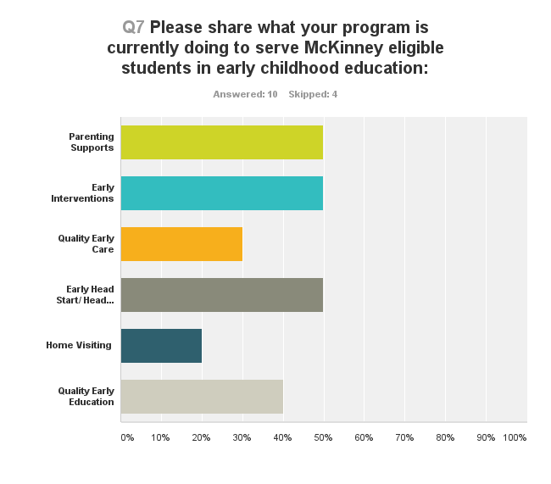
Services in McKinney-Vento Sub-grantee School Districts

Slide 3
What is working?
Open communication with the preschool and Head Start organizations
Connecting parents to the information about support and resources
Making referrals to community resources
Partnering with Early Childhood offices within the district

Slide 4
Partners in Early Childhood
Health Clinics
Child Find
Shelters
Food Pantries
Head Start
District Early Childhood Programs
Community Based Organizations

Slide 5
Reflection
Take a moment to reflect on the impact of homelessness on young children and their families and the relevance of this information to your work. Jot down a phrase or two.
What are some challenges in collaborating with early childhood education, that, if solved, would impact practice, policy and/or outcomes for McKinney eligible young children in your program or district?
What would success in this partnership and collaboration look like?

Slide 6
Peer Presentations and Discussions
Jefferson County Public Schools
St. Vrain Valley School District
Scenarios

Slide 7
Reflection Part II
Have any of your reflections or thoughts changed?
Action Steps

