Slide 1
Unaccompanied Homeless Youth Panel of Peers
Supporting and Serving
Youth Experiencing Homelessness While Not in the Physical Custody of a Parent or Guardian
McKinney-Vento Sub-grantee District Meeting
April 13, 2016

Slide 2
Panel Presenters
Marc Fortney, Centennial BOCES
Rural Perspective
Partnership with Migrant Education Program
Runaway & Homeless Youth Services
Promis Bruno, Fountain/Ft. Carson
Protocols and Practices for Supporting UHY in Suburban Settings
Jennifer Wilson, Jefferson County Public Schools
Medicaid, CHP+ and Accessing Supports for UHY
Dorothy Leyba, Denver Public Schools
UHY and Government Issued Identification

Slide 3
Panel Process
Each Panel Member Presents (15 minutes )
Hold questions and Comments for the End
Think, Pair, Share

Slide 4
Centennial BOCES

Slide 5
Centennial Board of Cooperative Educational Services
Northeast Quadrant of Colorado
13 Counties
53 School Districts
100+ Communities, Villages
Summertime, Winter Break & School Year
Rural, Remote = 1 hr for Sheriff to Arrive
Grover, Greeley, Sterling, Sedgwick, Kit Carson, Deer Trail, Fort Morgan, Fort Collins…

Slide 6
20 + Years with YU
13 runaway, 15 living w/ girlfriend & other teens, 18 chronic year outside in Denver Metro/Boulder
Street outreach to dirt county road outreach
Consultation for building & sustaining Outreach programs for Youth w/out habitat from Chicago, Denver, Boulder, Tuscan, Las Vegas, San Diego…
10 years with Centennial BOCES
Bachelors and Masters in Eclectic Social Work

Slide 7
Migrant Agricultural Advocates via Migrant Education Program
Outreach & Language Accuracy
= Fields, dairies, schools, labor camps
(rural ag-ghetto), youth referring youth
Outreach with educational iPod
& health resources to Out of School Youth
18%+ students of MEP are Houseless

Slide 8
MEP
Holistic Counsel
Flexible funding: “What’s getting in your way? As longs as it’s worthy, let’s unite!”
Identification documents, hygiene, bedding, GED, academic advice, food security…
Youth without documentation / SS#
Highly venerable for Human Trafficking, Exploitation
Not eligible for most Human Service
ICE is THREAT to life

Slide 9
Unique, Stand-out, Successful
Go anywhere, anytime, again and again differently
Personalismo = building a trusting relationship
Our times are of Love, Raw, Fun, Emotion, Foci
Mental, biological, spiritual, emotional counsel is infused
Eliminating reality barriers
Acknowledging context / environmental phenomenon, addiction, gangsterism, racism, time
Patience, grace, being present
I’m not your uncle, mother, yet I can kind of help with what they should do…let’s problem solve together…
Text, Facebook, write letters to jail, out of state…
Never, ever give up, as we change

Slide 10
Runaway & Homeless Youth Act
CO Rural Collaborative = Basic Center Program Grant
12-17 yr old youth, unaccompanied / previously
In-school, out-of-school, summer, winter break outreach
Counsel
$250.00 VISA debit card = Survival goods, soothing hobbies, transportation (bike, skateboard, etc)…
“Family” advice for sustainability, comfort
Host Home - $30 / day up to 21 days = $650

Slide 11
Youth Summit - RHYA
Annual, 12-21 yr olds
Topics: Mental Health, Nestlessness
1-3 days, own hotel room Denver, GJ
$200.00 Visa debit stipend for engagement
Service learning, social emotional introspection, leadership & fun!

Slide 12
Fountain/Ft. Carson

Slide 13
Fountain-Fort Carson D8 Background
Considered to be Urban living
17 miles from Colorado Springs
Government resources are housed in C/S.
Select resources are housed in Fountain certain days of the week.
Limited public transportation
Staff and board members connected to this community.
former teacher, child attended, military connected
Small town living everyone knows everyone
Graduation ceremony still resides at the HS stadium

Slide 14
Fountain-Fort Carson D8 Best Practices
LEA- is housed at the High school
Majority of UHY are HS age at FFC8
Allows for timely follow up with students who become homeless
Shower vouchers, clothing, hygiene, school supplies, student fees etc.
Weekly/Bi-weekly check ins with UHY
Direct involvement with HS counselors

Slide 15
Fountain - Fort Carson D8 Best Practices
Immediate involvement with UHY
who may have an IEP, on probation, truancy or other concerns
Progress monitoring, connect with teachers/admin, counselors
Provide direct resource referral to school and local agencies
Teen shelter, clothing, DHS support, GED, Summer School info.

Slide 16
Fountain-Fort Carson D8 Process/Procedures
Ex. 1
When a student is identified by school staff. They will refer them directly to the LEA.
LEA will identify the need(s), and reach out to the appropriate resource.
The LEA will schedule weekly/Bi-weekly check ins moving forward.

Slide 17
Fountain-Fort Carson D8 Process/Procedures
Ex. 2
UHY stops coming to school, the LEA typically will know this before hearing from the school counselor or attendance.
LEA will conduct home visit to all know addresses. Hopeful, to have student return to school.

Slide 18
MA Supports for UHY
Jeffco Schools
Community & Family Connections (CFC)

Slide 19
MA Site Overview
Staffing: 6 CFC staff (1 coordinator, 5 liaisons)
2 bilingual (Spanish-speaking) liaisons
50/50 MV & MA
Hours: Mon-Fri, 8a-4p
Rotating intake line
Walk-ins, phone, mail, by appointment
Processing Goal: 5 business days
Medicaid & CHP+
Able to expedite as needed
Denver Health Training & QA Support

Slide 20
Outreach Efforts
Title I-A
District Departments
School Staff
District Events
Community Partners
Free/Reduced Lunch
Enrollment
Website
District Newsletters
Notes:
Title I/Family Engagement Program
District Departments (Health Services, ESL, SPED, SEO, Counselor Corps)
School Staff
Leadership
District Events (resource fairs, back to school nights, family nights, FSP, APTT)
Community Partners (clinics, shelters, food banks, FT/HESS, Lakewood Faith Coalition, Edgewater Collective)
Free/Reduced Lunch
Enrollment
Website
District Newsletters

Slide 21
UHY Impact
Stats:
2014-15: 26 UY apps (248 total)
2015-16: 23 UY apps (98 total)
McKinney-Vento supports
Easy access
No age restriction
Address unmet needs
Notes:
McKinney-Vento supports
Easy Access:
Apply at school during breaks/lunch/etc
Easy to call/troubleshoot with liaison
No age limit
Address unmet needs:
Undocumented
Vision/dental – community partnership

Slide 22
District Developments
Catalysts:
Looking to expand MA & MV outreach
Reauthorization of NCLB (ESSA)
Elevated community expectations – student data privacy and protections
Information Gathering:
District Partners (Legal, Data Privacy & Security, Health Services, Student Services, Student Engagement)
Other Districts
Results:
Increased awareness – FERPA & HIPAA
Identification at enrollment
Leadership, administrator, & support staff training
Refining language – district policy, website, leadership memos, etc.
Notes:
FERPA = Family Educational Rights and Privacy Act
HIPAA = Health Insurance Portability and Accountability Act

Slide 23
Assisting Unaccompanied Homeless Youth (UHY) with Government Issued Identification
Dorothy D. Leyba, MSW
Homeless Education Network
Denver Public Schools

Slide 24
Colorado Identification Cards/Driver’s Licenses
In order to obtain a CO ID one must prove 4 elements:
1.) Identity 2.) Age 3.) Name and 4.) Lawful presence
Handout #1

Slide 25
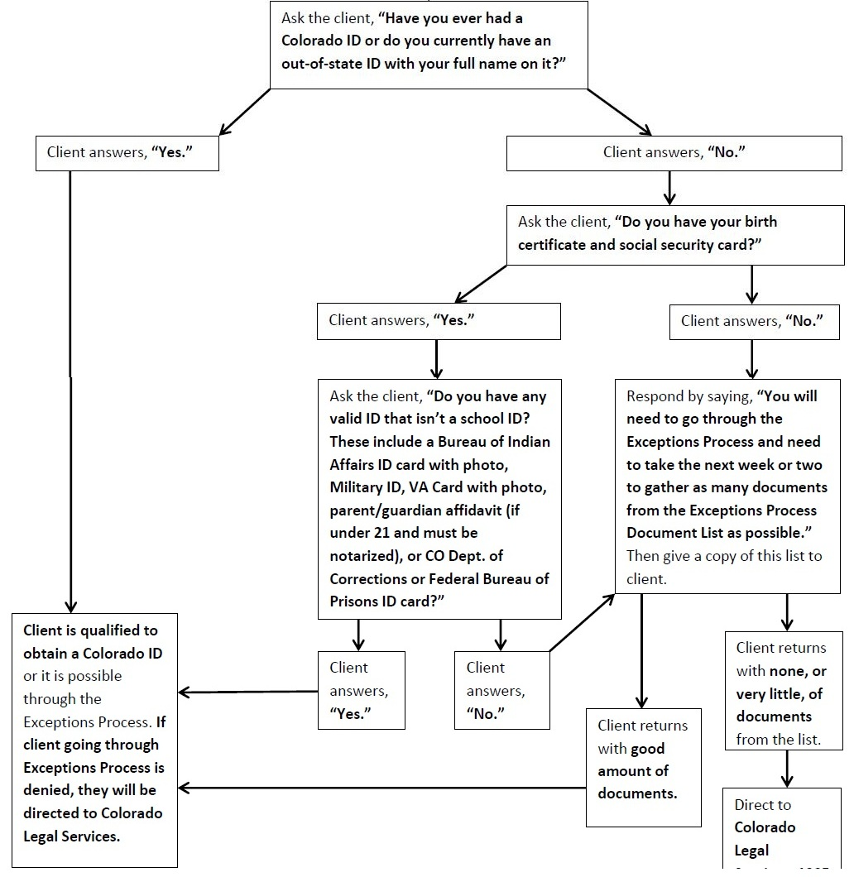
Handout #2

Slide 26
Challenges
UHY who have never had a Colorado ID, or a state-issued ID in general, struggle the most with obtaining an ID/DL card.

Slide 27
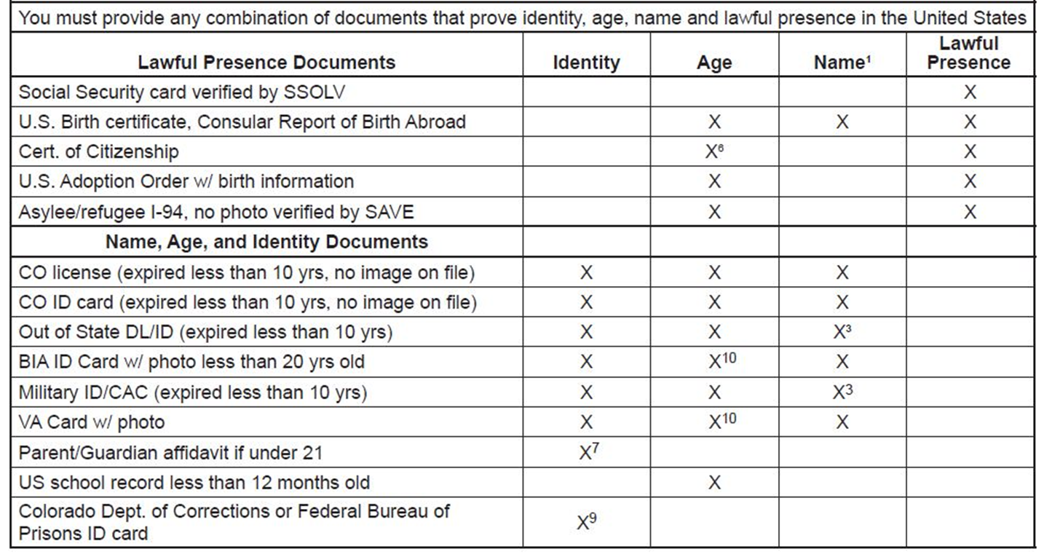
Typically they will have Birth Certificate and Social Security Card

Slide 28
Exception Process
The Exceptions Process requires UHY to gather as many identifying documents as possible.
UHY must provide Birth Certificate, Social Security Card PLUS 3-5 documents from the list numbered 1 – 14. (Handout #5).
Police records: court, booking photos, DOC ID cards.
School Records: face sheet, transcripts, yearbook photo
Medical: Medicaid Card, immunization records
Employment Records: W2 forms, employee ID, tax returns.
Religious Records: Baptismal records
Tribal Documents: Certificate of Indian blood, Tribal ID

Slide 29
Exception Process
UHY need to make an appointment online at www.colorado.gov/revenue or call 303-205-5842
Walk in Hours M-F 8am-3pm
Exceptions Processing applications may be submitted at one of the four regional driver license offices. (Same day reviews)
Denver Central - 1865 West Mississippi Avenue., Unit C, Denver CO 80223
Colorado Springs - 2447 North Union Blvd., Colorado Springs CO 80909
Fort Collins -3030 South College Avenue., Suite 100, Fort Collins CO 80525
Grand Junction - 222 South 6th., Suite 111, Grand Junction Colorado 81501

Slide 30
Barriers
UHY who have never had a Colorado ID, or a state-issued ID.
Colorado is a “full name state” meaning any identifying document must have one’s full first, middle, and last name. For instance, California ID’s use the middle initial instead of the full middle name so clients with California ID’s cannot use these to identify themselves.
Documents must have the full name spelled correctly and punctuation must match. For example a Native American UHY had issue with last name being four words, to protect confidentiality, were Tree Bear Fly Wind. Some of his documents for the Exceptions Process spelled this last name as all one word or used hyphens. This disqualified the youth from the process.

Slide 31
Barriers
As of August 2015, the Colorado DMV now requires 2 documents proving residency in order to apply for a license for the first time. These documents must be within 1 year of the date of issuance.
Remote Exception Process can take 2-3 weeks for result.
Cost: ID cards are $11.50 and driver’s licenses are $25.00.
Transportation
Hours of walk ins and appointments are during school/work hours
Legal Guardian Affidavit: Not living with parent/guardian or no contact
UHY who do not have birth certificates or Social Security Cards or knowledge of original documents.

Slide 32
Supports
Colorado Legal Services 1905 Sherman St. Denver, CO 80203 (303) 837-1313
Colorado Poverty Law Project (CPLP) organizes a monthly pro bono legal clinic 3rd Wednesday of each month from 4pm-6pm 2130 Stout Street Denver CO
Exceptions Processing Coordinator Rhonda Bliss (303) 922-0629
Urban Peak – Outreach Case manager does weekly visits to DMV when youth request.
Assisting UHY with checklist of documents before appt.
Cover cost of ID or DL
Become a Notary.
Have patience

Slide 33
Questions

Slide 34
Think, Pair, Share
Think:
Write down one new piece of information you gained from today’s presentations AND
one practice or support for UHY you implement that you would like to share
Pair:
Stand up and find a partner who is not from your district
Share your new piece of information and the practice you implement
Share:
Return to your district or school group and share out

