Slide 1
The Vision Space Webinar # 4
Your opportunity to create the SPACE you want.
December 2, 2014 Colorado School Counselor Corps Grant
Pamela Decker and John Happs

Slide 2
AGENDA
An example of this project and how to focus on your vision
Visualizing where you need to be according to the data you have collected
Themes, patterns and trends you have discovered
List the top 3-5 questions that seem to be emerging from multiple data sources
Use guiding questions worksheet
Prioritizing data results
Understanding and accepting Change

Slide 3
Oh to be an educator
.

Slide 4
Now You See It Now you Don’t Welcome to the Vision Space

Slide 5
Can You See Me Now?

Slide 6
The Vision Space
You have now gathered all your data
You have analyzed all the data you have collected
You have the opportunity to do anything you want –really do you OR Not really???
You have the chance to bring all of your stakeholders or some of your stakeholders together to “Brainstorm”

Slide 7
The Once was a High School

Slide 8
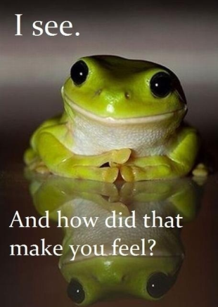
Whose Counselor- got a Grant?

Slide 9
John and Pam looked at the survey data and found
1. Nobody knew what ICAP meant
2. Everybody knew their name
3. 40% of the student’s surveyed had
no idea about options beyond high school.
4. None of the Students/parents/staff
understood financial aid.

Slide 10
They looked at their Environmental Scan
Micro Internal showed that no one in the counseling office had training around post-secondary readiness
Micro External showed that the school had a reputation of turning out gangsters rather than college grads.
Macro Internal showed that there were no programs for first generation and low income students.
Macro External showed that the community’s socio-economic status was mostly below the poverty level and filled with many high school dropouts.
Are you tired of seeing this

Slide 11
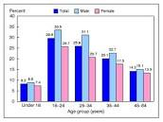
The School’s School Profile Data Showed
15% of the students missed more than 20 classes each semester
The freshman “F” rate was 38% last year.
The school had a 20% dropout rate for the 2010 cohort
The school has 80% free and reduced lunch
The school has a 23% CER
The school is 15% white students and 90% white staff
The school has 115 students that are ELL and Spanish speaking and only one bi-lingual staff member.

Slide 12
The Counselors did a College Going Culture Assessment
UC Berkeley:
College-Going Culture Rubric
Center for Educational Outreach at UC Berkeley
The 9 Elements to Support and Encourage a College-Going Culture
And they found many areas of need around creating a culture that promotes their students to go on to college.

Slide 13
Questions (not answers)
List 3-5 Questions on whiteboard that seem to keep emerging from your data sources?
Notes:
Type in or use the white board

Slide 14
Guiding Questions Worksheet

Slide 15
Possibilities
What can we do to change what is going on?
Who do you want to ask—stakeholders???????
Are there several possibilities to the same problem?
Are there several possibilities to several identified problems?
Don’t bite off more than you can chew
For now “visualize anything” Please don’t say “we can’t”
Remember that the solutions need to be systemic

Slide 16
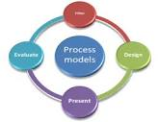
Types of People for Decisions
Relationship People Data People
Process People
Notes:
These are all necessary to make a good decision. How do you facilitate?

Slide 17
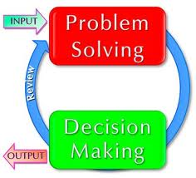
Who Makes the Decision
Decide in the beginning as to who has the ability to decide
Do all stakeholders have equal decision making ability, or do some of them just give input.
Does the person or persons that hold the “purse strings” have the ultimate decision making power.

Slide 18
Change is Hard
When you are trying to change anything remember:
Great communication to all stakeholders
Be a great listener
Be flexible
Be transparent
Be open to other’s ideas
Be a great facilitator
Look for “buy in”
Educate your stakeholders about the data collected and reasons for the change

Slide 19
The First Phase of Working Through the Vision Space
The purpose is to generate an image for the future
The agreement is that the program that we envision reflects what we want to do
The vision must be different from the status quo.
Is the vision systemic?

Slide 20
The Second Phase is the Thematic Phase
Identify common elements based on the data
Reach consensus with your stakeholders that the identified problem is an area worth changing

Slide 21
What to Do
Look for Themes in your data
Explore the themes—disaggregate
What kinds of systemic interventions would you use for a particular theme?
Facilitate and look for collaboration.
Agree
Educate your populations

Slide 22
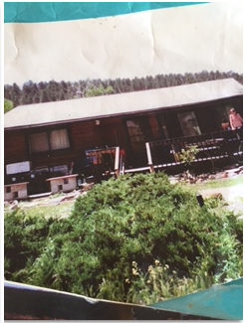
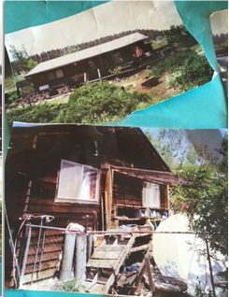
VISION???????

Slide 23
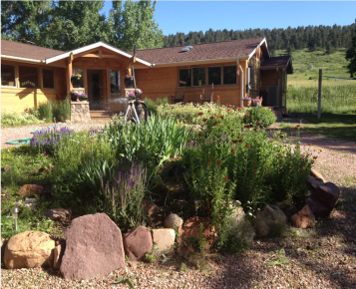
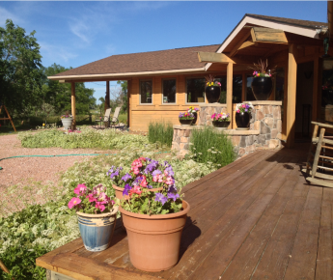
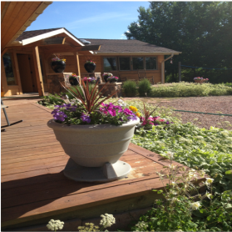
Our Vision Accomplished

Slide 24
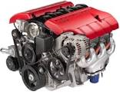
Get Ready to Start your Engines
Answer the questions that your data identifies
Solve the problems that your data identifies
Get Ready for “Action Planning”.

Slide 25
THANK YOU SO MUCH!
Have a great December and we will see you virtually iN January !
Pam and john and eve

