Slide 1
September 11, 2025
Data Pipeline Town Hall
The goal of the webinar is to provide updates on the Data Pipeline, current, and upcoming data collections. These webinars also provide a forum for districts, BOCES, and Administrative Units to have questions answered about Data Pipeline.

Slide 2
Colorado Department of Education
Identity Management (IdM)
Identity Management Site
Frequently Asked Questions
How do I add myself or others to the email listserv for town hall emails and/or a specific collection?
  Email lists are dependent on a person’s access rights in IdM. Contact your LAM to get an account or be assigned to a specific collection.
Where can I find the IdM role mappings for Data Pipeline and other applications?
  Role Mapping (XLS)
I am a LAM. How do I update the user permissions for someone in my district?
  Follow the steps outlined in the IdM Quick Guide for Access Management (DOCX)
Important: Users are not automatically removed from IdM when their email address is no longer active in your district. The LAM must deactivate their IdM account to ensure only designated staff can access CDE’s data reporting system.
Support:
  Michael Threlkeld
  Forgot Password
  Request LAM Assistance
Notes:
LAMs, please check the IdM roles for your district. Remove permissions for users who have retired, left your district, or are no longer assigned to a collection. Add roles for new hires and newly assigned respondents for specific collections.

Slide 3

What is PII?
Student and Staff Personally Identifiable Information (PII) is defined by state and federal laws as information that, alone or in combination, personally identifies an individual
  This includes direct identifiers
  (i.e. student and staff names, SASID, EDID, etc.)
  Includes information that when combined is identifiable
Colorado’s Student Data Transparency and Security Act outlines requirements for how Student PII is collected, used and shared
See the Data Privacy and Security website for prepared guidance on how to comply with this and other privacy laws.

Slide 4

Sharing Data
Use secure methods to transfer any PII to CDE
  Contact Data Collection leads with questions about how to transmit PII securely
    Each Data Collection leads maintains their own Syncplicity folders for specific collections, reach out to the collection lead for access
  Use Syncplicity to encrypt emails to CDE
Avoid sending PII via unencrypted email or to unsecured faxes when sharing data between or within districts
  Use Syncplicity to encrypt emails to CDE
Check local policies for restrictions, requirements, etc. regarding PII
  Do not use PII in trainings, presentations, etc.
  Do not share PII with unauthorized individuals
  Do not share passwords
  Follow local policies when transmitting PII to any third party

Slide 5
Today’s Agenda
Agenda Topic | Presenter
Open Data Collections and Upcoming Deadlines in Data Pipeline | Host: Jessica Tribbett
Title I Interchange | Melissa Chaffin
Student October | Collin Slutzky
Special Education End of Year | Lindsey Heitman
Instructional Days & Hours | Jessica Tribbett

Slide 6
Open Collections and
Upcoming Deadlines in
Data Pipeline

Slide 7
Open Collections and Upcoming Dates:
Year-Round & Interchanges
Name | Category | Status | Key Dates
RITS | Year Round | Open | N/A
EDIS | Year Round | Open | N/A
Directory | Year Round | Open | N/A
Student | Interchange | 2025 & 2026 Open | 2024-2025: Maintain error free files 2025-2026: Interim Deadline 10/2, initial DEM and SSA upload
At-Risk | Interchange | Open | Questions from the Field—Live Q&A, 10/9, 1pm (Registration Link)
Title I | Interchange | 2025 & 2026 Open | 2024-2025: Maintain error free file 2025-2026: Interim Deadline 10/2, initial upload
Special Education IEP | Interchange | Open | Maintain error free files
Staff | Interchange | 2025 & 2026 Open | 2024-2025: Maintain error free files 2025-2026: Interim Deadlines for initial uploads 10/24 staff profile initial file upload 10/31 staff assignment initial file upload
Teacher Student Data Link | Interchange | Open | Maintain error free file
Data Pipeline Resources: Data Pipeline Collection Dates (XLS)

Slide 8
Open Collections and Upcoming Dates:
Snapshots
Name | Category | Status | Final Deadline Date | Next Milestone | Looking Ahead
Teacher Student Data Link | Snapshot | Open |  | Submit TSDL Snapshot to CDE
Staff Evaluation | Snapshot | Open | Oct. 15, 2025 | Report Review: 7/15 to 8/15 Final snapshot report review | State Deadline: 10/15
Student End of Year: Regular Phase | Snapshot | Closed | Sept. 4, 2025 | State Deadline: 9/4/25 | Cross LEA Phase
Student End of Year: Cross LEA Phase | Snapshot | Coming Soon | Oct. 16, 2024 | Training Event: 9/16/25 September SEY Office Hours (register) | Opens: 9/18/25 all LEAs may begin creating snapshots once receive snapshot unlocked notification email
Special Education EOY | Snapshot | Open | Oct. 3, 2025 | Interim Deadline: 9/11/25 Error free snapshot | Interim Deadline: 9/12 – 9/19 Report Review
Student October | Snapshot | Open | Nov. 10, 2025 | Interim Deadline: 10/02/25 Initial SSA, DEM, At-risk, and Title 1 file uploads | Interim Deadline: 10/9/25 Error-free interchange files
Data Pipeline Resources: Data Pipeline Collection Dates (XLS)

Slide 9
Open Collections and Upcoming Dates:
Periodic
Name | Category | Status | Final Deadline Date | Next Milestone | Looking Ahead
Summer EBT: Corrections Period | Periodic | Closed | Sept. 3, 2025
READ Training | Periodic | Closed | Aug. 30, 2025 | Interim Deadline: 8/26/25 Error-free submission | Deadline: 8/30/25 collection closes, submit sign-off forms to CDE
Instructional Days and Hours | Periodic | Coming Soon | Dec. 19, 2025 | Collection Opens: 9/17/25
Data Pipeline Resources: Data Pipeline Collection Dates (XLS)

Slide 10
Title I Interchange
Melissa Chaffin

Slide 11
2024-2025 Title I Interchange
Date | Event | Event Description
9/18/2024 to 10/16/2025 | Student End of Year: Cross-LEA Phase | Final opportunity to update Title 1 TA data for 2024-2025 school year. Error free Title 1 Interchange file required for LEAs with TA programs.
10/17/2025 | Closes | 2024-2025 Title 1 Interchange closes.
Title 1 Interchange
Chaffin_m@cde.state.co.us

Slide 12
2025-2026 Title I Interchange
Date | Event | Event Description
8/29/2025 | Open | Please start uploading Title I file for Targeted Assistance schools and grade spans so we can address any errors early on. This would be for the school year 25-26 for Student October.
10/2/2025 | Interim Deadline | Upload initial file
10/9/2025 | Interim Deadline | Error free file for use in Student October collection
11/10/2025 12:00pm | Student October Deadline | Error free Title 1 Interchange file required
5/8/2026 | Interim Deadline | Upload initial end of year file encompassing all students receiving TA services during the current year for use in Student End of Year collection
6/10/2026 | Interim Deadline | Error free Title 1 Interchange File
Fall 2026 | Student End of Year Deadline | Error free Title 1 Interchange File required for LEAs operating TA programs
Title I Part A
Chaffin_m@cde.state.co.us

Slide 13
Title I List Now Available
Title 1-A School List Site—Includes lists of schools and grade spans to check status (TA, SW, NS) by school year
  2025-2026 is now posted
Only Targeted Assistance students are reported, Schoolwide will automatically report at snapshot.
On this list, please note the grade spans for TA schools. If a student is in 7th grade, and the TA eligible-school only covers grades K-6, then you will get an error.
Title I
Chaffin_m@cde.state.co.us

Slide 14
New template for Student October 25-26
Important template change for Student October 25-26
The Title I template for Student October 25-26 no longer collects the gender option.
No Gender template = Student October 25-26
The new Title I file template can be found on the Title 1 Interchange site
There was an error showing in the Validation Report in the Data Pipeline for gender (T1007), but it appears that it may been fixed.
If you are updating the SEY 24-25, please use the old template with the Gender option.
Title I Part A
Chaffin_m@cde.state.co.us

Slide 15
Title I Interchange Targeted Assistance (TA)
The student data in the file must match the exact data in the Student School Association file in the Data Pipeline, or there will be errors.
If the file needs to be updated, then override or replace the old file with the updated file.
Maintain a complete data file at district or school level, make updates to this file if needed.
Make sure to include leading zeros, for example, district codes, school codes, DOB.
  District code example: 0123 or 1122 (must have 4 digits)
  School code example: 0123 or 1122 (must have 4 digits)
  DOB example: 05102019 or 11232018 (must have 8 digits)
Indicate resource(s) students received (reading, math, etc.): 1 for yes, 0 for no. All service cells must be either 1 or 0.
More than 1 school can be listed on the same file for the same district.
Title I Part A
Chaffin_m@cde.state.co.us

Slide 16
Title I Common Errors
Most common Title I Interchange data does not match Student Interchange data
TI003: This school is not a Targeted Assistance school for the grade of the student’s enrollment in the Student Profile.
  Check the Title I Status Designation list for the school and grade span status.
TI004: There must be a School Association record for this student in the Student Profile at this school for the current School Year.
  Make sure the Student School Association file is uploaded first.
OC067: At least one student should be reported in the Title I Interchange as participating in Title I services within a school that implements a Targeted Assistance program. Please update/upload your Title I Interchange file.
May have to refresh October Count file for system to re-read the files.
General data errors
Invalid SASID, first and last name swapped, missing letters.
Services not marked 0 or 1 in template; blanks=errors
May have to refresh October Count file for system to re-read the files
The full list of business rules for Title I can be found on the Title I Interchange Collection Site
I will be going through the Title I uploads in the dashboard next week to assist with errors.
Title I
Chaffin_m@cde.state.co.us

Slide 17
Who To Contact for Title I Part A collection questions
If you have questions regarding:
  Which Title I template to use, email me chaffin_m@cde.state.co.us
  Errors for your Title I upload in the Data Pipeline, or how to upload, email me chaffin_m@cde.state.co.us
  If you think your school or school grade span is incorrectly identified (TA, SW, NS), please see your Title I Part A coordinator first. If there are still questions, please contact either me or the CDE Federal Programs Regional Coordinator that handles their Consolidated Application.
  Thanks!
Title I Part A
Chaffin_m@cde.state.co.us

Slide 18
Questions & Resources:
Title I Interchange
Melissa Chaffin
chaffin_m@cde.state.co.us
720-908-1379

Slide 19
Student October
Collin Slutzky

Slide 20
October Count Timeline
Date​ | Event​ | Event Description​
07/14/2025 | Open​ | Districts may begin uploading Student Interchange Files (Student Demographic and Student School Association).​
08/29/2025 | Open​ | Districts may begin creating snapshots. Student October Snapshot dependencies are the Student Demographic File, Student School Association File, Title I File (if applicable) and At-Risk File.​
09/02/2025​ | Training Event​ | Data Pipeline Training 10-11 a.m.​ Registration Link
09/04/2025 | Training Event​ | New Respondent Training 1-2 p.m.​ Registration Link
09/10/2025 | Training Event​ | Multilingual Learner (English Learner) Training 11-12 p.m.​ Registration Link
09/16/2025 | Training Event​ | Veteran Respondent Training 11:30-12:30 p.m.​ Registration Link
09/17/2025 | Training Event​ | Postsecondary Program Coding Training 11-12 p.m.​ Registration Link
10/01/2025 | Other Date​ | Official Count Day for 2025
10/02/2025 | Interim Deadline​ | Upload Student Demographic and Student School Association Files. Upload Title I Interchange File (if applicable). Upload At-Risk Interchange File.​
10/09/2025 | Interim Deadline​ | Error-free Student Interchange File Uploads (DEM and SSA)
10/14/2025 | Training Event​ | Mid-Collection Office Hours 1-2 p.m. Registration Link
10/14/2025 | Interim Deadline​ | Create an initial Student October Snapshot​
10/27/2025 | Interim Deadline​ | Submit any necessary reporting exceptions for review.
10/27/2025 | Interim Deadline​ | Error free Student October Snapshot​
10/28/2025 | Training Event​ | Data Validation, Transfer Enrollment Exceptions and Cognos Reports 1-2 p.m.​ Registration Link
10/30/2025 | Training Event​ | Data Pipeline Duplicate Process and Submission 11-12 pm Registration Link
11/03/2025 | Report Review​ | Review Student October Cognos Reports for data validation. Submit Student October Snapshot data as soon as review is complete.​
11/10/2025, 12:00 p.m.​ | State Deadline​ | Submit Student October Snapshot data​
Student October
StudentOctober@cde.state.co.us

Slide 21
October Count Timeline:
Duplicate Phase
Date​ | Event​ | Event Description​
11/13/2025 | Deadline | Duplicate count funding documentation due to School Auditing Office​
11/19/2025 | Other Date | School Auditing makes decisions on funding duplicates
11/26/2025 | Deadline​ | Resubmit Student October Snapshot data to CDE based on decisions from School Auditing
12/05/2025 | Deadline​ | Collection Closes Secretary of the Board of Education Verification (sign-off) form due Data remains embargoed until the official release in January
01/21/2026 | Data Release​ | Official data release
Student October
StudentOctober@cde.state.co.us

Slide 22
Student October:
Changes and Updates
High-risk students who are 21 years old and attending an AEC may be eligible for funding if they have sufficient credits to graduate by the end of the current school year
  These students will be pulled into your snapshot, but will flag an error (OC210) and require an exception
Recent training recordings and slides will be posted to the website over the next week
Some districts are reporting that 2025-2026 SSA extracts are improperly formatted
Student October
StudentOctober@cde.state.co.us

Slide 23
Student October Training Schedule
Data Pipeline Training
  Date/Time: 09/02/2025, 10-11 a.m.
  Click here to register for the Data Pipeline Training
New Respondent Training
  Date/Time: 09/04/2025, 1-2 p.m.
  Click here to register for the New Respondent Training
Multilingual Learner Training
  Date/Time: 09/10/2025, 11-12 p.m.
  Click here to register for the Multilingual Training
Veteran Respondent Training
  Date/Time: 09/16/2025 11:30-12:30 p.m.
  Click here to register for the Veteran Respondent Training
Postsecondary Program Coding Training
  Date/Time: 09/17/2024, 11-12 p.m.
  Click here to register for the Postsecondary Training
Mid-Collection Office Hours
  Date/Time: 10/14/2025 1-2 p.m
  Click here to register for the Mid-Collection Office Hours
Data Validation and Cognos Reports Training
  Date/Time: 10/24/2025 1-2 p.m.
  Click here to register for the Data Validation and Cognos Training
Data Pipeline Duplicate Process and Submission Training
  Date/Time: 10/28/2025 9-10 a.m.
  Click here to register for the Duplicate Process and Submission Training
Student October
StudentOctober@cde.state.co.us

Slide 24
Questions & Resources:
October Count
Collin Slutzky
studentoctober@cde.state.co.us
(720) 760-3569
Student October Website
Student Interchange Website
School Auditing Office Website

Slide 25
Special Education End of Year
Lindsey Heitman

Slide 26
Special Education End of Year
Timeline and AU Snapshot Status
September 11, 2025 – All errors resolved- complete snapshot
  Once error-free, review the validation reports in the cognos Special Education EOY folder
  Report list on next slide
September 12 -19, 2025 -Initial Report Review
  Reports do not need to be signed or submitted during this time frame
  They will likely need to be printed again after changes to resolve duplicates or other issues
September 22 - 26, 2025 – Resolving duplicates and data validity issues
September 29 – October 1, 2025 – Final Report Review
October 3, 2025 - Final submission due to CDE
Special Education EOY – Lindsey Heitman
SpedEndofYear@cde.state.co.us

Slide 27
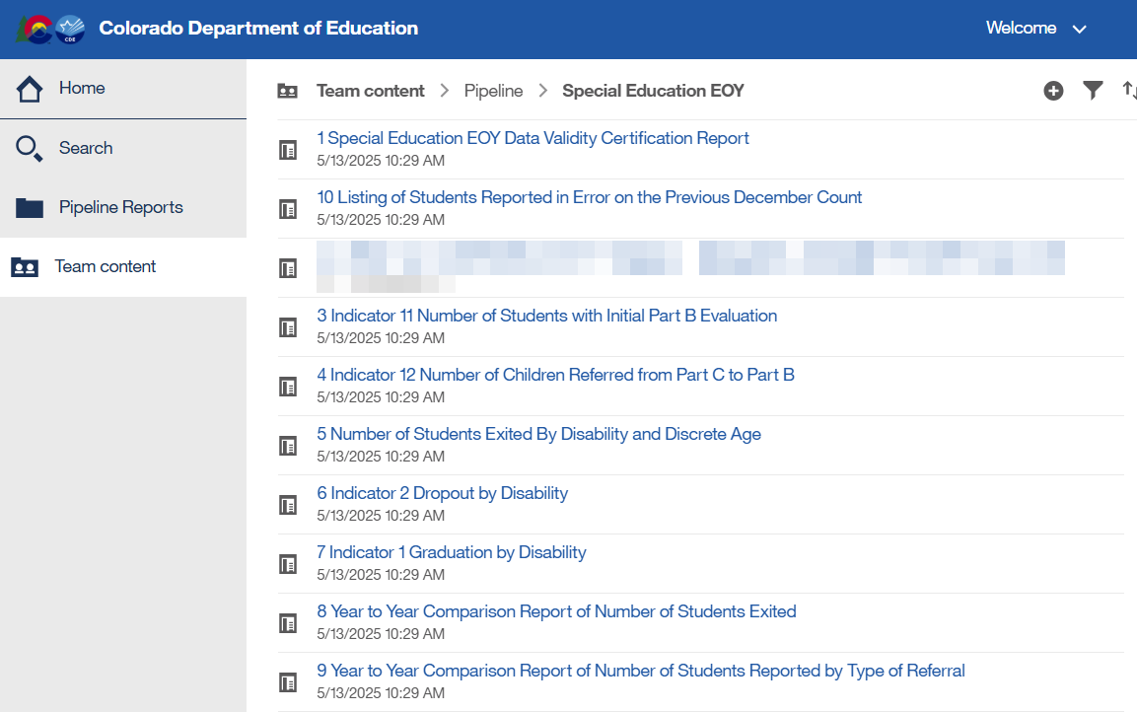
Special Education End of Year
Reports to Review
Special Education EOY – Lindsey Heitman
SpedEndofYear@cde.state.co.us

Slide 28
Special Education End of Year
Warnings to Clear
SY282 - Possible Transfer, this student is reported as in attendance (not exited) at another AU/SOP.
  Other AU and their Start Date is listed in the error record row
  25 of these left statewide
SY307: about 270 records still overlapping SPED start and end dates statewide
  Enrich system reporting 7/1/24 instead of actual Start Date of school/services in the new AU
    Check your larger SIS to see what the actual start date was for that student and update it in Enrich/Participation file
    AU respondent contact list found in Special Education EOY cognos folder
SY263: This Path 3 student was reported in your AU last year as a Path 3 student, please verify whether your current reporting is correct.
  Important to fix so you aren’t bringing your indicator 11 percentage down
SY258: These students were reported on the previous EOY as exiting due to 01-Reached Maximum Age for Services, 02-Death, 90-Graduated or 92-Completed (non-diploma certificate); please verify attendance.
    If record was misreported last year, keep what was correct for this year
SpedEndofYear@cde.state.co.us
Special Education End of Year – Lindsey Heitman

Slide 29
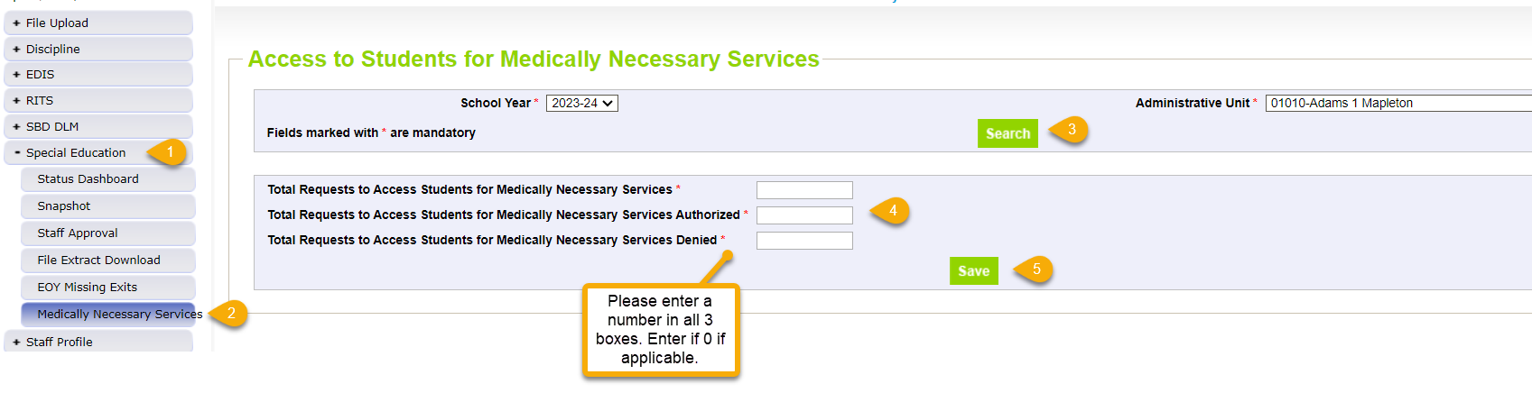
Medically Necessary Services:
Reminder to AUs to Submit 24-25 Counts
Notes:
Counts must reflect all districts within AU from July 1, 2024 – June 30, 2025
Must be completed by the time Sped EOY is approved – by 10/03/25
AUs are able to modify counts until their final Sped EOY is locked/approved
Zero counts must still be entered and click save
42 AUs have completed this so far
Steps
1. Click Special Education tab
2. Click Medically Necessary Services tab
3. Select School Year/AU and click Search button
4. Enter a number in all 3 boxes
5. Click Save button
# Requests Authorized
# Requests Denied
Total # of Requests
Special Education EOY – Lindsey Heitman
SpedEndofYear@cde.state.co.us

Slide 30
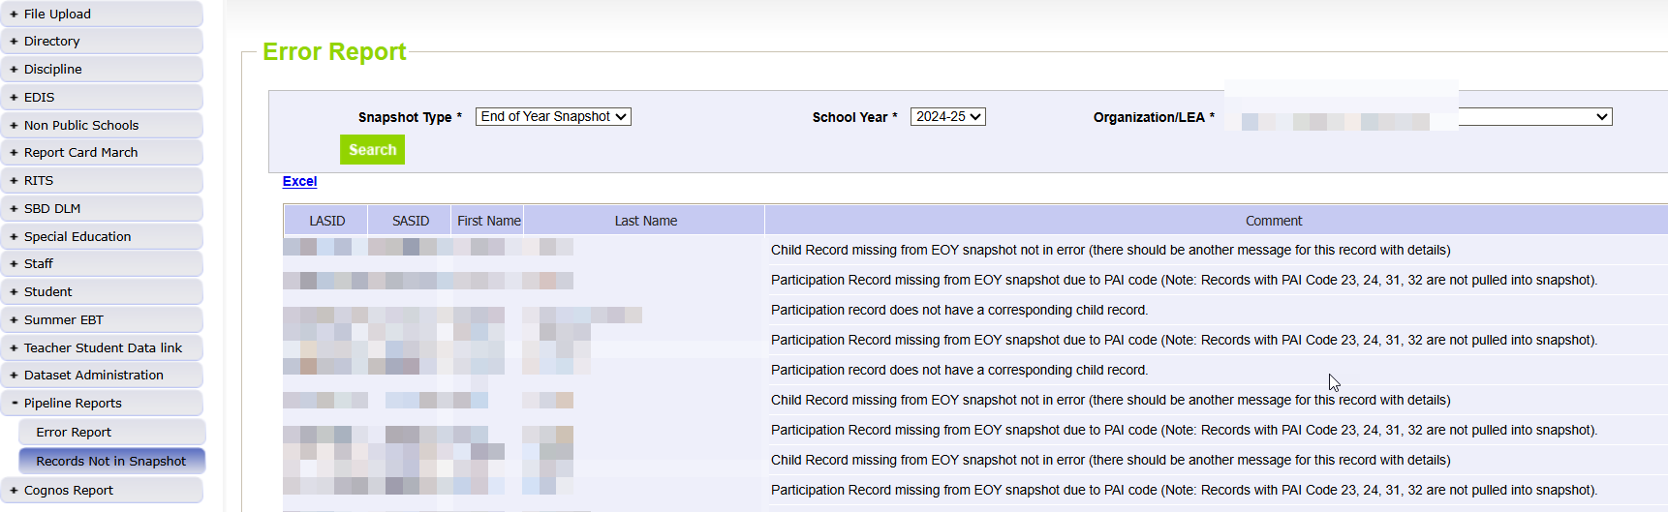
Special Education End of Year
– Missing Snapshot Records
Missing Snapshot Records Report- Please Check
Identify records missing from snapshot due to:
  Interchange errors
  Criteria issues such as mismatched SASIDs or LASIDs
  Records missing from either Child or Participation file
  Some records are correctly excluded (those with PAI code 31 and no SY108 error)
SpedEndofYear@cde.state.co.us
Special Education EOY – Lindsey Heitman

Slide 31
Questions & Resources:
SPED End of Year
SpedEndofYear@cde.state.co.us
Lindsey Heitman
(720) 456-2033
Special Education IEP Interchange Webpage
Special Education End of Year Snapshot Webpage

Slide 32
Instructional Days and Hours
Jessica Tribbett

Slide 33
Instructional Days and Hours:
Timeline & Submission Determination
Collection Timeline
OPEN: Wednesday, September 17th
CLOSE: Friday, December 19th
Required to Submit
  Districts,
  BOCES operating schools,
  and the Charter School Institute
will need to submit data for all public schools serving grades K-12 (006-120).
Do NOT submit data for:
  Pre-K
  Public schools serving only grades 004-004
  100% Home Options Schools (school system code 10)
Instructional Days and Hours
DirectoryData@cde.state.co.us

Slide 34
Instructional Days and Hours:
IDM Roles
IDM ROLES ARE AVAILABLE
IDH APPROVER
IDH USER
IDH VIEWER
Instructional Days and Hours
DirectoryData@cde.state.co.us

Slide 35
Instructional Days and Hours:
Training and Office Hours
TRAINING
  Wednesday, September 10th @ 10 a.m. Register here.
OFFICE HOURS
  Wednesday, September 24th @ 10 a.m. Register here.
Registration links can also be found on the Instructional Days and Hours website.
Instructional Days and Hours
DirectoryData@cde.state.co.us

Slide 36
Questions & Resources:
Instructional Days and Hours
DirectoryData@cde.state.co.us
Instructional Days and Hours Website

Slide 37

Thank you for Joining Today!
Next Town Hall will be September 18th
Reminder:
When emailing us, please provide your 4-digit district number or 5-digit AU number.
It’s super helpful if this code is part of the subject line in the email.

