Slide 1
September 4, 2025
Data Pipeline Town Hall
The goal of the webinar is to provide updates on the Data Pipeline, current, and upcoming data collections. These webinars also provide a forum for districts, BOCES, and Administrative Units to have questions answered about Data Pipeline.

Slide 2
Colorado Department of Education
Identity Management (IdM)
Identity Management Site
Frequently Asked Questions
How do I add myself or others to the email listserv for town hall emails and/or a specific collection?
  Email lists are dependent on a person’s access rights in IdM. Contact your LAM to get an account or be assigned to a specific collection.
Where can I find the IdM role mappings for Data Pipeline and other applications?
  Role Mapping (XLS)
I am a LAM. How do I update the user permissions for someone in my district?
  Follow the steps outlined in the IdM Quick Guide for Access Management (DOCX)
Important: Users are not automatically removed from IdM when their email address is no longer active in your district. The LAM must deactivate their IdM account to ensure only designated staff can access CDE’s data reporting system.
Support:
  Michael Threlkeld
  Forgot Password
  Request LAM Assistance
Notes:
LAMs, please check the IdM roles for your district. Remove permissions for users who have retired, left your district, or are no longer assigned to a collection. Add roles for new hires and newly assigned respondents for specific collections.

Slide 3

What is PII?
Student and Staff Personally Identifiable Information (PII) is defined by state and federal laws as information that, alone or in combination, personally identifies an individual
  This includes direct identifiers
  (i.e. student and staff names, SASID, EDID, etc.)
  Includes information that when combined is identifiable
Colorado’s Student Data Transparency and Security Act outlines requirements for how Student PII is collected, used and shared
See the Data Privacy and Security website for prepared guidance on how to comply with this and other privacy laws.

Slide 4

Sharing Data
Use secure methods to transfer any PII to CDE
  Contact Data Collection leads with questions about how to transmit PII securely
    Each Data Collection leads maintains their own Syncplicity folders for specific collections, reach out to the collection lead for access
  Use Syncplicity to encrypt emails to CDE
Avoid sending PII via unencrypted email or to unsecured faxes when sharing data between or within districts
  Use Syncplicity to encrypt emails to CDE
Check local policies for restrictions, requirements, etc. regarding PII
  Do not use PII in trainings, presentations, etc.
  Do not share PII with unauthorized individuals
  Do not share passwords
  Follow local policies when transmitting PII to any third party

Slide 5
Today’s Agenda
Agenda Topic | Presenter
Open Data Collections and Upcoming Deadlines in Data Pipeline | Host: Collin Slutzky
Federal Programs & Support Unit & Human Resources | Tina Negley
Title I Interchange | Melissa Chaffin
Student End of Year | Reagan Ward
2025-2026 File Layout Reminders | Reagan Ward
Student October | Collin Slutzky
Special Education End of Year | Lindsey Heitman
Instructional Days & Hours | Jessica Tribbett
READ Collections | Tara Rhodes

Slide 6
Open Collections and
Upcoming Deadlines in
Data Pipeline

Slide 7
Open Collections and Upcoming Dates:
Year-Round & Interchanges
Name | Category | Status | Key Dates
RITS | Year Round | Open | N/A
EDIS | Year Round | Open | N/A
Directory | Year Round | Open | N/A
Student | Interchange | 2025 & 2026 Open | 2024-2025: Maintain error free files 2025-2026: Interim Deadline 10/2, initial DEM and SSA upload
At-Risk | Interchange | Open | Tools to Validate Census Block Data, 9/9 (Registration Link)
Title I | Interchange | 2025 & 2026 Open | 2024-2025: Maintain error free file 2025-2026: Interim Deadline 10/2, initial upload
Special Education IEP | Interchange | Open | Maintain error free files
Staff | Interchange | 2025 & 2026 Open | 2024-2025: Maintain error free files 2025-2026: Interim Deadlines for initial uploads 10/24 staff profile initial file upload 10/31 staff assignment initial file upload
Teacher Student Data Link | Interchange | Open | Maintain error free file
Data Pipeline Resources: Data Pipeline Collection Dates (XLS)

Slide 8
Open Collections and Upcoming Dates:
Snapshots
Name | Category | Status | Final Deadline Date | Next Milestone | Looking Ahead
Teacher Student Data Link | Snapshot | Open | Aug. 29, 2025 | Deadline – 8/29 Submit TSDL Snapshot to CDE | Report Review: 8/25 to 8/28 Final snapshot report review
Staff Evaluation | Snapshot | Open | Oct. 15, 2025 | Report Review: 7/15 to 8/15 Final snapshot report review | State Deadline: 10/15
Student End of Year: Regular Phase | Snapshot | Closes Today | Sept. 4, 2025 | State Deadline: 9/4/25 Submit error-free SEY Snapshot | Cross LEA Phase
Student End of Year: Cross LEA Phase | Snapshot | Coming Soon | Oct. 16, 2024 | Training Event: 9/16/25 September SEY Office Hours (register) | Opens: 9/18/25 all LEAs may begin creating snapshots once receive snapshot unlocked notification email
Special Education EOY | Snapshot | Open | Oct. 3, 2025 | Interim Deadline: 9/4/25 all exception requests submitted to CDE for review | Interim Deadline: 9/11/25 error free snapshot
Student October | Snapshot | Open | Nov. 10, 2025 | Interim Deadline: 10/02/25 Initial SSA, DEM, At-risk, and Title 1 file uploads | Interim Deadline: 10/9/25 Error-free interchange files
Data Pipeline Resources: Data Pipeline Collection Dates (XLS)

Slide 9
Open Collections and Upcoming Dates:
Periodic
Name | Category | Status | Final Deadline Date | Next Milestone | Looking Ahead
Summer EBT: Corrections Period | Periodic | Closed | Sept. 3, 2025
READ Training | Periodic | Closed | Aug. 30, 2025 | Interim Deadline: 8/26/25 Error-free submission | Deadline: 8/30/25 collection closes, submit sign-off forms to CDE
Instructional Days and Hours | Periodic | Coming Soon | Dec. 19, 2025 | Collection Opens: 9/17/25
Data Pipeline Resources: Data Pipeline Collection Dates (XLS)

Slide 10
Federal Programs and Support Unit in Collaboration with
Data Services Unit
Tina Negley-ESEA Program Effectiveness Supervisor
Dawna Gudka-Human Resources collection lead

Slide 11
Ensuring Data Quality
Data reported as part of the Human Resources Snapshot are used to calculate the following ESEA Title I, Part A requirements:
  Comparability – Fiscal rule within ESSA designed to ensure that LEAs provide State- and locally-funded services in Title I schools that are at least comparable to services provided in schools that do not receive support under Title I, Part A.
  Equitable Distribution of Teachers (EDT) - ESSA requires SEAs to evaluate annually whether low-income and minority students are taught disproportionately by ineffective, out-of-field, or inexperienced teachers compared to their higher-income, non-minority peers.
Collaboration can help ensure the accuracy of the data submitted and, therefore, the results of these analyses. CDE recommends:
  The LEA's Data Respondent collaborates with the LEA’s ESEA Consolidated Application Coordinator to code Title I staff assignments.
  LEAs collaborate with respective Charter Schools to implement data quality checks.
Human Resources Snapshot Collection
HumanResourcesData@cde.state.co.us

Slide 12
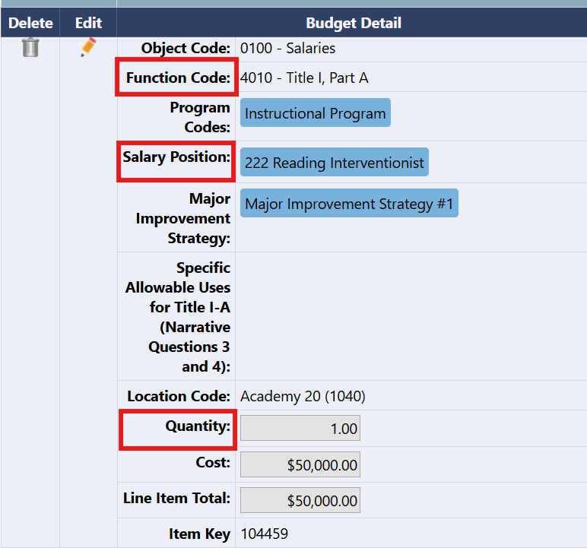
Staff Assignment Coding for Title I Schools
The screenshot on the left shows a budgeted activity from the ESEA Consolidated Application.
For each Title I staff position, HR coding should align with the Function Code, Salary Position and Quantity/FTE that was submitted in the ESEA Consolidated Application.
Human Resources Snapshot Collection
HumanResourcesData@cde.state.co.us

Slide 13
Staff Assignment Coding Alignment with ESEA Consolidated Application Codes
Some of the codes in the ESEA Consolidated Application have different labels than the Staff Assignment Interchange.
The table below outlines how codes in the ESEA Consolidated Application correlate with the Staff Interchange.
ESEA Consolidated Application | Staff Assignment Interchange
Function Code | Funding Source
Salary Position | Job Code
Quantity | FTE (Calculated based on Hours per Day and Contract Days)
Human Resources Snapshot Collection
HumanResourcesData@cde.state.co.us

Slide 14
Funding Sources for Staff in Title I Schools
Funding Source Code 03 Federal funding source (Title 1, Part A) should be used for positions budgeted in Title I of the ESEA Consolidated Application.
  If a partial salary is included in the application, the portion of the salary paid with Title I funds should be coded to 03 Federal funding source (Title I, Part A). This means some positions may need to be split and entered multiple times with different funding sources.
The updated Staff Assignment Coding Guide provides examples of how to code positions that are partially or fully funded with Title I.
Human Resources Snapshot Collection
HumanResourcesData@cde.state.co.us

Slide 15
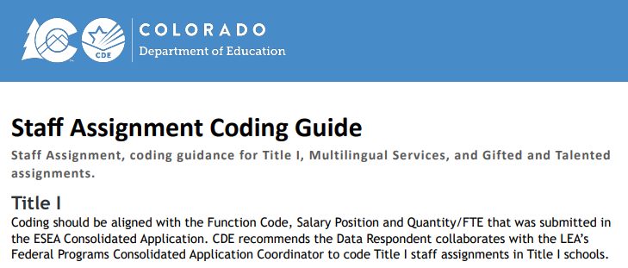
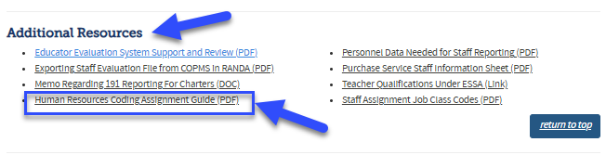
New Coding Guide on Website
Staff Assignment Coding Guide for Title I, Multilingual Services, and Gifted & Talented
Staff Interchange website
  Under Additional Resources
    Human Resources Coding Assignment Guide
Human Resources Snapshot Collection
HumanResourcesData@cde.state.co.us

Slide 16
Staff Assignment Coding Example for a Fully Funded Title I FTE
  Example data from the ESEA Consolidated Application
  Function Code: 4010 - Title I, Part A
  Salary Position: 222 Reading Interventionist
  Quantity/FTE: 1.0
  Example for a Schoolwide or Targeted Assistance Title I School
  Title I funds are used for an entire salary for a Reading Interventionist.
JobCode | StartDate | EndDate | EmplStatus | ContractDays | HoursPerDay | Hourly | BaseSalary | TeachingSubjectArea | AdminInstArea | FundingSource
222 | 08012025 |  | 11 | 180 | 0800 | 00000 | 050000 | 0570 | 0009 | 03
Human Resources Snapshot Collection
HumanResourcesData@cde.state.co.us

Slide 17
Staff Assignment Coding Example for Partially Funded Title I
  Example data from the ESEA Consolidated Application
  Function Code: 4010 - Title I, Part A
  Salary Position: 222 Reading Interventionist
  Quantity/FTE: 0.1
  Example for a Schoolwide or Targeted Assistance Title I School
  Title I funds are used towards 10% of a salary for a Reading Interventionist.
JobCode | StartDate | EndDate | EmplStatus | ContractDays | HoursPerDay | Hourly | BaseSalary | TeachingSubjectArea | AdminInstArea | FundingSource
222 | 08012025 |  | 11 | 180 | 0720 | 00000 | 045000 | 0570 | 0001 | 02
222 | 08012025 |  | 11 | 180 | 0080 | 00000 | 005000 | 0570 | 0009 | 03
Human Resources Snapshot Collection
HumanResourcesData@cde.state.co.us

Slide 18
Questions & Resources:
Tina Negley - ESEA Program Effectiveness Supervisor
Negley_t@cde.state.co.us
Rachel Echsner - ESEA Title I, II and V Specialist
Echsner_r@cde.state.co.us
Dawna Gudka - Data Services Unit, Human Resources Collection Lead
HumanResourcesData@cde.state.co.us
(303) 598-7901

Slide 19
Title 1 Interchange
Melissa Chaffin

Slide 20
2024-2025 Title 1 Interchange
Date | Event | Event Description
9/4/2024 | Student End of Year Regular Phase Deadline | Error free Title 1 Interchange file required for LEAs with TA programs.
10/16/2025 | Student End of Year Cross-LEA Deadline | Error free Title 1 Interchange file required for LEAs with TA programs. Last opportunity to update Title 1 TA data for 2024-2025 school year.
10/17/2025 | Closes | 2024-2025 Title 1 Interchange closes.
Title 1 Interchange
Chaffin_m@cde.state.co.us

Slide 21
2025-2026 Title 1 Interchange
Date | Event | Event Description
8/29/2025 | Open
10/2/2025 | Interim Deadline | Upload initial file
10/9/2025 | Interim Deadline | Error free file for use in Student October collection
11/10/2025 12:00pm | Student October Deadline | Error free Title 1 Interchange file required
5/8/2026 | Interim Deadline | Upload initial end of year file encompassing all students receiving TA services during the current year for use in Student End of Year collection
6/10/2026 | Interim Deadline | Error free Title 1 Interchange File
Fall 2026 | Student End of Year Deadline | Error free Title 1 Interchange File required for LEAs operating TA programs
Title I Part A
Chaffin_m@cde.state.co.us

Slide 22
New template for Student October 25-26
Important template change for Student October 25-26
List of schools and grade spans to check status (TA, SW, NS): Title 1-A School List Site
  25-26 is now posted
ONLY schools and grade spans marked for TA are reported. SW will automatically report at snapshot.
The Title I template for Student October 25-26 no longer collects the gender option.
For Student October, please choose 25-26 in the dropdown.
No Gender template = Student October 25-26
The new Title I file template can be found on the Title 1 Interchange site
If you are updating the EOY 24-25, please use the old template with the Gender option.
Title I Part A
Chaffin_m@cde.state.co.us

Slide 23
Title I Interchange Targeted Assistance (TA)
The student data in the file must match the exact data in the Student School Association file in the Data Pipeline.
If the file needs to be updated, then override or replace the old file with the updated file.
Maintain a complete data file at district or school level, make updates to this file if needed.
Make sure to include leading zeros, for example, district codes, school codes, DOB.
  District code example: 0123 or 1122 (must have 4 digits)
  School code example: 0123 or 1122 (must have 4 digits)
  DOB example: 05102019 or 11232018 (must have 8 digits)
Indicate resource(s) students received (reading, math, etc.): 1 for yes, 0 for no. All service cells must be either 1 or 0.
More than 1 school can be listed on the same file for the same district.
Title I Part A
Chaffin_m@cde.state.co.us

Slide 24
Who To Contact for Title I Part A collection questions
If you have questions regarding:
  Which Title I template to use, email me chaffin_m@cde.state.co.us
  Errors for your Title I upload in the Data Pipeline, or how to upload, email me chaffin_m@cde.state.co.us
  If you think your school or school grade span is incorrectly identified (TA, SW, NS), please see your Title I Part A coordinator first. If there are still questions, they can contact either me or the Regional Coordinator that handles their Consolidated Application.
  Thanks!
Title I Part A
Chaffin_m@cde.state.co.us

Slide 25
Questions & Resources:
Title 1 Interchange
Melissa Chaffin
chaffin_m@cde.state.co.us
720-908-1379

Slide 26
Student End of Year
Reagan Ward

Slide 27
SEY Collection Timeline
Date | Event | Event Description
9/4/2025 | State Deadline | Submit error-free SEY snapshot
9/5/2025 to 9/17/2025 | Closed | SEY Snapshot is closed until the start of the Cross LEA phase
9/16/2025 10:30-11:30am | Training Event | September SEY Office Hours (Registration Link) Focus: Cross-LEA Phase
9/18/2025 to 10/16/2025 | Cross LEA Phase | See the SEY Website for the detailed timeline
10/23/2025 to 11/18/2025 | Post-Cross LEA Phase | See the SEY Website for the detailed timeline
12/2/2025 | Deadline | Superintendent Verification (Sign-Off) form due. Collection Closes.
Student End of Year
StudentEndOfYear@cde.state.co.us

Slide 28
SEY Status as of 8am on 9/4
Submission Checklist:
*LEA Approvers*
Error free interchange files
  Student Demographic
  Student School Association
  Graduation Guidelines
  Title 1 (Targeted Assistance Programs Only)
  IEP Interchange Files
Validate Data
  Review Warnings
  Review CEDAR/COGNOS reports
  (rates and lists)
Error free SEY Snapshot
Student End of Year
StudentEndOfYear@cde.state.co.us

Slide 29
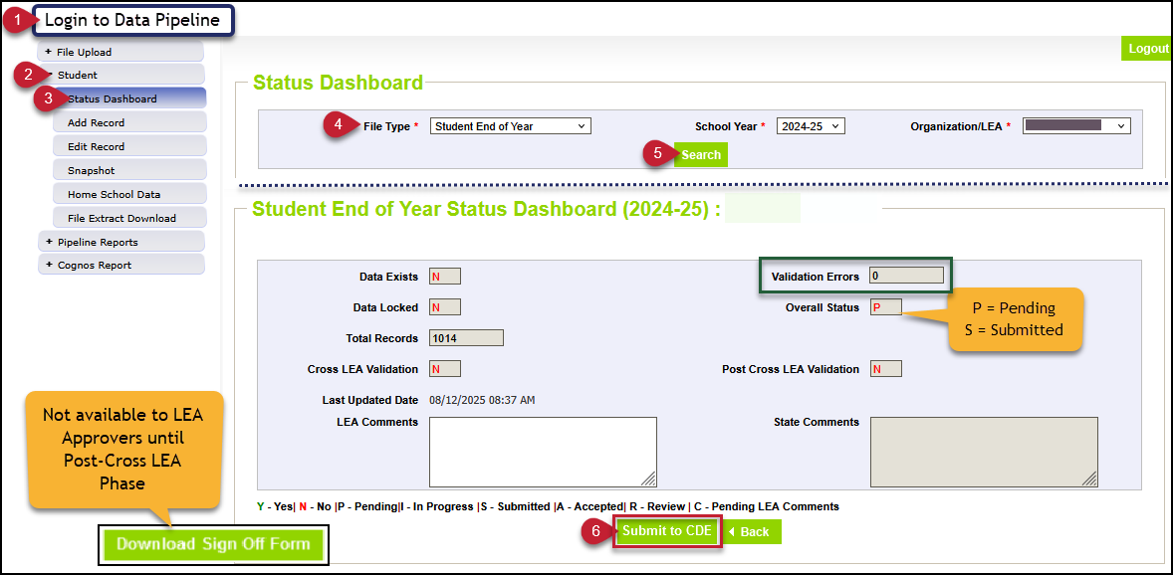
SEY Snapshot Submission Steps
Login to Data Pipeline
Select student
Select status dashboard
Select file type Student End of Year
Click Search
Click Submit to CDE
Student End of Year
StudentEndOfYear@cde.state.co.us

Slide 30
Questions & Resources:
Student End of Year
StudentEndOfYear@cde.state.co.us
720-484-9057
  Student End of Year Collection Website
  Student Interchange Website
  Graduation Guidelines (Program) Website

Slide 31
2025-2026 File Layout Reminders
Reagan Ward

Slide 32
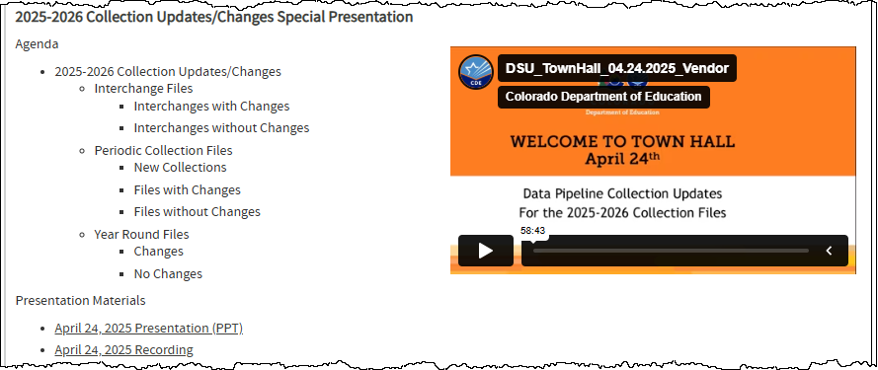
Resource Highlight:
2025-2026 Changes Presentation for Vendors and Data Respondents
Town Hall Presentation and Agenda Page
Data Pipeline Frequently Requested Codes and Resources Page
Both sites includes recording, slide deck, and changes overview PDF
2025-2026 File Layout Reminders
Data Pipeline Homepage

Slide 33
File Layouts: Available on Collection Websites
2025-2026 File layouts were posted on their respective collection webpages last April
Some pages include a more detailed 2025-2026 changes overview document or additional changes information and FAQs
Collections with File Updates (fields, codes, or definitions)
Discipline Interchange
Staff Interchange: Staff Assignment and Staff Evaluation Files
Student Interchange: all files
Teacher Student Data Link Interchange
Title 1 Interchange
Year-Round—Directory
Year-Round—RITS
New Periodic—Instructional Days and Hours
New Periodic—Student Restraint and Seclusion
Periodic—Kindergarten School Readiness
Periodic—Non-Public Schools Fall Enrollment Count
Periodic—READ Spring Assessments
Periodic—READ Training
Periodic—Report Card March
Periodic—Summer EBT
2025-2026 File Layout Reminders
Data Pipeline Homepage

Slide 34
File Upload Troubleshooting and Reminders
Common File Requirements
  .csv or .xlsx format
  Header row is required
  Zero fill non-applicable data fields
Common Issues that may cause a file upload to fail
  File is missing columns, or the columns are out of order compared to file layout
  Leading zeros or other formatting issues with specific data columns
    Must align to the required field length and example on the file layout
  Alpha (text) characters in data fields that only accept numeric values
  Codes in a data field that are not part of the listed options for that field
  Blank data fields when at least zero-fill is required
File Naming Reminder: files cannot have blank spaces in the name
  SSA_upload_9-5-2024.xlsx
  SSA file 9-4-2024.xlsx
Respondent Training Page—Data Pipeline Upload Directions (PDF)
Data Pipeline Homepage
2025-2026 File Layout Reminders

Slide 35
Data Pipeline Resources
Data Pipeline Homepage
Town Hall Presentation and Agenda Page
Data Pipeline Frequently Requested Codes and Resources Page

Slide 36
Student October
Collin Slutzky

Slide 37
October Count Timeline
Date​ | Event​ | Event Description​
07/14/2025 | Open​ | Districts may begin uploading Student Interchange Files (Student Demographic and Student School Association).​
08/29/2025 | Open​ | Districts may begin creating snapshots. Student October Snapshot dependencies are the Student Demographic File, Student School Association File, Title I File (if applicable) and At-Risk File.​
09/02/2025​ | Training Event​ | Data Pipeline Training 10-11 a.m.​ Registration Link
09/04/2025 | Training Event​ | New Respondent Training 1-2 p.m.​ Registration Link
09/10/2025 | Training Event​ | Multilingual Learner (English Learner) Training 11-12 p.m.​ Registration Link
09/16/2025 | Training Event​ | Veteran Respondent Training 11:30-12:30 p.m.​ Registration Link
09/17/2025 | Training Event​ | Postsecondary Program Coding Training 11-12 p.m.​ Registration Link
10/01/2025 | Other Date​ | Official Count Day for 2025
10/02/2025 | Interim Deadline​ | Upload Student Demographic and Student School Association Files. Upload Title I Interchange File (if applicable). Upload At-Risk Interchange File.​
10/09/2025 | Interim Deadline​ | Error-free Student Interchange File Uploads (DEM and SSA)
10/14/2025 | Training Event​ | Mid-Collection Office Hours 1-2 p.m. Registration Link
10/14/2025 | Interim Deadline​ | Create an initial Student October Snapshot​
10/27/2025 | Interim Deadline​ | Submit any necessary reporting exceptions for review.
10/27/2025 | Interim Deadline​ | Error free Student October Snapshot​
10/28/2025 | Training Event​ | Data Validation, Transfer Enrollment Exceptions and Cognos Reports 1-2 p.m.​ Registration Link
10/30/2025 | Training Event​ | Data Pipeline Duplicate Process and Submission 11-12 pm Registration Link
11/03/2025 | Report Review​ | Review Student October Cognos Reports for data validation. Submit Student October Snapshot data as soon as review is complete.​
11/10/2025, 12:00 p.m.​ | State Deadline​ | Submit Student October Snapshot data​
Student October
StudentOctober@cde.state.co.us

Slide 38
October Count Timeline:
Duplicate Phase
Date​ | Event​ | Event Description​
11/13/2025 | Deadline | Duplicate count funding documentation due to School Auditing Office​
11/19/2025 | Other Date | School Auditing makes decisions on funding duplicates
11/26/2025 | Deadline​ | Resubmit Student October Snapshot data to CDE based on decisions from School Auditing
12/05/2025 | Deadline​ | Collection Closes Secretary of the Board of Education Verification (sign-off) form due Data remains embargoed until the official release in January
01/21/2026 | Data Release​ | Official data release
Student October
StudentOctober@cde.state.co.us

Slide 39
Student October Training Schedule
Data Pipeline Training
  Date/Time: 09/02/2025, 10-11 a.m.
  Click here to register for the Data Pipeline Training
New Respondent Training
  Date/Time: 09/04/2025, 1-2 p.m.
  Click here to register for the New Respondent Training
Multilingual Learner Training
  Date/Time: 09/10/2025, 11-12 p.m.
  Click here to register for the Multilingual Training
Veteran Respondent Training
  Date/Time: 09/16/2025 11:30-12:30 p.m.
  Click here to register for the Veteran Respondent Training
Postsecondary Program Coding Training
  Date/Time: 09/17/2024, 11-12 p.m.
  Click here to register for the Postsecondary Training
Mid-Collection Office Hours
  Date/Time: 10/14/2025 1-2 p.m
  Click here to register for the Mid-Collection Office Hours
Data Validation and Cognos Reports Training
  Date/Time: 10/24/2025 1-2 p.m.
  Click here to register for the Data Validation and Cognos Training
Data Pipeline Duplicate Process and Submission Training
  Date/Time: 10/28/2025 9-10 a.m.
  Click here to register for the Duplicate Process and Submission Training
Student October
StudentOctober@cde.state.co.us

Slide 40
Questions & Resources:
October Count
Collin Slutzky
studentoctober@cde.state.co.us
(720) 760-3569
Student October Website
Student Interchange Website
School Auditing Office Website

Slide 41
Special Education End of Year
Lindsey Heitman

Slide 42
Special Education End of Year
Timeline and Status
May 1, 2025 - SPED EOY Snapshot official open
June 26, 2025 – IEP Interchange files error-free
September 4, 2025 - All Exception requests submitted to CDE
September 11, 2025 – All errors resolved at snapshot/interchange
September 12 -19, 2025 -Initial Report Review
September 22 - 26, 2025 – Resolving duplicates
September 29 – October 1, 2025 – Final Report Review
October 3, 2025 - Final submission due to CDE
Status:
Error- free = 26 AUs
20 errors or less = 23 AUs
More than 20 errors = 18 AUs
Haven’t taken a snapshot = 2 SOPs
Special Education EOY – Lindsey Heitman
SpedEndofYear@cde.state.co.us

Slide 43
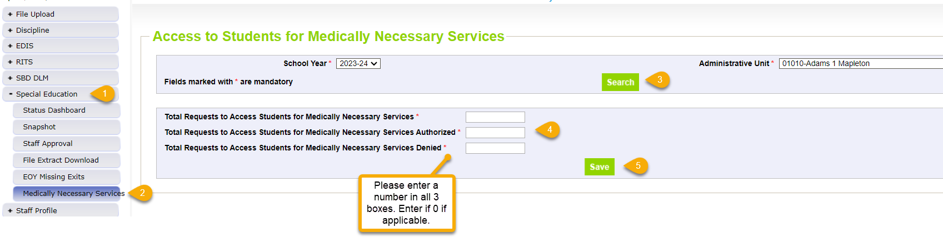
Medically Necessary Services:
Reminder to AUs to Submit 24-25 Counts
Notes:
Counts must reflect all districts within AU from July 1, 2024 – June 30, 2025
Must be completed by the time Sped EOY is approved – by 10/03/25
AUs are able to modify counts until their final Sped EOY is locked/approved
pop up message will ensure each box is populated with a number
pop up message will ensure total # box (1st box) is the sum of those authorized and denied
Steps
1. Click Special Education tab
2. Click Medically Necessary Services tab
3. Select School Year/AU and click Search button
4. Enter a number in all 3 boxes
5. Click Save button
# Requests Authorized
# Requests Denied
Total # of Requests
Special Education EOY – Lindsey Heitman
SpedEndofYear@cde.state.co.us

Slide 44
Special Education End of Year
Reporting Reminders
Be sure you have created a new snapshot since 8/15
  This will ensure you are pulling in the most recent data from all the places
Check Special Education EOY cognos folder report #’s 8 and 9! These will help you locate potential missing records or reporting issues
  ‘A’ flags require an explanation from your director
Please complete CEIS file upload if you are one of the 9 AUs that must upload this file
  4 AUs still need to upload their file
  File layout is found on the Special Education IEP Interchange webpage
  CEIS start and end dates must align with the school entry and exit dates for the school code reported on the record
SY307 – about 399 records still overlapping SPED start and end dates statewide
  Enrich system not reflecting correct Start Date at the new AU
    Check your larger SIS to see what the actual start date was for that student and update it in Enrich/Participation file
AU respondent contact list found in Special Education EOY cognos folder
SpedEndofYear@cde.state.co.us
Special Education End of Year – Lindsey Heitman

Slide 45
Questions & Resources:
SPED End of Year
SpedEndofYear@cde.state.co.us
Lindsey Heitman
(720) 456-2033
Special Education IEP Interchange Webpage
Special Education End of Year Snapshot Webpage

Slide 46
Instructional Days and Hours
Jessica Tribbett

Slide 47
Instructional Days and Hours:
Timeline & Submission Determination
Collection Timeline
OPEN: Wednesday, September 17th
CLOSE: Friday, December 19th
Required to Submit
  Districts,
  BOCES operating schools,
  and the Charter School Institute
will need to submit data for all public schools serving grades K-12 (006-120).
Do NOT submit data for:
  Pre-K
  Public schools serving only grades 004-004
  100% Home Options Schools (school system code 10)
Instructional Days and Hours
DirectoryData@cde.state.co.us

Slide 48
Instructional Days and Hours:
IDM Roles
IDM ROLES ARE AVAILABLE
IDH APPROVER
IDH USER
IDH VIEWER
Instructional Days and Hours
DirectoryData@cde.state.co.us

Slide 49
Instructional Days and Hours:
Training and Office Hours
TRAINING
  Wednesday, September 10th @ 10 a.m. Register here.
OFFICE HOURS
  Wednesday, September 24th @ 10 a.m. Register here.
Registration links can also be found on the Instructional Days and Hours website.
Instructional Days and Hours
DirectoryData@cde.state.co.us

Slide 50
Questions & Resources:
Instructional Days and Hours
DirectoryData@cde.state.co.us
Instructional Days and Hours Website

Slide 51
READ Training Data Collection
Tara Rhodes

Slide 52
Collection Timeline
Date | Event | Event Description
7/15/2025 | Training Event | This training event will cover changes for the 25-26 READ Training collection. This is a live event from 1-2pm and will be recorded.
8/1/2025 | Open | The 25-26 READ Training collection opens in Data Pipeline.
8/15/2025 | Other Date | This is the date by which teachers, principals, and administrators should have their respective READ training designations added to their COOL accounts.
8/19/2025 | Other Date | This is the target upload date for the collection. Please complete an upload by this date.
8/26/2025 | Other Date | This is the target date for an error-free submission for the collection. Please resolve errors by this date.
8/30/2025 | Deadline | The 25-26 READ Training collection closes in Data Pipeline and sign-off forms are due.
9/8/2025 | Other Date | CDE prepares preliminary State Board of Education documents for any extension requests. Any districts requesting a good cause extension for their educators must have their submission locked by this date.
10/8/2025 | Other Date | State Board of Education hears extension requests and provides the final decision around the approval of any extension requests.
READ Training
READActData@cde.state.co.us

Slide 53

READ Training:
Status Update
READ Training
READActData@cde.state.co.us

Slide 54
Questions & Resources:
READ Data Collections
Tara Rhodes
Phone: 720.601.4125
READActData@cde.state.co.us
READ Training Data Collection Website
READ Training Website (Pathway Information and How to Add Documentation in COOL)

Slide 55
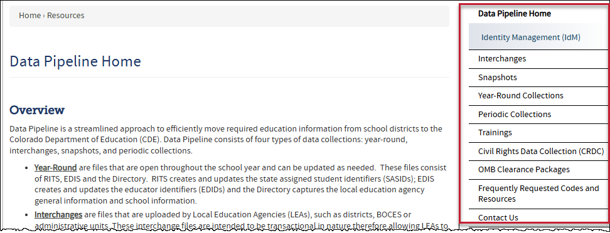
Thank you for joining today!
Next Town Hall will be September 11th
Reminder:
Each data collection has a more detailed timeline, file layout and other helpful resources posted on their corresponding webpage.
Visit the Data Pipeline Homepage to access collection pages.
The navigation menu has been updated too. Check out the new Town Hall page in the Trainings section!

