Slide 1
Student End of Year Data Collection Overview (2018-2019)

Slide 2
Collection Summary
Collection Schedule
Regular Process Phase
Interchange Uploads
Interchange Errors
Exceptions
Snapshot
Snapshot Errors
Submission
Cross LEA Validation Phase
Adjustments
Post-Cross LEA Validation Phase
Adequate Documentation
Reminders for the 2018-2019 Collection
Rates and Reports
Glossary
Contact Information

Slide 3
What is the End of Year Snapshot?
The purpose of the Student End of Year Snapshot is to summarize the annual educational history for students throughout the school year. The data from this collection is used to derive the graduation, completion, dropout, mobility, and stability rates. The End of Year snapshot also pulls in Advanced Placement course completion and post- secondary program information.

Slide 4
Purpose of the Student End of Year data collection
Accuracy is essential:
Data from the Student End of Year snapshot produces graduation, completion, and dropout rates. This information informs policy at the state and federal level and becomes public information that is used in official reports and news articles.
Data from the Student End of Year snapshot is used in school and district-level accountability measures.

Slide 5
Purpose of Student End of Year
How to ensure your data is accurate?
Thoroughly review your data
Ask your district’s subject area experts to assist in verifying data
That might include people from: Finance Department, English Learner Department, Special Education, and Registrar
Use the COGNOS reports available through Data Pipeline to assist in data verification
An error free snapshot does not guarantee accurately reported data
Do NOT report inaccurate data to avoid errors:
If a student is generating errors please request an exception
Call CDE if you have questions about how to properly code a student
We will do our best to ensure allow you to submit accurate data

Slide 6
End of Year Collection Schedule

Slide 7
Collection Schedule
 | Date | Event
Data Collection and Cleanup Phase | Thursday 06/06/2019 | Target: Create first End of Year Snapshot Snapshot should include records
 | Thursday 06/27/2019 | Target: Interchanges are error free
 | Thursday 07/25/2019 | Target: Error free Student End of Year Snapshot
 | Thursday 09/05/2019 | Soft Deadline: Submit Student End of Year Snapshot
 | Thursday 09/12/2019 | Deadline: Submit Student End of Year Snapshot Approve initial data summary reports Deadline is mandated under Colorado Administrative Rules

Slide 8
Collection Schedule
 | Date | Event
Cross LEA Validation Phase A | Monday 09/23/2019 | Snapshots reopen after running Cross LEA validation Districts may now reclaim dropouts from prior collection years If applicable, districts will be asked to participate in the mini-phase A post collection concerning transfers to facilities
 | Thursday 10/17/2019 | Deadline: Resubmit data to CDE
Post Cross LEA Validation Phase B | Thursday 10/24/2019 | Post Cross LEA validation phase begins (formerly Post Collection Phase B) Verifying transfers and dropouts within Colorado If applicable, districts will be asked to participate in the mini-phase B post collection concerning transfers to facilities
 | Thursday 11/21/2019 | Deadline: End of Post Cross LEA validation phase
Final Dates | Monday 12/02/2019 | Begin final review of graduation and dropout rates after the AYG reconciliation Any changes will require a new sign-off page
 | Thursday 12/05/2019 | Deadline: Superintendents must approve final Data Summary Reports (collection closes)
 | Thursday 01/16/2020 | Official/final data and rates posted on the CDE website and released to the public

Slide 9
Regular Process Phase

Slide 10
Colorado Department of Education Identity Management
https://cdeapps.cde.state.co.us/faqs.html
Frequently Asked Questions 1-12
#12 Where can I find the Identity Management role mappings for Data Pipeline and other applications?
https://cdeapps.cde.state.co.us/IdentityManagementGroups.xls
Access Management

Slide 11
Colorado Department of Education Identity Management
Application | Collection | Role | Access Level
Pipeline | Student Interchange | LEA User | Upload and Edit Records for the Student Demographic, School Association, and Advanced Course Completion files
Pipeline | Student End of Year | LEA User | Create Snapshot - cannot submit
Pipeline | Student End of Year | LEAAPPROVER | Create Snapshot and submit
Pipeline | Any | LEA Viewer | View Cognos reports – cannot edit
Pipeline | Title I Interchange | LEA User | Upload and Edit Records
You can only have one role for each Collection.
An LEAAPPROVER can do all the things an LEA User can do.
Link to full instructions: http://www.cde.state.co.us/datapipeline/assigneoyroles

Slide 12
Submission Process Student Interchange Preparation
Get SASIDs for your new students
You can do this through RITS or Data Pipeline
Resources on getting SASIDs can be found here:
http://www.cde.state.co.us/datapipeline/yr_rits
Go down to trainings for information on different methods of adding students and getting SASIDs
Create Extracts from your Student Information System
Pull data for the Student Demographic/Profile file and Student School Association
You don’t need to do this simultaneously
Data Pipeline accepts .csv, .xls, .xlsx formats
.xls is the recommended format
If opening file in excel please make sure you don’t lose leading zeros
CDE has a guide to keeping leading zeros on Student Interchange website
CDE recommends using a file naming convention:
Example: 0110_DEM_OCTtag_10112016.xls
No spaces in file name are allowed

Slide 13
Submission Process Student Interchange Preparation
Districts upload the interchange files
Wait for a Confirmation Email from the Pipeline System
The email will show you the number of errors in your upload
You’ll want to resolve ALL errors in your interchange files
Check your error reports
Upload files in the correct order, otherwise you will get unnecessary errors
Update your Interchange files to address the errors
I would suggest updating your student information system so the data in your system matches that supplied to the state
You can also update records directly in the pipeline using the Edit Record tool
Upload Student Demographic File
Upload Student School Association File
Upload Advanced Course Completion File

Slide 14
Step by Step documentation
Student End of Year checklist
Step by step document of process
http://www.cde.state.co.us/datapipeline/seychecklist
Frequently Asked Questions
Useful information on common questions
http://www.cde.state.co.us/datapipeline/eoycommonfaq

Slide 15
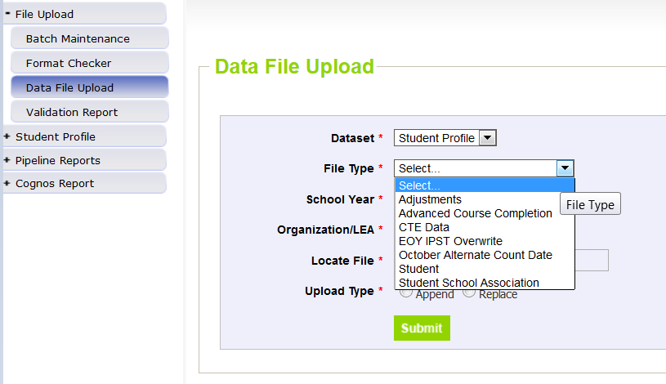
Data File Upload

Slide 16
Pipeline Reports: Error Report
Review your errors
View error reports:
1) Within pipeline -> Pipeline Reports -> Error Report
Make sure to select a ‘Tag’ option (none for Student End of Year)
2) Within Cognos Report -> Student Profile -> Error Detail Reports

Slide 17
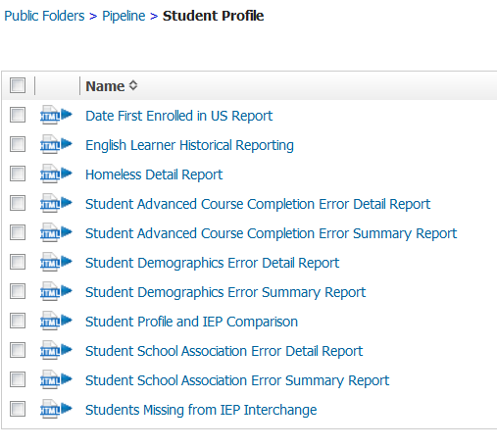
Interchange Cognos Reports

Slide 18
Common Demographic Errors

Slide 19
Who is an English Learner?
Language Proficiency – A student's English language proficiency is described by his or her ability to speak, listen, read, and write in English.
English Learners (EL): (1) NEP Non-English Proficient (2) LEP Limited English Proficient (6) FEP Fluent English Proficient Monitor Year 1 (7) FEP Fluent English Proficient Monitor Year 2 (8) FEP Fluent English Proficient Exited Year 1 (9) FEP Fluent English Proficient Exited Year 2
Non-EL students must be coded as (0) NA or (4) PHOLTE Primary or Home Language Other Than English
Former English Learners are coded as (5) FELL- Former EL

Slide 20
Edits For ELL
The goal of EOY is to collect whether or not a student has received ELL services throughout the year, not just the status at the end of the year.
There are a large number of EL edits to ensure accurate coding. Hopefully you have already cleared most edits earlier in the year.
Warning SP470 will trigger if a student goes from being an English Learner (EL) in October to Not EL in End of Year
ELL Status must be 1 (Yes) if it was also 1 (Yes) in Student October for the current year.
Properly coding the students receiving languages services through your district can impact the funding your district receives.

Slide 21
Common School Association Errors

Slide 22
Key Terms
Date First Enrolled in the United States -
Districts may zero-fill this field and CDE will calculate the date of first enrollment based upon the date a student first had an entry date in a CDE student interchange data collection.
Student’s date of first enrollment will be calculated based on the earliest entry date in the grades kindergarten and greater.
If a date has been entered for a student, CDE will not override that field with a calculated value, though the entered value may not be more recent than the date CDE calculates.

Slide 23
Key Terms
Common Questions
Students with an entry type of 14 (Entry from another state) as their earliest entry in their educational history may not have this field zero-filled.
Schools on US military bases count as US schools
Home School does not count as a “public or non-public school.”
Students with an entry code of 05 (Entry from another country) and 16 (Entry from homeschool) will generate a warning asking a district to confirm the Date of First Enrollment.
Student’s date of first enrollment will be calculated based on entry type and date in the grades kindergarten and greater.

Slide 24
Postsecondary Program Field
Code | Program | Grade | CDE Contact
00 | Not Applicable
01 | ASCENT Program | 12 only | Mary Anne Hunter (Hunter_Mary@cde.state.co.us)
02 | Concurrent Enrollment | 9 - 12 | Mary Anne Hunter (Hunter_Mary@cde.state.co.us)
07 | Early College | 9-12 | Mary Anne Hunter (Hunter_Mary@cde.state.co.us)
08 | Community College Dropout Recovery | Age 16-21 | Judith Martinez (Martinez_j@cde.state.co.us)
09 | Carry Forward ASCENT Full Time | 12 only | Mary Anne Hunter (Hunter_Mary@cde.state.co.us)
10 | Carry Forward ASCENT Part Time | 12 only | Mary Anne Hunter (Hunter_Mary@cde.state.co.us)
15 | P-TECH Years 1-4 | 9-12 | Mary Anne Hunter (Hunter_Mary@cde.state.co.us)
16 | P-TECH Years 5-6 | 12 only | Mary Anne Hunter (Hunter_Mary@cde.state.co.us)

Slide 25
Creating Exceptions

Slide 26
Exceptions
Make sure you have access to a syncplicity folder at my.syncplicity.com
You may need to create a free Syncplicity account if you haven’t already
The folder used for EOY exceptions is called: District Number- District Name- Student
Copy the key fields from your error report into the exception template
Exception Request Template and Instructions - Link (XLSX)
Explanations do not need to be long
Please create a unique file for exceptions for each file (DEM, SSA, and SEY)

Slide 27
Exceptions
Upload your exception template to the requested exception folder on Syncplicity.
Once your file has been uploaded, you’ll need to email me to let me know you have an exception request: callinan_a@cde.state.co.us
(Depending on the volume of requests from districts across the state, exceptions may take a few days to complete.)

Slide 28
Creating a Snapshot

Slide 29
Snapshot Submission Process
Create Student End of Year snapshot (Student Profile → Snapshot)
Snapshot of previously submitted Student Profile Interchanges
Creating a new snapshot will remove your previous snapshot
Go to “Cognos Report” on the Pipeline menu to download errors and warnings
Correct errors (within the Pipeline or by loading new interchange files)
Once all edit checks have passed, submit approval of your data to CDE
Use Cognos Report to validate data
Student Profile -> Status Dashboard -> Submit to CDE
You cannot download the signoff form until December
CDE identifies dropouts from prior years showing up in other districts
CDE checks across all districts to make sure student exit type is valid
Note: all errors must be resolved before continuing to the next step in the process

Slide 30
Creating a New Snapshot

Slide 31
Snapshot Pipeline Reports

Slide 32
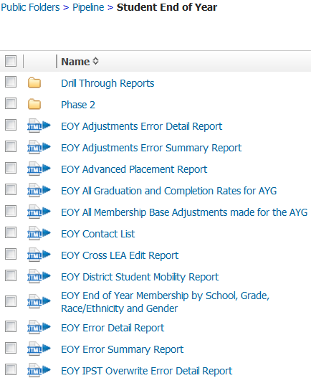
Snapshot Cognos Reports
These are the Snapshot Error Reports

Slide 33
Common Errors
All Snapshot level errors are posted on the Student End of Year Business Rules file.
You can find the file on the Student End of Year website:
http://www.cde.state.co.us/datapipeline/snap_eoy

Slide 34
Common Errors - Enter and Exit types
Entry and exit types and dates are used to track an overview of a student’s attendance throughout the year.
A full list of the possible Entry and Exit types are available in the SSA file format:
Which can be found on the Student Interchange website
http://www.cde.state.co.us/datapipeline/inter_student
Make sure to look at the 2018-2019 file

Slide 35
Why do we use entry and exit types?
Entry Type – Indicates how a student entered the school or district
02 – Continuous in same school (start of year)
05 – Transfer from out of country
11 – Transfer from school in same district
13 - Transfer from another district
14 – Transfer from out of state
70 – Return to school after transferring to a GED program

Slide 36
Why do we use entry and exit types?
Exit Type – Indicates how a student exits the school or district
11 – Transfer to school in same district
13 – Transfer to another district
40 – Drop out
90 – Graduate
00 – Student finished the year at the school or left in the last three weeks of the school year

Slide 37
Why do we use entry and exit types?
Student returns from prior year (Entry Type 02)
Student exits to transfer to another district (Exit Type 13)
Later in the year student comes back from another district (Entry Type 13)
Student exits for the summer (Exit Type 00)
District | SASID | Entry Date | Entry Type | Exit Date | Exit Type
0180 | 1234567890 | 08212016 | 02 | 10022016 | 13
0180 | 1234567890 | 12102016 | 13 | 00000000 | 00

Slide 38
Common Errors
SE091 | Students with Exit Type Code 11 should be followed by record with Entry Type Code 11 or 12.
SE099 | Entry Code must <> 11 where Grade <> lowest grade for the school code and where no previous record exists with the same SASID, district with Exit Type = 11 in the same school year.
SE109 | Entry Type may be 11 (Transfer from a public school in the same district) for the first detail record, only if the student finished the prior year at a different School Building Code with Exit Type Code = 00.
SE102 | Entry Type may be 02 (Continuous in same school with no interruption of schooling) for the first detail record only if the student was reported in the prior year as finishing at the same School Building Code with Exit Type Code = 00.
SE104 | If a grade K-12 student was reported last year with Exit Type=00 in the last detail record, they must be reported this year with an Entry Type = 00, 02, 03, 10, 11, 90 or 91, in the first detail record.
SE171 | Exit Type cannot be 00 if Entry Grade Level = 120 and Retention Code = 0
SE171 errors will be resolved once you’ve recorded the graduation of seniors. Seniors have until August 31st to graduate during the 2018-19 school year. Please record seniors who graduate after summer school with an exit date of the graduation with the rest of their class.

Slide 39
Common issues
SE 400’s Records not getting into snapshot
Please make sure primary school flag is set correctly in student school association file. The primary school flag must be set to 1 for the student to appear
Check to see if the record is in error in student interchange file
Validate the pupils attendance code is correct
SE060 Student reported on Student October not in Student End of Year
If a student was reported on Student October, system expects record for student on October 1st in Student End of Year
Use Syncplicity to request an exception

Slide 40
Common Errors
SE104 | If a grade K-12 student was reported last year with Exit Type=00 in the last detail record, they must be reported this year with an Entry Type = 00, 02, 03, 11, 90 or 91, in the first detail record.
SE049 | If a student was reported in Student October in grade K-12 with Attendance Code 01-08 they must have at least 1 record in EOY. Note: Pre-K students who did not complete the school year in your district do not have to be reported on the Student End of Year.
SE404 | A K-12 student was reported last year with Exit Type=00 in the last detail record, they must have a record in your current year School Association file.
SE401 | A PK-12 grade student has errors at the interchange level (SSA).
SE405 | A PK-12 grade student has errors at the interchange level (DEM).
WSE412 | A grade PK-12 student was reported in the student school association file with a primary school flag set to zero. Please confirm that this status is approrpiate as the record will not be included in the End of Year snapshot.
WSE413 | A grade PK-12 student was reported in the student school association file with a pupil attendance code that is not between 01 and 08. Please confirm that this status is approrpriate as the record will not be included in the End of Year snapshot.
Missing Record errors have mostly been changed to the SE400 range. SE104 now only triggers on an inappropriate entry type. SE049 and SE404 indicate a missing record. Please create a new record as appropriate, even if it’s just a one day record returning the student to school and then exiting them the same day.

Slide 41
SE404 One-Day Records
SE404 errors trigger when a student exited the previous year with a 00 exit type
Over the summer, the student left and never attended during the 2017-18 school year
The student will still need a record indicating where they are attending school
For example:
District | Sasid | Entry Date | Entry Type | Exit Date | Exit Type
0180 | 1234567890 | 08212018 | 02 | 08212018 | 15

Slide 42
Submit Your Snapshot

Slide 43
Submit your Snapshot to CDE
Once you’ve completed resolving your snapshot errors, you will want to submit your snapshot.
Deadline is Thursday, September 12th
(Soft Deadline is Thursday, September 5th)
Submit your snapshot through the status dashboard
The collection is not over at that point. There are two additional phases for data validation: 1) The Cross-LEA Phase and the 2) Post-Cross LEA Phase.

Slide 44
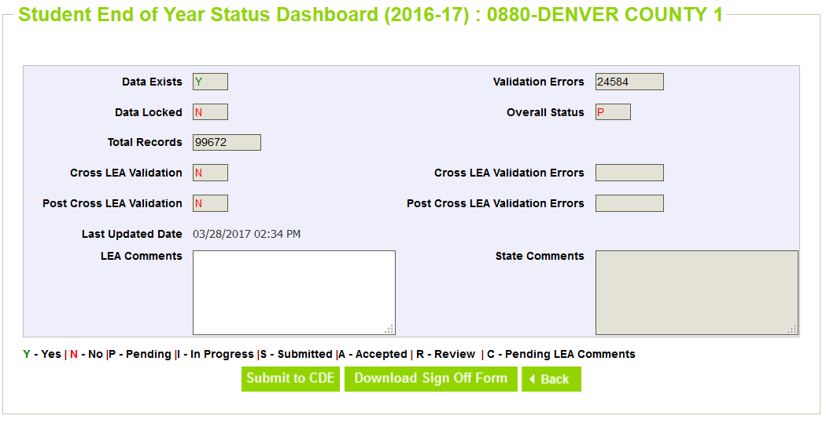
Submit your Snapshot to CDE

Slide 45
Cross LEA Validation Phase

Slide 46
Cross LEA Process
Once all districts have their data submitted and locked CDE will run the Cross LEA process
Once the Cross LEA Validation is complete, districts will receive an email
New errors are generated during this process
Two types of Errors
Current Year Errors
Prior Year Errors

Slide 47
Cross LEA Process
Current Year Errors
May require editing records to change the exit type of a student
Edit Record Screen is in data pipeline under Student Profile
Just make sure you select the correct school year by the time we get to Cross LEA the 2018-2019 school year will be the default option
Prior Year Errors
How your district reported a student in the previous Student End of Year does not match this year’s records.
You may need to add a one-day record
Submit an Adjustment

Slide 48
Cross LEA Adjustment File
Two ways to make adjustments:
Upload an Adjustment File
If you have more than a couple of adjustments to make it is probably easier to complete a file upload.
This upload works just like a student interchange upload
The file layout can be found: http://www.cde.state.co.us/datapipeline/snap_eoy
Create an Adjustment Record within Pipeline
If you only have to create an adjustment for one or two students then it might be easier to create an adjustment record within pipeline
Just use the Add Record option under Student Profile and select Adjustment
In both you will need to submit fields that match the error record you received including:
district code, sasid, student first name, student last name, student gender, birth date student, adjustment code, adjustment school, adjustment year
Adjustments for prior year dropouts, expulsions and GED transfers
File loaded same as the student interchange files
File layout at the following link: http://www.cde.state.co.us/datapipeline/snap_eoy
Fields are: district code, sasid, student first name, student last name, student gender, birth date student, adjustment code, adjustment school, adjustment year

Slide 49
Cross LEA Adjustment File
Adjustments are used to modify records from the prior year for students who were reported as dropouts, expulsions, and HSED transfers
Adjustments may have errors and you will need to correct them to get the adjustment to work
Once your adjustments file is error free you will need to create a new Student End of Year snapshot to clear the errors/warnings that were triggered in the cross LEA process

Slide 50
Cross LEA Process
Once you have made changes to your data as a part of the Cross LEA process and added any necessary adjustments.
You will need to get your Student End of Year snapshot back to zero (0) errors
This may mean making changes to your SSA file or adding more adjustments
When you have another error-free snapshot you will want to:
Validate your data using Cognos reports to ensure your rates and other information is accurate
Submit snapshot to CDE again

Slide 51
Post Cross LEA Validation Phase

Slide 52
Post Cross LEA Process
Once all districts have resubmitted their data to CDE after the Cross LEA process CDE will run the Post Cross LEA process
The Post Cross LEA process identifies students that:
were listed as transfers but were not recovered by other districts
it also identifies dropouts who were recovered by other districts
The Post Cross LEA process will trigger three errors and two warnings:
SE 901, 902, 903, 904 (W), 905 (W)
There are instructions on how to resolve these errors on the Student End of Year Website
http://www.cde.state.co.us/datapipeline/snap_eoy

Slide 53
Record Request/ Confirmation of Enrollment and Attendance Template
Used by the receiving district when the student has begun attending the receiving school
Can be used as documentation of transfer ONLY if Date of Enrollment and Date of Attendance are provided
Other record request forms without that information will not be accepted
If the former district lacks this documentation, please use the Request for Confirmation of Enrollment and Attendance

Slide 54
Where can I find more information?
Adequate documentation
http://www.cde.state.co.us/datapipeline/snap_eoy
Documents
Adequate Documentation of Transfer List
Record Request/Confirmation of Enrollment and Attendance
Request for Confirmation of Enrollment and Attendance
Notification of Withdrawal
Student Transfer Follow up

Slide 55
Reminder About Transfer Students
Students who tell you that they are transferring in the next school year but who complete all coursework in your district (up to three weeks before the end of school) should have an exit code of ‘00’. If they are coded with exit code ‘13’ they will be counted as a dropout because they will not have time to show up in another school/district before the end of the year.
When a student is transferring, make sure to follow up with that student immediately to get adequate documentation of the transfer. This way, you can avoid students unnecessarily being coded as dropouts.

Slide 56
Reminders for the 2018-2019 Collection

Slide 57
ASCENT and P-TECH
New Exit Codes for Concurrent Enrollment Students
23 - previous graduate did not complete a postsecondary program
24 - previous graduate completed a postsecondary program
96 - graduated and completed a postsecondary program
Remember to use the retention code of ‘2’ for 12th Graders being retained for P-Tech and ASCENT. This coding ensures they are included in your 4-year graduation cohort rate. Once a student is exited with a ‘90’, an entry type of ‘90’ will be used the next school year.

Slide 58
McKinney-Vento
McKinney-Vento Homeless Student Data
The K-12 data on homeless students will be collected through the totals in the Student End of Year collection going forward
That means that making sure you are capturing all of your homeless students in the Student End of Year collection is more important than ever
Please coordinate with the McKinney-Vento Liaison in your district to ensure that all of the identified students are showing up on the Homeless Detail Report (under Student Profile) in Cognos
Students are identified as Homeless in the Student Demographic file using the Homeless and Primary Nighttime Residence fields
For more information on the homeless data requirements:
http://www.cde.state.co.us/dropoutprevention/homeless_index

Slide 59
Rates and Reports

Slide 60
End of Year Data Online
Used for school, district and state rates
Graduation & Completion Rates
http://www.cde.state.co.us/cdereval/gradratecurrent
Dropout Rates
http://www.cde.state.co.us/cdereval/dropoutcurrent
Mobility / Stability Rates
http://www.cde.state.co.us/cdereval/mobility-stabilitycurrent
You have access to early versions of these rates in your Cognos reports.

Slide 61
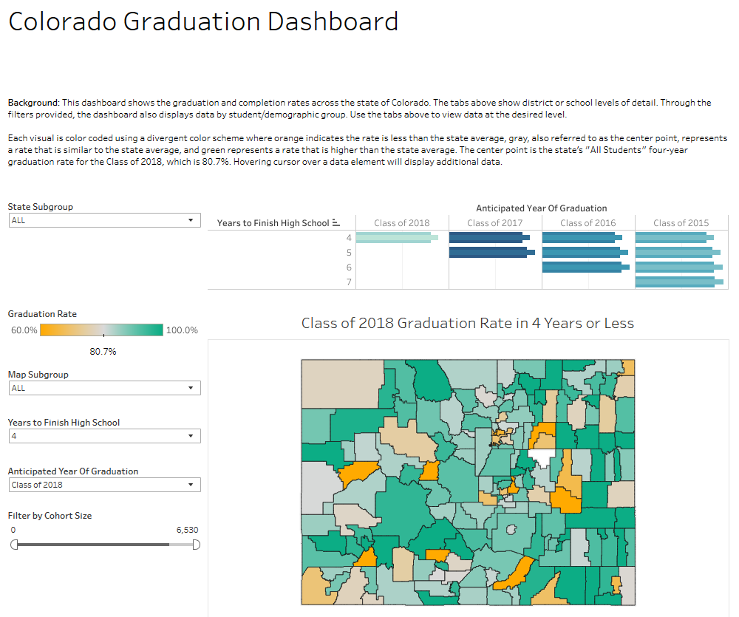
End of Year Data Online
http://www.cde.state.co.us/code/graduationrate

Slide 62
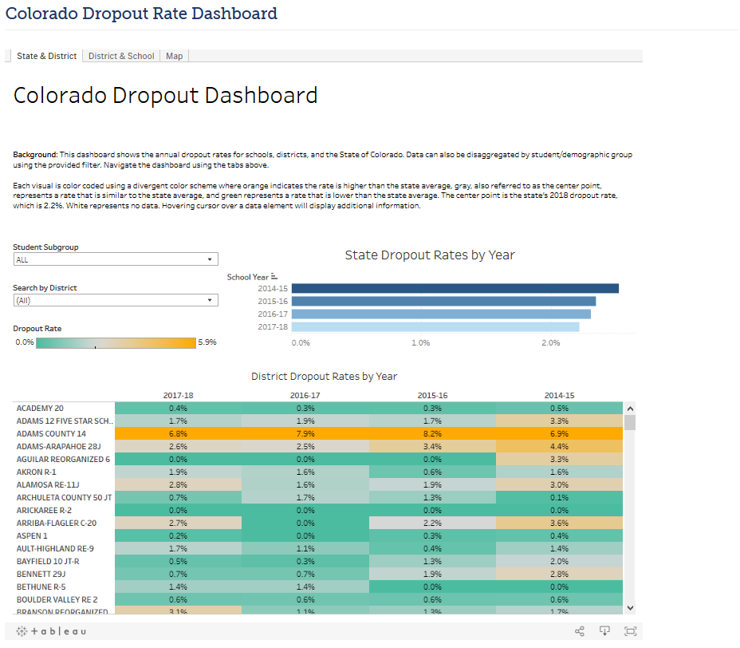
End of Year Data Online
http://www.cde.state.co.us/code/dropoutrate

Slide 63
Glossary

Slide 64
Key Terms
AYG – Anticipated Year of Graduation (4 years after enter 9th grade)
IPST – Instructional Program Service Type (Free and Reduced Lunch, Title I, Migrant, etc.)
Cohort – Group of students with same AYG and/or common IPST category.
Graduate – Student receiving High School diploma

Slide 65
Key Terms
Completer – Student receiving High School diploma, or GED, or certificate of completion
SPF and DPF – School Performance Framework or District Performance Framework
Summer dropout – Student leaves 8th grade and is not reported at a public school in the state of Colorado the following school year

Slide 66
Thank you

Slide 67
Who to Contact at CDE
DATA SERVICES UNIT
Student End of Year data collection: Amanda Callinan
Callinan_A@cde.state.co.us, 303-866-6961
October Count data collection: Genevieve Hale
Hale_G@cde.state.co.us, 303-866-6970
Postsecondary Programs: Mary Anne Hunter
Hunter_Mary@cde.state.co.us, 303-866-6596
Dropout and Dropout Recovery: Judith Martinez
Martinez_J@cde.state.co.us, 303-866-6127
Homeless Reporting (McKinney-Vento): Kerry Wrenick
Wrenick_K@cde.state.co.us, 303-866-6930

Slide 68
Thank you!
DATA SERVICES UNIT
Thank you to all of the Student End of Year Contacts for all of the hard work you do to submit your district’s data accurately and on time!

