Slide 1
2017-2018
Special Education IEP Introduction
Kristi A. Gleason
Gleason_k@cde.state.co.us
(303) 866-4620
October 11th, 2017

Slide 2
Special Education IEP
Welcome to the Special Education IEP Introduction Training!
URL https://cdeinfotech.adobeconnect.com/data_services/
Dial in number is 1-855-397-4421
Special Education IEP contact information
Kristi Gleason – gleason_k@cde.state.co.us 303-866-4620
Lindsey Heitman – heitman_l@cde.state.co.us 303-866-5759
Orla Bolger – bolger_o@cde.state.co.us 303-866-6896

Slide 3
A Little Webinar Housekeeping
Remember to Mute Your Phones
Questions?
You can put them in Chat
Raise Your Hand
We’ll Open the Phones Periodically to Answer Any Questions You May Have

Slide 4
Poll Q1

Slide 5
TRAINING TOPICS
Date Pipeline Website
Home Page
Town Hall Trainings
Resources
Interchanges
Snapshot
Frequently Requested Codes
Data Pipeline System
Identity Management
Accessing the System
System Elements
Cognos
Data Pipeline
Processes
File Upload
Special Education
Pipeline Reports
Cognos

Slide 6
DATA PIPELINE WEBSITE
IEP Intro Q2

Slide 7
Data Pipeline Home Page
http://www.cde.state.co.us/datapipeline
Overview
Single Sign-On

Slide 8
Town Hall Trainings
http://www.cde.state.co.us/datapipeline/train_schedule
Town Hall’s occur every Thursday from 9-10 am during the school year with a modified summer schedule.
URL https://cdeinfotech.adobeconnect.com/cde-data-pipeline/
Dial in number is 1-866-764-6750

Slide 9
Resources
http://www.cde.state.co.us/datapipeline/resources
Data Pipeline
Definitions
Mandatory Data Pipeline Collections: Legislation & Uses
Collection Dates
CSIS Presentation on New Data Elements & ESSA
Configure Internet Explorer to download Excel Files from Cognos
Convert CSV file to Excel and not lose the leading zeros
Identity Management (IdM)
Identity Management Groups
Identity Management Access

Slide 10
Glossary of Terms
Term | Definition
Cognos | A type of report in which the user can view applicable reports that are formatted in a user friendly environment
Data Pipeline | A streamlined approach to efficiently move required education information from school districts to the CDE
ESSU Data Management System | Statewide system for students receiving Special Education and other services
Interchange | The method of providing data to CDE in which LEA’s may choose from multiple file formats to submit data transactions throughout the year.
LAM | Local Access Manager responsible for assigning the appropriate access to CDE applications
LEA | Local Education Agencies
IdM | Identity Management. A single sign on system, allowing the user to navigate between the applications without entering user ID information a second time.
Snapshot | A date in time when data is pulled from the appropriate interchanges, validated by additional business rules, and approval given that signifies it was accurately reported for a specific point in time by an LEA

Slide 11
INTERCHANGES
http://www.cde.state.co.us/datapipeline/inter_interchanges
Discipline
Special Education IEP
Staff
Standard Course Codes
Student
Teacher/Student Data Link
Title I

Slide 12
SNAPSHOTS
http://www.cde.state.co.us/datapipeline/snap_snapshots
End of Year
Human Resources
READ
Special Education December Count
Special Education Discipline
Special Education End of Year
Student October
Teacher Student Data Link
IEP Intro Q3

Slide 13
Frequently Requested Codes
http://www.cde.state.co.us/datapipeline/org_orgcodes
We Welcome 2 New Administrative Units: Durango & Colorado River BOCES
Go to this link to find out more http://www.cde.state.co.us/datapipeline/2016-17administrativeunitanddistrictcodes

Slide 14
Special Education IEP Interchange
http://www.cde.state.co.us/datapipeline/inter_sped-iep
Overview
Deadlines
http://www.cde.state.co.us/datapipeline/2017-2018specialeducationdecembercounttimeline
File Layout and Definitions
Child http://www.cde.state.co.us/datapipeline/2017-2018specialeducationchildfilelayoutanddefinitions
Participation http://www.cde.state.co.us/datapipeline/2017-2018specialeducationparticipationfilelayoutanddefinitions
Business Rules
File Formatting
Templates
Trainings
Additional Resources

Slide 15
Special Education IEP Interchange – 2 Files
Child File
Demographic information
1 record per student
Participation File
Special Education services information
1 record per student
Student data is used to meet federal reporting requirements, calculate Indicators 5,6,9, 10 Significant Disproportionality, generate sample lists for Indicator 8 Parent Surveys and record review, and determine ECEA funding for Students with Disabilities.

Slide 16
File Layout and Definition Documents
Purpose
Dependencies
SASID & LASID MUST MATCH between the Child & Participation files.
Record Expectation
Use Summary
Special Education December Count
Special Education Discipline
Special Education End of Year

Slide 17
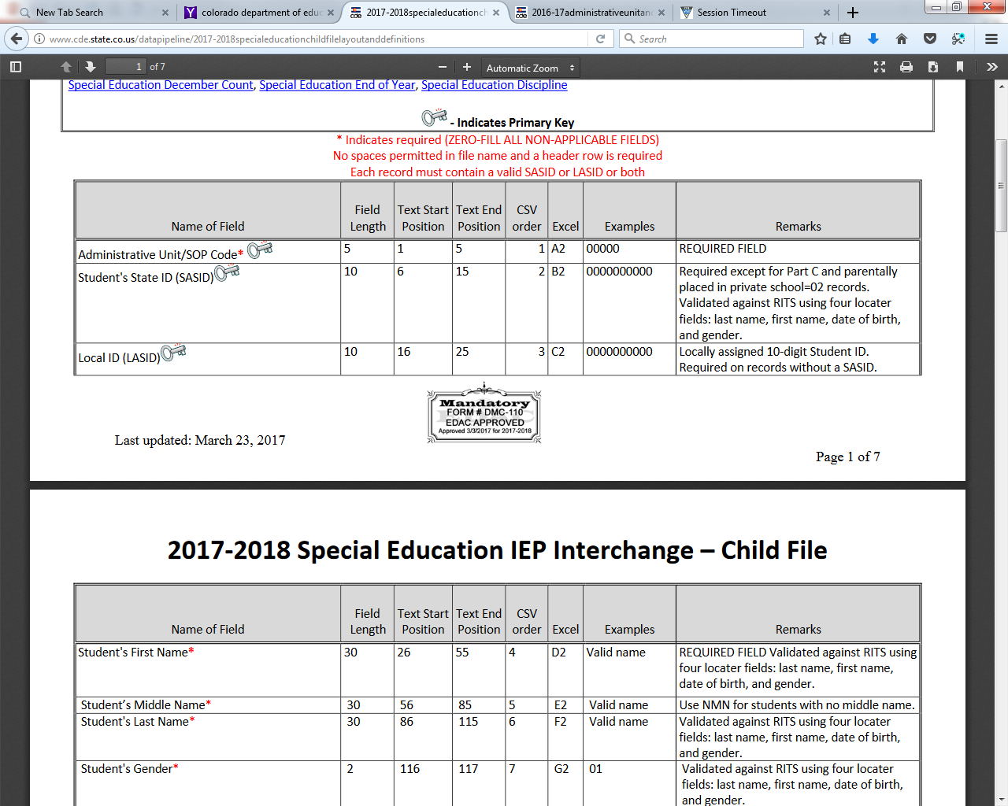
Screen Shot of the Child File Layout
File Layout
Definitions
Every Field Name included in the File Layout will have a corresponding “Definition”
We also include any changes in the document at the bottom of it.

Slide 18
Tips on Files
Excel, CSV, or Text formats are accepted
Simple Excel template for Child and Participation Files posted online http://www.cde.state.co.us/datapipeline/inter_sped-iep under Templates (however, it is not necessary to use a template if your file already extracts in one of the accepted formats)
No spaces in file name
No blank fields
Be sure the file is not open when uploading
Be sure you haven’t lost all your leading zeros on a CSV file or it won’t upload (steps for saving them posted online)
1 record per student and should reflect the student’s latest Sped status within the reporting year
Be sure your SASIDs and LASIDs match between the record on Child and on Participation

Slide 19
Example of IEP Record (in excel)
IEP Intro Q4
CHILD
AU/SOP Code | SASID | LASID | First Name | Middle Name
16010 | 234567899 | 1111111111 | Spongebob | Snicklefritz
PARTICIPATION
AU/SOP Code | SASID | LASID | First Name | Last Name
16010 | 254367899 | 0000000000 | Spongebob | Snicklefritz

Slide 20
Other Resource Documents You May Need
Under Additional Resources on the IEP Page
How to load the Special Education IEP Files
http://www.cde.state.co.us/datapipeline/howtoloadthespecialeducationiepfiles
Data Collection Guide for Enrich Users
Save CSV Leading Zeros
Grade to Age Table
Pupil’s Attendance Information Code Flow Chart
Pupil’s Attendance Information Codes
December Count Educational Environment Guidance
Allowable Approved Facility Schools and Other Agency

Slide 21
Other Resource Documents You May Need
Under Special Education December Count Page
Process Manual
Student Data Content Guide
Student Code Table

Slide 22
A few tips
Create a folder to save your files into
We recommend a simple versioning process to keep track of the files uploaded.
We suggest you “Create a Rule” for handling the Data Pipeline System Generated Emails as you will need to refer to them throughout the Data Pipeline Process.
IEP Intro Q5

Slide 23
DATA PIPELINE SYSTEM

Slide 24
1st Step - Access Privileges
In order to Access the Data Pipeline System, you must first be given a role in Access Management or Identity Management (IdM)
Superintendents create a user or a group of users known as the Local Access Manager (LAM) group.
The Admin Unit LAM is responsible for approving and administering access to CDE systems

Slide 25
Single-Sign On and the SPE Role
The Special Education IEP Interchange has ONLY 1 Role
PIPELINE-#####-SPE~LEAUSER
##### = 5 Digit Administrative Unit Code
You’ll Create a Single-Sign On User Account
User Name = Email
Password = see this link for more information on passwords, LAMs, roles and groups
https://cdeapps.cde.state.co.us/faqs.html#7

Slide 26
https://cdeapps.cde.state.co.us/index.html
*single sign-on used for all CDE applications listed here
*LAMS: Click Access Management to add or modify IdM accounts
*Special Education Directors click Executive Director Registration to register as AU User Manager in IdM.

Slide 27
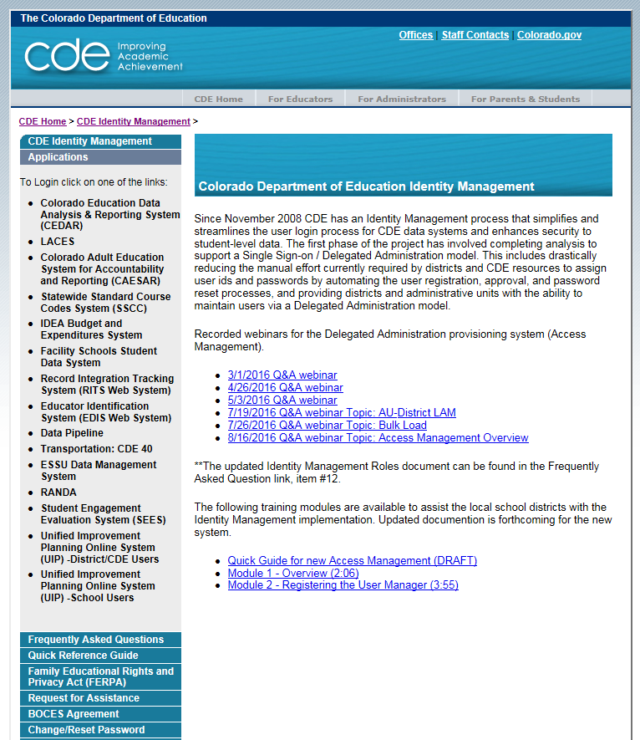
Accessing the Data Pipeline
https://cdeapps.cde.state.co.us/index.html
*single sign-on login used for all CDE applications listed here

Slide 28
Single Sign On
Username is the email address associated with your IdM account
Password specified by you

Slide 29
Data Pipeline System
File Upload
Batch Maintenance
Format Checker
Data File Upload
Validation Report
Special Education
Status Dashboard
Snapshot
File Extract Download
Pipeline Reports
Error Report
Cognos Reports (A type of report in which the user can view applicable reports that are formatted in a user friendly environment)
Special Education IEP

Slide 30
DATA PIPELINE PROCESSES

Slide 31
1st Step: Format Checker
Once the file is created, you have the option to run it through the Format Checker to ensure all the bytes are correct.
The system checks the first row of data only.
All fields PASS = Ready to upload

Slide 32
Passed Format Checker but did it really?

Slide 33
Step 2: Data File Upload
Click on File Upload/Data File Upload
Choose File Type and School Year. Organization should populate with your AU.
Click on Browse to locate File
Choose Replace
Hit Submit
Note message in green below. A Batch ID will be created.

Slide 34
File Upload: Email Confirmation
Check email to ensure file was successfully uploaded
Below is an email in a case where the file didn’t successfully upload. Additional details are provided

Slide 35
Step 3: Batch Maintenance – Very Important Step
Check Batch Maintenance to ensure files have processed successfully.
Processed Indicator will say “YES”. If blank or “No”, file did not upload
Check Record Count, Error Count, and make sure submitted date and time look accurate.

Slide 36
File Did Not Process
If this happens be sure:
there are no spaces in the name of the file
the file isn’t open when you upload it
the bytes/fields are accurate and there are no blank fields
Run file through Format Checker again. If file Passes re-upload to Data File Upload

Slide 37
Checking IEP Interchange Errors – 2 places
1. Data Pipeline-Cognos Reports-Special Education IEP:
Detail and Summary Error Report for each File
All errors located here so be sure to check before final submission

Slide 38
Cognos Reports
Example: Special Ed Child Error Detail Report

Slide 39
Pipeline Error Reports
Another option for accessing Interchange and Snapshot level error reports
Dataset: Special Education IEP Interchange
File Type: choose the file name for Interchange errors and “Special Education Child”
Choose Error Type: Errors and Warnings, Errors, Warnings
Search
Export to Excel to view errors in detail

Slide 40
Interchange Process
Create/Update Data Files
Upload files in Data File Upload
Check Email
Review Batch Maintenance
Review Error Reports in Cognos Or Pipeline Reports
Correct Data Files in Source System
Upload files in Format Checker
Once No Errors in All Files Needed -> Create Snapshot

Slide 41
Thank you for Joining Us Today
IEP Intro Q6

Slide 42
Special Education IEP Interchange: Questions?
If you have ANY questions about the Special Education IEP Interchange please feel free to contact us. No question or concern should remain unanswered of unresolved.
We are just a phone call or email away!
Kristi Gleason (303) 866-4620 gleason_k@cde.state.co.us
Lindsey Heitman (303) 866-5759 heitman_l@cde.state.co.us
Orla Bolger (303) 866-6896 bolger_o@cde.state.co.us
Email protocol – please include:
Administrative Unit #
Phone number where you may be reached. Be sure to get that added in Access Management.
Subject of the email
NOTE: Never send files or reports via email – contact us to determine best technical assistance avenue.
Thank you for joining us today!

