Slide 1
2017
End of Year Snapshot
Custodian - Duncan Anderson
Anderson_d@cde.state.co.us
Last updated: 4/5/17
Notes:
1

Slide 2
Agenda
Collection overview
Schedule
Regular Process
Interchange Uploads
Interchange Errors
Exceptions
Snapshot
Snapshot Errors
Submission
Cross LEA Process
Adjustments
Post-Cross LEA Process
Adequate Documentation
Rates and Reports

Slide 3
What is the End of Year Snapshot?
The purpose of the Student End of Year Snapshot is to see the annual educational history for students throughout the year. The data from this collection is used to derive the graduation, dropout, mobility, and stability rates.
It also collects Advanced Placement course completion and post secondary information

Slide 4
End of Year Collection Schedule

Slide 5
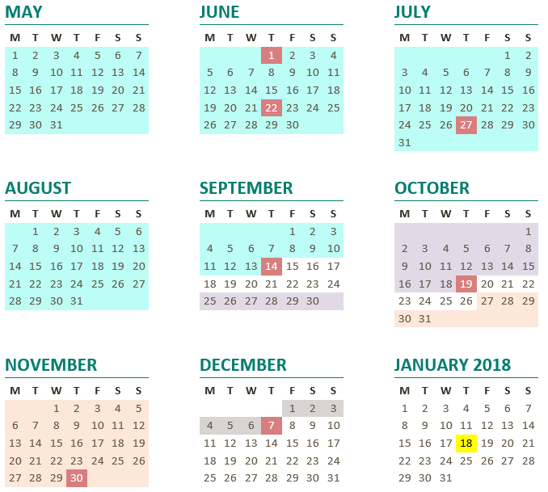
At A Glace

Slide 6
Important Dates for the 2016-17 Collection
Regular Process
June 1th – All districts create an End of Year snapshot. Snapshot must contain records.
June 22nd – All districts pass Student Interchange and Title I interchange level edits. Majority of data flows through to the snapshot.
July 27th - All districts have clean snapshot with no errors
September 14th – All districts submit their End of Year snapshots and approve initial Data Summary reports. This deadline is mandated under Colorado Administrative Rules.

Slide 7
Important Dates for the 2016-17 Collection
Cross LEA Validation Phase
September 25th through October 19th – Cross LEA validation (reclaiming dropouts from prior collection years).
Post Cross LEA Validation Phase
October 26th through November 30th – Post Cross LEA validation (verifying transfers and dropouts within Colorado)
Final Dates
December 4th – 7th – Districts review final rates after AYG reconciliation. New sign off page required if rates changed.
December 7th – Superintendents must approve final Data Summary Reports (collection closes)
January 18st, 2016 – Official/final data and rates posted on the CDE web site and released to the public
Download: http://www.cde.state.co.us/sites/default/files/docs/datapipeline/2016-2017%20End%20of%20Year%20schedule_1.pdf

Slide 8
EOY Collection process and Cross LEA validation process
Warnings will inform district of some Cross LEA warnings during the Regular Process of the collection.
These 700 level warnings are based on the data submitted by other districts, meaning that the final students that will receive these warnings is may not be completely set until the September 15th deadline.
Districts may address these errors by creating adjustments as needed throughout the Regular Process and Cross LEA phase of the collection. While the list may be partial, addressing those errors early will help to ensure accurate graduation rates for your district.

Slide 9
Regular Process

Slide 10
Uploading Files

Slide 11
Submission Process Student Interchange Preparation
Obtain Student Identifiers (SASIDs)
Update school information in Directory (web form)
Extract Interchange files in correct format from your Student Information System
Make sure you have the proper IdM role
Only the SEY~LEAAPROVER role is able to submit the snapshot
SEY~LEAUSER role is used for staff that upload and edit files
SEY~LEAVIEW role only has access to reports, but cannot upload files
Full instuctions here: http://www.cde.state.co.us/datapipeline/assigneoyroles
11
Notes:
For file upload instructions, please see
Trainings:

Slide 12
Step by Step documentation
Student End of Year checklist
Step by step document of process
http://www.cde.state.co.us/datapipeline/seychecklist
Frequently Asked Questions
Good information on common questions
http://www.cde.state.co.us/datapipeline/eoycommonfaq

Slide 13
Submission Process Student Interchange Preparation
Districts upload the interchange file
Upload the Demographic file, then School Association file, then the Advanced Course Completion file
Wait for a Confirmation Email from the Pipeline System
The email will show you the number of errors in your upload
You’ll want to resolve ALL errors in your interchange files
Check your error reports
Update your Interchange files to address the errors
I would suggest updating your student information system so the data in your system matches that supplied to the state
You can also update records directly in the pipeline using the Edit Record tool
13
Notes:
For file upload instructions, please see
Trainings:

Slide 14
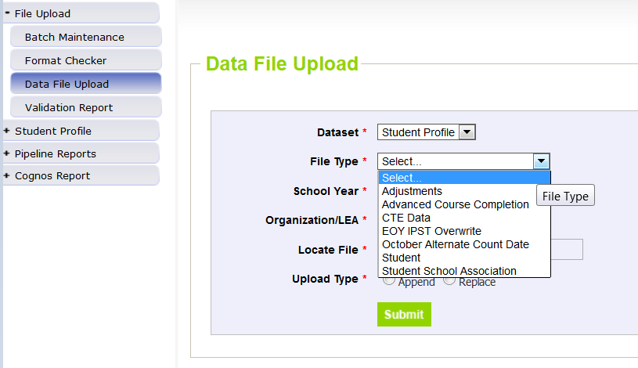
Data File Upload
14
Notes:
For file upload instructions, please see
Trainings:

Slide 15
Interchange Pipeline Reports
15
Notes:
For file upload instructions, please see
Trainings:

Slide 16
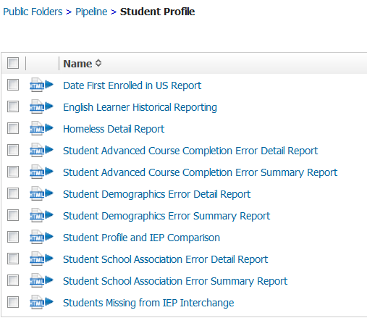
Interchange Cognos Reports
16
Notes:
For file upload instructions, please see
Trainings:

Slide 17
Common Demographic Errors: Language Edits

Slide 18
Edits For ELL
The goal of EOY is to collect whether or not a student has received ELL services throughout the year, not just the status at the end of the year. The SP180 edit has been implemented to insure that student status is properly captured.
ELL Status must be 1(Yes) if it was also 1(Yes) in Student October for the current year.
Properly coding the students receiving languages services through your district can impact the funding your district receives.

Slide 19
Definition of ELL student
Note: A student is calculated as an ELL in the following way:
Language Background | Bilingual | ESL | ELL Status
ENG (English) | 0 | 0 | No (0)
 | 1 | 0 | No (0)
Not ENG (Not English) | 1 | 0 | Yes (1)
 | 2 | 0 | Yes (1)
 | 3 | 0 | Yes (1)
 | 4 | 0 | No (0)
 | 5 | 0 | Yes (1)
 | 0 | 1 | Yes (1)
 | 0 | 2 | Yes (1)
 | 0 | 3 | Yes (1)
 | 0 | 4 | No (0)
 | 0 | 5 | Yes (1)

Slide 20
Language Proficiency Codes
Reminder of the two codes (in addition to NEP, LEP and FEP)
PHLOTE, English Proficient
FELL- Former ELL
Why:
Currently, when students leave a district, information is lost. These codes will insure that student data is not left out when he/she moves to a different district.
Student history is preserved.
When:
These codes should only be used when a student is new to a district. Exceptions will be made in the first year for districts who would like to go back and correct their data.

Slide 21
PHLOTE, English Proficient
Primary or Home Language Other Than English (PHLOTE)
Never been served in (or no information that the student has been served in) an English language instruction education program (i.e., ELA, ESL, Bilingual) in another district, state, or country.
Proficient in English, via WIDA and body of evidence.

Slide 22
FELL- Former ELL
Former English Language Learner (FELL)
Previously received English language instruction education program (i.e: ELA, ESL, Bilingual) in another district, state, or country
Proficient in English, via WIDA and body of evidence
Note: You may receive an error that this student is reported as receiving language services in another district. In that case, you can count the student for additional funding if you place them into monitoring them (2 bilingual or ESL status)
Notes:
Question on Categories: Morgan Cox: cox_m@cde.state.co.us

Slide 23
Common School Association Errors: Date First Enrolled in the US

Slide 24
Key Terms
Date First Enrolled in the United States -
This field collects the date a student first enrolled in any public or non-public US school (not including Puerto Rico)
Districts may zero-fill this field and CDE will calculate the date of first enrollment based upon the date a student first had an entry date in a CDE student interchange data collection.
If a date has been entered for a student CDE will not override that field with a calculated value, though the entered value may not be more recent than the date CDE calculates.

Slide 25
Key Terms
Common Questions
Students with an entry type of 14 (Entry from another state) as their earliest entry in their educational history may not have this field zero-filled.
Schools on US military bases count as US schools
Home School does not count as a “public or non-public school.”
Students with an entry code of 05 (Entry from another country) and 16 (Entry from homeschool) will generate a warning asking a district to confirm the Date of First Enrollment.
Student in grades greater than 010 (first grade) will generate a warning if their entry type is 01 (new to educational system) or 06 (entry from unknown educational setting).
Student’s date of first enrollment will be calculated based on entry type and date in the grades kindergarten and greater.

Slide 26
Common Advanced Course Errors: Post Secondary Programs

Slide 27
Post Secondary Program Field
Participation types Aligned with student October.
The Institute of Higher Education that a student attends will still need to be reported. An updated list has been provided. This is the only field that has not experienced a change.
If a student attends more than one Institute of Higher Education or participates in more than one post-secondary program type, the Semester ‘A’ and Semester ‘B’ designations should be used.

Slide 28
Post Secondary Program Field
Code | Program | Grade | CDE Contact
0 | Not Applicable
1 | ASCENT Program | 12 only | Judith Martinez (303) 866-6127
2 | Concurrent Enrollment | 9 - 12 | Judith Martinez (303) 866-6127
7 | Early College | 9-12 | Audit Team (audit@cde.state.co.us)
8 | Community College Dropout Recovery | Age 16-21 | Audit Team (audit@cde.state.co.us)
9 | Carry Forward Ascent | 12 only | Audit Team (audit@cde.state.co.us)

Slide 29
Creating Exceptions

Slide 30
Exceptions
Make sure you have access to a syncplicity folder at my.syncplicity.com
You may need to create a free Syncplicity account if you haven’t already
The folder used for EOY exceptions is called: District Number- District Name- Student
Copy the key fields from your error report into the exception template
Exception Request Template and Instructions - Link (XLSX)
Explanations do not need to be long, but please include if it’s an SSA, DEM or Snapshot exception

Slide 31
Exceptions
Upload your exception template to the requested exception folder on syncplicity
Once your file has been uploaded, you’ll need to email me to let me know you have an exception request: Anderson_d@cde.state.co.us

Slide 32
Key Terms
Personally Identifiable Information (PII)
Information about a student that allow or in combination could be used to identify that student
Federal and Colorado laws govern the inappropriate disclosure of student PII
CDE data collections require the secure transmission of a great deal of personally identifiable information

Slide 33
Do not send PII over email
Instead please use the Student folder that has been set up for your district in Syncplicity: https://my.syncplicity.com/
This is the same folder that was used for Student October and with districts during last years End of Year
Please contact me, anderson_d@cde.state.co.us, if you need to have the permissions set to access your syncplicity folder
Once documents have been submitted to Syncplicity, please contact me to make sure that they have been reviewed prior to creating adjustments

Slide 34
Creating a Snapshot

Slide 35
Submission Process Student End of Year
Create Student End of Year snapshot (Student Profile → Snapshot)
Not a new file submission
Snapshot of previously submitted Student Profile Interchanges
Creating a new snapshot will remove your previous snapshot
Go to “Cognos Report” on the Pipeline menu to download errors and warnings
Correct errors (within the Pipeline or by loading new interchange files)
Once all edit checks have passed, submit approval of your data to CDE
Use Cognos Report to validate data
Student Profile -> Status Dashboard -> Submit to CDE
YOU CANNOT DOWNLOAD THE SIGNOFF FORM UNTIL DECEMBER
CDE identifies dropouts from prior years showing up in other districts
CDE checks across all districts to make sure student exit type is valid
Note: all errors must be resolved before continuing to the next step in the process
35
Notes:
For file upload instructions, please see
Trainings: Student End of Year directions (PDF)
On the Data Pipeline Snapshots webpage, http://www.cde.state.co.us/DataPipeline/snap_studentOctober.asp

Slide 36
Creating a New Snapshot
36
Notes:
For file upload instructions, please see
Trainings:

Slide 37
Snapshot Pipeline Reports
37
Notes:
For file upload instructions, please see
Trainings:

Slide 38
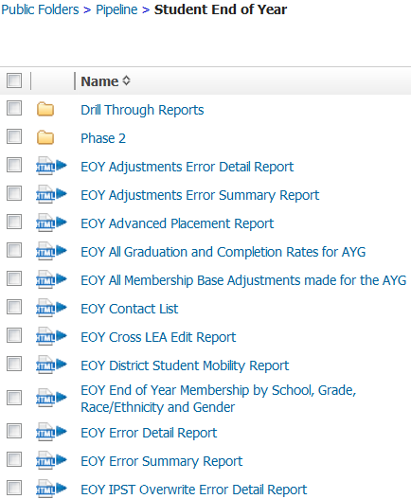
Interchange Cognos Reports
These are the Snapshot Error Reports
38
Notes:
For file upload instructions, please see
Trainings:

Slide 39
Common Errors
Student End of Year Snapshot Business Rules (XLS)
Check that links to see any updates to Businesss Rules
Some rules have been inactivated for the 2016-17 due to improvements in the process
39
Notes:
For file upload instructions, please see
Trainings:

Slide 40
Common Errors - Enter and Exit types
Entry and exit types and dates are used to track an overview of a student’s attendance throughout the year.
A full list of the possible Entry and Exit types are available in the SSA file format: http://www.cde.state.co.us/datapipeline/201617studssalayout

Slide 41
Why do we use entry and exit types?
Entry Type – Indicates how a student entered the school or district
Code = 02 – Continuous in same school (Start of year)
Code = 05 – Transfer from out of country
Code = 11 – Transfer from school in same district
Code = 13 - Transfer from another district
Code = 14 – Transfer from out of state
Code = 70 – Return to school after transferring to a GED program

Slide 42
Why do we use entry and exit types?
Exit Type – Indicates how a student exits the school or district
Code = 11 – Transfer to school in same district
Code = 13 - Transfer to another district
Code = 40 – Drop out
Code = 90 – Graduate
Code = 00 – Student finished the year at the school or left in the last three weeks of the school year
When in doubt, please refer to the SSA guide. For k-6 students, you can use a 06 when in doubt. For 7-12 students, you will need to use a dropout exit (40) in situations where you don’t have documentation

Slide 43
Why do we use entry and exit types?
Student returns from prior year (entry type 02).
Student exits to transfer to another district (exit type 13)
Later in the year student comes back from another district (entry type 13)
Student exits for the summer (exit 00)
District | Sasid | Entry Date | Entry Type | Exit Date | Exit Type
0180 | 1234567890 | 08212016 | 02 | 10022016 | 13
0180 | 1234567890 | 12102016 | 13 | 00000000 | 00

Slide 44
Enter and Exit types
Most exit types that end in 0 are terminal exit types, meaning that the student is not expected to return during the school year:
00 – No Exit
10 – Grade Reassignment (Reentry Required)
20 – Transfer To A District Facility
30 – Permanent Exit due to Illness
40 – Permanent Dropout
50 – Permanent Expulsion without Services
70 – Exit to a HSED prep program
90 – Graduate

Slide 45
Common Errors
SE083 | 12th grade students must either be retained (Retention Code<> 0) or have an appropriate Exit Type (Exit Type other than 00).
SE171 | Exit Type cannot be 00 if Entry Grade Level = 120 and Retention Code = 0
SE083 and SE171 are identical errors, and now SE083 has been inactivated so that your error counts are more accurate. SE171 errors will be resolved once you’ve recorded the graduation of seniors. Seniors have until August 31st to graduate during the 2016-17 school year. Please record seniors who graduate after summer school with an exit date of the graduation with the rest of their class.
45
Notes:
For file upload instructions, please see
Trainings:

Slide 46
Common Errors
SE091 | Students with Exit Type Code 11 should be followed by record with Entry Type Code 11 or 12.
SE099 | Entry Code must <> 11 where Grade <> lowest grade for the school code and where no previous record exists with the same SASID, district with Exit Type = 11 in the same school year.
SE109 | Entry Type may be 11 (Transfer from a public school in the same district) for the first detail record, only if the student finished the prior year at a different School Building Code with Exit Type Code = 00.
SE102 | Entry Type may be 02 (Continuous in same school with no interruption of schooling) for the first detail record only if the student was reported in the prior year as finishing at the same School Building Code with Exit Type Code = 00.
SE104 | If a grade K-12 student was reported last year with Exit Type=00 in the last detail record, they must be reported this year with an Entry Type = 00, 02, 03, 10, 11, 90 or 91, in the first detail record.
The 11 entry type should be used for students that finished the year in one school and begin the year in another school. If a student finished with a 00 in the last year, most will have a start status of 02 (Continuous in the same school) or 11 (In district transfer). If a student SE104 gives the full list: 00 is only for summer dropouts, 03 is only for a school closure, and 90 or 91 are only used for misreported graduates.
46
Notes:
For file upload instructions, please see
Trainings:

Slide 47
Common issues
NEW SE 400’s Records not getting into snapshot
Please make sure primary school flag is set correctly in student school association file. The primary school flag must be set to 1 for the student to appear
Check to see if the record is in error in student interchange file
Validate the pupils attendance code is correct
SE060 Student reported on Student October not in Student End of Year
If a student was reported on Student October, system expects record for student on October 1st in Student End of Year
Use Syncplicity to request an exception

Slide 48
Common Errors
SE104 | If a grade K-12 student was reported last year with Exit Type=00 in the last detail record, they must be reported this year with an Entry Type = 00, 02, 03, 11, 90 or 91, in the first detail record.
SE049 | If a student was reported in Student October in grade K-12 with Attendance Code 01-08 they must have at least 1 record in EOY. Note: Pre-K students who did not complete the school year in your district do not have to be reported on the Student End of Year.
SE404 | A K-12 student was reported last year with Exit Type=00 in the last detail record, they must have a record in your current year School Association file.
SE401 | A PK-12 grade student has errors at the interchange level (SSA).
SE405 | A PK-12 grade student has errors at the interchange level (DEM).
WSE412 | A grade PK-12 student was reported in the student school association file with a primary school flag set to zero. Please confirm that this status is approrpiate as the record will not be included in the End of Year snapshot.
WSE413 | A grade PK-12 student was reported in the student school association file with a pupil attendance code that is not between 01 and 08. Please confirm that this status is approrpiate as the record will not be included in the End of Year snapshot.
Missing Record errors have mostly been changed to the SE400 range. SE104 now only triggers on an inappropriate entry type. SE049 and SE404 indicate a missing record. Please create a new record as appropriate, even if it’s just a one day record returning the student to school and then exiting them the same day.
48
Notes:
For file upload instructions, please see
Trainings:

Slide 49
SE404 Stitching Records
SE404 errors trigger when a student exited the previous year with a 00 exit type
Over the summer, the student left and never attended during the 2016-17 school year
The student will still need a record indicating where they are attending school
For example:
This is only required for students in 7-12th grade to accurately document dropouts.
Other students in k-6 are treated as 06 (Unknown status) if they don’t have a record.
District | Sasid | Entry Date | Entry Type | Exit Date | Exit Type
0180 | 1234567890 | 08212016 | 02 | 08212016 | 15
49
Notes:
For file upload instructions, please see
Trainings:

Slide 50
Submit Your Snapshot!

Slide 51
Submit your Snapshot to CDE
Once you’ve completed resolving your snapshot errors, you will need to submit your snapshot by September 14th!
Submit your snapshot through the status dashboard
The collection is not over at that point. There are two additional phases for data validation

Slide 52
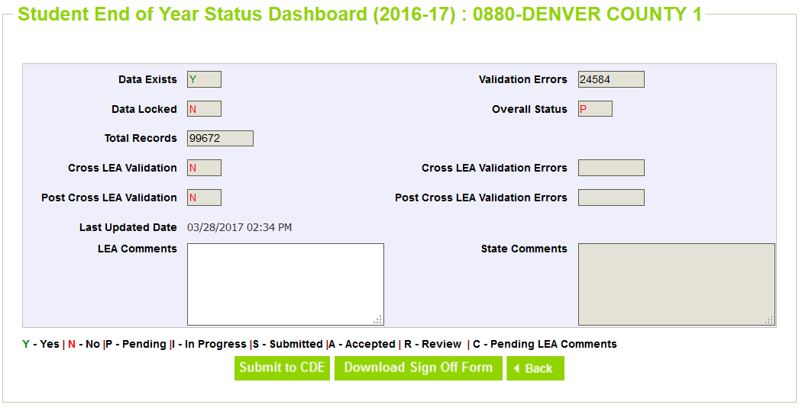
Submit your Snapshot to CDE

Slide 53
Cross and Post Cross

Slide 54
Important Dates for the 2015-16 Collection
Cross LEA Validation Phase
September 25th through October 19th – Cross LEA validation (reclaiming dropouts from prior collection years).
Cross LEA phase (Oct)
Post Cross LEA Validation Phase
October 26th through November 30th – Post Cross LEA validation (verifying transfers and dropouts within Colorado)
Post-Cross LEA phase (Nov)
Final Dates
December 4th – 7th – Districts review final rates after AYG reconciliation. New sign off page required if rates changed.
December 7th – Superintendents must approve final Data Summary Reports (collection closes)
January 18st, 2016 – Official/final data and rates posted on the CDE web site and released to the public
Download: http://www.cde.state.co.us/sites/default/files/docs/datapipeline/2016-2017%20End%20of%20Year%20schedule_1.pdf

Slide 55
Cross LEA Adjustment File
Adjustments for prior year dropouts, expulsions and GED transfers
File loaded same as the student interchange files
File layout at the following link: http://www.cde.state.co.us/datapipeline/snap_eoy
Fields are: district code, sasid, student first name, student last name, student gender, birth date student, adjustment code, adjustment school, adjustment year

Slide 56
Adjustment File
Fields are used to link back to prior year information
Removes student from graduation base

Slide 57
Post Cross LEA
This identifies students that were listed as transfers but were not recovered by other districts
It also identifies dropouts who were recovered by other districts

Slide 58
Record Request/ Confirmation of Enrollment and Attendance template
To be used by the receiving district when the student has begun attending the receiving school
Can be used as documentation of transfer ONLY if Date of Enrollment and Date of Attendance are provided
Other record request forms without that information will not be accepted
If the former district lacks this documentation, please use the Request for Confirmation of Enrollment and Attendance

Slide 59
Where can I find more information
Adequate documentation
http://www.cde.state.co.us/datapipeline/snap_eoy
Documents
Adequate Documentation of Transfer List
Record Request/Confirmation of Enrollment and Attendance
Request for Confirmation of Enrollment and Attendance
Notification of Withdrawal
Student Transfer Follow up

Slide 60
Reminder About Transfer Students
Students who tell you that they are transferring in the next school year but who complete all coursework in your district (up to three weeks before the end of school) should have an exit code of ‘00’. If they are coded with exit code ‘13’ they will be counted as a dropout because they will not have time to show up in another school/district before the end of the year.
When a student is transferring, insure to follow up with that student immediately to get adequate documentation of the transfer. This way, you can avoid students unnecessarily being coded as dropouts.
Note: Please see http://www.cde.state.co.us/datapipeline/snap_eoy for an adequate documentation list complete with exit codes.

Slide 61
Rates and Reports

Slide 62
Key Terms
AYG – Anticipated Year of Graduation (4 years after enter 9th grade)
IPST – Instructional Program Service Type (Free and reduced lunch, Title I, Migrant, etc)
Cohort – Group of students with same AYG and common IPST category.
Graduate – Student receiving High School diploma

Slide 63
Key Terms
Completer – Student receiving High School diploma, or GED, or certificate of completion
SPF and DPF – School Performance Framework or District Performance Framework
Summer dropout – Student leaves 8th grade and is not reported at a public school in the state of Colorado the following school year

Slide 64
How is data used?
Used for school, district and state rates
Graduation -
Completion
http://www.cde.state.co.us/cdereval/gradratecurrent
Dropout
http://www.cde.state.co.us/cdereval/dropoutcurrent
Mobility
Stability
http://www.cde.state.co.us/cdereval/mobility-stabilitycurrent
You have access to early versions of these rates in your Cognos reports

Slide 65
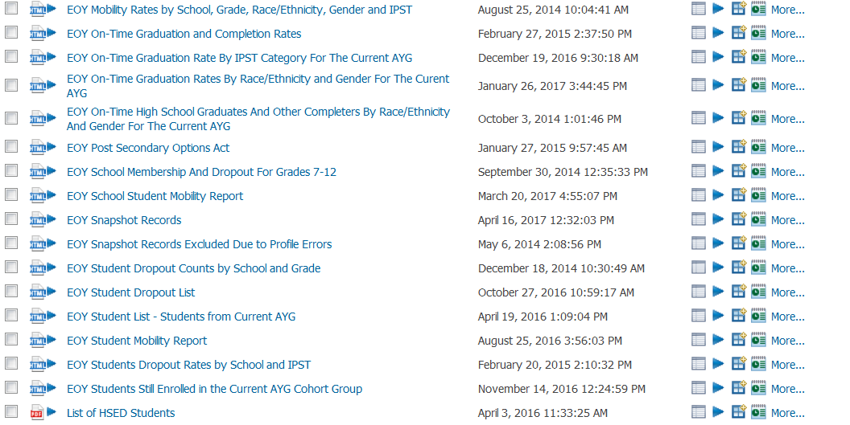
Where is this data used?

Slide 66
Where is this data used?
School and District Performance Frameworks
Community uses it for evaluation purposes
Reported to the Federal Government
Research and data analysis
Media reports it

Slide 67
Who to Contact at CDE
DATA SERVICES UNIT
End of Year
Duncan Anderson, Data Specialist
(303) 866-6970
Anderson_D@cde.state.co.us

