Slide 1
SEY Office Hours
September 2025

Slide 2
Agenda
Timeline Review
Cross LEA Phase
  Overview
  Steps
  Business Rules
  Important Data to Review
  Validating Data Checklist
  Submit Snapshot Screen
  Adequate Documentation of Transfer
  Adjustment File
Cross LEA: CEDAR/COGNOS Reports
SE700 Rule List with Notes
Questions

Slide 3
Regular Phase Timeline
Date | Event | Event Description | Notes
9/18/2025 | Open | Cross LEA Phase Opens | Snapshots unlocked mid-day, districts receive specific email regarding their data
10/6/2025 | Interim Deadline | Error free SEY Snapshot | Ensure errors are addressed Continue working through warnings, especially SE722 that requires collaboration with other LEAs and potentially requesting SASID merges from RITS
10/6/2025 to 10/16/2025 | Report Review | • Validate Student End of Year data using CEDAR/COGNOS reports. • Submit snapshot as soon as review is complete | Review Rates School Summary of All Rates Mobility: District and School Rates Dropout: District and School Rates Graduation: 3-,4-,5-,6-,7- year Rates by School Year Still Enrolled Rates: District and School by AYG
10/16/2025 | Deadline | Resubmit error-free SEY Snapshot | Only users with the LEA Approver role for the SEY collection can submit the snapshot. Title 1 Interchange Closes Special Education IEP Interchange Closes upon completion of SPED EOY
Reminder: This collection has multiple phases requiring action by SEY Data Respondents
Cross LEA Phase: 9/18/2025 to 10/16/2025
Post-Cross LEA Phase: 10/23/2025 to 11/18/2025
Final Deadline (Superintendent Verification Form): 12/2/2025
Data Release: January 2026

Slide 4
Cross LEA Phase

Slide 5
Overview
Purpose
Required LEA Tasks
Second phase of SEY collection
CDE runs a process to cross validate student educational history across all school districts/BOCES
  SE700 series errors/warnings are triggered
    Not all LEAs will have SE700 errors or warnings, but all LEAs should review any SE001-SE500 errors and warnings as well
Ensures accuracy of education statistics
  Graduate/completers
  Dropouts
  Exit one district and recovered by another
  Completed HSED
Final opportunity to correct demographic data
Review errors/warnings
Create at least one SEY snapshot
  Even if the LEA’s snapshot was error free on 9/18 when the phase began
Review data, making updates as needed
  All data fields may be corrected during this phase
  Last chance to correct any miscoded student demographic information
Resubmit by October 16, 2025
Notes:
Some districts will receive new errors/warnings to address
SE700/SE800 series are the primary focus
Any SE001-SE400 series error that arises must also be addressed
Districts with errors/warnings to address make modifications to student records as needed

Slide 6
Cross LEA Phase Steps
Review errors and warnings
  SE700 series and any remaining SE001-SE500 series
Resolve SEY Errors
  Update interchange files (DEM & SSA) as needed to resolve errors/warnings
    Any data field may be changed during this phase
    Final opportunity to address demographic updates
  Upload Adjustment file
    If needed to address SE700 errors
Create SEY snapshot, repeating steps 1 through 3 as needed
Review SEY Data using CEDAR/COGNOS reports
Submit error-free SEY snapshot
  LEA Approver role required
Note: Steps 1, 4, 5, and 6 are required for all LEAs, even if they are error free at the beginning of this phase

Slide 7
Reviewing Errors/Warnings Steps
Step 1 Preferred Method:
Data Pipeline Error Report
Select ‘errors and warnings’
Reflects all SEY business rules
Can check/uncheck specific business rules before choosing to ‘View More Details’
  Does not display more than 1000 student records when viewing more details
Note: For this collection, leave the Tag dropdown set to ‘All’
Step 1 Alternate Method:
CEDAR Report SEY Error Summary and Detail
Use when more than 1000 student records in error/warning
Select ‘errors and warnings’
Will likely need to ‘page down’ many times since this report has multiple sections OR extract the data as an excel file
  SASID level rules
  Missing Record (Might be seeing ‘No Data Available’ instead of this section right now)
  School/Collection Level
  Summary
Step 2 (both methods):
CEDAR report Cross LEA List – Students with SE700 Errors or Warnings
  Shows the ‘other’ district reporting the student related to the SE700 error or warning

Slide 8
Business Rules
Current Year
Prior Year
Based on the interplay between current year student records across CO districts
Updates take place on current year SSA and DEM files
Any SE001 through SE500 series business rule
Some SE700 series rules
  SE702, SE703, SE707, SE708, SE710, SE711, SE712, SE720, SE721, SE722, SE724, SE725, SE726, SE727
Some warnings become errors in post-cross phase if not addressed
  SE720, SE721, SE722, SE724
Based on information related to a student’s final reported status in a previous SEY collections
  These students are not included in the 2024-2025 SEY collection or related interchange files
Most of these errors are cleared using an adjustment record
Some may be cleared using a one-day record in the current year
Only SE700 series rules
  SE704, SE706, SE710

Slide 9
Important Data to Review
Critical Resources:
CEDAR/COGNOS Cross LEA Reports
CEDAR/COGNOS Report—SEY Snapshot Records
CEDAR/COGNOS Report—Student List: AYG Cohort
Summer Graduate/Completers
  School exit types 90-96 may be used with school exit dates up through 08/31/2025
Retention Codes
  Retained K-11 students should have retention code 1 in 2025 and begin the 2026 school year in the same grade they ended in 2025
  ASCENT/PTECH years 5-6/TREP
    SE233 & SE239 warnings
  SPED Transition
    SPED EOY basis of exit compared to SEY school exit type 2025
SPED Students
  Collaborate with SPED EOY reporting team, resolving any errors in SPED EOY related to SEY exit coding
  Ensure all attending SPED Students included in SEY
    SE414 and SE415 warnings
Dual Enrolled or Late Exits
  SE137 Warning (exit 13 after May 1)
  SE138 Warning (exit 00 in multiple LEAs)
Exit 13 without another LEA claiming student
  SE722 grades 7-12
  SE727 grades K-6
Address SASID merges
  SE722 and SE727 often uncover the need for SASID merges when COA shows student is attending another CO district
Student Demographic Information
  Homeless, English Learner, Immigrant, Military Enlisted, Military Connected, etc.

Slide 10
Validating Data: Report Checklist
School Summary of All Rates
Mobility: District and School Rates
  Dig Deeper?
    Student List: District and School Mobility Instances
Dropout: District and School Rates
  Dig Deeper?
    Student List: Dropout
Graduation: 3-,4-,5-,6-,7- year Rates by School Year
  Dig Deeper?
    Graduation Rates: District and School by AYG
    Still Enrolled Rates: District and School by AYG
    Student List: AYG Cohort
    Student List: AYG Cohort Adjustments

Slide 11
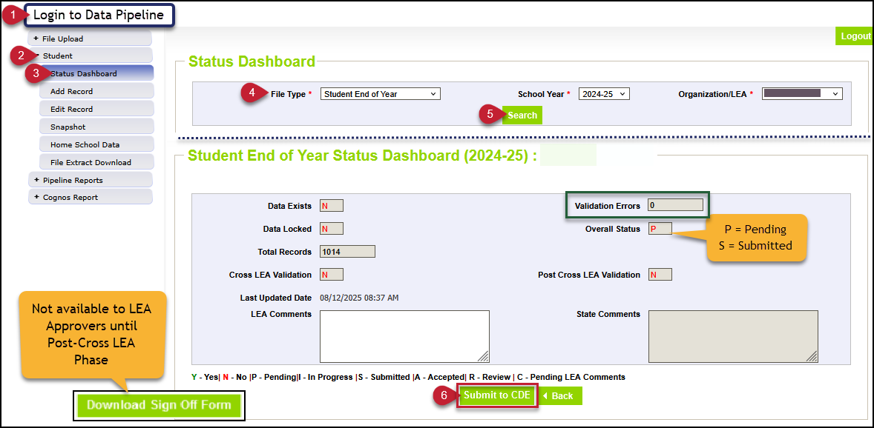
Completing the Regular Phase: Submitting Snapshot
Submission Checklist
*LEA Approvers*
Error Free
Reconciled summer graduate/completers
(updated exit types)
Checked retention codes
  If grade level in 2025-2026 = 2024-2025 then, retention code 2024-2025 cannot be zero
Validated data
  Reviewed rates
  Reviewed lists
  (dropout, AYG cohort)
Encouraged:
  Uploaded 2025-2026 DEM & SSA files at least once
  Created at least one OCT snapshot
Note: Download Sign Off Form not available until Post-Cross LEA Phase

Slide 12
Adequate Documentation of Transfer

Slide 13
Adequate Documentation Overview
Adequate documentation is the documentation maintained by districts/schools when students transfer out of their district
  Details and sample forms available on the adequate documentation website
    Confirmation of Enrollment/Attendance is the most common and must include the student’s full name, date of birth, and SASID
    RITS is not considered adequate documentation of transfer
Requirements are outlined in state rule, as seen here: 1 CCR 301-1 Rules for the Administration of the Accreditation of School Districts
  Colorado Public Schools and local education agencies are required to send transcripts or to confirm attendance when requested from another Colorado Public School or local education agency within two weeks of receiving the request with the exception of students in out of-home placements whose records must be transferred within five (5) days pursuant to sections 22-32-138(2)(a)(II) and (3)(a), C.R.S
  When a student withdraws, districts are authorized to request information from the parent or guardian about the specific type of educational enviornment that a student is transferring to in order to monitor compliance with the School Attendance Law. [section 22-33-104 (1), C.R.S.]
Notes:
For students who are withdrawing from a Public School, Districts and the Institute are authorized to request information from the parent or guardian about the specific type of educational environment to which the student will be transferring, in order to monitor compliance with the School Attendance Law, section 22-33-104 (1), C.R.S.

Slide 14
Adequate Documentation Expectations
Types of documentation
Confirmation of enrollment and attendance
  Provided by receiving district when student has begun attending the receiving school
  Must include date of enrollment and date of attendance
  School Exit Type 13 only allows this type of documentation
Written records request
Certificate of enrollment
Signed parent/guardian letter
Written confirmation from school administrator
RITS is NOT adequate documentation because a student may enroll, be claimed in RITS, and not attend
All documentation should include the student’s SASID and full name
  If a SASID merge has taken place or student is found to have two different SASIDs, include both SASIDs on the documentation
SEY Adequate Documentation Site
  Sample forms and templates
  List of documentation required for each school exit type
    Required documentation varies by school exit type

Slide 15
Student Interchange:
Adjustment File

Slide 16
Adjustment File Overview
7th-12th grade students only
Adjusts the final exit type for a student in a prior school year who did not attend your district in the current year.
Only used to adjust students with very specific exit scenarios
  Dropout (Exit 40)
  Expulsion (Exit 50)
  HSED transfer (Exit 70)
  Did not Exit (Exit 00)
  Other special circumstance (Exits 18, 19, 21, 26, 30)
Record is loaded in the current year using an adjustment file
Methods:
  File Upload (preferred method)
    Functions like a student interchange upload
    File layout and business rules posted on SEY website
  Manually add record in pipeline
    Uses same adjustment justification codes as a file upload
    Step-by-step: Adjustment File Directions
    File layout and business rules posted on SEY website
Student does not have a record on your DEM or SSA file in the current year
Adjustment goes into effect after you create a SEY snapshot

Slide 17
Adjustment File Layout
Adjustment File Layout
Template
Directions
Important Note:
Most student information systems do not have a file extract for this file.
Name of Field | Length | Excel Column | Examples | Notes
District Code | 4 | A | 0000
SASID | 10 | B | 0000000000 | Must match RITS
First Name Student | 30 | C | Valid name | Must match RITS
Last Name Student | 30 | D | Valid name | Must match RITS
Gender Student | 2 | E | 01 or 02 | Must match RITS
Birth Date Student | 8 | F | 12312013 | MMDDYYYY
Adjustment Justification Code | 2 | G | 00 | Corresponds to exit type on SEY error details for SE700 errors/warnings
Adjustment School Code | 4 | H | 0000 | Last school attended in your district Matches the SEY error detail report for SE700 series errors/warnings
Adjustment Year | 4 | I | 2022 | Last school year (spring semester) the student attended in your district. For example, an exit date in the 2021-2022 school year is Adjustment Year 2022.

Slide 18
Adjustment Justification Codes
Code | Description | Prior Year Exit | AYG Cohort Impact
00 | Not Applicable | any | AYG Cohort status remains intact
40 | No Documentation of Reenrollment | 00 | Remains in AYG cohort
41 | Request for transcripts received | 40 or 00 18, 19, 21, 26, 30 | Removed from cohort
42 | Student received HSED from an educational program not administered by reporting district | 40 or 00 18, 19, 21, 26, 30 | Counted as an HSED recipient (completer)
51 | Request for transcripts received | 50 | Removed from cohort
52 | Student received HSED from an educational program not administered by reporting district | 50 | Counted as an HSED recipient (completer)
71 | Request for transcripts received | 70 | Removed from cohort
77 | Student received HSED from an educational program not administered by reporting district | 70 | Counted as an HSED recipient (completer)
90 | Misreported Graduate Note: Do not use for SPED Transition or Postsecondary Program Participants. In most cases, it is better to include a one-day record to count the student as a graduate. | 00 | Counted as a graduate AYG 2021 + requires graduation guidelines
96 | Misreported Graduate, Postsecondary Program Note: In most cases, it is better to include a one-day record to count the student as a graduate. | 00 with retention 2 | Counted as a graduate AYG 2021 + requires graduation guidelines

Slide 19
CEDAR/COGNOS: Cross LEA Reports

Slide 20
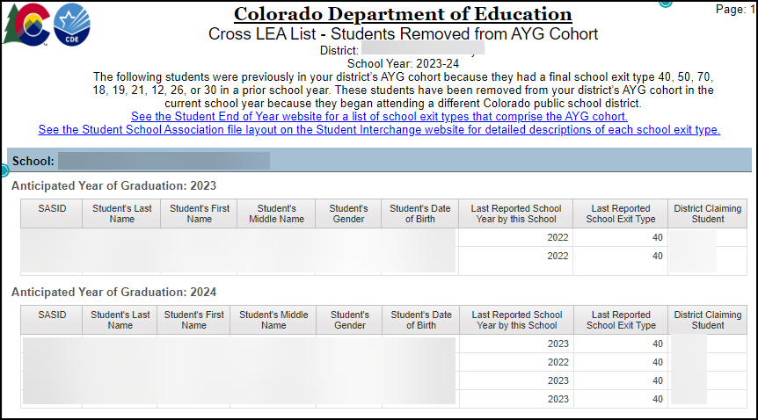
Cross LEA List – Students Removed from AYG Cohort
Prior year:
Exit type where student remained in the AYG Cohort for the School/LEA
Current Year:
Student began attending another CO LEA
  Added to AYG cohort of new LEA
  Removed from AYG Cohort of prior LEA
Also reflects students with SE701, SE705, and SE709 warnings
Exit types that comprise the AYG Cohort:
00, 90-96, 40, 50, 70, 18, 19, 21, 12, 26, or 30

Slide 21
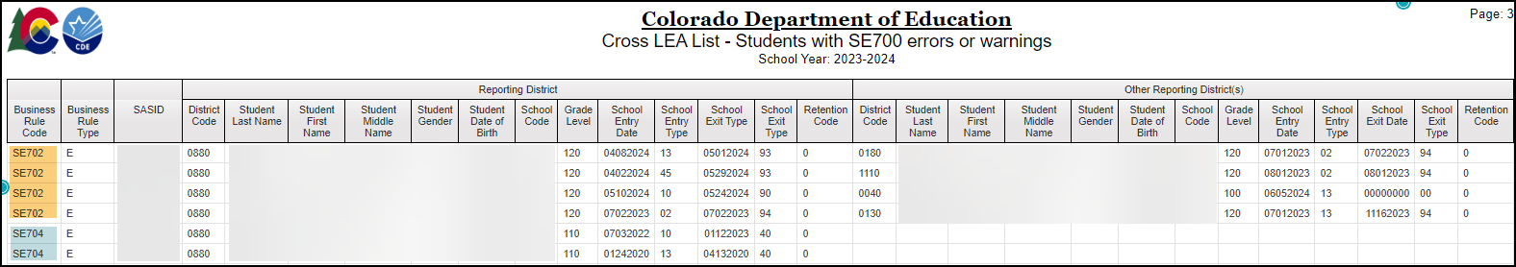
Cross LEA List – Students with SE700 errors or warnings
Shows both your LEA and the other reporting LEA for any student with a SE700 error or warning.
Second step to reviewing SE700 errors/warnings after using pipeline error report
Reminders:
Not all SE700 series rules will have an ‘other reporting district’
Some SE700 rules require districts to collaborate to resolve the issue

Slide 22
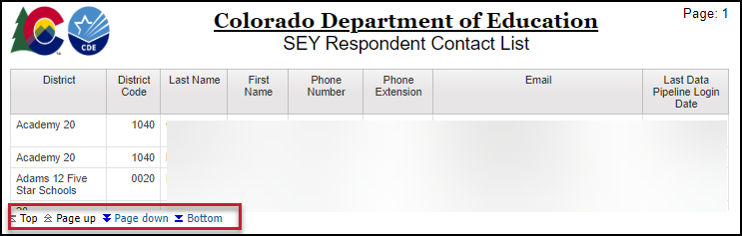
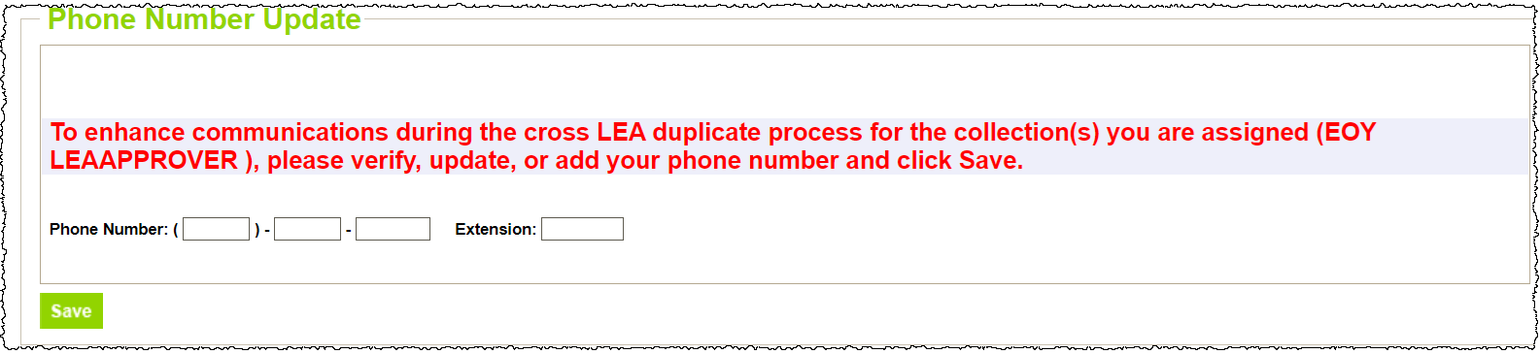
SEY Respondent Contact List
Lists all IdM users with SEY~LEA Approver or SEY~LEA User permissions
Email address reflects IdM account
Phone number reflects the number entered into pipeline through the on-screen prompt in pipeline
  If you don’t have the on-screen prompt and your phone number is incorrect on this report, email StudentEndOfYear@cde.state.co.us to have it updated
Use:
Find contact information for the ‘other district’s’ SEY respondent when resolving SE700 errors and warnings or investigating SE137 & SE138 warnings

Slide 23
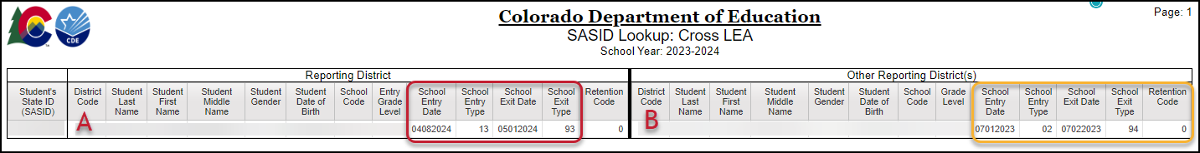
SASID Lookup: Cross LEA
Available throughout the entire collection
Designed to help research SE700 business rules, SE900 business rules, and some regular phase business rules (SE137, SE138, etc.)
In the example above, District A is the last district of attendance. We’d expect District B to update their exit type to show exit type 13.
Former Report Name EOY Cross LEA Lookup by SASID

Slide 24
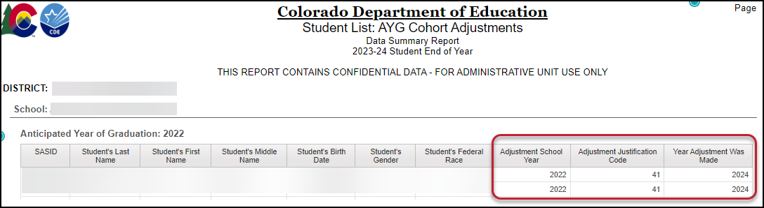
Student List: AYG Cohort Adjustments
Review impact of adjustment records uploaded in the current year
Organized by AYG cohort
Critical Fields
  Adjustment School Year = prior year exit that the adjustment record applies to
  Adjustment Justification Code = new exit status for the student
  Year Adjustment Was Made = SEY reported collection when LEA received updated information regarding student’s educational status causing need for adjustment

Slide 25
SE700 Rule List with notes

Slide 26
SE700 Rules and Next Steps (1 of 3)
Code(s) | Type | Scenario | Next Steps
SE701, SE705, SE709 | W | Student removed from AYG cohort due to attending another CO LEA | No Action Required Review with CEDAR report Cross LEA List – Students Removed from AYG Cohort
SE702 | E | Conflicting exits in two LEAs (90-96 in one LEA with 90-96, 00, or 01 in another) | Collaborate with other LEA to determine who is counting student as graduate/completer One LEA uses exit type 13 while others use exit type 90-96
SE703 | E | Adjustment Justification Code conflict with current year record in another LEA | Update adjustment justification code
SE704 & SE706 | E | Exit Type in prior year remained in AYG Cohort but received HSED in current year | Adjustment record required
SE707 | W | Entry Type 26 in current year, but no detention center record before attending your LEA | Check student’s prior educational history and update entry date accordingly
SE708 | W | Exit Type 26 without a detention center record after leaving your LEA | Review adequate documentation, update exit type as needed Becomes Post-Cross Error if not addressed
SE710 | E | Exit Type 12 in current or prior year for student who received HSED in current year | If current year, exit type 93/94 (may require final one-day record) If prior year, adjustment record

Slide 27
SE700 Rules and Next Steps (2 of 3)
Code(s) | Type | Scenario | Next Steps
SE711 | E | Exit type 13 or 40 but student reporting attending a facility school (entry at facility after exit at your LEA) | Change to exit type 19 Request exception if your adequate documentation shows another LEA after leaving your LEA to support exit 13
SE712 | W | Student with multiple records across CO with different grade levels for a student whose AYG will be assigned this year | Confirm grade level Expect student’s AYG will be reconciled during Post-Cross Phase
SE720 & SE721 | W | Exit Type where students remains in AYG cohort in current year but student attending another CO LEA in current year after leaving your LEA | Change to exit type 13 and request adequate documentation of transfer Will become error in Post-Cross Phase if not addressed
SE725 | W | Date First Enrolled in US in your LEA is more recent than another CO LEA reporting the student in the current year | These students may receive SSA errors in 2025-2026 If zero fill date first enrolled in US, will cause your file to use CDE’s auto calculated earliest date Resource: Date First Enrolled in US—SSA Data Field (PDF)
SE726 | W | School Exit Type 19 without a record at a facility school in the current year | Review adequate documentation of transfer and update exit type as applicable

Slide 28
SE700 Rules and Next Steps (3 of 3)
Code(s) | Type | Scenario | Next Steps
SE722 & SE727 | W | Exit Type 13 but no record in another CO LEA after leaving your LEA | Review adequate documentation and update exit type as needed K-6 no documentation use exit type 06 7-12 no documentation use exit type 40 Check SASID! If believe a merge is needed, follow RITS process and then update data as needed Resource: Handling SASID Merges in the Regular and Cross LEA Phases (PDF) 7-12 will become an error in post-cross if not addressed Resource: Data Pipeline Frequently Requested Codes (School Code list)
LEAs are encouraged to review and address SE722 and SE727 warnings during the Cross LEA phase as these updates become more complicated to address during Post-Cross Phase

Slide 29
Questions?

