Slide 1
SEY Office Hours
October 2025

Slide 2
Agenda
Timeline Review
Post-Cross LEA Phase
Overview
Steps
Phase Mechanics
Update Snapshot
Edit Record Screen (SSA file)
Exceptions
Post-Cross Change Requests
SASID Merges in Post-Cross
Adding Records in Post-Cross (response to SE500)
SE900 Business Rules
Final Dates
CDE Final Report Review
Superintendent Verification Form
January Data Release
Questions

Slide 3
Post-Cross LEA Phase Timeline
Date | Event | Event Description | Notes
10/23/2025 | Open | Post-Cross LEA Phase Opens | Snapshots are not unlocked Districts may begin using the ‘update snapshot’ button to address SE900 errors
11/10/2025 | Interim Deadline | Error free SEY Snapshot | Error free SEY snapshot and responses provided to any requests for adequate documentation by another district/BOCES.
11/12/2025 | Other Date | LEAs may begin submitting Sign-Off Forms | Forms will not be accepted prior to this date. Forms must include last updated date 10/24 or later and a signature of 11/12 or later
11/12/2025 to 11/18/2025 | Report Review | Validate Student End of Year data using CEDAR/COGNOS reports | Reminder: There is no submit button at the end of this phase
11/18/2025 (noon) | Deadline | Post-Cross Phase ends. Error-free SEY snapshot required | Districts should have addressed any necessary post-cross changes as well.
11/19/2025 | Closed | SEY snapshot closed | Only LEAs with approved changes during the final report review window will be able to make any additional updates.

Slide 4
Final Dates Timeline
Date | Event | Event Description | Notes
11/21/2025 to 11/25/2025 (noon) | Report Review | Final review of rates | SEY collection lead will reach out if any necessary changes are found during the CDE final review process. Any changes will require a new Superintendent Verification Form
12/02/2025 | Deadline | Superintendent Verification Forms Due | Data remains embargoed until the official release in January
12/03/2025 | Closed | Collection closed | Absolutely no data changes can be made at this point
01/14/2025 | Data Release | Official data release and embargo lifts | SEY Respondents notified when embargo lifts (mid-day) Data posted on CDE website Media briefing

Slide 5
Post-Cross LEA Phase

Slide 6
Overview
Third and final phase of the Student End of Year data collection
Initiated by a process run by CDE after districts submit their data for the Cross LEA Phase
Triggers SE900 series errors/warnings
Any SE001-SE700 errors that arise must also be addressed
Focus
Grades 7-12 school exit types (enrollment records) to ensure accurate graduation, completion, and dropout rates
Interplay between SEY 2025 Retention Codes and October 2026 records
Final opportunity for districts to validate their SEY data
During this phase, snapshots are not unlocked, only ‘updated’
All districts must ‘update’ their snapshot at least once during this phase, even if no SE900 business rules were triggered.
Limited Data Updates
Independent: School exit types for students with SE900 series errors and retention codes for students with SE906, SE908, SE912, and SE913 warnings
Supported: Updates to correct SE001-SE700 series errors, correcting SEY retention codes in response to 2025-2026 October errors, correcting SEY data fields in response to other SE900 warnings

Slide 7
Steps
Note: All LEAs must update their SEY snapshot even if they are error free at the start of the phase
Review errors and warnings
SE900 series and any remaining SE001-SE700 series
Edit SSA records as needed (Data Pipeline > Edit Record Screen)
Contact SEY collection lead before making Student Demographic changes
Graduation Guidelines and Adjustment Files still use the ‘file upload’ option
Update SEY snapshot, repeating steps 1 through 3 as needed
Review SEY Data using CEDAR/COGNOS reports
Submit Superintendent Sign-Off Form
LEA Approver role required to download form
Forms accepted 11/12 through 12/2 only
Email signed forms to StudentEndOfYear@cde.state.co.us or upload signed form to Syncplicity and notify StudentEndOfYear@cde.state.co.us

Slide 8
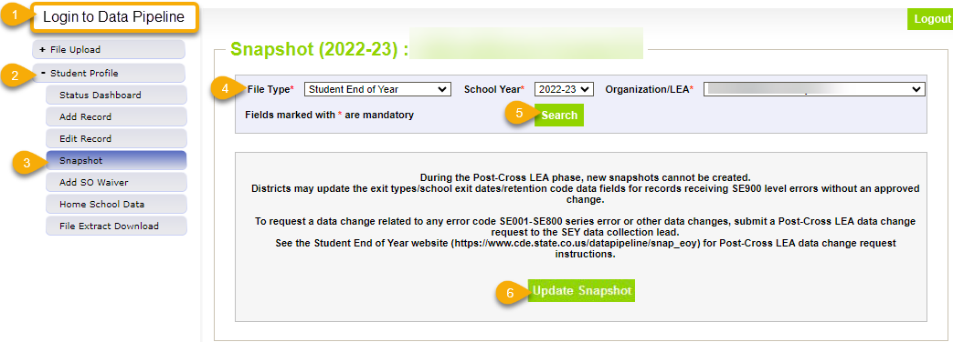
Phase Mechanics
Snapshots are NOT unlocked, only updated
Limited Data Changes
School exit types for SASIDs with SE900 errors
Retention codes for SASIDs with applicable SE900 warnings
Approved post-cross LEA data changes
SSA updates: completed manually through the edit record screen in pipeline
DEM updates: talk to SEY collection lead first
GG & Adj files: continue to use the file upload screen in pipeline
Update Snapshot:
Pulls in exit types to clear SE900 errors
Pulls in retention codes to clear SE906, SE908, SE912, and SE913 warnings
Recognizes approved exceptions for SE900 errors
Recognizes approved exceptions for other rules
Pulls in data changes for approved post-cross changes
Checks SE900 warnings against most recent OCT snapshot
Rechecks all business rules
Rechecks AYG

Slide 9
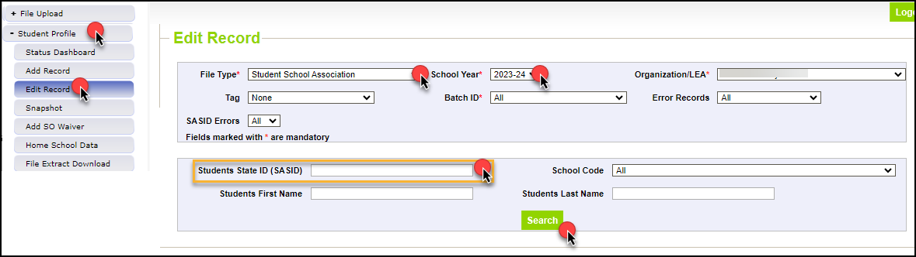
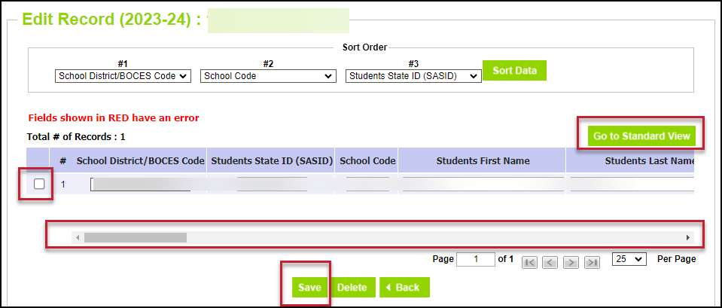
Editing SSA Records in Data Pipeline
Login to Data Pipeline
Select Student Profile
Select Edit Record
Complete drop-down menus
File Type: Student School Association
School Year: 2024-2025
SASID: enter applicable SASID
Select Search
Tips:
Select ‘go to standard view’ to see more data fields
Don’t forget to press the check box at the beginning of the student’s row of data before saving
Use scroll bar at the bottom to scroll across data fields

Slide 10









Exception Requests & Data Change Requests
Data Issue
SE900 error
Data is accurate as reported
Data is incorrect and must be updated
Manually edit school exit type on SSA file
Manually edit SSA data field If need to make DEM updates, contact SEY first
Submit Exception Request Note: SE900 errors require a copy of the student’s adequate documentation to be included as supporting evidence
Supported Correction
Update SEY Snapshot
Independent Change
Submit Post-Cross LEA Data Change Request
Supported Change

Slide 11
Exception Request
Data does not change
Error/warning clears because the business rule has been overridden
Submit completed exception request template to Syncplicity
SE900 exceptions require LEAs to upload a copy of the adequate documentation (confirmation of enrollment & attendance) in addition to the exception request template
Email StudentEndOfYear@cde.state.co.us to notify request has been placed in Syncplicity for review
Exception Request Template and Exception Request Directions are available on the SEY Website

Slide 12
Post-Cross LEA Data Change Request
Unique to Post-Cross LEA phase of SEY Collection
Data is changed, manually edited in pipeline using the edit record tool
School Exit Type
School Exit Date
Retention Code
Other data fields in rare circumstances
Error/warning clears due to corrected data
Email StudentEndOfYear@cde.state.co.us to notify request has been placed in Syncplicity for review
Post-Cross LEA Data Change Request Template and Post-Cross LEA Data Change Request Directions are available on the SEY Website

Slide 13
SASID Merges in Post-Cross Phase
LEA will receive a SE500 error indicating the old and new SASIDs when a SASID merge is required
Rare situations, typically found when researching SE903 errors
Must be handled precisely as directions provided by SEY collection lead dictate due to unique nature of this phase
Post-Cross SASID merge directions posted on SEY Website in the Post-Cross LEA Phase section
General Steps:
Upload a single ‘append’ record to the DEM file for the single impacted SASID
DO NOT delete or alter the original ‘old’ SASID record for this student
DO NOT use the ‘replace’ function, this overwrites your entire DEM file
Manually edit the SSA file to reflect the updated SASID
Correct GG records
Correct source GG file and upload, replace, GG file containing all student records
Submit Post Cross Data Change Request
After receive notification from SEY Collection Lead, update snapshot and use CEDAR/COGNOS report SASID Lookup: SEY and OCT record (prior, current, subsequent year) to verify new SASID has pulled into snapshot

Slide 14
Adding Records in Post-Cross Phase
LEA will receive a SE500 error indicating they may need to add a record for a missing student, or they may determine this through their own data review
Rare situations, typically found when researching SE903 errors
Must be handled precisely as directions provided by SEY collection lead dictate due to unique nature of this phase
Post-Cross adding records directions posted on SEY Website in the Post-Cross LEA Phase section
General Steps:
Upload a single ‘append’ record to the DEM file for the single impacted student
Upload a single ‘append’ record to the SSA file for the single impacted student
Correct GG records
Correct source GG file and upload, replace, GG file containing all student records
Submit Post Cross Data Change Request
After receive notification from SEY Collection Lead, update snapshot and use CEDAR/COGNOS report SASID Lookup: SEY and OCT record (prior, current, subsequent year) to verify new SASID has pulled into snapshot

Slide 15
SE900 Business Rules

Slide 16
General Information
SE900 errors
LEAs can clear these by manually updating the school exit type on their SSA file then updating their snapshot.
These are the only errors that can be addressed independently by LEAs during this phase.
SE900 warnings
Some will clear when subsequent OCT snapshot is created and then SEY snapshot is updated
*New* Independent Change—correct retention codes in response to SE906, SE908, SE912, and SE913 warnings without a post-cross data change request
Any other change to the SEY data is needed, LEAs must request a Post-Cross LEA Data Change
Any SE001-SE700 series errors
LEAs may request a Post-Cross LEA Data Change if they need to update student data to clear this rule.
LEAs may request an exception if the student is accurately coded, and the business rule needs to be ignored for this situation.
October 2025-2026 errors, OC173 or OC185
LEAs should request a Post-Cross LEA Data Change to correct the retention code in 2024-2025 SEY if the student is not receiving a SE908 or SE912 warning

Slide 17
SE901 Error
Sending LEA: Student has school exit type
40 dropped out
50 expelled
70 transfer to HSED prep program
Student reported attending a CO public LEA after leaving sending district (receiving LEA)
Sending LEA: Change to school exit type 13
Impact: If 9th-12th grade, student now belongs to AYG cohort of receiving LEA for graduation/completion rates.

Slide 18
SE902 Error
Sending LEA: Student has school exit type
18 transfer to CTE/Vocational program not run by a CO public school district
19 transfer to facility school/state operated program
21 transfer to CO department of corrections or Division of youth corrections
30 illness/injury
Student reported attending a CO public school district after leaving sending district (receiving LEA)
Sending LEA: Change to school exit type 13
Note: If changing to exit type 13 causes a SE711 error, request an exception to clear the SE711 error.
Impact: If 9th-12th grade, student now belongs to AYG cohort of receiving LEA for graduation/completion rates.

Slide 19
SE903 Error
Sending District: Student has school exit type 13, transfer to CO public school
No other district has claimed the student after they left the sending district
Sending District: Determine which outcome below is true of the student
Outcome 1—Student transferred to a different educational setting.
Update their school exit type accordingly.
Outcome 2—No adequate documentation.
Change to school exit type 40, dropped out.
Outcome 3—Adequate documentation proves student attended another CO public school and student was reported by the receiving district with a different SASID.
Complete SASID Merge request in RITS web system.
Outcome 4—Adequate documentation shows student attended another CO school in 2024-2025 school year, but a SASID merge is not suspected.
Upload copy of adequate documentation to Syncplicity and request an exception to keep student coded with exit type 13
Impact: School exit type will determine if student remains in AYG cohort, is counted as a dropout, or transfers out of AYG cohort for the sending district.
Resources:
2024-2025 List of Colorado School Codes public, non-public, detention, DYS, facility
National – Public School Lookup (out of state)
National – Private School Lookup (out of state)

Slide 20
SE904 Error
Sending LEA: Student has school exit type 26, transfer to CO detention center
No detention center reported the student after they left the sending LEA
Sending LEA: Determine which outcome below is true of the student
Outcome 1—Adequate documentation shows student transferred to a different educational setting.
Update their school exit type accordingly.
Often, student transferred to DYS or facility school instead
Outcome 2—No adequate documentation. Change to school exit type 40, dropped out.
Outcome 3—Adequate documentation proves student attended CO detention center and student was reported by the receiving detention center with a different SASID.
Complete SASID Merge request in RITS web system.
Outcome 4—Adequate documentation shows student attended CO detention center in 2024-2025 school year, but a SASID merge is not suspected.
Upload copy of adequate documentation to Syncplicity and request an exception to keep student coded with exit type 26
Impact: School exit type will determine if student remains in AYG cohort, is counted as a dropout, or transfers out of AYG cohort for the sending LEA.
Resource: 2024-2025 List of Colorado School Codes public, non-public, detention, DYS, facility

Slide 21
SE905 Error
Sending LEA: Student has school exit type 13, transfer to CO public school
No other LEA has claimed the student after they left the sending LEA
Student is on HSED list, indicating they received their HSED in 2024-2025
Sending LEA: Change school exit type to one of the following
93 HSED recipient, program administered by reporting LEA
94 transferred to program not run by the LEA and received HSED
Impact: Student remains in the AYG cohort for sending LEA and is counted as a completer for completion rates.

Slide 22
SE907 Error
Sending LEA: Student has school exit type
40 dropped out
50 expelled
70 transfer to HSED prep program
Student reported attending a CO detention center after leaving sending LEA (receiving LEA/detention center)
Sending LEA: Change to school exit type 26
Impact: If 9th-12th grade, student remains in AYG cohort sending LEA for graduation/completion rates. Student is not counted as a dropout if changing from school exit type 40 to 26.
Resource: 2024-2025 List of Colorado School Codes public, non-public, detention, DYS, facility

Slide 23
SE909, SE910, SE911 Warnings
Designed to highlight specific anticipated year of graduation (AYG) circumstances.
AYG is set as part of the SEY collection
Once set, AYG does not change
AYG has implications for students who wish to participate in postsecondary programs in a future year as it determines if a student is eligible (5th or 6th year students depending on program)
Scenarios:
SE909 – Student’s AYG was reconciled across two or more enrollment records, set based upon the highest reported grade level on or after 10/1 this year.
SE910 – Student in grade K-8 reported as receiving an AYG.
Note: This is only expected in rare circumstances where a grade reassignment has occurred.
SE911 – Grade 10, 11, 12 student with entry type 05 or 14. AYG is set based upon current school year.
Action:
Review student’s enrollment records in CEDAR/COGNOS
SASID Lookup: SEY and OCT record (prior, current, subsequent year) to review grade level within the LEA
SASID Lookup: Cross-LEA to review grade level in another LEA
Contact SEY if you believe reported grade level in your LEA is incorrect, or if you have questions/concerns.

Slide 24
SE906 Warning
12th grade student has retention code in SEY 2024-2025 but does not have a record in the same LEA for October 2025-2026.
SE906 = any retention (grade 12 only)
Possible outcomes and actions:
Outcome 1—Student should not have been marked retained because they completed their education in 2024-2025 and are not returning in 2025-2026.
Scenarios:
Summer graduates/completers
Students who planned to participate in a postsecondary program or SPED transition, then changed plan over the summer and accepted diploma instead.
Action: Remove retention code in SEY 2024-2025 and ensure correct school exit type/date.
Update SEY snapshot for change to take effect
Request post-cross change if it doesn’t go through.
Outcome 2—Student was retained and met requirements to be included in OCT 2025-2026
Action: Update OCT snapshot to include the student, then update SEY to clear warning
Outcome 3—Student was retained but did not meet requirements to be included in OCT 2025-2026 (enrollment record with school exit date prior to 10/01/2025)
Action: Ignore warning.

Slide 25
SE908 and SE912 Warnings
12th grade student has retention code in SEY 2024-2025 but does not have a record in the same LEA for October 2025-2026.
SE908 = retention 2, postsecondary
SE912 = retention 3, SPED transition
Possible outcomes and actions:
Outcome 1—Student should not have been marked retained because they completed their education in 2024-2025 and are not returning in 2025-2026.
Scenario: Students who planned to participate in a postsecondary program or SPED transition, then changed plan over the summer and accepted diploma instead.
Action: Remove retention code in SEY 2024-2025 and ensure correct school exit type/date.
Update SEY snapshot for change to take effect. Request post-cross change if it doesn’t go through.
School exit type + retention code pattern must align with Postsecondary Coding or SPED Transition Coding in SEY Collection Manual
Outcome 2—Student was retained and met requirements to be included in OCT 2025-2026.
Action: Update OCT 2025-2026 snapshot to include the student, then update SEY 2024-2025 to clear warning.
Outcome 3—Student was retained but did not meet requirements to be included in OCT 2025-2026 (enrollment record with school exit date prior to 10/01/2025).
Action: Ignore warning.
SE908 Note: If student is SPED Transition + Postsecondary, follow SPED Transition coding and using retention 3 and ignore SE908 warning

Slide 26
SE913 Warning (NEW)
SEY Grades K-11
Scenario: SEY 2024-2025 grade level and October 2025-2026 are the same but there is no retention code in SEY 2024-2025
Action: Determine appropriate outcome
Outcome 1—Student was retained
Update retention code in SEY 2024-2025 to show Retention Code = 1, then update snapshot
Outcome 2—Student was not retained, OCT 2025-2026 grade level is incorrect
Update grade level in OCT 2025-2026 data, then create SEY 2024-2025 snapshot to clear the warning

Slide 27
Adequate Documentation Reminders
Adequate documentation is the documentation maintained by districts/schools when students transfer out of their district
Documentation necessary to avoid incorrectly coding students as dropouts.
Documentation supports selecting the appropriate exit type for ‘verified transfers out’ of your AYG graduation cohort
Requirements are further outlined in state rule, as seen here: 1 CCR 301-1 Rules for the Administration of the Accreditation of School Districts
Colorado Public Schools and local education agencies are required to send transcripts or to confirm attendance when requested from another Colorado Public School or local education agency within two weeks of receiving the request with the exception of students in out of-home placements whose records must be transferred within five (5) days pursuant to sections 22-32-138(2)(a)(II) and (3)(a), C.R.S
More information and sample forms available on SEY Adequate Documentation site
Notes:
When a student withdraws, districts are authorized to request information from the parent or guardian about the specific type of educational enviornment that a student is transferring to in order to monitor compliance with the School Attendance Law. [section 22-33-104 (1), C.R.S.]

Slide 28
Final Dates

Slide 29
Final Report Review 11/21/2025 to 11/25/2025 (noon)
CDE
Completes a final review of rates
Will reach out to a LEA if a change is needed for a specific student
LEAs
Contact SEY if have any questions regarding your data
If receive from SEY Lead notification a change is required, respond promptly

Slide 30
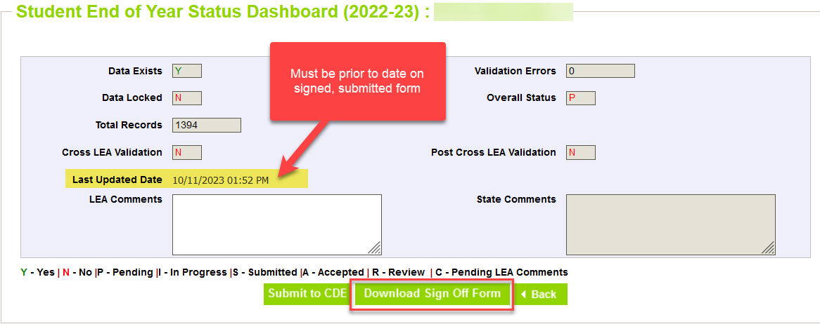
Superintendent Verification (Sign-Off)
Downloaded from data pipeline ‘Status Dashboard’ screen by LEA Approver
Must be error free
Must have updated snapshot at least once during Post-Cross Phase
Cannot have a snapshot update in process
Signed by Superintendent
Certifies SEY and Graduation Guidelines data is accurate and complete
Acknowledgment that this data is used in district/school accountability frameworks
Dated after the last updated date of your SEY snapshot as shown on the SEY status dashboard
New sign-off form required if snapshot updated after it has been signed
Scan and email to SEY Collection lead, StudentEndOfYear@cde.state.co.us OR upload to your LEA’s student Syncplicity folder and notify SEY Collection inbox
Begin submitting 11/12/2025
*will not be accepted early*
Due 12/2/2025

Slide 31
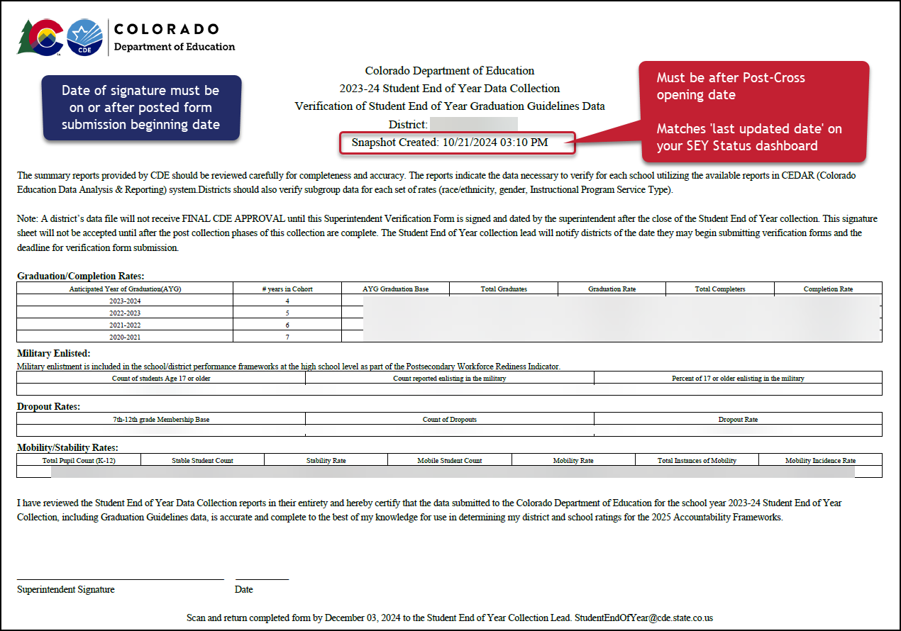
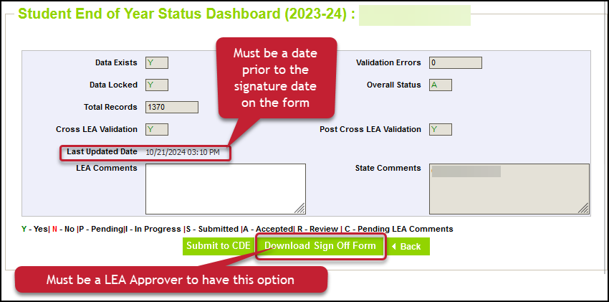
Checklist before submitting Superintendent Verification
Checklist before submitting form:
Snapshot Updated at least once (10/24/25 date or later)
Error Free
All additional changes addressed
Data Validated
Form contains rates for all categories
Signature date after the ‘last updated date’ on your status dashboard
Snapshot created date on top of form matches last updated date on status dashboard
Signature Date 11/12/25 or later
Email completed forms to StudentEndOfYear@cde.state.co.us
Or upload to Syncplicity and notify StudentEndOfYear@cde.state.co.us

Slide 32
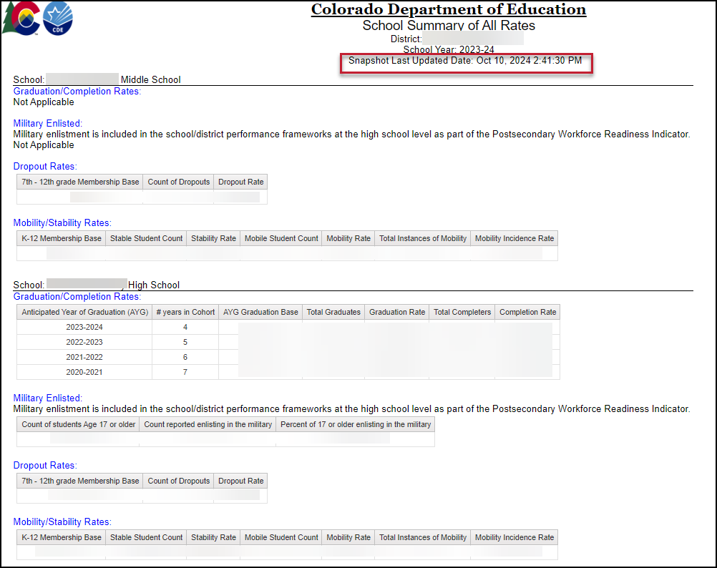
CEDAR/COGNOS Report Highlight: School Summary of All Rates
District level and School Level
Mirrors sign-off form as a high-level overview of rates
Only includes ‘all students’, not student groups
Displays ‘not applicable’ message under that rate heading when a school does not include the grade range required for a specific type of rate
Shows the last updated date of the SEY snapshot

Slide 33
SEY Public Data Release Scheduled Date – January 14, 2026
Education statistics based upon the 2024-2025 SEY data are embargoed until the public data release in January 2026
District data available through COGNOS/CEDAR reports
Districts receive a preview of the state-wide data a few days prior to the public data release
Sent to SEY Data Respondents from the SEY Collection Lead
SEY Data Respondents should share with applicable administrative staff within their district (i.e. superintendent, accountability contact, etc.)
CDE sends out a press release and notifications through their communication department when this data is publicly released
SEY Data Collection lead will send an email to data respondents when the embargo has lifted and data has been publicly released as well
Mobility/Stability Rates & Statistics
Annual calculation
Reflect students in grades K-12
Dropout Rates & Statistics
Annual calculation
Reflect students in grades 7-12
Annual Instructional Program Service Type (IPST) status
Graduation/Completion Rates & Statistics
Cohort based calculation
Reflect students in given Anticipated Year of Graduation (AYG) cohort
IPST cohort based upon qualifying IPST status at some point during 9-12th grade

Slide 34
SEY Privacy Guidelines: District & School Level Data
Privacy Methods: blurring of cohort/membership base sizes with small populations (all students & subgroups), top & bottom masking of rates, and limited suppression
Using a mix of methods ensures student data is protected while providing transparent information regarding rates
Graduation/Completion and Mobility/Stability use the same rules
Dropout has the same methods, but different membership base size groups and top/bottom masking
More Information: Graduation, Dropout Mobility Rates – Aggregate Data Privacy Guidelines Site
AYG Cohort/ Membership Base Size | Student Group Notes | Top/Bottom Masking
Graduation/Mobility: When 51 or greater, reflect specific size Dropout: 201 or greater | Subgroups with a size of 0-50 (0-200) students shown as “50 or less” (200 or less) Subgroups with a size of 51 (201) or greater are shown as the specific size when doing so does not directly disclose a complementary subgroup size of 50 or less. (200 or less) If a subgroup of 50 (200) or less would be disclosed, the complementary larger subgroup will be shown as “51 or greater” (201 or greater) | Graduation/Mobility: ≥ 98% and ≤ 2% Dropout: ≥ 99.5% and ≤ 0.5%
Graduation/Mobility: 16-50 Dropout: 16-200 | All subgroup cohorts shown as “50 or less” (200 or less) | Graduation/Mobility: ≥ 98% and ≤ 2% Dropout: ≥ 99.5% and ≤ 0.5%
15 or less | All subgroup cohorts shown as (-) | ≥ 90% and ≤ 10%
N/A (0 students) | All subgroups shown as “N/A” | All rates shown as “N/A”

Slide 35
Questions?

