Slide 1
Student End of Year Office Hours
November 2023

Slide 2
Agenda
Timeline Review
Post Cross Phase: Exceptions & Post-Cross Data Changes
AYG Overview & Assignment Logic
SE186 errors
Superintendent Verification
January Data Release
SEY Privacy Guidelines

Slide 3
Timeline Review: What should I be working on at this point in the collection?
Date | Event
11/16/2023 | Deadline: Post-Cross Phase ends, error free snapshot, all updates completed
11/27/2023 | Final Review of graduation and dropout rates after the AYG reconciliation - Any changes will require a new Superintendent Verification (sign-off) form
11/30/2023 | Deadline: Superintendent Verification (Sign-Off) form due (collection closes)
01/09/2024 | Official/final data and rates posted on the CDE website and released to the public.
Address any remaining errors
Address any district specific issues (directly emailed to you by SEY collection lead)
Final data validation
Graduation/completion, dropout, mobility/stability rates
Retention codes in SEY compared to enrollment records in 2023-2024

Slide 4
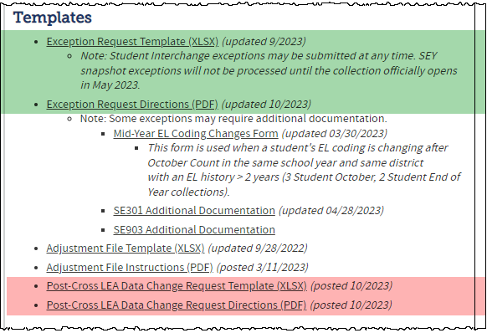
Exception Requests & Data Change Requests
Post-Cross Error or Data issue
Submit a Post-Cross LEA Data Change Request
SEY Data is Accurate as Reported
Submit an Exception Request
SEY Data Incorrect and must be updated

Slide 5
Anticipated Year of Graduation (AYG)
Assigned in the school year a student is first reported as entering high school in Colorado through the Student End of Year collection (grades 9-12)
AYG is automatically assigned during the SEY collection process
Once assigned, AYG does not change
Based upon the student’s highest grade level as of October 1st
If reported in multiple districts, will base AYG on the highest grade level as of 10/1
EXAMPLE:
District A reports 10th grade with an exit date on/after October 1st
District B reports 9th grade with an exit date on/after October 1st
Student’s AYG will be calculated based on the 10th grade record in District A
Post-Cross Phase includes mechanics to reconcile AYG across districts
The following data fields are all set in the year that a student’s AYG is assigned
Starting Year for Graduation Cohort
Starting Grade for Graduation Cohort
Starting District for Graduation Cohort
Anticipated Year of Graduation
Grade Level | AYG Calculation | Example (Current Year 2022-2023)
9th | Current Year + 3 | AYG 2026
10th | Current Year + 2 | AYG 2025
11th | Current Year + 1 | AYG 2024
12th | Current Year | AYG 2023
Notes:
Verified Transfer Out: School Exit Types 02, 05, 13, 14, 15, 16
Exit Types that Comprise the AYG Cohort: 00, 01, 40, 12, 26, 18, 19, 21, 30, 50, 70, 90, 92, 93, 94, 95, 96

Slide 6
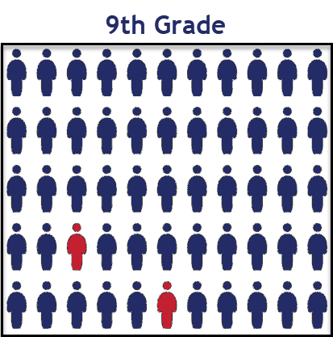
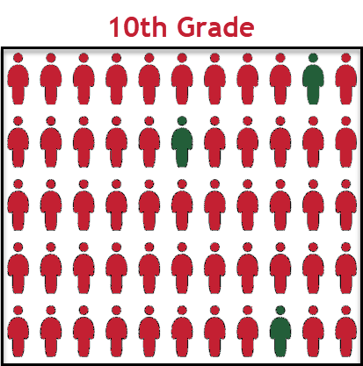
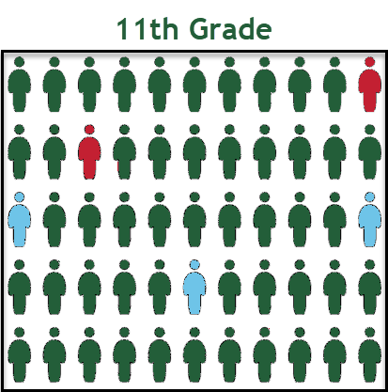
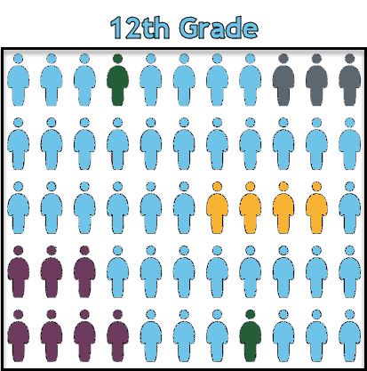
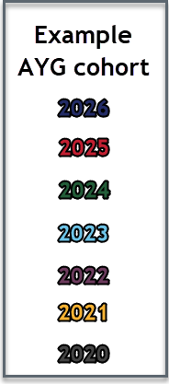
AYG represented in a High School Population
Once a student is assigned an AYG, that AYG remains constant.
Students who experience grade reassignments (acceleration or retention) remain in their original AYG cohort.

Slide 7
SE186 Errors
Student in grade PK-8 has been reported as receiving an Anticipated Year of Graduation (AYG). Required Action: Contact the RITS SASID Consultant to confirm that the student does not have a duplicate SASID. If the SASID is accurate and the student's grade level is accurately reported, request an exception from the SEY Collection Lead.
Business rule updated in 2022-2023 from PK-5 to PK-8
Triggering for students in Post-Cross phase because of AYG reconciliation process
Known grade reassignment (8th skipped to 9th) – request exception
CEDAR/COGNOS report EOY Cross LEA Student Lookup by SASID
Believe SASID used in error by another district – call SEY Collection Lead 720-484-9057
Other reason believe AYG assignment is incorrect – call SEY Collection Lead 720-484-9057

Slide 8
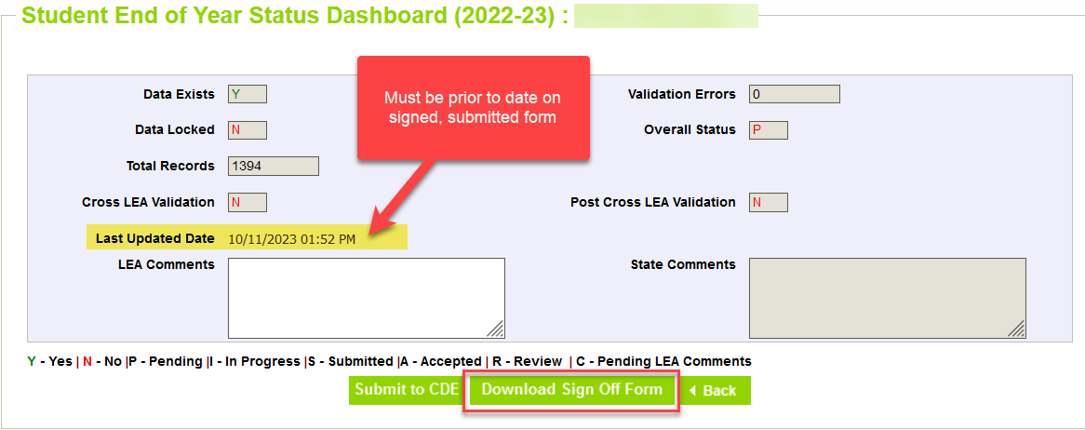
Superintendent Verification Form
Checklist before submitting form:
Snapshot Updated at least once (10/20/23 date or later)
Error Free
All additional changes addressed
Data Validated
Form contains rates for all categories
Signature date after the ‘last updated date’ on your status dashboard
Snapshot created date on top of form matches last updated date on status dashboard
Signature Date 11/09/2023 or later
Email completed forms to StudentEndOfYear@cde.state.co.us

Slide 9
SEY Public Data Release Scheduled Date – January 9, 2024
Education statistics based upon the 2022-2023 SEY data are embargoed until the public data release in January 2024
District data available through COGNOS/CEDAR reports
Districts receive a preview of the state-wide data a few days prior to the public data release
Sent to SEY Data Respondents from the SEY Collection Lead
SEY Data Respondents should share with applicable administrative staff within their district (i.e. superintendent, accountability contact, etc.)
CDE sends out a press release and notifications through their communication department when this data is publicly released
SEY Data Collection lead will send an email to data respondents when the embargo has lifted and data has been publicly released as well
Mobility/Stability Rates & Statistics
Annual calculation
Reflect students in grades K-12
Dropout Rates & Statistics
Annual calculation
Reflect students in grades 7-12
Annual Instructional Program Service Type (IPST) status
Graduation/Completion Rates & Statistics
Cohort based calculation
Reflect students in given Anticipated Year of Graduation (AYG) cohort
IPST cohort based upon qualifying IPST status at some point during 9-12th grade

Slide 10
SEY Privacy Guidelines: District & School Level Data
New
What: SEY Privacy Guidelines updated in preparation for upcoming data release
When: 2022-2023 Public Data Release
Why: Better protect student data privacy in aggregate public data in alignment with FERPA & Colorado’s Student Data Transparency & Security Act
Impact:
Yes: CDE’s publicly posted data based upon the SEY collection such as the Education Statistics Webpages
No: Individual district CEDAR/COGNOS reports available to SEY Data Respondents
Privacy Methods: blurring of cohort/membership base sizes with small populations (all students & subgroups), top & bottom masking of rates, and limited suppression
Using a mix of methods ensures student data is protected while providing transparent information regarding rates
Communication: This month’s CDE communications ‘CDE Update’ and ‘The Scoop’ include information about these updated guidelines for all subscribed individuals (Superintendents, district administrators, etc.)
More Information: Graduation, Dropout Mobility Rates – Aggregate Data Privacy Guidelines Site

Slide 11
Privacy Methods
Graduation/Completion
Mobility/Stability
AYG Cohort (all students) K-12 Membership Base (all students) | Subgroup Cohort Subgroup Membership Base | Top/Bottom Masking
When 51 or greater, reflect specific size | Subgroups with a size of 0-50 students shown as “50 or less” Subgroups with a size of 51 or greater are shown as the specific size when doing so does not directly disclose a complementary subgroup size of 50 or less. If a subgroup of 50 or less would be disclosed, the complementary larger subgroup will be shown as “51 or greater” | ≥ 98% ≤ 2%
16-50 | All subgroup cohorts shown as “50 or less” | ≥ 98% ≤ 2%
15 or less | All subgroup cohorts shown as (-) | ≥ 90% ≤ 10%
N/A (0 students) | All subgroups shown as “N/A” | All rates shown as “N/A”
Dropout
7-12 Membership Base (all students) | Subgroup Cohort | Top/Bottom Masking
When 201 or greater, reflect specific size | Subgroups with a size of 0-200 students shown as “200 or less” Subgroups with a size of 201 or greater are shown as the specific size when doing so does not directly disclose a complementary subgroup size of 200 or less. If a subgroup of 200 or less would be disclosed, the complementary larger subgroup will be shown as “201 or greater” | ≥ 99.5% ≤ 0.5%
16-200 | All subgroup cohorts shown as “200 or less” | ≥ 99.5% ≤ 0.5%
15 or less | All subgroup cohorts shown as (-) | ≥ 90% ≤ 10%
N/A (0 students) | All subgroups shown as “N/A” | All rates shown as “N/A”
More Information & 2021-2022 datasets with updated guidelines applied: Graduation, Dropout Mobility Rates – Aggregate Data Privacy Guidelines Site

Slide 12
Privacy Guidelines: Graduation Example
Old Method (2021-2022 and prior)
School | All Students: AYG Cohort | All Students: Graduate Count | All Students: Graduation Rate | Subgroup A: AYG Cohort | Subgroup A: Graduate Count | Subgroup A: Graduation Rate
School A | 0 | 0 | 0.0% | 0 | 0 | 0.0%
School B | 12 | 11 | 91.7% | 5 | 4 | 80.0%
School C | 50 | 48 | 96.0% | 31 | 31 | 100.0%
School D | 85 | 82 | 96.5% | 21 | 20 | 95.2%
School E | 433 | 415 | 95.8% | 351 | 334 | 95.2%
School F | 99 | 98 | 99.0% | 55 | 55 | 100.0%
New Guidelines
2022-2023 forward
School | All Students: AYG Cohort | All Students: Graduation Rate | Subgroup A: AYG Cohort | Subgroup A: Graduation Rate | Subgroup B: AYG Cohort | Subgroup B: Graduation Rate
School A | N/A | N/A | N/A | N/A | N/A | N/A
School B | 15 or less | ≥ 90% | (-) | (-) | (-) | (-)
School C | 16-50 | 96.0% | 50 or less | ≥ 98.0% | 50 or less | 85.0%
School D | 85 | 96.5% | 50 or less | 95.2% | 50 or less | ≥ 98.0%
School E | 433 | 95.8% | 351 | 95.2% | 50 or less | ≤ 2%
School F | 99 | ≥ 98.0% | 51 or greater | ≥ 98.0% | 50 or less | 97.7%

Slide 13
Q&A

