Slide 1
Teacher Student Data Link (TSDL)
Annette Severson

Slide 2
Agenda
Data Uses/Reports
Pipeline Review
Getting Started – What is Required
Timeline
Resources
Interchange Steps and Edit Review
Snapshot Process and Reports

Slide 3
Data Uses: Reporting and Analysis
Public District Course Directory (public)
Interact tool allows users to view and identify courses a district offers
Released to the public on Nov 1, 2017
Report uses state course code data
http://www2.cde.state.co.us/schoolview/coursedirectory/districtcoursedirectorydata.asp
Educator Preparation Performance Report (development):
Review of teacher preparation programs pursuant to 23-1-121
Report will use TSDL (both course enrollment and course instructor) and state course code

Slide 4
Data Reporting – CRDC on behalf of districts
Since 1968, the U.S. Department of Education (ED) has conducted the Civil Rights Data Collection (CRDC) to collect data on key education and civil rights issues in our nation's public schools
Previously, all data was reported directly from the LEA to ED. Starting for the 2013-14 collection, CDE pre-populates data if possible based on data reported from LEAs to CDE
Collection is completed every other year
TSDL data elements provide 23% of all data elements CDE pre-populates for LEAs

Slide 5
Authority To Collect
Derived from both Colorado Revised Statutes (C.R.S) and the Colorado State Board of Education’s rules:
Concerning Statutory Changes to K-12 Education, House Bill 13-12-19: 22-2-116.5
Course Participation and Student Proficiency Reports, House Bill 14-1376: 22-11-503.5
Monitoring of Written Evaluation System, C.R.S. 22-9-106 (1.5) (a-b)
Rules for administration of a statewide system to evaluate the effectiveness of licensed personnel employed by school districts and boards of cooperative services 1 CCR 301-87(6.04) (i), (A), (C) (2) (b, d, and e), and (C) (3) (a).
Commissioner Duties - reviewing the content of educator preparation programs in Colorado, C.R.S. 22-2-112 (p-q)

Slide 6
Pipeline Review

Slide 7
Glossary of Terms
Term | Definition
Cognos | A type of report in which the user can view applicable reports that are formatted in a user friendly environment
Data Pipeline | A streamlined approach to efficiently move required education information from school districts to the CDE
Interchange | The method of providing data to CDE in which LEA’s may choose from multiple file formats to submit data transactions throughout the year.
LAM | Local Access Manager responsible for assigning the appropriate access to CDE applications
LEA | Local Education Agencies
IdM | Identity Management. A single sign on system, allowing the user to navigate between the applications without entering user ID information a second time.
Snapshot | A date in time when data is pulled from the appropriate interchanges, validated by additional business rules, and approval given that signifies it was accurately reported for a specific point in time by an LEA

Slide 8
Training Opportunities
Town Hall occurs every Thursday from 9 to 10 am
Monthly webinars scheduled to review and discuss the Teacher Student Data Link Interchange and Snapshot:
Every 2nd Tuesday of the month from 1 to 2pm
To join webinar:
https://cdeinfotech.adobeconnect.com/data_services/
Call in number: 1-855-397-4421
Reminders will be sent via email

Slide 9
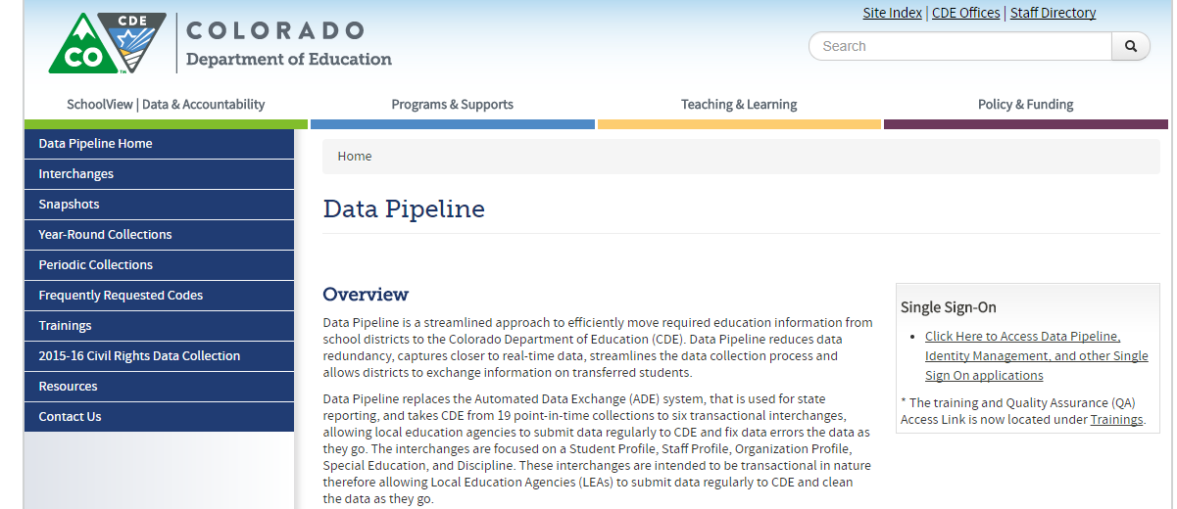
Website Overview
https://www.cde.state.co.us/datapipeline
For Teacher Student Data Link Interchange Information
To Log In Pipeline System:
click here
For Teacher Student Data Link Snapshot Information
Codes – frequently used codes are found here (district codes, school codes, institutes of higher education, etc.)
Collection dates, Mandatory Collections- legislation and uses, converting csv files to excel, etc.

Slide 10
Website Overview - Interchanges
Teacher Student Data Link
Deadlines
File Layouts and Field Definitions with Codes
Training
Templates
Business Rules
Additional Resources

Slide 11
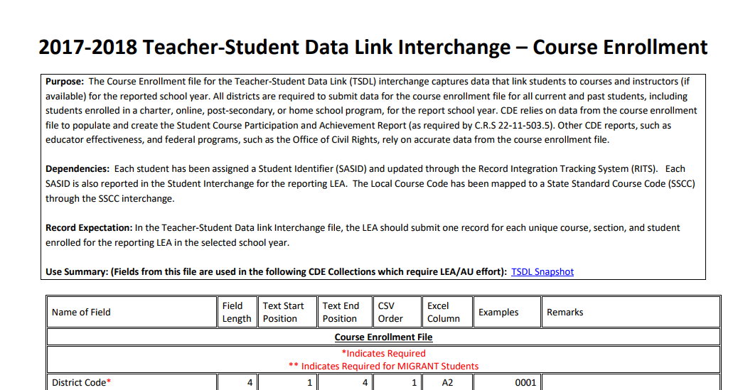
Screenshot of Course Enrollment File Layout
Definitions - Every Field Name included in the File Layout will have a corresponding “Definition” listed under the file layout table
We also include any changes in the document at the bottom of it.

Slide 12
Website Overview – Interchanges (cont.)
Standard Course Codes (SSCC)
Deadlines
File Layouts and Field Definitions with Codes
Training
Templates
Business Rules
Additional Resources

Slide 13
Website Overview – Snapshots
Teacher Student Data Link
Information for 2017-2018 will be updated in December

Slide 14
Getting Started – What is Required?

Slide 15
Identity Management Roles
Teacher Student Data Link Interchange Roles:
TSL~ LEAUSER – upload and modify TSDL interchange files OR
TSL~LEAVIEWER – view (only) TSDL interchange data
Teacher Student Data Link Snapshot Roles:
TLS~LEAAPPROVER – Approves, creates, views Snapshot OR
TLS~LEAUSER - creates, views Snapshot OR
TLS~LEAVIEWER- views snapshot

Slide 16
Course Codes
ALL Local Course Codes must be mapped to a State Standard Course Code
Use the SSCC (State Standard Course Code) system to map your local course codes
https://www.cde.state.co.us/datapipeline/sscc-details
Available now for update
Option available to roll over courses from 2016-17 to 2017-18
Even if you use the Standard Course Codes as your Local Course Code- they need to be mapped within the system

Slide 17
Required K-12 Courses
Mathematics
Science
Social Studies
English Language Arts
All other courses may be included but are not required to be reported

Slide 18
Creating Files
Pull data files from SIS Extract
Create Course Enrollment File and Create Course Instructor File
File Layouts found online at: https://www.cde.state.co.us/datapipeline/inter_teacherstudent
File Requirements:
Excel, CSV or Text File all accepted
Need 2 separate files
1st record of data must be field names/titles

Slide 19
Tips on Files
Excel, CSV, or Text formats are accepted
Simple Excel template for Course Enrollment and Course Instructor Files posted online https://www.cde.state.co.us/datapipeline/inter_teacherstudent under Templates (however, it is not necessary to use a template if your file already extracts in one of the accepted formats)
No spaces in file name
No blank fields
Be sure the file is not open when uploading
Be sure you haven’t lost all your leading zeros on a CSV file or it won’t upload (steps for saving them posted online)

Slide 20
Interchange Files
Course Enrollment
All students enrolled in a required course (mathematics, science, social studies, and English language arts) for at least 4 consecutive weeks
Each record must be unique based on: school code, local course code, section number, SASID , student's grade level and term
Course Instructor
All teachers teaching the required courses reported in the course enrollment file for at least 4 consecutive weeks
Each record must be unique based on: school code, local course code, section number, EDID and term

Slide 21
TSDL Fields
Course Enrollment File
Course Instructor File
Name of Field
School District/BOCES Code
School Code
Local Course Code
Section Number
SASID
Student's Last Name
Student's First Name
Student's Gender
Student's Date of Birth
Roster Start Date
Roster End Date
Student’s Grade Level
Term
Credits Granted
Final Grade/Course Completion Status
Name of Field
School District/BOCES Code
School Code
Local Course Code
Section Number
EDID
Staff's Last Name
Staff's First Name
Staff's Gender
Staff's Date of Birth
Term
Staff Role
Used to link records in the TSDL Snapshot

Slide 22
Interchange Process
Upload files in Data File Upload
Review Batch Maintenance
Review Error Reports in Cognos/Pipeline
Correct Data Files in Source System
Create/Update Data Files
- Continue until all errors are resolved

Slide 23
Timeline

Slide 24
TSDL Interchange Timeline
Prior to TSDL files:
Statewide Standard Course Code Submission
Open year round
Student Interchange Files uploaded
Staff Interchange Files uploaded
Interchange:
Open Wednesday, November 15th 2017
Remains open throughout the year

Slide 25
TSDL Snapshot Timeline
Date | Event
Wednesday, Nov 15th 2017 | Interchange open
Wednesday, Jan 17th 2018 | Snapshot open
Friday, June 1st 2018 | Target: All districts create a TSDL snapshot
Friday, June 15th 2018 | Target: TSDL Interchange files error free
Friday, June 22nd 2018 | Target: TSDL Snapshot error free
Friday, June 29th 2018 | Soft Deadline: Recommended date to finalize the TSDL snapshot. After this date, many school systems roll over to the next school year.
Friday, August 31st 2018 | Deadline: Snapshot must be finalized

Slide 26
Webinar Trainings
Date/Time | Topic
Tuesday, November 14th 1 -2 pm | Getting Started – What is Required?
Tuesday, December 12th 1 -2 pm | TSDL Interchange Updates and Process
Tuesday, January 9th 1 -2 pm | TSDL Interchange Edits Guide
Tuesday, February 13th 1 -2 pm | TSDL Snapshot Data Reports
Tuesday, March 13th 1 -2 pm | Overall Process Review (Interchange and Snapshot)
Tuesday, April 10th 1 -2 pm | TSDL Snapshot Process
Tuesday, May 8th 1 -2 pm | TSDL Snapshot Edits and Reports
Tuesday, June 12th 1 -2 pm | Reports Review & Finalizing Steps
Tuesday, July 10th 1 -2 pm | Status Check – Final Steps
Tuesday, August 14th 1 -2 pm | Final Review

Slide 27
Interchange Steps

Slide 28
Identity Management Roles
Teacher Student Data Link Interchange Roles:
TSL~ LEAUSER – upload and modify TSDL interchange files OR
TSL~LEAVIEWER – view (only) TSDL interchange data
Teacher Student Data Link Snapshot Roles:
TLS~LEAAPPROVER – Approves, creates, views Snapshot OR
TLS~LEAUSER - creates, views Snapshot OR
TLS~LEAVIEWER- views snapshot

Slide 29
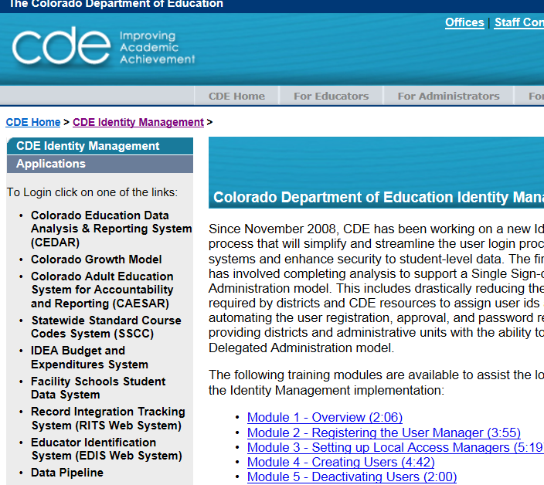
Pre-Step: Getting to Data Pipeline
https://cdeapps.cde.state.co.us/index.html

Slide 30
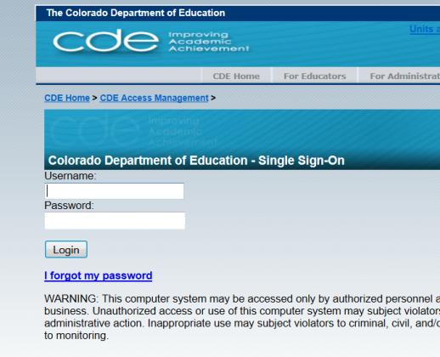
#1: Logging into Data Pipeline
Username = Email Address
Password – you created it
If forgotten password, use ‘I forgot my password’

Slide 31
Uploading Interchange Files
Format Checker - Ensures file layout is correct
Data File Upload - Upload data file
Batch Maintenance - Check Status
Pipeline Error Reports - Provides errors
Correct File

Slide 32
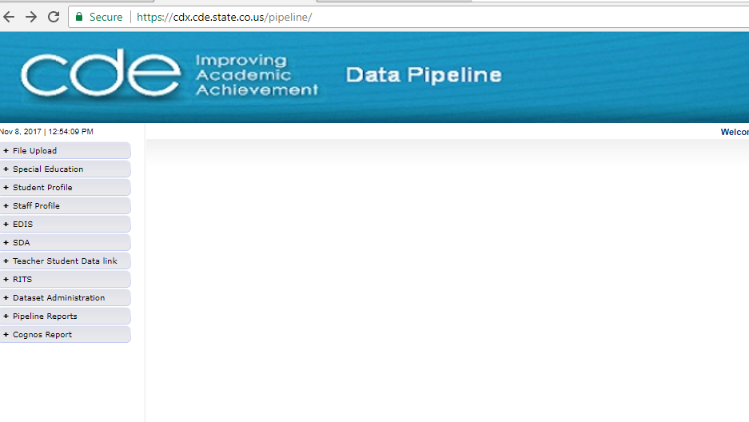
Pipeline Website Review
Batch Maintenance, Format Checker and Data File Upload
Based on your Identity Management Roles
Error reports and other validation reports

Slide 33
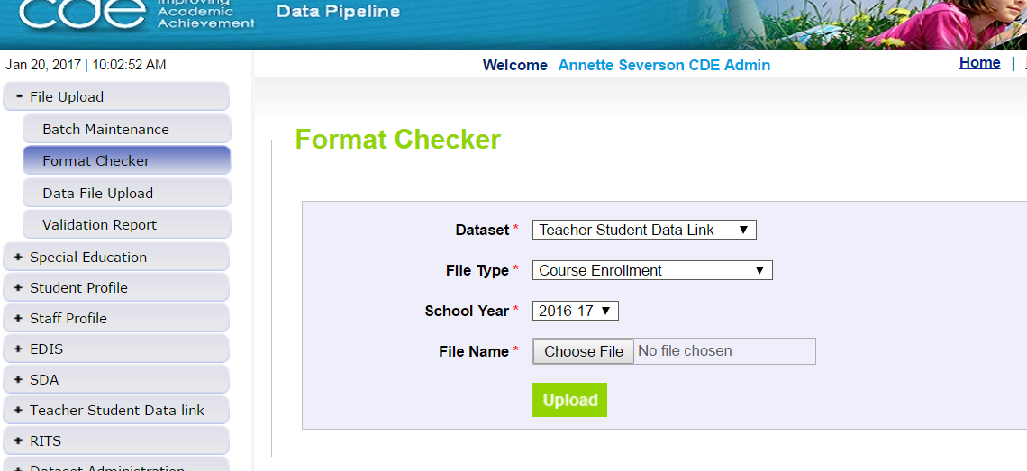
File Upload – Format Checker
Course Enrollment or Course Instructor

Slide 34
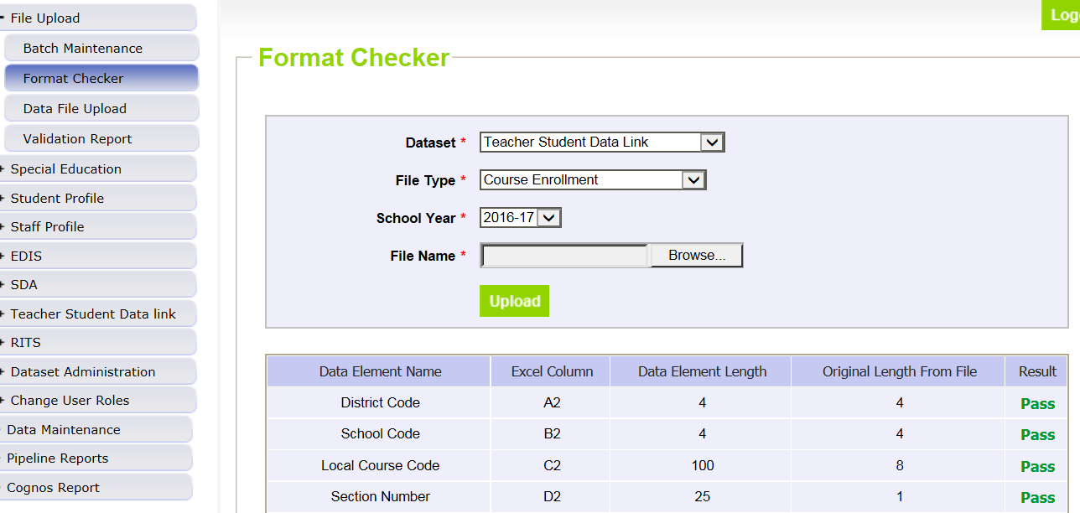
Format Checker – Upload Results

Slide 35
Format Checker Notes
Format Checker will only review the 2nd row in your file
Passing format checker Does Not Equal file will process
Green ‘Pass’ for each field is desired result
Red ‘Fail’ for a field indicates file is not in the correct format- please refer to the 2017-2018 file layout on web

Slide 36
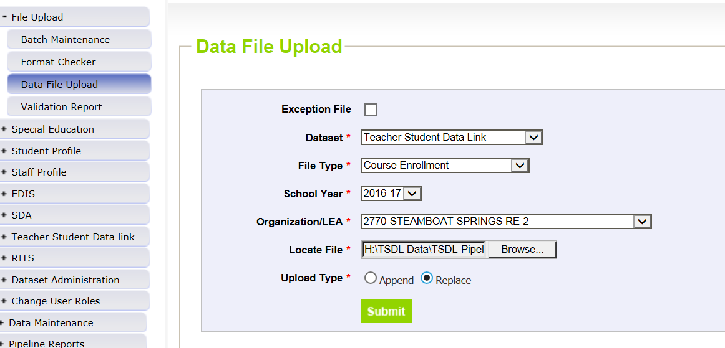
Data File Upload

Slide 37
Data File Upload Types
Append = adds file to existing file, all records from both files included
Can be tricky with fixing errors
Replace = deletes any prior data file and replaces it with the file being uploaded
RECOMMENDED

Slide 38
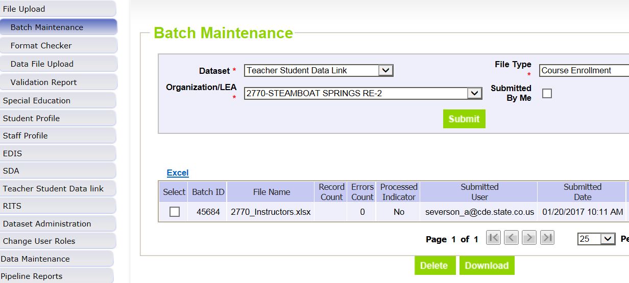
Batch Maintenance Screen – Not Processed

Slide 39
File Not Processed – Next Steps
Ensure file has all green ‘pass’ in format checker
YES?
Open file and review all records are formatted the same as the 2nd row
Be sure all codes and dates have leading zeros included
NO?
Review file layout posted online and re-format the file
For further assistance, contact Annette Severson
DO NOT INCLUDE THE FILE IN ANY EMAILS

Slide 40
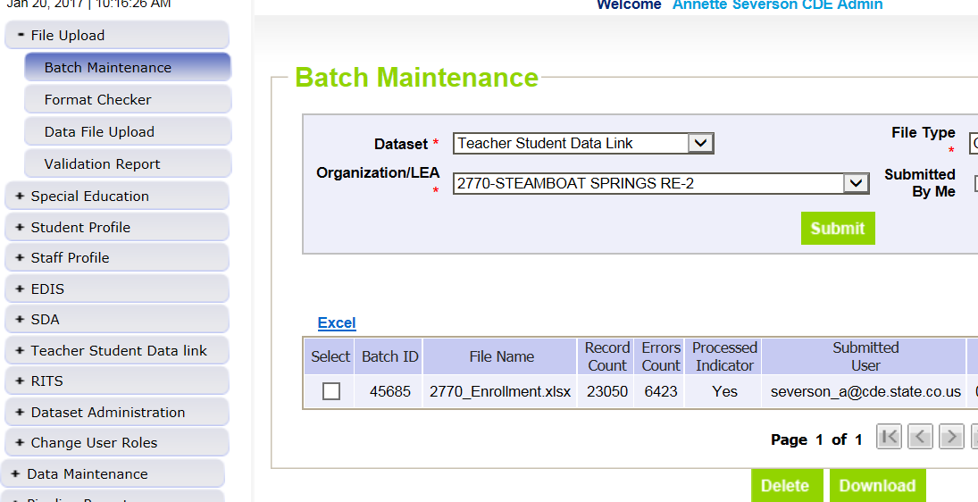
Batch Maintenance – File Processed

Slide 41
File Processed – Next Steps
Use same screen to see the Number of Errors:

Slide 42
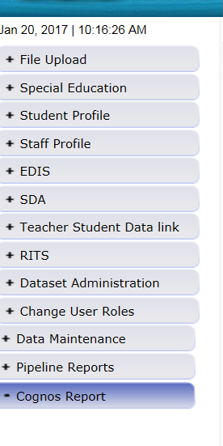
Review Errors in Detail
2 methods available:
Data Pipeline Reports -> Error Reports
Cognos Reports – > Teacher Student Data Link

Slide 43
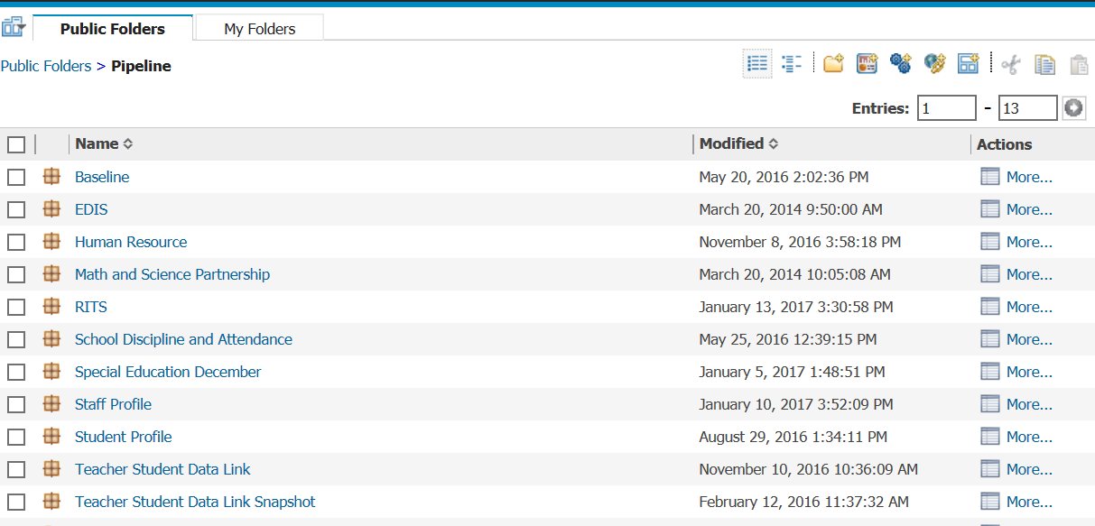
Clicking on Cognos Reports- Opens in a new Screen
These dates are to be ignored

Slide 44
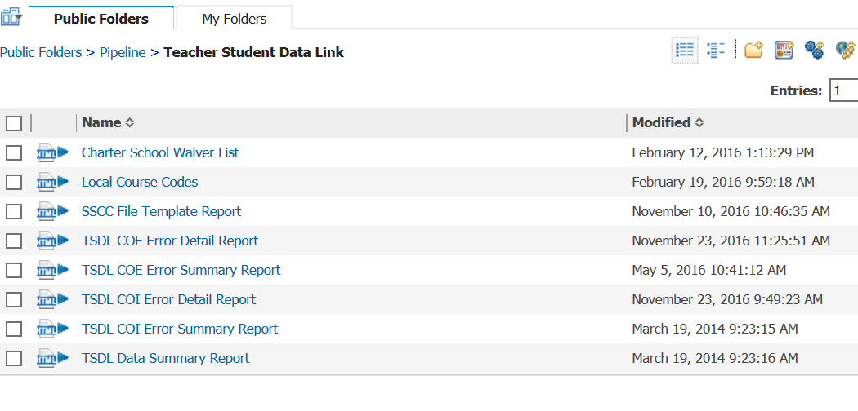
TSDL Interchange Errors
Detail Reports – provides detailed records with descriptions of error
Summary Reports – provides a count of records by type of error
*Do Not Send Error reports via email to CDE for assistance

Slide 45
Error Reports
Error Detail Report
Provides specific records causing the error with the error description
Can select to View ALL error records or 1 type of error at a time
Error Summary Report
Provides a count of errors generated per error type and description
Resubmit either file as needed for corrections for all data errors to be resolved
Be sure to update source file with corrections as well

Slide 46
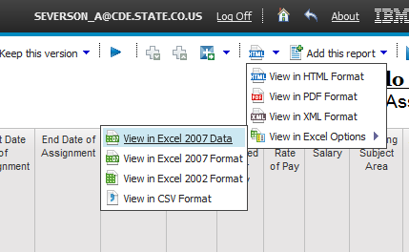
Error Detail Report- Excel

Slide 47
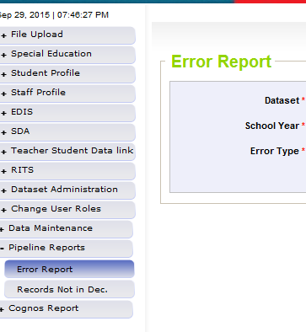
Pipeline Reports
Search:
Dataset = Teacher Student Data Link
School Year = 2016-2017
Error type = Errors and Warnings
File Type: Course Enrollment or Course Instructor
Org/LEA = Code
Click ‘Search’

Slide 48
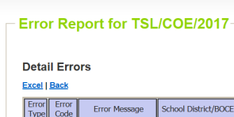
Pipeline Error Reports – Viewing Details
Summary of Errors in File are next provide
Click on ‘View Details’ to view each record with the error
Choose ‘Excel’ to download error report in Excel – recommended

Slide 49
Correcting Errors
Correct the errors in the file:
May have to fix errors in both Course Enrollment and Course Instructor files
Keep file versions – in case updated file causes even more errors, you can re-start using a prior file version
CDE does not maintain these versions, once the file has been replaced, all prior data files have been deleted in pipeline
Resubmit your data records using the same process and replacing your existing data file using the Data File Upload tool
All errors must be corrected, all warnings should be reviewed

Slide 50
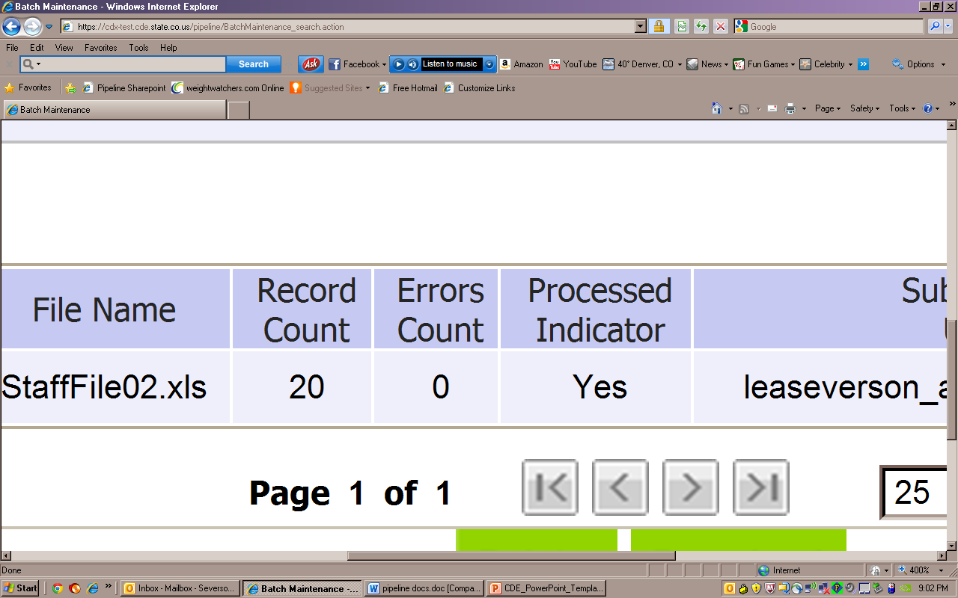
Batch Maintenance: No Errors

Slide 51
Next Steps – TSDL Snapshot
Course Enrollment File= Processed and Zero Error Count
Course Instructor File = Processed and Zero Error Count
Create TSDL Snapshot (opens in January)

Slide 52
Interchange Edits Review – Course Enrollment File

Slide 53
Must be Valid Codes
District code
School Code
Section Number
Term
Final Grade/Course Completion Status

Slide 54
Local Course Code
Local Course Code must be mapped for 2017-18 in the State Standard Course Code System (SSCC)
Local Course Code must match EXACTLY with Local Course Code mapped within SSCC
Leading zeros often cause issues
Additional codes before or after local course codes can also cause issues

Slide 55
SASID/Student Demographic Information
Students’ Last Name, First Name, Date of Birth and Gender must match with SASID record (present information or historical)
Student Last Name cannot be blank
Student First Name cannot be blank
Student Gender must be valid code:
01 for Female
02 for Male
Student’s Date of Birth must be valid date and formatted as MMDDYYYY

Slide 56
Roster Dates
Roster Start Date and Roster End Data must be formatted as MMDDYYYY or be blank
For the record to be included in CRDC data pre-population, these dates must be reported
Roster End Date must be AFTER Roster Start Date

Slide 57
Grade Level
Must be a valid code
Must be within the grade range for the school code reported in record
Grade of the course- not necessarily the student
If an 8th grade student is taking a 9th grade course, it would be reported as 9th grade for that course

Slide 58
Credits Granted
Credits Granted is required for Migrant Students and must be between 0.0 and 9.0
Credits Granted must either be blank or between 0.0 and 9.0 for all other students
NOTE: Migrant student status is based on information from the Migrant Office at CDE
List can be found in Cognos Report -> Teacher Student Data Link -> Migrant Student List

Slide 59
Final Grade/Course Completion Status
Required and cannot be blank or reported as ‘0’
Choose which codes best fit terminology used within school/district
Use all codes or only those applicable for school/district
1 | Completed - No Credit/No Grade/No Mark
2 | Completed - Pass
3 | Completed - Satisfactory
4 | Completed - Unsatisfactory
5 | Completed - Fail
6 | Incomplete – No Credit/No Grade/No Mark
7 | Withdrew – No Credit/No Grade/No Mark

Slide 60
Duplicate Records
Records must be unique- based on:
School Code
Local Course Code
Section Number
Term

Slide 61
WARNING
All school codes must have at least 2 unique local course codes reported that have been mapped to SCED codes starting with 01, 02, 03, 04, 23, 51, 52, 53 or 54
Stating that each school should be reported at least 2 unique course for the required content areas (math, science, social studies or English)
School code(s) with this warning would be viewed in the COGNOS error report
Warnings are not required to be corrected- but this may help pinpoint courses that are not being reported that should be

Slide 62
Interchange Edits Review – Course Instructor File

Slide 63
Must be Valid Codes
District code
School Code
Section Number
Term
Staff Role

Slide 64
Local Course Code
Local Course Code must be mapped for 2017-18 in the State Standard Course Code System (SSCC)
Local Course Code must match EXACTLY with Local Course Code mapped within SSCC
Leading zeros often cause issues
Additional codes before or after local course codes can also cause issues

Slide 65
EDID/Demographic Information
Staff’s Last Name, First Name, Date of Birth and Gender must match with EDID record (present information or historical)
Staff Last Name cannot be blank
Staff First Name cannot be blank
Staff Gender must be valid code:
01 for Female
02 for Male
Staff’s Date of Birth must be valid date and formatted as MMDDYYYY

Slide 66
Duplicate Records
Records must be unique- based on:
School Code
Local Course Code
Section Number
EDID
Term

Slide 67
Snapshot Process

Slide 68
Snapshot Process
Interchange files uploaded and error free
Create Snapshot ( pipeline step)
Additional Business Rules
Errors? Correct Errors in Interchange Files
Upload corrected interchange files
No errors? Review Reports and Finalize if Accurate

Slide 69
Teacher Student Data Link Snapshot: Access
Local Access Manager (LAM) will need to assign you prior to logging into Pipeline
TLS_LEAAPPROVER – creates, views and finalizes data
TLS_LEAUSER – create and review snapshot data
TLS_LEAVIEWER – View the data only (not modify or submit)
Can only be assigned one or the other.

Slide 70
Creating Snapshot Steps
Log into Data Pipeline
Click on Teacher Student Data Link tab (on the left)
Select ‘Snapshot’ from the expanded list
Enter appropriate search criteria (Teacher Student Data Link Snapshot/2016-2017/Org Code)
Click on Search (green button on bottom)
Select ‘Create Snapshot’
New message should appear: “Snapshot creation triggered and processing. A notification email will be sent upon completion.”

Slide 71
Pre-Step: Getting to Data Pipeline
https://cdeapps.cde.state.co.us/index.html

Slide 72
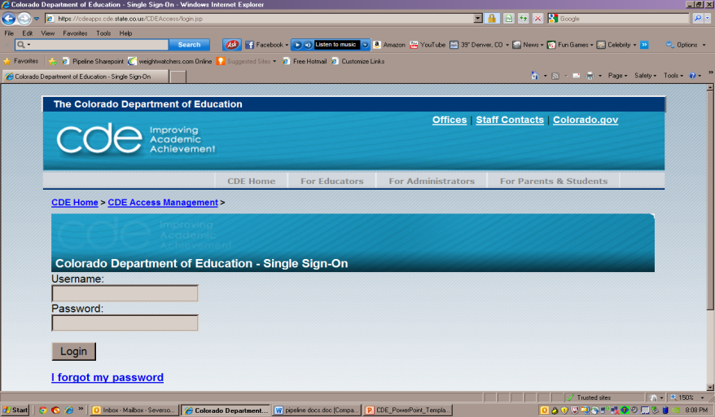
Pipeline Log-In Screen (same as before)
https://cdeapps.cde.state.co.us/index.html

Slide 73
#1: Logging into Data Pipeline
Username = Email Address
Password – you created it
If forgotten password, use ‘I forgot my password’

Slide 74
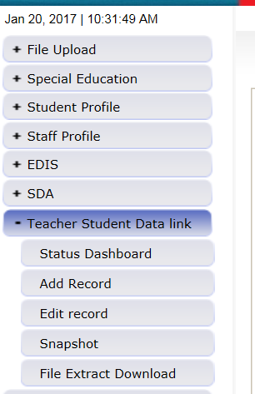
#2 and #3: Selecting Teacher Student Data Link -> Snapshot
#2
#3

Slide 75
#4 and #5: TSDL Snapshot Screen
#4
#5

Slide 76
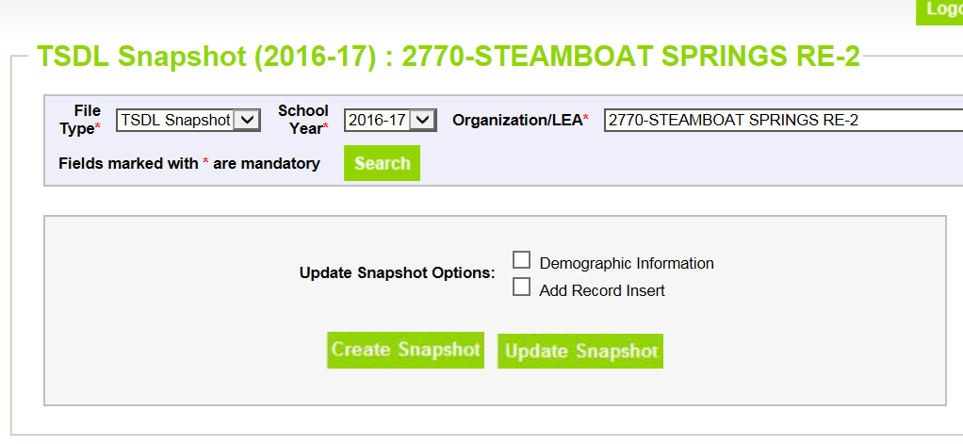
#6 and #7: Creating Snapshot- Screenshot
#6
#7

Slide 77
Next Steps
View Status of TSDL snapshot
Email will be sent with status
Status Dashboard screen –shows if processed and # of errors
View Snapshot errors in Cognos or Data Pipeline
Make corrections to Teacher Student Data Link interchange files
Upload updated Teacher Student Data Link interchange files
Re-create Teacher Student Data Link snapshot

Slide 78
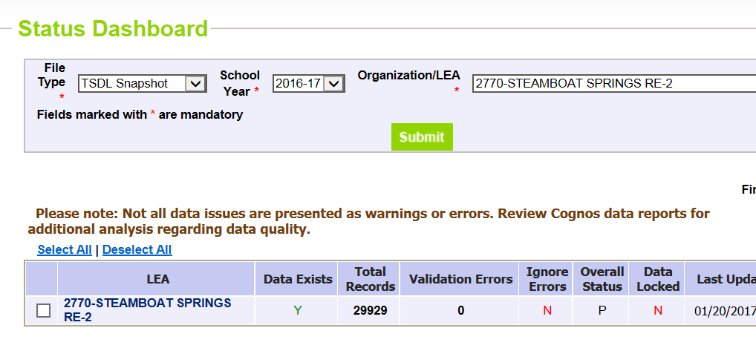
Status Dashboard Screen
Y = snapshot successful!
N= snapshot wasn’t taken/no data in snapshot
Date/Time of Snapshot created
# of Snapshot Record Errors

Slide 79
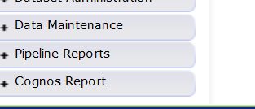
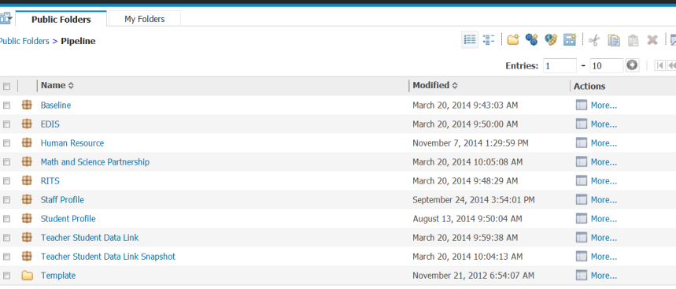
Accessing Cognos Reports
Opens new window
Teacher Student Data Link Snapshot

Slide 80
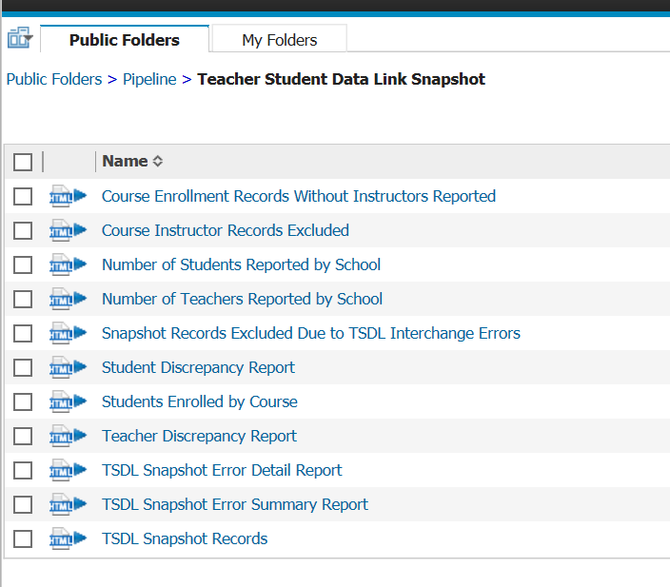
Teacher Student Data Link Cognos Reports

Slide 81
View Errors – Teacher Student Data Link Error Detail Report

Slide 82
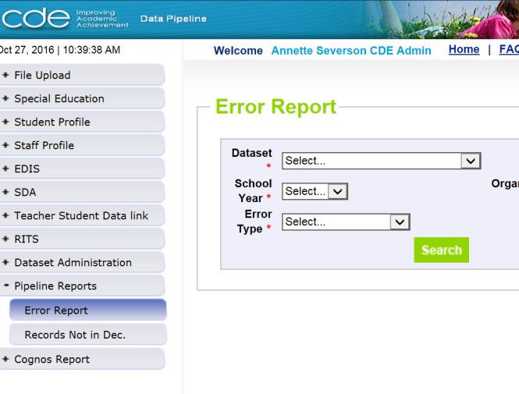
Viewing Errors in Data Pipeline

Slide 83
Edits
Edits are in place to assist with providing most accurate information to CDE which is published, analyzed and reviewed by legislators, federal government, researchers, etc.
Edits should provide adequate information to assist you with determining corrections needed.

Slide 84
TSDL Snapshot Edit
TD068 – Duplicate records are not allowed in the TSDL snapshot. A duplicate record would have the same school code, local course code, section number, term, EDID and SASID.

Slide 85
Finalizing Steps
Once all Errors are resolved in Snapshot…
Review, review, review data reports for accuracy!
If mistakes/misreporting is found, correct files again and create new snapshot
If data reports are all accurate- you may finalize the data by submitting it to CDE
http://www.cde.state.co.us/datapipeline/tsdl-snap-reports-guide

Slide 86
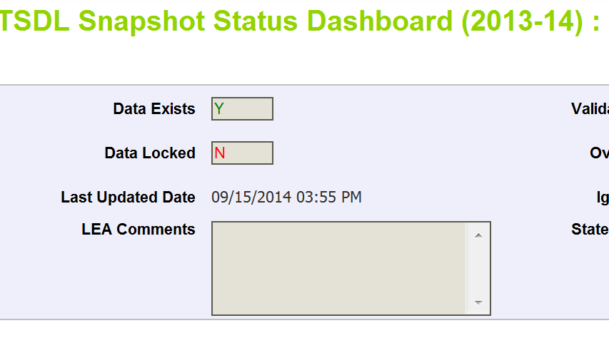
Finalizing Data
Once data is accurate-all reports reviewed and correct…
TLS~LEAAPPROVER for district will need to ‘Submit to CDE’
TSDL Snapshot Status Dashboard (2016-2017):
Submit to CDE

Slide 87
2017-18 Updates

Slide 88
Course Instructor File Changes
Removed field “MSP Project Code” from file layout
Removed field “MSP Most Recent Year of PD Participation” from file layout

Slide 89
Course Enrollment File Changes
Removed field “Course Completion Status” from file layout
Removed field “Verified” from file layout
Updated field “Final Grade” to be “Final Grade/Course Completion Status”
The final indicator of the student’s performance and course completion status at the time of data submission. Districts may find “Completed – Pass” and “Completed – Satisfactory” to be similar; for clarification, districts may opt to use “Completed – Pass” for courses with no credit/no grade/no mark and “Completed – Satisfactory” for courses that result in a grade/credit/mark.

Slide 90
Final Grade/Course Completion Status
Code | Description
1 | Completed - No Credit/No Grade/No Mark
2 | Completed - Pass
3 | Completed - Satisfactory
4 | Completed - Unsatisfactory
5 | Completed - Fail
6 | Incomplete – No Credit/No Grade/No Mark
7 | Withdrew – No Credit/No Grade/No Mark

Slide 91
TSDL Snapshot Reports (cognos)

Slide 92
Available Reports
Course Enrollment Records Without Instructors Reported
Course Instructor Records Excluded
Number of Students Reported by School
Number of Teachers Reported by School
Snapshot Records Excluded Due to TSDL Interchange Errors
Student Discrepancy Report
Student Enrolled by Course
Teacher Discrepancy Report
TSDL Snapshot Error Detail Report
TSDL Snapshot Error Summary Report
TSDL Snapshot Records

Slide 93
Course Enrollment Records Without Instructors Reported
Displays All Records from Course Enrollment file where there was no matching record in the Course Instructor file.
Records are matched based on:
School District/BOCES Code
School Code
Local Course Code
Section Number
Term
These records will have no instructor linked to the course/student

Slide 94
Course Instructor Records Excluded
Displays all records in Course Instructor file that are not being included in the snapshot
There is no matching record in the course enrollment file
Snapshots records are created using all Enrollment File records and matching those with the Instructor file based on the fields:
School District/BOCES Code
School Code
Local Course Code
Section Number
Term

Slide 95
Number of Students Reported by School
Provides headcount of students by school code/name
Headcount is counting the unique SASIDs reported for each school

Slide 96
Number of Teachers Reported by School
Provides headcount of teachers by school code/name
Headcount is counting the unique EDIDs reported for each school

Slide 97
Snapshot Records Excluded Due to TSDL Interchange Errors
Due to TSDL Interchange errors (either in Course Enrollment or Course Instructor) the records are not being included in the Snapshot
Next Steps – review and correct TSDL interchange files and create a new TSDL Snapshot

Slide 98
Student Discrepancy Report
Displays ALL students reported in the Student Interchange that are NOT included in the TSDL Snapshot
Also calculates and displays ‘Weeks Enrolled’
Can be used to sort- those enrolled for a long period of time should be included
Can download report into excel to sort as necessary

Slide 99
Students Enrolled by Course
Provides count of students (headcount) by school, final grade/course completion status and local course code
Provides total by school and final grade/course completion status

Slide 100
Teacher Discrepancy Report
Provides list of staff reported in the Staff Assignment file with job class code between 201 and 206 (teachers) that are not included in the TSDL snapshot
Also provides the Teaching Subject Area reported in the Staff Assignment file

Slide 101
Error Reports
TSDL Snapshot Error Detail Report
Displays each error and record in detail
TSDL Snapshot Error Summary Report
Displays a count of records with each error code

Slide 102
TSDL Snapshot Records
Provides the full snapshot records included in your snapshot
Can only provide current year due to size of TSDL snapshot files

Slide 103
TSDL Fields
Course Enrollment File
Course Instructor File
Name of Field
School District/BOCES Code
School Code
Local Course Code
Section Number
SASID
Student's Last Name
Student's First Name
Student's Gender
Student's Date of Birth
Roster Start Date
Roster End Date
Student’s Grade Level
Term
Credits Granted
Final Grade/Course Completion Status
Name of Field
School District/BOCES Code
School Code
Local Course Code
Section Number
EDID
Staff's Last Name
Staff's First Name
Staff's Gender
Staff's Date of Birth
Term
Staff Role
Used to link records in the TSDL Snapshot
TSDL- Annette Severson - severson_a@cde.state.co.us

Slide 104
Resources and Contact Information

Slide 105
TSDL Interchange Resources
Course Code Documentation found at:
https://www.cde.state.co.us/datapipeline/sscc-details
TSDL Interchange Documentation found at: http://www.cde.state.co.us/datapipeline/inter_teacherstudent
Deadlines
File layouts and definitions
Defects
Business Rules
Trainings
Additional Resources – Frequently Asked Questions
Contact:
Annette Severson: severson_a@cde.state.co.us or 303-866-6824
Please note – I will be unavailable the week of Thanksgiving but can provide assistance upon my return (Monday, November 27th)

Slide 106
TSDL Snapshot Resources
TSDL Snapshot Documentation found at: http://www.cde.state.co.us/datapipeline/tsdl
Deadlines
File layouts and definitions
Defects
Trainings
For assistance with either Interchange or Snapshot:
Annette Severson
Severson_a@cde.state.co.us
303-866-6824

