Slide 1
April 10, 2025
Data Pipeline Town Hall
The goal of the webinar is to provide updates on the Data Pipeline, current, and upcoming data collections. These webinars also provide a forum for districts, BOCES, and Administrative Units to have questions answered about Data Pipeline.

Slide 2
Colorado Department of Education
Identity Management (IdM)
Identity Management Site
Frequently Asked Questions
How do I add myself or others to the email listserv for town hall emails and/or a specific collection?
  Email lists are dependent on a person’s access rights in IdM. Contact your LAM to get an account or be assigned to a specific collection.
Where can I find the IdM role mappings for Data Pipeline and other applications?
  Role Mapping (XLS)
I am a LAM. How do I update the user permissions for someone in my district?
  Follow the steps outlined in the IdM Quick Guide for Access Management (DOCX)
Important: Users are not automatically removed from IdM when their email address is no longer active in your district. The LAM must deactivate their IdM account to ensure only designated staff can access CDE’s data reporting system.
Notes:
LAMs, please check the IdM roles for your district. Remove permissions for users who have retired, left your district, or are no longer assigned to a collection. Add roles for new hires and newly assigned respondents for specific collections.

Slide 3
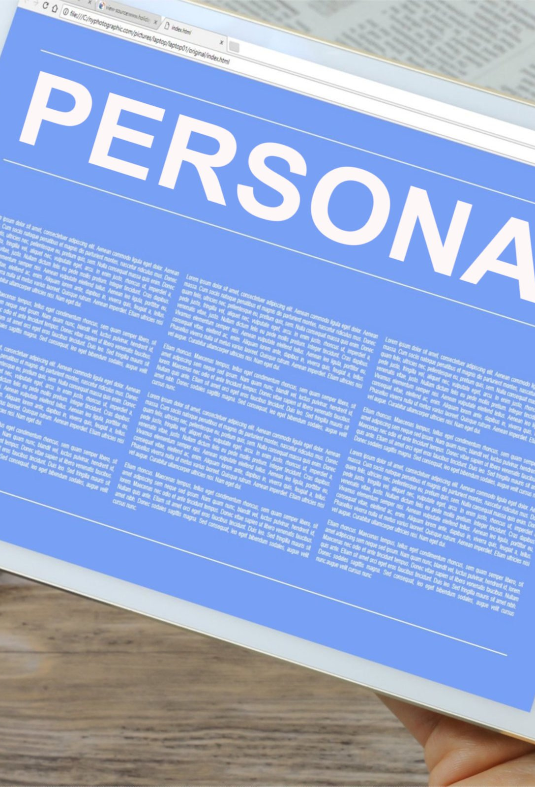
What is PII?
Student and Staff Personally Identifiable Information (PII) is defined by state and federal laws as information that, alone or in combination, personally identifies an individual
  This includes direct identifiers
  (i.e. student and staff names, SASID, EDID, etc.)
  Includes information that when combined is identifiable
Colorado’s Student Data Transparency and Security Act outlines requirements for how Student PII is collected, used and shared
See the Data Privacy and Security website for prepared guidance on how to comply with this and other privacy laws.

Slide 4

Sharing Data
Use secure methods to transfer any PII to CDE
  Contact Data Collection leads with questions about how to transmit PII securely
    Each Data Collection leads maintains their own Syncplicity folders for specific collections, reach out to the collection lead for access
  Use Syncplicity to encrypt emails to CDE
Avoid sending PII via unencrypted email or to unsecured faxes when sharing data between or within districts
  Use Syncplicity to encrypt emails to CDE
Check local policies for restrictions, requirements, etc. regarding PII
  Do not use PII in trainings, presentations, etc.
  Do not share PII with unauthorized individuals
  Do not share passwords
  Follow local policies when transmitting PII to any third party

Slide 5
Today’s Agenda
Agenda Topic | Presenter
Open Data Collections and Upcoming Deadlines in Data Pipeline | Host: Reagan Ward
Data Services Unit Updates | Annette Severson
Teacher Student Data Link | Peter Hoffman
READ Collections | Tara Rhodes

Slide 6
Open Collections and
Upcoming Deadlines in
Data Pipeline

Slide 7
Open Collections and Upcoming Dates:
Year-Round & Interchanges
Name | Category | Status | Key Dates
RITS | Year Round | Open | N/A
EDIS | Year Round | Open | N/A
Directory | Year Round | Open | Reduced Academic Calendar: 2/5/2025 to 5/9/2025 School Code Change Requests: 2/5/2025 to 6/30/2025
Student | Interchange | Open | April Recommendation: Upload GG by 4/10
At-Risk | Interchange | Closed | N/A
Title I | Interchange | Open | May 2025: Update file in preparation for SEY and ATS reporting
Special Education IEP | Interchange | Open | Special Education EOY Snapshot soft open now
Staff | Interchange | Open | Staff Evaluation Interchange opens 5/21/25
Discipline Action | Interchange | Open | This interchange file is needed for Student Discipline Snapshot and Special Education Discipline Snapshot Collections
Teacher Student Data Link | Interchange | Open | Upload an interchange file at least once by 5/16/2025
Data Pipeline Resources: Data Pipeline Collection Dates (XLS)

Slide 8
Open Collections and Upcoming Dates:
Snapshots
Name | Category | Status | Final Deadline Date | Next Milestone | Looking Ahead
Teacher Student Data Link | Snapshot | Open | Aug. 29, 2025 | Interim Deadline: 5/16/2025, upload TSDL interchange at least once | Interim Deadline: 6/13/2025, error free TSDL interchange
Student End of Year | Snapshot | Soft Open | Dec. 2, 2025 | Other Date: 4/10/2025—Upload GG file and review COGNOS reports to monitor GG | Training Event: Special Education 18-21 Transition Services Collaborative Webinar—4/22/2025, 1:00-2:00pm
Student Attendance | Snapshot | Coming Soon | July 25, 2025 | Interim Deadline: Upload SSA/DEM files by 5/09 | Snapshot Opens: 4/16/2025 Collection Training 5/7/2025
Special Education Discipline | Snapshot | Coming Soon | Aug. 1, 2025 | Office Hours 4/14/25 Teams-JoinNOW 10AM | Snapshot Opens: 5/1/2025
Student Discipline | Snapshot | Coming Soon | July 31, 2025 | Office Hours 4/14/25 Teams-JoinNOW 10AM | Snapshot Opens: 5/1/2025
Special Education EOY | Snapshot | Coming Soon | Oct. 3, 2025 |  | Snapshot Opens: 5/1/2025
Data Pipeline Resources: Data Pipeline Collection Dates (XLS)

Slide 9
Open Collections and Upcoming Dates:
Periodic
Name | Category | Status | Final Deadline Date | Next Milestone | Looking Ahead
Summer EBT | Periodic | Closed | Feb. 28, 2025 | Collection Closes: 2/28/2025 LEAs must submit an error-free file | Corrections Period: 5/19/2025 to 9/3/2025
Report Card March | Periodic | Deadline Approaching | Apr. 11, 2025 | Deadline: 4/11/2025
Alternative Education Campus | Periodic | Open | Jun. 27, 2025 | Application/Renewal File: 3/19/25 to 4/25/25 Planned Measures File: 3/19/2025 to 6/27/2025 | Actual Measures File: 5/19/25 to 6/27/25
READ Spring Assessments | Periodic | Coming Soon | June 13, 2025 | Collection Opens 4/15/25 | Other Date: 5/15/2025 target initial upload date
READ Literacy Programs & Assessments | Periodic | Coming Soon | June 13, 2025 | Training Event: 4/8/25, 1-2pm | Collection Opens 4/15/25
Data Pipeline Resources: Data Pipeline Collection Dates (XLS)

Slide 10
Data Services Unit Updates
Annette Severson

Slide 11
Collection Contacts
The Data Services Unit team has a few updates. Brooke moved to another state, and we have now welcomed Carrie Martin to our team!
Continue to use the provided collection email list for assistance as we transition the team with the following updates:
Collection Name/Website | Collection Email | Updated Collection Lead
Report Card March | ReportCard@cde.state.co.us | Jessica Tribbett
Student Discipline & Discipline Interchange | StudentDiscipline@cde.state.co.us | Carrie Martin
Prevent Harassment and Discrimination | HarassmentData@cde.state.co.us | Carrie Martin
Student Attendance | Attendance@cde.state.co.us | Peter Hoffman
Student October | StudentOctober@cde.state.co.us | Collin Slutzky
Student Interchange | StudentEndofYear@cde.state.co.us (general questions) | Reagan Ward* *in partnership with OCT and Attendance leads
Data Services Unit Updates

Slide 12
Vendor Presentation
April 24, 2025
9am
CDE will be hosting a vendor presentation during the April 24th town hall to go over the 2025-2026 collection updates.
  Data Respondents are welcome to join too!
LEA’s, please invite your vendor representatives
Note: Interchange layouts for 2025-2026 collections are already posted on their respective websites
Data Services Unit Updates
Severson_A@cde.state.co.us

Slide 13
Teacher Student Data Link
Peter Hoffman

Slide 14
2024-2025 TSDL Timeline
Date | Event | Event Description
Friday, May 16, 2025 | Interim Deadline | TARGET: Date by which you should have uploaded the TSDL Upload interchange file at least once
Friday, June 13, 2025 | Interim Deadline | TARGET: Date by which the TSDL Upload interchange should be uploaded and error free.
Friday, June 27, 2025 | Interim Deadline | TARGET: Date by which the TSDL snapshot should be created at least once.
Friday, August 22, 2025 | Interim Deadline | TARGET: Date by which you should have a complete Teacher Student Data Link Snapshot. Complete Teacher Student Data Link Snapshot means: All TSDL interchange errors are resolved All TSDL snapshot errors are resolved If you anticipate that you will not be able to meet this deadline, please contact CDE at TeacherStudentDataLink@cde.state.co.us
Monday, August 25, 2025 – Thursday, August 28, 2025 | Report Review | Final Snapshot Report Review – This is your opportunity to review reports in detail and make any data corrections you deem necessary to make sure you are reporting valid and reliable data. All data corrections must be completed during this time.
Friday, August 29, 2025 | Deadline | Required to have TSDL snapshot error free and finalized before or on this date. TSDL closed and final report is signed and provided to CDE via email TeacherStudentDataLink@cde.state.co.us
Teacher Student Data Link
TeacherStudentDataLink@cde.state.co.us

Slide 15
Upcoming Office Hours / Training
Upcoming office hours / training for TSDL on April 23, 2025 11:00am – 12:00pm
Registration link here or on the Teacher Student Data Link Website.
Teacher Student Data Link – Peter Hoffman
TeacherStudentDataLink@cde.state.co.us

Slide 16
Questions & Resources:
TSDL
Peter Hoffman
720-925-8611
TeacherStudentDataLink@cde.state.co.us

Slide 17
READ Collections
Tara Rhodes

Slide 18
Spring READ Assessment

Slide 19
READ Act District Reporting Requirements
Districts must annually report the information necessary to determine the prevalence of SRDs among students in grades K-3.
This data determines the per-pupil funding for districts by dividing the amount of money available by the total number of K-3 students identified as having an SRD in the preceding budget year. Districts must also report whether students in grades 4-12 remain on a READ plan.
The data provided in this report will be publicly reported and will enable the department to calculate district funding.
The 2024-25 collection will run from 4/15/2025 through 6/13/2025.
READ Act Data Collections – Spring READ Assessment
READActData@cde.state.co.us

Slide 20
Spring READ Assessment:
Changes for 24-25
No structural changes to the file layout (no addition/deletion of fields).
Drop-down menus in Pipeline have been updated to "READ Assessment" for clarity.
Some assessments were removed. These are ones that are no longer approved.
Cleaned up language and standardized field names.
For example, the SRD Status field is now labeled as such.
Added a warning that checks to see if the district's READ Literacy Programs and Assessment data collection has been submitted.
Altered the sign-off form to include the count of SRD as well as the SRD percentage for the district.
Please have the appropriate staff review this at your district before submitting your data!
READ Act Data Collections: Spring READ Assessment
READActData@cde.state.co.us

Slide 21
Spring READ Assessment:
Reminders
As you are approaching your assessment window, please make sure that all kindergarten through 3rd grade students are assessed.
Please also make sure that: 1. all enrolled kindergarten through 3rd grade students are included in your file submission; and 2. the students noted on your cohort report in 4th-12th grade.
Please make sure that you have confirmed and coded the correct assessment for each student in your file submission. This affects the identification of students with significant reading deficiencies in your submission.
READ Act Data Collections: Spring READ Assessment
READActData@cde.state.co.us

Slide 22
READ Literacy Programs and Assessment

Slide 23
READ Literacy Programs and Assessment:
Changes for 25-26
Changes:
No structural changes to the file layout (no addition/deletion of fields).
Drop-down menus in Pipeline have been updated to "READ Literacy" for clarity.
Three codes were added to the file layout for three programs that came up during last year's collection.
Added a business rule that checks to see if the district's Spring READ Assessment data collection has been submitted.
Reminders:
As a reminder, this collection looks ahead to next school year (25-26). Please either submit or work with district leaders to submit any school code changes before the 6/30 deadline so that your school list is accurate for this collection.
Please also work with any other district personnel to ensure that any changes for programming for next year are reflected in this collection.
READ Act Data Collections – READ Literacy
READActData@cde.state.co.us

Slide 24
Collection Timeline
Date | Event | Event Description
4/1/2025 | Training Event | Training Webinar for Spring READ Assessment Data Collection (Recorded)
4/8/2025 | Training Event | Training Webinar for READ Literacy Programs and Assessment Data Collection (Recorded)
4/15/2025 | Collection Open | Spring READ Assessment and READ Literacy Programs and Assessment data collections open.
5/15/2025 | Other Date | Target date for preliminary uploads
6/6/2025 | Other Date | Target date for error-free submission
6/6/2025 | Report Review | Assuming an error-free upload, this week can be used to verify the accuracy of the data submitted through the available reports in Cognos.
6/13/2025 | Collection Close | Spring READ Assessment and READ Literacy Programs and Assessment data collections close
READ Act Data Collections
READActData@cde.state.co.us

Slide 25
READ Training

Slide 26
READ Training:
General Information and Action Steps
General Information
Data Collection Dates: 8/1/2025 - 8/30/2025
READ Training Data Collection Webinar: 7/15/2025 from 1-2pm
Our training team is hosting a series of office hours as well, which are focused more on the training requirements but I will be presenting some information around the data components. Those are being held:
April 22, 2025 from 3-4pm
May 20, 2025 from 3-4pm
Please make sure that anyone who is required to take the training does so before August 1, 2025.
READ Act Data Collections – READ Training
READActData@cde.state.co.us

Slide 27
READ Act Data Collections:
Resources
Resources:
Updated webpages
  Spring READ Assessment
  READ Literacy Programs and Assessment
  READ Training
Working to get the recordings and slide decks from the training webinars up on the website as well.
READ Act Data Collections
READActData@cde.state.co.us

Slide 28
Questions & Resources:
READ Collections
Tara Rhodes
READActData@cde.state.co.us
Phone: 720.601.4125

Slide 29

Thank you for Joining Today!
Next Town Hall will be
April 17th
Vendor Presentation coming to town hall soon!
CDE will be hosting a vendor presentation during the April 24th town hall to go over the 2025-2026 collection updates.

