Slide 1
March 28, 2024 Data Pipeline Town Hall
The goal of the webinar is to provide updates on the Data Pipeline, current, and upcoming data collections. These webinars also provide a forum for districts, BOCES, and Administrative Units to have questions answered about Data Pipeline.

Slide 2
Colorado Department of Education Identity Management (IdM)
Identity Management Site
Frequently Asked Questions
How do I add myself or others to the email listserv for town hall emails and/or a specific collection?
Email lists are dependent on a person’s access rights in IdM. Contact your LAM to get an account or be assigned to a specific collection.
Where can I find the IdM role mappings for Data Pipeline and other applications?
Role Mapping (XLS)
I am a LAM. How do I update the user permissions for someone in my district?
Follow the steps outlined in the IdM Quick Guide for Access Management (DOCX)
Important: Users are not automatically removed from IdM when their email address is no longer active in your district. The LAM must deactivate their IdM account to ensure only designated staff can access CDE’s data reporting system.

Slide 3
What is PII?
Student Personally Identifiable Information (PII) is defined by state and federal laws as information that, alone or in combination, personally identifies an individual
This includes direct identifiers (i.e. student and staff names, SASID, EDID, etc.)
Includes information that when combined is identifiable
Colorado’s Student Data Transparency and Security Act outlines requirements for how Student PII is collected, used and shared
See the Data Privacy and Security website for prepared guidance on how to comply with this and other privacy laws.

Slide 4
Sharing Data
Use secure methods to transfer any PII to CDE
Contact Data Collection leads with questions about how to transmit PII securely
Each Data Collection leads maintains their own Syncplicity folders for specific collections, reach out to the collection lead for access
Use Syncplicity to encrypt emails to CDE
Avoid sending PII via unencrypted email or to unsecured faxes when sharing data between or within districts
Use Syncplicity to encrypt emails to CDE
Check local policies for restrictions, requirements, etc. regarding PII
Do not use PII in trainings, presentations, etc.
Do not share PII with unauthorized individuals
Do not share passwords
Follow local policies when transmitting PII to any third party

Slide 5
Today’s Agenda
Agenda Topic | Presenter
Open Data Collections and Upcoming Deadlines in Data Pipeline
Civil Rights Data Collection (CRDC) | Annette Severson
Student End of Year | Reagan Ward
Student Discipline | Dawna Gudka
Summer EBT | Michelle Monge

Slide 6
Open Collections and Upcoming Deadlines in Data Pipeline

Slide 7
Open Collections and Upcoming Dates
Name | Category | Status | Key Dates
RITS | Year Round | Open
EDIS | Year Round | Open
Directory | Year Round | Open | Reduced Academic Calendar Applications 3/6/2024 to 5/10/2024 School Code Change Requests 2/5/2024 to 6/28/2024
Student | Interchange | Open | Interim Deadline: 4/11/24 upload initial GG file
Title I | Interchange | Open
Special Education IEP | Interchange | Open
Staff | Interchange | Open
TSDL | Interchange | Open
Data Pipeline Resources: Data Pipeline Collection Dates (XLS)

Slide 8
Open Collections and Upcoming Dates cont.
Name | Category | Status | Final Deadline Date | Deadline Milestone | Looking Ahead
TSDL | Snapshot | Open | Aug. 30, 2024
Attendance | Snapshot | Coming Soon | July 12, 2024 |  | Opens 4/17/2024
Student Discipline | Snapshot | Coming Soon | July 31, 2024 |  | Interchange file opens 4/15/2024
Student End of Year | Snapshot | Coming Soon | Nov. 19, 2024 | Interim Deadline: Upload initial GG file by 4/11/2024 | Soft Open 4/1/2024
Report Card March | Periodic | Open | Apr. 12, 2024
S-EBT | Periodic | Coming Soon | Apr. 30, 2024 |  | Opens 4/1/2024
Data Pipeline Resources: Data Pipeline Collection Dates (XLS)

Slide 9
Civil Rights Data Collection (CRDC)
Annette Severson

Slide 10
Current Status
Final Extension set for April 1st
For questions or assistance with the collection process, please contact the CRDC Partner Support:
CRDC Partner Support Center
Email: CRDC@aemcorp.com
Phone: (855) 255-6901
Civil Rights Data Collection
CRDC@aemcorp.com

Slide 11
Overall District Status – great job!!
Civil Rights Data Collection
CRDC@aemcorp.com

Slide 12
Questions & Resources: CRDC
CRDC Partner Support Center
Email: CRDC@aemcorp.com
Phone: (855) 255-6901

Slide 13
Student End of Year
Reagan Ward

Slide 14
SEY Collection Timeline: Soft Open Phase
Date | Event | Event Description
04/01/2024 | Open | Districts may begin creating snapshots.
04/03/2024 1:00-2:30pm | Training Event | Collection Overview Training 1 of 2: This training covers all elements of the Student End of Year collection. It is being offered in two identical sessions to provide the opportunity for all SEY data respondents to attend a live session. Click here to register for this training event.
04/11/2024 | Interim Deadline | Upload initial Graduation Guidelines (GG) interchange file. Districts are expected to have an upload date 01/01/2024 or later to meet this interim deadline.
04/22/2024 1:00-2:00pm | Training Event | Collaborative Webinar – Special Education 18-21 Transition Services This webinar is designed for data respondents and district special education staff who support 18-21 transition services. Click here to register for this training event.
04/26/2024 | Closed | Soft open phase ends and snapshots are closed until the next phase.
Visit the SEY Website to download the complete SEY Collection Timeline with Training Dates
Student End of Year – Reagan Ward
StudentEndOfYear@cde.state.co.us

Slide 15
Graduation Guidelines Interim Deadline: April 11, 2024
Upload 2023-2024 GG file at least once
Upload date of 01/01/2024 or later expected
Minimum Requirement: records for students who are expected to graduate in 2023-2024 whose GG information was not reported in a prior year
At least one ELA
At least one Math
Best Practice: Include records for all completed graduation guidelines from the menu of options within the year (or prior years if needed), even if they are not expected to graduate in 2023-2024.
Supports use of CEDAR reports to monitor GG completion status
Graduation Guidelines List of Students – Summary
Graduation Guidelines Student Completion List
Supports transfer students, including their completed GG measures in pipeline for use when the student graduates no matter their district
Student End of Year – Reagan Ward
StudentEndOfYear@cde.state.co.us
Notes:
53/185 districts as of noon on 3/27

Slide 16
New Resource: Student Enrollment Record Guide
Posted on Student End of Year and Student Interchange websites
Focuses on ‘Group A’ PAI code enrollment records
Covers all entry/exit types:
Standard progression (did not leave the LEA)
Movement between LEAs
Movement in/out of a Colorado LEA
Movement within a LEA
AYG Cohort Reminders
Student End of Year – Reagan Ward
StudentEndOfYear@cde.state.co.us

Slide 17
Reporting Instances of Mobility
Per state board rule, districts should indicate an instance of mobility for a student after ten consecutive days of absence as part of the Student End of Year (SEY) collection.
Used to calculate mobility rates
Also has implications for Attendance collection
Impacts total days possible, attended, excused, and unexcused
Time frame between enrollment records (instance of mobility) not part of attendance data, impacting chronic absenteeism rate
Requires multiple enrollment records
School Exit/Entry 25 used if student’s absence is 10+ days to 6 weeks
School Exit/Entry 45 used if student’s absence is 6+ weeks
School exit date indicates last date of attendance
School entry date indicates date student began attending district again
Record | School Code | School Entry Date | School Entry Type | School Exit Date | School Exit Type
#1: Mobility instance | 1234 | 08152023 | 02 | 02012024 | 25
#2: Return to school | 1234 | 04012024 | 25 | 00000000 | 00
Student End of Year – Reagan Ward
StudentEndOfYear@cde.state.co.us

Slide 18
Questions & Resources: Student End of Year
Reagan Ward
StudentEndOfYear@cde.state.co.us
720-484-9057
Student End of Year Webpage Student Interchange Webpage Graduation Guidelines Webpage

Slide 19
Student Discipline
Dawna Gudka

Slide 20
Student Discipline: Collection Timeline
Date | Event | Event Description
March 20th | Webinar Training | 9-10AM Recording
April 15th | Interchange | Student Demographics, and Student School Association files need to be updated
April 15th | Discipline Interchange Opens | LEA’s can begin uploading the discipline by action interchange file
May 6th | Discipline Snapshot Opens | LEA’s can create a Student Discipline Snapshot
May 8th | Target deadline | LEA’s must upload at least one discipline interchange file
May 24th | Interchange files updated | LEA’s must update and upload the student demographics and student school association files into Data Pipeline
June 5th | Office Hours | 9-10AM Click here to join the meeting
June 14th | Target deadline | Interchange files error free
June 21st | Target deadline | Create at least one student discipline snapshot
July 8th | Target deadline | Discipline snapshot is error free
July 31st | DEADLINE | All LEA’s must have Student Discipline Snapshot approved and submitted to CDE
Student Discipline Snapshot
Student Discipline Snapshot email

Slide 21
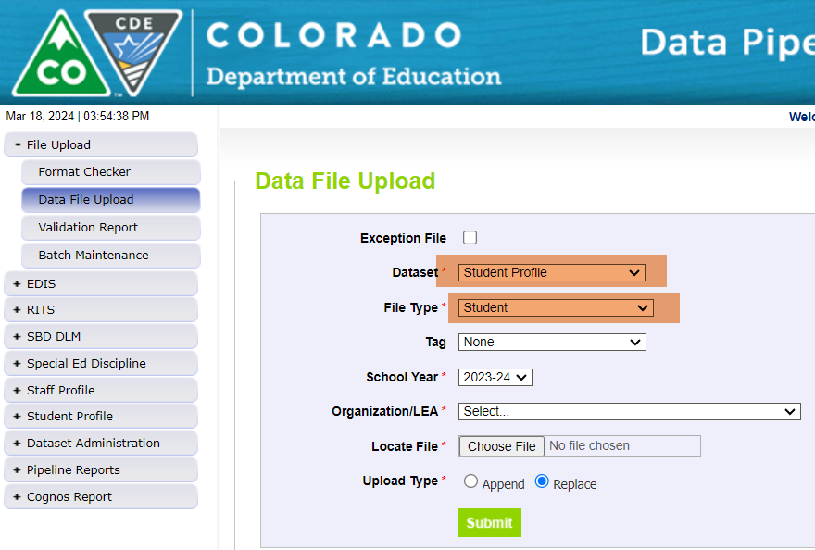
Student Discipline Snapshot Collection Preparing for the Student Discipline Interchange to OPEN-Upload Student Profile file
What can I do to prepare for the Student Discipline Interchange to open?
Upload your current Student Profile (demographics) file
Student Discipline Snapshot Collection
Student Discipline Snapshot Email

Slide 22
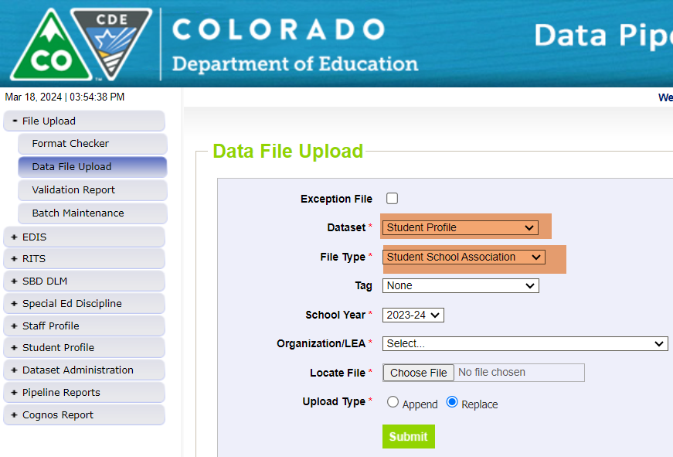
Student Discipline Snapshot Collection Preparing for the Student Discipline Collection to OPEN- Upload Student School Association file
What can I do to prepare for the Student Discipline Interchange to open?
Upload your current Student School Association file
Discipline by Action interchange will open April 15th
Student Discipline Snapshot Collection
Student Discipline Snapshot Email

Slide 23
Questions & Resources: Student Discipline
Student Interchange website
Student Demographics file layout
Student School Association file layout
Discipline Interchange website
Discipline file layout
Student Discipline Snapshot website
Student Discipline Snapshot file layout
Dawna Gudka-collection lead
(303) 598-7901
Email Student Discipline Snapshot

Slide 24
Summer-EBT Program

Slide 25
Summer EBT Data Collection
Collection will open April 1 through April 30
All districts required to submit student level data by due date
All enrolled students must be included in collection
Provisional sites are required to use current year eligibility determinations
Office hours will be available once collection is open
Utilize file layout to start building collection
Verify current student enrollment for missing information and up to date eligibility
Submit student data in data pipeline
Summer EBT
s-ebt@cde.state.co.us

Slide 26
S-EBT File Layout
 | Name of Field | Field Length | Text Start Position | Text End Position | CSV Order | Excel Column | Examples | Remarks
1 | School District Code* | 4 | 1 | 4 | 1 | A2 | 0000
2 | School Code* | 4 | 5 | 8 | 2 | B2 | 0000
3 | Entry Date* | 8 | 9 | 16 | 3 | C2 | 08152021 | Format is MMDDYYYY
4 | Exit Withdraw Date* | 8 | 17 | 24 | 4 | D2 | 10152021 | Format is MMDDYYYY; 0 fill if N/A
5 | Student’s State ID (SASID)* | 10 | 25 | 34 | 5 | E2 | 0000000000
6 | Local ID (LASID)* | 10 | 35 | 44 | 6 | F2 | 0000000000
7 | Student’s First Name* | 30 | 45 | 74 | 7 | G2 | Valid Name
8 | Student’s Middle Name* | 30 | 75 | 104 | 8 | H2 | Valid Name | NMN if none
9 | Student’s Last Name* | 30 | 105 | 134 | 9 | I2 | Valid Name
10 | Student’s Gender* | 2 | 135 | 136 | 10 | J2 | 01, 02
11 | Student’s Date of Birth* | 8 | 137 | 144 | 11 | K2 | 08152008 | Format is MMDDYYYY
12 | Student’s Grade Level* | 3 | 145 | 147 | 12 | L2 | 060
13 | Student’s Language Background | 3 | 148 | 150 | 13 | M2 | ENG
14 | Primary Parent/Guardian First Name* | 30 | 151 | 180 | 14 | N2 | Valid Name
15 | Primary Parent/Guardian Last Name* | 30 | 181 | 210 | 15 | O2 | Valid Name
16 | Primary Parent/Guardian Telephone Number | 10 | 211 | 220 | 16 | P2 | 5551231234; None
17 | Student’s Primary Mailing Address 1* | 44 | 221 | 264 | 17 | Q2 | 123 Star Quarry Road
18 | Student’s Primary Mailing Address 2 | 42 | 265 | 306 | 18 | R2 | Apt. 2 | Try to avoid special characters, i.e., #, &, @, etc.
19 | Student’s Primary Mailing City* | 50 | 307 | 356 | 19 | S2 | Nowhere
20 | Student’s Primary Mailing State* | 2 | 357 | 358 | 20 | T2 | CO
21 | Student’s Primary Mailing Postal Code* | 10 | 359 | 368 | 21 | U2 | 99999-0000, 99999
22 | Free/Reduced Lunch Price Eligible* | 2 | 369 | 370 | 22 | V2 | 00, 01, 02
23 | FRPL Eligibility Date | 8 | 371 | 378 | 23 | W2 | 10152021 | Format is MMDDYYYY
Summer EBT
s-ebt@cde.state.co.us

Slide 27
Questions & Resources: Summer EBT
S-EBT General Email
Data Collection FAQ
School Nutrition Summer-EBT webpage
Data Pipeline S-EBT webpage
Office Hours Sign-up

Slide 28
Thank you for joining today!
Next Town Hall will be April 4th
LAMs, please review your district’s list of data pipeline users.
Remove staff who have left your district.
Ensure appropriate staff are assigned to Spring data collections.

Slide 29
Collection Email Addresses
Additional support has been added to help manage emails for the CDE Team
Some emails may be signed as "Technical Help Support"
The data collection leads you know, and trust are:
Still responding and signing their names as needed
Training & assisting the Technical Help Support staff
Note: These email addresses are also posted on the Data Pipeline website and Contact list for reference
Data Collection | Email Addresses
Attendance | Attendance@cde.state.co.us
Directory | DirectoryData@cde.state.co.us
EDIS | EDIS@cde.state.co.us
Human Resources | HumanResourcesData@cde.state.co.us
READ Collections | ReadActData@cde.state.co.us
Report Card March | ReportCard@cde.state.co.us
RITS | RITS@cde.state.co.us
Special Ed December Count | SpedDecCount@cde.state.co.us
Special Ed Discipline | SpedDiscipline@cde.state.co.us
Special Ed End of Year | SpedEndOfYear@cde.state.co.us
Staff Evaluation | StaffEvaluation@cde.state.co.us
Student Discipline Snapshot | StudentDiscipline@cde.state.co.us
Student End of Year | StudentEndOfYear@cde.state.co.us
Student October Count | StudentOctober@cde.state.co.us
Teacher Student Data Link | TeacherStudentDataLink@cde.state.co.us

