Slide 1
March 7, 2024 Data Pipeline Town Hall
The goal of the webinar is to provide updates on the Data Pipeline, current, and upcoming data collections. These webinars also provide a forum for districts, BOCES, and Administrative Units to have questions answered about Data Pipeline.

Slide 2
Colorado Department of Education Identity Management (IdM)
Identity Management Site
Frequently Asked Questions
How do I add myself or others to the email listserv for town hall emails and/or a specific collection?
Email lists are dependent on a person’s access rights in IdM. Contact your LAM to get an account or be assigned to a specific collection.
Where can I find the IdM role mappings for Data Pipeline and other applications?
Role Mapping (XLS)
I am a LAM. How do I update the user permissions for someone in my district?
Follow the steps outlined in the IdM Quick Guide for Access Management (DOCX)
Important: Users are not automatically removed from IdM when their email address is no longer active in your district. The LAM must deactivate their IdM account to ensure only designated staff can access CDE’s data reporting system.

Slide 3
What is PII?
Student Personally Identifiable Information (PII) is defined by state and federal laws as information that, alone or in combination, personally identifies an individual
This includes direct identifiers (i.e. student and staff names, SASID, EDID, etc.)
Includes information that when combined is identifiable
Colorado’s Student Data Transparency and Security Act outlines requirements for how Student PII is collected, used and shared
See the Data Privacy and Security website for prepared guidance on how to comply with this and other privacy laws.

Slide 4
Sharing Data
Use secure methods to transfer any PII to CDE
Contact Data Collection leads with questions about how to transmit PII securely
Each Data Collection leads maintains their own Syncplicity folders for specific collections, reach out to the collection lead for access
Use Syncplicity to encrypt emails to CDE
Avoid sending PII via unencrypted email or to unsecured faxes when sharing data between or within districts
Use Syncplicity to encrypt emails to CDE
Check local policies for restrictions, requirements, etc. regarding PII
Do not use PII in trainings, presentations, etc.
Do not share PII with unauthorized individuals
Do not share passwords
Follow local policies when transmitting PII to any third party

Slide 5
Today’s Agenda
Agenda Topic | Presenter
Open Data Collections and Upcoming Deadlines in Data Pipeline
Civil Rights Data Collection (CRDC) | Annette Severson
ACCESS SBD | Tara Rhodes
Summer EBT | Madeleine Breza
Report Card March | Peter Hoffman
Reduced Academic Calendar | Jessica Tribbett
Attendance | Brooke Wenzel

Slide 6
Open Collections and Upcoming Deadlines in Data Pipeline

Slide 7
Open Collections and Upcoming Dates
Name | Category | Status | Key Dates
RITS | Year Round | Open
EDIS | Year Round | Open
Directory | Year Round | Open | Reduced Academic Calendar Applications 3/6/2024 to 5/10/2024 School Code Change Requests 2/5/2024 to 6/28/2024
Student | Interchange | Open | Interim Deadline: 4/11/24 upload initial GG file
Title I | Interchange | Open
Special Education IEP | Interchange | Open
Staff | Interchange | Open
TSDL | Interchange | Open
Data Pipeline Resources: Data Pipeline Collection Dates (XLS)

Slide 8
Open Collection and Upcoming Dates cont.
Name | Category | Status | Final Deadline Date | Deadline Milestone | Looking Ahead
Human Resources | Snapshot | Open | Feb. 23, 2024
Report Card March | Periodic | Open | Apr. 12, 2024 | Opens 3/6/2024
TSDL | Snapshot | Open | Aug. 30, 2024
ACCESS for ELLs | Periodic | Coming Soon | Mar. 20, 2024 |  | Opens 3/11/2024
Data Pipeline Resources: Data Pipeline Collection Dates (XLS)

Slide 9
Civil Rights Data Collection (CRDC)
Annette Severson

Slide 10
Current Status
CRDC deadline extended until March 18th
Issues with their data system have been resolved
For questions or assistance with the collection process, please contact the CRDC Partner Support:
CRDC Partner Support Center
Email: CRDC@aemcorp.com
Phone: (855) 255-6901
Civil Rights Data Collection
CRDC@aemcorp.com

Slide 11
Overall District Status – Making Progress!
Civil Rights Data Collection
CRDC@aemcorp.com

Slide 12
Questions & Resources: CRDC
CRDC Partner Support Center
Email: CRDC@aemcorp.com
Phone: (855) 255-6901

Slide 13
ACCESS for ELLs SBD
Tara Rhodes

Slide 14
Student Biographical Data (SBD) Timeline
SBD Collections
There are four collections, one for each assessment vendor
Details are in the Periodic Collections on the Data Pipeline page
Documents will be updated closer to the collection openings
Timelines are subject to change; please make sure you have users in each collection group to receive emails about the specific collection
 | Assessment | Data Pipeline Group | SBD Review Window
1 | ACCESS for ELLs® ACCESS for ELLs Alternate | ACC | March 11 – 20, 2024
2 | Colorado PSAT/SAT | SAT | May 15 – 22, 2024
3 | Colorado Measures of Academic Success (CMAS): Mathematics, ELA, CSLA, Science and Social Studies Colorado Alternate (CoAlt): Science and Social Studies | CMS | May 16 – 29, 2024
4 | Colorado Alternate (CoAlt): English Language Arts and Mathematics (Dynamic Learning Maps) | DLM | May 29 – June 5, 2024
ACCESS SBD
sbdsupport@cde.state.co.us

Slide 15
WIDA ACCESS for ELLs SBD
WIDA ACCESS for ELLs is the English Language Proficiency assessment.
Students classified as Non-English Proficient (NEP) or Limited English Proficient (LEP) are required to take WIDA ACCESS. No other students take this assessment.
The assessment is offered in all grades, K-12.
There is an alternate version (Alt-ACCESS) used for students with significant cognitive disabilities.
The testing window starts in January, so the data clean up is earlier than other state assessments.
ACCESS SBD
sbdsupport@cde.state.co.us

Slide 16
Changes for 2023-24 ACCESS SBD Collection
Three main changes were made for the 2023-24 collection:
The first change is the addition of a nonbinary category for the gender field.
The second change is the addition of a Not Tested Reason field to the file layout.
This field provides the reason as to why students did not test. This field is updateable during SBD and blanks are allowed. Please see the file layout for valid values.
The addition of this field also affected the Do Not Score (DNS) fields. The DNS fields are now not updateable, as any INV cases should have been reported to Assessment during administration.
The third change is the addition of a new failsafe form.
This failsafe form can be used to submit students to CDE who have newly arrived in the U.S. Please see the file layout and the failsafe form for more instructions.
Changes are highlighted in yellow on the file layout.
ACCESS SBD
sbdsupport@cde.state.co.us

Slide 17
ACCESS for ELLs SBD Collection Documentation
All documentation is on the Data Pipeline Collection page here.
File Layout and Definitions Section:
There were three main changes to the file layout from the 22-23 collection year.
Business Rules Section:
There was the addition or modification of six business rules for the 2023-24 collection year.
Link to the SBD Manual:
This links to the manual that is applicable for all SBDs and lays out the SBD process step-by-step.
Templates:
The District Transfers Failsafe Form: This is the document used to move students between districts. There was no change from the 22-23 collection year.
This should only be used for students who are in your district’s SBD file but moved out of your district before or during the testing window and DID NOT TEST in your district.
Do not use the Failsafe form to report any students who tested in your district and moved afterward. If they moved after testing, the student data should remain in the district where the student tested.
The Add a Newly Arrived to the U.S. Student Failsafe Form: Please use this form to submit students to CDE who: 1. were not included in the Colorado October 1 Count collection, 2. recently arrived to the United States and, 3. enrolled in your district as their first enrollment in the US.
Training Recording:
Here's a link to the recording of the training that was held earlier this week.
ACCESS SBD
sbdsupport@cde.state.co.us

Slide 18
ACCESS for ELLs SBD Tips
Tips for Completing the SBD Process:
If you are new to the SBD collections, please review the SBD manual before beginning any of the collections.
Please also read the SBD File Layout and Definitions document before you begin the SBD Review Process.
Changes from the previous year are highlighted
Not all of the fields in the SBD file layouts are updateable. Please review the file layout to learn which ones are.
The file layout also provides the position, format, and length of fields for the SBD collection as well as valid values.
The business rules document lists all the business rules, but also provides some information on how to fix errors and warnings.
ACCESS SBD
sbdsupport@cde.state.co.us

Slide 19
ACCESS SBD: Contact Information
Please contact SBD Support with any questions:
Email: sbdsupport@cde.state.co.us
Phone: 720.696.0185
ACCESS SBD Website

Slide 20
Summer EBT Program
Madeleine Breza

Slide 21
Permanent Summer-EBT
New, permanent federal program that helps ensure Colorado children can access adequate, healthy foods during summer break
$120/eligible student, EBT card to purchase groceries
Administrative funding for SFAs
State Legislation passed in November 2023 (SB23B-002)
CDHS lead agency, CDE partner agency
Similar to P-EBT: data collection, CDHS disbursement
Major Differences: mandatory data collection, ability to use family contact info, community-based organizations support
Summer EBT
s-ebt@cde.state.co.us
Notes:
The Summer Electronic Benefit Transfer (S-EBT) Program is a new, permanent federal program that helps ensure Colorado children can access adequate, healthy foods during summer break when school is out of session.
The program will go in to effect this summer, 2024, and families with school aged children that are eligible for free or reduced-priced school meals may receive $40/month ($120 total) per child during the summer months to purchase groceries. Funds will be placed on EBT cards and received via mail. This program will operate alongside the summer meals program.

Slide 22
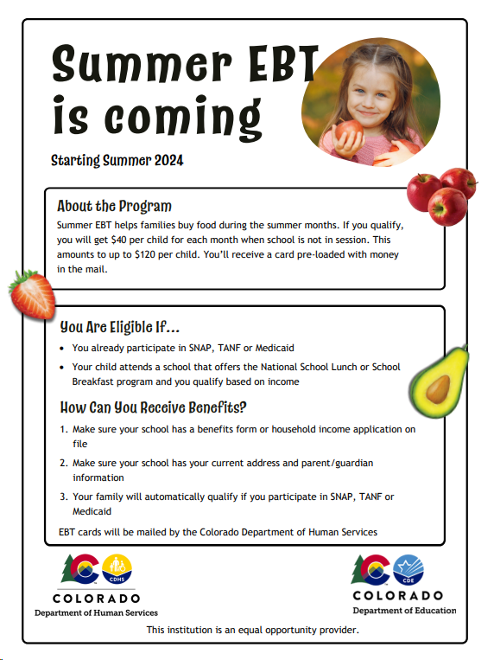
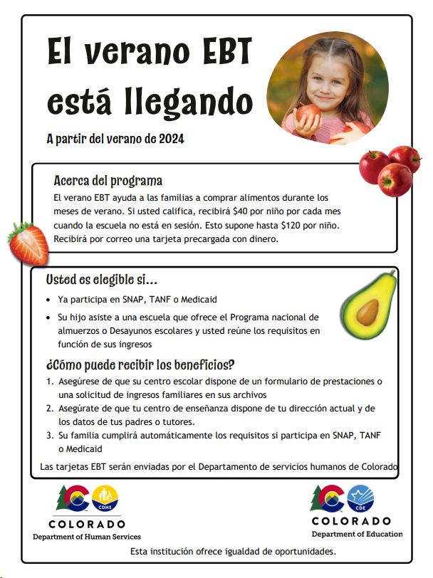
Currently…
CDHS & CDE submitted state plan and waiting for USDA approval
Encourage families to submit household income information through nutrition income applications
Connect with your district’s nutrition team to start conversations around submission
Ensure all student eligibility is received and up to date
Additional outreach materials, FAQs and training resources coming soon!
Summer EBT
s-ebt@cde.state.co.us
Notes:
To ensure families receive these benefits, continue to encourage families to submit household income information and update their mailing address using your district’s communication channels this school year. Household income information may be collected through free and reduced lunch applications, a combo form or the Family Economic Data Survey (FEDS) form.
Make sure that

Slide 23
Data Collection
Collection will open April 1 through April 30
All districts required to submit student level data by due date
All enrolled students must be included in collection
Office hours will be available once collection is open
Utilize file layout to start building collection
Verify current student enrollment for missing information and up to date eligibility
Submit student data in data pipeline
Summer EBT
s-ebt@cde.state.co.us

Slide 24
File Layout
Summer EBT
s-ebt@cde.state.co.us

Slide 25
Questions & Resources: Summer EBT
Websites:
School Nutrition Summer-EBT
Data Pipeline S-EBT
Email:
s-ebt@cde.state.co.us

Slide 26
Report Card March
Peter Hoffman

Slide 27
Report Card March: Collection Timeline
Date | Event | Event Description
March 6, 2024 | Report Card March Opens | Report Card March available to upload
April 12, 2024 | Report Card March Closes | Date that Report Card March must be submitted to CDE and sign off form returned to ReportCard@cde.state.co.us
Report Card March
ReportCard@cde.state.co.us

Slide 28
Changes to 2023-2023 Report Card March
HB 21-1221 Jack & Caits Law
6 Fields Added
Updates to this house bill caused a few fields in RCM to be updated.
Link to HB 21-1221
Bullying Policy: Prohibit Bullying Flag
Bullying Policy: Define Bullying Flag
Bullying Policy: Prevention and Intervention Flag
Bullying Policy: Reporting Flag
Bullying Policy: Investigating and Responding Flag
Bullying Policy: Supports and Referrals Flag
3 Fields Removed
Bullying policy: Biennial Survey Flag
Bullying Policy: Bullying Prevention Team Flag
Bullying Policy: Consequences Flag
Report Card March
ReportCard@cde.state.co.us

Slide 29
Changes to 2023-2023 Report Card March – New Fields
New fields are all yes or no responses
0 for no
1 for yes
6 Fields Added
Bullying Policy: Prohibit Bullying Flag - yes or no flag which indicates whether or not your school publicly (e.g., in school handbook, on school website) prohibits bullying, retaliation against those reporting bullying, and making knowingly false accusations of bullying behavior.
Bullying Policy: Define Bullying Flag - A yes or no flag which indicates whether or not your school publicly defines bullying and how it is different from other forms of aggression.
Bullying Policy: Prevention and Intervention Flag - yes or no flag which indicates whether or not your school publicly describes its bullying prevention and intervention efforts (e.g., training staff, a team that leads bullying prevention efforts, surveying students on the severity and frequency of bullying).
Bullying Policy: Reporting Flag - A yes or no flag which indicates whether or not your school publicly describes the ways bullying can be reported to school staff.
Bullying Policy: Investigating and Responding Flag - A yes or no flag which indicates whether or not your school publicly describes the investigative procedures that the school follows when a report of bullying is made and how the school responds to bullying behavior.
Bullying Policy: Supports and Referrals Flag - A yes or no flag which indicates whether or not your school publicly describes the supports and referrals provided to students involved in bullying. This includes efforts to:
change the behavior of students engaged in bullying,
support targets of bullying in ways that avoid increasing their likelihood of discipline, and
support witnesses of bullying.
Report Card March
ReportCard@cde.state.co.us

Slide 30
2023-2023 Report Card March
IDM Roles
Ways to Submit
RCM~LEAVIEWER
RCM~LEAUSER
RCM~LEAAPPROVER
Only one role can be assigned. If you are the sole person responsible for the entirety of RCM it is recommended you be assigned the LEA~APPROVER role.
Edit Record
File Upload
Only choose one method, if you use file upload you cannot edit your data later via edit record and vice versa. Doing so can lead to errors.
COVID Response Remote Learning Days Reminder
A numeric field which indicates the number of whole and partial days the entire school was forced to switch from in-person to remote learning as a result of responding to COVID health and safety concerns. Exclude days when the school was forced to switch from in-person to remote learning as a result of emergency school closures (i.e. due to severe weather or an emergency facilities issue such as a water leak). Also exclude days when only a portion of the school community was forced to switch to remote learning, for instance due to the quarantine of a cohort of students.
Report Card March
ReportCard@cde.state.co.us

Slide 31
Questions & Resources: Report Card March
Peter Hoffman
720-965-8611
ReportCard@cde.state.co.us
Report Card March Website

Slide 32
Reduced Academic Calendar
Jessica Tribbett

Slide 33
Reduced Academic Calendar: Requests
Reduced Academic Calendar Requests*
Fewer than 160 contact days
3/6/2024 – 5/10/2024
*Formally the 4 Day School Week
The general process is the same:
Complete Reduced Academic Calendar Request form in Data Pipeline.
If your district is on a district wide improvement plan, you will need to extra documentation to field services via this webform.
Field services and the commissioner will approve by 6/30/2024 and districts will be notified
Reduced Academic Calendar – Jessica Tribbett
DirectoryData@cde.state.co.us

Slide 34
Reduced Academic Calendar: Request form field updates
Field Name | Previous Location | New Location
Reduced Academic Calendar (Y/N) | Previously named 4 Day Week Y/N - school level data | Name change – school level data
4 Day School Week | School level data | School level data
Day Not in Session | District level data | School level data
# of Days is Session | District level data | School level data
# of Elem. Hours Scheduled | District level data | School level data
#of Secondary Hours Scheduled | District level data | School level data
Reduced Academic Calendar – Jessica Tribbett
DirectoryData@cde.state.co.us

Slide 35
Reduced Academic Calendar: Request form
If blank email me
District Accreditation Rating
Previously district level data
Reduced Academic Calendar – Jessica Tribbett
DirectoryData@cde.state.co.us

Slide 36
Questions & Resources: Reduced Academic Calendar
Questions & Resources DirectoryData@cde.state.co.us

Slide 37
Attendance
Brooke Wenzel

Slide 38
Attendance Timeline
Date | Event | Event Description
04/17/2024 | Open | Districts may begin creating snapshots. Attendance Snapshot dependencies are the Student Demographic File and Student School Association File.
05/08/2024 10:30-12:00 p.m. | Training Event | Collection Overview Training
05/09/2024 | Interim Deadline | Upload Student Demographic and Student School Association Files
05/28/2024 | Interim Deadline | Create an initial Attendance Snapshot
06/12/2024 | Interim Deadline | Error free Student Interchange file uploads
06/26/2024 | Interim Deadline | Error free Attendance Snapshot
07/05/2024 | Report Review | Review Attendance Cognos Reports for data validation. Submit Attendance Snapshot data as soon as review is complete.
07/12/2024 | Deadline | Submit Attendance Snapshot data.
07/26/2024 | Deadline | Collection closes Superintendent Verification (sign-off) form due. Data remains embargoed until the official release in August.
08/16/2024 | Data Release | Official data release
See the Attendance website for collection timeline
Attendance – Brooke Wenzel
Attendance@cde.state.co.us

Slide 39
Student School Association File
Make sure your attendance fields are populating upon extract
Total Days Attended, Total Days Excused, Total Days Unexcused, Total Days Possible
Students must have at least 10.0 Total Days Possible to be pulled into the Attendance Snapshot
Having issues with attendance fields populating?
Reach out to your SIS vendor!
Attendance – Brooke Wenzel
Attendance@cde.state.co.us

Slide 40
Location of Attendance Snapshot (NEW) – Not yet moved to Production
Attendance will now be located under Student Profile since SDA is gone
Snapshot, Status Dashboard, Submit to CDE, etc.
New IDM Role (~ATS)
Will automatically be assigned to those that have an ~SDA role when changes are officially ready
Cognos/CEDAR
Will have reports under a new folder – Attendance Snapshot
Attendance – Brooke Wenzel
Attendance@cde.state.co.us

Slide 41
Attendance Training
2023-2024 Collection Overview
May 8th, 2024
10:30-12:00 p.m.
Login information is posted on the Attendance Website under Training
Attendance – Brooke Wenzel
Attendance@cde.state.co.us

Slide 42
Questions & Resources: Attendance
Brooke Wenzel
Attendance@cde.state.co.us
720-441-7963
Attendance Webpage
Student Interchange Webpage

Slide 43
Thank you for joining today!
LAMs, please review your district’s list of data pipeline users.
Remove staff who have left your district.
Ensure appropriate staff are assigned to Spring data collections.
Next Town Hall will be March 14th

Slide 44
Collection Email Addresses
Additional support has been added to help manage emails for the CDE Team
Some emails may be signed as "Technical Help Support"
The data collection leads you know, and trust are:
Still responding and signing their names as needed
Training & assisting the Technical Help Support staff
Note: These email addresses are also posted on the Data Pipeline website and Contact list for reference
Data Collection | Email Addresses
Attendance | Attendance@cde.state.co.us
Directory | DirectoryData@cde.state.co.us
EDIS | EDIS@cde.state.co.us
Human Resources | HumanResourcesData@cde.state.co.us
READ Collections | ReadActData@cde.state.co.us
Report Card March | ReportCard@cde.state.co.us
RITS | RITS@cde.state.co.us
Special Ed December Count | SpedDecCount@cde.state.co.us
Special Ed Discipline | SpedDiscipline@cde.state.co.us
Special Ed End of Year | SpedEndOfYear@cde.state.co.us
Staff Evaluation | StaffEvaluation@cde.state.co.us
Student Discipline Snapshot | StudentDiscipline@cde.state.co.us
Student End of Year | StudentEndOfYear@cde.state.co.us
Student October Count | StudentOctober@cde.state.co.us
Teacher Student Data Link | TeacherStudentDataLink@cde.state.co.us

