Slide 1
February 22nd, 2024 Data Pipeline Town Hall
The goal of the webinar is to provide updates on the Data Pipeline, and current or upcoming data collections. These webinars also provide a forum for districts, BOCES, and Administrative Units to have questions answered about Data Pipeline.

Slide 2
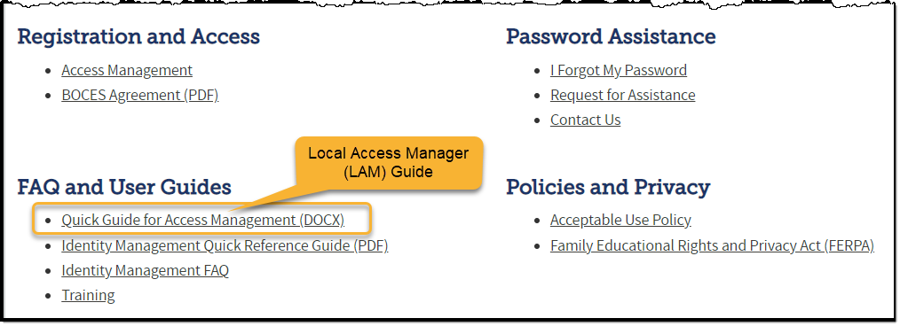
Colorado Department of Education Identity Management (IdM)
Identity Management Site
Frequently Asked Questions
How do I add myself or others to the email listserv for town hall emails and/or a specific collection?
Email lists are dependent on a person’s access rights in IdM. Contact your LAM to get an account or be assigned to a specific collection.
Where can I find the IdM role mappings for Data Pipeline and other applications?
Role Mapping (XLS)

Slide 3
Collection Email Addresses
Additional support has been added to help manage emails for the CDE Team
Some emails may be signed as "Technical Help Support"
The data collection leads you know, and trust are:
Still responding and signing their names as needed
Training & assisting the Technical Help Support staff
Data Collection | Email Addresses
Attendance | Attendance@cde.state.co.us
Directory | DirectoryData@cde.state.co.us
EDIS | EDIS@cde.state.co.us
Human Resources | HumanResourcesData@cde.state.co.us
READ Collections | ReadActData@cde.state.co.us
Report Card March | ReportCard@cde.state.co.us
RITS | RITS@cde.state.co.us
Special Ed December Count | SpedDecCount@cde.state.co.us
Special Ed Discipline | SpedDiscipline@cde.state.co.us
Special Ed End of Year | SpedEndOfYear@cde.state.co.us
Staff Evaluation | StaffEvaluation@cde.state.co.us
Student Discipline Snapshot | StudentDiscipline@cde.state.co.us
Student End of Year | StudentEndOfYear@cde.state.co.us
Student October Count | StudentOctober@cde.state.co.us
Teacher Student Data Link | TeacherStudentDataLink@cde.state.co.us
These email addresses are also posted on the Data Pipeline website and Contact list for reference

Slide 4
What is PII?
Personally Identifiable Information (PII) is defined by state and federal laws as information that, alone or in combination, personally identifies an individual
This includes direct identifiers (i.e. student and staff names, SASID, EDID, etc.)
Includes information that when combined is identifiable
Colorado’s Student Data Transparency and Security Act outlines requirements for how Student PII is collected, used and shared
CDE has prepared guidance on how to comply with this and other privacy laws which can be found here.

Slide 5
Sharing Data
Use secure methods to transfer any PII to CDE
Contact Data Collection leads with questions about how to transmit PII securely
Each Data Collection leads maintains their own Syncplicity folders for specific collections, reach out to the collection lead for access
Use Syncplicity to encrypt emails to CDE
Avoid sending PII via unencrypted email or to unsecured faxes when sharing data between or within districts
Use Syncplicity to encrypt emails to CDE
Check local policies for restrictions, requirements, etc. regarding PII
Do not use PII in trainings, presentations, etc.
Do not share PII with unauthorized individuals
Do not share passwords
Follow local policies when transmitting PII to any third party

Slide 6
Today’s Agenda
Agenda Topic | Presenter
Open Data Collections and Upcoming Deadlines in Data Pipeline
Human Resources | Dawna Gudka
Student Discipline | Dawna Gudka
Special Education December Count | Lindsey Heitman
Attendance | Brooke Wenzel

Slide 7
Open Collections and Upcoming Deadlines in Data Pipeline

Slide 8
Open Collections and Upcoming Dates – 1 of 2
Name | Category | Status | Key Dates
RITS | Year Round | Open
EDIS | Year Round | Open
Directory | Year Round | Open
Student | Interchange | Open | Interim Deadline: 4/11/24 upload initial GG file
Title I | Interchange | Open
Special Education IEP | Interchange | Open
Staff | Interchange | Open
TSDL | Interchange | Open
Data Pipeline Resources: Data Pipeline Collection Dates (XLS)

Slide 9
Open Collections and Upcoming Dates – 2 of 2
Name | Category | Status | Final Deadline Date | Deadline Milestone | Looking Ahead
SPED December | Snapshot | Open | Feb. 23, 2024 | Deadline: 2/23/2024 Final Submission Due to CDE | 02/19/24 – 02/23/24 final report review and submission to CDE
Human Resources | Snapshot | Open | Feb. 23, 2024 | Deadline 2/15/24 must have a complete error free Human Resources Snapshot | 2/16-2/22 Final Snapshot Report Review
Data Pipeline Resources: Data Pipeline Collection Dates (XLS)

Slide 10
Human Resources
Dawna Gudka

Slide 11
Human Resources Collection Status as of 2/21 7pm
Human Resources Snapshot Collection
Gudka_d@cde.state.co.us

Slide 12
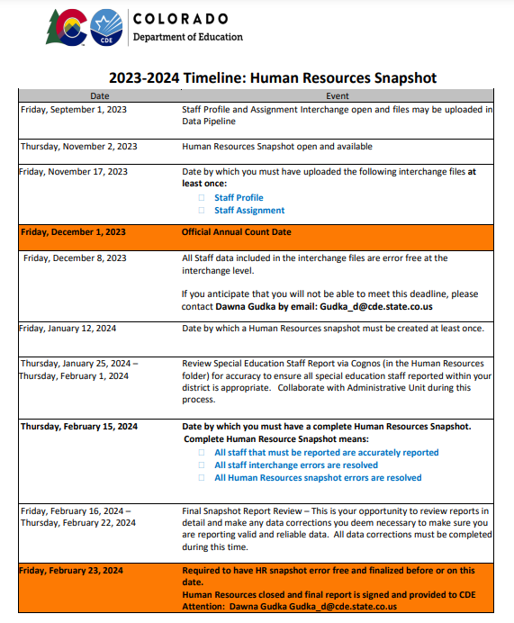
Human Resources Collection Timeline
2/23 Human Resources Snapshot Deadline
Human Resources Snapshot Collection
Gudka_d@cde.state.co.us

Slide 13
Human Resources Collection Submit your data to CDE
Human Resources Snapshot Collection
Gudka_d@cde.state.co.us

Slide 14
Questions & Resources for Human Resources Collection
Collection Resources
Staff Interchange
Staff Profile File Layout
Staff Assignment File Layout
Human Resources Snapshot
Questions
Email: Human Resources
Dawna Gudka (303) 598-7901

Slide 15
Discipline
Dawna Gudka

Slide 16
Student Discipline Changes
2023-2024 Discipline is now collected at the Student level
This collection is now a Snapshot collection
What does that mean?
One discipline interchange file 2023-2024 Student Discipline File Layout
Plus, the student demographics interchange file 2023-2024 Student Demographics File Layout
And the Student School Association file 2023-2024 Student School Association File Layout
will make up the Student Discipline Snapshot Collection
Student Discipline
Student Discipline Snapshot

Slide 17
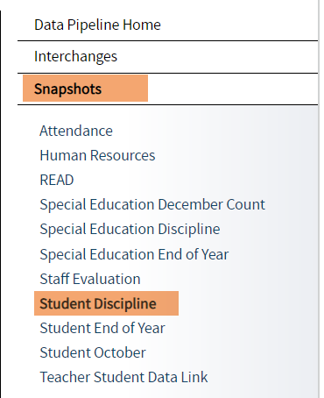
Student Discipline websites
2023-2024 Discipline Interchange Website
2023-2024 Student Discipline Snapshot Website
Student Discipline
Student Discipline Snapshot

Slide 18
Questions & Resources for Student Discipline Snapshot Collection
Collection Resources
Discipline Interchange website
Student Discipline Snapshot website
Questions
Email: Student Discipline Snapshot Collection
Dawna Gudka (303) 598-7901

Slide 19
Special Education December Count
Lindsey Heitman

Slide 20
Special Education December Count: Final Submission Status
68 AUs -December Count Snapshot Final Submission Status
63 AUs – error free in both Staff and Student December Count snapshots
33 AUs – approved and locked in Data Pipeline→ Data Locked= Y
35 AUs – not yet approved
5 AUs – still working on a few errors in either student or staff snapshots *as of 6:30 am today
Special Education December Count - Lindsey Heitman - SpedDecCount@cde.state.co.us (303) 866-5759

Slide 21
Special Education December Count: Final Steps – Please Complete by February 23rd
Download the 16 staff and student reports (report #’s on next slide) from Data Pipeline→Cognos Reports/Special Education December - Folder. Data respondent/SPED Director review and verify data is valid and reliable.
Sped Director must sign each of the 16 reports. Please scan them into one PDF for upload to the ESSU Data Management System.
If you have “A” flags on any of your Year to Year student reports (#’s 2.1, 2.2, 2.3, or 2.4), download the “Special Education December Count Flag Explanations Document” found on the December Count Snapshot webpage under the Reports section and provide an explanation for the count and percentage change of 20 or more.
Upload the following to the ESSU Data Management System under Documents:
Signed 16 reports saved in one single pdf – include all pages of each report
Flag explanation template - upload in a separate Word document
LAST STEP – Approve and lock your final snapshot in the Data Pipeline by clicking “Submit to CDE” button under the Special Education tab/Status Dashboard
*Must complete both steps 4 and 5 to meet the final collection deadline on Friday!
SPED December Count – Lindsey Heitman
SpedDecCount@cde.state.co.us (303)866-5759

Slide 22
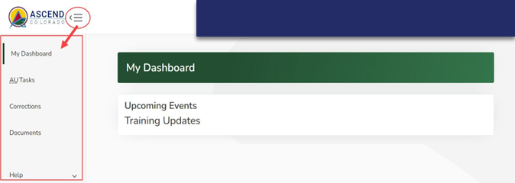
Special Education December Count – Reports Due for Upload to the Data Management System
By February 23, 2024
Upload Required Reports to the Data Management System
Staff Report #’s: 1.0, 1.1, 1.2, 1.4, SAM 1.5
Student Report #’s: 2.0, 2.1, 2.2, 2.3, 2.4, 2.5, 2.6, 2.7, 2.8, 2.9, 2.10
Questions on DMS access or report uploads? Email Josh Fails Fails_j@cde.state.co.us
Reports are to be uploaded to the Data Management System to the Documents (same location as the Discipline and EOY Reports)
SPED December Count – Lindsey Heitman
SpedDecCount@cde.state.co.us (303)866-5759

Slide 23
Special Education December Count Don’t Forget Last Step – Submit to CDE
Special Education December Count- Lindsey Heitman
SpedDecCount@cde.state.co.us (303)866-5759

Slide 24
Questions & Resources: Special Education December Count
Lindsey Heitman
SpedDecCount@cde.state.co.us
(303) 866 - 5759
Special Education IEP Interchange Webpage
Special Education December Count Snapshot Webpage

Slide 25
Attendance
Brooke Wenzel

Slide 26
Attendance Timeline
Date | Event | Event Description
04/17/2024 | Open | Districts may begin creating snapshots. Attendance Snapshot dependencies are the Student Demographic File and Student School Association File.
05/08/2024 10:30-12:00 p.m. | Training Event | Collection Overview Training
05/09/2024 | Interim Deadline | Upload Student Demographic and Student School Association Files
05/28/2024 | Interim Deadline | Create an initial Attendance Snapshot
06/12/2024 | Interim Deadline | Error free Student Interchange file uploads
06/26/2024 | Interim Deadline | Error free Attendance Snapshot
07/05/2024 | Report Review | Review Attendance Cognos Reports for data validation. Submit Attendance Snapshot data as soon as review is complete.
07/12/2024 | Deadline | Submit Attendance Snapshot data.
07/26/2024 | Deadline | Collection closes Superintendent Verification (sign-off) form due. Data remains embargoed until the official release in August.
08/16/2024 | Data Release | Official data release
See the Attendance website for collection timeline
Attendance – Brooke Wenzel
Attendance@cde.state.co.us

Slide 27
Student School Association File
Make sure your attendance fields are populating upon extract
Total Days Attended, Total Days Excused, Total Days Unexcused, Total Days Possible
Students must have at least 10.0 Total Days Possible to be pulled into the Attendance Snapshot
Having issues with attendance fields populating?
Reach out to your SIS vendor!
Attendance – Brooke Wenzel
Attendance@cde.state.co.us

Slide 28
Attendance Training
2023-2024 Collection Overview
May 8th, 2024
10:30-12:00 p.m.
Login information is posted on the Attendance Website under Training
Attendance – Brooke Wenzel
Attendance@cde.state.co.us

Slide 29
Questions & Resources: Attendance
Brooke Wenzel
Attendance@cde.state.co.us
720-441-7963
Attendance Webpage
Student Interchange Webpage

Slide 30
Thank you for joining today!
Next Town Hall will be February 29th, 2024
No reminder this week a Thank you instead! Thank you to all the data respondents that work to ensure that data is reported accurately and on time!!

