Slide 1
Special Education December Count
Welcome to the Special Education December Count Office Hours!
To join: https://cdeinfotech.adobeconnect.com/data_services/
Call in number: 1-855-397-4421
Special Education Data Team Contact Information
Lindsey Heitman – heitman_l@cde.state.co.us 303-866-5759 All December Count questions
Orla Bolger – bolger_o@cde.state.co.us 303-866-6896 All December Count questions
Alyssa Ohleyer – ohleyer_a@cde.state.co.us 303-866-6308 -Reports, Data Management System
Lauren Rossini – Rossini_l@cde.state.co.us 303-866-6688 -Staff Reporting and Qualifications (SAM)
Annette Severson – Severson_a@cde.state.co.us 303-866-6824 -Staff Interchange
Melissa Chaffin - Chaffin_m@cde.state.co.us 303-866-6819 -Enrich/Frontline

Slide 2
Special Education December Count – Schedule
Thursday, January 24th- 31st – Initial Report Review
Review December Count Staff and Student Cognos reports
Thursday, January 31st is the following STATE DEADLINE. Date by which the Administrative Unit must have created a Complete Error Free Special Education December Count Snapshot in Pipeline.
Upload the following signed reports to the ESSU Data Management System:
Staff Data Validity Certification Report (1 page)
Student Data Validity Certification Report (1 page)
*No need to upload all signed reports or ‘Submit to CDE’ just yet!
- That comes after the final report review February 14-21
These certify you have reviewed all the staff and student December Count reports and warnings with your director.
Special Education December Count - Lindsey Heitman - heitman_l@cde.state.co.us (303) 866-5759

Slide 3
How do I view the reports?
From the Data Pipeline website, click on +Cognos Report
In COGNOS choose Special Education December
The following types of reports are available
Included – Staff and Student
Excluded – Staff and Student
Error Reports – Summary and Detail for Staff and Student
Staff Summary and Detail Reports
Student Summary and Detail Reports
Staff and Student Data Validity Certification Reports
SAM Reports
Educational Orphan (New)

Slide 4
Special Education December Count - SAM
Reasons SAM Warnings DC208, DC209, DC210, or DC211 may trigger
EDIS/SSN issue -Debbie Puccetti RITS/EDIS contact (303)866-6612
Not meeting the student disability caseload match of 50%
required to hold an appropriate special education endorsement for the majority (50% or more) of allowable student disability categories reported in the staff's student caseload
DC209 and DC210 trigger when this happens
May need to switch the primary provider to the SLP on students with an 08 (SLI)
Incorrect AIA code:
0041-Early Childhood/Elementary, students in grades K-2 identified as Developmental Delayed (disability code 11)
- 0035-Early Childhood/Prekindergarten, PreK grade only

Slide 5
Special Education December Count – SAM Report
Helpful Cognos Reports:
Warnings DC210 and DC209?
SAM:1.5 Non-Qualified Personnel Status Report
Overview of staff not qualified or not meeting the caseload match
SAM: Caseload Student Detail (DC210 Detail) to see caseload details. Lists staff along with students they serve, disability types, and % of each type
License may be approved but caseload not approved on staff w/ DC210/DC209
Export to PDF if searching within the report
Helpful report online to reference for matching the disability with endorsement qualifications : ‘Special Education Endorsement Qualifications by Assignment, Disability, and Age of Student’ -http://www.cde.state.co.us/datapipeline/snap_sped-december under Staff Approval Matrix Trainings

Slide 6
DEADLINES WHAT’s DUE & WHEN
January 31, 2019
Staff Data Validity Certification Report 1.0
Student Data Validity Certification Report 2.0
February 21, 2019
Upload Required Reports to the Data Management System (all other “numbered” reports)
Reports are to be uploaded to the Data Management System under the Profile Tab (Same location as the Discipline and EOY Reports)
.

Slide 7
Report Checklist
http://www.cde.state.co.us/datapipeline/snap_sped-december -found at this link under the ‘Reports’ section

Slide 8
STAFF DATA VALIDITY Certification Report
* Note 1.3 has been removed
*
Your Director must certify that they have reviewed all these reports. Report Numbers 1, 2, and 4 will be uploaded to the DMS in February, after the CDE had reviewed state data for duplicates.

Slide 9
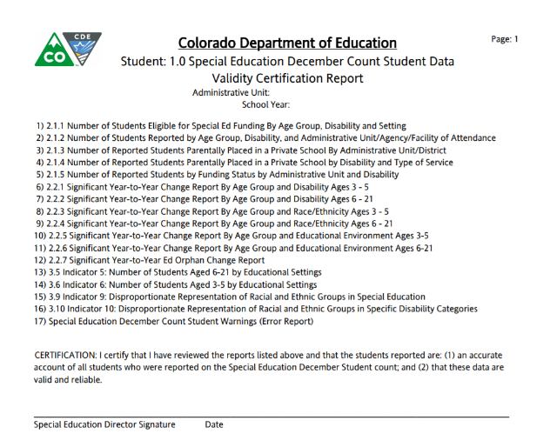
Student Data Validity Certification Report
☑
Your Director must certify that they have reviewed all these reports in January. Report Numbers 1, 2, 3, 4, 5, 7, 9, 10, 12, 13, 14, and 15 will not be uploaded to the DMS until February, after the CDE had reviewed state data for duplicates.
Notes:
Before the January due date your director must review the Error Reports for Warnings. Your director must also review the other reports listed and they may want to review “detail” reports that are tied to these.

Slide 10
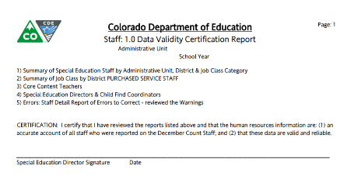
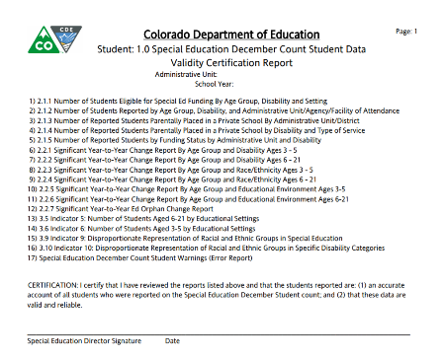
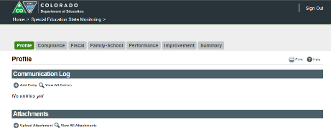
Submitting Data Certification Reports (2 reports)
Staff and Student Data Certification Reports are due on Thursday, January 31, 2019
Reports require a wet signature by the Special Education Director along with the date the reports were signed.
Scan both signed documents into a PDF
Upload the PDF to the Data Management System/Profile Tab

Slide 11
Special Education December Count Contacts
Special Education Data Team Contact Information
Lindsey Heitman – heitman_l@cde.state.co.us 303-866-5759 All December Count questions
Orla Bolger – bolger_o@cde.state.co.us 03-866-6896 All December Count questions
Alyssa Ohleyer – ohleyer_o@cde.state.co.us 303-866-6308 -Reports, Data Management System
Lauren Rossini – Rossini_l@cde.state.co.us 303-866-6688 -Staff Reporting and Qualifications (SAM)
Annette Severson – Severson_a@cde.state.co.us 303-866-6824 -Staff Interchange
Melissa Chaffin - Chaffin_m@cde.state.co.us 303-866-6819 -Enrich/Frontline
*Please include your AU #, District #, Error code # (if applicable), and phone number in emails ☺
Online Resources
Special Education IEP Interchange: http://www.cde.state.co.us/datapipeline/inter_sped-iep
Staff Interchange: http://www.cde.state.co.us/datapipeline/inter_staff
December Count Snapshot: http://www.cde.state.co.us/datapipeline/snap_sped-december
THANK YOU!

