Slide 1
November 1, 2023
Staff Interchange-Human Resources Snapshot Collection Training
Dawna Gudka-Collection Lead

Slide 2
Today's agenda, November 1st, 2023
IdM (Idenity Management System) Roles
Collection Roles
Interchange files
What makes up the HR Snapshot
Staff Interchange website
HR Timeline
Staff that gets reported
What collections use staff data
Data Pipeline Process
How we share PII data
PII data
Why is it important to report accurate data
Collection Resources

Slide 3
Townhalls
Every Thursday from 9-10AM Data Services Unit host Townhall
Upcoming Townhalls and Trainings
Archived Townhall Presentations
Email DATASERVICES-subscribe-request@cdelist.cde.state.co.us to sign up for weekly town hall email reminders.

Slide 4
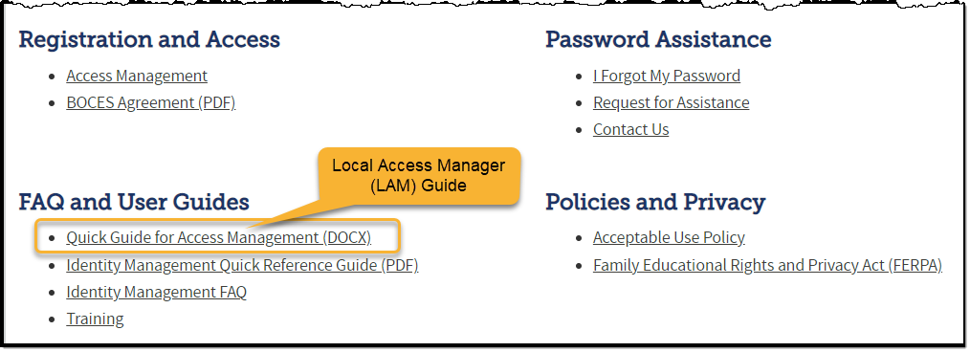
Colorado Department of Education Identity Management (IdM)
Identity Management Site
Frequently Asked Questions
How do I add myself or others to the email listserv for town hall emails and/or a specific collection?
Email lists are dependent on a person’s access rights in IdM. Contact your LAM to get an account or be assigned to a specific collection.
Where can I find the IdM role mappings for Data Pipeline and other applications?
Role Mapping (XLS)

Slide 5
IdM Roles for the Staff Collections (Identity Management System)
Staff Interchange Roles (both 4-digit LEAs and 5-digit AUs):
STF~ LEAUSER – upload and modify staff interchange files OR
STF~LEAVIEWER – view (only) staff interchange data
Human Resources Snapshot Roles (only 4-digit LEA codes):
HRD~LEAAPPROVER – Approves, creates, views Snapshot OR
HRD~LEAUSER - creates, views Snapshot OR
HRD~LEAVIEWER- views snapshot
Special Ed December Count Snapshot Roles (only 5-digit AU codes):
DEC~LEAAPPROVER – Approves, creates, views Snapshot OR
DEC~LEAUSER - creates, views Snapshot OR
DEC~LEAVIEWER- views snapshot
Staff Evaluation Snapshot Roles (only 4-digit LEA codes):
EVS~LEAAPPROVER =(YOUR LEA)-EVS~LEAAPPROVER APPROVER ​ Approves, Creates, views Snapshot​.
EVS~LEAUSER = (YOUR LEA)-EVS~LEAUSER SUBMIT AND MODIFY ​ Creates, views Snapshot​.
EVS~LEAVIEWER = (YOUR LEA)-EVS~LEAVIEWER READ-ONLY ​ Views Snapshot​
Staff Interchange
Human Resources Snapshot Collection

Slide 6
Staff Interchange
Dawna Gudka

Slide 7
Staff Interchange files make up the Human Resources Snapshot
Staff Profile interchange file
Staff Assignment interchange file
Human Resources Snapshot Collection
Staff Interchange
Human Resources Snapshot

Slide 8
Staff Interchange-website
Bookmark-Staff Interchange website
Staff Interchange
Human Resources Snapshot

Slide 9
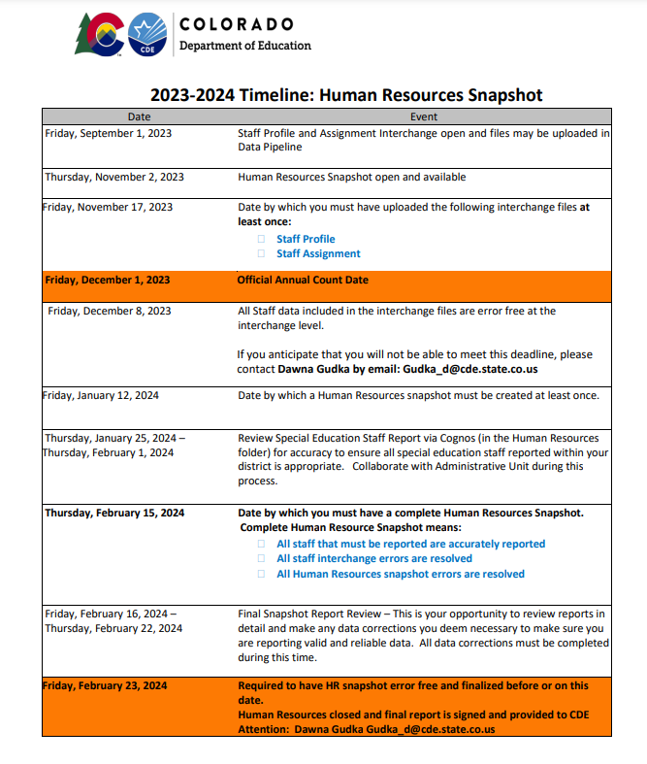
Staff Interchange Human Resources Timeline
Staff Interchange
Human Resources Snapshot

Slide 10
Staff Interchange What Staff do I report?
Staff Profile
General information of staff
Only 1 record per staff
Staff Profile file must be uploaded first
Staff Assignment
Provides specifics to actual duties and locations
Multiple records per staff allowed
Staff Interchange
Human Resources Snapshot

Slide 11
Staff Interchange What staff are included?
All staff employed and or servicing LEA (district students) as of December 1st are included in the Human Resources Collection
ALL Employed STAFF
Full & Part time staff
General Education staff
Special Education staff
Districts report their Special Ed Staff as part of their staff interchange files OR
Administrative Unit reports special education staff for all member districts and the districts exclude them
Charter School staff
Active assignment on December 1st
District (LEA) staff
District level staff are reported with School Code 9980 for ‘District Wide’
Purchased Staff servicing LEA students
Purchased staff resource documentation
Staff Interchange
Human Resources Snapshot

Slide 12
Purchased Staff

Slide 13
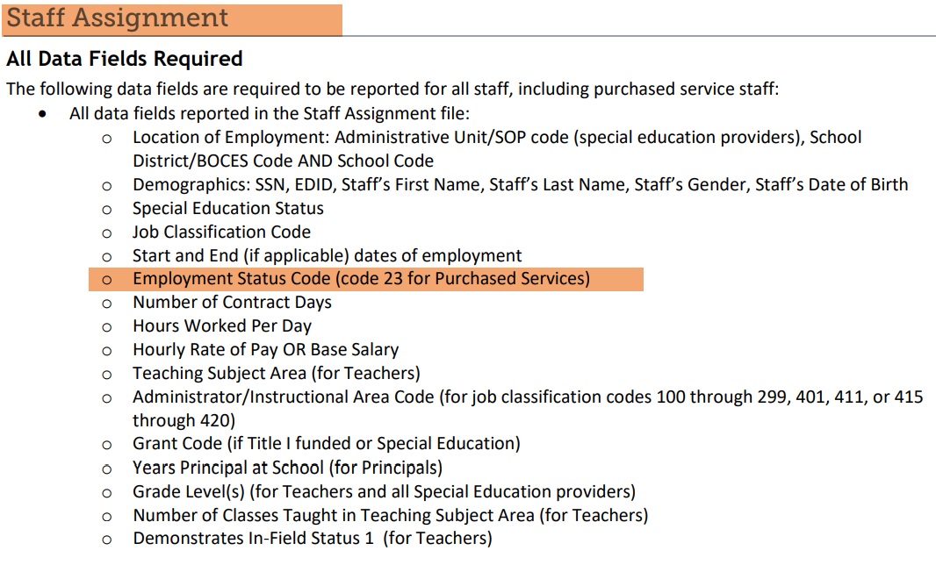
Purchased Staff What data elements are required to be in the interchange files?

Slide 14
Staff Interchange files are used for other collections
Staff Interchange files are used in the following snapshots:
Human Resources Snapshot
Special Education December Count
Teacher Student Data Link (TSDL)
Staff Evaluation Snapshot
Notes on the Snapshot Process:
Human Resources and Special Education December Count Snapshots pull the records from Staff Assignment and Staff Profile files matching the criteria set for each snapshot
Snapshots are not automatically updated when interchange files are uploaded- a new snapshot must be created within the system to pull in the updated records

Slide 15
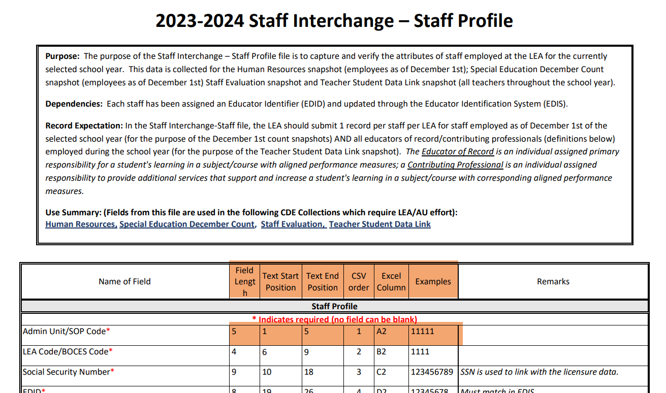
Staff Interchange-Staff Profile file layout
Staff Interchange
Human Resources Snapshot

Slide 16
Staff Profile Template Sample File

Slide 17
Staff Profile-data continues

Slide 18
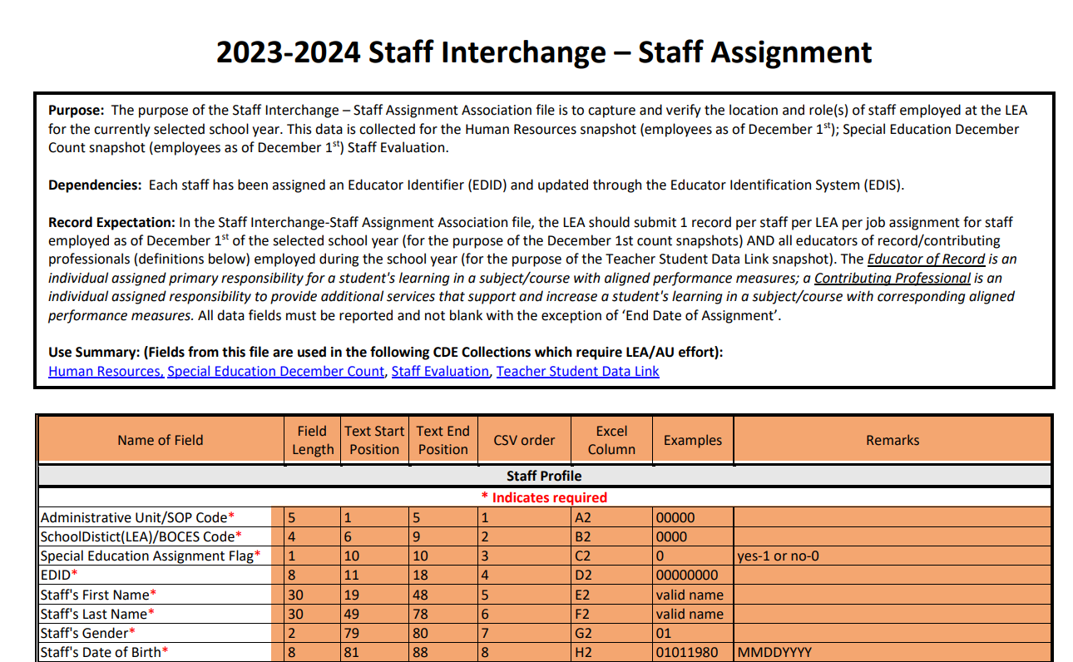
Staff Interchange-Staff Assignment file layout
Staff Interchange
Human Resources Snapshot

Slide 19
Staff Assignment file

Slide 20
Data Pipeline Process

Slide 21
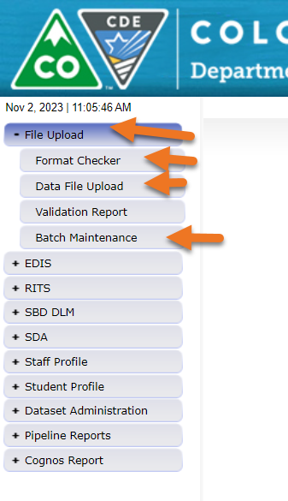
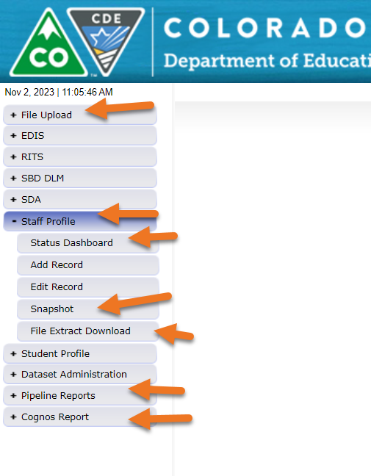
Data Pipeline Overview

Slide 22
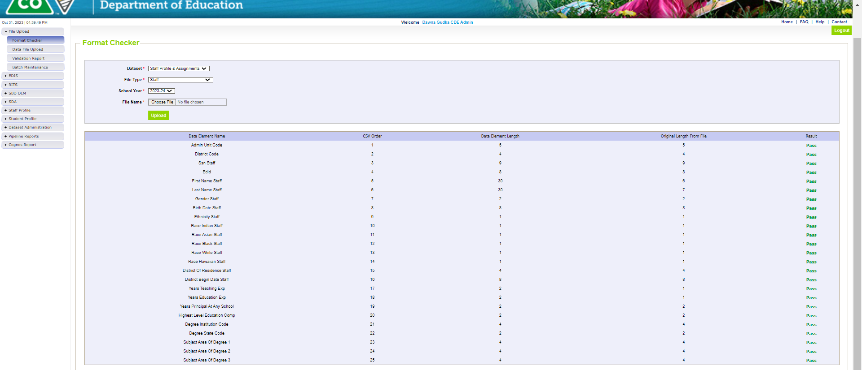
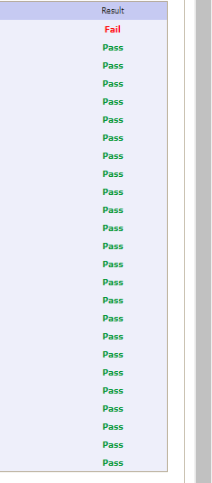
Using format checker

Slide 23
Using Format Checker File Not Processed-Next Steps
Ensure file has all green ‘pass’ in format checker
YES?
Open file and review all records are formatted the same as the 2nd row
Be sure all codes and dates have leading zeros included
NO?
Review file layout posted online and re-format the file
For further assistance, contact Dawna Gudka (Staff Interchange/Human Resources or Lindsey Heitman (Special Education December Count)
DO NOT INCLUDE THE FILE IN ANY EMAILS – if needed we can send a syncplicity folder to share the file(s) securely

Slide 24
Data Pipeline Process-Upload Staff Profile

Slide 25
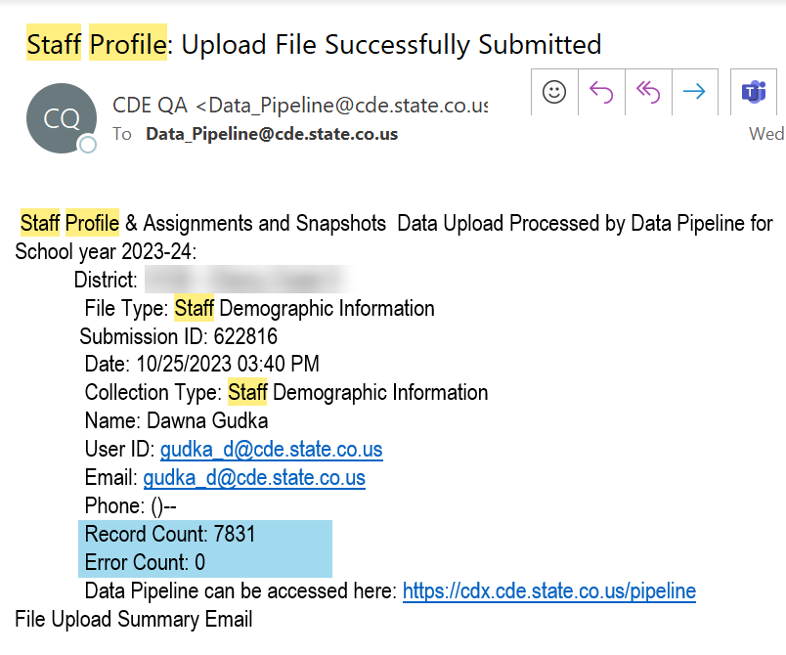
Data Pipeline Process-Checking the file process
Once your file has processed you will receive an email
Another way to check your files status

Slide 26
Data Pipeline Process-checking for errors
Checking for errors in Data Pipeline Error Report
Click on View Details to see the error in detail

Slide 27
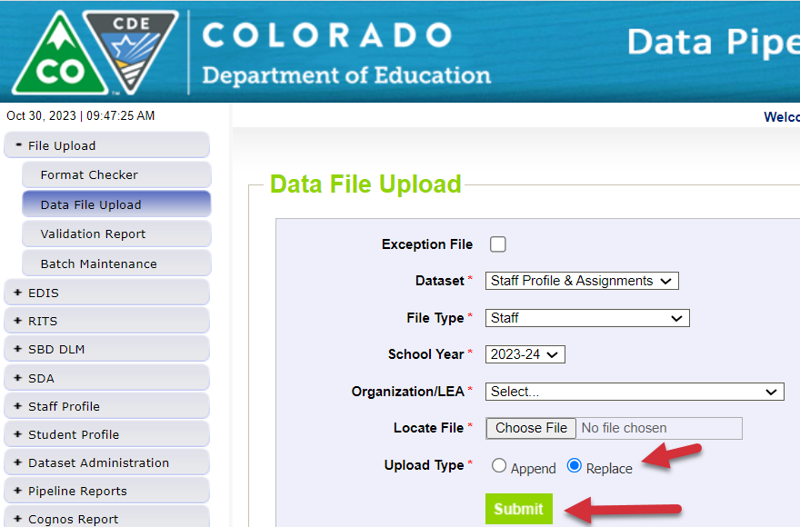
Data Pipeline Process-correcting the errors
Always correct your errors in your staff information system
Then extract the staff profile file again, and reupload into Data Pipeline replacing your file:
Repeat the steps to check your file processing status then check for errors and warnings, correct if any errors then reupload by replacing your file again until you are error free

Slide 28
Data Pipeline Process-Uploading Staff Assignment Interchange file

Slide 29
Data Pipeline Process-File Processing Checking batch maintenance or status dashboard

Slide 30
Data Pipeline Process-Checking for Staff Assignment interchange errors and correcting the errors

Slide 31
Data Pipeline Process-Human Resources Snapshot
Creating a Snapshot Data Pipeline merges the interchange files together
Staff Profile = Processed and Zero Error Count
Staff Assignment File = Processed and Zero Error Count
Create Snapshot
Districts/BOCES create Human Resources Snapshot
Administrative Units create Special Education December Count Snapshot

Slide 32
Data Pipeline Process-Human Resources Snapshot-checking for errors
Once you click search, you can see your errors, then click on view details to see your errors in detail

Slide 33
Data Pipeline Process-Human Resources Snapshot-errors
Correct the errors in the file:
May have to fix errors in both Staff Profile and Staff Assignment files
Keep file versions – in case updated file causes even more errors, you can re-start using a prior file version
Resubmit your data records using the same process and replacing your existing data file using the Data File Upload tool
All errors must be corrected, all warnings should be reviewed

Slide 34
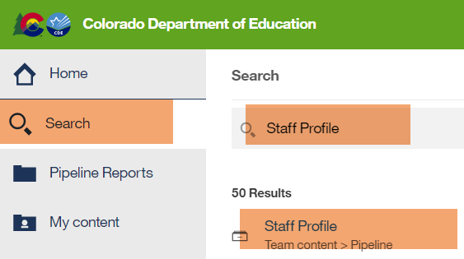
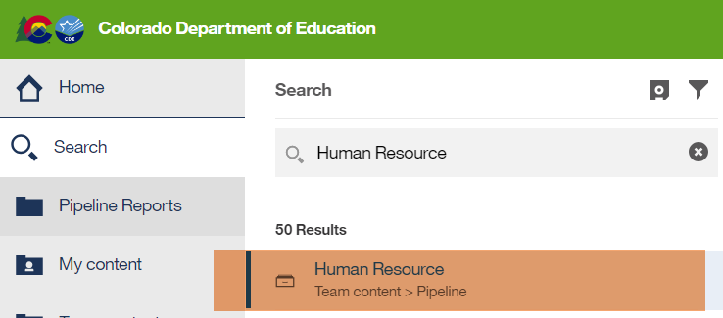
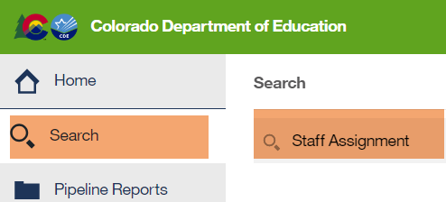
Data Pipeline Process-Human Resources Snapshot Validate your data
How to validate your data? Using Cognos Reports

Slide 35
Pulling your Human Resources Snapshot Records
Snapshot Records review

Slide 36
Data Pipeline Process-Correcting your errors in your interchange files then create a new snapshot to pull in the new data
Once your interchange files are error free and your Human Resources Snapshot is error free you can submit your data to CDE,

Slide 37
What is PII?
Student Personally Identifiable Information (PII) is defined by state and federal laws as information that, alone or in combination, personally identifies an individual
This includes direct identifiers (i.e. student and staff names, SASID, EDID, etc.)
Includes information that when combined is identifiable
Colorado’s Student Data Transparency and Security Act outlines requirements for how Student PII is collected, used and shared
CDE has prepared guidance on how to comply with this and other privacy laws which can be found here.

Slide 38
Sharing Data
Use secure methods to transfer any PII to CDE
Contact Data Collection leads with questions about how to transmit PII securely
Each Data Collection leads maintains their own Syncplicity folders for specific collections, reach out to the collection lead for access
Use Syncplicity to encrypt emails to CDE
Avoid sending PII via unencrypted email or to unsecured faxes when sharing data between or within districts
Use Syncplicity to encrypt emails to CDE
Check local policies for restrictions, requirements, etc. regarding PII
Do not use PII in trainings, presentations, etc.
Do not share PII with unauthorized individuals
Do not share passwords
Follow local policies when transmitting PII to any third party

Slide 39
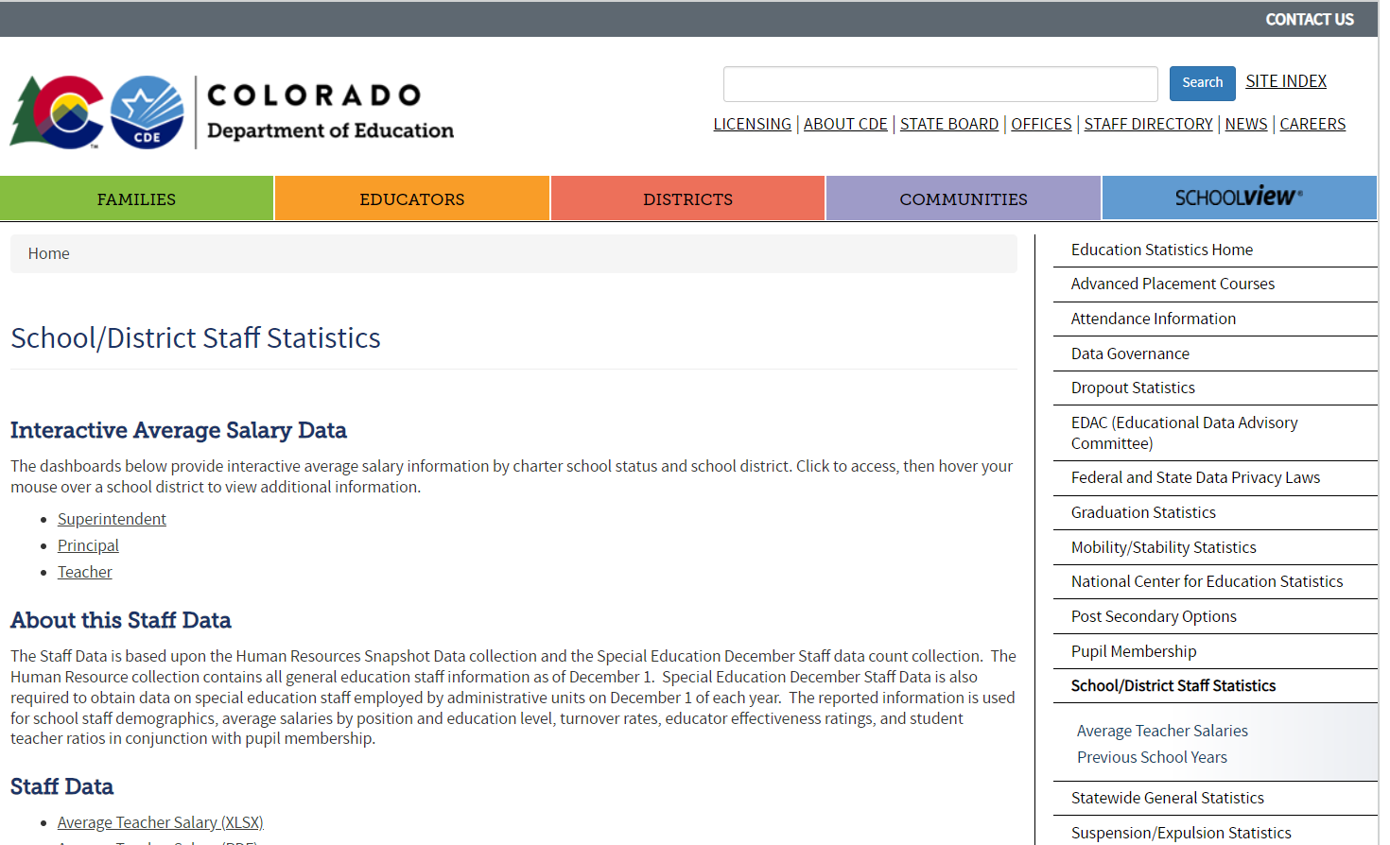
Published Staff Data
LEA’s are required to report to CDE, and CDE is required to report to the US Department of Education and publish reports on our website
DATA CENTER
CURRENT STAFF DATA

Slide 40
QUESTIONS
Please include your 4-digit LEA district or 5-digit AU Code when emailing us
Staff Questions
Human Resources
HumanResourcesData@cde.state.co.us
Dawna Gudka-Collection Lead
(303) 598-7901
Special Education Staff Questions
Special Education December Count
SpedDecCount@cde.state.co.us
Lindsey Heitman-SPED December Count Collection Lead

