Slide 1
Student October Mid-Collection Office Hours 2024-2025
Brooke Wenzel StudentOctober@cde.state.co.us

Slide 2
Agenda
Timeline
Exceptions
Home School Data
Pupil Attendance Information
Transfer Enrollment Exceptions
PK Data Reporting

Slide 3
Timeline

Slide 4
Data Collection and Cleanup Phase Timeline
Date | Event | Event Description
10/14/2024 | Interim Deadline | Create an initial Student October Snapshot
10/22/2024 | Interim Deadline | Error free Student October Snapshot
10/24/2024 | Training Event | Data Validation, Transfer Enrollment Exceptions and Cognos Reports 1-2 p.m.
10/28/2024 | Training Event | Data Pipeline Duplicate Process and Submission 9-10 a.m.
11/01/2024 | Report Review | Review Student October Cognos Reports for data validation. Submit Student October Snapshot data as soon as review is complete.
11/08/2024 12:00 p.m. | State Deadline | Submit Student October Snapshot data

Slide 5
Duplicate Count Phase Timeline
Date | Event | Event Description
11/12/2024 12:00 p.m. | Deadline | Duplicate funding documentation due to School Auditing Office
11/18/2024 | Other Date | School Auditing makes decisions on funding duplicates
11/27/2024 | Deadline | Resubmit Student October Snapshot data to CDE based on decisions from School Auditing
12/06/2024 | Deadline | Collection closes Secretary of the Board of Education Verification (sign-off) form due. Data remains embargoed until the official release in January.
01/15/2025 | Data Release | Official data release
General Duplicate Count Process
Begins once all districts have submitted their Student October Snapshot to CDE, Friday, November 8th
~3 business days after running the duplicate process Duplicate Documentation is due to The CDE School Auditing Office
~2 business days after documentation received decisions will be sent to districts
Signature Page
Due Friday, December 6th: Signed by Secretary of Board of Education AND the Chief Financial Officer
If your district needs an extension, please send Student October Collection lead an email with the day when your School Board Secretary will be able to sign the form

Slide 6
Exceptions

Slide 7
When are reporting exceptions needed?
Sometimes a student’s records will have accurate information, but their educational history will not follow the anticipated coding patterns outlined in the business rules for an interchange file or snapshot
These are unique circumstances and apply to few students
Reporting exceptions are used to clear the errors associated with a student’s record without changing the data
Data respondents must work with the data collection lead for a given file/snapshot to request an exception be granted

Slide 8
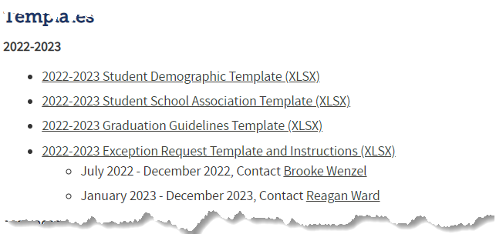
Reporting Exception Process (Option 2)
Complete exception request template
Upload exception request template to your district’s Syncplicity student folder
Folder: 1234 – DISTRICT NAME – Student
Notify the OCT collection lead (StudentOctober@cde.state.co.us) that you’ve uploaded a document for review
Collection lead will review your request and notify you of the outcome
Approved requests – reupload interchange file and/or create a new OCT snapshot
Denied requests – collection lead will provide next steps for clearing the error
Additional information needed – collection lead will request information
Available on Student Interchange Website
Pro Tip: Include the date in name of your exception request file as you may upload more than one exception during the collection cycle

Slide 9
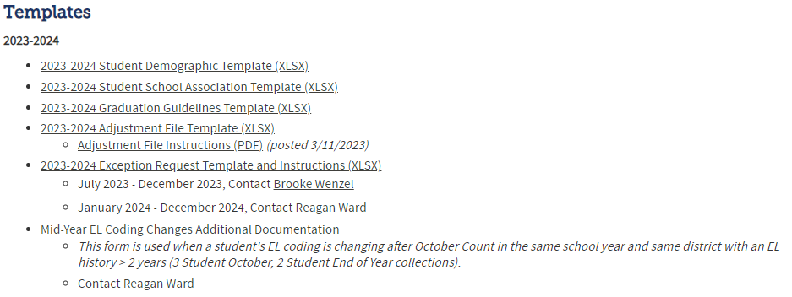
Requesting Exceptions (Option 2)
Each error needs a row, even if the same SASID is generating multiple errors
You can use the same explanation multiple times though
Fields Required for exceptions to errors in Demographic File
Where do I find the Exception Request Template?
Student Interchange Website

Slide 10
Home School Data

Slide 11
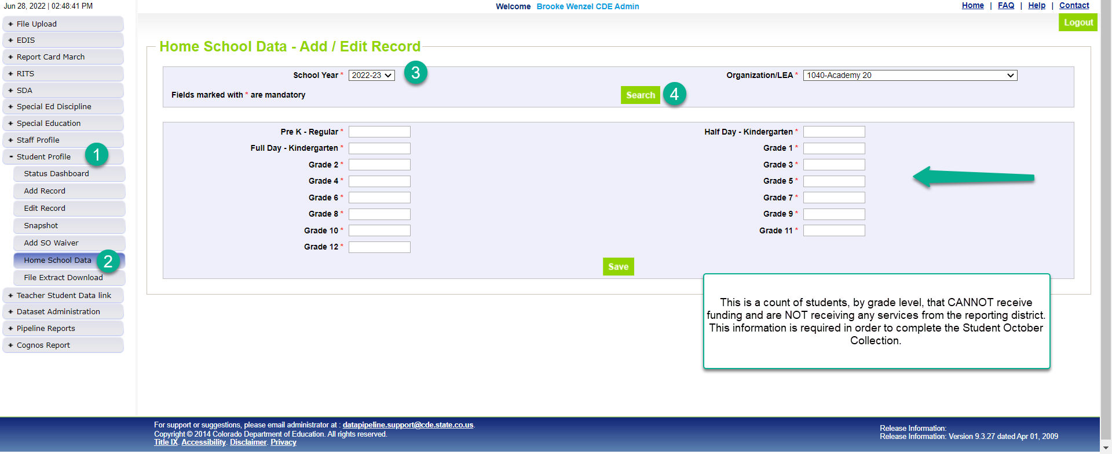
Home School Data Screen
*Please note that you’ll need to include any homeschool students receiving some regular education services provided by the district in your interchange files. They are only eligible for a maximum of part-time funding. For homeschool student receiving no services report them in Home School Data under Student Profile. These students who are not taking any classes offered through the district are not eligible for funding.

Slide 12
Pupil Attendance Information

Slide 13
PAI Overview
Pupil Attendance Information (PAI)
Students in membership at a given school or program
Students in membership at another district/BOCES school or program

Slide 14
Criteria for PAI Codes
Which Students get included in Student October?
Students in membership at your district’s schools (PAI=01-08)
Students your district is contracting with an outside program/district/BOCES to educate (PAI=24-33)
What is membership?
Enrolled by the count day (or alternate count day)
Attendance on count day OR
Has established attendance prior to count day during the current school year AND resumes attendance within 30 days following the count day
Enrollment
Attendance
Membership

Slide 15
01-08 PAI Codes
Resident Pupils Attending an Educational Program Operated by the Reporting District
01-Resident, Designated School
02-Resident, School of Choice (Open Enrollment)
03-Resident, Non-District Site (Expelled, Preschool)
04-Non-Resident, Choice (Public Schools of Choice)
05-Non-Resident, Non-Choice
08-Resident, Non-Choice
These codes are for students being educated in the district reporting them. Resident/Non-resident should be determined by the district associated with the residence of the parent(s).

Slide 16
24-33 PAI Codes
Resident Pupils Attending an Educational Program Not Operated by the Reporting District
24 – Court Mandated Juvenile Detention
27 – Non-Public Schools (Contractual Agreement)
28 – Outside of Colorado Public Education Agency
29 – Outside of Colorado Non-Public School
30 – Colorado Public Agency (Contractual Agreement)
31 – School District or BOCES (Contractual Agreement)
33 – Online Schools (Contractual Agreement)
These codes are used for students who are residents of reporting district, but the district is not educating the student

Slide 17
OCT: Students attending BOCES Schools/Programs
Contract with a BOCES?
School: BOCES has own school code
Home District: OCT record, Group B PAI = 31 or 33, Funding Code = Applicable
BOCES District: OCT record, Group A PAI = 02 or 04,
Funding Code = not funded
Program: BOCES does NOT have a school code
Home District: OCT Record with Group A PAI 01-08 and Non-School Program Code 03
BOCES Program: no state reporting
Notes:
PAI Codes (on the SSA file):
Group A = Pupils attending an educational program operated by the reporting district
Group B = Resident Pupils attending an educational program not operated by the reporting district
Special Education PAI Codes:
See the Special Education IEP Interchange – Child Participation file layout for information
Based upon students within the Administrative Unit (AU) – which means codes may vary from the PAI codes used on the SSA file since those are based upon district level information

Slide 18
New Warnings
OC183: You currently have a student that is being contracted through a BOCES (Pupil Attendance Information = '31' or '33') and is not being picked up by a BOCES. Please verify with your BOCES contact(s) that this student will be picked up by the BOCES for educational services.
Will flag for everyone that doesn’t have student being picked up by a BOCES.
OC184: You currently have a student that is coded as a Schools of Choice student (Pupil Attendance Information = '02' or '04') and is not being picked up by a district. Please verify with your district contact(s) that this student will be picked up by the district for funding purposes.
Only will flag for BOCES

Slide 19
Common Contract Students
Contract with another district or BOCES school that has a school code
Resident District
Pupil Attendance Information 31 for the enrollment record showing the contract for funding purposes(brick and mortar).
Attending District or BOCES
Will have a record with PAI 02 or 04 to show student is attending their district. This record will have a non-funded code because they are paid through the contract instead.
Contract with another district or BOCES program that doesn’t have a school code
Resident District
Pupil Attendance Information 01-08 and Non-School Program of 03 to indicate that the resident district is taking accountability with the non-school 03 indicating the student is receiving all their educational services through a program that is run and operated by another district (i.e., non-reporting district) or BOCES with which the district has a contractual agreement.
Facility School
Resident District
Most likely, you won’t have a record for this student because funding for facility schools is different. More information on these rare scenarios can be found in the Audit Resource Guide.
Posted: Contract student document on the Student Interchange Website under Additional Resources with common scenarios for all student-level collections (including special education).
Student October
StudentOctober@cde.state.co.us

Slide 20
Parent’s Residence Fields

Slide 21
PAI Code and Parent’s Residence
District of Parent’s Residence - School district where the parent/guardian resides if the student attends a district and resides in CO.
For records having an Attendance/Residence code of "04 – Non-Resident, Choice", or "05 - Non-Resident, Non-Choice" use the district code of the parent/guardian’s home district.
For records where the parent/guardian’s residence is in the district the student is attending use the district code of the home district.
The fields [State of Parent’s Residence for Non-Residence Students] and [Country of Parent’s Residence for Non-Residence Students] should be zero filled when this field is used.
Country of Parent’s Residence for Non-Residence Students - Country code where the parent/guardian resides, for foreign exchange students.
This code is required for records having an Attendance/Residence code of "04 - Non-Resident, Choice", or "05 - Non-Resident, Non- Choice".
The fields [State of Parent’s Residence for Non-Residence Students] and [District of Parent’s Residence] should be zero filled when this field is used.
State of Parent’s Residence for Non-Residence Students - State code where the parent/guardian resides, if the student attends a district other than the school district of residence.
This code is required for records having an Attendance/Residence code of "04 - Non-Resident, Choice", or "05 - Non-Resident, Non- Choice".
The fields [Country of Parent’s Residence for Non-Residence Students] and [District of Parent’s Residence] should be zero filled when this field is used.

Slide 22
Transfer Enrollment Exceptions

Slide 23
Funding Requirement: Transfer Enrollment Exceptions
Students enrolling after the pupil enrollment count date, but before the end of the 11-day count period, may be eligible for funding if they meet the requirements for one of the transfer enrollment exceptions:
Within-District Transfers
Within-State Transfers
Out-of-State Transfers
Submit Transfer Enrollment Exceptions for these students
Template can be found on the Student October Website under “Templates”

Slide 24
Out-of-State Transfer Enrollment Exceptions
Out-of-State Transfer Enrollment Exceptions (1 CCR 301-39 (5.04)(1))
If a student moves to Colorado (from another state or country) within 30 days prior to the applicable count date and enrolls in a district after the applicable count date, but before the end of the 11-day count period, the student may be eligible for funding if:
The student establishes enrollment and attendance at the receiving district prior to the end of the 11-day count period, AND
The student has a schedule at the receiving district prior to the end of the 11-day count period.
New: A sample Out of State Transfer Enrollment Eligibility Sample Form is available as a Word document on the Pupil Count page.

Slide 25
Preschool Data Reporting

Slide 26
Student October Expectations
LEAs Will Report
LEAs Will Not Report
All PK students receiving services from the LEA (regardless of UPK funding status) – PAI 01-08
These students should have a SASID assigned
All PK students as Not Funded (Public School Finance Funding Status ‘86’, ’87’ or ‘96’) for enrollment purposes
All related Demographic and School information
Any PK students not receiving services from the LEA (optional) – PAI 24-33
An alternate count date for PK students (if applicable)
All students will fall under the October Count Date
CPP/ECARE Funding Information – no longer applicable
*LEA = Local Education Agency (district, Charter School Institute and BOCES are included)

Slide 27
Resources

Slide 28
Thank You for Attending!
720-441-7963
StudentOctober@cde.state.co.us
Student October Website
Student Interchange Website
Identity Management/Data Pipeline
Auditing Office’s Pupil Count Website
At-Risk Interchange Website
Title I Interchange Website

