Slide 1
Special Education End-of-Year Collection Training 2023-2024
May 14, 2024
Lindsey Heitman
Heitman_l@cde.state.co.us

Slide 2
Welcome and Contact Information
Welcome and thank you for joining the training!
Data Services Contact:
Lindsey Heitman – SpedEndofYear@cde.state.co.us
heitman_l@cde.state.co.us 303-866-5759
Collection manager
Data Pipeline submission
Business Unit – Exceptional Student Services Unit Contacts:
Orla Bolger – bolger_o@cde.state.co.us ESSU Contact – data content clarification/data requests
Josh Fails – fails_J@cde.state.co.us ESSU Contact – Data Management System/questions on uploading final reports to the DMS
Please include in emails:
AU #
error code # (if applicable)
any school code #’s referenced

Slide 3
Agenda
Purpose/Content/Timeline – slides 5-10
Special Ed IEP Interchange/Special Ed EOY Snapshot/Resources – slides 12-22
What’s New – slides 24-27
Who to Report- Content Details slides 29-37
Summary of Paths/When to Report – slides 39-54
Exceptions Process – slide 67
EOY Summer/Missing Exits – slides 60-61
Exits from Special Education- slides 56-66
Data Pipeline Process –slides 69-80
More on Cognos Reports – slides 82-85

Slide 4
Overview

Slide 5
Frequently Used Terms and Acronyms
Term | Definition
LEA | Local Education Agency
AU | AU stands for Administrative Unit and means a school district, board of cooperative services, multi-district administrative unit, a charter school network, a charter school collaborative, or the State Charter School Institute, that is providing educational services to exceptional children and that is responsible for the local administration of services.
IdM | Identity Management. A single sign on system, allowing users to navigate between most CDE applications with the same login.
LAM | Local Access Manager. The individual with your LEA that is responsible for assigning the appropriate access to CDE applications.
Interchange | The data holding place within the Data Pipeline. A method of providing data to CDE in which LEA’s may choose from multiple file formats to submit data throughout the year.
Snapshot | A date in time when data is pulled from the appropriate interchanges, validated by additional business rules, and approval given that signifies it was accurately reported for a specific point in time by an LEA.
Cognos Reports/Cedar | Colorado Education Data Analysis and Reporting System (CEDAR). A type of report in which the user can view applicable reports that are formatted in a user-friendly environment.
DMS | The ESSU Data Management System (DMS) is a single sign on system that assists AUs in meeting accountability requirements for Special Education and Gifted Education.

Slide 6


Collection Process Overview
Schools
Track data throughout school year
Admin Unit/SOP
Combines data from schools. Determines the appropriate coding for each record.
Reports data to CDE
CDE via Data Pipeline
Provide data to Admin Unit/SOP
Verifies accuracy, corrects and approves data.
Checks data for accuracy
Collects data from Admin Unit/SOP
Edits data, all errors must be corrected
Federal Government
CDE Reviews and validates data and submits to U.S. Department of Education
Allows approval once passed all edit validations
Notes:
Admin Unit/SOPs collect data from schools and/or member districts. Data is compiled at the AU level and submitted to the CDE via the Data Pipeline.

Slide 7
Purpose and Content
FS009 File: Children with Disabilities Exiting Special Education
The unduplicated number of students with disabilities (IDEA) who are ages 14 through 21, were in special education at the start of the reporting period and were not in special education at the end of the reporting period.
The data collected using this file specification are collected under the authority of the Individuals with Disabilities Education Act (IDEA), Section 618.
OSERS/OSEP – Office of Special Education and Rehabilitative Services/Office of Special Education Programs
State Performance Plan Indicators
Indicator 1: Graduation - percent of youth with IEPs graduating w/ regular diploma
Indicator 2: Dropout – percent of youth w/ IEPs dropping out
Indicator 11: Timely Initial Evaluation - percent of children evaluated for Part B Services within 60 days
Indicator 12: Part C to B Transition -percent of children with IEP by 3rd birthday
Indicator 14: Post School Outcomes - percent of youth with IEPs no longer in school
Exceptional Student Services Unit – CDE Office of Special Education home page
Click General Supervision and Monitoring, then Results Driven Accountability
Find published Special Education data reports for Colorado
Find descriptions of each of the State Performance Plan Indicators as well as the Annual Performance Reports for Colorado

Slide 8
Identity Management: Access to the Data Pipeline
INTERCHANGE ROLES *1 per account | ENABLES USER TO:
SPE~LEAViewer | read-only access
SPE~LEAUSER | upload files, view interchange level errors
SNAPSHOT ROLES *1 per account | ENABLES USER TO:
EOY~LEAVIEWER | read-only access
EOY~LEAUSER | create snapshots and view snapshot level errors
EOY~LEAAPPROVER *Need at least 1 | create snapshots, view snapshot level errors, AND can approve data (Submit final snapshot to CDE)
Special Education IEP group is: SPE
Special Education EOY Snapshot group is: EOY
Assigned by LAM (Local Access Manager)
LAMs click here to get to the IdM Home page
Only 1 role per group/account
LEAs may have as many Viewers, Users, and Approvers as needed

Slide 9
Special Education EOY 23-24 Timeline
May 1, 2024 - SPED EOY Snapshot official open
June 27, 2024 – IEP Interchange files error-free
August 29, 2024 - All Exception requests submitted to CDE
September 5, 2024 – All errors resolved at snapshot/interchange
September 5 -13, 2024 -Initial Report Review
September 16 - 20, 2024 – Resolving duplicates
September 20 - 27, 2024 – Final Report Review
September 27, 2024 - Final approval in Data Pipeline and reports uploaded to DMS
Download full Timeline from the Special Education End of Year Snapshot webpage

Slide 10
Reporting Period
The Special Education End of Year reporting period is July 1, 2023 through June 30, 2024.
The purpose of this snapshot is to obtain data on students who were referred, evaluated, and/or received special education services in your AU at any point during the reporting period.
All Users: Please update your Child and Participation files with a SPED EOY reporting focus now
Enrich Users:
Be sure you are selecting the EOY 23-24 option for your Child and Participation files.
Check collection parameters under collection settings to be sure it shows the full collection period of 07/01/23 – 06/30/2024.

Slide 11
Special Education IEP Interchange and Special Education End of Year Snapshot

Slide 12

From where does the Special Education EOY Snapshot extract data?
*An Interchange is the data holding place where your data files may be uploaded and validated throughout the school year
Special Education EOY Snapshot
IEP Interchange
Child File
Participation File
Student Interchange
Student Dem File
Student School Association File
*A snapshot is a point in time “picture” of your data extracted from the Interchange files
Begin creating snapshots once the required files are uploaded
Records with errors at the interchange level will not pull into your level 2 snapshot validations

Slide 13
Special Education IEP Interchange includes 2 Files
Child File
Demographic information
1 record per student
The primary source of this information is the Student Interchange Student Demographic File -Untagged File IF LASIDS match between district and AU
If student is not required to be submitted in the Student Interchange (private school or facility students) the demographic data is pulled from this file into the snapshot
Participation File
Special Education services information
1 record per student
Record should reflect a student’s latest Sped status within the reporting period
The primary source of the Entry Grade Level field is the Student Interchange Student School Association File- Untagged File
If student is not required to be submitted in the Student Interchange (private school or facility students) the Grade Level is pulled from this file
Each record must have a valid SASID and/or a LASID combination on each file
LASIDs must match district uploaded Student Interchange files in order for the demographics to pull from the district files

Slide 14
Special Education IEP Interchange
The Special Education IEP Interchange consists of two main files which contain Special Education data for the school year. The CEIS file is an additional file required by a small number of AUs each year.
Special Education Child File
Student demographic information
The demographic data pulls primarily from the Student Demographic File
If student is not required to be submitted in the Student Interchange (private school or approved facility students) the demographic data is pulled from this file into the snapshot
Special Education Participation File
Special Education services and referral information
Grade Level is included in this file but pulls into each snapshot primarily from the Student School Association file
If student is not required to be submitted in the Student Interchange (private school or approved facility students) the Grade Level is pulled from this file
Coordinated Early Intervening Services File
Only required if your AU funded CEIS or CCEIS using federal dollars
You will be contacted by CDE if you need to upload this file
Medically Necessary Services Screen
New input screen to manually add counts related to medically necessary services

Slide 15
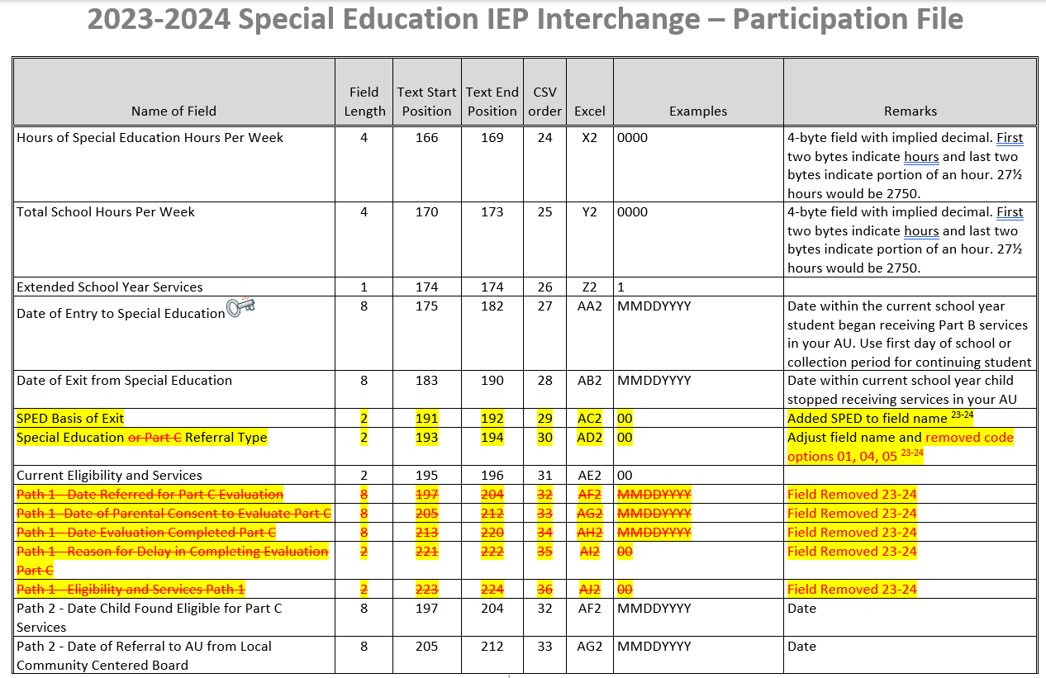
File Layout and Definitions Document: Helpful to refer to for reporting questions
What’s included in the file layout?
Dependencies and record expectation
Name and Order (format) of the fields
Number of characters in each field
Examples and remarks that help clarify
Data field name, definition, and applicable codes for each field provided below the ordered format
Changes listed at bottom of layout and highlighted in yellow, items removed listed in red font and strikethrough.

Slide 16
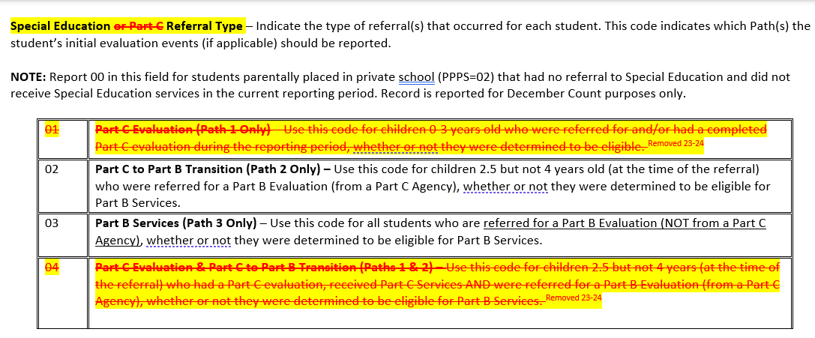
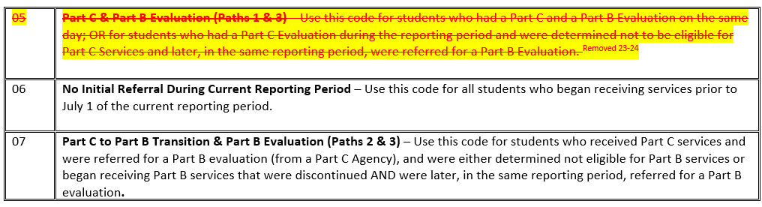
Special Education Participation File Layout
Field Name
Field Definition
All code options and their definitions

Slide 17
File Upload Tips
Excel, CSV, or Text formats are accepted
Excel templates for Child and Participation Files posted on the IEP Interchange page under Templates (if needed)
No blank fields (it likely won’t upload if there are blanks)
Be sure the file is not open when uploading it
Be sure each field has the correct number of characters
PLEASE BE AWARE OF THIS ISSUE WITH CSV Files
CSV files lose leading zeros within a data field after opening.
A file will not process successfully unless the field has the correct # of bytes.
Any field that could start with a zero will not have the correct number of bytes unless you format it to retain those leading zeros (custom or text)
Find steps for converting it to text posted here.
If your file won’t upload, add the filter to each column and scan the column filter box for those that have incorrect characters (i.e. letters instead of numbers or incorrect number of characters)
Use a version process that makes sense to you to keep track of files uploaded.
Create a folder to save your files in as you work on each snapshot.
Create an email folder for handling the Data Pipeline System Generated Emails as you will need to refer to them throughout the Data Pipeline Process.
Be sure to save your final set of files for each snapshot.

Slide 18
SPED EOY Snapshot Criteria
For a record to be added to the Special Education EOY Snapshot it must:
be included in both the Child and Participation Files
contain a matching SASID and/or LASID in both the Child and Participation Files
be error free in both the Child and Participation Files
All records that meet the above criteria will be pulled into the snapshot EXCEPT those with a PAI code of 23, 24, 31, or 32 or a Special Education Part C Referral code of 00.
Data pulled from the Student Profile Interchange will be the untagged data
Note: if records are missing from your snapshot, it is likely they have one of the following:
errors at the Interchange level
contain one of the excluded PAI codes above (which may be correct if student has already been exited)
an incorrect SASID or LASID on one file
missing a record altogether from one file

Slide 19
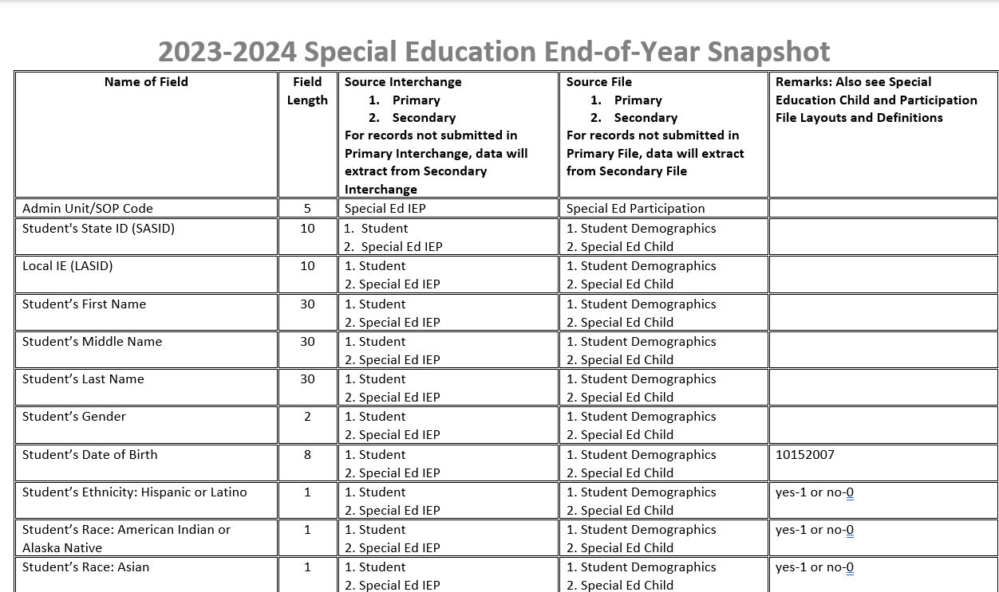
Special Education End of Year Snapshot File Layout
Snapshot File Layout found on the Special Education EOY Snapshot Webpage
Find which data fields are pulled into this snapshot
Find which Interchange file each field is pulled from

Slide 20
Snapshot Fields in which the data should pull from the Student Interchange district files
Student Interchange- Authoritative Source Fields
Student Demographic File- Untagged
SASID
LASID
Student First Name
Student Middle Name
Student Last Name
Student Gender
Student Date of birth
Student Ethnicity
Student Race
Student School Association File-Untagged
Grade Level
Please be aware the fields above pull into your Sped EOY Snapshot from these files in most cases.
If the student is not submitted by a district (Facility School and Private School records) the data will be pulled from the IEP Interchange files instead
*remember this when troubleshooting your errors around these fields!

Slide 21
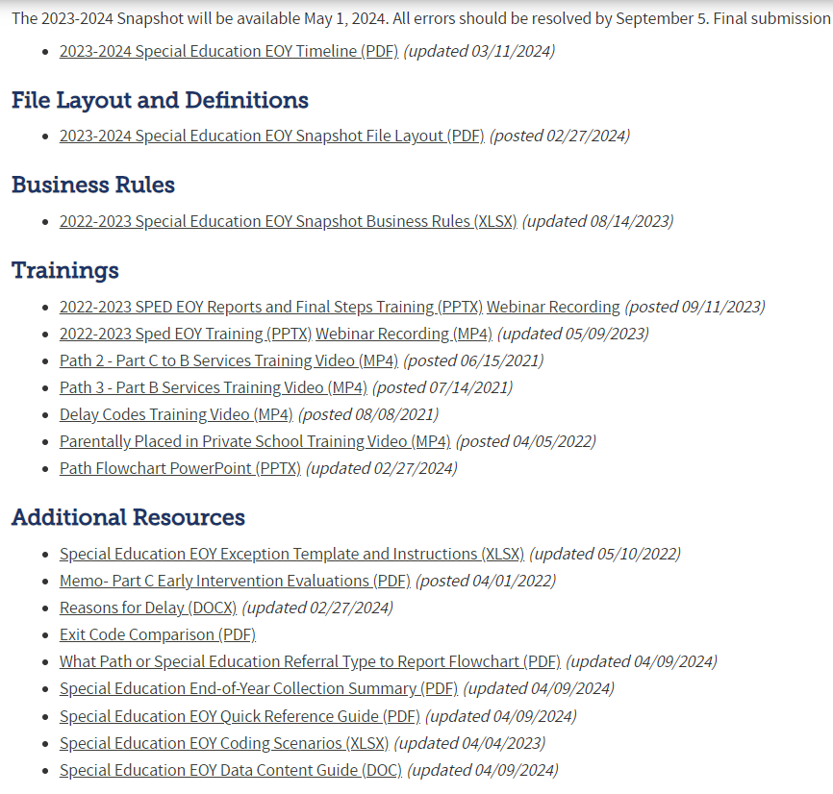
Special Education EOY Snapshot Webpage Resources
Timeline
Snapshot File Layout
Errors/Business Rules
Trainings - Overview of Paths, Delay Codes, etc.
Exception Template
Reasons for Delay – share internally/initial referral records
Path Flowchart
Sped EOY Data Content Guide

Slide 22
Syncplicity Folder– Secure place to share student and staff information
Syncplicity – online platform used for secure file sharing
Please email me if you do not yet have a folder and I will share the folder link with you
Once a file has been shared you can access Syncplicity at: my.syncplicity.com
File name is your AU code
Used for Exception requests, questions that include PII, sharing files, etc
Please email CDE to notify us you’ve placed something in the folder. We aren’t automatically notified when you’ve saved something in your Syncplicity folder.

Slide 23
What’s New in 2023-2024?

Slide 24

Special Education IEP Interchange 2023-2024 Changes
Participation File Changes:
Removed Path 1 data fields:
Date Referred for Part C Evaluation
Date of Parental Consent to Evaluate Part C
Date Evaluation Completed Part C
Reason for Delay in Completing Evaluation Part C
Eligibility and Services- Path 1
Removed Special Education or Part C Referral Codes of 01, 04, and 05
Remove Primary Disability code 12 – Infant/Toddler with a Disability
Add new Gender code 03 (non-binary)
Adjust “Basis of Exit” field name to “SPED Basis of Exit”
Adjust “Pupils Attendance Information” field name to “SPED Pupils Attendance Information”
Adjust “Special Education or Part C Referral” field name to “Special Education Referral Type”
New Input Screen in Data Pipeline for AUs to report number of requests for access to students for Medically Necessary Services

Slide 25
Medically Necessary Services: Required by all AUs in 23-24
Access to Students for Medically Necessary Services
NEW reporting requirement started in 2023-2024 school year – House Bill 22-1260
AUs must report # of requests for access to students for medically necessary services
Beginning 7/01/2024, the AU must report to CDE the number of requests during the 23-24 school year for access to a student by a private healthcare specialist and whether the access was authorized or denied.
Starting in January 2025, CDE must make this information available online.
Each AU must report to CDE the total counts for the following (no student level information is needed):
# of requests for access to a student for medically necessary services
# of those requests authorized
# of those requests denied
These counts will be collected in a new input screen within the Data Pipeline under the IEP Interchange. ‘SPE User Role’ access. (see next slide for steps)
AU will not be able to approve final SpEd EOY Snapshot until counts have been entered and saved in the Data Pipeline
Counts will not be included in your SpEd EOY Snapshot though

Slide 26
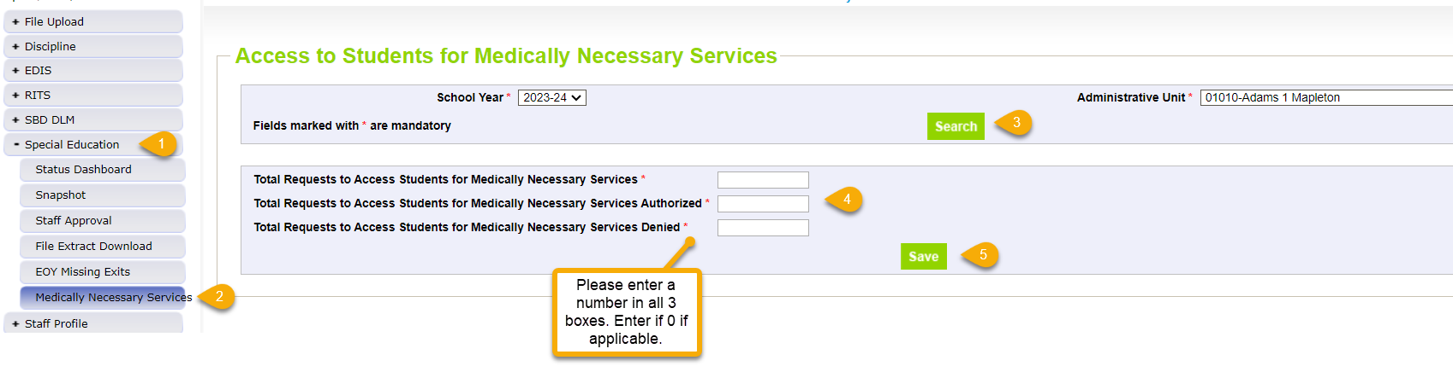
Medically Necessary Services: Steps to Submit Counts to Data Pipeline
Notes:
Counts must reflect all districts within AU from July 1, 2023 – June 30, 2024
Must be completed by the time Sped EOY is approved – by 9/27/24
AUs are able to modify counts until their final Sped EOY is locked/approved
pop up message will ensure each box is populated with a number
pop up message will ensure total # box (1st box) is the sum of those authorized and denied
Steps
1. Click Special Education tab
2. Click Medically Necessary Services tab
3. Select School Year/AU and click Search button
4. Enter a number in all 3 boxes
5. Click Save button
# Requests Authorized
# Requests Denied
Total # of Requests

Slide 27
New Business Rules: Errors or Warnings
SY311: Delay Code 41 -Parents chose to extend Part C Services - may only be used on students with third birth dates between May 1st and the start of the following school year.
SY312: Delay Code 41 - Parents chose to extend Part C services - may only be used on students beginning services at the start of the school year
SY313: Delay Code 49 -Child's third birthday occurred over the summer - may only be used on students with birth dates between May 15th of the prior school year and the start of the following school year.
SY314: Delay Code 49 - Child's third birthday occurred over the summer - may only be used on students beginning services at the start of the school year
SY310: Duplicate, this student is also reported as in attendance at another AU/SOP and has the same date of exit. Please verify your records for this student and contact the other AU to determine how to resolve on both ends.
SY315: Student is reported as completing transition in the Student EOY Snapshot with a School Exit Type of 28, indicating they met graduation requirements in a prior year. Please report a 90 in the Sped Basis of Exit field.

Slide 28
Who to Report

Slide 29
Report All Students Who:
Received services in your Administrative Unit (or a detention center within your AU) at any point during this reporting period (July 1-June 30)
Had an initial evaluation for Part B services:
were 2.5 but not 4 years old when they were referred from Part C to Part B (path 2)
were referred for a Part B special education Initial Evaluation (path 3)
Were placed in an Allowed Eligible Facility and you are the Administrative Unit of residence
Were detained at a Detention Center located within your AU boundaries
Were on an IEP and received services at a private school on a tuition basis or parentally placed in a private school, have an ISP and receive Sped services from the AU
*more specific details on who should be reported can be found on the Special Education EOY Data Content Guide pages 1 and 2. Posted here under Additional Resources: http://www.cde.state.co.us/datapipeline/snap_sped-eoy

Slide 30
Definition of Initial Evaluation for State Reporting:
who were not eligible at the time of evaluation* – student may have received Special Education Services in the past but had returned to regular education prior to this evaluation
*exception to this are transfer students in which your AU decides to do their own initial evaluation
for whom parents revoked consent for services – student received Special Education Services for a period of time prior to parent deciding to cease services. When child is again referred/re-evaluated, please report them as an initial evaluation.
who have never been evaluated for Part B Services - these students have never had an evaluation in your Administrative Unit/State Operated Program , another Administrative Unit/State Operated Program, or an Eligible Facility in Colorado.
who received Special Education Services in another state, for whom it was determined that an initial evaluation was needed.
who are parentally placed in a private school and had a Part B Initial Evaluation during the current reporting period (these students are reported by the Administrative Unit in which the private school is located).
who were educated in a non-public home-based educational program (i.e., homeschooled) and had a Part B initial evaluation during the reporting period.
Everything else is considered a re-evaluation and those dates/events do not need to be reported to CDE!

Slide 31
Please Be Sure to Include students who:
were evaluated, even if they were found not eligible. Check your data extracts to make sure students found not eligible are being reported too!
were on an IEP and received services at a private school on a tuition basis (these students are placed at a private school by the IEP team and should be reported by the Administrative Unit of Residence).
were parentally placed in a private school, have an ISP and received services from the Administrative Unit (these students must be reported by the Administrative Unit where the private school is located).
received services outside of the State of Colorado and are the responsibility of your Administrative Unit (these students are placed out of state per their IEP and should be reported by the Administrative Unit of Residence).
Any students in a Special Education Transition Program that your AU is providing services to

Slide 32
Special Education EOY: Facility Schools, Detention Centers, SOPs, and SPED Programs
The term “Facility” is used throughout the state for different types of schools/entities. In Colorado we have:
1. CDE Approved Facility Schools (“facility” students for state reporting purposes means this one)
2. Special Education Programs - programs run by a district or AU – usually located in a different building than the school
3. Detention Centers – student is detained – there are 8 detention centers currently in Colorado
4. State Operated Programs – there are 4 in Colorado DYS-66080, DOC-66070, CMHI-66060, CSDB-66050 - student is “committed” if reported by DYS or DOC
How to Code for Sped EOY:
Report the student’s latest/last attendance during the school year
Report an exit if student transfers out of your AU at any point (even if you report them for December Count).
Reporting for Sped EOY is different than December Count for these types of records! There are different reporting requirements for each snapshot. Sped EOY should include all students that your AU physically serves, along with resident students in a CDE Facility School.
Helpful codes document with a tab for each type found under Frequently Requested Codes http://www.cde.state.co.us/datapipeline/org_orgcodes. Allowable Approved Facility Schools and Other Agency Codes

Slide 33
Detention Centers
The AUs where these detention centers are located should report any detained students if this was the latest status in the school year.
Detention Centers | District Code | Name | Allowable Setting Codes 6-21
9801 | 0040 | Prairie Vista Youth Services Center | 307
9802 | 0130 | Marvin W Foote Youth Services | 307
9803 | 0880 | Gilliam Youth Services Center | 307
9804 | 1020 | Zebulon Pike Youth Services Center | 307
9805 | 1420 | Mountview Youth Service Center | 307
9807 | 2000 | Grand Mesa Youth Services Center | 307
9808 | 2690 | Pueblo Youth Service Center | 307
9809 | 3120 | Platte Valley Youth Services Center | 307

Slide 34
State Operated Programs
Division of Youth Services and Department Of Corrections report committed students.
AU 66070 or AU 66080 would report these students
SOP Code | School Code | District Code | Name | Allowable Setting Codes 3-5 | Allowable Setting Codes 6-21
66060 | 6178 | 8102 | Colorado Mental Health Institute at Pueblo | 206 | 306
66050 | 1924 | 9000 | Colorado School for the Deaf and Blind | 205 or 206 | 304 or 305
66070 | 2759 | 8103 | Department of Corrections |  | 307
66080 |  | 8104 | Division of Youth Services |  | 307
66080 | 2688 | 8104 | Lookout Mountain (Division of Yourth Services) |  | 307
66080 | 2689 | 8104 | Spring Creek (Division of Youth Services) |  | 307
66080 | 2690 | 8104 | Grand Mesa Youth Services Center (Division of Youth Services) |  | 307
66080 | 2691 | 8104 | Mount View Youth Services Center (Division of Youth Services) |  | 307
66080 | 2692 | 8104 | Platte Valley Youth Services Center (Division of Youth Services) |  | 307
66080 | 2694 | 8104 | Betty K. Marler Youth Services Center (Division of Youth Services) |  | 307

Slide 35
Special Education End of Year “Facility” Student Reporting
Entity (facility) Type | Who Reports for Sped EOY | School Code | PAI Code | Exit From Sped EOY Required?
Allowed Approved Facility (located anywhere in the state) | AU of residence | Valid Facility Code | 22 | No. If an AU resident student transfers to a CDE Facility School located anywhere in the state, no exit is necessary
Special Education Program (tuition contract) | AU where program is located | Zero-fill and report a valid Sped Program Code | For Sped EOY, “backdate” code to last attendance circumstances in AU | Yes. For Sped EOY, the AU of residence must exit this student with code 13 and report the student’s last enrollment information within their AU.
Detention Center (detained student) | AU where DT Center is located reports detained students | Detention Center Code | For Sped EOY, “backdate” code to last attendance circumstances in AU | Yes. For Sped EOY, the AU of residence must exit this student with a code 13 and report the student’s last enrollment information within their AU.
State Operated Program (committed student) | SOP reports committed students | SOP School Code | For Sped EOY, “backdate” code to last attendance circumstances in AU | Yes. For Sped EOY, the AU of residence must exit this student with a code 21 and report the student’s last enrollment information within their AU.

Slide 36
Reporting Private School Student Records
Parentally Placed in Private School Field –
For all students, indicate whether the student is placed by his/her parents in a private school and whether or not he/she is receiving services on an ISP.
00 Not Applicable
01 Special Education and related services are provided on an ISP. (SPED EOY)
02 Student with a disability – no services provided by administrative unit. (December Count only)
More Clarification on PPPS field definitions:
PPPS = 01
Those on ISPs who are receiving services from the AU and their staff, either salaried or contractual, have the same reporting requirements as any IEP student.
These students should have PAI Code of 14-17 and Funding Status of 54
PPPS = 02
Those who are parentally placed in a private school and receive NO SERVICES from the AU at all in any way, these are PPPS=02 and have PAI and Funding zero-filled.
-Students with codes 00 and 01 will be pulled into the Sped EOY Snapshot.
-Those with 02 will not pull into this snapshot unless they also happened to have a part b evaluation this year

Slide 37
Which Records Need a SASID?
SASID REQUIRED
SASIDs are required for students in Path 2 or 3 who are found eligible for Special Education and any existing special education students receiving services.
PPPS = 01 Private school students on an ISP require a SASID
Typically, the district in which the private school is located would apply for the student’s SASID in RITS. There is a designation in RITS upon entering a student in the School Type dropdown that would indicate the student is attending a Non-Public School. There are many non-public schools in the School drop down, but if the non-public school is not listed in the drop down then the submitter would choose NON-ATTENDING.
SASID NOT REQUIRED
Path 1 – Part C Students (LASID required if no SASID)
Those who are preschool age or younger (path 2) and found not eligible and do not receive Special Education service hours.
PPPS = 02 Parentally Placed in Private School students cannot have a SASID (edits will require you to zero-fill it)
*Each record on your Child and Participation Files must have a SASID and/or a LASID- both fields cannot be zero-filled.

Slide 38
What and When to Report

Slide 39
Summary of Path 2 and Path 3
What are Paths 2 and 3 Referring to?
Part B of IDEA governs how special education and related services are provided to school-aged children with disabilities.
These students are being referred/evaluated for an IEP (individualized education program).
These records that had an initial referral this year or one that began last year and carried over to this reporting year
When to Report?
For those determined eligible, report in the school year in which the IEP was implemented/services started
For those C to B referrals with spring evaluation dates and parents waited to enroll and start services until the fall, please report that initial referral record in the following reporting year 24-25 and report nothing this year for that child
For students determined NOT eligible for Part B, report record in the school year the evaluation dates occurred – current year 23-24
Path 2 – Part C to B - ages 2.5 to not yet 4
Who to Report?
Children receiving Part C Early Intervention Services that were referred for Part B Special Education services
This includes all children referred to Part B, even if they weren’t evaluated, those evaluated for Part B, those evaluated and found not eligible for Part B, as well as those who actually had an IEP implemented and received Part B Services during the reporting period.
Path 3 – Part B – ages 2.5 to 21
Who to Report?
Students ages 2.5 – 21 who were referred for Special Education Part B services and were not receiving Part C services at the time of referral
This includes those referred to Part B, ONLY if parental consent to evaluate was received, those evaluated for Part B, those evaluated and found not eligible for Part B, as well as those who actually had an IEP implemented and received Part B Services during the reporting period.

Slide 40
Special Education End of Year: Initial Evaluations and Which Path to Report them in
You no longer need to report Part C evaluations (early intervention), but you will need to know which children were receiving Part C services to determine if they should be reported in Path 2.
Report Path 2 and 3 records in the school year the IEP was implemented – meaning services have physically begun
Path 1
Includes ages 0-3 evaluated for Part C
Path 2
Includes ages 2.5-3.9 referred from Part C to Part B services
Path 3
Includes ages 2.5-21 referred to Part B services and not receiving Part C at time of referral
NOTE:
Path 2 field – Date Child Found Eligible for Path 1 is still required to be reported
Only INITIAL referrals/evaluations need to be reported to CDE and in only one collection year!

Slide 41
Path 2 Initial Referral Dates: What is really taking place for each required field?
Date Child is Found Eligible for Part C Services – the date the child was originally found eligible for Part C services, in many cases this may be the same as the date of their Part C evaluation. If this date is not available, a close approximation would be the date the child began receiving Part C services.
Date of Referral to AU from the Local Community Centered Board – the date the Part C agency or local CCB notifies the AU that the child may be potentially eligible for Part B services transitioning from C to B.
Date of Parental Consent to Evaluate C to B - the date the signed form was received. If the date received is not available, then report the date signed.
Date Evaluation Completed C to B – the date the evaluation is completed which means there is nothing else to be done in the evaluation including recording of results and analysis of assessment data and completion of the evaluation report.
Reason for Delay in Completing the Evaluation C to B – if the evaluation is completed more than 60 days from the date parental consent is received; provide the reason for this delay.
Date of Initial Eligibility Meeting – the date of the initial eligibility meeting; this is the meeting where eligibility for special education is determined.
Reason for Delay in Initial Eligibility Meeting C to B – if the eligibility meeting was not held prior to the child’s third birthday, provide the reason for the delay.
Date IEP was Implemented C to B –the date when services physically begin per the IEP/should match Start Date of Sped
Reason for Delay in IEP Implementation C to B – if the IEP is not implemented by the child’s third birthday, provide the reason for this delay.
Eligibility and Services Path 2 - the eligibility outcome (eligible/not eligible). If the evaluation was not completed for any reason and eligibility was not determined at all, report 00.

Slide 42
Path 3 Initial Referral Dates: What is really taking place for each required field?
Date of Parental Consent to Evaluate Part B - the date the signed form was received. If the date received is not available, then report the date signed.
Date Evaluation Completed Part B - the date the evaluation is completed which means there is nothing else to be done in the evaluation including recording of results and analysis of assessment data and completion of the evaluation report.
Reason for Delay in Completing the Evaluation Part B – if the evaluation is completed more than 60 days from the date the parental consent is received; provide the reason for this delay.
Date of Initial Eligibility Meeting Part B - the date of the initial eligibility meeting; this is the meeting where eligibility for special education is determined.
Date Initial IEP was Finalized Part B – the date the initial IEP is written and finalized detailing the services the child will receive.
Reason for Delay in Finalizing the Initial IEP Part B – if the IEP is finalized more than 90 days after parental consent is received; provide the reason for the delay.
Date IEP was Implemented Part B – the date services physically begin per the IEP/should match Start Date of Sped
Reason the IEP was Never Implemented Part B – if an IEP is never implemented, provide the reason why.
Eligibility and Services Path 3 - the eligibility outcome (eligible/not eligible). If the evaluation was not completed for any reason and eligibility was not determined at all, report 00.

Slide 43
SPED EOY Records: Clarification
How records come to be included in the SPED EOY Snapshot:
1st year - Initial referral to Special Education services (referral codes 02, 03, or 07)
This record should include the applicable path referral dates and delay codes
Should only be reported in one collection year
2nd year – referral 06 should be reported to indicate student is an existing SPED student
Report an 06 referral code and zero-fill the path data on the student’s record every year until student exits Special Education services within your AU

Slide 44
The Special Education Referral Type field indicates which path should be filled out.
Code | Special Education or Part C Referral Type
02 | Part C to Part B Transition (Path 2 Only) – Use this code for children 2.5 but not 4 years old (at the time of the referral) who were referred for a Part B Evaluation (from a Part C Agency), whether or not they were determined to be eligible for Part B Services. INITIAL REFERRAL
03 | Part B Services (Path 3 Only) – Use this code for all students who are referred for a Part B Evaluation (NOT from a Part C Agency), whether or not they were determined to be eligible for Part B Services. INITIAL REFERRAL
06 | No Initial Referral During Current Reporting Period – Use this code for all students who began receiving services prior to July 1 of the current reporting period or for students who received EIS only.
07 | Part C to Part B Transition & Part B Evaluation (Paths 2 & 3) – Use this code for students who received Part C services and were referred for a Part B evaluation (from a Part C Agency), and were either determined not eligible for Part B services or began receiving Part B services that were discontinued AND were later, in the same reporting period, referred for a Part B evaluation. INITIAL REFERRAL
FIRST STEP when clearing errors is to be sure the ‘Special Education Referral Type’ is correct.
Determine whether the record has an initial referral in the last year
If so, determine whether record should be reported in path 2 or path 3 (or path 7) and report the dates and delay codes as applicable in the year the IEP was implemented/services started
Many of the other edits are dependent on this field being correct.
Most records are reported with Sped Referral Type 06 (came into school year already in Sped)

Slide 45
Data Fields in the 2 Paths
Path 1 Data Fields (5):
Date Referred for Part C Evaluation
Date of Parental Consent to Evaluate Part C
Date Evaluation Completed Part C
Reason for Delay in Completing the Evaluation Part C
Eligibility and Services Path 1
Sped Referral Type = 02 - Path 2 Data Fields (10):
Date Child is Found Eligible for Part C Services
Date of Referral to Administrative Unit from the Local Community Centered Board
Date of Parental Consent to Evaluate C to B
Date Evaluation Completed C to B
Reason for Delay in Completing the Evaluation C to B
Date of Initial Eligibility Meeting
Reason for Delay in Initial Eligibility Meeting C to B
Date IEP was Implemented C to B
Reason for Delay in IEP Implementation C to B
Eligibility and Services Path 2
Sped Referral Type = 03 - Path 3 Data Fields (9):
Date of Parental Consent to Evaluate Part B
Date Evaluation Completed Part B
Reason for Delay in Completing the Evaluation Part B
Date of Initial Eligibility Meeting Part B
Date Initial IEP was Finalized Part B
Reason for Delay in Finalizing the Initial IEP Part B
Date IEP was Implemented Part B
Reason the IEP was Never Implemented Part B
Eligibility and Services Path 3

Slide 46
Special Education Referral Type 06
06 | No Initial Referral During Current Reporting Period – Use this code for all students who began receiving services prior to July 1 of the current reporting period or for students who received EIS only.
Start Date Of Sped | End Date Of Sped | Reason Exited Sped
08012023 | 00000000 | 00
Sped Referral Type | Sped Eligibility And Services | Date Eligible Part C | Date Referral Admin Unit | Date Parental Consent C To B | Date Eval Complete C To B | Evalulation Delay C To B | Date Eligibility Meeting | Eligibility Meeting Delay | Date Iep Implemented C To B | Iep Implementation Delay | Eligibility Services Path 2
06 | 02 | 00000000 | 00000000 | 00000000 | 00000000 | 00 | 00000000 | 00 | 00000000 | 00 | 00
Date Parental Consent Part B | Date Eval Complete Part B | Evalulation Delay Part B | Date Elig Meeting Part B | Date Iep Finalized | Finalize Iep Delay | Date Iep Implemented Part B | Reason Iep Not Implemented | Eligibility Services Path 3
00000000 | 00000000 | 00 | 00000000 | 00000000 | 00 | 00000000 | 00 | 00
Student came into the school year already in Special Education
Special Education Referral = 06
Sped Eligibility and Services = 02
Start Date of Sped = beginning of reporting year (8/1/23, 7/1/23, 8/16/23)
All path date and delay fields= zero-filled

Slide 47
Special Education Referral Type 02
02 | Part C to Part B Transition (Path 2 Only) – Use this code for children 2.5 but not 4 years old (at the time of the referral) who were referred for a Part B Evaluation (from a Part C Agency), whether or not they were determined to be eligible for Part B Services.
Start Date Of Sped | End Date Of Spd | Reason Exited Sped
03122024 | 00000000 | 00
Sped Referral Type | Sped Eligibility And Services | Date Eligible Part C | Date Referral Admin Unit | Date Parental Consent C To B | Date Eval Complete C To B | Evaluation Delay C To B | Date Eligibility Meeting | Eligibility Meeting Delay | Date IEP Implemented C To B | IEP Implementation Delay | Eligibility Services Path 2
02 | 02 | 07112023 | 07212023 | 02152024 | 02152024 | 00 | 02152024 | 00 | 03122024 | 00 | 02
Date Parental Consent Part B | Date Eval Complete Part B | Evaluation Delay Part B | Date Elig Meeting Part B | Date Iep Finalized | Finalize Iep Delay | Date IEP Implemented Part B | Reason IEP Not Implemented | Eligibility Services Path 3
00000000 | 00000000 | 00 | 00000000 | 00000000 | 00 | 00000000 | 00 | 00
Student had an initial to referral Special Education, was receiving Part C services at time of referral, found eligible, no delays
Special Education Referral Type= 02
Sped Eligibility and Services = 02
Start Date of Sped = Date IEP Implemented C to B = 03/12/2024
Path 2 date fields reported, path 3 date fields zero-filled

Slide 48
Special Education Referral Type 03
03 | Part B Services (Path 3 Only) – Use this code for all students who are referred for a Part B Evaluation (NOT from a Part C Agency), whether or not they were determined to be eligible for Part B Services.
Start Date Of Sped | End Date Of Spd | Reason Exited Sped
10252023 | 00000000 | 00
Sped Referral Type | Sped Eligibility And Services | Date Eligible Part C | Date Referral Admin Unit | Date Parental Consent C To B | Date Eval Complete C To B | Evaluation Delay C To B | Date Eligibility Meeting | Eligibility Meeting Delay | Date IEP Implemented C To B | IEP Implementation Delay | Eligibility Services Path 2
03 | 02 | 00000000 | 00000000 | 00000000 | 00000000 | 00 | 00000000 | 00 | 00000000 | 00 | 00
Date Parental Consent Part B | Date Eval Complete Part B | Evaluation Delay Part B | Date Elig Meeting Part B | Date Iep Finalized | Finalize Iep Delay | Date IEP Implemented Part B | Reason IEP Not Implemented | Eligibility Services Path 3
10032023 | 10152023 | 00 | 10152023 | 10152023 | 00 | 10252023 | 00 | 02
Student had an initial referral to Special Education, was not receiving Part C services at time of referral, found eligible, no delays
Special Education Referral Type= 03
Sped Eligibility and Services = 02
Start Date of Sped = Date IEP Implemented Part B = 10/25/2023
Path 2 date fields zero-filled, path 3 date fields reported

Slide 49
Special Education Referral Type 07
Start Date Of Sped | End Date Of Spd | Reason Exited Sped
02102024 | 00000000 | 00
07 | Part C to Part B Transition & Part B Evaluation (Paths 2 & 3) – Use this code for students who received Part C services and were referred for a Part B evaluation (from a Part C Agency), and were either determined not eligible for Part B services or began receiving Part B services that were discontinued AND were later, in the same reporting period, referred for a Part B evaluation.
Sped Referral Type | Sped Eligibility And Services | Date Eligible Part C | Date Referral Admin Unit | Date Parental Consent C To B | Date Eval Complete C To B | Evaluation Delay C To B | Date Eligibility Meeting | Eligibility Meeting Delay | Date IEP Implemented C To B | IEP Implementation Delay | Eligibility Services Path 2
07 | 02 | 08152022 | 09272023 | 09272023 | 09272023 | 00 | 09272023 | 00 | 00000000 | 00 | 04
Date Parental Consent Part B | Date Eval Complete Part B | Evaluation Delay Part B | Date Elig Meeting Part B | Date Iep Finalized | Finalize Iep Delay | Date IEP Implemented Part B | Reason IEP Not Implemented | Eligibility Services Path 3
01252024 | 01252024 | 00 | 01252024 | 01252024 | 00 | 02102024 | 00 | 02
Child referred to Path 2 (from path 1) and either determined not eligible or received services for awhile. Then services stopped, then they were referred to Path 3 again in same year.
Special Education Referral Type= 07
Sped Eligibility and Services = 04 – path 2, 02 – path 3
Start Date of Sped = Date IEP Implemented Part B = 02/10/2024
Path 2 date fields reported, path 3 date fields reported

Slide 50
Reporting Initial Evaluations/Referrals
If a record was reported as a Path 2 or Path 3 referral last year, those same path events should not be reported again this year. If an IEP was implemented, the record would be a referral 06 this year.
Remember:
Only Initial Evaluations need to be reported in one reporting year
No need to report the reevaluation dates to CDE
Referrals and any delays affects your indicator percentages
Check for these errors and warnings for repeat referrals reported:
Error SY262: This record was reported in Path 2 last year. If student is on an IEP as a result of last year's initial evaluation, they should be reported as a Referral 06 this year.
Warning SY263: This Path 3 student was reported in your Administrative Unit last year as a Path 3 student, please verify whether your current reporting is correct.

Slide 51
Special Education End of Year - parents request delay in start of services
How to report a referral in which parents request delay in start of services to the fall:
Ideally, a path 2 or 3 referral record should be reported in the school year in which the IEP was implemented. We advise to report the referral in the fall/school year – 24-25 - if you expect student to enroll next fall.
If parent does not enroll their child once the evaluation process completes, delay code ’01’ is applicable
In Enrich- 2 options:
1. Populate the Actual Start Date of Services with the expected first day of school for the 24-25 school year. Example: 08/16/2024
System will automatically withhold the record from the 23-24 Sped EOY and report it in the 24-25 Sped EOY instead. A delay code of 45 (or 49 depending on age) would fit.
2. End the record in 23-24 (meaning you will report the referral in the 23-24 Sped EOY) with a delay code of 01 and all applicable evaluation dates.
Then reactivate the record in 24-25 if the student does go on to enroll. This record would require a ‘Special Education Referral Type’ of 06. All referral dates should be zero-filled on this record, since they were reported in 24-25.

Slide 52
Reasons for Delay Codes
The reasons for delay codes are codes reported when an event happened late or did not happen at all during the initial evaluation process. They explain why an event happened beyond the expected timeline or why the event did not happen at all.
Path 2 Part C to Part B Transition (60-day timeline and 3rd birthday timeline):
Path 2 – Reason for Delay in Completing the Evaluation C to B
Required when the C to B evaluation is completed more than 60 days from the date of parental consent OR if the evaluation was not completed
Path 2 - Reason for Delay in Initial Eligibility Meeting C to B
Required when the initial eligibility meeting for a C to B transition child is held on or after their third birthday or if the initial eligibility meeting was not completed
Path 2 – Reason for Delay in IEP Implementation C to B
Required when the IEP for a C to B transition child is implemented after their third birthday or if the IEP is not implemented at all
Path 3 Part B Initial Evaluation (60-day timeline and 90-day timeline):
Path 3 – Reason for Delay in Completing the Evaluation Part B
Required when the initial Part B evaluation is completed more than 60 days from the date of parental consent OR if the evaluation was not completed
Path 3 – Reason for Delay in Finalizing the Initial IEP Part B
Required when the initial IEP is finalized more than 90 days after parental consent to evaluate was received.
Path 3 – Reason the IEP was Never Implemented Part B
Required when an initial Part B IEP is never implemented for a student who was found eligible and had an IEP finalized.

Slide 53
Reasons for Delay Affect Your AU Indicator 11 and 12 Percentages
Reason for Delay in IEP Implementation C to B
01 - Parent refused to provide consent or revoked consent during the process or child is never enrolled, process ended
03 - Deceased, process ended
41 - Parent chose to extend Part C Services
45 - Parent repeatedly failed or refused to: produce child; give consent, respond to meeting requests; attend scheduled meetings. Includes delays due to illness and any requested meeting delays from parent. Process was delayed but did not end.
46 - Student moved into district after process initiated in another district; current district is making sufficient progress to ensure a prompt completion of the initial referral process by the date which parent and the current district agree.
47 - Student moved out of district after the initial referral process initiated, process ended
49 - Child's 3rd birthday occurred over the summer, parents and district determined the date the IEP services will begin
56 - No educational disability suspected. Prior Written Notice issued.
58 - NOT VALID - Additional evaluations or special evaluations needed
59 - NOT VALID - Other _________________ (provide explanation in exception request)
60 - NOT VALID - Staff missed the timeline
Not all delay codes are available for each delay reason field
Delay code 41 may only be used on students with third birthdays between May – August and parents are choosing to extend Part C services until school starts in the fall when the IEP services begin
Delay code 45 may be reported for parent related delays, including when they wait until the fall to enroll child (report 41 if it fits though)
Delay codes that indicate NOT VALID will lower your indicator 11 and 12 percentages
Delay codes 01, 03, 47, 56 indicate process stopped altogether
Delay codes 41, 43, 45, 46, 49, 58, 59, 60 indicate process was delayed but did not stop
Reason the IEP was Never Implemented Part B
01 - Parent refused to provide consent or revoked consent during the process or child is never enrolled, process ended (Path 3 use only if consent revoked or child never enrolled)
03 - Deceased, process ended
47 - Student moved out of district after the initial referral process initiated, process ended
59 - NOT VALID - Other _________________ (provide explanation in exception request)

Slide 54
Special Education EOY: Common Error Question
Part C services are the early intervention services for the 0-3 years olds. The services end at age 3 and the goal is to transition the child to Part B Special Education services on an IEP by age 3, if they are eligible.
SY281: Date Child is Found Eligible for Part C [path 2] is less than 45 days before or after the 3rd birthday. Only students transitioning from Part C to Part B should be reported in Path 2. Students who are not transitioning from Part C should be reported in Path 3. First, double check whether the "Date Child is Found Eligible for Part C [path 2] is correct on this record. If so, please contact CDE for assistance in determining which Path this record should be reported.
How to Fix?
First consult with your Child Find Coordinator to figure out which of the below is the case
Either adjust the ‘Date Child Found Eligible for Part C’ to an earlier date OR
Move the record to path 3 (this would be the case if the child hadn’t been receiving Part C/EI services at the time of referral to Part B) OR
Submit an exception request for SY281 stating the data is correct and child was found eligible for Part C services within 45 days of turning age 3.
This may be the case if parents choose to extend Part C services until child starts preschool in the fall
*This error triggers on a path 2 data field, but pertains to “path 1” data (Part C/Early Intervention services)

Slide 55
Exits from Special Education

Slide 56
Sped EOY Exit Clarification
An exit for Sped EOY purposes is a student who has exited from Special Education services in your AU
Student records may have different Exit Codes in regular EOY
A student record that does not ever begin receiving Special Education Part B Services (i.e. Date of Entry to Special Education is zero-filled) should not contain a Date of Exit or Basis of Exit.
Students should never be reported with a Date of Exit or Basis of Exit if:
They didn’t start receiving Special Education services
An evaluation was never completed.
He/she was evaluated and found not eligible.
He/she was evaluated and determined eligible, but services were never initiated.

Slide 57
How to Code Student that DNQ/ Staffed Out of Special Education
Primary Disability | School Code | Sped Program Code | Entry Grade Level | District Of Attendance | Pupil Attendance Info
08 | 7500 | 0000 | 050 | 0030 | 01
Sped Funding Status | Educational Environment | Sped Hours Per Week | School Hours Per Week | Extended Year Services | Start Date Of Sped | End Date Of Sped | Reason Exited Sped | Sped Referral Type | Sped Eligibility And Services
50 | 209 | 0046 | 3209 | 0 | 07012023 | 11162023 | 09 | 06 | 02
Student came into school year in Special Education, had reevaluation during the school year and did not qualify
Special Education Referral Type= 06
Sped Eligibility and Services = 02
Start Date of Sped = beginning of school year/reporting year 07/01/2023
End Date of Sped = date exited 11/16/2023
Report the Primary Disability and Sped Hours
Do not remove the Primary Disability, Sped Hours, or Eligibility and Services=02 (Eligible) on a record that staffed out during the year
The key is to remember to report student as of their last date of receiving services

Slide 58
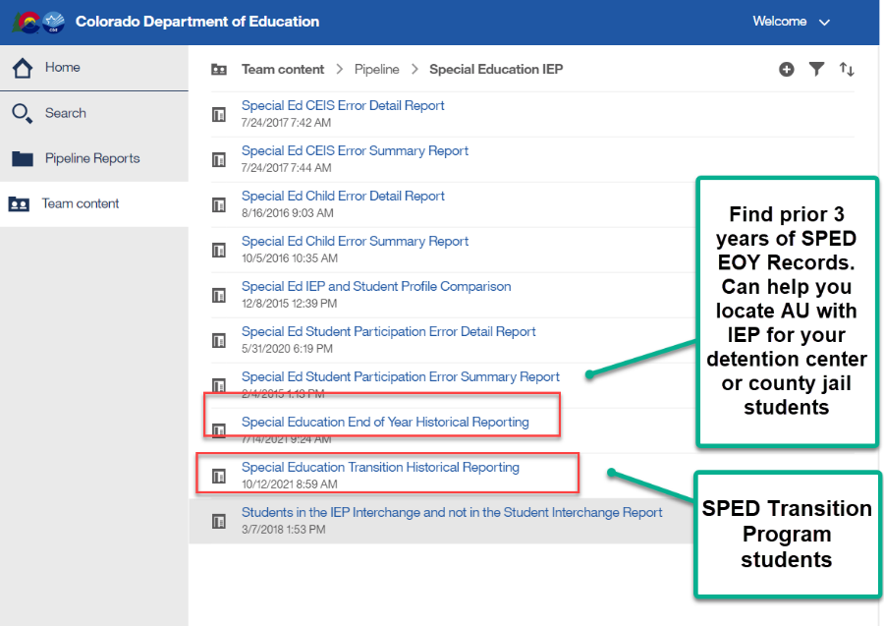
Special Education EOY Sped Transition students, Detention Center students, county jail students
Sped Transition Program Students – warnings for these type of records
SY309: If student is currently in or will begin a Sped transition program next year, the Sped EOY Basis of Exit should be zero-filled.
Check to be sure you are not exiting your students moving to a transition program.
They may be reported with exit code 90 in Student EOY snapshot if they met grad requirements, but should not be exited in Sped EOY until they exit the program or age out
Reference SPED transition Cognos report to see transition students based on district reporting
SY315: Student is reported as completing transition in the Student EOY Snapshot with a School Exit Type of 28, indicating they met graduation requirements in a prior year. Please report a 90 in the Sped Basis of Exit field.
Must have ‘SPE User’ role to access these reports

Slide 59
ERROR CODE SY108
SY108 Triggers when a record that was on last year’s snapshot is missing from the current year snapshot
This error can trigger for the following reason(s) that do not need an exception:
Student exited over the summer or in the prior year and has not returned to your AU this year (more information on next two slides regarding this)
An error exists at the IEP Interchange
An IEP Interchange file (child or participation) didn’t successfully process
Criteria Issue (i.e. mismatched SASID or LASID between files, interchange error, etc)
Check the Pipeline Report - Records Not in Snapshot for details
Only reason an exception would be used for this error:
Merged SASID or school closings/unusual circumstances

Slide 60
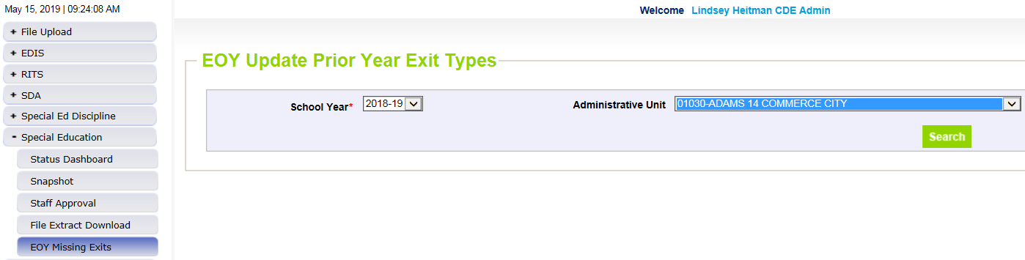
EOY Missing/Summer Exits Screen – students that exited over the summer of 2023 and didn’t attend at all in 23-24
Click Special Education/EOY Missing Exits. Select 2023-24 School Year and click “Search”.
This will bring up your AU’s list of records that are likely “Missed Exits” from the summer. The system will not include any records in this screen that are on your Child or Participation file (whether or not they’ve made it to snapshot yet).
Manually enter the “Missing Exit Type” on the records you have that information for and click “Save”. You don’t have to do them all at once. They will stay visible in this screen through the end of the collection.
Once you create a new snapshot, the saved records will be added to your 23-24 snapshot with a “Date of Entry to Sped” and “Date of Exit from Sped” of 07/01/2023 and the “Basis of Exit” reason you chose.
This will resolve SY108 when you create a new Snapshot.
In the COGNOS report “Snapshot Records: Special Education EOY Snapshot Records” you will see records that were added through the EOY Summer Exits screen in column B “EOY Summer Exit” = Y.

Slide 61
Special Education EOY Summer/Missing Exits Reporting Concern
Reporting Concern:
Several AUs have had a large number of “EOY Missing Exits” - records with 7/1 SPED entry and exit date that didn’t attend at all in the reporting year, and are not included in your files and generate under your EOY Missing Exits screen in the Data Pipeline
Reminder that all SPED students who exit the AU by the end of the school year are expected to be reported in the 23-24 SPED EOY with appropriate exit type
EOY Missing Exits screen should really only be used for students that left over the summer
These “missed exits” affect your indicator 14 sample, indicator 1 graduates, Indicator 2 dropout percentage, etc.
If you pull your Participation file early in the spring from your SIS and don’t continue to take nightly updates from your SIS, you may be missing valid exits that need to be reported in 23-24.
Reporting Tips:
Be sure to reconcile the exits with your district(s) records/exits up until the due date in September.
Compare your exits from Special Education to the Student EOY exits being reported
Be sure to check your warnings

Slide 62
Warnings for Possible Missed Exits
Will help you locate potential Missing Exits:
SY296: These students are currently reported as attending in your Administrative Unit with no exit code, AND are also being reported by a district within a different AU in the next school year. Please double check your records to verify whether the student failed to return to your AU in the fall and an exit code and date are necessary. Reporting the exit in the current collection year is optional.
SY295: Student is being reported as exiting with an exit type of 70, 90, 92, 93, or 94 in the regular EOY collection- please double check the student's exit records to ensure you're reporting applicable exits from Special Education. Ignore the warning on transition students that met graduation requirements in regular EOY, this is a valid difference.

Slide 63
Excluded from Snapshot: PAI Code 31 – on Tuition Contract w/ another AU
Records triggering an SY108 errors
Excluded from the snapshot due to a 31 PAI Code
If student exited to receive services from another AU on a tuition contract, they will need to be exited in your Participation file for Sped EOY. Student should have been reported on Dec Count for funding but should be exited for Sped EOY reporting requirements at this point in time.
How to Report and clear error SY108:
“Back date” the school enrollment info to what it was as of the last date of attendance in your AU. Adjust:
PAI Code
School Code
District of Attendance
Add a Date of Exit and Reason Exited
This change should bring the record into you snapshot and clear error SY108
Note: student only needs to be exited from your AU once, so if they have been attending the program for a couple of years and you exited them to the program the first year, leaving them excluded from the snapshot with a 31 PAI code is correct

Slide 64

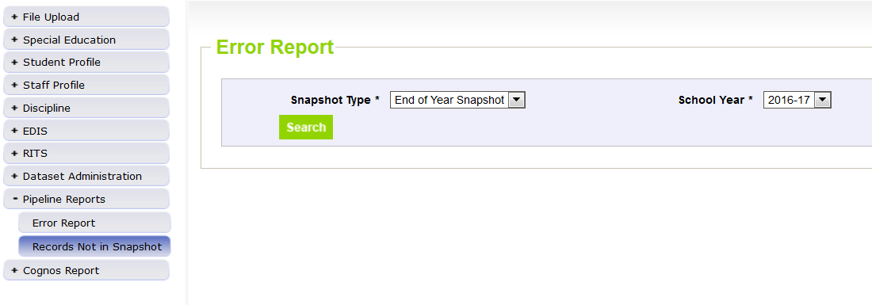
Special Education End of Year – Missing Snapshot Records
Missing Snapshot Records Report-Check it out!
Identify records missing from snapshot due to:
Interchange errors
Criteria issues such as excluded PAI codes or mismatched sasids or lasids
Records missing from either Child or Participation file
Do you have SY107 or SY108 errors? Check this report first!
Special Education EOY - Lindsey Heitman - heitman_l@cde.state.co.us (303) 866-5759

Slide 65
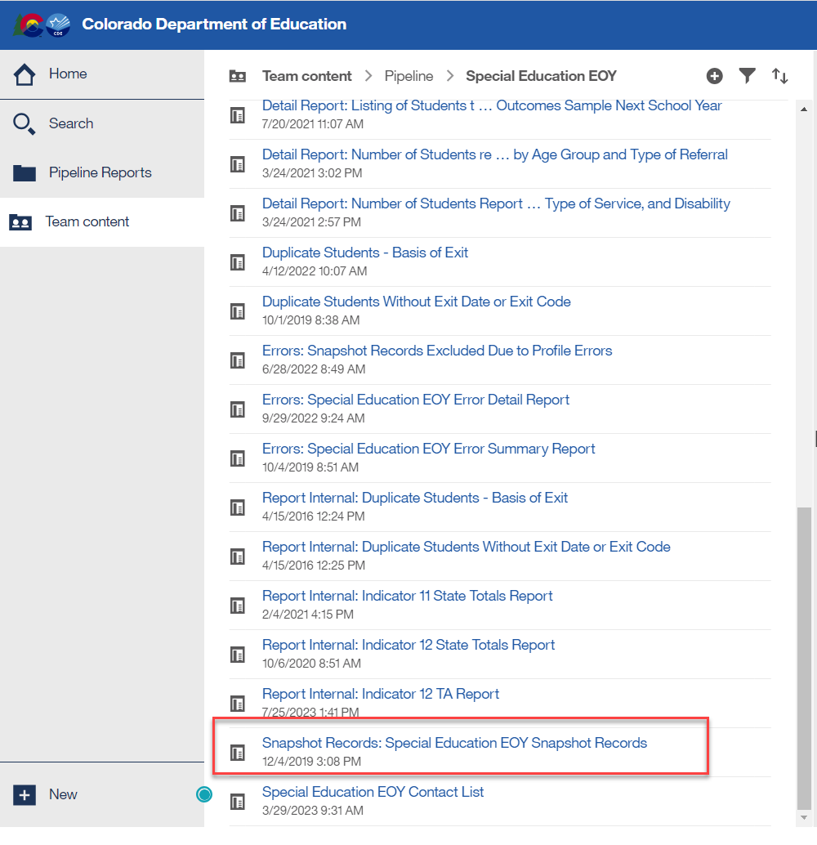
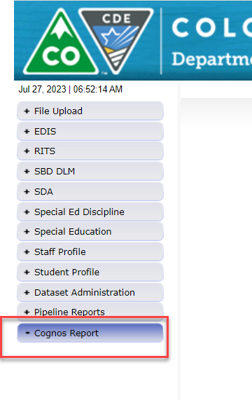
Special Education EOY Use Prior Year Snapshot Records to Inform Coding
Reporting Tip:
Download your Sped EOY Snapshot records from last year (22-23) to help you determine how to code records for this year
Export report to Excel and sort by various data fields: Sped Referral Codes, Eligibility and Services codes, Exit Types
This will help you see what fields are required in a particular coding scenario

Slide 66
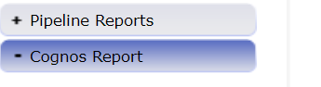
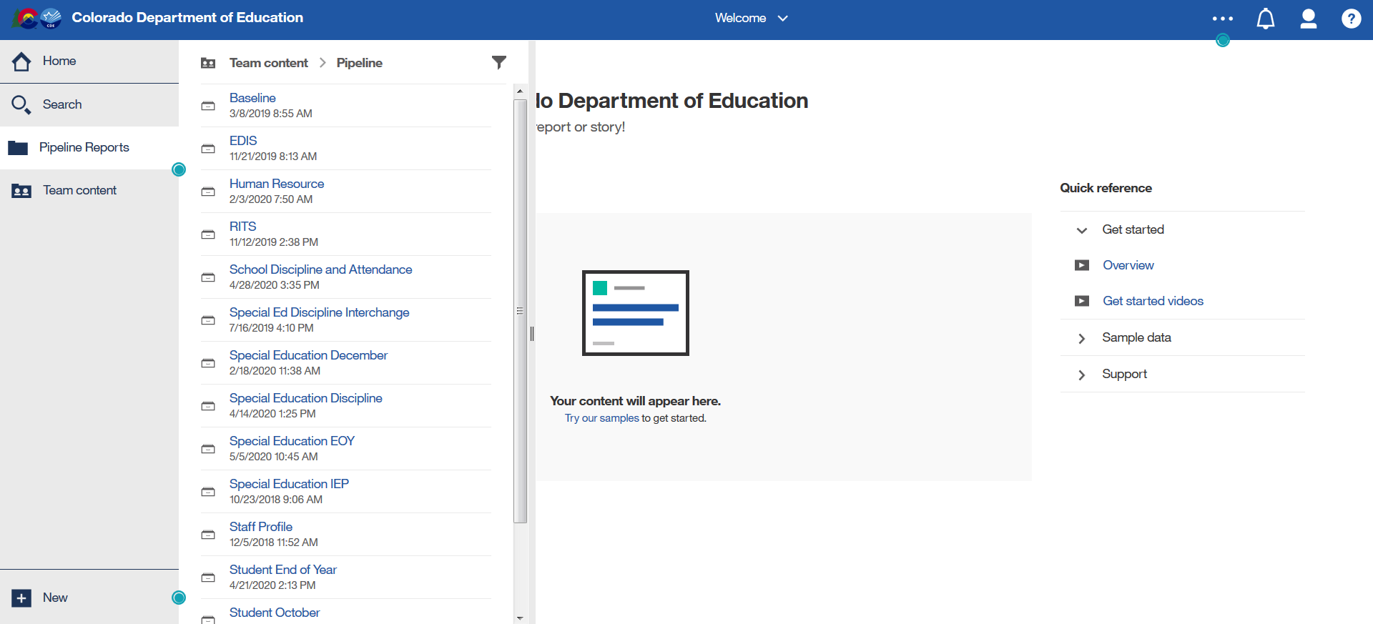
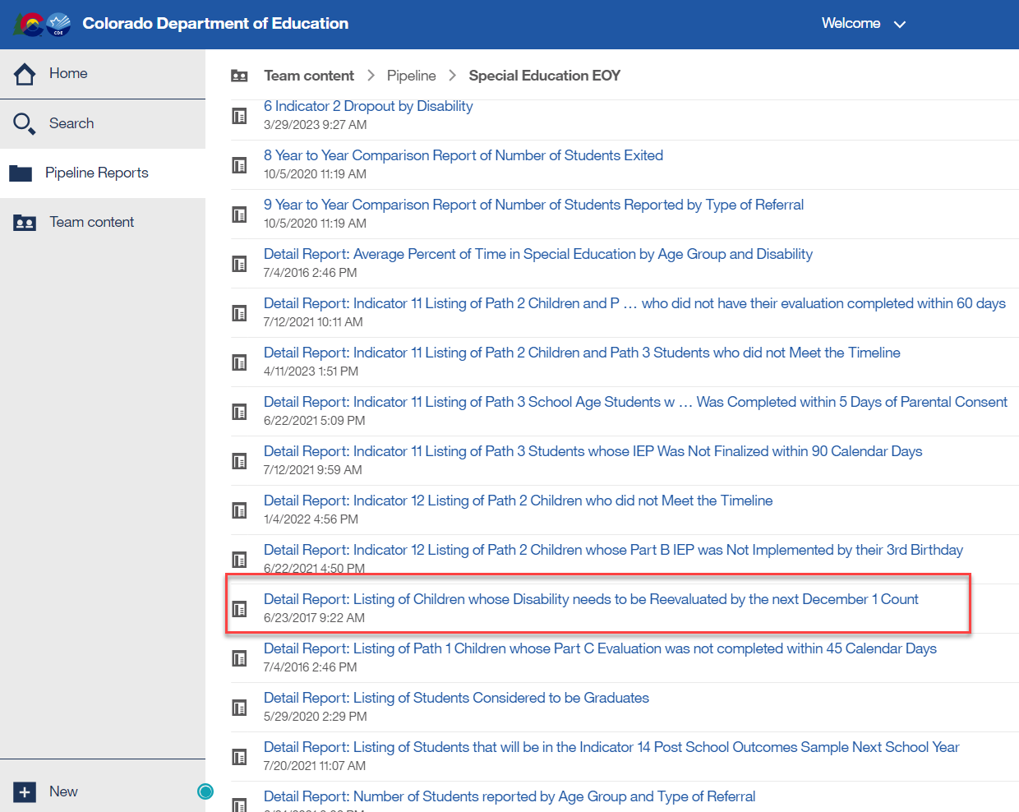
Special Education EOY: Cognos Reports CAUTION
Please don’t use Search!
Also don’t click a report listed in the white screen under ‘Recent’ section. You must download new reports every time for the most up to date data.
1.
2.
3.
Be sure to always download Cognos Reports from the actual folder. Follow these steps and double click on the name of the report to download it

Slide 67
Special Education End of Year: Exception Requests
Exception Requests Due to CDE By August 29
To find the Sped EOY Exception template click here and go to Additional Resources section
Please save your filled out exception template in your AU # Syncplicity folder and email SpedEndofYear@cde.state.co.us to let us know it’s ready for upload. I will email you if I have questions and/or once it has been uploaded to the Data Pipeline. The errors should resolve once you create a new snapshot.
Explanation box must have 400 characters or less
LEN Function under “Formulas/Insert Function” tells you how many characters are in a cell
Be sure to download the Sped EOY template and not the EOY template – they are different
Format on the template must be exactly as specified or file won’t upload – double check SASID, error code, number of characters in explanation is < 400
SY247 exceptions (for dropouts under the age of 17 on exit date)? Check Warning SY282 first to be sure the student didn’t transfer to a different AU

Slide 68
Data Pipeline Process Data Pipeline Process

Slide 69
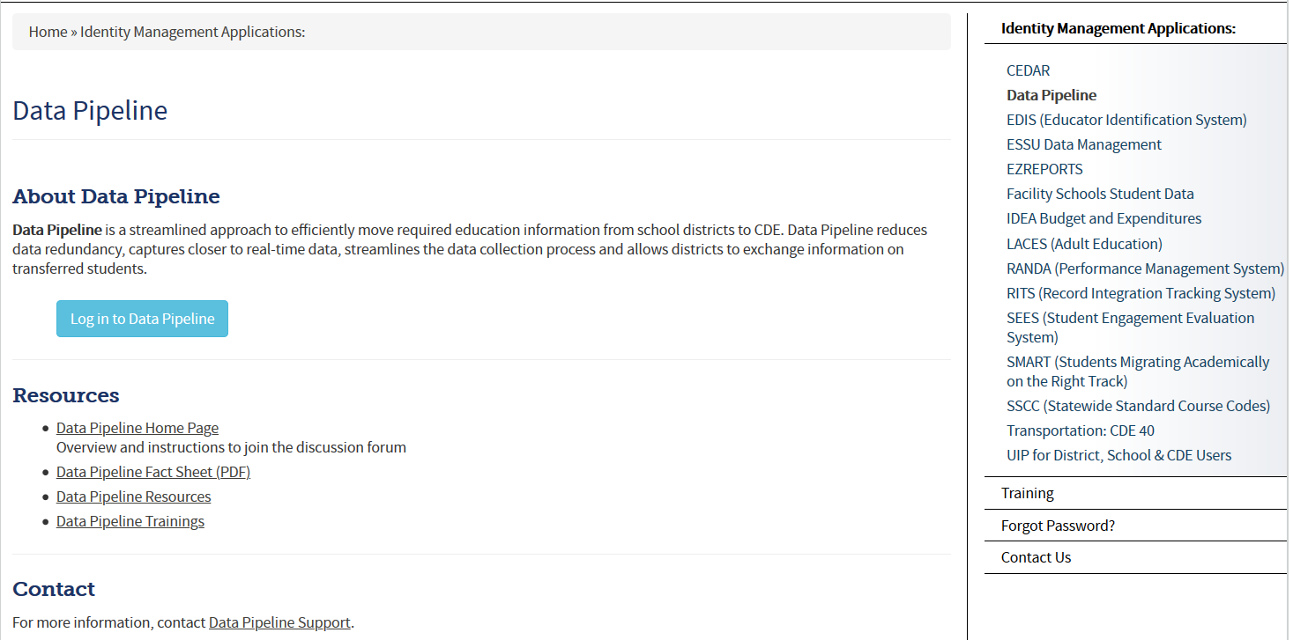
Accessing the Data Pipeline
Recommended page to bookmark for accessing the system - CDE Identity Management Home Page
From IdM home page click Data Pipeline bullet to get to this screen below.
Next click the blue login button.
*your single sign-on login may be used for all CDE applications listed here that you have access to

Slide 70
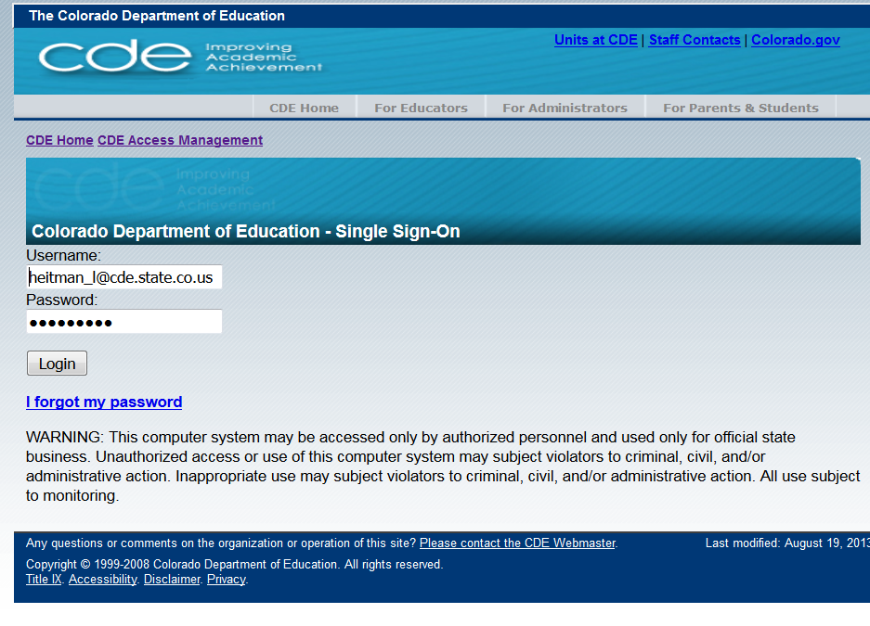
Single Sign On
Username is the email address associated with your IdM account
Password specified by you

Slide 71
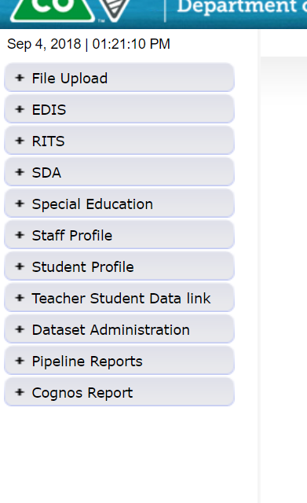
Pipeline System
Batch Maintenance, Format Checker and Data File Upload
These tabs will vary depending on your LEA and level of access. An AU respondent should always see a Special Education tab.
Many AU respondents will not see a Staff Profile or Student Profile tab.
Based on your Identity Management Roles
Error reports and other validation reports

Slide 72
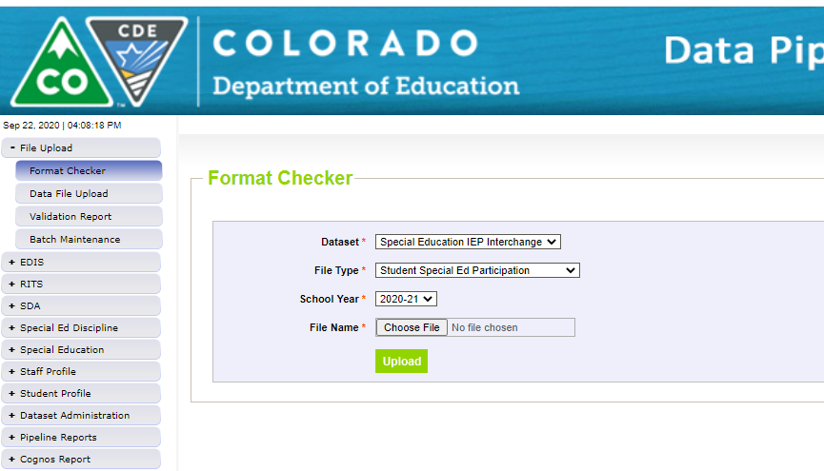
Step 1: Format Checker
Once the file is created, you have the option to run it through the Format Checker to help confirm the format is correct.
Format Checker ONLY checks the first row of data (2nd row on the file because you must have a header).
A field will only fail if there are too many characters in the field (too few will pass).
All fields PASS = Ready to upload but doesn’t mean it’s completely correct. You must have the correct number of characters in each field and it will only fail if there’s too many vs too few.
Find the IEP Interchange file templates on the Special Education IEP webpage under the Templates section.

Slide 73
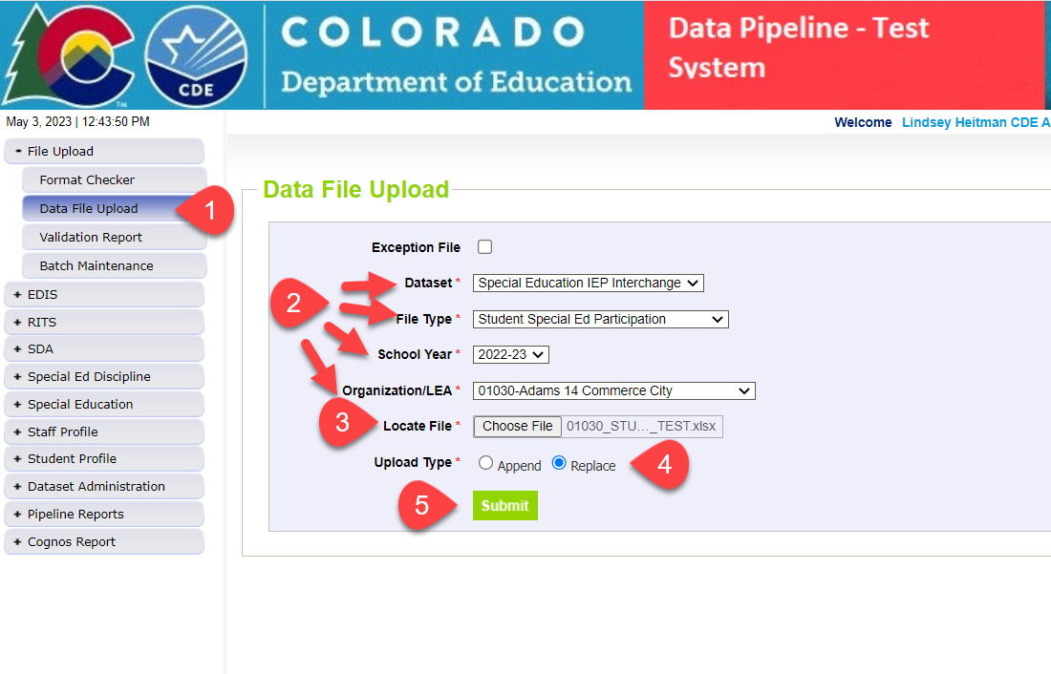
Step 2: Uploading Files to the IEP Interchange
1. Click on File Upload/Data File Upload
2. Select Dataset, File Type, School Year, and Organization/LEA
3. Click on Choose File to locate file
4. Select Replace
5. Click Submit message in green will display across the top indicating file submission has been attempted and a Batch ID will be created
6. Check Batch Maintenance Screen to verify file processed
*Email confirmation will be sent once complete
APPEND – adds to existing data files. Allows for multiple files to be uploaded at one time. Records on all files uploaded that meet the criteria will pull into snapshot.
REPLACE – deletes any prior uploaded data and replaces it with new file. *Most AUs use replace

Slide 74
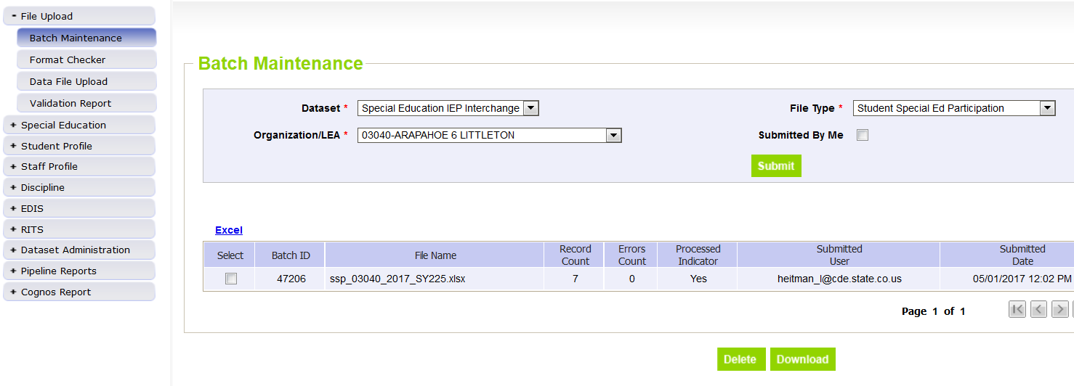
Step 3: Batch Maintenance – Important Step (don’t forget to check this screen after every upload or transfer from Enrich)
Check Batch Maintenance to ensure files have processed successfully.
Processed Indicator will say “YES”. If blank or “No”, file did not upload
Check Record Count, Error Count, and make sure submitted date and time look accurate.
Option to download or delete last uploaded file from this screen. Check the ‘select’ box and click ‘Download’ or ‘Delete’
AFTER EVERY FILE UPLOAD - Verify Record Count, Error Count, Processed Indicator = Yes, Submitted Date!

Slide 75
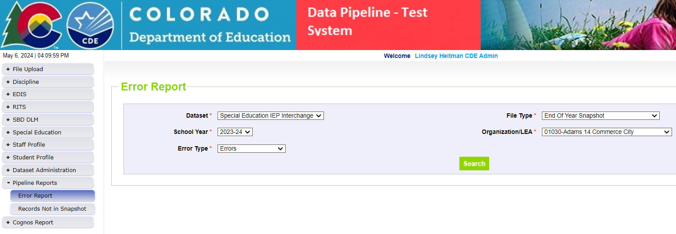
Step 4: Checking IEP Interchange and Sped EOY Snapshot Errors in Pipeline Error Reports
Pipeline Reports- Error Report
Interchange and Snapshot level error reports
Dataset: Special Education IEP
File Type: select which file you’re working on – Child, Participation, or End of Year Snapshot
Export to Excel to view errors in detail - only shows the first 1000 errors

Slide 76
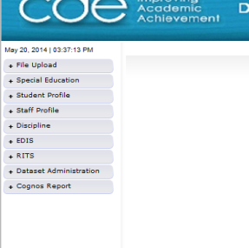
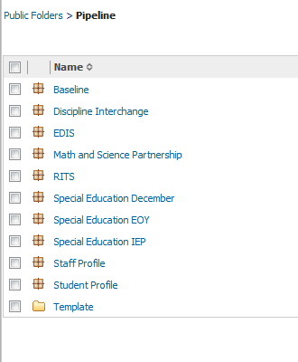
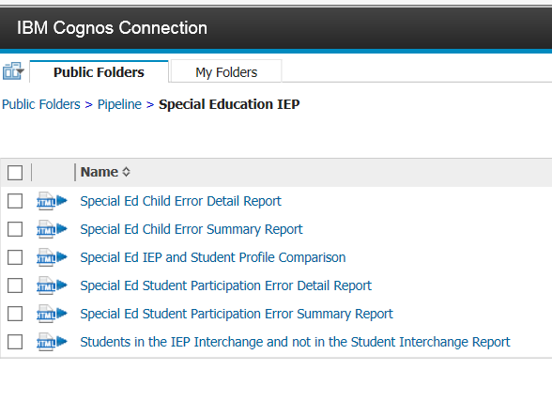
Cognos Reports Option for Checking Interchange Errors
Data Pipeline-Cognos Reports-Special Education IEP:
Detail and Summary Error Report for each File
All errors located here so be sure to check before final submission

Slide 77
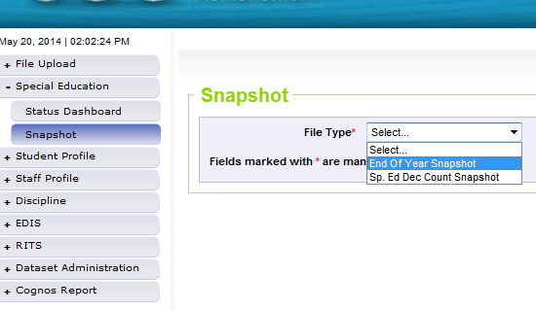
Step 5: Special Education EOY Snapshot
Create Snapshot
Click the Special Education tab
Click Snapshot tab
Select “End of Year Snapshot”
Click Search to bring up the “Create Snapshot” button in green.
Helpful to have most Interchange errors cleared before starting on your snapshot errors
Why? Because records with errors at Interchange level will not pull into snapshot validations so you may be wasting your time looking into snapshot errors

Slide 78
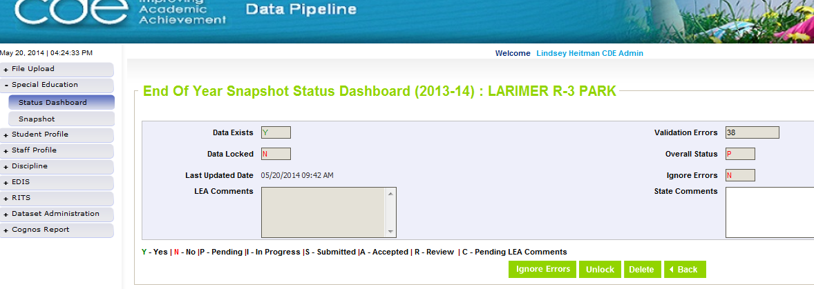
Step 6: Status Dashboard- Check Status of Snapshot
Be sure that Data Exists (Y)
Check to see that Last Updated Date is the most recent snapshot created
View and resolve your Snapshot Errors (these are your level 2 snapshot errors)

Slide 79
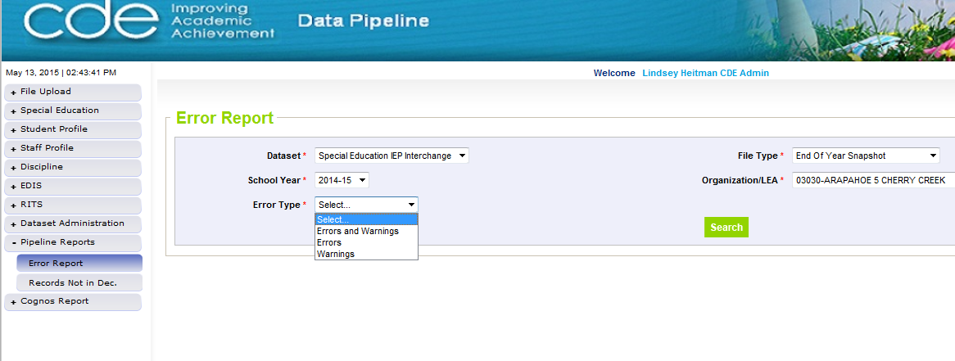
Step 7: Check Snapshot Errors under Pipeline Reports
Pipeline Reports-Error Reports
This error report will only
show the first 1000 errors!

Slide 80
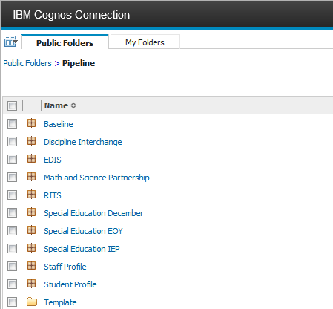
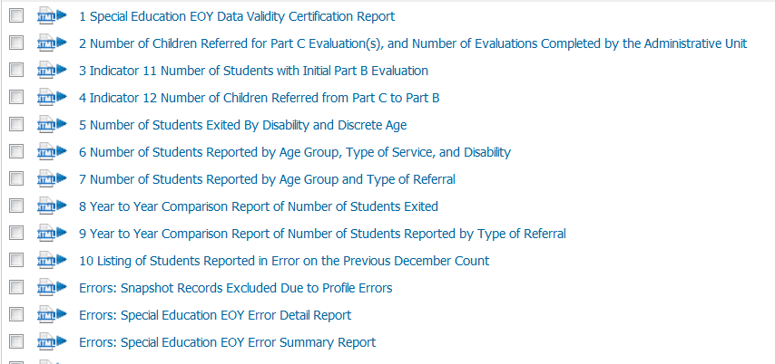
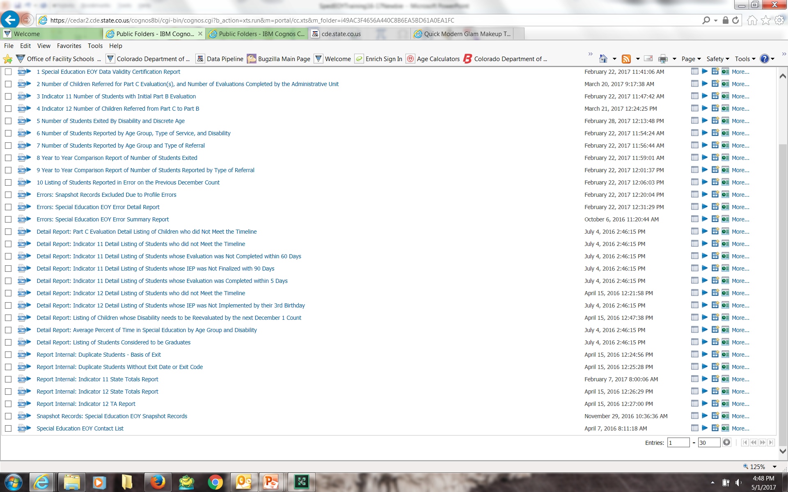
OR find errors under Cognos Reports
Click Cognos Reports (or Pipeline Reports) and then Special Education EOY:
Records with errors at Interchange
Snapshot error details
Snapshot error summary
re
snapshot records – check this report to ensure snapshot has the correct number of records you’re expecting

Slide 81
More on Cognos Reports

Slide 82
Reviewing Data Reports
Once All Errors are corrected, review your Cognos validation/detail reports for accuracy. Errors do not catch everything!
If after reviewing, you notice something that needs to be fixed:
IEP Interchange File(s) will need to be resubmitted
Special Education EOY Snapshot will need to be re-created
Reports are created from your last snapshot so any changes to files will change your reports.
Final Reports Submission and Data File Approval within Data Pipeline are the last steps-NOT until September after we complete the duplicate process:
Once you’ve reviewed the reports and made all changes:
Submit the 8 reports required for signature and the flag explanations document if necessary to the ESSU Data Management System
Then in Data Pipeline, click the “SUBMIT TO CDE” button. Only the Sped EOY Approver will have ability to do this
Finalizes the data for CDE to begin their validation process before submission to the federal government

Slide 83
Cognos Reports – Special Education EOY
This screen is what you will see after clicking ‘Cognos Reports’
1.
2.

Slide 84
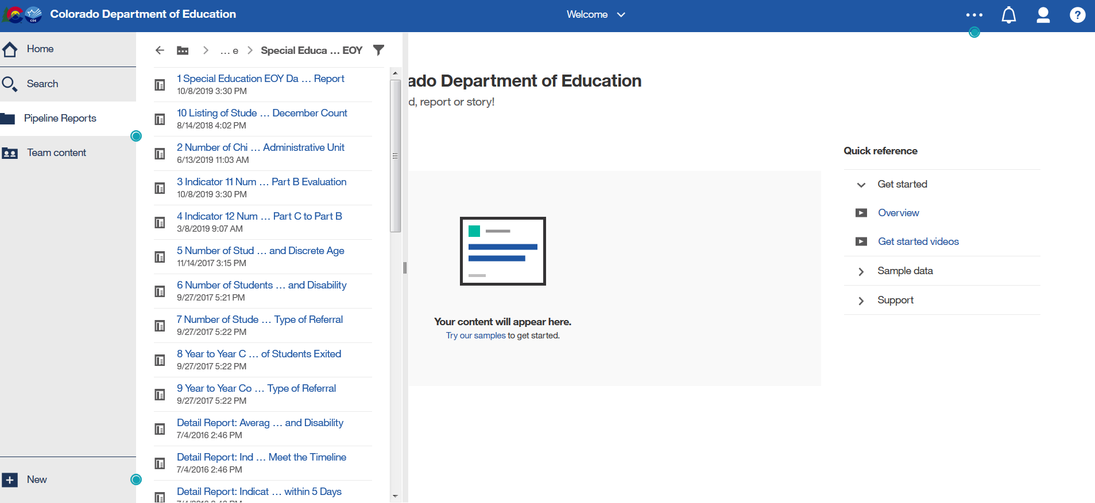
Sped EOY Cognos Report List
Scroll down to see full report list
Expand screen to the right to see full report name
*Ignore the date and time listed under the report (internal use)

Slide 85
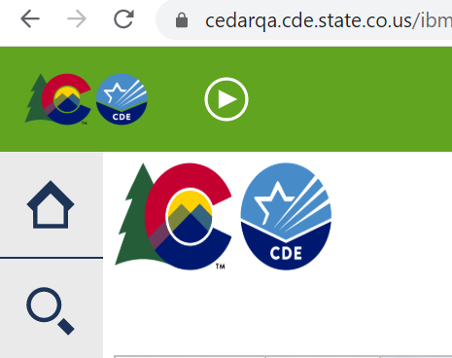
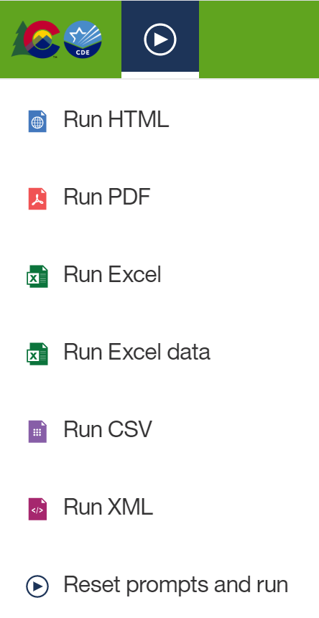
Exporting to Excel
Click on ‘Play’ Button
(available when a report is showing)

Slide 86

Your participation is appreciated!

