Slide 1
Special Education Discipline 2023-24
Reports Training
Summer 2024

Slide 2
AGENDA
Deadlines
Error Reports
Detail Reports
Signature Reports
Final Submission to CDE

Slide 3
Purpose & Content Reminder
20 U.S.C. 1416(a)(3)(A); 1412(a)(22) of IDEA requires that states report to the federal government the number of children with disabilities by race, ethnicity, and disability category who are removed to an interim alternative educational setting or are subject to long-term suspensions or expulsion.
EDFacts – U.S. Department of Education federal requirements
State Performance Plan Indicators 4A and 4B which reports the disproportionate rates of suspensions and expulsions greater than 10 school days in a school year for children with IEP’s
Significant Disproportionality for Discipline
Research requests
Monitoring
Consultant analysis to support technical assistance needs in the state
Special Education Fiscal Advisory Council (SEFAC)
Reporting Period: July 1, 2023 – June 30, 2024

Slide 4
Last Steps
Thursday August 22nd: Complete Snapshot – ERROR FREE
Date by which you must have generated your complete Special Education Discipline Snapshot dataset by passing all interchange and snapshot validations in preparation for report review
Thursday August 22th – August 29th Report Review Week
Director and data respondent review reports in detail and make any data corrections deemed necessary to ensure you are reporting valid and reliable data
  All changes must be made by end of day August 29, 2024
Thursday, August 29th
  Final snapshot approval within Data Pipeline, upload signed reports to DMS.
  *It is okay to do this as soon as you’ve reviewed your reports and signed off on your data.

Slide 5

Special Education Discipline Reports Checklist
Helpful guide to use while reviewing reports
Can be found under Snapshots/Special Education Discipline- posted under the Reports section
Link to reports checklist: http://www.cde.state.co.us/datapipeline/specialeducationdisciplinereportschecklist
5

Slide 6
REPORTS AVAILABLE TO RESOLVE SNAPSHOT ERRORS

Slide 7
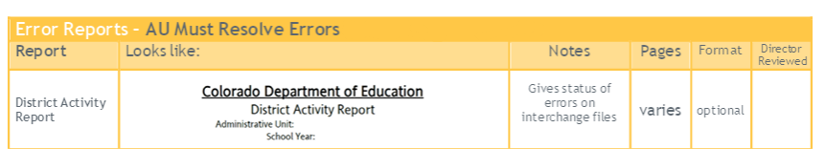
Reports to Help Identify Errors and Warnings
This PowerPoint is color coordinated with the Checklist
District Activity Report
SPED Error Detail Report (Warnings will stay on the Error Report)
SPED Incident and School Enrollment Date Comparison Report (will only have data if you trigger SD017)
SPED Snapshot Records Excluded Due to Profile Errors

Slide 8
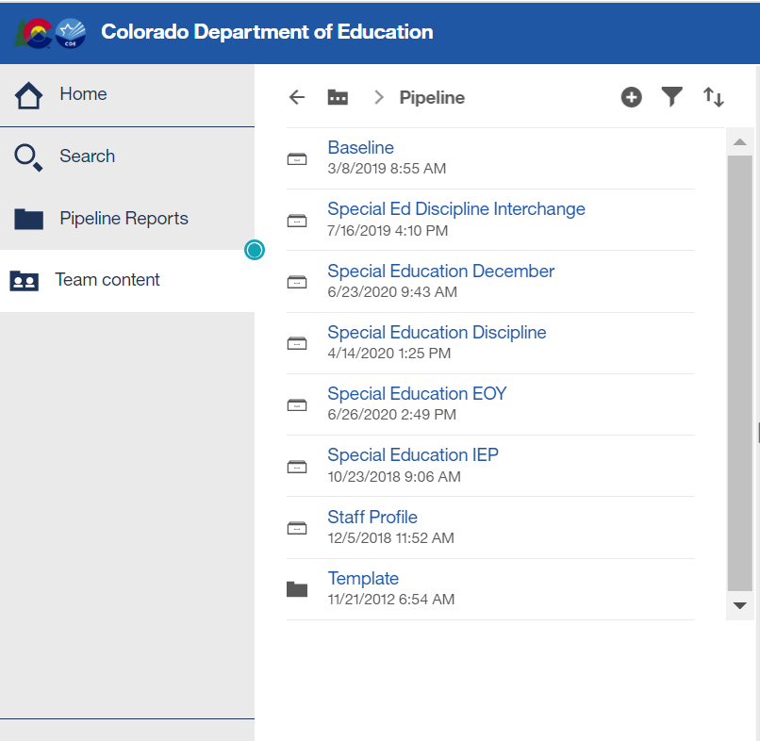
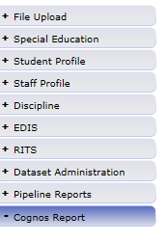
Where to Find SPED Discipline Cognos Reports
From Single Sign On > select Data Pipeline> Click Cognos Reports>Special Education Discipline:

Slide 9
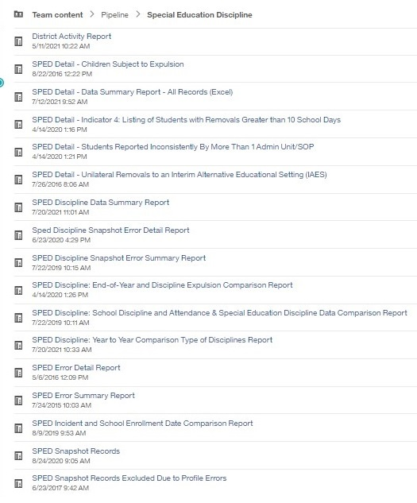
Cognos Reports Available to help resolve Errors
District Activity
Error Detail
Error Summary
Incident and School Enrollment Comparison
Records Excluded

Slide 10
Pay close attention to this WARNING
DA025 - Under Colorado law, a student may not be suspended for more than 25 school days. C.R.S. 22-33-105(b). (Interchange level)

Slide 11
Review Week
August 22-29
Review Week
This is your chance to review your reports in detail and make any data corrections you deem necessary to make sure you are reporting valid and reliable data.

Slide 12
Review Week COGNOS Reports
*Detail Reports - for your information
Signature Report - PDF
Signature Report- PDF
*More about this report on the next slide
Notes:
`

Slide 13
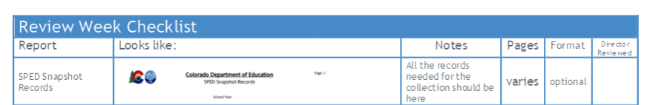
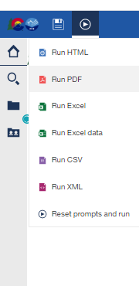
Cognos Report-SPED Snapshot Records
Review week detail reports
These are all the records in your SPED Discipline Snapshot
You can use this as a reference when questions arise from other reports
It’s a good idea to download and save the report in Excel
The number of rows of data records should match the number of records on your SPED Discipline Action file

Slide 14

Detail Reports
Detail Reports were created to assist Districts and Administrative Units in validating the Data Summary and Year-to-Year Comparison Reports

Slide 15

SPED Detail – Indicator 4
SPED Detail – Indicator 4 – Disproportionate Representation in Discipline
  This report is a listing of all student records that appear in the count for Indicator 4.
  We do not collect this report as a signed report, it is for your information.
  Refer to the SPED Discipline Data Summary Report. Find the Table “Federal Race/Ethnicity Reporting Category” (pp. 3-4) and pay special attention to the column titled “Out-of-School Suspensions/Expulsions > 10 Days Count of Students.”
    The totals for this column are used to determine your Indicator 4A compliance
    The racial/ethnic data in this column are used to determine Indicator 4B compliance

Slide 16

Students Reported Inconsistently by More Than 1 Administrative Unit
This report is for your information to ensure you have reported demographic and primary disability accurately.
The report will provide data that is inconsistent between you and other Administrative Units
The Errors appearing here may be legitimate entries.
  For example, a student’s disability identification may have changed at a mid-year staffing
  A student’s parents may choose to report race differently when they move to a new district (for example: a student is identified “Hispanic,” then “2 or More Races”)
Investigate things that don’t make sense

Slide 17
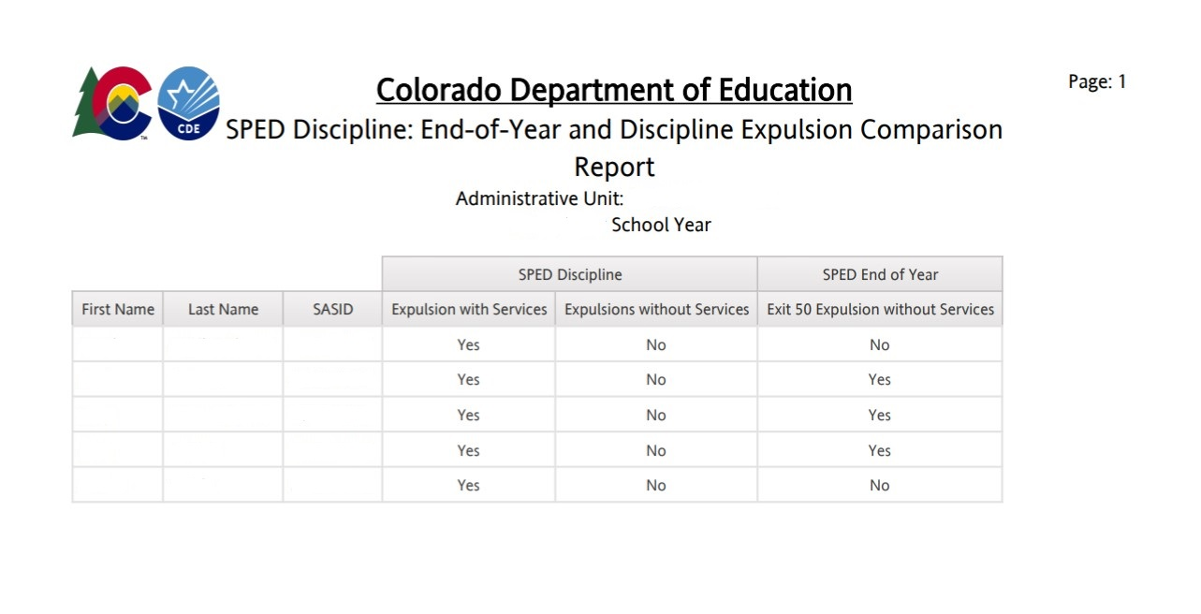
Special Education EOY/Discipline Expulsion
Match
No Match
If you reported an Expulsion Without Services in the Discipline collection (Data Summary Report, pp. 7-8) we would expect to see the student with an Exit 50 in the End-of-Year and vice versa.
If you reported an Expulsion with services, the student would not have an Exit 50 in the End-of-Year collection.
Data between the two collections is not an Apples-to-Apples comparison. Please review the report to ensure data is reported accurately.
Notes:
An example of a mis-match is rare, but happens when a student is expelled without services early in the school year and then returns later and re-enrolls in another school within the AU. Error SD026 would require an exception request.

Slide 18
Signed Reports Intro
By August 29
Signed Reports
All the reports in the previous section reflect valid and accurate data. These last two reports must be signed and uploaded to the Data Management System by August 29

Slide 19
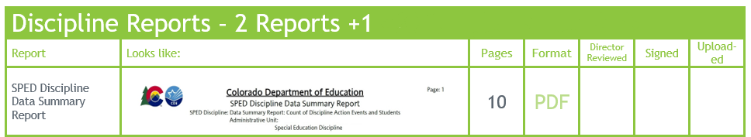
August 29, 2024, Deadline
Summary of final approval and report submission.
  Date by which the Administrative Unit must approve their completed Special Education Discipline Data Collection Snapshot and;
  Electronically SUBMIT the data to CDE via the Data Pipeline,
  Verifying that it’s valid and reliable by uploading the signed Data Summary Report (exported to PDF) (all 10 pages) and the Year-to-Year Report (exported to PDF) (all 1 page) along with explanations for flags document (if applicable) to the Data Management System.
    Please upload the Data Summary Report and Year-to-Year Report together in one PDF. The Flag Explanations document should be uploaded separately in a word document.
  Districts send District Authority Sign-Off Form to Administrative Unit Respondent (This report is found in the Special Ed Discipline Interchange in COGNOS)

Slide 20

SIGNATURE REPORTS
ADMINISTRATIVE UNIT
SPED Discipline Data Summary Report (10 Pages)
SPED Discipline Year-to-Year Comparison Type of Disciplines Report (1 Page)
Year-to-Year Flag Explanation Document (Word)
DISTRICT
District Authority Sign-Off Form
  (requested by Special Education Directors for data assurance purposes and found on the Special Ed Discipline Interchange in COGNOS)
  *Do Not to send to CDE – for your records

Slide 21
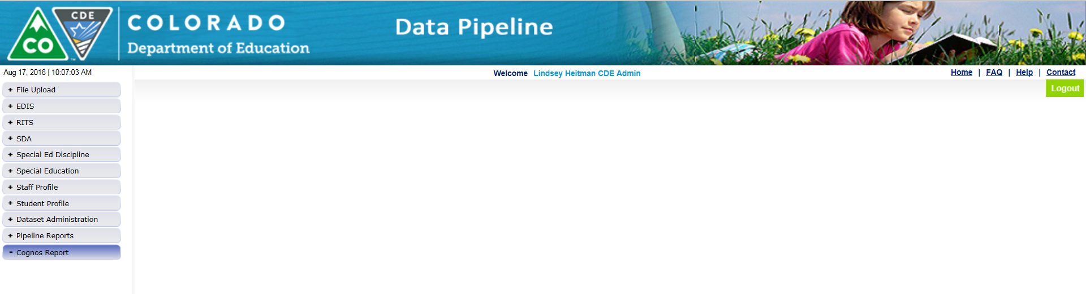
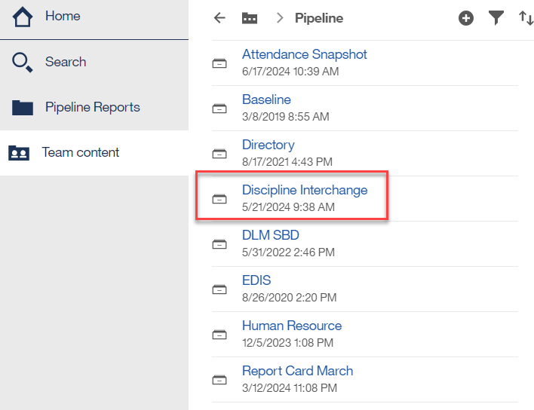
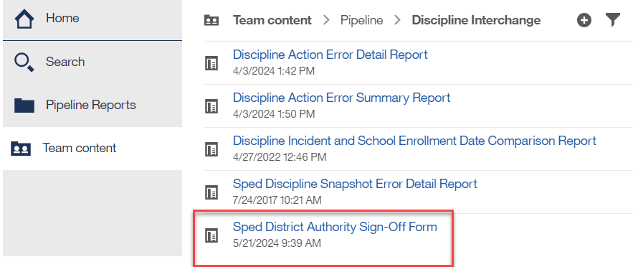
Where to Find the District Authority Sign-Off Form
District responsibility (DIS role)
Found under Cognos Reports/Special Ed Discipline Interchange

Slide 22
District Authority Sign-Off Form
Report Contains the following data:
Unilateral Removals to an Interim Alternative Educational Setting by School Personnel
  (A) Number of Children (B) Drugs (C) Weapons (D)Serious Bodily Injury
Removals to an Interim Alternative Educational Setting Based on a Hearing Officer Determination Regarding Likely Injury
Out-of-School Suspensions or Expulsions
  (A) Number of Children with Out-of-School Suspensions/Expulsions Totaling 10 Days or Less
  (B) Number of Children with Out-of-School Suspensions/Expulsions Totaling Greater than 10 Days
In-School Suspensions
  (A) Number of Children with In-School Suspensions Totaling 10 Days or Less
  (B) Number of Children with In-School Suspensions Totaling Greater than 10 Days
Disciplinary Removals
  (A) Total Disciplinary Removals
  (B) Number of Children with Disciplinary Removals Totaling 1 Day or Less
  (C) Number of Children with Disciplinary Removals Totaling 2-10 Days
  (D) Number of Children with Disciplinary Removals Totaling Greater than 10 Days
Children Subject to Expulsion
  (A) Received Educational Services During Expulsion
  (B) Did Not Receive Education Services During Expulsion
District Superintendents confirm their numbers for AU directors with the form. This form is for AU directors' information and record keeping.

Slide 23
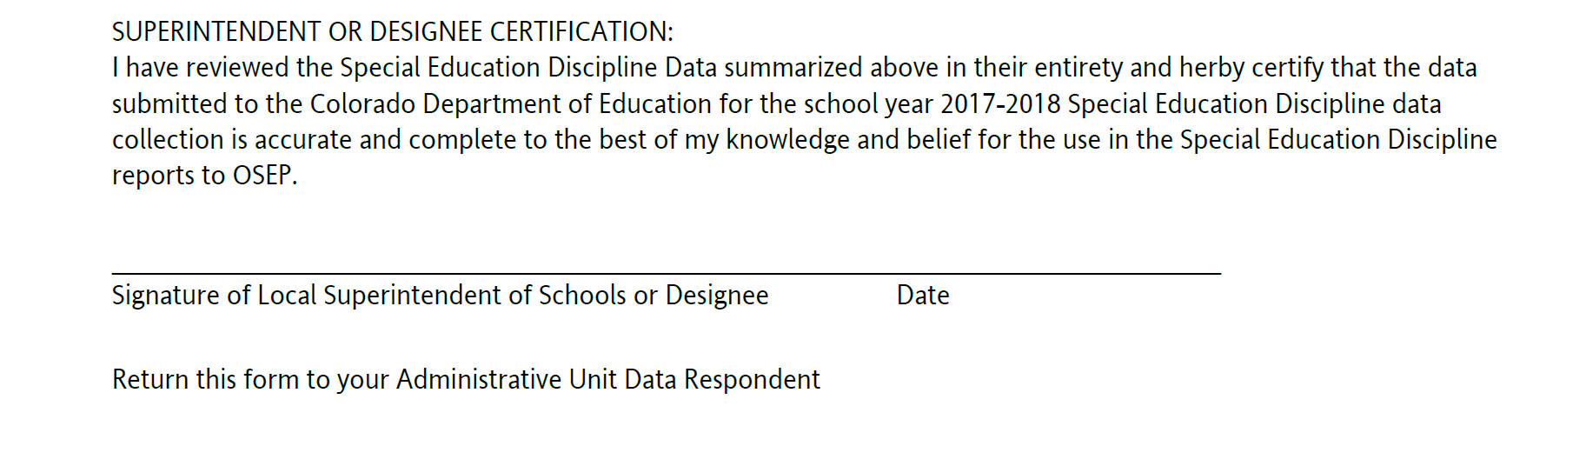
Superintendent Sign-Off Form
[reporting school year]
This report is due to the Administrative Unit Data Respondent by August 17th. Districts with Exempt status may send the report in early.
NOTE: This report is for the AUs and should NOT be uploaded to CDE.

Slide 24

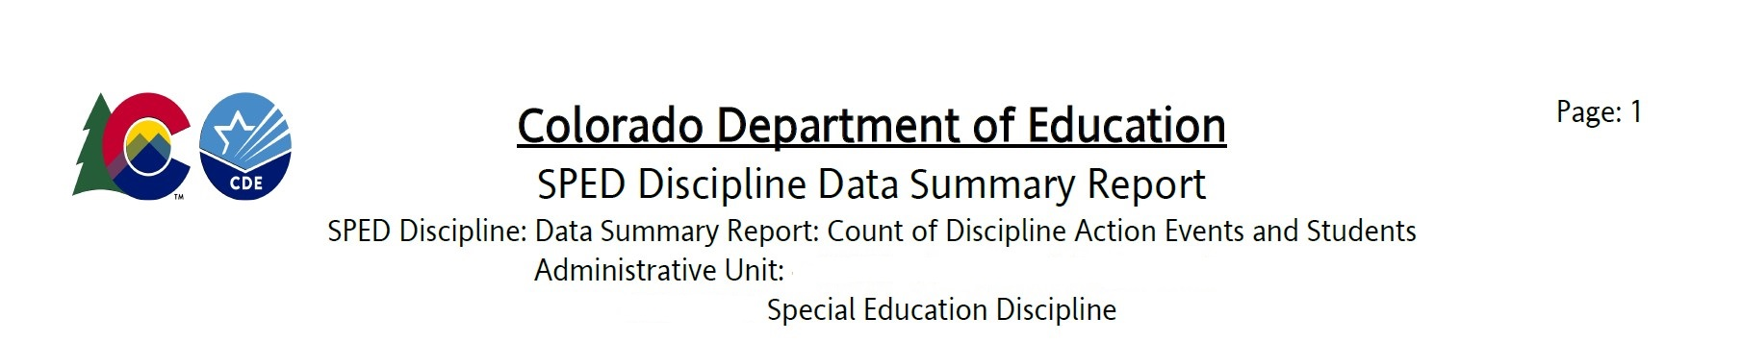
SPED Discipline Data Summary Report
This report has been modified to improve readability and the report has 5 sections. Each section breaks down the data into demographic categories: Disability, Grade Range, Race/Ethnicity, Gender, and EL Status.
  Count of Discipline Action Events and Students (pp. 1-2)
  In-School and Out-of-School Suspensions/Expulsions (pp. 3-4)
  Removal Length (pp. 5-6)
  Expulsions (pp. 7-8)
  Unilateral Removal to Interim Alternative Educational Setting (pp. 9-10)

Slide 25
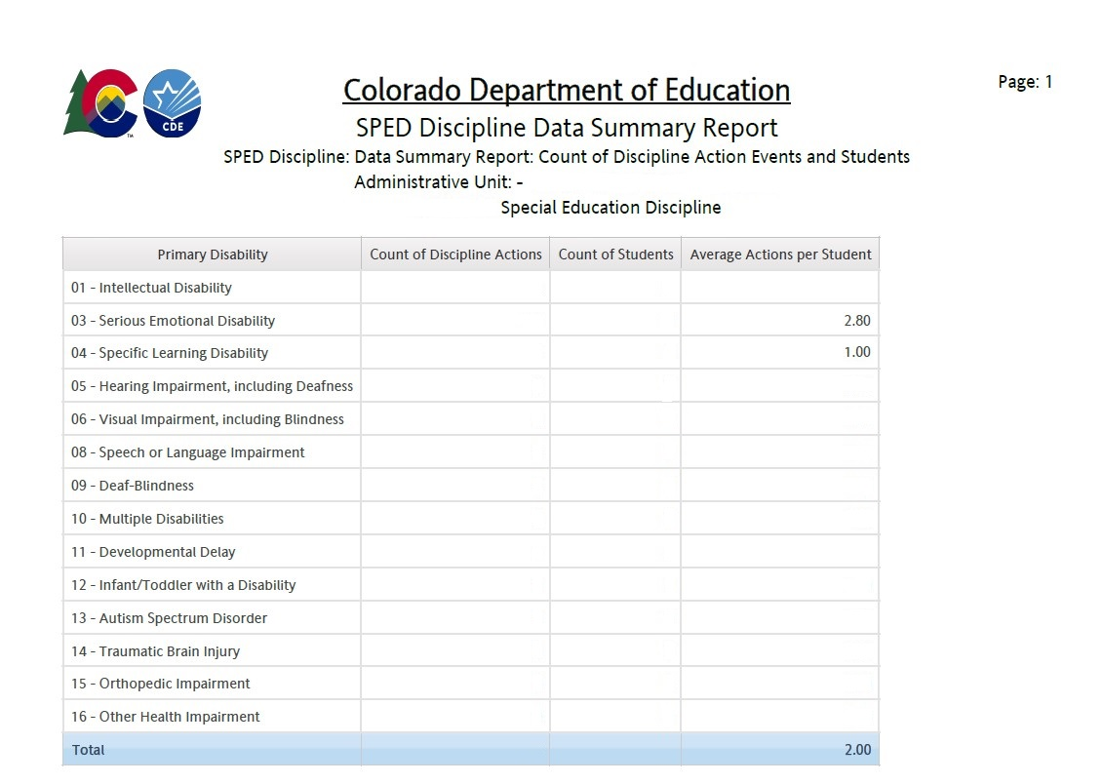
SPED Discipline Data Summary Report: Count of Discipline Action Events and Students
Each section breaks down the data into demographic categories: Disability, Grade Range, Race/Ethnicity, Gender, and EL Status. You can see Disability in the example.
This section compares the count of discipline actions per group to the number of students in the group.
The final column provides the average action per student to provide easy comparison.

Slide 26
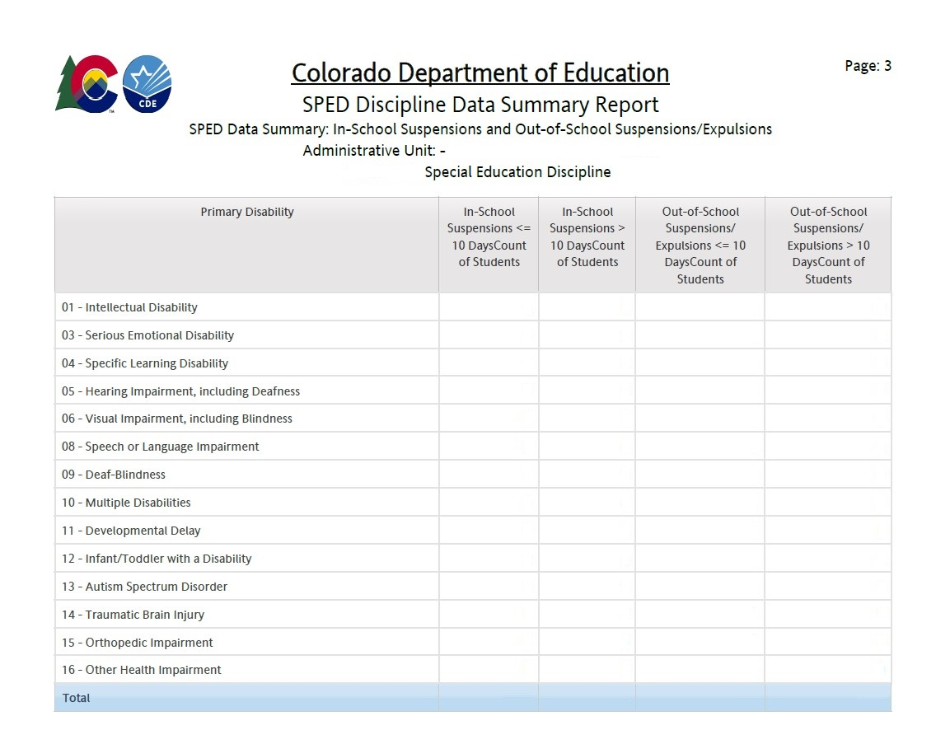
SPED Discipline Data Summary Report:
In-School and Out-of-School Suspensions/Expulsions
This section breaks down the data for each demographic group by student into:
In-school Suspensions ≤ 10 days
In-school Suspensions > 10 days
Out-of-School Suspensions or Expulsions ≤ 10 days
Out-of-School Suspensions or Expulsions > 10 days

Slide 27
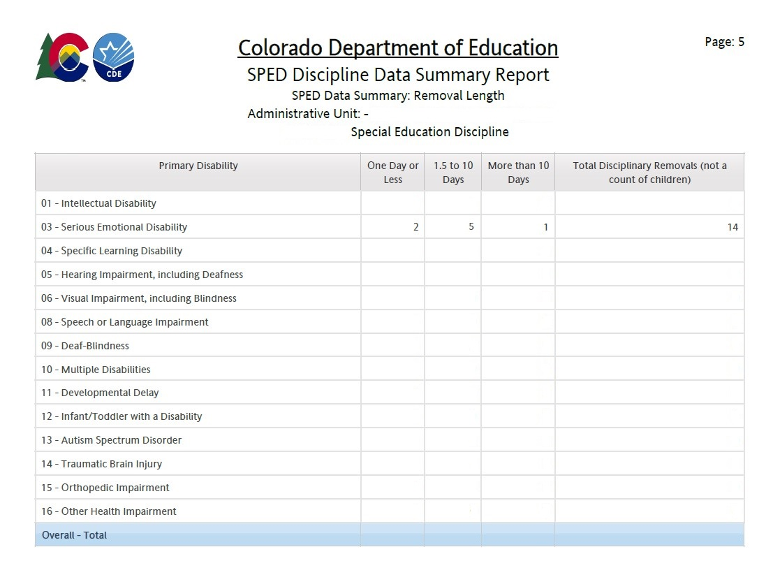

SPED Discipline Data Summary Report:
Removal Length
This section breaks down the data for each demographic group by Students and removals into:
One Day or Less
1.5 to 10 days
More than 10 Days
Total Disciplinary Removals
__$+___+___ ≠$ __
Count of Students
Count of Removals

Slide 28
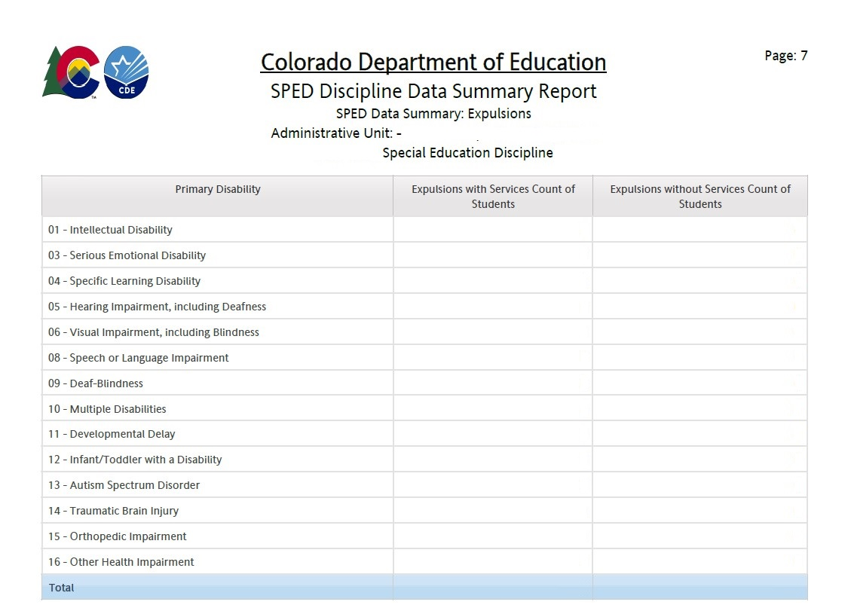
SPED Discipline Data Summary Report:
Expulsions
This section breaks down the data for each demographic group by Expulsions with and without services.
Note: Children with disabilities must receive educational services during an expulsion of more than 10 school days. The only children with disabilities who should be reported as not receiving services are those who were removed for less than 10 school days after an expulsion.

Slide 29
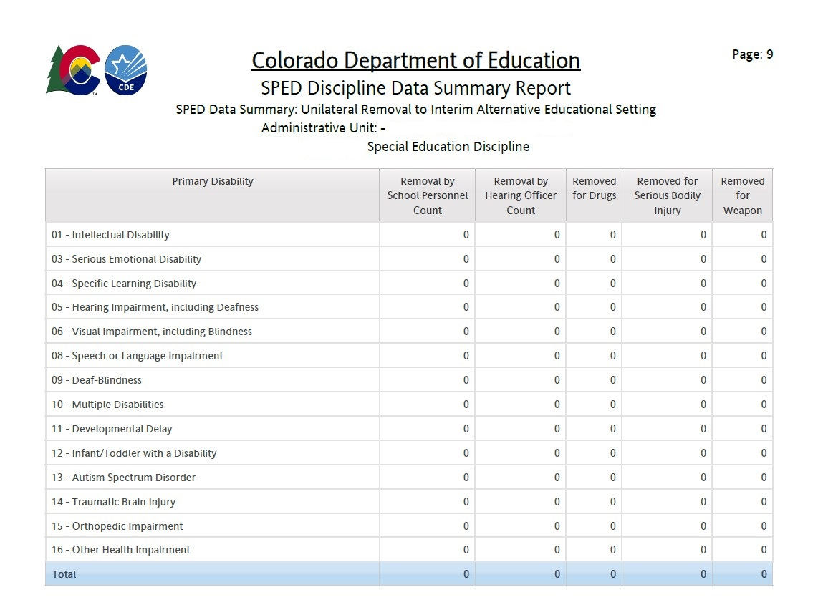
SPED Discipline Data Summary Report:
Unilateral Removal to Interim Alternative Educational Setting
These types of removals are very rare.
If a student has a Unilateral Removal for more than one of the three removal reasons, they should report two records on the file with the same Discipline Action Identifier, each with a different Removal Reason.
Count of Students
Count of types of offense

Slide 30
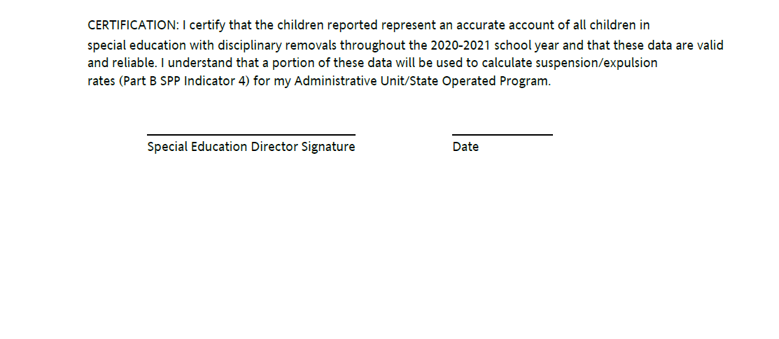

Data Summary Signature Page
[reporting school year]
By authorizing this report, the director is confirming in writing that the data reported is both valid and reliable.
Reminder: Review detail reports before submitting this signed report.
Notes:
By authorizing this report, the director is confirming in writing that the data reported is both valid and reliable.
REMINDER: When you send in the Data Summary Report, please send the 14 page report in its entirety.

Slide 31
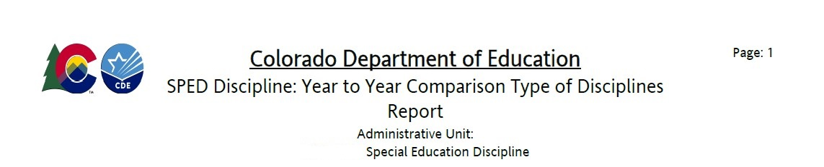
Year-to-Year Comparison Type of Disciplines Report
The report covers totals.
  Discipline – Count of Records
  Discipline – Count of Students
  All Disciplines Total Days – Count of Students
  Out-of-School Suspensions/Expulsions – Count of Students

Slide 32
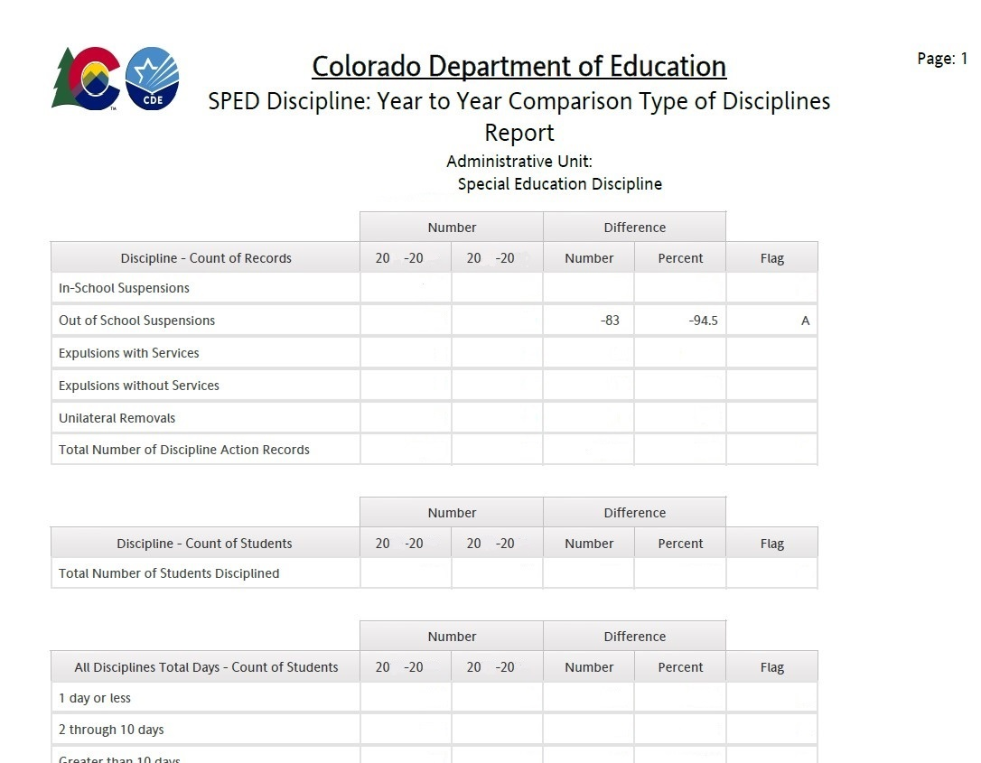
Year-to-Year Comparison Report example
You will only see flags - “A” – if both the number of the change is over 20 students AND the Percent of the Change is over 20%
These are the only data points that require explanation on the Flag Explanations sheet
32

Slide 33
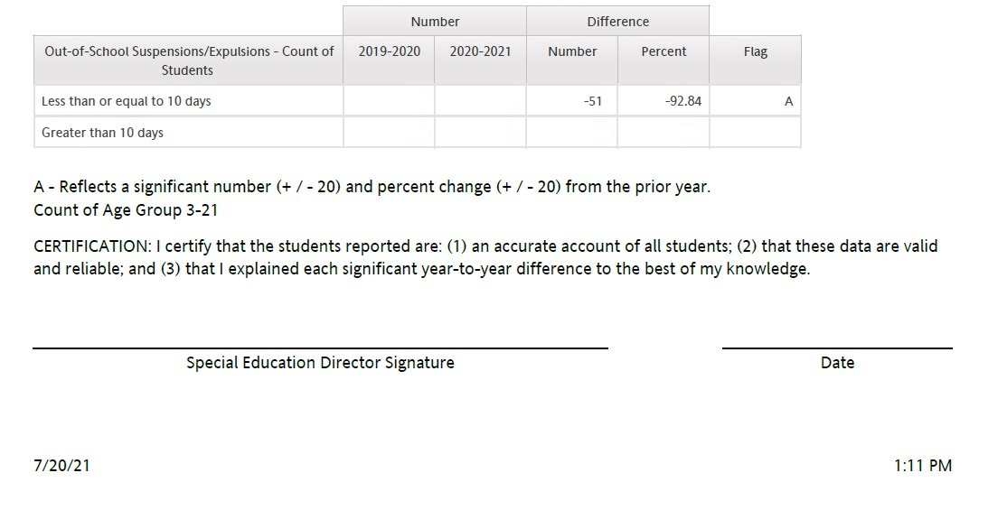

Year-to-Year Signature Page
CERTIFICATION: I certify that the students reported are: (1) an accurate account of all students; (2) that these data are valid and reliable; and (3) that I explained each significant year-to-year difference to the best of my knowledge.
By authorizing this report, the director is confirming in writing that the data reported is both valid and reliable.
Reminder: Review detail reports before submitting this signed report.
Notes:
By authorizing this report, you are confirming in writing that the data reported is both valid and reliable.
REMINDER: When you send in the Data Summary Report, please send the 14-page report in its entirety.

Slide 34
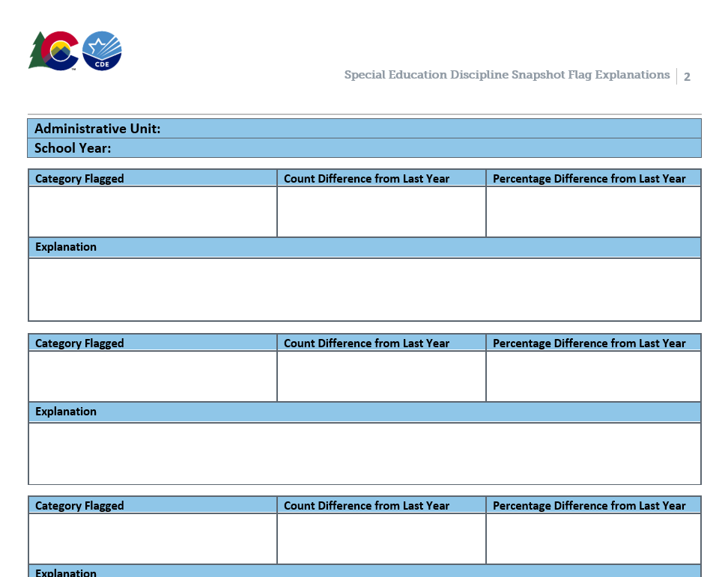

Year-to-Year Report Flag Explanations
Please provide explanations for the A flags from the page 1 of the Year-to-Year Report no later than August 29, 2024
The Word Document is located here under Reports: http://www.cde.state.co.us/datapipeline/snap_sped-discipline
You can include multiple flag categories when the same explanation applies
Upload as

Slide 35
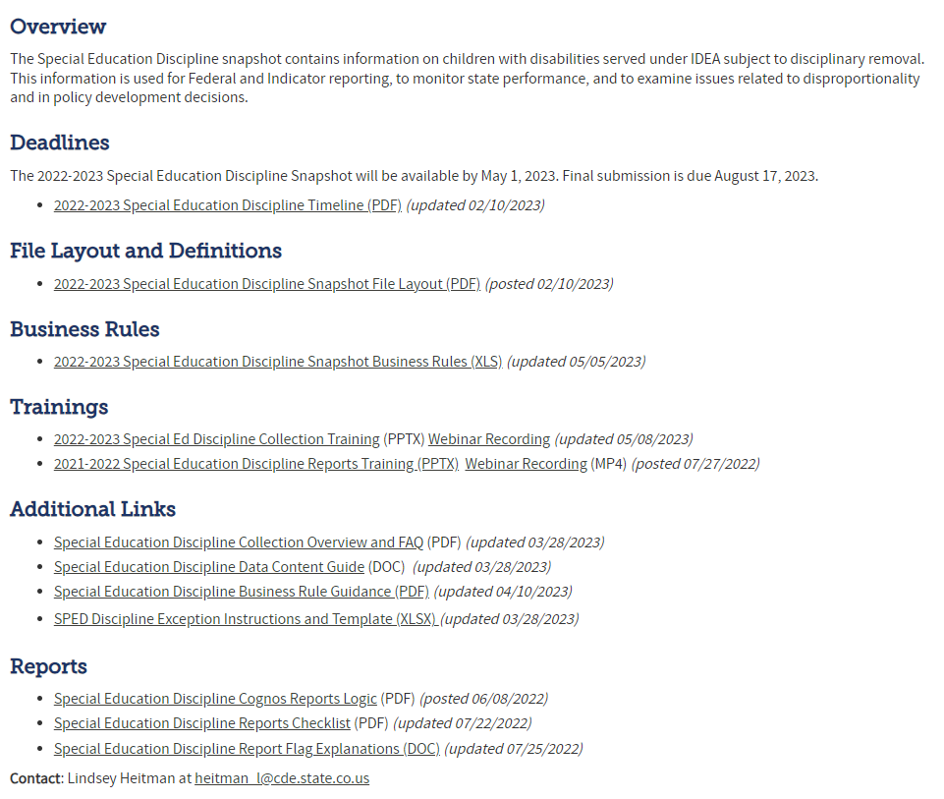
Flag Explanations Doc: Snapshots/Special Education Discipline- Reports
Special Education Discipline Webpage

Slide 36
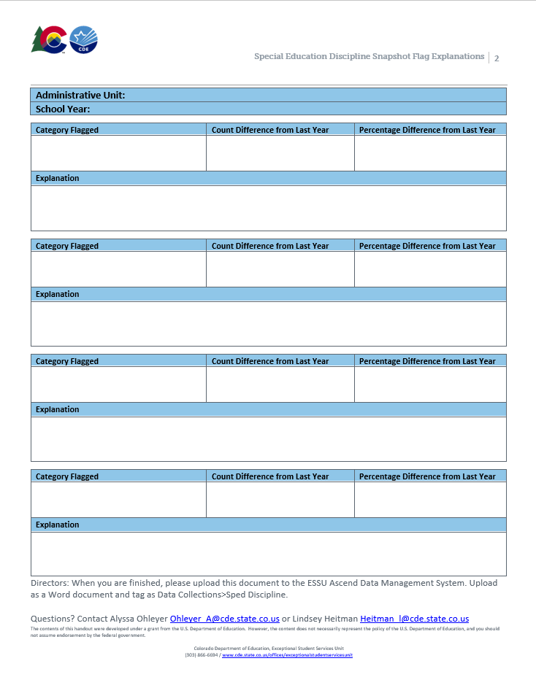
Completing Flag Explanations
Use the second page of the technical assistance document to provide explanations for each flag.
The CDE needs AUs’ explanations to:
  Identify the best practices and support needs in the field
  To report the year-to-year differences to OSEP
We appreciate explanations with:
  Great details
  Cause and effect (e.g., program implementation, unusual mobility)
Copy and paste the template on a new page as needed.
Upload this page to the Data Management System as a Word file, separate from the signed reports.

Slide 37
Which reports must be uploaded to the DMS?
Director Signed Reports + Flag Explanations (if necessary)
SPED Discipline Data Summary
*found under Cognos Reports/Special Education Discipline
SPED Year-to-Year Comparison Type of Discipline Report *found under Cognos Reports/Special Education Discipline
+ Special Education Discipline Flag Explanations *found here: http://www.cde.state.co.us/datapipeline/snap_sped-discipline under Reports section

Slide 38
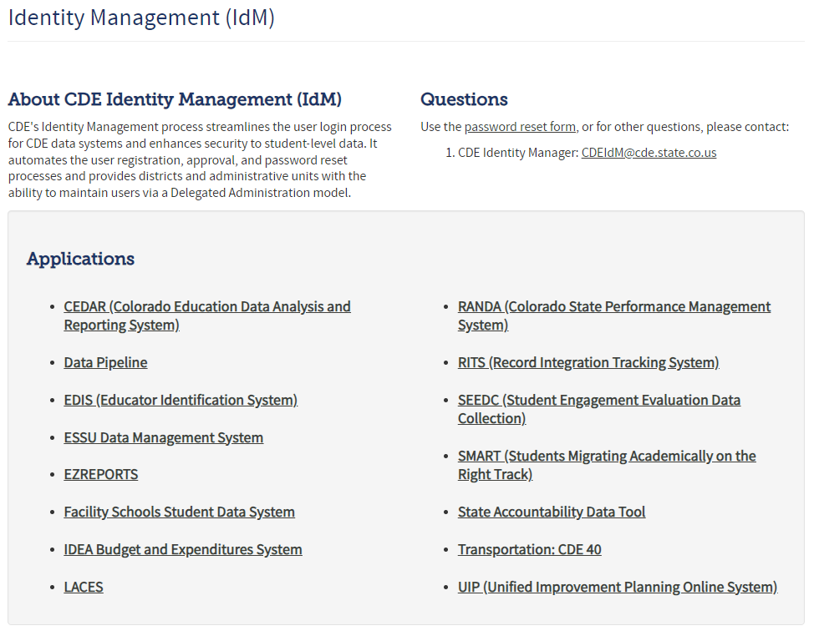
Uploading to the Ascend Data Management System
Log into the Ascend Data Management System
Click “ESSU Data Management System” Link to Data Pipeline Single Sign-on Page (opens in browser)

Slide 39
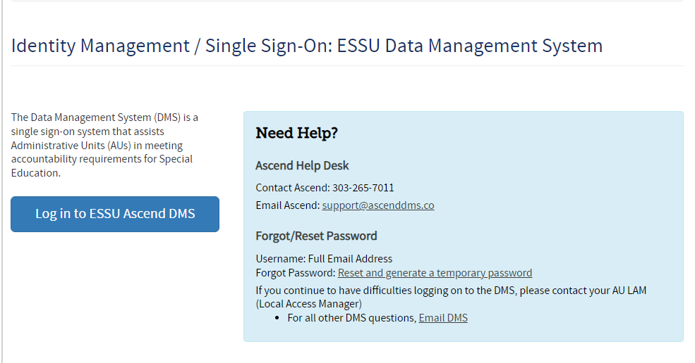
Log into the Ascend Data Management System
Identity Management / Single Sign-On: ESSU Data Management System

Slide 40
Uploading to Ascend DMS
Please Note!!
To upload files to the “Documents,” you must be able to log into the Ascend DMS
Please check that you can do this before the upload deadline August 29.
Your Local Access Manager (LAM) can assign you an appropriate role that will allow you to log in.
  If you encounter any trouble with the Ascend DMS, please email Josh Fails (fails_j@cde.state.co.us).

Slide 41
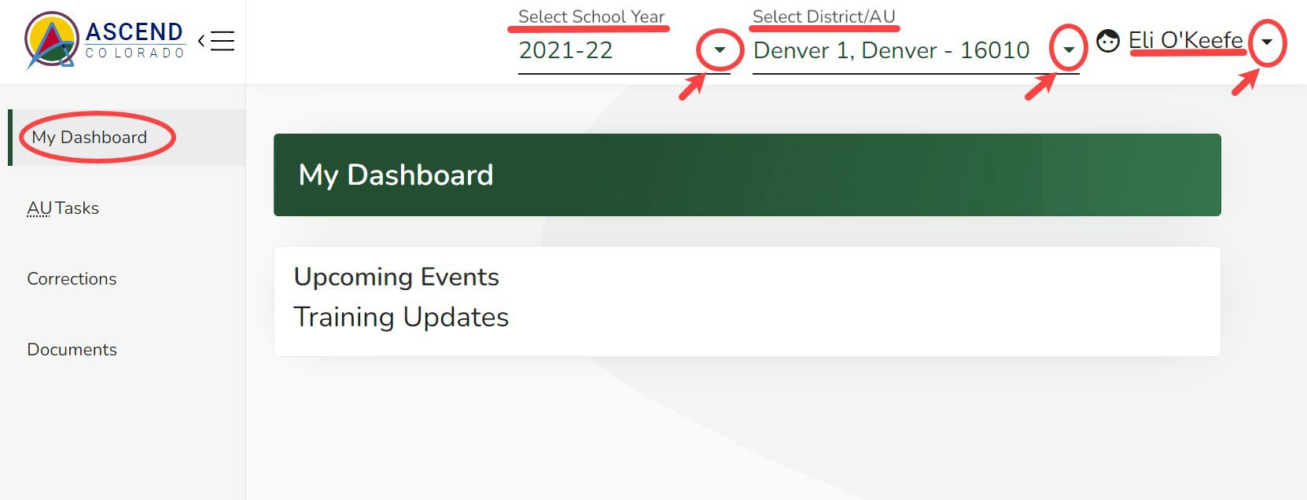

Quick Navigation in the Data Management System – Overview
Ascend DMS Dashboard
Upon logging into Ascend DMS, you will land on the “My Dashboard” page. Along the top right side of the screen, you will see 3 drop-down fields:
Select School Year
District/AU (*only shows your AU)
Username
Clicking on the shaded caret will give you further options.
When uploading documents, the year in the dropdown is not important.
Caret → 

Slide 42
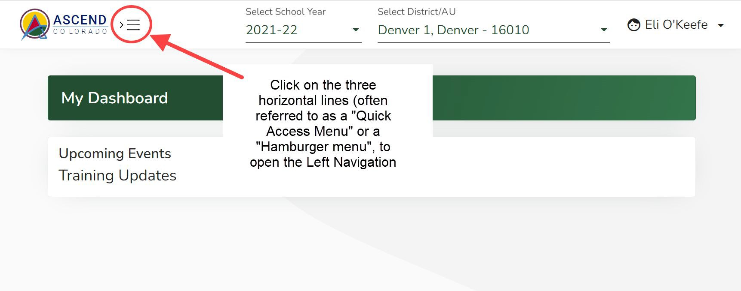
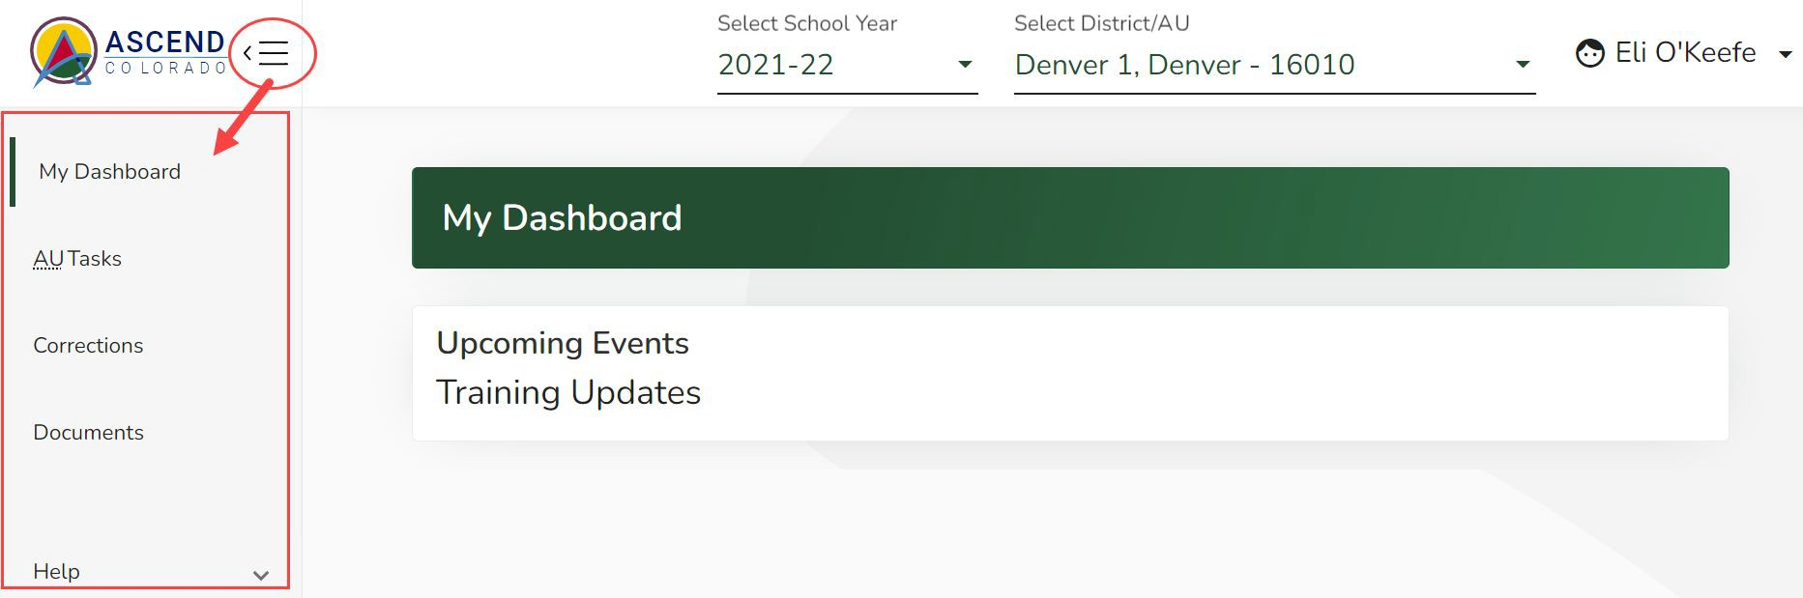
Ascend DMS Left Navigation Pane
Ascend may open with the left navigation pane closed. The left navigation pane contains the links to the various module pages such as AU Tasks, Corrections, Documents, and Help.
To open the left navigation pane:
Click on the Quick Access menu (3 horizontal lines icon) located to the right of the ASCEND logo located in the upper left corner of the screen.
To upload your Discipline Reports, select Documents from the menu

Slide 43
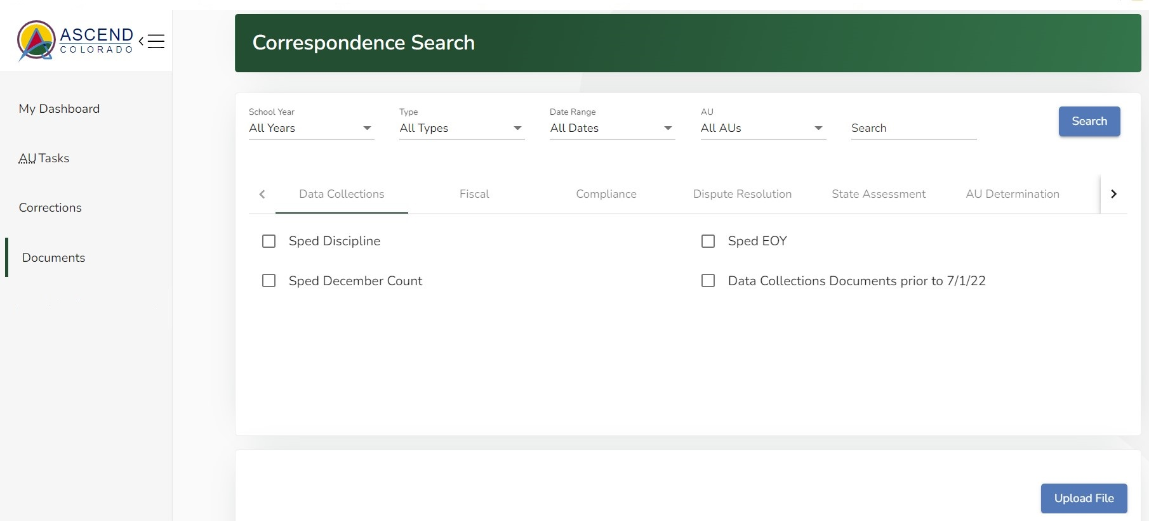
To Upload Documents
Click on “Upload File” button on this Documents Dashboard

Slide 44
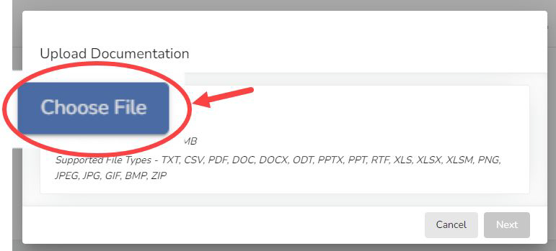
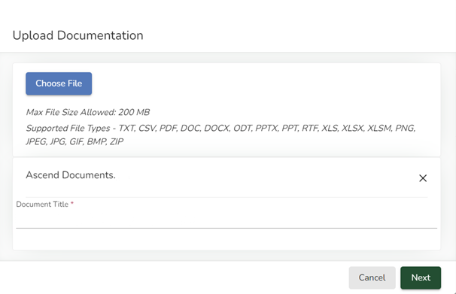
Uploading Discipline Report Documents
To upload documents:
  Choose the file(s) from your computer
  Type in the Document Title using the exact examples below.
“2023-24 Discipline Signature Reports” for the PDFs
“2023-24 Discipline Flag Explanations” for the Flag Explanations Word file
2023-24 Discipline Signature Reports

Slide 45
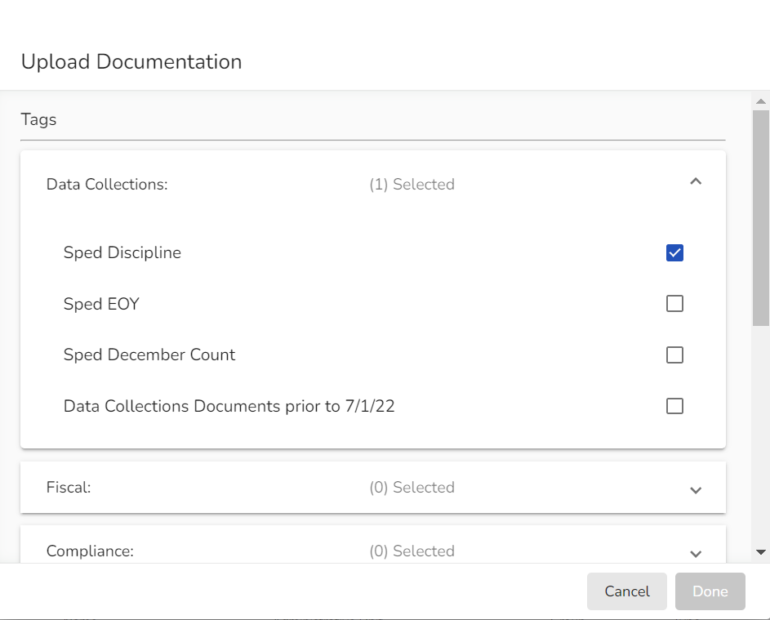
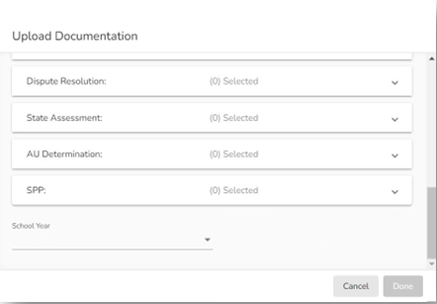

Tagging your Document
Use the carets on the right side of the Upload Documentation box to open Tag selection field for Data Collections
Select Sped Discipline
Scroll down
Select 2023-24 for the School Year
Click the “Done” button when it turns green (if it has not turned green, you have missed required info)

Slide 46
Final Snapshot Approval Steps within Pipeline
*required by August 29, 2024
Within Data Pipeline
1. Click Discipline on the left menu
2. Click Status Dashboard
3. Use the drop downs to select the appropriate values
  File Type: SPED Discipline Snapshot
  School Year: 2023-24
  Organization/LEA: defaults to your AU
Notice the Data Locked value on this screen is set to N
Notice the Overall Status is set to P (pending) indicating the data has not been submitted to CDE.
Check the box next to the Admin Unit name and number and then click on your Admin Unit name to get to the screen which contains the submit button.
Click the Submit to CDE button (Only SPI-APPROVERS will have this ability) (must have 0 errors)
Click OK
  A green message should display above the File Type box indicating the data was submitted
  The Data Locked value should change to Y
  The Overall Status should change to S

Slide 47
Assistance Needed?
For questions or support with the Special Education Discipline Data Collection, contact:
Lindsey Heitman heitman_l@cde.state.co.us Collection Lead
Josh Fails Fails_j@cde.state.co.us Data Management System, Document uploads
Email protocol – please include:
District # and Administrative Unit #
Phone number where you may be reached
Subject of the email
NOTE: Never send files or reports via email – contact us to determine best technical assistance avenue.
Thank you

