Slide 1
2021-2022 Student End of Year (SEY) Training: Coding Special Circumstances
June 9, 2022
Reagan Ward ward_r@cde.state.co.us

Slide 2
Agenda
Overview & Timeline
Reporting Exceptions: Request Process
Student Demographic Fields
English Learner
McKinney Vento (Homeless)
Military Enlisted
Student School Association Fields
PAI & Non-School Program Codes
BOCES Programs vs. Schools
Gifted and Talented
Expelled Students
Resources & Contact Information

Slide 3
Overview & Timeline

Slide 4
Purpose and use of SEY snapshot information
Summarize annual educational history for students throughout the school year
Derive graduation, completion, dropout, mobility, and stability rates
Inform state and federal policy
Public information; used in official reports and news articles
School and District Accountability measures
Reminder:
Report all students in grades PK-12 counted in membership at any time between July 1, 2021, and June 30, 2022

Slide 5
Key Dates: Regular Phase
 | Date | Event
Data Collection and Cleanup Phase (Regular Phase) | Monday 03/14/2022 | Snapshot Soft Open
 | Thursday 05/05/2022 | Snapshot Official Open
 | Thursday 06/02/2022 | Target: Create first End of Year Snapshot
 | Thursday 06/23/2022 | Target: Error free Student Interchange Uploads
 | Thursday 07/21/2022 | Target: Error free Student End of Year Snapshot
 | Thursday 09/01/2022 | Soft Deadline: Submit Student End of Year Snapshot
 | Thursday 09/08/2022 | Deadline: Submit Student End of Year Snapshot Approve initial data summary reports Deadline is mandated under Colorado Administrative Rules

Slide 6
SEY Post-Collection Phases
 | Date | Event
Cross LEA Validation | Thursday 9/22/2022 | Cross LEA Validation begins: Snapshots reopen
 | Thursday 10/06/2022 | Target: Error free Student End of Year Snapshot
 | Thursday 10/13/2022 | Deadline: Resubmit data to CDE
 | Date | Event
Post-Cross LEA Validation | Thursday 10/20/2022 | Post-Cross LEA Validation begins
 | Thursday 11/10/2022 | Target: Error free Student End of Year Snapshot
 | Thursday 11/17/2022 | Deadline: End of Post-Cross LEA validation phase
 | Date | Event
Final Dates | Monday 11/28/2022 | Begin final review of graduation and dropout rates after the AYG reconciliation Any changes will require a new sign-off page
 | Thursday 12/01/2022 | Deadline: Superintendents must approve final Data Summary Reports (collection closes)
 | Tuesday 01/10/2023 | Official/final data and rates posted on the CDE website and released to the public

Slide 7
Reporting Exceptions: Request Process

Slide 8
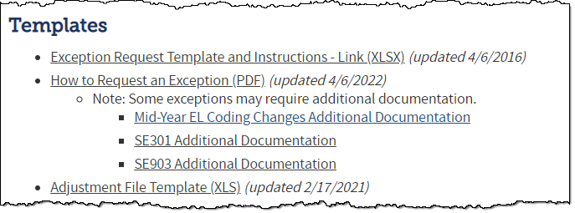
When are reporting exceptions needed?
Sometimes a student’s records will have accurate information, but their educational history will not follow the anticipated coding patterns outlined in the business rules for an interchange file or snapshot
These are unique circumstances and apply to few students
Reporting exceptions are used to clear the errors associated with a student’s record without changing the data
Student Demographic
Student School Association
Student End of Year
Data respondents must work with the data collection lead for a given file/snapshot to request an exception be granted
SEY Website: How to Request an Exception

Slide 9
Reporting Exception Process
Complete exception request template
Upload exception request template to your district’s Syncplicity student folder
Folder: 1234 – DISTRICT NAME – Student
Notify the SEY collection lead (ward_r@cde.state.co.us) that you’ve uploaded a document for review
Subfolder: SEY 2021-22
Collection lead will review your request and notify you of the outcome
Approved requests – reupload interchange file and/or create a new SEY snapshot
Denied requests – collection lead will provide next steps for clearing the error
Additional information needed – collection lead will request information
Available on SEY Website
Pro Tip: Include the date in name of your exception request file as you may upload more than one exception during the collection cycle

Slide 10
What types of exceptions might need additional information?
If the reason given for the exception doesn’t make sense with the coding pattern, clarification may be requested
SASID merge situations
Work with the RITS coordinator to resolve (details on RITS site)
English Learners whose status changed mid-year
More detail on slides 19-20
Mid-Year EL Coding Changes Additional Documentation
Post-Cross LEA SE903 errors
Adequate documentation required for student to remain coded as Exit 13 (transfer to a public school in another CO district)
Missing graduation guidelines records for a graduating student
SE301 Exception Request Supporting Documentation
Notes:
SE301 Supporting Documentation
Reason for Request: “Please provide detail regarding extenuating circumstances that have led to this request. Please include your districts’ process for making this decision.”

Slide 11
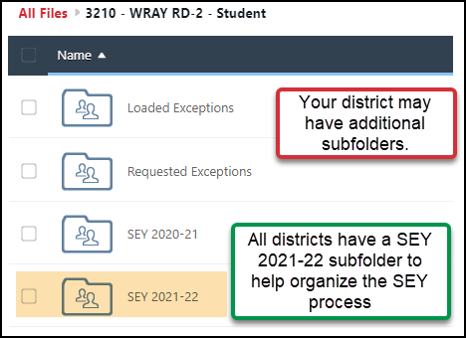
Additional Information
Who?
Where?
Student Interchange
Time of Year dependent
July – current Dec.
Student October Lead
Jan. – following Dec.
Student End of Year Lead
Student End of Year
SEY lead: Reagan Ward ward_r@cde.state.co.us
Syncplicity
https://my.syncplicity.com/
Same folder used for Student October, Student End of Year, & Attendance
Folder: 1234 – DISTRICT NAME – Student
Subfolder: SEY 2021-22

Slide 12
Student Demographic Fields

Slide 13
English Learner

Slide 14
Student Demographic Data Fields
Language Background
Identified on the Home Language Survey (HLS)
Students who are NEP, LEP, FEP, FELL, or PHLOTE must have a language background other than English (ENG) [Language Codes]
Language Proficiency
Indicates student’s English language proficiency (ability to speak, listen, read, and write in English)
Language Instruction Program
Indicates the type of English language instructional program used to education a student who is an English learner
Not an English Learner | English Learner
0 – Not Applicable 4 – PHLOTE, English Proficient (Primary Home Language Other Than English) | 1 – NEP, Non English Proficient 2 – LEP, Limited English Proficient 5 – FELL, Former EL 6 – FEP, Monitor Year 1 7 – FEP, Monitor Year 2 8 – FEP, Exited Year 1 9 – FEP, Exited Year 2

Slide 15
Language Proficiency Procedures Overview
Reminder: Districts should maintain copies EL Screener & WIDA ACCESS 2.0 scores
Site: CDE ELL Count & Audit
Language Background = ENG
Language Proficiency = 0
Language Instruction Program = 00
HLS & BOE review (COGNOS)
Language Background: ENG
Student Enrolls
English Proficient & never received language instruction = PHLOTE
EL
Language Background: other than ENG = EL SCREENER
Language Background = applicable code
Language Proficiency = 4
Language Instruction Program = 00
Language Background = applicable code
Language Proficiency = applicable code
Language Instruction Program = applicable code
Site: CDE Procedures for English Learner Identification
Notes:
How should a district code a student whose home language survey indicates that their home language is not English but, after taking an English Language assessment, is found to be Fluent English Proficient (FEP)? The student’s Language Background should be coded as the student’s home language, and he or she should have a Language Proficiency code if 4 (PHLOTE) or 5 (FELL).
PHLOTE indicates the student is fluent in English, has a primary home language other than English, and the student has never been in an EL program.
FELL indicates the student is fluent in English, has a primary home language other than English, and the student has been in an EL program in another district prior to enrolling in the current district.

Slide 16
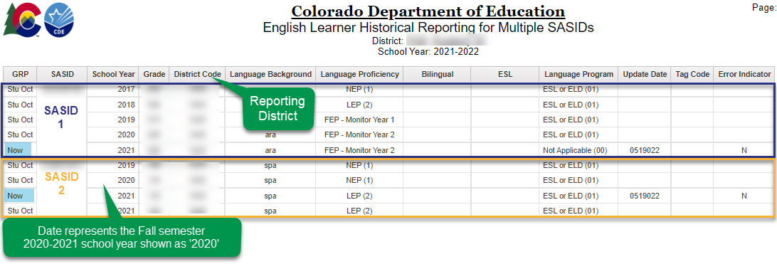
COGNOS/CEDAR Report Student Profile → EL Historical Reporting for Multiple SASIDS
Look up full EL history based on selected SASIDs
Shows all reporting districts
Document: SEY COGNOS/CEDAR Report Guide

Slide 17
Language Proficiency Annual Coding Cycle
Reminder: Districts should maintain copies EL Screener & WIDA ACCESS 2.0 scores
Site: CDE ELL Count & Audit
End of Year
Summer
Coding remains same as October
October
Review body of evidence (BOE)
WIDA ACCESS administered
NEP/LEP students only
Plan for next year, redesignate as needed
Student moves along progression based on BOE
Student End of Year
Is the summation of the current school year
Is not the status of the student for next year
Site: CDE EL Redesignation & Exiting Students

Slide 18
English Learner State Proficiency Progression
Reminder: Districts should maintain copies EL Screener & WIDA ACCESS 2.0 scores
Site: CDE ELL Count & Audit
SCREENER & BOE
NEP/LEP
FEP Monitor Year 1
FEP Monitor Year 2
FEP Exited Year 1
FEP Exited Year 2
FELL
Notes:
All identified NEPs & LEPs take annual ELP assessment, ACCESS/Alt.ACCESS
Language Proficiency = ‘1’ or ‘2’
Language Instruction Program = 98 (Not in a Language Instruction Program, Parent Choice)
A parent opt-out letter must be on file at the district when using this code
Parent/family may opt-out of ELD services but not annual ELP testing required by ESSA.
Site: CDE Procedures for English Learner Identification

Slide 19
Exceptions: Mid-Year EL Coding Changes
Student was mis-identified (data error) in Student October
Only changes considered: students identified as NEP/LEP in Student October advancing along progression or changing to non-EL
<2 years (2 October, 1 SEY), regular exception
>2 years (3 October, 2 SEY), mid-year coding change document required
Example: Student was redesignated over the summer per the standard coding cycle, but Student October did not show the updated status.
Extenuating circumstances
Only changes considered: students identified as NEP/LEP in Student October advancing along progression or changing to non-EL
<2 years (2 October, 1 SEY), regular exception
>2 years (3 October, 2 SEY), mid-year coding change document required

Slide 20
Mid-Year Parent Request
Parent/Guardian insists student was mis-identified as an EL and would like student’s EL coding changed
Contact the CLDE department for guidance
Doris Nguyen Brock-Nguyen_D@cde.state.co.us
Student’s coding should indicate their English language proficiency. A parent/guardian may opt-out of ELD services, but not annual ELP testing required by ESSA.
In the rare circumstance when district and parents have discussed student’s EL Proficiency level and determined the HLS was misinterpreted or an additional evidence concludes the student is ENG only, district should be prepared to provide detail about how this was determined and document the decision in their SIS.
Mid-year coding change document required

Slide 21
Mid-Year District Change: Students changing districts between OCT & SEY
Reminders:
Students should be screened upon entry into your district if their educational records indicate a language influence per the state’s standardized identification procedures. COGNOS is a great tool for reviewing a student’s EL History.
Districts were required to follow up with in person testing upon return to in-person learning for students with Provisional EL Identifications due to remote learning in 2020-2021
OCT through mid-February (close of ACCESS testing window)
If student was NEP/LEP in OCT and your district’s evidence now places them as FEP or non-EL so the student will not be participating in WIDA ACCESS testing…
Regular exception (indicate screener completed in ‘reason for exception’)
Mid-February (after ACCESS window) through June
Code student to match OCT and wait until next year to update EL coding per the normal progression
Note: You may begin providing services immediately, it is only the coding that needs to wait to be updated.
Student was not rescreened upon entry to district
Mid-year coding change document required
Please provide extensive detail regarding this unique circumstance with a detailed body of evidence.

Slide 22
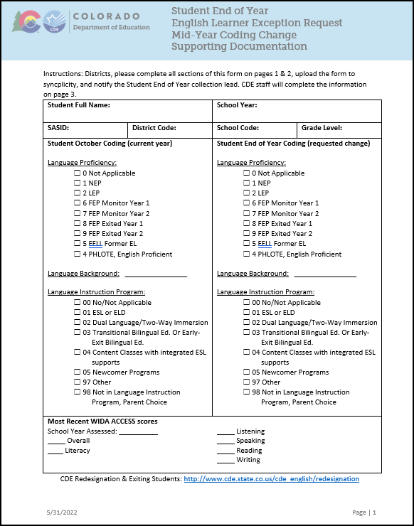
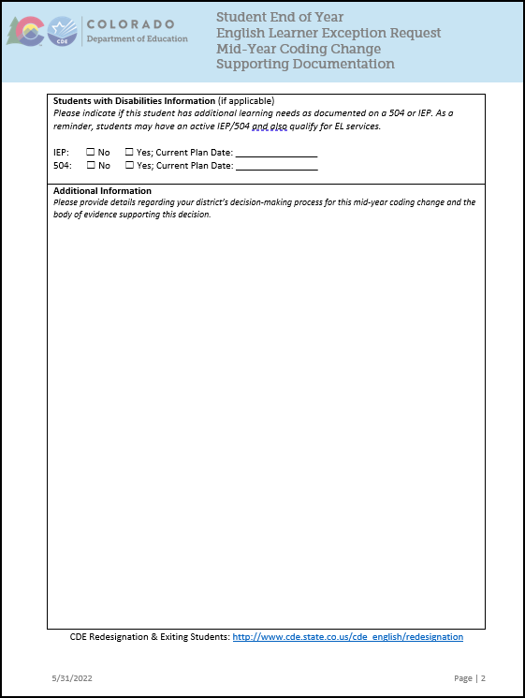
Mid-Year EL Coding Change Additional Documentation

Slide 23
McKinney Vento (Homeless)

Slide 24
Data Fields Student Demographic File
Existing SEY Fields
New SEY Fields 2021-2022
Homeless
3 – Yes, in custody of parent/guardian
4 – Yes, not in custody of parent/guardian (unaccompanied youth)
Primary Nighttime Residence
00 – N/A
01 – Shelters/Transitional
02 – Double Up due to Economic Hardship
03 – Unsheltered (Cars, Parks, Campgrounds)
04 – Hotels/Motels
Cause of Housing Crisis & Additional Cause of Housing Crisis
0 – N/A
01 – Eviction/Foreclosure/ cannot afford housing
02 – Household/Domestic Factor
03 – Loss or decrease in income/Loss of job/Seasonal Employee
04 – Natural Disaster
05 – Pandemic
98 – Prefer not to Answer/ Decline
99 – None of the Above
Note: These data fields should reflect a student’s status at the end of the school year.

Slide 25
Business Rules: Student Demographic File
Errors: If Homeless is 3 or 4 (yes), then
SP491: Cause of Housing cannot be 00 (n/a)
SP85: Primary Nighttime Residence cannot be 00 (n/a)
SP102: Free/Reduced Lunch must be 01 (Free Lunch Eligible)
Errors: If Homeless is 0 (no), then
SP493: Cause of Housing must be 00 (n/a)
SP494: Additional Cause of must be 00 (n/a)
SP84: Primary Nighttime Residence must be 00 (n/a)
Warning SP508: If Additional Cause of Housing Crisis is 00 (n/a) for all homeless students in your district

Slide 26
Business Rules: SEY Snapshot Level Warnings
SE017 – No students have Homeless = 3 or 4 (Yes)
Although this would be fantastic, for many districts this is unlikely
Verify the Homeless data fields on your demographic file include current information
SE023 – No students have a different Homeless status from the current year Student October collection.
It is unlikely that no students have experienced a change since October.
Some students who were in stable housing in October may now be displaced
Verify that the homeless data fields on your demographic file include current information

Slide 27
Military Enlisted

Slide 28
Student Demographic File
Military Enlisted – Student who has or will enlist in the military
This includes all branches of the military and full-time National Guard duty
Students only need to be identified if 17 years of age or older. Students may possibly be identified more than once.
Added in 2020-2021 due to statutory requirement SB18-012
Planned future connection to PWR measure in Accountability Frameworks
Document: Future PWR Changes Fact Sheet
0 | No
1 | Yes

Slide 29
Business Rules
Error
Warnings
SE225: PK-8 student reported as military enlisted = 1
SE226: Grade 9-12 student under the age of 17 reported as Military Enlisted = 1
SE211: __% of students age 17 or older reported as enlisting in the military. Military enlistment is included in the accountability frameworks
Note: Military Enlisted is not the same as Military Connected.
Military Connected – student has a parent or guardian who is an active-duty member of the Armed Forces or on full-time National guard duty.

Slide 30
Student School Association Fields

Slide 31
PAI (Pupil Attendance Info) & Non-School Program Codes

Slide 32
(PAI) Pupil Attendance Information
Indicates if student is attending a district school/program (A) or is a resident student attending an educational program not operated by the reporting district (B)
Group A: Pupils Attending an Educational Program Operated by the Reporting District
01 – 08, pulls into SEY
Group B: Resident Pupils Attending an Educational Program Not Operated by the Reporting District
24 – 33, does not pull into SEY
Note: Special Education IEP Interchange – Participation File
This file has additional PAI codes (11-23, 32) that do not pull into SEY
These are specific to the Special Education data collections

Slide 33
Non-School Program
Indicates that a student is being educated in a program without a school code
Programs run by a district, BOCES, or third-party entity in which a student is receiving all their educational services delivered through this program
PAI 01-08 only
School Code = student’s home school or district chosen school of accountability
00 | No, student is NOT enrolled in a non-school program
01 | Single District On-Line Program
02 | District-Run Program
03 | School District or BOCES Program
04 | Third Party Program
05 | 100% Remote Learning Option (Applicable to 2021-2022 only)

Slide 34
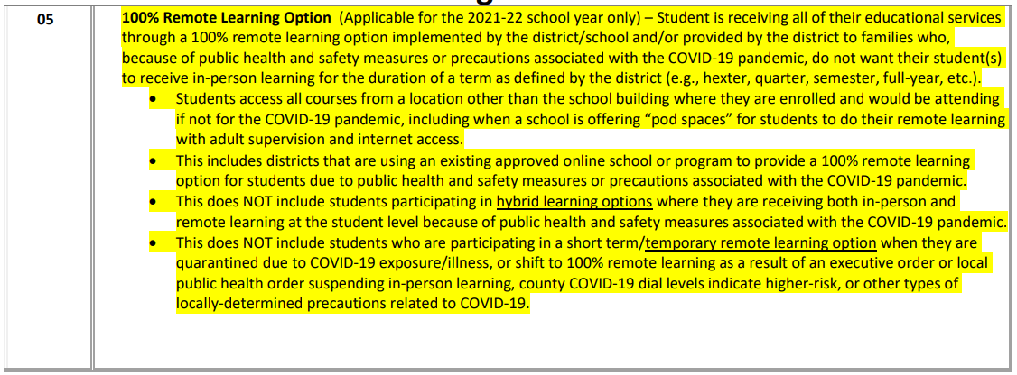
Non School Program 05
Report student’s most current participation status as of the last date of enrollment

Slide 35
BOCES Program vs. BOCES School District of Accountability
BOCES Program
BOCES School
PAI: 01—08
Non-School Program: 03
School Code: Student’s home school/school of accountability
Notes:
The district of accountability will have a record in SEY for these students because they are attending a program that DOES NOT have a school code
Do not exit these students unless they are exiting your district and no longer attending the BOCES program (i.e. move out of state)
PAI: 31 or 33
Non-School Program: 00
School Code: BOCES school of attendance
Notes:
These records will not pull into the SEY snapshot for the district of accountability
The BOCES school will have a record in SEY with a PAI 01-08 and the school code matching the BOCES school of attendance

Slide 36
Dual Enrolled in two separate districts
Students who are counted in membership in a district at any point during the year are included in the SEY snapshot
A student may only be counted as a graduate/completer from one district.
Districts must work together to determine which district will claim the student as a graduate/completer and which will exit the student with Exit Type 13 (transfer to a public school in a different CO district)

Slide 37
Gifted and Talented

Slide 38
Gifted and Talented Fields on SSA file
Students who have been formally identified as gifted using administrative unit-wide procedures aligned with CDE guidelines. Gifted students may be identified in any or a combination of these categories (domains).
Once a student is identified in a domain, they remain coded as such for all subsequent years. A student may add additional areas of identification in subsequent years as well.
Gifted in General Intellect | Gifted Social Studies
Gifted Creative and Productive Thinking | Gifted World Language
Gifted Leadership | Gifted Visual Arts
Gifted Reading | Gifted Drama and Theater
Gifted Writing | Gifted Musical
Gifted Math | Gifted Dance
Gifted Science | Gifted Psychomotor

Slide 39
SEY Field & Business Rules
Gifted and Talented (Internal Flag): Student identified as Gifted and Talented in one or more of the 14 domains indicated on the SSA file.
SE163: WARNING Grade 8-12 student whose Gifted and Talented identification differs from prior year. This student was previously identified as Gifted and Talented in one or more domains and should still be identified as such.
Check areas of identification on SSA field
Did student add an area of identification?
Ignore warning
Was student identified in an area last year that is missing this year?
Correct data fields
0 | No
9 | Yes

Slide 40
Expelled Students

Slide 41
Expelled Students: Exit & Entry Types
Exit Type
Entry Type
50 | Expulsion – student is not receiving educational services and does not return before the end of the reported year
55 | Expelled without educational services and returned – student returns before the end of the reported year
56 | Expelled with educational services – student is receiving educational services during time of expulsion
50 | Re-entry after expulsion without educational services from same school district in a prior year
55 | Re-entry after being expelled without educational services earlier in the same school year
56 | Re-entry after being expelled with educational services earlier in the same school year
Note: The SSA file includes a yes/no data field ‘Expelled Education’ used to indicate a student is attending a program providing educational services while expelled. This data field does not pull into the SEY snapshot.

Slide 42
Sample Coding Pattern: Expelled without services
Does not Return in current year
Returns in current year
2021-2022 Final SSA Record
School Exit Date = date of expulsion
School Exit Type = 50
2022-2023 First SSA Record
School Entry Date = date student returns to school
School Entry Type = 50
2021-2022 SSA Record
School Exit Date = date of expulsion
School Exit Type = 55
2021-2022 SSA Record
School Entry Date = date student returns to school
School Entry Type = 55

Slide 43
Sample Coding Pattern: Expelled with services
Expulsion ends before end of current year
Expulsion continues into next year
SSA Record 1 Exit Date: date of expulsion Exit Type: 56 School Code: applicable code
SSA Record 2 Entry Date: date services begin Entry Type: 56 School Code: applicable code, often same as above Exit Date: date expulsion ends Exit Type: 11
SSA Record 3 Entry Date: date return to school Entry Type: 11 School Code: applicable code
2021-2022 SSA Record 1 Exit Date: date of expulsion Exit Type: 56 School Code: applicable code
2021-2022 SSA Record 2 Entry Date: date services begin Entry Type: 56 School Code: applicable code, often same as above Exit Date: 00000000 Exit Type: 00
2022-2023 SSA Record 1 Entry Date: first day of school Entry Type: 02 or 11 School Code: applicable code
Note: In these examples, record 2 may also have the ‘Expelled Education’ field set to 1 (yes) on the SSA file. This field does not pull into the SEY snapshot.
Notes:
In the 2022-2023 example, the student may have a second SSA record to transfer back to in-person learning if the expulsion time period lasts into the next school year, not just through the end of the prior.
2022-2023 SSA Record 1
Entry Date: first day of school
Entry Type: 02 or 11
School Code: applicable code
Exit Date: date expulsion ends
Exit Type: 11
2022-2023 SSA Record 2
Entry Date: date return to in-person learning
Entry Type: 11
School Code: applicable code

Slide 44
Business Rules
SE066 – Exit 56 cannot be the last record for the year
SE096 – Re-Entry in same year not allowed after Exit Type (01,02,40,50,90-96) A record with one of these exit codes must be the last record
SE097 – Record with Entry (01, 02, 03, 40, 50, 90-93) must be first record for a given SASID
This is based on prior year exit type
SE131 – Exit 55 must be followed by a record with entry 55
SE132 – Entry 55 must be preceded by a record with exit 55
SE135 – Exit 56 must be followed by a record with entry 56
SE135 – Entry 56 must be preceded by a record with exit 56
SE145 – Exit 50 not allowed if student was Exit 90 in a prior year.

Slide 45
Resources & Contact Information

Slide 46
Resources
Student End of Year
Timeline
File layouts & Business Rules (SEY & Adjustment)
Trainings (SEY & GG)
Regular Phase Resources
SEY Overview & Checklist
Regular Phase
FAQs
SEY COGNOS/CEDAR Report Guide
Additional Resources
Student Interchange
File Layouts (DEM, SSA, GG)
Business Rules (DEM, SSA, GG)
Graduation Guidelines
Menu of Options
Background/History
FAQ
Postsecondary & Workforce Readiness
Postsecondary Programs

Slide 47
Contacts
Name | Area of Expertise | Contact Info
Reagan Ward | Student End of Year Graduation Guidelines Data | ward_r@cde.state.co.us 720-484-9057
Brooke Wenzel | October Count Student Interchange | wenzel_b@cde.state.co.us
Debbie Puccetti Peter Hoffman | RITS/EDIS | ruccetti_d@cde.state.co.us hoffman_p@cde.state.co.us
Robin Russel | Graduation Guidelines Manager | russel_r@cde.state.co.us
Michelle Romero Erica Ryan | Postsecondary Programs | romero_m@cde.state.co.us ryan_e@cde.state.co.us
Paula Gumina | McKinney Vento Homeless Education | gumina_p@cde.state.co.us
Doris Nguyen | EL Students | nguyen_d@cde.state.co.us

