Slide 1
2022-2023 Staff Interchange
Training
In the chat, please use your district/LEA code when asking a question.

Slide 2
We will be covering today
In the chat, please let me know if you are a new respondent, or if you are not new how many years have you been doing Staff/HR collection
CDE Staff Website
File Layout
Staff Profile
Staff Assignment
Templates
Business Rules
Resources
What is the Human Resources Snapshot?
Data Pipeline
Format Checker
Upload Staff Profile File
Upload Staff Assignment File
WELCOME
Data Pipeline Reports
Checking for errors and fixing errors
Cognos Reports

Slide 3
Identity Management Roles
Staff Interchange Roles (both 4-digit LEAs and 5 digit AUs):
STF~ LEAUSER – upload and modify staff interchange files OR
STF~LEAVIEWER – view (only) staff interchange data
Human Resources Snapshot Roles (only 4-digit LEA codes):
HRD~LEAAPPROVER – Approves, creates, views Snapshot OR
HRD~LEAUSER - creates, views Snapshot OR
HRD~LEAVIEWER- views snapshot
Special Ed December Count Snapshot Roles (only 5-digit AU codes):
DEC~LEAAPPROVER – Approves, creates, views Snapshot OR
DEC~LEAUSER - creates, views Snapshot OR
DEC~LEAVIEWER- views snapshot

Slide 4
Additional Guidance - Staff Interchange Role (STF)
Those with the STF role for an Administrative Unit (5-digit code) should only report Special Education Staff (Special Education flag = 1)
Those with the STF role for a district/BOCES (4-digit code) can report ALL staff, regular and special education, for the district/BOCES (4-digit code)
For those reporting all staff, you must meet all timeline dates for the Special Education December Count snapshot

Slide 5
Website Overview - https://www.cde.state.co.us/datapipeline
For Staff Interchange Information
For Human Resources and Special Ed December Count Information
To Login to the Pipeline System
click here:
Codes – frequently used codes are found here (district codes, school codes, institutes of higher education, etc.)
Collection dates, Mandatory Collections- legislation and uses, converting csv files to excel, etc.

Slide 6
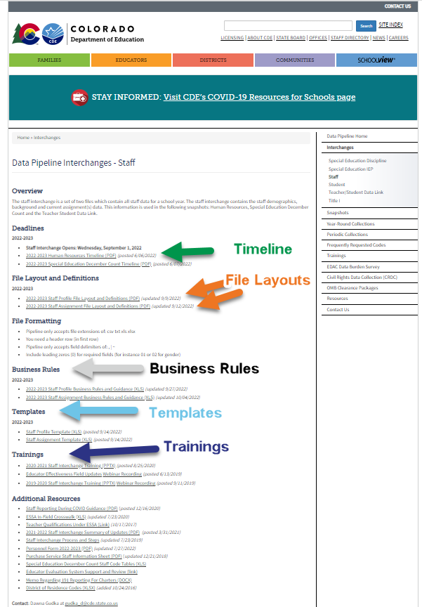
Website Overview - Interchanges
Staff website resources
Human Resources Timeline
Staff Profile File Layout
Staff Assignment File Layout
Business Rules
Training-
Today's recording will be posted on our website soon after the training ends.
Today is the first for the 22-23 school year, MORE to come throughout the collection. They will be announced on our website, through email, and at Townhall

Slide 7
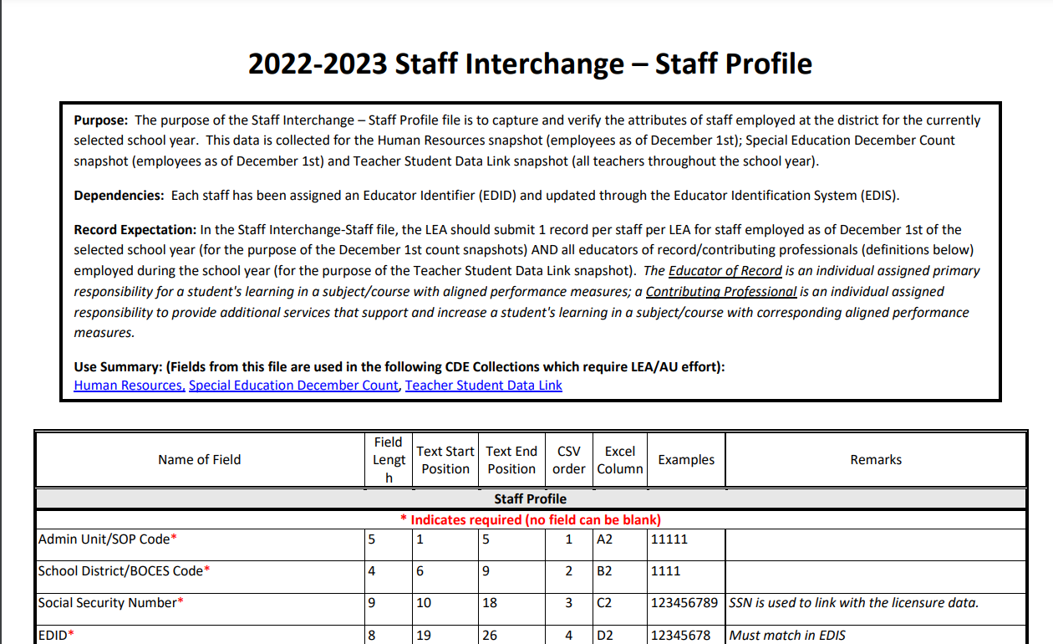
Staff Profile File Layout

Slide 8
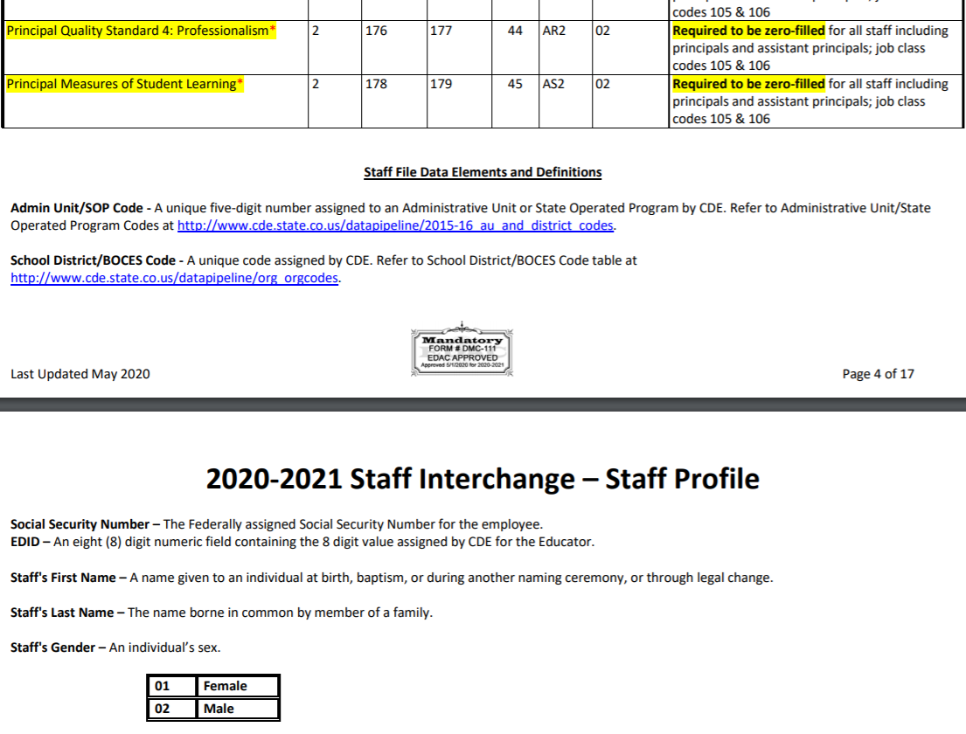
Staff Profile File Layout
Definitions - Every Field Name included in the File Layout will have a corresponding “Definition” listed under the file layout table
Changes included at the bottom of the document

Slide 9
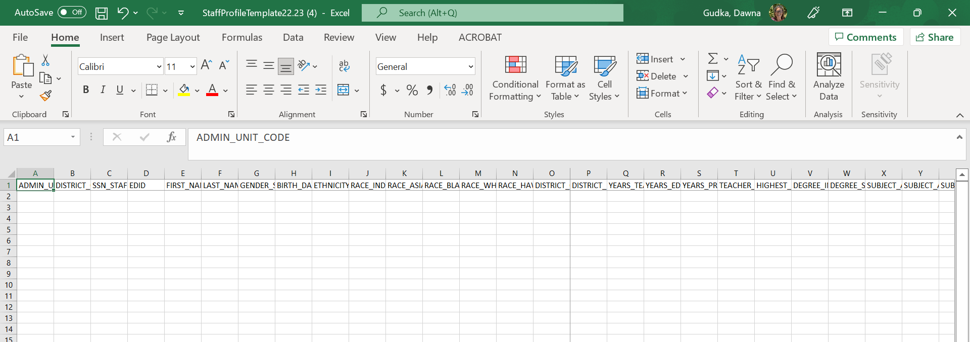
Using the template staff profile

Slide 10
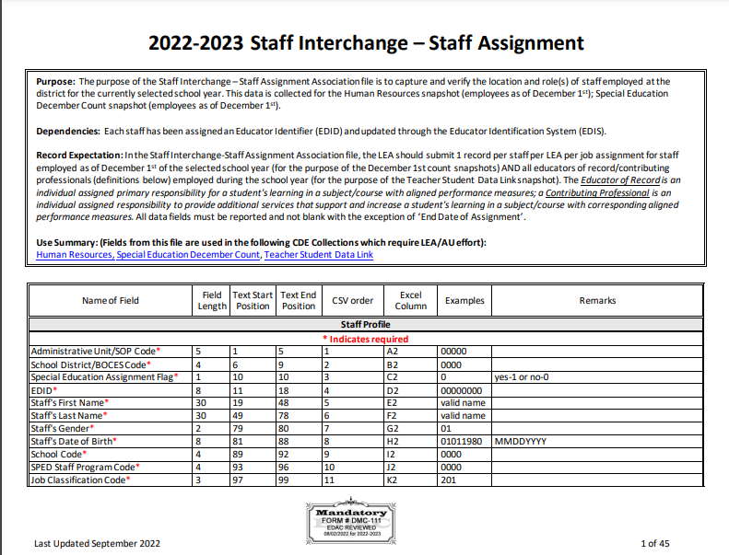
Staff Assignment File Layout

Slide 11
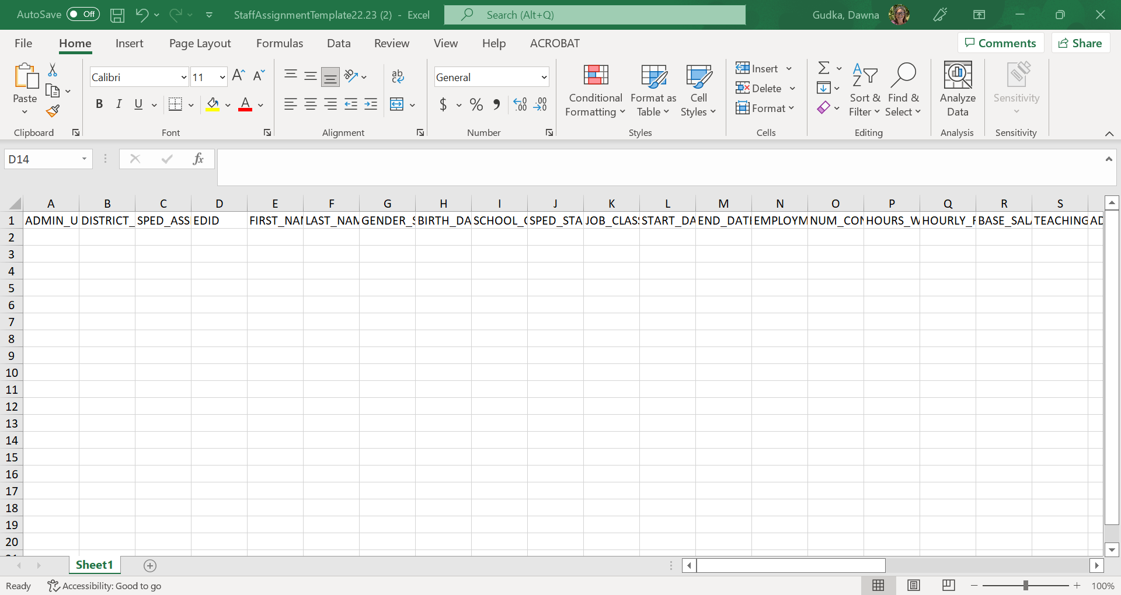
Using the template for the Staff Assignment

Slide 12
Glossary of Terms
Term | Definition
Cognos | A type of report in which the user can view applicable reports that are formatted in a user-friendly environment
Data Pipeline | A streamlined approach to efficiently move required education information from school districts to the CDE
Interchange | The method of providing data to CDE in which LEA’s may choose from multiple file formats to submit data transactions throughout the year.
LAM | Local Access Manager responsible for assigning the appropriate access to CDE applications
LEA | Local Education Agencies
IdM | Identity Management. A single sign on system, allowing the user to navigate between the applications without entering user ID information a second time.
Snapshot | A date in time when data is pulled from the appropriate interchanges, validated by additional business rules, and approval given that signifies it was accurately reported for a specific point in time by an LEA.

Slide 13
Staff Interchange Overview and Data Uses

Slide 14
Interchange Process leads to HR Snapshot
Start Here
Create/Update Data Files
Upload files in Data File Upload
Review Batch Maintenance
Data Pipeline Reports or Error Reports in Cognos
Correct Data Files in Source System
Upload files in Format Checker
Once No Errors in All Files -> Create Snapshot

Slide 15
Staff Interchange Files
Staff Profile
General information of staff
Only 1 record per staff
Must be uploaded first
Staff Assignment
Provides specifics to actual duties and locations
Multiple records per staff allowed

Slide 16
Who is Reported?
Full time and Part time staff
General Education
Special Education
Districts report their Special Ed Staff as part of their staff interchange files OR
Administrative Unit reports special education staff for all member districts and the districts exclude them
Contracted/Purchased Services Staff
Details can be found at: https://www.cde.state.co.us/datapipeline/inter-staff-purchase-service-info
Charter school staff
District level staff as well as school level staff
District level staff are reported with School Code 9980 for ‘District Wide’

Slide 17
Staff Interchange Uses
Staff Interchange files are used in the following snapshots:
Human Resources
Special Education December Count
Teacher Student Data Link (TSDL)
Notes on the Snapshot Process:
Snapshots pull the records from Staff Assignment and Staff Profile files matching the criteria set for each snapshot
Snapshots are not automatically updated when interchange files are uploaded- a new snapshot must be created within the system to pull in the updated records

Slide 18
Criteria for Human Resources Records
All error-free records from the Staff Assignment that:
Special Education Flag = 0 (Non-Special Education)
Start date is December 1st or prior to December 1st of reporting school year
End Date is either blank or post December 1st of the reporting school year
Job class codes are not equal to 632 (Temporary/Part-time Worker As Needed) or 634 (Student Worker)
Employment Status Code = 11, 12, 13, 23, 25 or 26
EDID is reported in both Staff Profile (Profile and educational background) and Staff Assignment Association files for reporting district.

Slide 19
Human Resources – Use of Data
EDFacts – federal reports US Department of Education
SchoolView.org/Data Center
Performance Reports – staff statistics
ESSA In-Field Reporting
Media and external data requests
Colorado Department of Labor and Employment
Colorado Department of Higher Education

Slide 20
Criteria for Special Education December Count Records
All error-free records from the Staff Assignment that:
Special Education Flag = 1
Start date is December 1st or prior to December 1st of reporting school year
End Date is either blank (not ended) or post December 1st of the reporting school year
EDID is reported in both Staff Profile (Profile and educational background) and Staff Assignment Association files for reporting district.
Employment Status Codes will be included: 11, 12, 13, 23, 25 or 26.
Administrative Unit code cannot be zero-filled in either staff profile or staff assignment files

Slide 21
Special Education December Count– Use of Data
EDFacts – federal reports US Department of Education
Report on educator effectiveness
Draw random samples for parent survey
Compliance record review
Monitoring
Provide information regarding the fiscal impacts of the numbers
Indicator reporting – Significant Disproportionality
Public reporting
Legislature and Research requests
Consultant analysis to support technical assistance needs in the state

Slide 22
SPED December Count Timeline 2022-2023

Slide 23
HR Timeline 2022-2023

Slide 24
2022-2023 File Review

Slide 25
Staff Profile Overview
1 record per staff employee
EDID cannot be zero – filled
Last Name, First Name, Date of Birth and Gender must match with information in EDIS for the EDID
Race must be provided for all staff
Ethnicity – Hispanic or Latino is considered an Ethnicity, a race must also be reported
No fields can be blank except Exit Date
If field is not required for a staff member, it may be zero-filled instead

Slide 26
Summary of Changes – Staff Profile
Existing field ‘Teacher Probationary Status’ was updated to be ‘Probationary Status’ a few years ago and is required for all principals, teachers, and special services providers (SSPs)
File Layout changed – additional fields added to the end of the Staff Profile File
All evaluation fields are for reporting Evaluation Ratings for the following staff:
Teachers
Special Services Providers
Principals
Summary of Updates posted online on our staff website each year
2022-2023 Staff Interchange Summary of Updates

Slide 27
Staff Assignment Overview
1 record per position/assignment
If the same employee has two positions, include multiple records, 1 for each position held
Multiple records are necessary per person if they hold multiple positions based on the following:
Special Education Status
Location
Job Class Code
Grant Code
Teaching Subject Area
Grade levels (elementary and secondary need to be separated)
When reporting 2 or more records for a person:
Contract Days would not be split
Base Salary would be split accordingly
Hours per Day would be split accordingly

Slide 28
Staff Assignment Record Example
An art teacher teaching K-12 grades at school 1111. He works 8 hours per day, 160 days with a salary of 45,000:
Record 1:
job class code = 201 (teacher); teaching subject area = 0020 (art); school = 1111; grades K, 1, 2, 3, 4, 5 = 1 (yes); hours per day = 0400 (4 hours for elementary level); base salary = 022500 and contract days = 160 days
Record 2:
job class code = 201 (teacher); teaching subject area = 0020 (art); school = 1111; grades 6, 7, 8, 9, 10, 11, 12 = 1 (yes); hours per day = 0400 (4 hours for secondary level); base salary = 022500 and contract days = 160 days

Slide 29
Summary of Changes – Staff Assignment file
Job Classification codes updated to align with the Chart of Accounts job classification codes and definitions
Previous years we had codes 107 and 108 are no longer valid job class codes
Summary of Changes posted on the staff website every year.
2022-2023 Staff Interchange Summary of Updates

Slide 30
Highlights of ALL Coding Changes

Slide 31
Demonstrates In-Field Status Guidance

Slide 32
Summary – Equitable Distribution of Teachers (EDT) and Teacher In-Field Status
ESSA requires LEAs accepting Title I, Part A funds to develop plans to address any disparities in low-income and minority students’ access to effective, in-field, or experienced teachers compared to their higher-income, non-minority peers. Colorado’s ESSA State Plan defines these teacher indicators as follows:
ESSA Indicator | Definition | Collected Data
Ineffective | Teacher received an Ineffective or Partially Effective evaluation rating, based on Colorado’s Educator Quality Standards. Half of this rating is based on professional practices and half is based on measures of student learning/outcomes. | Overall Evaluation Rating – reported in Staff Profile (suspended due to COVID)
Out-of-Field | Teacher does not hold at least one of the following in the subject area they teach: Endorsement on a Colorado teaching license Degree (bachelor’s or higher) 36 semester hours Passing score on a SBE-approved content exam (currently the ETS Praxis Series) | Demonstrates In-Field Status – reported in the Staff Assignment file
Inexperienced | Someone who has taught in a K-12 setting fewer than 3 full years (not limited to Colorado). | Teaching Experience – reported in the Staff Profile

Slide 33
Teachers (job class codes 201, 202, 206) Reported with Teaching Subject Area Codes:
Code
Must be Reported with a Demonstrates In-Field Status Code:015
General 7th-8th Grade
0070
Co-Alt Exclusively
0200-0299
Art
0500-0599
English Language Arts
0600-0699
Foreign Languages
1100-1199
Mathematics
1200-1299
Music
1300-1399
Natural Science
1500-1599
Social Sciences
1700-1799
Special Education
Code | Description
01 | Subject area endorsement on teaching license
02 | Degree (BA or higher) in subject area
03 | 36 semester credit hours in subject area
04 | Passed State Board of Education approved content exam in subject area
05 | None (teacher is out-of-field)
0010 | General Elementary
0015 | General 7th-8th Grade
0070 | Co-Alt Exclusively
0200-0299 | Art
0500-0599 | English Language Arts
0600-0699 | Foreign Languages
1100-1199 | Mathematics
1200-1299 | Music
1300-1399 | Natural Science
1500-1599 | Social Sciences
1700-1799 | Special Education

Slide 34
Using Code 01 – Subject area endorsement on teaching license
View Teacher’s Endorsement(s) using the Cognos Report:
Verify Teacher’s Endorsement(s) align with Teaching Subject Area and Grades using the ESSA In-Field Crosswalk (https://www.cde.state.co.us/datapipeline/essain-fieldcrosswalk)
cognos
Folders: Staff Profile
Staff Licensing Status

Slide 35
Using Code 02 – Degree (BA or higher) in subject area
Verify Teacher’s Subject Area of Degree (reported in Staff Profile) aligns with Teaching Subject Area (reported in Staff Assignment) using the ESSA In-Field Crosswalk (https://www.cde.state.co.us/datapipeline/essain-fieldcrosswalk)

Slide 36
Using Codes 03– 36 semester credit hours
To identify first 24 credit hours, use the endorsement content evaluation worksheets at: https://www.cde.state.co.us/cdeprof/endorsementrequirements
For the remaining 12 credit hours, LEAs may determine alignment based on a sound rationale, whether that be an existing LEA policy regarding relevant coursework that informed the in-field decision, or a cogent explanation of how the coursework being considered as in-field aligns to the course(s) taught.
Sixth Grade In-Field Question: If secondary teachers are leading 6th grade content, which falls outside the typical grades for in-field, these teachers may be considered in-field if:
the secondary endorsement(s) held aligns with the course(s) taught; AND
the school is structured such that teachers are leading subject area content (in alignment with secondary endorsement) throughout day, rather than covering multiple subjects.

Slide 37
Equitable Distribution of Teachers – Good to Know!
CDE conducts EDT analyses annually, based on data reported by districts via the October Count and HR Pipeline. District-level results are publicly available under the resources section on the EDT web-page. Unsuppressed district and school results are shared with ESEA Consolidated Application authorized representatives via a secure file transfer system.
LEAs with less than 1,000 students enrolled or only one school per grade span are exempted from EDT analyses.
The term “highly qualified,” codified under NCLB, no longer applies. Under ESSA, states define what effective, in-field, and experienced mean, as Colorado has done in it’s ESSA state plan. These three indicators are the reference points of EDT.
More information in response to FAQs about EDT requirements is located here Educator Qualifications under ESSA and here: Equitable Distribution of Teachers.
Any questions about EDT plans required under ESSA may be directed to Jeremy Meredith, ESEA Senior Consultant @ Meredith_J@cde.state.co.us.

Slide 38
Data Pipeline Uploading Data Files

Slide 39
Create Files
Excel, CSV or Text File all accepted
Need to create 2 separate files:
Staff Profile – demographic and educational background info
Staff Assignment File – specifics for location and duties
1st record of data must be field names/titles
File layouts, definitions and codes all found at: http://www.cde.state.co.us/datapipeline/inter_staff

Slide 40
Creating Files – Helpful Tips
First Record = Headings or Titles
can be labeled to make the most sense to you
Pipeline system ignores these headers-essentially skips it to the 2nd row with actual data
Codes must match codes within file layout
Include leading zeros
Blanks are not allowed except for Staff End Date
Templates available if needed at: http://www.cde.state.co.us/datapipeline/inter_staff

Slide 41
Referencing/Using Last Year’s Data File
You may download last year’s data file as a starting point if needed
File layout will be in prior year (2021-2022) file layout; updates would be required for the Staff Profile File
Data Pipeline -> Staff Profile -> File Extract Download
This may also be used to download recent files uploaded into pipeline
Includes any updates made in ‘Edit Record Screen’
Includes all data records from all files uploaded

Slide 42
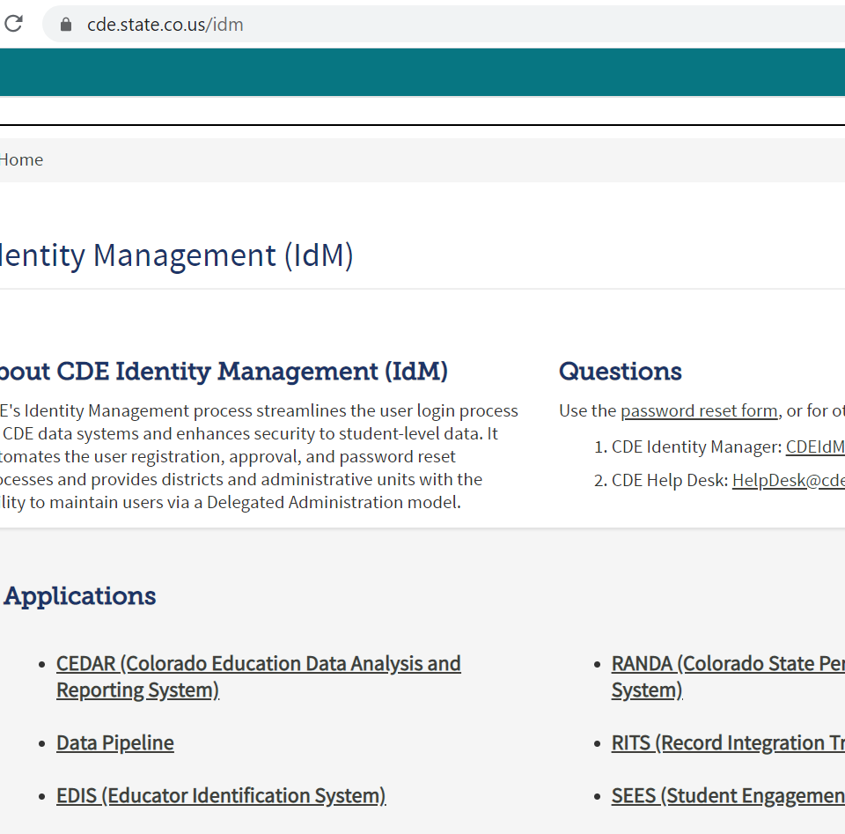
Accessing Data Pipeline
Identity Management Page

Slide 43
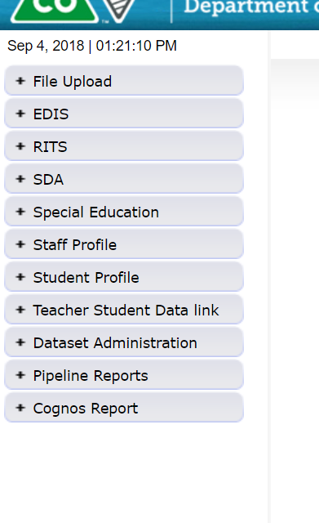
Pipeline Website Review
Batch Maintenance, Format Checker and Data File Upload
Based on your Identity Management Roles
Error reports and other validation reports

Slide 44
Format Checker Notes
Format Checker will only review the 2nd row in your file
Passing format checker Does Not Equal file will process
Green ‘Pass’ for each field is desired result
Red ‘Fail’ for a field indicates file is not in the correct format- please refer to the 2020-21 file layout on web

Slide 45
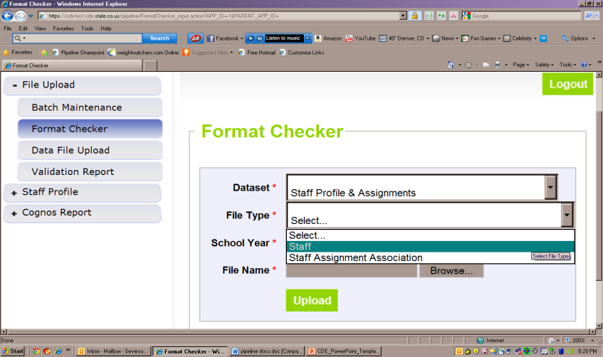
File Upload – Format Checker

Slide 46
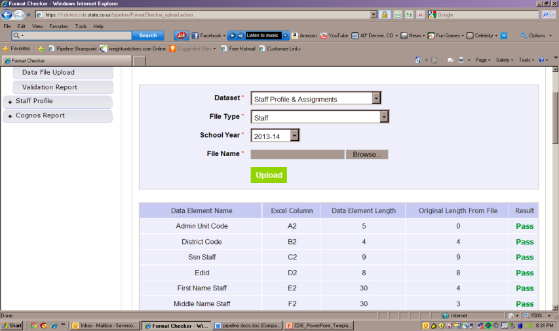
Format Checker – Upload Results shows All PASS

Slide 47
Data File Upload Notes
Upload Staff Profile file first
Upload staff assignment file second
Staff profile does not have to be error free, just uploaded before staff assignment file is uploaded.
Upload Types:
Append = adds file to existing file, all records from both files included
Can be tricky with fixing errors
Replace = deletes any prior data file and replaces it with the file being uploaded
RECOMMENDED

Slide 48
Data File Upload

Slide 49
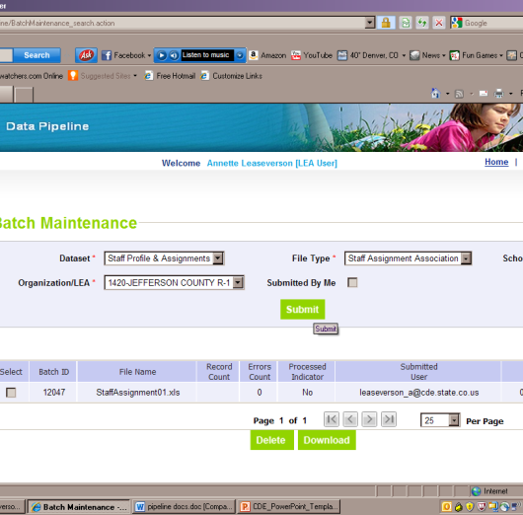
Batch Maintenance Screen- ‘No’ indicates the file did not process

Slide 50
File Not Processed – Next Steps
Ensure file has all green ‘pass’ in format checker
YES?
Open file and review all records are formatted the same as the 2nd row
Be sure all codes and dates have leading zeros included
NO?
Review file layout posted online and re-format the file
For further assistance, contact Dawna Gudka (Staff Interchange/Human Resources or Lindsey Heitman (Special Education December Count)
DO NOT INCLUDE THE FILE IN ANY EMAILS – if needed we can send a syncplicity folder to share the file(s) securely

Slide 51
Batch Maintenance – ‘Yes’ indicates Processed & Displays the Number of Errors

Slide 52
Review Errors in Detail
2 methods available:
Data Pipeline Reports -> Error Reports
Cognos Reports – > Staff Profile
All Business rules (errors and warnings) can be found at:
http://www.cde.state.co.us/datapipeline/inter_staff
Cognos Reports -> Baseline -> Business Rules

Slide 53
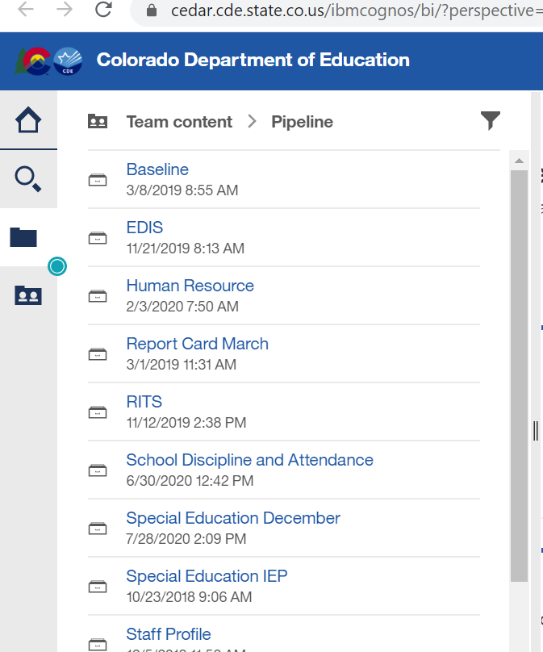
Clicking on Cognos Reports- Opens in a new Screen

Slide 54
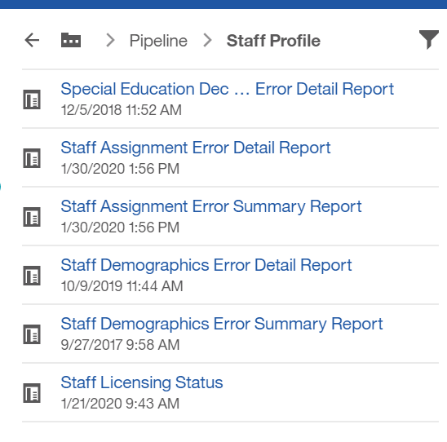
Staff Profile Folder in Cognos

Slide 55
Error Reports
Error Detail Report
Provides specific records causing the error with the error description
Can select to View ALL error records or 1 type of error at a time
Error Summary Report
Provides a count of errors generated per error type and description
Resubmit either file as needed for corrections for all data errors to be resolved
Be sure to update source file with corrections as well

Slide 56
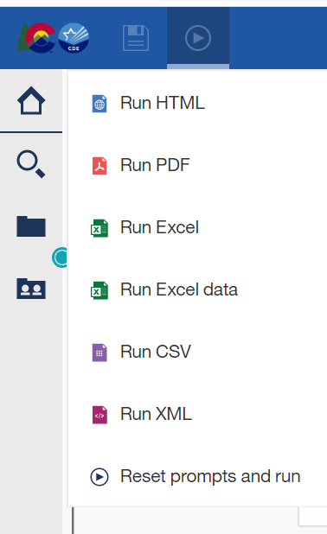
Error Detail Report- Excel
All cognos reports can be downloaded into excel
Click on t button on the top left
Choose ‘Run Excel’ when making selection

Slide 57
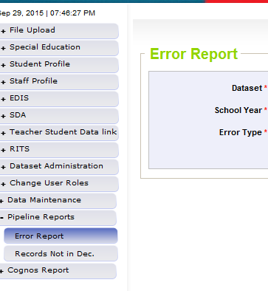
Pipeline Reports – Method to Review Errors
Search:
Dataset = Staff Profile and Assignments
School Year = 2020-21
Error type = Errors and Warnings
File Type: Staff/Staff Assignment
Org/LEA = Code
Click ‘Search’

Slide 58
Pipeline Error Reports – Viewing Details
Summary of Errors are next provided:
From this screen:
Click on ‘View Details’ to view each record with the error
Choose ‘Excel’ to download error report in Excel

Slide 59
Correcting Errors
Correct the errors in the file:
May have to fix errors in both Staff Profile and Staff Assignment files
Keep file versions – in case updated file causes even more errors, you can re-start using a prior file version
Resubmit your data records using the same process and replacing your existing data file using the Data File Upload tool
All errors must be corrected, all warnings should be reviewed

Slide 60
Next Steps – Staff
Staff Profile = Processed and Zero Error Count
Staff Assignment File = Processed and Zero Error Count
Create Snapshot
Districts/BOCES create Human Resources Snapshot
Administrative Units create Special Education December Count Snapshot

Slide 61
Additional Cognos Reports

Slide 62
Staff Interchange Cognos Reports
Special Education December Snapshot Error Detail Report
Staff Assignment Error Detail Report
Staff Assignment Error Summary Report
Staff Demographics Error Detail Report
Staff Demographics Error Summary Report
Staff Licensing Status

Slide 63
Special Education December Snapshot Error Detail Report (staff errors)
Useful if you are responsible for reporting the Special Education staff in your Staff Interchange files
Provides list of staff errors found in the Special Ed December Count Snapshot
Only available with data after the Special Ed December Count Snapshot has been created by the Administrative Unit
Only displays the staff records with errors that are reported for your entity

Slide 64
Staff Licensing Status
Provides all current licenses held for ALL staff reported in the Staff Profile file based on the SSN in the file
Use to check license status for teachers and/or special education providers
Use to check endorsements for teachers for the Demonstrating In-Field Status
If a staff person is not in the report, then a license was not found for the SSN reported
Check to ensure the SSN on the license matches the SSN in the Staff Profile file and in EDIS

Slide 65
Resources

Slide 66
Thank you
If you have any questions, please do not hesitate to contact us.
Staff Interchanges
Staff Profile File Layout Staff Assignment File Layout
Human Resources Snapshot
Timeline
Dawna Gudka
(303) 598-7901
gudka_d@cde.state.co.us
Special Education December Count
Lindsey Heitman
Heitman_l@cde.state.co.us
Thank you for joining us!

