Slide 1
Special Education Discipline 2022-2023
May 2, 2023
Lindsey Heitman
Heitman_l@cde.state.co.us

Slide 2
Special Education Discipline – Annual Training
Welcome and thank you for joining the webinar!
Tuesday May 2 10:00 – 11:00
Slides and recording posted on both webpages:
Special Ed Discipline Interchange
Special Ed Discipline Snapshot
Microsoft Teams meeting
Click here to join the meeting
Meeting ID: 282 852 572 455 Passcode: rEuC6H
Download Teams | Join on the web
Or call in (audio only)
+1 929-341-4269, 729365451#
Phone Conference ID: 729 365 451#
Special Education Discipline - Lindsey Heitman - heitman_l@cde.state.co.us (303) 866-5759

Slide 3
Agenda
Purpose/Collection Overview
Data Pipeline Access – IdM
Timeline
Sped Discipline Interchange
Data Collected
Sped Discipline Snapshot
Data Pipeline Process
Exception Processing

Slide 4
Frequently Used Terms
Term | Definition
Cognos | A type of report in which the user can view applicable reports that are formatted in a user-friendly environment
Data Pipeline | A streamlined approach to efficiently move required education information from school districts to the CDE
DMS | The ESSU Data Management System (DMS) is a single sign on system that assists AUs in meeting accountability requirements for Special Education and Gifted Education.
Interchange | The data holding place within the Data Pipeline. A method of providing data to CDE in which LEA’s may choose from multiple file formats to submit data throughout the year.
LAM | Local Access Manager responsible for assigning the appropriate access to CDE applications
LEA | Local Education Agencies
IdM | Identity Management. A single sign on system, allowing the user to navigate between the applications without entering user ID information a second time.
Snapshot | A date in time when data is pulled from the appropriate interchanges, validated by additional business rules, and approval given that signifies it was accurately reported for a specific point in time by an LEA

Slide 5
Special Education Discipline vs. School Discipline
There are two separate discipline collections in the Data Pipeline!
Collection Manager – Dawna Gudka
Periodic collection process
School level data
3 possible files required with aggregate data
count of incidents
count of students
Includes ALL students disciplined counted and reported
Districts submit data and finalize data within Pipeline
Special Education Discipline
School Discipline (SDA)
Collection Manager – Lindsey Heitman
Interchange/Snapshot process
Student level data
1 file required -Special Ed Discipline Action file
Includes Special Education Students
Student must have had an active IEP at the time of the Discipline Action Start Date
Districts submit the Sped Discipline Action file; AUs create and finalize the Sped Discipline Snapshot

Slide 6
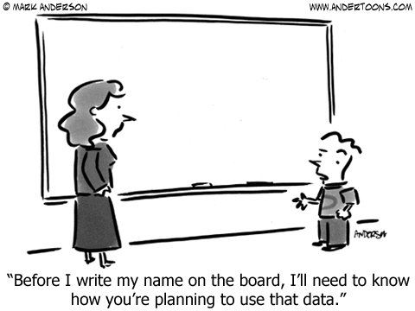
Purpose
https://www.cde.state.co.us/cdesped/sped_data
Find AU Special Education data at this link/State Performance Plan and Annual Performance Reports
Indicator 4A. Percent of local educational agencies (LEA) that have a significant discrepancy, as defined by the State, in the rate of suspensions and expulsions of greater than 10 days in a school year for children with IEPs; and
Indicator 4B. Percent of LEAs that have: (a) a significant discrepancy, as defined by the State, by race or ethnicity, in the rate of suspensions and expulsions of greater than 10 days in a school year for children with IEPs; and (b) policies, procedures or practices that contribute to the significant discrepancy, as defined by the State, and do not comply with requirements relating to the development and implementation of IEPs, the use of positive behavioral interventions and supports, and procedural safeguards.
(20 U.S.C. 1416(a)(3)(A); 1412(a)(22))
U.S. Department of Education federal requirements (next slide)
Research requests
Monitoring
Consultant analysis to support technical assistance needs in the state
Special Education Fiscal Advisory Council (SEFAC)

Slide 7
Content
Section 618(a)(I)(A)(vii) of IDEA requires that states report to the federal government the number of children with disabilities by race, ethnicity, and disability category who are removed to an interim alternative educational setting or are subject to long-term suspensions or expulsion.
Students with disabilities who were subject to:
1. DISCIPLINE - Suspensions
In-School
Out-of-School
2. DISCIPLINE - Expulsions
With or without educational services
3. REMOVAL - Unilateral Removals by School Personnel to an IAES for one of the following reasons
Drugs
Weapons
Serious Bodily Injury
4. REMOVAL - Removal based on a Hearing Officer Determination based on the hearing officer’s determination that maintaining the child’s current placement is substantially likely to result in injury to the child or others.
IMPORTANT NOTE: student must have been an active Sped student at the time of the Discipline Action Start Date. If student exited Sped prior to that date, record/action does not need to be reported in this file.

Slide 8
Special Education Discipline: Identity Management: Data Pipeline Access
DISTRICT RESPONDENT ROLE
INTERCHANGE ROLE OPTIONS *1 role per account | ENABLES USER TO:
DIS~LEAVIEWER | read-only access
DIS~LEAUSER | upload files, view interchange level errors
Data Pipeline responsibility breakdown:
Districts (DIS role) upload Special Education Discipline Action File OR Mark No Discipline Actions
Districts (DIS role) research and resolve Sped Discipline Action File errors and upload corrected file
AUs (SPI role) create Special Education Discipline Snapshot
AUs (SPI) work with districts (DIS) to resolve snapshot errors
AU RESPONDENT ROLE
SNAPSHOT ROLE OPTIONS *1 role per account | ENABLES USER TO:
SPI~LEAVIEWER | read-only access
SPI~LEAUSER | create snapshots and view snapshot level errors
SPI~LEAAPPROVER *Need at least 1 | create snapshots, view snapshot level errors, AND approve the final snapshot (by clicking submit to CDE)
Process until all interchange and snapshot errors are resolved
Single district AU may have the same person responsible for both
*Assigned by Local Access Manager (LAM)
*Important: only 1 role per group/account!
*Same person/account may have both the DIS and SPI role

Slide 9
Who is Responsible for What?
Overview of Collection Responsibilities
DISTRICTS | ADMINISTRATIVE UNITS
Submit Special Education Discipline Action File of students on an IEP with discipline actions that occurred during the current reporting period July 1, 20212 - June 30, 2023. Resolve Interchange and Snapshot errors in accordance with the timeline. | Submit Special Education IEP Child and Participation Files for the current reporting period July 1, 2022 – June 30, 2023. Create Special Education Discipline Snapshot and work with district to resolve errors. Review reports with the Special Education Directors during report review week. Submit data to CDE at the close of the collection. Upload Final Signed Reports to the Data Management System under the Profile tab.
Collaboration

Slide 10
DISCIPLINE
SPECIAL EDUCATION DISCIPLINE
AU Responsibility
District(s) Responsibility
Special Education Discipline Interchange
AU 64233: Colorado River BOCES
*Special Education Discipline Snapshot
District 1195: Discipline Action File
District 1180: Discipline Action File
District 1220: Discipline Action File
*A snapshot is a point in time “picture” of your data extracted from the Interchange files
District 9175: Discipline Action File
Student Interchange
Special Education IEP Interchange
District 1195: SSA File
District 1195: Student File
District 1180: SSA File
AU 64233: Special Education Child File
AU 64233: Special Education Participation File
District 1220: SSA File
District 1220: Student File
District 1180: Student File
District 9175: SSA File
District 9175: Student File
*An Interchange is the data holding place where your data files may be uploaded and validated throughout the school year

Slide 11
2022-2023 Special Education Discipline Timeline
Timeline
May 1, 2023 | Sped Discipline Snapshot open (Interchange and Snapshot soft opened 4/3)
May 25, 2023 | All 5 Interchange files uploaded
June 29, 2023 | Interchange errors resolved/At least 1 snapshot created
Aug 3, 2023 | Exception requests submitted to CDE by this date
August 10, 2023 | Snapshot and Interchange errors resolved
Aug. 10 – 17, 2023 | Report Review
August 17, 2023 | Final Submission due to Data Pipeline and DMS
Download the full Timeline from here

Slide 12
Reporting Period
Special Education Discipline Reporting Period:
Report Disciplinary Actions occurring between July 1, 2022 and June 30, 2023
on incidents that occurred between July 1, 2021 and June 30, 2023
Incidents may occur in the prior school year but an exception is necessary to resolve edit DA043
*There were no changes in 2022-2023!

Slide 13
Special Education Discipline Interchange (District-DIS Role)

Slide 14
Special Education Discipline Interchange Resources
Timeline, Discipline Action File Layout, Template, Business Rules, and other helpful resources:
http://www.cde.state.co.us/datapipeline/inter_sped-discipline
The file layout and definitions is where you will find all of the data fields collected, their definitions, and code options and definitions

Slide 15
Special Ed Discipline Interchange: Contains 1 File
Special Education Discipline Action File
Report suspensions, expulsions, and unilateral removals on students with an active IEP
Record Expectation:
Each record represents a single Discipline Action - suspension, expulsion, or unilateral removal
Record should be reported in the school year in which the discipline action took place
Student must have been on an active IEP at the time of the action
Each record must have a 10-digit Incident Identifier #
May be duplicated in cases where a student has more than one action associated with the incident
May be duplicated in cases where more than one student is involved in the incident
Each record must have a *unique 10-digit Action Identifier #
Action Identifier may not be duplicated *EXCEPT in the case of a Unilateral Removal with more than one removal reason (i.e. weapons and bodily injury)

Slide 16
ACTION TYPES
Disciplines
Suspensions
In-school (01)
Out of School (02)
Expulsion (with or without services)
(03)
Removals
Unilateral Removal to an IAES by school personnel for up to 45 days
(01)
Removal by a hearing officer to an IAES for up to 45 days
(02)
OR
*Incident involving drugs (01), weapons (03), or serious bodily injury (02) -requires a REMOVAL REASON
*IAES – Interim Alternative Educational Setting
Each record should contain a Discipline OR a Removal. Not both!

Slide 17
Disciplines – Suspensions & Expulsions
Suspensions and Expulsions:
In-School Suspension – child is temporarily removed from regular classroom for disciplinary purposes but remains under the direct supervision of school personnel.
Out-of-School Suspension – child is temporarily removed from regular school for disciplinary purposes to another setting (e.g. home, behavior center).
Expulsion - An action taken by the LEA removing a child from his/her regular school for disciplinary purposes for the remainder of the school year or longer in accordance with local educational agency policy.

Slide 18
Removals
Removals- temporary change in placement to an IAES (determined by IEP team)
Unilateral Removal By School Personnel – school personnel order the removal of child with disabilities from their current educational placement to IAES for not more than 45 school days for drugs, weapons, or serious bodily injury.
- extreme situation, school personnel made decision without parent consent for a change in placement for typically 45 days.
Unilateral Removal Based on a Hearing Officer’s Determination – impartial hearing officer orders the removal of child with disabilities from current educational placement to IAES for not more than 45 school days.
Interim Alternative Educational Setting (IAES) – An appropriate setting determined by the child’s IEP team or hearing office in which the child is placed for no more than 45 school days. This setting enables the child to continue to receive educational services and participate in the general education curriculum (although in another setting) and to progress toward meeting the goals set out in the IEP.

Slide 19
Discipline Action Length Field
Discipline Action Length must be between a half day and 260 days. Number of days removed should not exceed the number of school days in a year.
*should reflect the number of actual school days missed within the reporting period of 7/1 – 6/30
½ day =0005
1 days = 0010
10 days = 0100
60 days = 0600
260 days = 2600

Slide 20
How to Report Disciplines
Suspension
Discipline field = 01 or 02 (in school or out of school suspension)
Discipline Start Date = date the suspension began
Discipline Action Length = length in days of the suspension (25 or less ideally) (0020 = 2 days)
Special Education Removal Type= zero-fill (only required on Removals)
Special Education Removal Reason= zero-fill (only required on Unilateral Removals by School personnel)
Received Services During Expulsion = zero-fill (only required on Expulsions)
Expulsion
Discipline field = 03 (expulsion)
Discipline Start Date = Date the expulsion began (02252022)
Discipline Action Length = length in days of the expulsion or school days removed (0900) 90 days
Special Education Removal Type = zero-fill (only required on Removals)
Special Education Removal Reason= zero-fill (only required on Unilateral Removals by school personnel)
Received Services During Expulsion = 0 No or 1 Yes

Slide 21
How to Report Removals
Unilateral Removal by School Personnel
Discipline field = 00 (always zero-filled)
Discipline Start Date = date the removal began
Discipline Action Length = length in days removed to an IEAS (0450) 45 days
Special Education Removal Type = 01 (Unilateral Removal by School Personnel)
Special Education Removal Reason= 01, 02, or 03 (drugs, bodily injury, or weapons)
Received Services During Expulsion = 0 No or 1 Yes
Removal by a Hearing Officer
Discipline field = 00 (always zero-filled)
Discipline Start Date = date the removal began
Discipline Action Length = length in days removed to an IEAS (0200) 20 days
Special Education Removal Type = 02 (Removal by Hearing Officer)
Special Education Removal Reason= zero-fill (only required on Unilateral Removals by school personnel)
Received Services During Expulsion = 0 No or 1 Yes

Slide 22
Action Type: Expulsion (Discipline)
Name of Field | How to Code | Notes
Incident Identifier | 4598103736 | Assigned per incident - may be duplicated if student had multiple actions
Date of Incident | 02232021 | Must be between 07/01/21 and 06/30/23
Discipline Action Identifier | 9977882244 | Must be unique per record
Disciplines | 03 | Required for suspensions or expulsions
Discipline Start Date | 02242022 | Must be between 07/01/22 and 06/30/23
Discipline Action Length | 0900 | Length in school days removed (0900) 90 days.
Special Education Removal Type | 00 | Not required for Disciplines – zero-fill
Special Education Removal Reason | 00 | Not required for Disciplines – zero-fill
Received Services During Expulsion | 0 | Required- report 1 for yes or 0 for no
Special Education Action Flag | 1 | Required – always 1

Slide 23
Who to Exclude
Which students should NOT be reported in this file?
Exclude students who have been suspended for less than half a school day.
Exclude parentally-placed private school students.
Exclude records who were moved from their current educational placement as a result of a decision by the IEP team to change a student’s placement.
For example, if following a discipline offense, the IEP team meets and determines that the child’s current placement is not the least restrictive environment for that child, and therefore makes a permanent change in the child’s IEP placement, do not report that record in the file.

Slide 24
Special Education Discipline Snapshot (AU-SPI Role)

Slide 25
Snapshot Criteria
Criteria:
Pull all error-free records from the Sped Discipline Action File where the SPED_DISCIPLINE_ACTION_FLAG = 1.
Dependencies:
Student has been assigned a SASID and updated in the RITS system
Student has a record in the Special Ed Discipline Interchange:
Special Education Discipline Action File
Student has a record in the Student Interchange:
Student Demographic (demographic data) *file must be untagged
Student School Association (grade level, school code) *file must be untagged
Student has a record in the Special Education IEP Interchange:
Participation File – Primary Disability, Dates of Entry/Exit to Special Education
Child File – demographics pulled in rare case that student is missing from Student Interchange

Slide 26
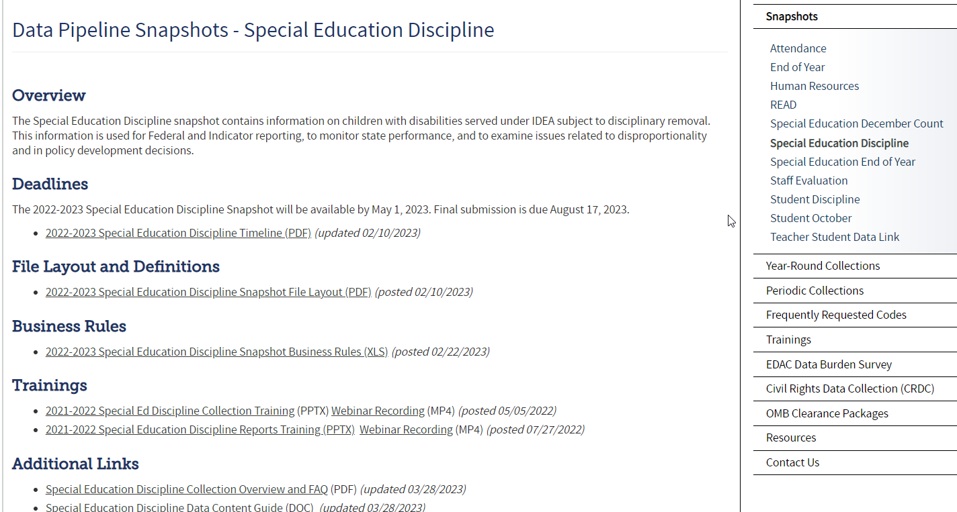
Special Education Discipline Snapshot Resources
http://www.cde.state.co.us/datapipeline/snap_sped-discipline

Slide 27
Snapshot Error Codes
The edits placed at the snapshot level contain data extracted from multiple interchanges and generally mean the data is missing from or incorrect in that interchange.
Examples:
SD017 – grade level comes from Student School Association file IF School Code matches between Discipline Action file and SSA file AND school entry/exit dates align.
SD018 – Primary Disability is pulled from Participation File. Record may be missing from Participation file.
Error Code | Error Type | Message
SD024 | Error | The Discipline Date in the Sped Discipline Action file must fall between the Dates of Entry and Exit of Special Education in the IEP Participation file. If this was the case at one point but the student's circumstances changed later in the school year, please submit an exception request.
SD017 | Error | The Grade Level field pulls from the Student Interchange-Student School Association (SSA) file and is missing from your snapshot. It is missing because either a record with a School Code matching the one reported in your Discipline Action file could not be found in the SSA file OR the Incident Date does not fall between the School Entry and Exit Date in the SSA file. Please check the Cognos Sped Incident and School Enrollment Date Comparison Report for details and adjust your file(s) as necessary.
SD009 | Error | At least one racial category must be selected for each student in the Student Interchange - Student Demographic File.
SD005 | Error | LASID must be included in the snapshot. This field is blank because a matching student record could not be found in the Student Interchange -Student Demographic File.
SD018 | Error | Primary Disability must be included in the snapshot. This field is blank because a matching student record could not be found in the Participation file in the Special Education IEP Interchange.

Slide 28
Discipline Incident and School Enrollment Date Comparison Report
Troubleshooting Snapshot Error SD017 – Misalignment with the School Codes, Entry Dates, and Incident Date
*This cognos report can help you determine what the issue is. Report will only contain data if you have error SD017. You will not see your district code listed an option if you don’t have error SD017 at the snapshot level.
School code must match between Student School Association file and the Discipline Action file
Incident Date must fall between the School Association file School Entry and Exit dates
The school code reported should be the school where the action took place

Slide 29
SPED Incident and School Enrollment Date Comparison Report – snapshot folder report

Slide 30
Sped or Discipline Incident and School Enrollment Date Comparison Report
Report provides inconsistent school code and dates between the Discipline Action File and Student School Association File. The incident date, school codes, and school entry and exit date from the SSA file must align or SD017 will trigger.
This cognos report may be used to help resolve edit SD017.
1. Problem with record below:
School Codes don’t match ☹
SASID | Discipline Action School Code | Incident Date | School Association School Code | Entry Date | Exit Date
1234567891 | 1234 | 01212023 | 4321 | 08/13/2022 | 00000000
2. Problem with record below:
Incident Date is not between the Entry and Exit date of the Student at the school ☹
SASID | Discipline Action School Code | Incident Date | School Association School Code | Entry Date | Exit Date
1234567891 | 1234 | 01212023 | 1234 | 02/28/2023 | 00000000

Slide 31
Data Pipeline Process

Slide 32
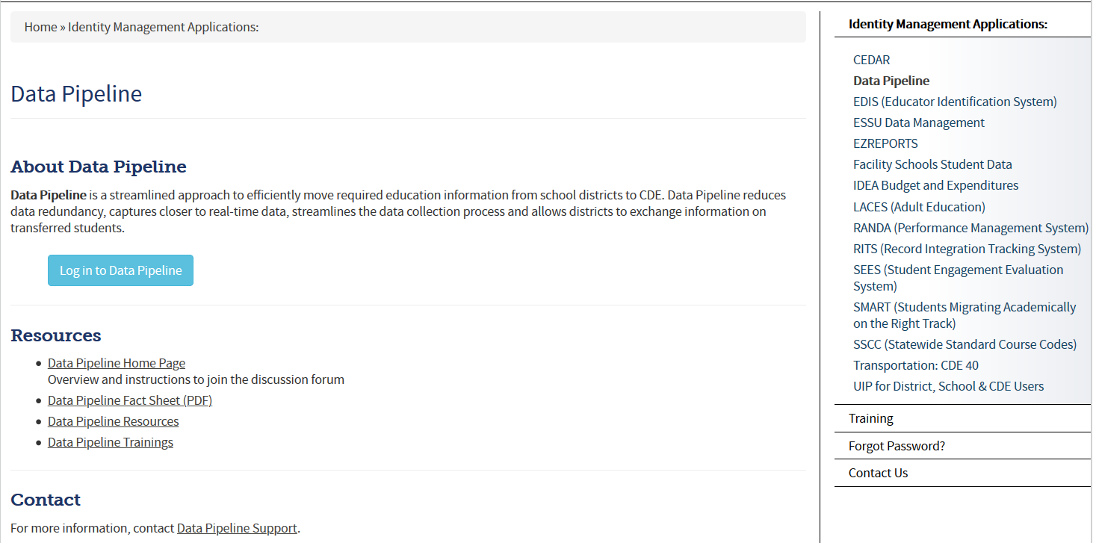
Accessing the Data Pipeline
Bookmark this link: https://www.cde.state.co.us/idm
From link click Data Pipeline to get to this screen.
Next click the blue login button.
*your single sign-on login may be used for all CDE applications listed here that you have access to

Slide 33
Single Sign On
Username is the email address associated with your IdM account
Password specified by you

Slide 34
1st Step: Format Checker *optional
Once your file is created, you have the option to run it through the Format Checker to check the file format
The system only checks the first row of data within your file
Only data fields that have too many bytes will error (those with too few will not)
All fields PASS = Ready to upload
Choose appropriate dataset/file type/SY
2022-23

Slide 35
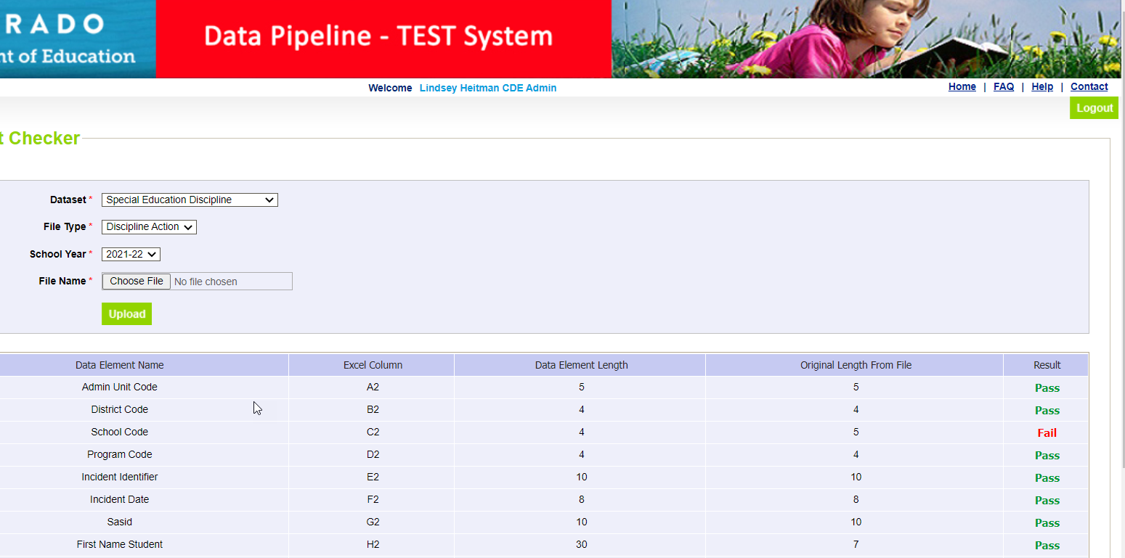
Format Checker Results
Pass Result – Proceed to Step 2: Data File Upload
Fail Result – compare field bytes to file layout expected # of bytes
School Code is 4 bytes. File shows 5 bytes.
2022-23

Slide 36
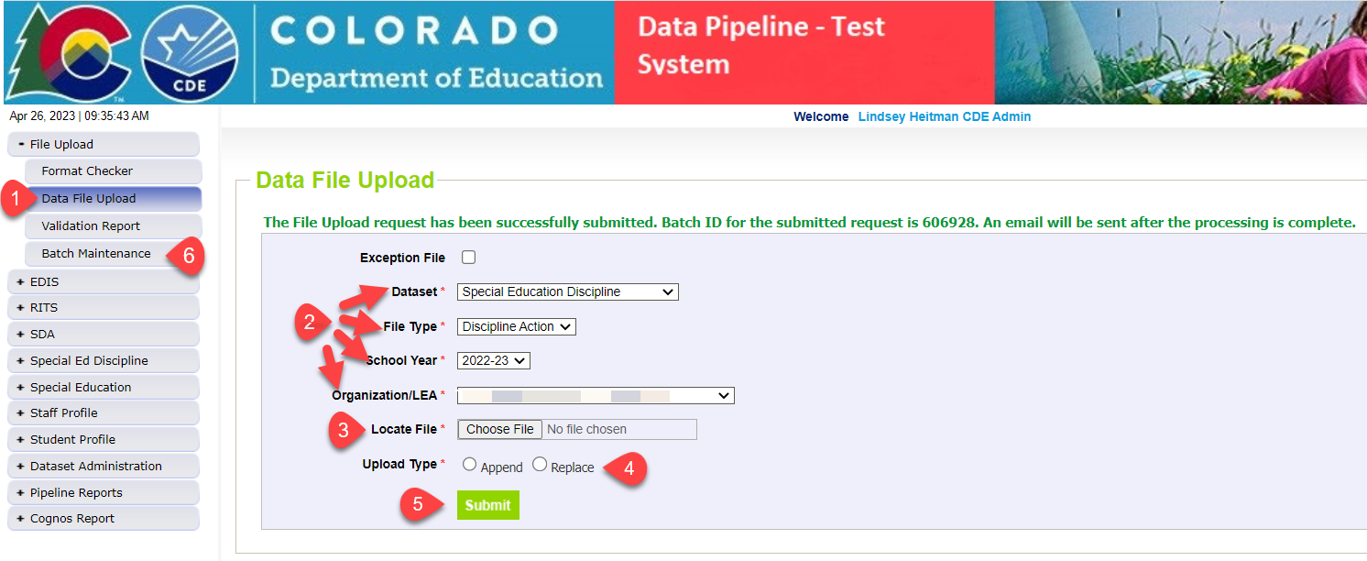
Special Education Discipline: How to Upload Sped Discipline Action File
1. Click on File Upload/Data File Upload
2. Select Dataset, File Type, School Year, and Organization/LEA
3. Click on Choose File to locate file
4. Select Replace
5. Click Submit message in green will display across the top indicating file submission has been attempted and a Batch ID will be created
6. Check Batch Maintenance Screen to verify file processed
*Email confirmation will be sent once complete

Slide 37
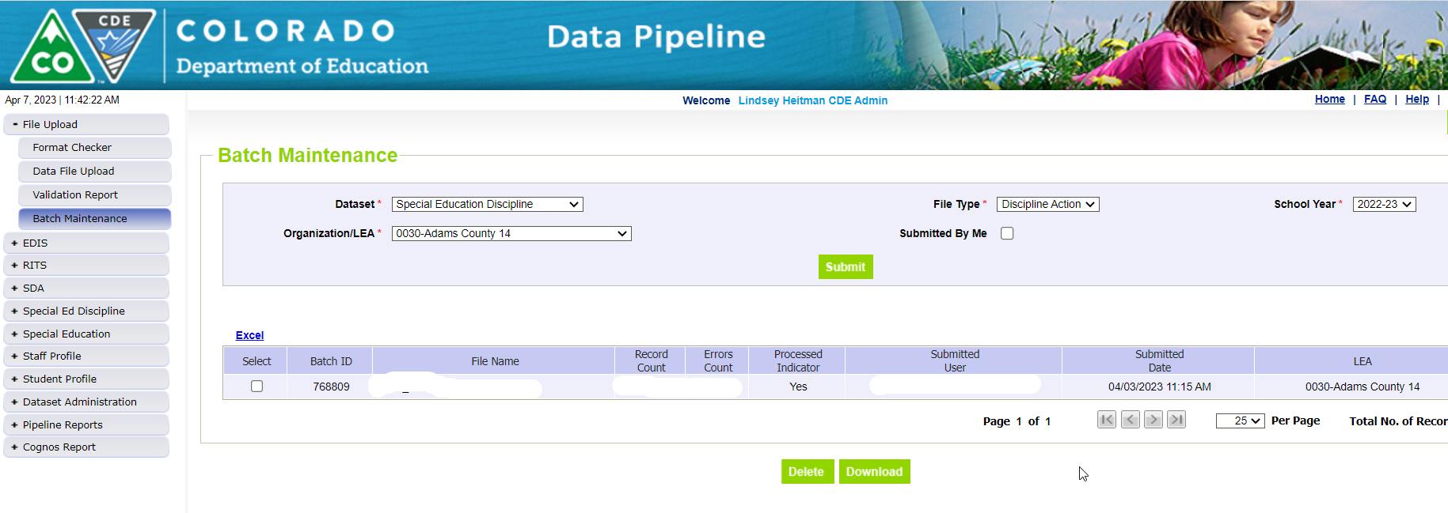
Step 3: Check Batch Maintenance Screen
Check Batch Maintenance to ensure files have processed successfully.
Processed Indicator will say “YES”. If blank or “No”, file did not upload
Check Record Count, Error Count, and make sure submitted date and time look accurate.
Option to download or delete last uploaded file from this screen. Check the ‘select’ box and click ‘Download’ or ‘Delete’
AFTER EVERY FILE UPLOAD - Verify Record Count, Error Count, Processed Indicator = Yes, Submitted Date!

Slide 38
Special Education Discipline: No Discipline Actions
How to report your district has no discipline actions:
Under the Special Ed Discipline Tab choose No Discipline Actions
Select the School Year, Click Submit
Mark Yes under No Discipline Actions and click Save
Be sure you see the “Successful Save” message at the top
2022-23
*No need to upload a Discipline Action file

Slide 39
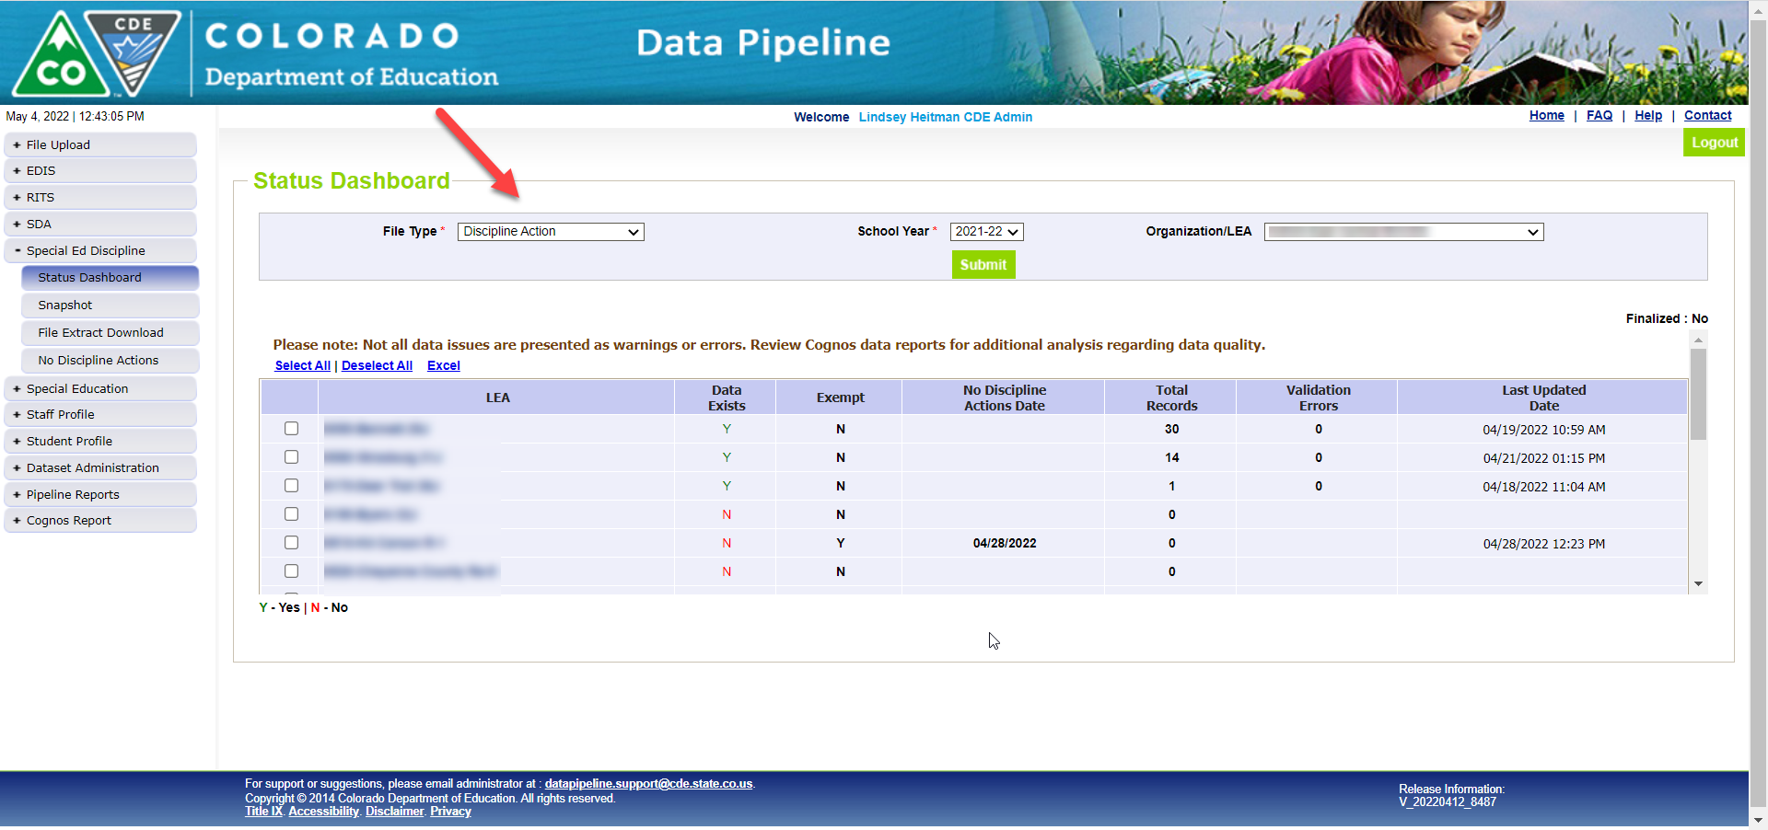
Helpful Status Screen
AUs (SPI role) can see file status of all member districts under Special Ed Discipline/Status Dashboard by filtering on File Type: Discipline Action
Screen also shows the date a district (DIS role) marks “No Discipline Actions”
Another option – District Activity Report found under Cognos Reports/Special Education Discipline

Slide 40
Creating a Snapshot (AU/SPI role)
Click Special Education Discipline tab
Click Snapshot
File Type Special Education Discipline
Click Search button
Click Create Snapshot
Expected Message: Snapshot creation triggered and processing. A notification email will be sent upon completion.
Confirmation email sent once snapshot has completed
2022-23

Slide 41
Reviewing Errors Under Pipeline Reports
Click Pipeline Reports and then Error Report
Select Dataset, File Type, School Year, Org/LEA, and Error Type
Click Search
*For Interchange errors (DIS role), select Discipline Action
*For Snapshot errors (SPI role), select Special Education Discipline

Slide 42
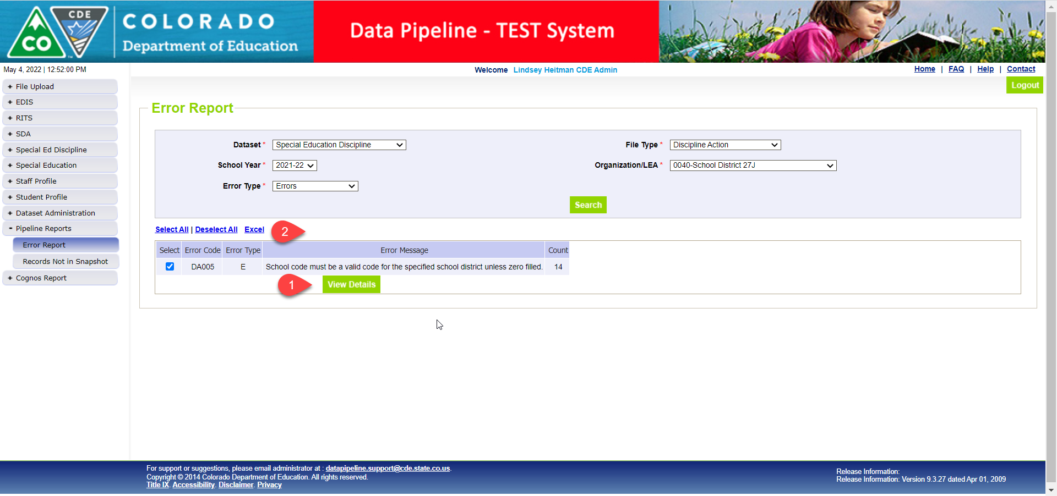
Reviewing Errors Under Pipeline Reports
To see errors, either click Select All or click the box of specific error codes to view and then click View Details for the details.
From there, click Excel if you’d like to export them to Excel
2022-23

Slide 43
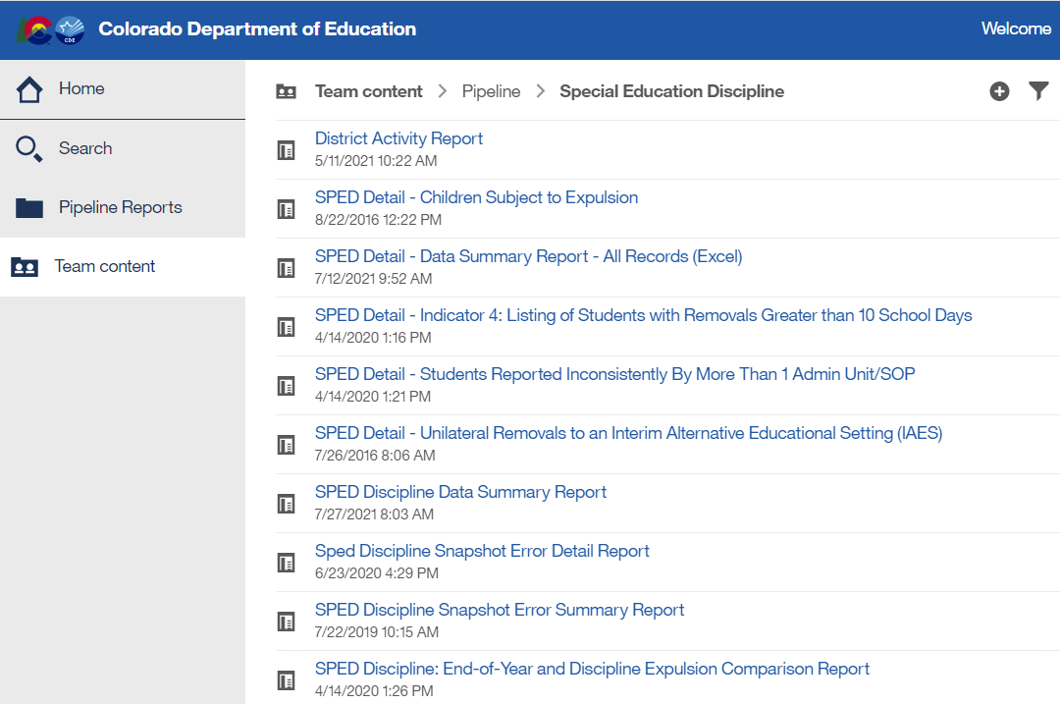
Reviewing Errors Under Cognos Reports
Click Cognos button at the bottom of the Screen
Another window will open
Click Special Ed Discipline Interchange (DIS) OR Special Education Discipline (SPI) and double click on the error report to open it
Interchange Reports
Snapshot Reports

Slide 44
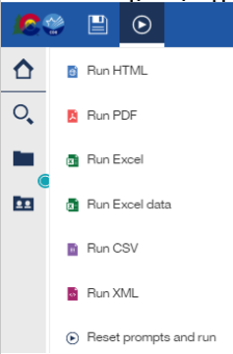
Reviewing Error Reports in COGNOS
To export error report to Excel click the “Play” button in the upper left of the screen and then double click “Run Excel” or “Run Excel Data”.
2022-23
From this screen you can choose to view only Errors, only Warnings, or Errors & Warnings. Select All at once or highlight specific codes. Click Finish.
Includes all errors
Allows for sorting

Slide 45
Special Education Discipline – Snapshot Validation Reports (SPI role-AUs)
Reminder:
Select Special Education Discipline to see the Sped Discipline Snapshot errors and other reports
This is the report that shows all records in your snapshot

Slide 46
District Report (DIS): For Viewing Snapshot Level Errors
This report allows the district respondent to see the Sped Discipline snapshot errors.

Slide 47
Exceptions

Slide 48
An Exception to the Rule
There are business rules at both the Interchange and Snapshot level that require an exception request in order to clear the error.
Interchange Exception Template here under Additional Resources: http://www.cde.state.co.us/datapipeline/inter_sped-discipline
Snapshot Exception Template here under Additional Links: http://www.cde.state.co.us/datapipeline/snap_sped-discipline
Submit exception requests to Syncplicity – online platform used for secure file sharing
Please email me if you do not yet have a folder. I will send you an email with a link to set it up.
Once a file has been shared you can access syncplicity at: my.syncplicity.com
File name is your AU code or District code
Used for Exception requests, questions that include PII, facility student information, etc
Please email CDE to notify us you’ve placed something in the folder. We aren’t automatically notified when you’ve saved something in your Syncplicity folder.

Slide 49
Snapshot Exceptions
Exception Template found here: http://www.cde.state.co.us/datapipeline/snap_sped-discipline
EXCEPTION TYPE | ERROR CODE (S) | INFORMATION NEEDED IN "COMMENTS AND EXPLANATION"
Grade to Age | SD020 | Please provide student's age and details of why student is not in an age appropriate grade.
Discipline Date | SD024 | Please provide a reason why the Discipline Date is not between the Date of Entry to Special Education or Date of Exit from Special Education.
Expulsion Without Services > 10 days | SD025 | Please provide a reason why the student did not receive offered services during an expulsion.
Expulsion Without Services - EOY? | SD026 | Please provide the reason an Expulsion Without Services was reported for this student in the Sped Discipline Snapshot, but not the Sped EOY Snapshot. [i.e. Special Education End of Year Exit is not 50 and you believe the data is correct, an exception is required.]
Expulsion Without Services - Sped Discipline? | SD027 | Please provide the reason an Expulsion Without Services was reported for this student in the Sped EOY Snapshot, but not the Sped Discipline Snapshot. [i.e. Special Education End of Year Exit is 50 but an Expulsion without services was not reported on Sped Discipline and you believe the data is correct, an exception is required.]
SD024 example explanation:
“Student was enrolled in district, left during the year and then returned. The start date of Special Education was picked up as the most recent re-enrollment, not the initial start date of special education. Student was enrolled in the district at the time of each behavioral incident.”

Slide 50
Assistance Needed?
If you have any questions about the Special Education Discipline Data Collection, please feel free to contact us!
Lindsey Heitman 303-866-5759 heitman_l@cde.state.co.us Collection Manager – primary contact
Orla Bolger 303-866-6896 bolger_o@cde.state.co.us ESSU Contact – data content
Alyssa Ohleyer 303-866-6308 ohleyer_a@cde.state.co.us ESSU Contact – DMS/reports
Email protocol – please include:
District # and Administrative Unit #
Subject of the email/applicable error codes/school codes referenced

