Slide 1
2020-2021 Special Education December Count Snapshot Basics
^{November 18th, 2020}

Slide 2
Special Education December Count Snapshot Basics
Welcome and thanks for joining the training!
URL https://cdeinfotech.adobeconnect.com/data_services/
No need to call in if you’re able to connect audio through your computer. It should prompt you for this right as you first login.
Dial in number (if you cannot hear through the computer) is 1-855-397-4421
Please mute your phone if you do call in!
Collection Coordinator
Lindsey Heitman
Heitman_l@cde.state.co.us
(303) 866-5759
Next Training Date:
Wednesday December 2nd 10:00 –11:00 am
December Count Student and Staff Content and Error Tips

Slide 3
AGENDA
General Overview
Accessing the Data Pipeline
Snapshot Process
TIMELINE/RESOURCES/ASSISTANCE

Slide 4
General Overview

Slide 5
Special Education December Count Purpose
Purpose:
The purpose of the Special Education December Count Snapshot is to obtain data for the annual count of students with disabilities as of December 1st and the associated staff members serving those students in order to fulfill federal and state reporting requirements.
Student:
Student data is used to meet federal reporting requirements, calculate SPP Indicators 5, 6, 9, and 10, generate sample lists for Indicator 8 Parent Surveys, and determine ECEA funding for students with disabilities.
Staff:
Staff data is used to meet federal reporting requirements and verify staff qualifications.

Slide 6
State Performance Plan Indicators associated with December Count Data
SPP Indicator 5 - LRE Placement: % of children 6-21 and 5 year olds in Kindergarten with IEPs served (A) Inside regular class 80% or more of day, (B) Inside regular class less than 40% of day, (C) In separate schools, residential facilities, or homebound/hospital placements
SPP Indicator 6 - Early Childhood Settings: % of children ages 3-5 (excluding 5 year olds in Kindergarten) with IEPs (A) Receiving majority of special education and related services in regular early childhood program, (B) Attending separate special education class, separate school, or residential facility
SPP Indicator 9 - Disproportionate Representation in Special Education: % of districts with disproportionate representation of racial/ethnic groups due to inappropriate identification
SPP Indicator 10 - Disproportionate Representation in Specific Disability Categories: % of districts with disproportionate representation of racial/ethnic groups in specific disability categories to inappropriate identification

Slide 7
Who to Report
Students receiving services on an active IEP on 12/01/2020
Parentally Placed Private School Students - even if not on an IEP - code 02
Includes:
all AU residents regardless of where they attend
all students who attend your AU regardless of where they live
residents in facilities
Students Parentally Placed in Private School, who attend a private school within your AU boundaries and receive no services whatsoever from the AU. These are reported for proportionate share calculations on two Dec reports.

Slide 8
Special Education December Count Snapshot
1. Student Snapshot
2. Staff Snapshot
Student Interchange
Special Education IEP Interchange
Staff Interchange
Special Education Child
Special Education Participation
Staff Profile
Staff Assignment
The data is pulled from these Interchange files:
Student School Association
Student Demographic
STUDENT
STUDENT
STUDENT
STUDENT
STAFF
STAFF

Slide 9
December Count Student Snapshot Criteria
For IEP Interchange records to be included in the Special Education December Count Snapshot, the following must be true:
Date of Entry to Special Education is December 1st or prior to December 1st of the reporting school year OR Parentally Placed in Private School is 02. A record with a Date of Exit from Special Education prior to December 1st would not be included in the December Count.
Pull all error-free records meeting above criteria from the Special Education Participation file and match them with records in the Student Interchange. The Student Interchange is the authoritative source for (SASID, LASID, Student First Name, Student Middle Name, Student Last Name, Student Gender, Student Date of birth, Student Ethnicity, Student Race and Grade level).
Data from the Student Interchange will pull primarily from a DEC tagged file. If the district has not tagged a file for DEC, it will pull from the untagged student file.
If student is not required to be submitted in the Student Interchange, the demographic data and grade level will pull from the Child and Participation files.
The Special Education Child file, the Special Education Participation file and the Student Profile files will be joined based on the following criteria: SASID, LASID, school year, district (or Admin Unit), and error free records.

Slide 10
Fields in which the data should pull from the Student Interchange district files
Student Interchange
Student Demographic File
SASID
LASID
Student First Name
Student Middle Name
Student Last Name
Student Gender
Student Date of birth
Student Ethnicity
Student Race
Student School Association File
Grade Level
Every district should have Untagged or DEC tagged Student Demographic and Student School Association files uploaded for December Count. Please communicate this to your district respondent.
Data from the Student Interchange will pull primarily from a DEC tagged file. If the district has not tagged a file for DEC, it will pull from the untagged student file.

Slide 11
December Count Staff Snapshot Criteria
For a staff record to be included in the Special Education December Count Data Collection the following must be true:
Must be Error free at the Staff Interchange
Special Education Flag = 1
AU code must be populated in both Staff files
Start date is December 1st or prior to December 1st of reporting school year
End Date is either blank (not ended) or post December 1st of the reporting school year
EDID is reported in both Staff Profile & Assignments Interchange
Records with the following Employment Status Codes will be included: 11, 12, 13, 23, 25 or 26
The Staff Profile and Staff Assignment Association File will be joined based on the School year, the teachers EDID, the sped assignment flag = 1, the district (or Admin Unit), and the records being error free.

Slide 12
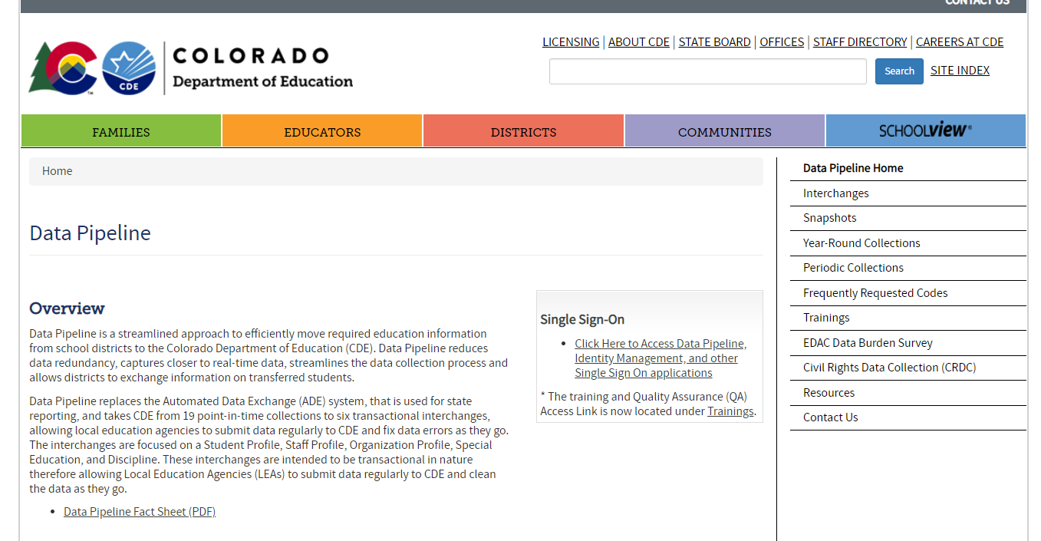
Website Overview
http://www.cde.state.co.us/datapipeline
Staff/IEP Interchange Information
To Log In Pipeline System:
click here
December Count Information
Collection dates, Mandatory Collections- legislation and uses, converting csv files to excel, etc.
Codes Available (district codes, school codes, institutes of higher education codes, etc.)

Slide 13
Special Education December Count Snapshot File Layout and Definitions
http://www.cde.state.co.us/datapipeline/snap_sped-december
Purpose
Dependencies
Criteria for records being pulled in
Name and length of each field in both the Student and Staff sections
Source interchange and source file the data is pulled from. Also referred to as primary interchange. *helpful to know when resolving errors
Secondary interchange and secondary file the data is pulled from if record doesn’t exist in the primary interchange. (ex. facility students)
Helpful remarks/details
Internal flags– fields calculated from existing data fields

Slide 14
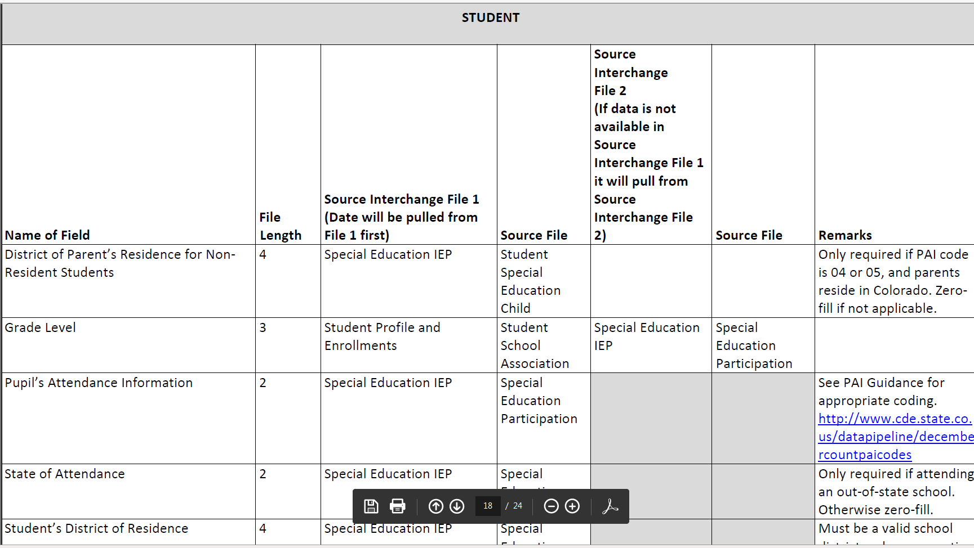
Snapshot File Layout – lists source file and secondary file data is pulling from

Slide 15
Authoritative Source
Student’s Demographic Data
1st comes from the Student Interchange - Student Demographic File
If the student is not submitted by a district, the data will be pulled from the IEP Child file (Part C, Facility, and Parentally Placed in Private School records)
Student’s Entry Grade Level
1st comes from the Student Interchange - Student School Association File
If the student is not submitted by a district, the Entry Grade Level will be pulled from the IEP Participation file
Keep this in mind when fixing errors related to Grade level. The student grade level pulls from the Student School Association file for most records. You will need to coordinate with your Student Interchange data respondent on any fixes required for this.

Slide 16
Interchange Data

Slide 17
Special Education IEP Interchange Resources
http://www.cde.state.co.us/datapipeline/inter_sped-iep
At this link you will find:
Timelines
File Layouts
Templates
Business Rules
Training Slides/ Webinars
Additional Resources

Slide 18
Special Education IEP Interchange
The Special Education IEP Interchange consists of 2 Files:
Child File
Demographic information
1 record per student
Participation File
Special Ed services and referral information
1 record per student

Slide 19
Screen Shot of the Participation File Layout
PLEASE NOTE:
Student’s LASID should match the LASID reported by the district for that student in the Student Interchange
Each record’s sasid/lasid combo must match the Child file record in order to be pulled into the snapshot(s)

Slide 20
Participation File Layout Screenshot Continued
What’s included in the file layout?
Dependencies and record expectation
Name and Order (format) of the fields
Number of characters in each field
Examples and remarks that help clarify
Data field name, definition, and applicable codes for each field provided below the ordered format
Changes listed at bottom of layout and highlighted or crossed out in the name and definitions

Slide 21
2020-2021 Special Education IEP Interchange: Summary of Changes
What’s new in 2020-2021 in the IEP Interchange?
IEP (Student): http://www.cde.state.co.us/datapipeline/inter_sped-iep
Educational Environment coding change – Beginning in the 2020-2021 school year, children who are 5 years old and in Kindergarten should be reported with a 300 level Educational Environment code
Delay Code 57 REMOVED
57 - Referral received by the AU with less than 60 days before the child’s third birthday

Slide 22
Website Overview – Staff Interchange
For information on Staff data reporting: http://www.cde.state.co.us/datapipeline/inter_staff
At this link you will find:
Timelines
File Layouts
Templates
Business Rules
Training Slides/ Webinars
Additional Resources
Timeline
File Layouts

Slide 23
Staff Interchange Files
Staff Profile
General information per staff
Only 1 record per staff
Must be uploaded first
Staff Assignment
Provides specifics to actual duties and locations
Multiple records per staff allowed
District status report found under Cognos Reports/Special Education December Count (DEC role):
Staff: District/AU Activity Report
Lists the status of all Staff Profile and Staff Assignment file uploads
Breaks it out by district and AU

Slide 24
Staff Profile File Overview
1 record per staff employee
Last Name, First Name, Date of Birth and Gender must match with information in EDIS for the EDID
Race must be provided for all staff
Ethnicity – Hispanic or Latino is considered an Ethnicity, a race must also be reported

Slide 25
Staff Assignment File Overview
Multiple records are allowed per person based on
Special Education Status
Location
Job Class Code
Grant Code
Teaching Subject Area
Grade levels (elementary and secondary need to be separated)
When reporting 2 or more records for a staff member…
Contract Days would not be split
Base Salary would be split accordingly
Hours per Day would be split accordingly

Slide 26
Staff Records Included in December Count Snapshot
Included:
All Special Education staff employed as of December 1st
Full or Part-time
Office/clerical, teachers, administrators, purchased staff
Excluded:
Substitutes unless they are permanent (90 days or more in the same classroom consecutively)
Temporary workers, such as after school coaches
Regular Education staff – they are reported in the Human Resources snapshot
Staff not employed December 1st

Slide 27
December Count Staff Snapshot Criteria
For a staff record to be included in the Special Education December Count Data Collection the following must be true:
Must be Error free at the Staff Interchange
Special Education Flag = 1
AU code must be populated in both Staff files
Start date is December 1st or prior to December 1st of reporting school year
End Date is either blank (not ended) or post December 1st of the reporting school year
EDID is reported in both Staff Profile & Assignments Interchange
Records with the following Employment Status Codes will be included: 11, 12, 13, 23, 25 or 26
The Staff Profile and Staff Assignment Association File will be joined based on the School year, the teachers EDID, the sped assignment flag = 1, the district (or Admin Unit), and the records being error free.

Slide 28
2020-2021 Staff Interchange: Summary of Changes
What’s new in the 2020-2021 Staff Interchange (related to December Count)?
Staff: http://www.cde.state.co.us/datapipeline/inter_staff
Staff Assignment File-
Job Class Codes 107 and 108 REMOVED
Staff Profile File-
Existing field ‘Teacher Probationary Status’ was changed to ‘Probationary Status’ and is required for all teachers and special services providers (SSPs)
File Layout changed – additional fields added to the end of the Staff Profile file (pages 3, 4 and 9-17 in the Staff Profile File Layout)
New fields are for breaking out the Evaluation Ratings into separate fields for the following staff: Teachers and Special Services Providers
Due to COVID-19, all new evaluation ratings fields must be zero-filled or blank in the 2020-2021 files
Fields and new evaluation rating codes will be used for the 2021-2022 reporting

Slide 29
Accessing the Data Pipeline

Slide 30
Accessing the Data Pipeline
Identity Management (IdM)
CDE provides Local Education Agencies (LEAs) a means of administering and maintaining user access to CDE applications.
IdM ensures protection of data received, collected, developed, and used by CDE in compliance with the Family Educational Rights and Privacy Act as well as other privacy mandates.
IdM Website: https://cdeapps.cde.state.co.us/index.html

Slide 31
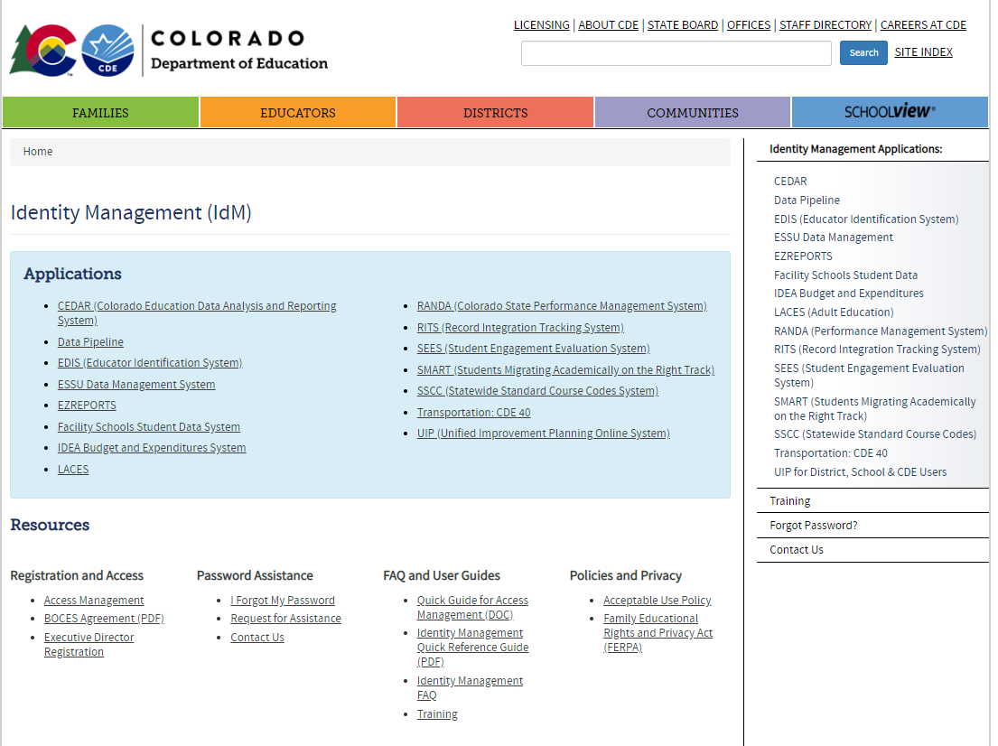
https://cdeapps.cde.state.co.us/index.html
*single sign-on used for all CDE applications listed here
LAM Help Guide and resource modules
*LAMS: Click Access Management to add or modify IdM accounts
*Special Education Directors click Executive Director Registration to register as AU User Manager in IdM.

Slide 32
Identity Management
Overview:
USER Manager (Special Education director or superintendent)
Responsible for creating and managing a user or a group of users known as the Local Access Managers (LAMs)
Local Access Manager (LAM)
Responsible for approving and administering access to CDE systems for all users within their organization.
District and Administrative Unit LAMs (access to assign 4 digit or 5 digit group roles)
User - employee of a local education agency (LEA) who has been granted CDE application access by either the District or the Administrative Unit LAM
Data Pipeline Groups applicable to December count
Interchanges
SPE - Special Education IEP
STF - Staff
Snapshot
DEC – Special Education December Count

Slide 33
Identity Management Roles
Staff Interchange Roles:
STF~ LEAUSER – upload and modify staff interchange files OR
STF~LEAVIEWER – view (only) staff interchange data
Special Education IEP Role:
SPE~LEAUSER – upload and modify Special Education IEP Interchange Files
Special Education December Count Snapshot Roles:
DEC~LEAAPPROVER – Approves, creates, views Snapshot OR
DEC~LEAUSER - creates, views Snapshot OR
DEC~LEAVIEWER- views snapshot
*Choose 1 role per Group

Slide 34
Special Education December Count DEC Approver
Every Administrative Unit should have at least 1 personnel member with the DEC “Approver” role
The Special Education Director is responsible for authorizing reports and your final set of data but they do not have to have to have the Data Pipeline Approver role.
There can be several staff members in your Admin Unit with a DEC role
There can only be one DEC role associated with a User Name (Email)
Special Education December Count Snapshot
VIEW ONLY | DEC~LEAVIEWER (does NOT receive Email communication)
CREATE SNAPSHOTS | DEC~LEAUSER
FINALIZE/SUBMIT TO CDE | DEC~LEAAPPROVER

Slide 35
Identity Management – Staff Roles
STF Associated with the 5 Digit AU Code
User may only report Special Education staff (flag=1)
Example: 64043-STF~LEAUSER
STF Associated with the 4 Digit District Code
User may report ALL staff data for the district - regular ed staff and Special Education staff
If you are reporting all staff be sure to be available to make changes to special education data in accordance with the timeline.
Example: 0030-STF~LEAUSER
STF Associated with the 4 Digit BOCES Code
User can report ALL staff for the BOCES – regular ed education and Special Education staff.
Example: 9095-STF~LEAUSER
A User can only have 1 STF role associated with their login
Districts and Administrative Units to determine structure

Slide 36
Data File Upload Process

Slide 37
Where to access the Data Pipeline
https://cdeapps.cde.state.co.us/index.html
*single sign-on login used for all CDE applications listed here

Slide 38
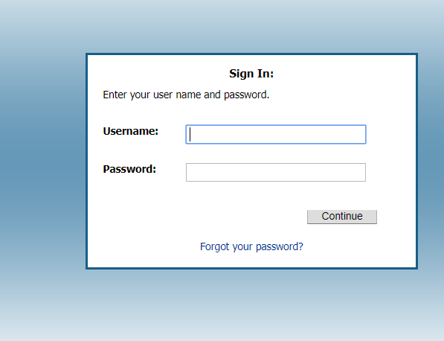
Login
Username is the email address associated with your IdM account
Password specified by you

Slide 39
Correct Access
The menu items listed on the left depend upon your IdM roles
Be sure you see the ‘Special Education’ tab (SPE and/or DEC role)
Be sure you see the ‘Staff Profile’ tab (STF role) if you’re uploading staff data

Slide 40
Interchange Process Overview
Create/Update Data Files
Upload files in Data File Upload
Review Batch Maintenance
Review Error Reports in Cognos
Correct Data Files in Source System
Upload files in Format Checker
Once No Errors in All Files Needed -> Create Snapshot

Slide 41
Step 1: Format Checker
Once the file is created, you have the option to run it through the Format Checker to ensure all the fields have the correct number of bytes.
The system checks the first row of data only.
All fields PASS = Ready to upload

Slide 42
A Note about Format Checker
Only reviews the 2nd row in your file
Passing format checker Does Not Equal file will process
Green ‘Pass’ for each field is desired result
Red ‘Fail’ for a field indicates file is not in the correct format- please refer to the 2020-21 file layouts on web http://www.cde.state.co.us/datapipeline/inter_sped-iep

Slide 43
Step 2: Data File Upload
Click on File Upload/Data File Upload
Choose File Type and School Year. Organization should populate with your AU.
Click on Browse to locate File
Choose Replace
Hit Submit
Note message in green below. A Batch ID will be created.
-Append – adds to existing data. Allows for multiple files to be uploaded at one time. Records on all files uploaded meeting criteria will pull to snapshot.
-Replace – deletes any prior uploaded data and replaces it with new file. *Recommended

Slide 44
File Upload: Email Confirmation
Check email to ensure file was successfully uploaded – you should receive a confirmation email for each file uploaded or snapshot taken.
Below is an email in a case where the file didn’t successfully upload. Additional details are provided
-----------------------------------------------------------------------
This message is to notify you of the Data Pipeline file upload errors. The errors must be corrected and the file must be uploaded again.
-----------------------------------------------------------------------
File Submission Processed by Data Pipeline:
Submission ID: 46765
Date: 05/02/2017 03:18 PM
Name: Lindsey Heitman
Year: 2017
User ID: heitman_l@cde.state.co.us
File Name: Participation_1617.xlsx
Error: Error in file upload with batch id : 46765

Slide 45
Step 3: Batch Maintenance – Very Important Step
Check Batch Maintenance to ensure files have processed successfully.
Processed Indicator will say “YES”. If blank or “No”, file did not process successfully
Check Record Count, Error Count, and make sure submitted date and time look accurate.
*Processed Indicator should say Yes

Slide 46
File Did Not Process
Things to check:
Are you losing leading zeros? Csv formatted files lose leading zeros and columns must be changed to text: http://www.cde.state.co.us/datapipeline/convertcsvtoexcel
Be sure there are no spaces in the name of the file
Be sure the file isn’t open when you upload it
Verify # of bytes/fields are accurate and there are no blank fields
If none of these help, try Copy/Paste Special Values the cells with data into a new spreadsheet/template.

Slide 47
SNAPSHOT PROCESS

Slide 48
Snapshot Steps
Prior to creating a snapshot:
Verify that all 4 files are uploaded and have processed successfully – Child, Participation, Staff Profile, Staff Assignment
Batch Maintenance screen
Email confirmations
Status Dashboard
Cognos Reports/Special Education December Count – Staff: District/AU Activity Report
Ideally files are error free, but not required in order to create a snapshot

Slide 49
How to Create a Special Education December Count Snapshot

Slide 50
How to Create a Special Education December Count Snapshot
1. Click on Special Education tab
2. Click Snapshot from expanded list
3. Select File Type – Sp. Ed Dec Count Snapshot
School Year – automatically populates with 2019-2020
Organization/LEA – automatically populates based on IdM role
4. Click Search
5. Click Create Snapshot button.
you should see a message display across the top left in green: “Snapshot creation triggered and processing. A notification email will be sent upon completion”
Watch for snapshot email confirmation. Snapshot is not finished processing until email is sent

Slide 51
Check Status Dashboard
Checking the Status of the Snapshot
Click Special Education->Status Dashboard:
*Email confirmation is the green light for checking status dashboard!

Slide 52
Checking Snapshot Errors
2 options:
Pipeline Reports - Error Reports/Special Education IEP Interchange
File Type: Sp. Ed December Count Staff OR
File Type: Sp. Ed December Count Student
Cognos Reports – Special Education December Count
The list of all December Count Student and Staff Business rules (errors and warnings) can be found at: http://www.cde.state.co.us/datapipeline/snap_sped-december under the ‘Business Rules’ section.

Slide 53
PIPELINE – ERROR REPORT *option for checking snapshot errors
File Type may be:
Sp. Ed December Count Staff
Sp. Ed December Count Student
Both are ‘DC’ error codes

Slide 54
PIPELINE – ERROR REPORT
Select “View Details”

Slide 55
PIPELINE – ERROR REPORT
Select “Excel”

Slide 56
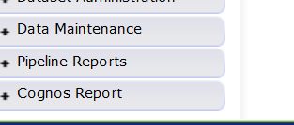
Cognos Reports – option for checking Snapshot errors
ERROR REPORTS
“COGNOS”
Opens new window
Special Education December

Slide 57
Special Education December Count Cognos Reports
Error Reports: Staff and Student have separate reports
Excluded Report: Includes excluded records – those w/ interchange errors
Included Report: Includes records that are included in the snapshot

Slide 58
Cognos DETAIL ERROR REPORT

Slide 59
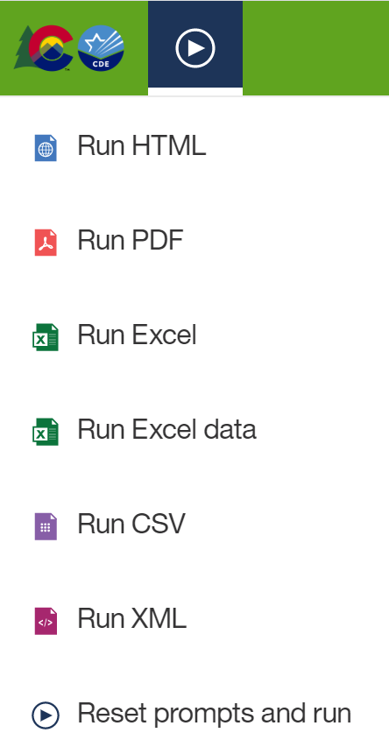
Exporting Cognos Report to Excel
Click on ‘Play’ Button
(available when a report is showing)

Slide 60
Correcting Snapshot Errors
View Status of December Count snapshot
Email will be sent with status
Then check Status Dashboard screen –shows if processed and # of errors
View errors in the Detail Error Reports (Pipeline Error Reports or Cognos)
Option to export the report to Excel if you’d like
Correct the errors in the appropriate Interchange File
preferably Enrich or your source system
Student/Staff files- will need to contact district respondent to resolve these errors (unless AU is submitting staff)
Re-upload your corrected files to the IEP Interchange. If errors only exist in 1 of the files, you can resubmit only the 1 file containing corrections.
Re-Create the Snapshot
Repeat as many times as needed

Slide 61
Summary Errors and Warnings
Summary Errors and Warnings work a little differently than other detail errors as they may pertain to a certain select group of records or even the entire set of data depending on the warning.
Example:
DC043 – Error – No Child Find Coordinator (Job Class Code 330) was reported. If accurate, please refer to the Exception Request Instructions.
DC042-Warning: More than 5 FTE Paraprofessionals (416) were reported as district-wide (9980). Paraprofessionals should be attributed to the buildings they serve
You can see which paraprofessionals are reported as district-wide in the “Included” report.

Slide 62
December Count Snapshot Error Exceptions
The Special Education December Count has 5 Allowable Exceptions.
If you receive one of the following errors it will be necessary to send us in an Exception. You may find the template under Additional Links here: http://www.cde.state.co.us/datapipeline/snap_sped-december
Student:
DC104 Age is outside of the min/max range for this grade level.
Staff:
DC033 No Special Education Director was reported.
DC043 No Child Find Coordinator was reported.
DC157 FTE total for an individual is outside of 0.005 and 1.71 allowable range
DC206 TOTAL FTE for an individual is outside of allowable range
Please see the Instructions tab for directions in completing the form. Paste the template into your AU # Syncplicity folder and let us know via email to look for it. Once approved, CDE will upload the exceptions and let you know to recreate the snapshot bypassing the business rule for the approved record.

Slide 63
Is the # of snapshot records the # expected?
If yes
Do you have Snapshot Errors?
If Yes, check the Error Report
If no
Are there interchange errors in the file where the data comes from?
Fix Interchange errors and Recreate the Snapshot
Are there records that didn’t meet the “Criteria” for the Snapshot?
Check the Pipeline Report “Records Not in Dec”

Slide 64
Records not found in Snapshot Report
Records that are not included in the included snapshot records report may be found in the report below.
Either there is an error at the interchange or the record doesn’t meet the snapshot criteria.
Missing records are broken out by Student or Staff and file types for each
Pipeline Reports: Records not Found in December Count Snapshot

Slide 65
Step 1: UPLOAD INTERCHANGE FILES
IEP
Staff
Student
Step 2: Create Snapshot
Step 3: ONCE EMAIL is received check status dashboard
Step 4: resolve validation errors
Step 5: UPLOAD UPDATED INTERCHANGE FILES and go through steps again

Slide 66
Timeline & Resources

Slide 67
December Count Timeline
November
December
18th (Friday): Interchange files error free and at least one snapshot created
January
21st (Thursday) All errors resolved – complete snapshot
February
4 – 11 Resolving Duplicates
25th (Wednesday) – Interchange files uploaded – Sped Child, Sped Participation, Staff Profile, Staff Assignment
October
28th (Wednesday) – December Count Snapshot Open
1st (Tuesday) Official Count Date
21 – 28 Report Review
11 – 18 Final Report Review
18 (Thursday) Final Submission Due

Slide 68
December Count Helpful Resources
At this link you will find the following helpful resources: http://www.cde.state.co.us/datapipeline/snap_sped-decembe
Staff Approval Matrix Training
Sped Licensing Requirements
PAI Coding Chart (PRINT!!)
PAI Coding Chart (PRINT!!)
Educational Environment Information(LRE)
Special Education Grant Codes

Slide 69
Helpful Reporting Resources
At this link you will find the following helpful resources:
http://www.cde.state.co.us/datapipeline/inter_sped-iep

Slide 70
CDE Contacts
Staff Interchange information:
http://www.cde.state.co.us/datapipeline/inter_staff
Annette Severson: severson_a@cde.state.co.us also HR
Human Resources Snapshot information:
http://www.cde.state.co.us/datapipeline/snap_hr
Special Education December Count Snapshot information:
http://www.cde.state.co.us/datapipeline/snap_sped-december
Additional Contacts:
Orla Bolger: bolger_o@cde.state.co.us Special Education Content
Lauren Rossini: rossini_r@cde.state.co.us Special Education Staff Qualifications
Alyssa Ohleyer: ohleyer_a@cde.state.co.us Accountability Specialist December Count Support

Slide 71
Questions?
If you have any questions about the Special Education December Count, please feel free to contact us.
Use email for the quickest response!
Lindsey Heitman heitman_l@cde.state.co.us (303) 866- 5759
Orla Bolger bolger_o@cde.state.co.us (303) 866-6896
Lauren Rossini rossini_l@cde.state.co.us (303) 866- 6688
Alyssa Ohleyer: ohleyer_a@cde.state.co.us (303) 866- 6308
Email protocol – please include:
Administrative Unit #/District #
Any applicable error code #’s or cognos report names
NOTE: Please do not send files or reports via email – contact us to determine best technical assistance avenue (Syncplicity). Thank you!

Slide 72
for your participation. We appreciate it!!!

