Slide 1
Special Education Discipline 2019-2020
May 6, 2020

Slide 2
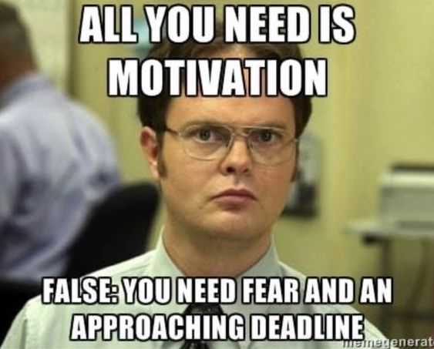
Special Education Discipline
Welcome and thank you for joining the webinar!
Login Information:
https://cdeinfotech.adobeconnect.com/data_services/
Call-in number: 1-855-397-4421
*Please mute your phone to minimize background noise
Collection coordinator:
Lindsey Heitman
Heitman_l@cde.state.co.us
(303) 866-5759

Slide 3
TRAINING TOPICS
General Overview
Data Pipeline Processes
Accessing the Data Pipeline
Questions
Responsibility and Roles
File Upload
Reports
Fixing Errors
Data Pipeline Access – IdM
Timeline
Data Content
No Discipline Actions

Slide 4
Purpose
U.S. Department of Education federal requirements
State Performance Plan Indicators 4A and 4B which reports the disproportionate rates of suspensions and expulsions greater than 10 school days in a school year for children with IEP’s
Research requests
Monitoring
Consultant analysis to support technical assistance needs in the state
Special Education Fiscal Advisory Council (SEFAC)

Slide 5
Special Education Discipline Interchange/Snapshot vs. School Discipline and Attendance (SDA)
Periodic Collection Process
School Level Data
count of incidents
count of students
ALL students disciplined counted and reported
Districts Submit data and finalize data within Pipeline
Special Education Discipline Interchange/Snapshot
School Discipline and Attendance (SDA)
Interchange/Snapshot Process
Student Level Data
ONLY students with disabilities subject to disciplinary removal are included
Districts submit data in pipeline; AU’s create and finalize Discipline Snapshot data

Slide 6
Special Education Discipline Identity Management: Access to Data Pipeline
ADMINISTRATIVE UNIT RESPONSIBILITY
DISTRICT RESPONSIBILITY
Special Education Discipline group is SPI.
1 of the following should be assigned(example):
16010-SPI~LEAVIEWER Read-Only
16010-SPI~LEAUSER Submit and Modify
16010-SPI~LEAAPPROVER Approver
Discipline Interchange group is DIS.
1 of the following should be assigned (example):
0880-DIS~LEAUSER Role Submit and Modify Role
0880-DIS~LEAVIEWER Role – Read-Only Role
*Assigned by LAM (Local Access Manager)
*Important: only 1 role per group/account!!
INTERCHANGE ROLE OPTIONS *1 per account | ENABLES USER TO:
Viewer | read-only access
User | upload files, view interchange level errors
SNAPSHOT ROLE OPTIONS *1 per account | ENABLES USER TO:
Viewer | read-only access
User | create snapshots and view snapshot level errors
Approver *Need at least 1 | create snapshots, view snapshot level errors, AND approve the final snapshot (by clicking submit to CDE)

Slide 7
Roles and Responsibilities
ROLES AND RESPONSIBILITIES OVERVIEW
DISTRICTS | ADMINISTRATIVE UNITS
Submit Special Education Discipline Action File of students on an IEP with discipline actions which occurred during the current reporting period July 1, 2019 - June 30, 2020. Resolve Interchange and Snapshot errors in accordance with the timeline. | Submit Special Education IEP Child and Participation Files for the current reporting period July 1, 2019 – June 30, 2020. Create Special Education Discipline Snapshot. Review reports with the Special Education Directors during report review week. Submit data to CDE at the close of the collection. Upload Final Signed Reports to the Data Management System under the Profile tab.
Collaboration

Slide 8
Data Pipeline Flow
Data Pipeline responsibility breakdown:
Districts (DIS role) upload Special Education Discipline Action File OR Mark No Discipline Actions
Districts (DIS role) research and resolve Sped Discipline Action File errors and upload corrected file
AUs (SPI role) create Special Education Discipline Snapshot
AUs (SPI) work with districts (DIS) to resolve snapshot errors
Process flow until all interchange and snapshot errors are resolved

Slide 9
DISCIPLINE
SPECIAL EDUCATION DISCIPLINE
AU Responsibility
District(s) Responsibility
Special Education Discipline Interchange
AU 64233: Colorado River BOCES
*Special Education Discipline Snapshot
District 1195: Discipline Action File
District 1180: Discipline Action File
District 1220: Discipline Action File
*a snapshot is a point in time “picture” of your data extracted from the Interchange files
District 9175: Discipline Action File
Student Interchange
Special Education IEP Interchange
District 1195: SSA File
District 1195: Student File
District 1180: SSA File
AU 64233: Special Education Child File
AU 64233: Special Education Participation File
District 1220: SSA File
District 1220: Student File
District 1180: Student File
District 9175: SSA File
District 9175: Student File
*an Interchange is the data holding place where your data files may be uploaded and validated throughout the school year.

Slide 10
Collection Timeline
Link to timeline: https://www.cde.state.co.us/datapipeline/2019-2020specialeducationdisciplinetimeline

Slide 11
Timeline Continued
Thursday, August 20, 2020 Thursday, September 10, 2020 | Date by which you should have generated a complete Special Education Discipline Snapshot dataset by passing all Interchange and Snapshot validations in preparation for report review. Administrative Units and Districts to work collaboratively to meet this deadline. All data records needed for the Special Education Discipline Snapshot should be submitted and passed Interchange and Snapshot edit validations. All data records needed are included in the Special Education Discipline Included Snapshot report Discipline Action errors resolved Special Education Discipline Snapshot errors resolved
Thursday, August 20, –Thursday, August 27, 2020 Thursday, Sept. 10, - Wednesday, Sept. 30, 2020 | Districts should be available to make any needed changes to the Discipline Action File. | Report review. This is your opportunity to review your reports in detail and make any data corrections you deem necessary to ensure you are reporting valid and reliable data.
Thursday, August 27, 2020 Wednesday, September 30, 2020 | All changes to files identified during report review are required by this date and a complete Special Education Discipline Snapshot created. Administrative Units and Districts to work collaboratively to meet this deadline. All data records needed for the Special Education Discipline Snapshot should be submitted and passed Interchange and Snapshot edit validations. Complete means that all required data fields are populated for all students reported AND that all students who must be reported have been reported. All Interchange and Snapshot errors are resolved.

Slide 12
Timeline Continued
Wednesday, September 30, 2020 |  | Final Data File Approval and Report Submission. Date by which your complete and final Special Education Discipline Snapshot approval is due through electronic submission to the Data Pipeline Approve final Special Education Discipline Snapshot by clicking “Submit to CDE” Date by which ALL Final signed reports must be received by CDE via the Data Management System (DMS) under the “Profile” tab (signed reports should display a printed date on or after your final Special Education Discipline Snapshot) The following signed reports are due today. Reports are to be uploaded to the Data Management system and must contain all pages of the reports listed below, not just the signature page. Data Summary Report Year to Year Report Flag Explanation Document for “A” flags (if applicable)

Slide 13
Content
Section 618(a)(I)(A)(vii) of IDEA requires that states report to the federal government the number of children with disabilities by race, ethnicity, and disability category who are removed to an interim alternative educational setting or are subject to long-term suspensions or expulsion.
Students with disabilities who were subject to:
REMOVAL - Unilateral Removals by School Personnel to an IAES for one of the following reasons
Drug
Weapons
Serious Bodily Injury
REMOVAL - Removal based on a Hearing Officer Determination regarding likely injury to an IAES
DISCIPLINE - Suspensions
In-School and Out-of-School totaling less than 10 school days and totaling more than 10 school days
DISCIPLINE - Expulsions
With and without educational services

Slide 14
Unilateral Removals
What is a Unilateral Removal?
Instances in which school personnel (not the IEP team) order the removal of children with disabilities from their current educational placement to an appropriate interim alternative educational setting for not more than 45 school days. The IEP team is responsible for determining the interim alternative educational setting. Unilateral removals do not include decisions by the IEP team to change a student’s placement.

Slide 15
Interim Alternative Educational Setting (IAES)
Unilateral Removals by School Personnel and
Removed Based on Hearing Officer’s Determination
*Interim Alternative Educational Setting (IAES) – An appropriate setting determined by the child’s IEP team or hearing office in which the child is placed for no more than 45 school days. This setting enables the child to continue to receive educational services and participate in the general education curriculum (although in another setting) and to progress toward meeting the goals set out in the IEP. As appropriate, the setting includes a functional behavioral assessment and behavioral intervention services and a modification to address the behavior violation so that it does not recur.

Slide 16
Reporting Period
Special Education Discipline reporting period:
Report Disciplinary Actions occurring in the current collection period of July 1, 2019 through June 30, 2020
on incidents that occurred generally between July 1, 2019 and June 30, 2020
Incidents may occur in the prior school year but an exception is needed to resolve edit DA043
*Okay if there are no Discipline Actions to report in your district after online services began

Slide 17
Special Education Discipline Interchange (District-DIS Role)

Slide 18
Special Education Discipline Interchange – 1 File
Discipline Action File
Discipline actions on students with an active IEP
SPED Discipline Interchange Resources found here: http://www.cde.state.co.us/datapipeline/inter_sped-discipline
File Layout and Definitions - lists all data fields, definitions, and codes
Timeline – please print for your reference
Business Rules – lists all edit validations and short message on how to fix
Excel Template – not required but helpful if you need it
Exception Template – under Additional Resources

Slide 19
Special Education Discipline Interchange Resources
Timeline, Discipline Action File Layout, Template, Business Rules, and other helpful resources:
http://www.cde.state.co.us/datapipeline/inter_sped-discipline

Slide 20
Disciplines – Suspension & Expulsions
Suspensions and Expulsions
In-School Suspension – child is temporarily removed from regular classroom for disciplinary purposes but remains under the direct supervision of school personnel.
Out-of-School Suspension – child is temporarily removed from regular school for disciplinary purposes to another setting (e.g. home, behavior center).
Expulsion - An action taken by the LEA removing a child from his/her regular school for disciplinary purposes for the remainder of the school year or longer in accordance with local educational agency policy.

Slide 21
Unilateral Removals
2 Types of Removal (temporary change in placement to IAES/IEP team determines where)
By School Personnel – school personnel order the removal of child with disabilities from their current educational placement to IAES for not more than 45 school days for drugs, weapons, or serious bodily injury.
- extreme situation, school personnel made decision without parent consent, for a change in placement for typically 45 days.
Based on a Hearing Officer’s Determination – impartial hearing officer orders the removal of child with disabilities from current educational placement to IAES for not more than 45 school days.

Slide 22
ACTION TYPES
Disciplines
Suspensions
In-school (01)
Out of School (02)
Expulsion (with or without services)
(03)
Removals
Unilateral Removal to IAES by school personnel for up to 45 days
(01)
Removal by a hearing officer to an IAES for up to 45 days
(02)
OR
*Incident involving drugs (01), weapons (03), or serious bodily injury (02) -requires a REMOVAL REASON
*IAES – Interim Alternative Educational Setting
Each record should contain a Discipline OR a Removal. Not both!

Slide 23
Discipline Action File
Each record represents a single Discipline Action (suspension, expulsion, or removal) as a result of an incident.
Record should be reported in the school year in which the Discipline Action took place
Student must be on an active IEP
Action Identifier may not be duplicated
Action Identifier must not match Incident Identifier
Incident Identifier
May be duplicated in cases where a student has more than one action associated with the incident
May be duplicated in cases where more than one student is involved in the incident
If a student gets in trouble in the morning and then again in the afternoon for reportable offenses there should be two records reported for the student with unique Incident and Action Identifiers associated with each offense.

Slide 24
Discipline Action Length
Change to edit DA024:
Discipline Action Length must be between a half day and 365 260 days. Number of days removed should not exceed the number of school days in a year.
*the number should reflect the number of school days missed

Slide 25
How to Report Disciplines
Suspension
Discipline field = 01 or 02 (in school or out of school suspension)
Discipline Start Date = date the suspension began
Discipline Action Length = length in days of the suspension (25 or less ideally) (0020 = 2 days)
Special Education Removal Type= zero-fill (only required on Removals)
Special Education Removal Reason= zero-fill (only required on Unilateral Removals by School personnel)
Received Services During Expulsion = zero-fill (only required on Expulsions)
Expulsion
Discipline field = 03 (expulsion)
Discipline Start Date = Date the expulsion began (02252019)
Discipline Action Length = length in days of the expulsion or school days removed (0900) 90 days
Special Education Removal Type = zero-fill (only required on Removals)
Special Education Removal Reason= zero-fill (only required on Unilateral Removals by school personnel)
Received Services During Expulsion = 0 No or 1 Yes

Slide 26
Action Type: Expulsion
Name of Field | How to Code | Notes
Incident Identifier | 4598103736 | Assigned per incident - may be duplicated if student had multiple actions
Date of Incident | 09232019 | Must be between 07/01/18 and 06/30/20
Discipline Action Identifier | 9977882244 | Must be unique per record
Disciplines | 03 | Required for suspensions or expulsions
Discipline Start Date | 09242019 | Must be between 07/01/19 and 06/30/20
Discipline Action Length | 0900 | Length in school days removed (0900) 90 days.
Special Education Removal Type | 00 | Not required for Disciplines – zero-fill
Special Education Removal Reason | 00 | Not required for Disciplines – zero-fill
Received Services During Expulsion | 0 | Required- report 1 for yes or 0 for no
Special Education Action Flag | 1 | Required – always 1

Slide 27
Action Type: Out-of-School Suspension
Name of Field | How to Code | Notes
Incident Identifier | 4598103736 | Assigned per incident - may be duplicated if 2 students were suspended for same incident
Date of Incident | 02012020 | Must be between 07/01/18 and 06/30/20
Discipline Action Identifier | 5967881204 | Must be unique per record
Disciplines | 02 | Required for suspensions or expulsions
Discipline Start Date | 02152020 | Date suspension began. Must be between 07/01/19 and 06/30/20
Discipline Action Length | 0020 | Length in school days removed( between ½ day and 25 days ideally) (0020 = 2 days)
Special Education Removal Type | 00 | Not required for Disciplines – zero-fill
Special Education Removal Reason | 00 | Not required for Disciplines – zero-fill
Received Services During Expulsion | 0 | Not required for suspensions – zero-fill
Special Education Action Flag | 1 | Required – always 1

Slide 28
How to Report Removals
Unilateral Removal by School Personnel
Discipline field = 00 (always zero-filled)
Discipline Start Date = date the removal began
Discipline Action Length = length in days removed to an IEAS (0450) 45 days
Special Education Removal Type = 01 (Unilateral Removal by School Personnel)
Special Education Removal Reason= 01, 02, or 03 (drugs, bodily injury, or weapons)
Received Services During Expulsion = 0 No or 1 Yes
Removal by a Hearing Officer
Discipline field = 00 (always zero-filled)
Discipline Start Date = date the removal began
Discipline Action Length = length in days removed to an IEAS (0200) 20 days
Special Education Removal Type = 02 (Removal by Hearing Officer)
Special Education Removal Reason= zero-fill (only required on Unilateral Removals by school personnel)
Received Services During Expulsion = 0 No or 1 Yes

Slide 29
Action Type: Unilateral Removal by School Personnel
Name of Field | How to Code | Notes
Incident Identifier | 4598103736 | Assigned per incident - may be duplicated if student had multiple actions
Date of Incident | 09232019 | Must be between 07/01/18 and 06/30/20
Discipline Action Identifier | 9977882244 | Must be unique per record
Disciplines | 00 | Not required for Removals – zero-fill
Discipline Start Date | 10012019 | Must be between 07/01/19 and 06/30/20
Discipline Action Length | 0900 | Length in days removed to an IEAS (0400) = 40 days typically 45 days or less
Special Education Removal Type | 01 | Required
Special Education Removal Reason | 01 | Required – 01, 02, or 03 for drugs, weapons, or bodily injury
Received Services During Expulsion | 0 | Not required for Removals – zero-fill
Special Education Action Flag | 1 | Required – always 1

Slide 30
Who to Exclude
Which students should not be reported in this file?
Exclude students who were moved from their current educational placement as a result of a decision by the IEP team to change a student’s placement. For example, if following a discipline offense, the IEP team meets and determines that the child’s current placement is not the least restrictive environment for that child, and therefore makes a permanent change in the child’s IEP placement, do not report the child in this file.
Exclude students who have cumulatively been suspended for less than half a school day.
Exclude parentally-placed private school students.

Slide 31
Special Education Discipline Snapshot (AU-SPI Role)

Slide 32
Snapshot Criteria
Criteria:
Pull all error-free records from the Discipline Action File where the SPED_DISCIPLINE_ACTION_FLAG = 1.
Dependencies:
Student has been assigned a SASID and updated in the RITS system
Student has a record in the Discipline Interchange for:
Discipline Action (contains Incident and Action data)
Student has a record in the Student and Enrollment interchange for:
Demographics (demographic data) *file must be untagged
School Association (grade level, school code) *file must be untagged
- Student has a record in the Special Education IEP Interchange for:
Participation File – Primary Disability
Child File – demographics pulled in rare case that student is missing from Student Interchange

Slide 33
Special Education Discipline Snapshot Resources
http://www.cde.state.co.us/datapipeline/snap_sped-discipline

Slide 34
Snapshot Error and Warning Codes
Many of the snapshot level edits are placed at the snapshot level because the data being validated in the edit is extracted from multiple interchanges
Example: SD017 – grade level comes from Student School Association file. ONLY if School Code matches between Discipline Action file and SSA file AND dates align.
SD018 – Primary Disability is pulled from Participation File. Record may be missing from Participation file.

Slide 35
Discipline Incident and School Enrollment Date Comparison Report
Troubleshooting SD017 - Grade Level must be included in the snapshot and be a valid code. This field is blank because a matching record could not be found in the Student Profile Interchange.
School Codes and Incident Date
*This cognos report can help. Only contains data if you have error SD017. Report should be blank.
School codes must coincide between Student School Association file and the Discipline Action file
Incident Date must fall between the School Association file School Entry and Exit dates
The school code reported should be the school where the action took place

Slide 36
Discipline Incident and School Enrollment Date Comparison Report
Report provides inconsistent school code and dates between the Discipline Action File and Student School Association File. Used to help resolve edit SD017.
1. Problem with record below:
School Codes don’t match ☹
SASID | Discipline Action School Code | Incident Date | School Association School Code | Entry Date | Exit Date
1234567891 | 1234 | 01212020 | 4321 | 08/13/2019 | 00000000
2. Problem with record below:
Incident Date is not between the Entry and Exit date of the Student at the school ☹
SASID | Discipline Action School Code | Incident Date | School Association School Code | Entry Date | Exit Date
1234567891 | 1234 | 01212020 | 1234 | 02/28/2020 | 00000000

Slide 37
Exceptions

Slide 38
Exception to the Rule
There are business rules at both the Interchange and Snapshot level that may require an exception request.
Interchange Exception Template here under Additional Resources: http://www.cde.state.co.us/datapipeline/inter_sped-discipline
Snapshot Exception Template here under Additional Links: http://www.cde.state.co.us/datapipeline/snap_sped-discipline
Submit exception requests to Syncplicity – online platform used for secure file sharing
Let us know if you do not yet have a folder. We will send you email with a link to set it up
Once a file has been shared you can access syncplicity at: my.syncplicity.com
File name is your AU code or District code
Used for Exception requests, questions that include PII, facility students information, etc
Please email CDE to notify us you’ve placed something in the folder. We aren’t automatically notified when you’ve saved something in your Syncplicity folder.

Slide 39
Interchange Exception
Business Rule | Description | Steps
DA043 | Date of Incident must be between July 1st and June 30th of the current school year. If Date of Incident is accurate, refer to Exception Request Instructions | Download the Exception template. Follow the instructions for data needed including reason for an exception and send to CDE
Example:
Sally had an incident at the end of the 2018-2019 school year and was expelled from school. The expulsion carried over into the 2019-2020 school year.
In order to clear error DA043 an exception must be requested.

Slide 40
Special Education Discipline
Scenario | How to Code
Action carries over to next school year. Student was expelled at end of school year 2019 and the actual expulsion begins in August 2019 (next collection period). | Report this incident/action in the 2019-20 collection Discipline Action Length = school days missed Exception required for edit DA043 because incident date was in prior school year
Action spans 2 school years. Student expulsion begins in May 2019 and carries over to the following semester. | Report this incident/action in both the 18-19 and 19-20 collections. Report the same Incident Identifier, Incident Date, and Action Identifier for the record in both years For Discipline Start Date, report the start of the expulsion in each year Discipline Action Length should be the number of days missed from school each year Exception required for edit DA043 because incident date was in prior school year

Slide 41
Snapshot Exceptions
Exception Template found here: http://www.cde.state.co.us/datapipeline/snap_sped-discipline
EXCEPTION TYPE | ERROR CODE (S) | INFORMATION NEEDED IN "COMMENTS AND EXPLANATION"
Grade to Age | SD020 | Please provide student's age and details of why student is not in an age appropriate grade.
Discipline Date | SD024 | Please provide a reason why the Discipline Date is not between the Date of Entry to Special Education or Date of Exit from Special Education.
Expulsion Without Services > 10 days | SD025 | Please provide a reason why the student did not receive offered services during an expulsion.
Expulsion Without Services - EOY? | SD026 | Please provide the reason an Expulsion Without Services was reported for this student in the Sped Discipline Snapshot, but not the Sped EOY Snapshot. [i.e. Special Education End of Year Exit is not 50 and you believe the data is correct, an exception is required.]
Expulsion Without Services - Sped Discipline? | SD027 | Please provide the reason an Expulsion Without Services was reported for this student in the Sped EOY Snapshot, but not the Sped Discipline Snapshot. [i.e. Special Education End of Year Exit is 50 but an Expulsion without services was not reported on Sped Discipline and you believe the data is correct, an exception is required.]
SD024 example explanation:
“Student was enrolled in district, left during the year and then returned. The start date of the IEP was picked up as the most recent re-enrollment, not the initial start date of special education. Student was enrolled in the district at the time of each behavioral incident.”

Slide 42
Data Pipeline Process

Slide 43
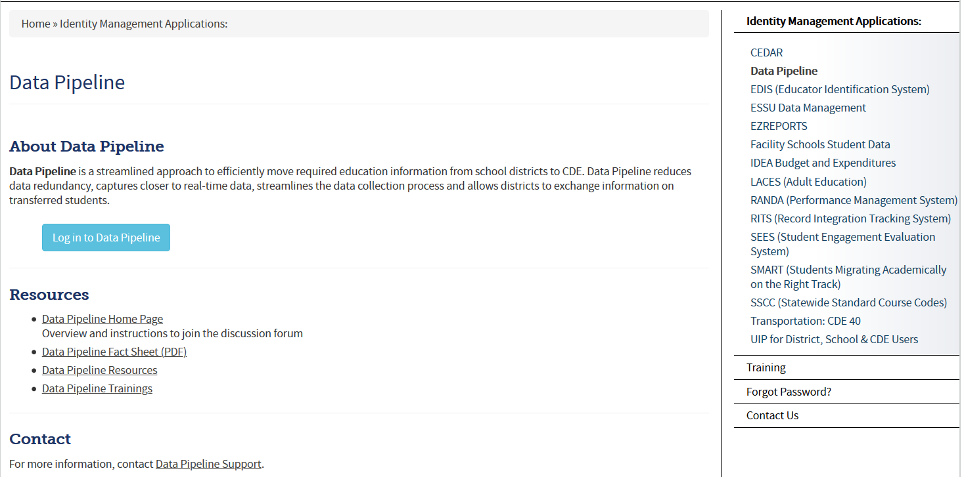
Accessing the Data Pipeline
*your single sign-on login may be used for all CDE applications listed here that you have access to
Bookmark this link: https://cdeapps.cde.state.co.us/index.html
From this page click Data Pipeline to get to this screen. Next click
the blue login button.

Slide 44
Single Sign On
Username is the email address associated with your IdM account
Password specified by you

Slide 45
Special Education Discipline- No Discipline Actions
How to report your district has no discipline actions:
Under the Special Ed Discipline Tab choose No Discipline Actions
Select the School Year, Click Submit
Mark Yes under No Discipline Actions and click Save
Be sure you see the “Successful Save” message at the top
*No need to upload a Discipline Action file

Slide 46
Helpful Status Screen
AUs (SPI role) can see file status of all member districts under Special Ed Discipline/Status Dashboard by filtering on File Type: Discipline Action
Screen also shows the date a district (DIS role) marks “No Discipline Actions”
Another option – District Activity Report found under Cognos Reports/Special Education Discipline

Slide 47
1st Step: Format Checker *optional
Once the file is created, you have the option to run it through the Format Checker to ensure all the bytes are correct.
The system checks the first row of data only.
All fields PASS = Ready to upload

Slide 48
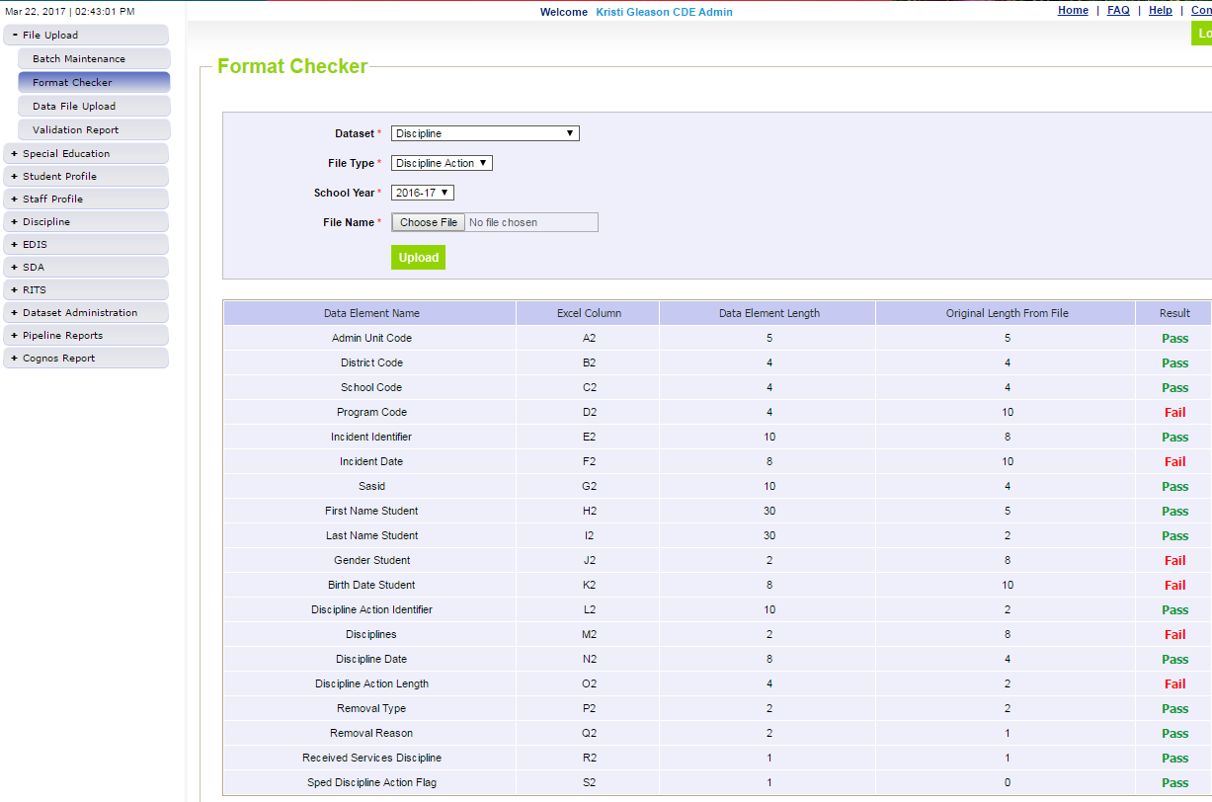
Format Checker Results
Pass Result – Proceed to Step 2: Data File Upload
Fail Result – check file against file layout. Upload the file to Format Checker until all fields = Pass
e.g. Program Code is 4 bytes. File shows 10 bytes.

Slide 49
Step 2: Data File Upload
Click on File Upload/Data File Upload
Choose File Type and School Year. Organization should populate with your district code.
Click on Browse to locate File
Choose Replace
Hit Submit
Note message in green below. A Batch ID will be created.
*Email confirmation will be sent once complete

Slide 50
Step 3: Check Batch Maintenance Screen
Check Batch Maintenance to ensure files have processed successfully.
Processed Indicator will say “YES”. If blank or “No”, file did not upload
Check Record Count, Error Count, and make sure submitted date and time look accurate.

Slide 51
File Won’t Upload?? Check for these…
Excel, CSV, or Text formats are accepted
CSV format loses leading zeros when you open it -steps for saving them posted here: http://www.cde.state.co.us/datapipeline/convertcsvtoexcel
Excel template for Discipline Action File posted online http://www.cde.state.co.us/datapipeline/inter_sped-discipline under Templates (however, it is not necessary to use a template if your file already extracts in one of the accepted formats)
No spaces in file name
No blank fields
Be sure the file is not open when uploading

Slide 52
Reviewing Errors – Pipeline Reports
From Pipeline Reports choose Error Report.
To see which records are receiving a specific error click on View Details. You can now review the errors in detail here or download them in Excel.

Slide 53
Reviewing Errors– Cognos Reports
Select Special Ed Discipline Interchange to see the Discipline Action file errors
File Type is Discipline Action
If you want to see a summary or detailed list of errors, go to
Cognos at the bottom of the Data Pipeline System Screen
Another window will open
Click Special Ed Discipline Interchange Folder and double click on one of the following error reports

Slide 54
Reviewing Errors Error Reports in COGNOS
To view detailed error records select ICON below, choose Excel Options, View In Excel 2007 Format.
From this screen you can choose to view Errors, Warnings, Errors & Warnings, Select All or Select One Error. Click “Finish”
If there are no errors you will not see your district in the drop down.

Slide 55
Creating a Snapshot (AU/SPI role)
Click Special Education Discipline tab
Click Snapshot
File Type Special Education Discipline
Click Search button
Click Create Snapshot
Expected Message: Snapshot creation triggered and processing. A notification email will be sent upon completion.
Confirmation email sent once snapshot has completed

Slide 56
Special Education Discipline – Snapshot Reports (SPI role-AUs)
Reminder:
Select Special Education Discipline to see the Sped Discipline Snapshot errors and other reports

Slide 57
District Report to see Snapshot Errors

Slide 58
Assistance Needed?
If you have ANY questions about the Special Education Discipline Data Collection please feel free to contact us. No question or concern should remain unanswered or unresolved.
Lindsey Heitman 303-866-5759 heitman_l@cde.state.co.us Collection Lead
Orla Bolger 303-866-6896 bolger_o@cde.state.co.us
Alyssa Ohleyer 303-866-6308 ohleyer_a@cde.state.co.us
Email protocol – please include:
District # and Administrative Unit #
Phone number where you may be reached
Subject of the email/applicable error codes
NOTE: Never send files or reports via email – contact us to determine best technical assistance avenue.

Slide 59
We appreciate your time and participation!

