Slide 1
2018-19 Staff Interchange
September 2018

Slide 2
Agenda
Pipeline Review
Staff Interchange Overview
Timeline
Data Pipeline Steps
2018-19 File Updates and Review
Educator Shortage Survey Information
Resources

Slide 3
Pipeline Review

Slide 4
Glossary of Terms
Term | Definition
Cognos | A type of report in which the user can view applicable reports that are formatted in a user friendly environment
Data Pipeline | A streamlined approach to efficiently move required education information from school districts to the CDE
Interchange | The method of providing data to CDE in which LEA’s may choose from multiple file formats to submit data transactions throughout the year.
LAM | Local Access Manager responsible for assigning the appropriate access to CDE applications
LEA | Local Education Agencies
IdM | Identity Management. A single sign on system, allowing the user to navigate between the applications without entering user ID information a second time.
Snapshot | A date in time when data is pulled from the appropriate interchanges, validated by additional business rules, and approval given that signifies it was accurately reported for a specific point in time by an LEA.

Slide 5
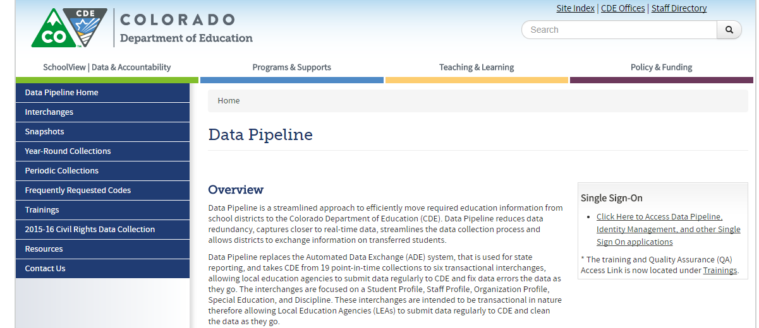
Website Overview
https://www.cde.state.co.us/datapipeline
For Staff Interchange Information
To Log In Pipeline System:
click here
For Human Resources and Special Ed December Count Information
Codes – frequently used codes are found here (district codes, school codes, institutes of higher education, etc.)
Collection dates, Mandatory Collections- legislation and uses, converting csv files to excel, etc.

Slide 6
Website Overview - Interchanges
Timelines
File Layouts
Edits

Slide 7
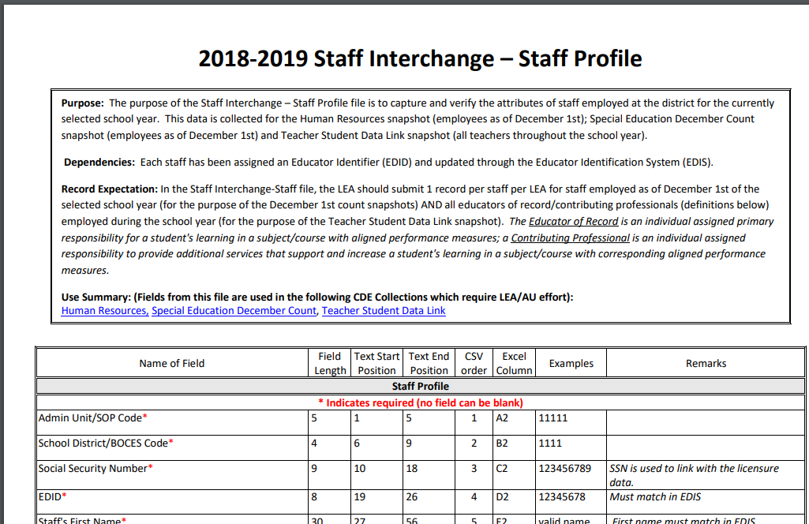
Screenshot of Staff Profile File Layout
Definitions - Every Field Name included in the File Layout will have a corresponding “Definition” listed under the file layout table
We also include any changes in the document at the bottom of it.

Slide 8
Staff Interchange Overview

Slide 9
Interchange Process
Create/Update Data Files
Upload files in Data File Upload
Review Batch Maintenance
Review Error Reports in Cognos
Correct Data Files in Source System
Upload files in Format Checker
Once No Errors in All Files Needed -> Create Snapshot

Slide 10
Staff Interchange Files
Staff Profile
General information per staff
Only 1 record per staff
Must be uploaded first
Staff Assignment
Provides specifics to actual duties and locations
Multiple records per staff allowed

Slide 11
Staff Interchange Uses
Staff Interchange files are used in the following snapshots:
Human Resources
Special Education December Count

Slide 12
Human Resources – Use of Data
EDFacts – federal reports
SchoolView.org/Data Center
Performance Reports – staff statistics
ESSA In-Field Reporting
Media and external data requests
Colorado Department of Labor and Employment
Colorado Department of Higher Education

Slide 13
Criteria for Human Resources Records
All error-free records from the Staff Assignment that:
Special Education Flag = 0 (Non-Special Education)
Start date is December 1st or prior to December 1st of reporting school year
End Date is either blank or post December 1st of the reporting school year
Job class codes are not equal to 632 (Temporary/Part-time Worker As Needed) or 634 (Student Worker)
Employment Status Code = 11, 12, 13, 23, 25 or 26
EDID is reported in both Staff Profile (Profile and educational background) and Staff Assignment Association files for reporting district.

Slide 14
Special Education December Count– Use of Data
EDFacts – federal reports
Report on educator effectiveness
Draw random samples for parent survey
Compliance record review
Monitoring
Provide information regarding the fiscal impacts of the numbers
Indicator reporting – Significant Disproportionality
Public reporting
Legislature and Research requests
Consultant analysis to support technical assistance needs in the state

Slide 15
Criteria for Special Education December Count Records
All error-free records from the Staff Assignment that:
Special Education Flag = 1
Start date is December 1st or prior to December 1st of reporting school year
End Date is either blank (not ended) or post December 1st of the reporting school year
EDID is reported in both Staff Profile (Profile and educational background) and Staff Assignment Association files for reporting district.
Employment Status Codes will be included: 11, 12, 13, 23, 25 or 26.
Administrative Unit code cannot zero-filled in either staff profile or staff assignment files

Slide 16
Timeline

Slide 17
Staff Interchange Timeline (Now – Dec 2018)
Wednesday, September 5, 2018 | Staff Interchange Opens
Thursday, November 1, 2018 | Human Resources/Special Education December Count Snapshot Opens
Wednesday, November 28, 2018 | Interchange Files Uploaded At Least Once
Saturday, December 1, 2018 | Official Count Date
Thursday, December 20, 2018 | Interchange Files Error Free

Slide 18
Timeline – Highlights of Snapshots
Start early… Staff Interchange is open and files can be uploaded multiple times throughout process
November 28th – Upload Interchange files at least once
December 20th – Interchange files error free
January 24th – 31st is the Data Report Review Week
Districts MUST REVIEW Special Education Staff Report (Cognos)
Districts and AUs must collaborate to ensure Special Education Staff data is reported accurately and complete
AUs review reports in detail and make any data corrections deemed necessary during this window

Slide 19
Timeline - Resources
Please reference detailed timelines online- much more information provided
Human Resources Timeline: https://www.cde.state.co.us/datapipeline/2018-2019humanresourcestimeline
Special Education December Count Timeline: https://www.cde.state.co.us/datapipeline/2018-2019specialeducationdecembercounttimeline

Slide 20
Data Pipeline Steps

Slide 21
Identity Management Roles
Staff Interchange Roles:
STF~ LEAUSER – upload and modify staff interchange files OR
STF~LEAVIEWER – view (only) staff interchange data
Human Resources Snapshot Roles:
HRD~LEAAPPROVER – Approves, creates, views Snapshot OR
HRD~LEAUSER - creates, views Snapshot OR
HRD~LEAVIEWER- views snapshot
Special Education December Count Snapshot Roles:
DEC~LEAAPPROVER – Approves, creates, views Snapshot OR
DEC~LEAUSER - creates, views Snapshot OR
DEC~LEAVIEWER- views snapshot

Slide 22
More about the roles
A respondent with the STF role associated with the 5 digit admin unit code can only report Special Education Staff (flag=1)
A respondent with the STF role associated with the 4 digit district code may report ALL staff, regular and special education, for the district.
If you are reporting all staff be sure to be available to make changes to special education data in accordance with the timeline.

Slide 23
Authoritative Source
Prior to reporting staff data be sure the structure for reporting has been established and the appropriate roles have been assigned. Determined by the Superintendent along with LAMs and Special Education Directors.
Here is a good resource for determining the Authoritative Source for staff http://www.cde.state.co.us/datapipeline/authoritativesourceforstaff
Often the reporting responsibility is determined by the personnel options, such as the staff member with experience or access to the most accurate data.

Slide 24
Create Files
Excel, CSV or Text File all accepted
Need to create 2 separate files:
Staff Profile – demographic and educational background info
Staff Assignment File – specifics for location and duties
1st record of data must be field names/titles
File layouts, definitions and codes all found at: http://www.cde.state.co.us/datapipeline/inter_staff

Slide 25
Creating Staff File/Assignment – Helpful Tips
First Record = Headings or Titles
can be labeled to make the most sense to you
Pipeline system ignores these headers-essentially skips it to the 2nd row with actual data
Codes must match codes within file layout
Include leading zeros
Blanks are not allowed – zero fill if N/A
Templates available if needed at: http://www.cde.state.co.us/datapipeline/inter_staff

Slide 26
Referencing/Using Last Year’s Data File
You may download last year’s data file as a starting point if needed
File layout will be in prior year (2017-2018) file layout, so updates would be required prior to re-uploading
Data Pipeline -> Staff Profile -> File Extract Download
This may also be used to download recent files uploaded into pipeline
Includes any updates made in ‘Edit Record Screen’
Includes all data records from all files uploaded

Slide 27
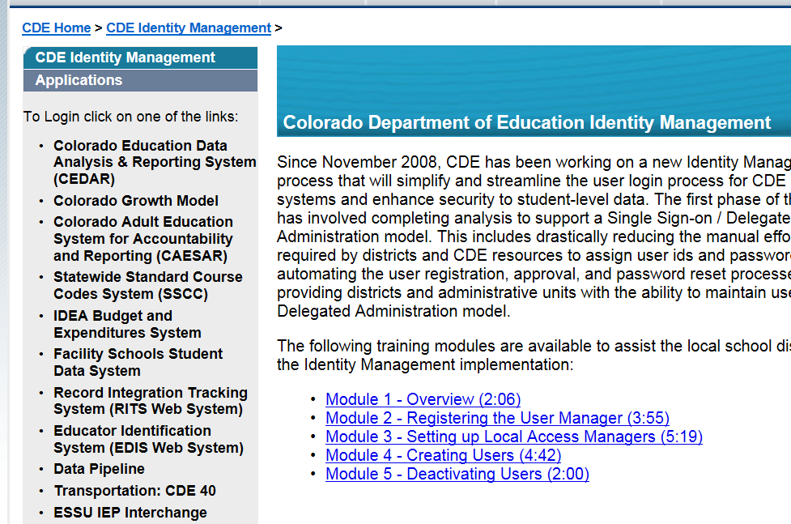
Accessing Data Pipeline
https://cdeapps.cde.state.co.us/index.html

Slide 28
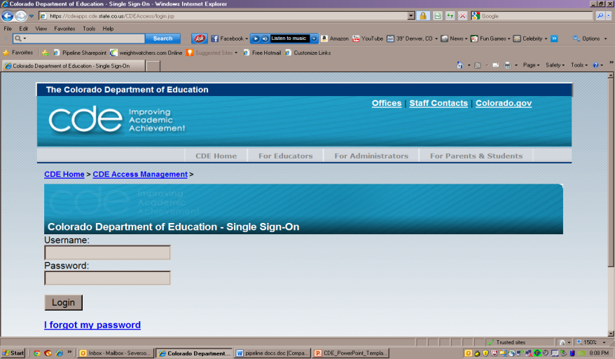
Pipeline Log-In Screen
User Name = Full Email Address
Password – is set by you; you may reset if needed

Slide 29
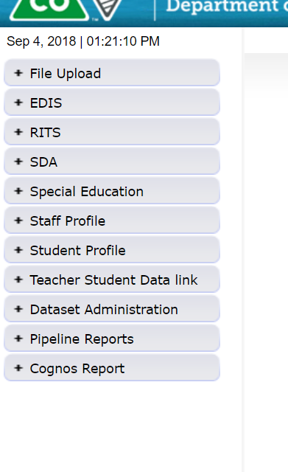
Pipeline Website Review
Batch Maintenance, Format Checker and Data File Upload
Based on your Identity Management Roles
Error reports and other validation reports

Slide 30
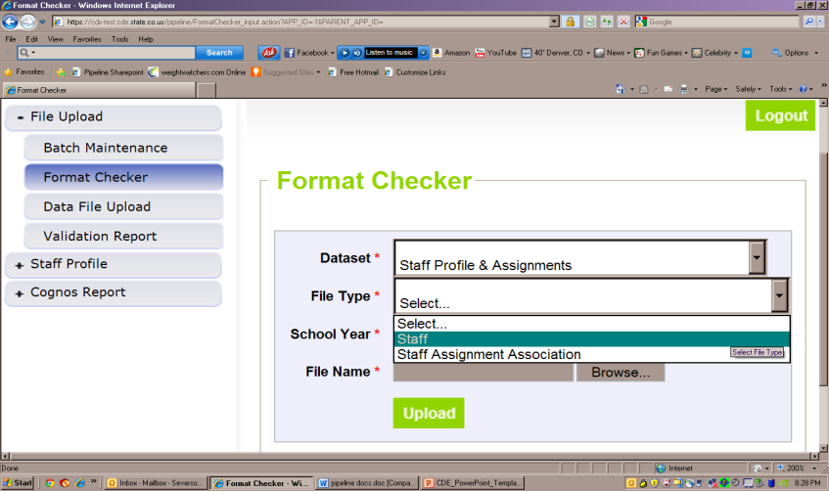
File Upload – Format Checker

Slide 31
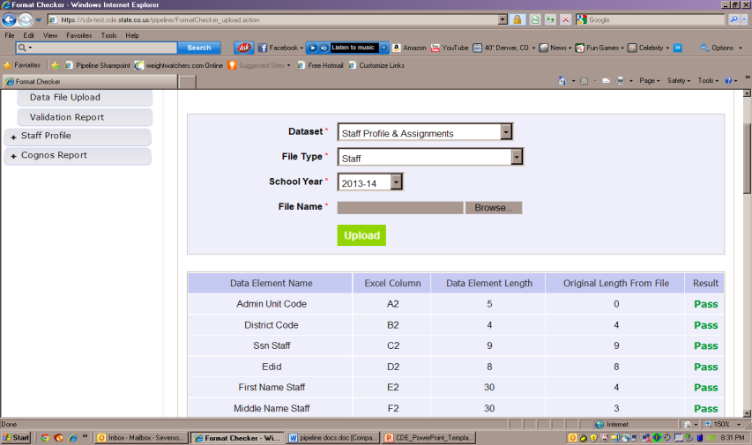
Format Checker – Upload Results

Slide 32
Format Checker Notes
Format Checker will only review the 2nd row in your file
Passing format checker Does Not Equal file will process
Green ‘Pass’ for each field is desired result
Red ‘Fail’ for a field indicates file is not in the correct format- please refer to the 2018-19 file layout on web

Slide 33
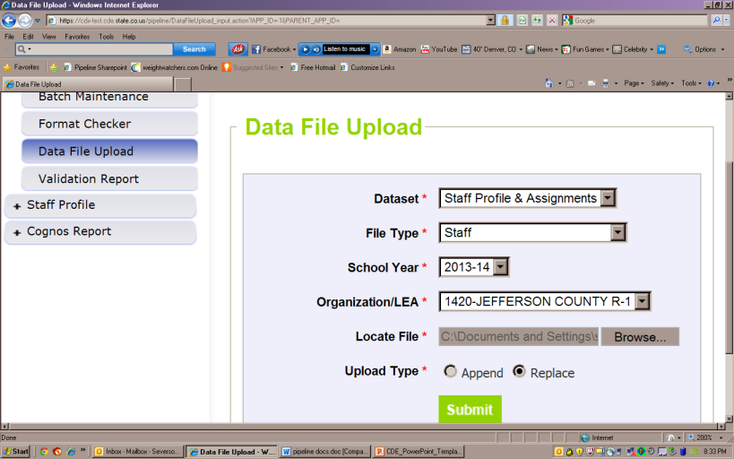
Data File Upload

Slide 34
Data File Upload Notes
Upload Staff Profile file first
Upload staff assignment file second
Staff profile does not have to be error free, just uploaded before staff assignment file is uploaded.
Upload Types:
Append = adds file to existing file, all records from both files included
Can be tricky with fixing errors
Replace = deletes any prior data file and replaces it with the file being uploaded
RECOMMENDED

Slide 35
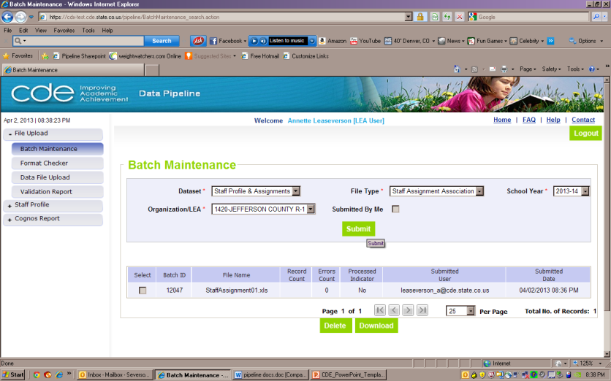
Batch Maintenance Screen

Slide 36
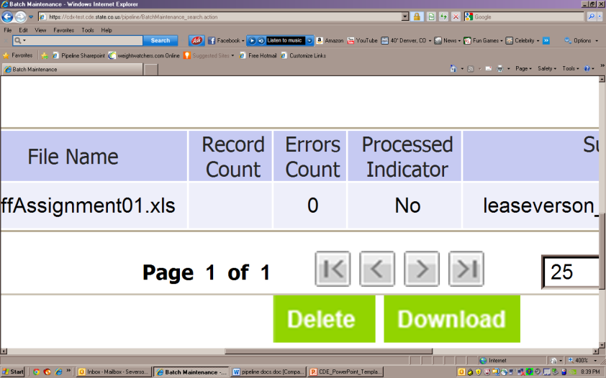
Batch Maintenance – Not Processed

Slide 37
File Not Processed – Next Steps
Ensure file has all green ‘pass’ in format checker
YES?
Open file and review all records are formatted the same as the 2nd row
Be sure all codes and dates have leading zeros included
NO?
Review file layout posted online and re-format the file
For further assistance, contact Annette Severson or Lindsey Heitman
DO NOT INCLUDE THE FILE IN ANY EMAILS – we will set up a syncplicity folder for you to use to share the file(s) securely

Slide 38
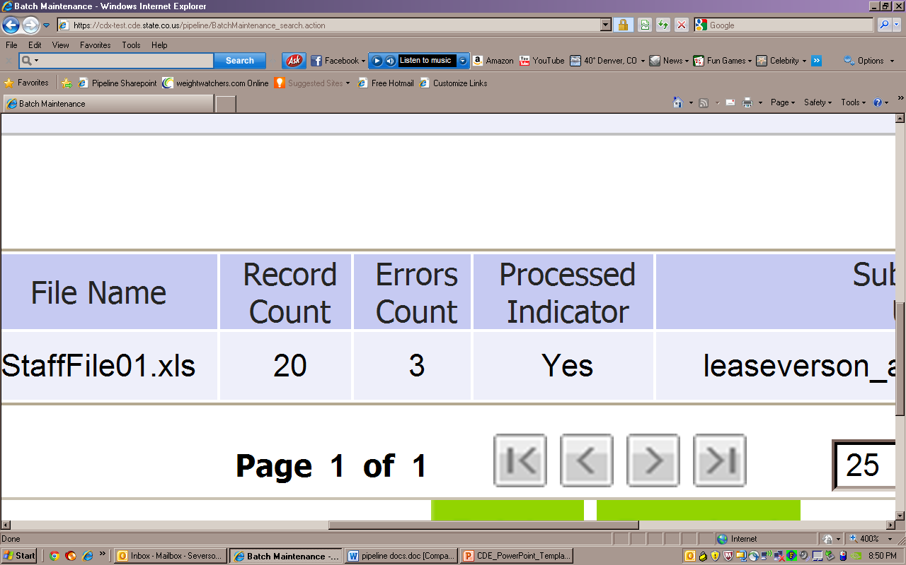
Batch Maintenance – File Processed

Slide 39
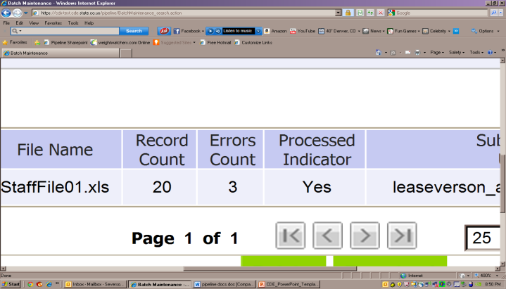
File Processed – Next Steps
Use same screen to see the Number of Errors:

Slide 40
Review Errors in Detail
2 methods available:
Data Pipeline Reports -> Error Reports
Cognos Reports – > Staff Profile
All Business rules (errors and warnings) can be found at:
http://www.cde.state.co.us/datapipeline/inter_staff
Cognos Reports -> Baseline -> Business Rules

Slide 41
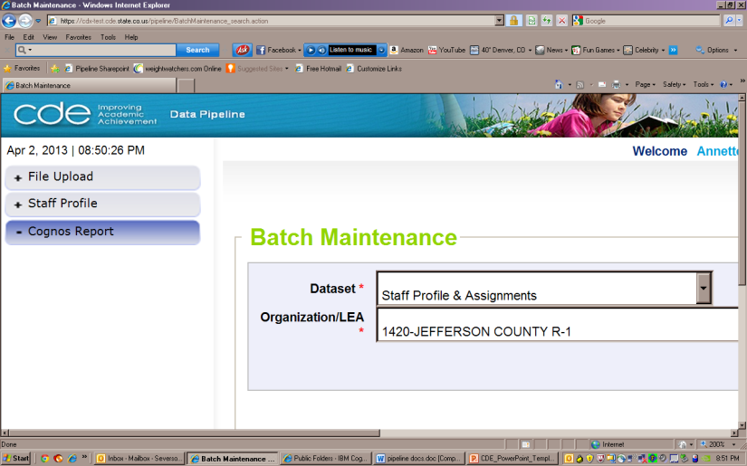
Cognos Reports

Slide 42
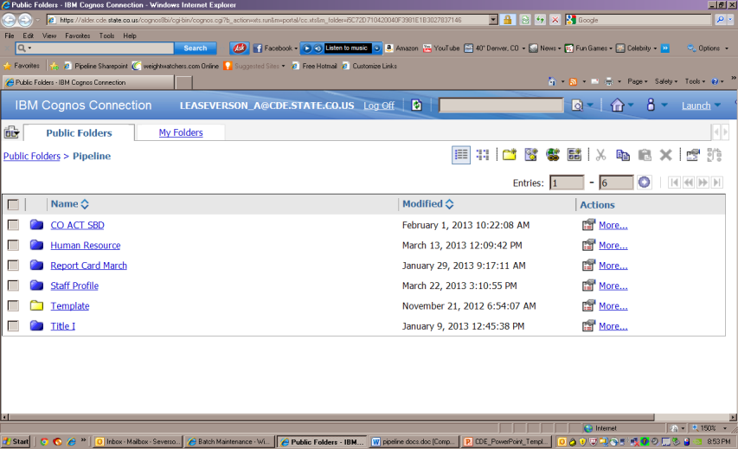
Clicking on Cognos Reports- Opens in a new Screen

Slide 43
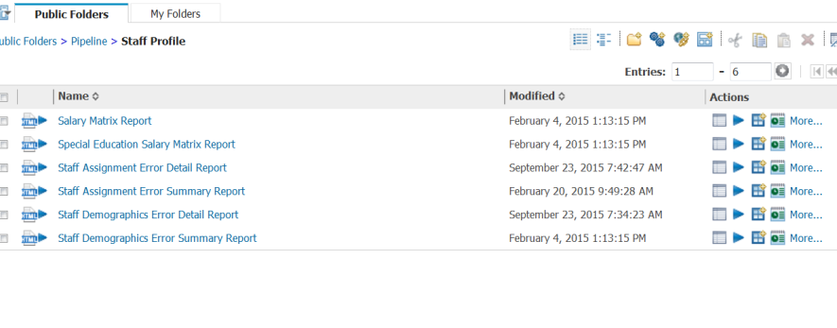
Staff Interchange Errors
Detail Reports – provides detailed records with descriptions of error
Summary Reports – provides a count of records by type of error
*Do Not Send Error reports via email to CDE for assistance

Slide 44
Error Reports
Error Detail Report
Provides specific records causing the error with the error description
Can select to View ALL error records or 1 type of error at a time
Error Summary Report
Provides a count of errors generated per error type and description
Resubmit either file as needed for corrections for all data errors to be resolved
Be sure to update source file with corrections as well

Slide 45
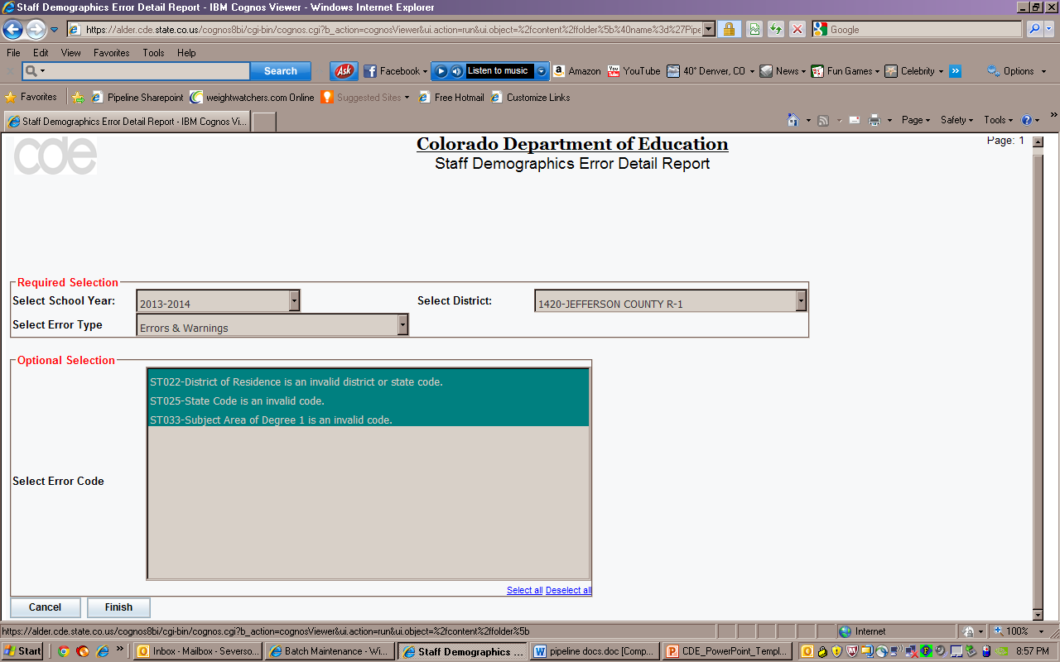
Error Detail Report

Slide 46
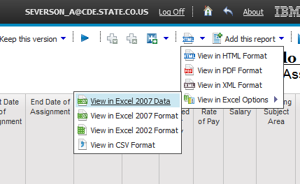
Error Detail Report- Excel
All cognos reports can be downloaded into excel
Choose ‘Excel Format’ when making selection

Slide 47
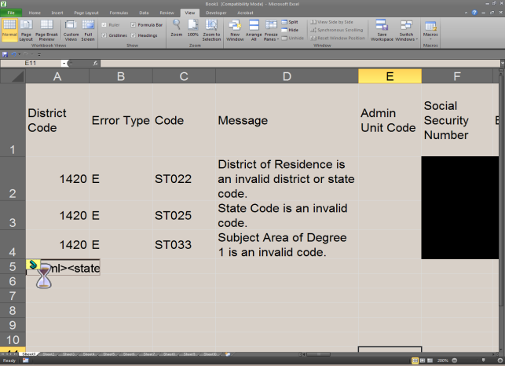
Example of Error Report – in Excel

Slide 48
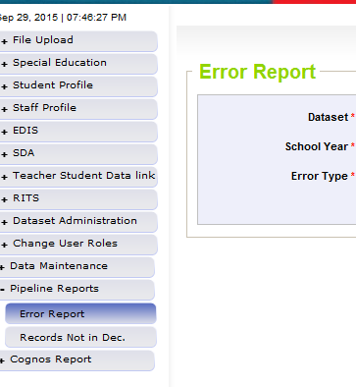
Pipeline Reports
Search:
Dataset = Staff Profile and Assignments
School Year = 2018-2019
Error type = Errors and Warnings
File Type: Staff/Staff Assignment
Org/LEA = Code
Click ‘Search’

Slide 49
Pipeline Error Reports – Viewing Details
Summary of Errors are next provided:
From this screen:
Click on ‘View Details’ to view each record with the error
Choose ‘Excel’ to download error report in Excel

Slide 50
Correcting Errors
Correct the errors in the file:
May have to fix errors in both Staff Profile and Staff Assignment files
Keep file versions – in case updated file causes even more errors, you can re-start using a prior file version
Resubmit your data records using the same process and replacing your existing data file using the Data File Upload tool
All errors must be corrected, all warnings should be reviewed

Slide 51
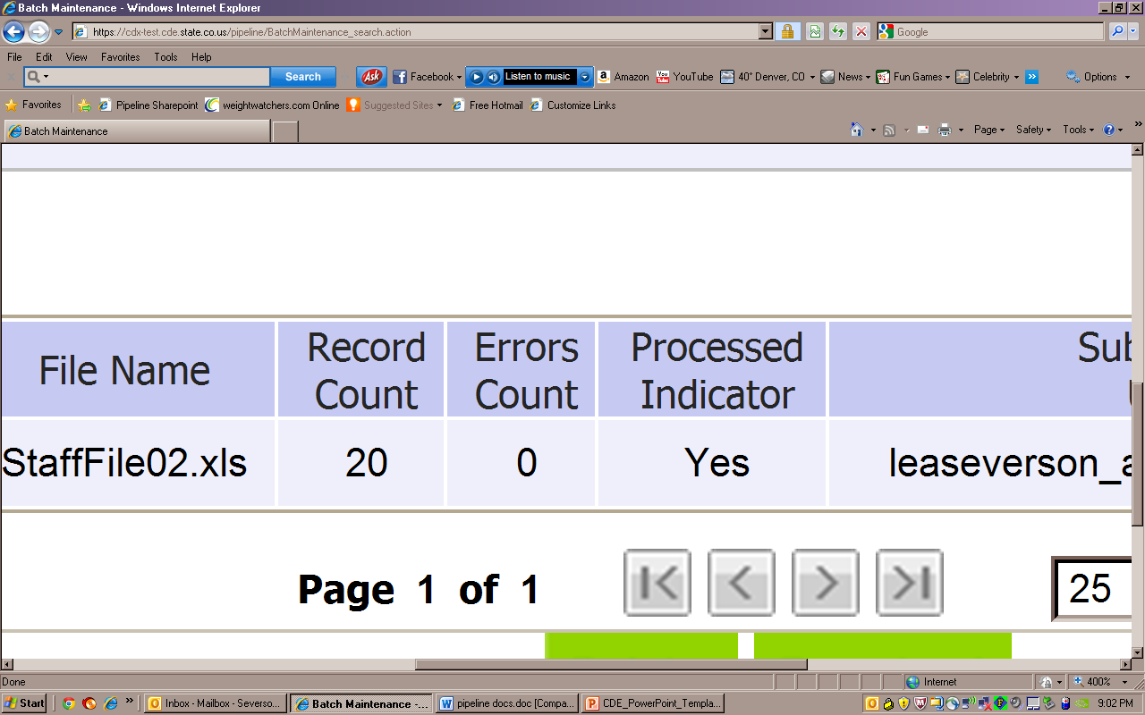
Batch Maintenance: No Errors

Slide 52
Next Steps – Staff
Staff Profile = Processed and Zero Error Count
Staff Assignment File = Processed and Zero Error Count
Create Snapshot
Districts/BOCES create Human Resources Snapshot
Administrative Units create Special Education December Count Snapshot

Slide 53
2018-19 File Updates and Review

Slide 54
Staff Profile Overview
1 record per staff employee
EDID cannot be zero – filled
Last Name, First Name, Date of Birth and Gender must match with information in EDIS for the EDID
Race must be provided for all staff
Ethnicity – Hispanic or Latino is considered an Ethnicity, a race must also be reported
No fields are allowed to be blank except Exit Date
If field is not required for a particular staff member, it may be zero-filled instead

Slide 55
Overall Performance and Quality Standard Ratings
All Teachers and Specialized Service Providers (SSPs) must have rating reported for the following job class codes:
All Principals and Assistant Principals must have rating reported for these job class codes:
105 – Principal
106 – Assistant Principals
201 – General Ed Teacher
202 – Special Ed Teacher
206 – Title I Teacher
222 – Reading Interventionist
223 – Math Interventionist
216 – Librarian
211 – Counselor
231 – Audiologist
233 – Registered Nurse
234 – Occupational Therapist
235 – Physical Therapist
236 – Psychologist
237 – Social Worker

Slide 56
Staff Profile Updates (changes from 2017-18)
Teacher Probationary Status code 03 updated:
03: Other- per local policy, a teacher that does not have a pathway to earn non-probationary status(e.g., a charter school employee, a BOCES teacher that does not have funding guaranteed for more than one year)”

Slide 57
Staff Assignment Overview
Multiple records are allowed per person based on
Special Education Status
Location
Job Class Code
Grant Code
Teaching Subject Area
Grade levels (elementary and secondary need to be separated)
When reporting 2 or more records for a person…
Contract Days would not be split
Base Salary would be split accordingly
Hours per Day would be split accordingly

Slide 58
Staff Assignment Record Example
Reporting Example – An art teacher teaching K-12 grades at school 1111. He works 8 hours per day, 160 days with a salary of 45,000:
Record 1: job class code = 201 (teacher); teaching subject area = 0020 (art); school = 1111; grades K, 1, 2, 3, 4, 5 = 1 (yes); hours per day = 0400 (4 hours for elementary level); base salary = 022500 and contract days = 160 days
Record 2: job class code = 201 (teacher); teaching subject area = 0020 (art); school = 1111; grades 6, 7, 8, 9, 10, 11, 12 = 1 (yes); hours per day = 0400 (4 hours for secondary level); base salary = 022500 and contract days = 160 days

Slide 59
Staff Assignment Updates
Removed field “Demonstrates In-Field Status 2”
New Job Class code 224 for Board Certified Behavior Analyst (BCBA).
Definition – Delivers consultative or direct behavior analytic services to meet the individual needs of students, and provides support to special education and general education staff in order to improve student access to instruction, behavioral skills and academic achievement”
Grant/Funding Source code – now also required for general education staff with job class codes 201, 206, 222, 223, 415 and 419. Continues to be required for ALL special education staff.

Slide 60
Grant Codes
Required for ALL special education staff (special education assignment flag =1) AND
Required for staff with job class codes 201 (general education teacher), 206 (Title I teacher), 222 (reading interventionist), 223 (math interventionists), 415 (general education teaching assistant) and 419 (Title I teaching assistant)
0000 is not considered a valid code for these job class staff

Slide 61
Purpose of Including Grant Codes for Instructional Staff
Until now, LEAs with Title I schools submitted comparability data through CDE’s online FTE-based platform.
To reduce LEA burden, CDE will conduct Comparability calculations using prior year HR data. Like the online system, CDE will compare Title I school student/teacher (State and Locally funded) ratios to non-Title I schools.
LEAs with schools that are not comparable based on CDE analysis of HR data will be notified and referred to the alternative calculator (Excel) and additional methods they may use to meet this requirement.
Notes:
This requirement must be met for schools in the same grade spans – elementary, middle, and high school (EMH). Not required for schools that have less than 100 students, or LEAs with only one school per grade span.

Slide 62
Reporting Grant Codes for General Education Staff
Use code ‘0001’ for any funding from local and/or state codes (aka non-federally funded)
Use more specific code(s) for federally funded:
4010 | Title I, Part A
8027 | Special Education: Grants to States IDEA Part B (15% for Early Intervening Services)
9201 | Preschool Set-Aside
9202 | Eligible Homeless Children Set-Aside
9203 | Family Literacy Set-Aside
9204 | Neglected Institutions Set-Aside
9205 | Non-Public School Set-Aside
9206 | District Managed Activity Set-Aside
9209 | Choice Set-Aside
9900 | Other Federally Funded - not listed above

Slide 63
Reporting Grant Codes – Example 1
A general elementary education teacher is funded 25% from local funds, 50% from Title IA and 25% from State funds. She works 8 hours per day and makes a total of $40,000 a year.
There will be 2 records for this teacher
Grant code = 0001; jobclass code = 201, hours per day = 4 (0.50*8); salary = $20,000 (0.50*$40,000)
Grant code = 4010, jobclass code 206, hours per day = 4 (0.50*8); salary = $20,000 (0.50*$40,000)

Slide 64
Reporting Grant Codes – Example 2
A general education paraprofessional is funded 60% from local funds, 30% from state funds, and 10% from Title IA Preschool Set-Aside. He works 8 hours per day and makes a total of $30,000 a year.
There will be 2 records for this paraprofessional
Grant code = 0001; job class code = 415, hours per day = 7.2 (0.9*8); salary = $27,000 (0.9*$30,000)
Grant code = 9201, job class code = 416, hours per day = 0.8 (0.1*8); salary = $3,000 (0.1*$30,000)

Slide 65
Reporting Grant Codes – Example 3 (option a)
A general elementary education teacher is funded 50% from local funds, 50% from Title IA. She works 8 hours per day and makes a total of $40,000 a year. She also splits her time between two schools:
There will be 4 records for this teacher
School A, Grant code = 0001; jobclass code = 201, hours per day = 2 (0.50*4); salary = $10,000 (0.50*$20,000)
School A, Grant code = 4010; jobclass code = 206, hours per day = 2 (0.50*4); salary = $10,000 (0.50*$20,000)
School B, Grant code = 0001; jobclass code = 201, hours per day = 2 (0.50*4); salary = $10,000 (0.50*$20,000)
School B, Grant code = 4010; jobclass code = 206, hours per day = 2 (0.50*4); salary = $10,000 (0.50*$20,000)

Slide 66
Reporting Grant Codes – Example 3 (option b)
A general elementary education teacher is funded 25% from local funds, 50% from Title IA, and 25% from State funds. She works 8 hours per day and makes a total of $40,000 a year. She also splits her time between two schools; Title I funds her at school X only.
2 records total for this teacher
School X - Grant code = 4010, jobclass code = 206, hours per day = 4 (0.50*8); salary = $20,000 (0.50*$40,000)
School Y - Grant code = 0001; jobclass code = 201, hours per day = 4 (0.50*8); salary = $20,000 (0.50*$40,000)
NOTE – State and Local funding is combined in Record 2

Slide 67
Demonstrates In-Field Status 1 Review
Using the list below, prioritize response by reporting the first applicable code for each teacher* (job class code 201 through 206):
*Not required for Study Hall or Co-Curricular Activities (codes 1800, 1900 or 2000)
Code | Description
01 | Subject Area Endorsement on Teaching License
02 | Degree (BA or higher) in subject area
03 | 36 semester credit hours in subject area
04 | Passed State Board of Education approved content exam in subject area
06 | Highly Qualified via 24 semester hours in subject area
05 | None (teacher is out of field)

Slide 68
Purpose of the ESSA In-Field Crosswalk
ESSA defers teacher qualification requirements in Title I programs to applicable State law. Percentages of classes taught by teachers who meet these requirements are reported to the ED in aggregate.
CDE encourages LEAs to prioritize hiring teachers who have demonstrated subject matter competency in the area(s) they will teach.
Teacher out-of-field, inexperienced, and ineffective FTE will be used to monitor and publicly report the rates at which students in schools with the highest poverty and minority percentages are taught by inexperienced, out-of-field, and ineffective teachers.
Notes:
Colorado law (C.R.S 22-63-201) requires that a teacher hold a valid license or authorization before they can be hired to teach in a public school, including a charter school, unless the school or district has received a waiver from this provision. Waivers are not applicable to Special Education teacher qualification requirements.

Slide 69
ESSA In-Field Crosswalk
Provides allowed endorsements for each teaching subject code
Provides Subject Area of Degree code for each teaching subject code
Reference list for Human Resources at: https://www.cde.state.co.us/datapipeline/hr-essa-infield-crosswalk

Slide 70
Educator Shortage Survey Information

Slide 71
Educator Shortage Survey: Purposes and Uses of Data
These exact shortage data allow CDE to identify educator shortage areas for all districts in Colorado and are reported to the Colorado Legislature to inform decisions regarding support to districts in recruiting and retaining educators.
Additionally, this enables CDE to provide accurate data to the USDOE in order for our educators to receive appropriate loan benefits.

Slide 72
Educator Shortage Survey: Requirements
HB 17-1003 required that the Colorado Department of Higher Education in conjunction with the CDE submit an action plan regarding educator shortages to the Legislature. In that plan and as a follow up, CDE and CDHE were asked to provide factual information about the educator shortages across Colorado.
HB 18-1002 requires CDE to annually identify geographic areas of the state and specific subject areas and grade levels for which there are critical shortages.
Data are also required by USDOE for annual submission in November of every year to meet the requirements for Federal benefits under the following regulations: 34 CFR 682.201(q), 34 CFR 674. 53(c), 34 CFR 686.

Slide 73
Educator Shortage Survey Administration
The Educator Shortage Survey is administered online through the link that will be posted at http://www.cde.state.co.us/datapipeline/snap_hr
The survey should only be completed once for each district by appropriate staff. The district’s Human Resource team have these data and may want to have the screen shots of the items provided here in advance to locate the data.
Each district must complete the Educator Shortage Survey prior to obtaining CDE sign-off on the 2018-2019 Human Resources Snapshot.

Slide 74
Educator Shortage Survey Items

Slide 75
If your district had open positions that needed to be filled, this page appears and lists all educator endorsement areas

Slide 76
Last page of the Educator Shortage Survey

Slide 77
Resources

Slide 78
Resources and Contact Information
Staff Interchange information:
http://www.cde.state.co.us/datapipeline/inter_staff
Annette Severson: severson_a@cde.state.co.us (also HR)
Lindsey Heitman: heitman_l@cde.state.co.us (also Dec Count)
Comparability and Teacher Qualifications Reporting:
Donna Morganstern: morganstern_d@cde.state.co.us
Barbara Vassis: vassis_b@cde.state.co.us
http://www.cde.state.co.us/fedprograms/ti/a_comp
Site will updated to describe the new process for demonstrating comparability
http://www.cde.state.co.us/fedprograms/tii/a_hqt
Snapshot information:
Human Resources - http://www.cde.state.co.us/datapipeline/snap_hr
Special Education December Count - http://www.cde.state.co.us/datapipeline/snap_sped-december

Slide 79
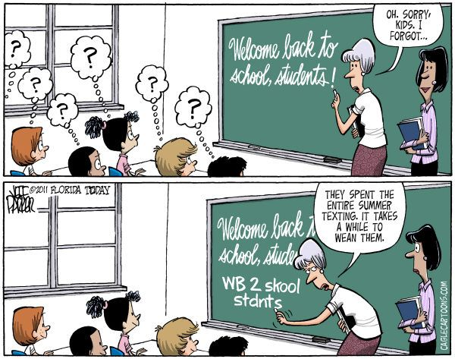
Thank you for joining us!
Questions?
Annette Severson: Severson_a@cde.state.co.us
Lindsey Heitman: heitman_l@cde.state.co.us

