Slide 1
2018-2019 Introduction to Special Education December Count Webinar Training
November 7th, 2018

Slide 2
AGENDA
General Overview
Accessing the Data Pipeline
Snapshot Process
TIMELINE/RESOURCES/ASSISTANCE

Slide 3
General Overview

Slide 4
Special Education December Count Purpose
Purpose:
The purpose of the Special Education December Count Snapshot is to obtain data for the Annual Count of Students with Disabilities as of December 1st in the State of Colorado and the associated Staff members to fulfill Federal and State reporting requirements.
Student:
Student data is used to meet federal reporting requirements, calculate Indicators 5, 6, 9, 10 Significant Disproportionality, generate sample lists for Indicator 8 Parent Surveys and record review, and determine ECEA funding for Students with Disabilities.
Staff:
Staff data is used to meet federal reporting requirements and verify staff qualifications.

Slide 5
State Performance Plan Indictors associated with December Count Data
SPP Indicator 5 - LRE Placement: % of children 6-21 with IEPs served (A) Inside regular class 80% or more of day, (B) Inside regular class less than 40% of day, (C) In separate schools, residential facilities, or homebound/hospital placements
SPP Indicator 6 - Early Childhood Settings: % of children ages 3-5 with IEPs (A) Receiving majority of special education and related services in regular early childhood program, (B) Attending separate special education class, separate school, or residential facility
SPP Indicator 9 - Disproportionate Representation in Special Education: % of districts with disproportionate representation of racial/ethnic groups due to inappropriate identification
SPP Indicator 10 - Disproportionate Representation in Specific Disability Categories: % of districts with disproportionate representation of racial/ethnic groups in specific disability categories to inappropriate identification

Slide 6
Who to Report
Students receiving services on an IEP on 12/01/2018
Parentally Placed Private School Students - even if not on an IEP - code 02
Includes:
all AU residents regardless of where they attend
all students who attend your AU regardless of where they live
residents in facilities
Parentally Placed in Private School students who attend a private school within your AU boundaries and get no services whatsoever from the AU, reported only for proportionate share calculations on two Dec reports
*Per OSEP

Slide 7
Glossary of Terms
Term | Definition
Cognos | A type of report in which the user can view applicable reports that are formatted in a user friendly environment
Data Pipeline | A streamlined approach to efficiently move required education information from school districts to the CDE
Interchange | The method of providing data to CDE in which LEA’s may choose from multiple file formats to submit data transactions throughout the year.
LAM | Local Access Manager responsible for assigning the appropriate access to CDE applications
LEA | Local Education Agencies
IdM | Identity Management. A single sign on system, allowing the user to navigate between the applications without entering user ID information a second time.
Snapshot | A date in time when data is pulled from the appropriate interchanges, validated by additional business rules, and approval given that signifies it was accurately reported for a specific point in time by an LEA.

Slide 8
Special Education December Count Snapshot
Special Education Child
Special Education Participation
Staff Profile
Staff Assignment
Student Interchange
Special Education IEP Interchange
Staff Interchange
The data is pulled from these Interchange files:
Student School Association
Student Demographic

Slide 9
Special Education December Count Snapshot File Layout and Definitions
Found here: http://www.cde.state.co.us/datapipeline/snap_sped-december
Purpose
Dependencies
Criteria for records being pulled in
Name and length of each field in both the Student and Staff sections
Source interchange and source file the data is pulled from. Also referred to as primary interchange. *helpful to know when resolving errors
Secondary interchange and secondary file the data is pulled from if record doesn’t exist in the primary interchange. (ex. Facility students)
Helpful remarks/details
Internal flags– fields calculated from existing data fields

Slide 10
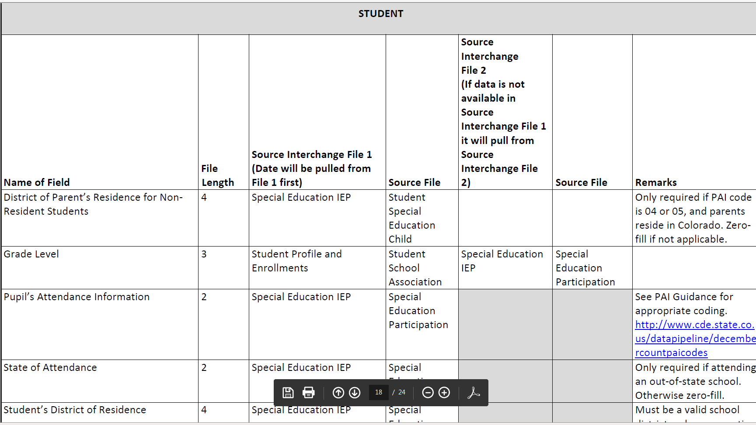
Snapshot File Layout – lists source file and secondary file data is pulling from.

Slide 11
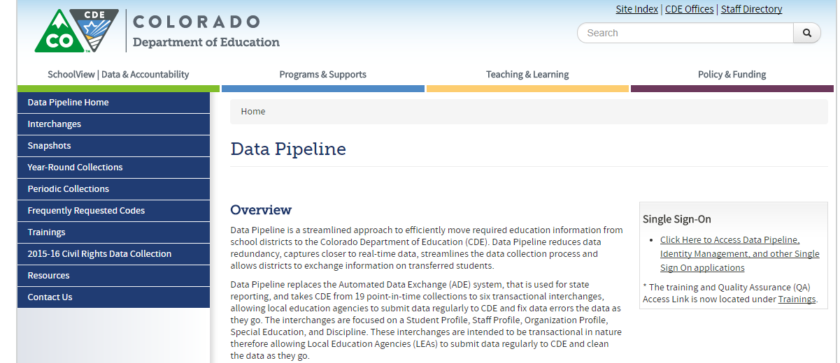
Website Overview
http://www.cde.state.co.us/datapipeline
https://www.cde.state.co.us/datapipeline
For Staff/IEP Interchange Information
To Log In Pipeline System:
click here
For December Count Information
Codes Available (district codes, school codes, institutes of higher education, etc.)
Collection dates, Mandatory Collections- legislation and uses, converting csv files to excel, etc.

Slide 12
Demographic Data Authoritative Source
Student’s Demographic Data
1st comes from the Student Interchange - Student Demographic File
If the student is not submitted by a district, the data will be pulled from the IEP Child file (Part C, Facility, and Parentally Placed in Private School records)
Student’s Entry Grade Level
1st comes from the Student Interchange - Student School Association File
If the student is not submitted by a district, the Entry Grade Level will be pulled from the IEP Participation file

Slide 13
Website Overview – Staff Interchange
For information on Staff data reporting: http://www.cde.state.co.us/datapipeline/inter_staff
At this link you will find:
Timelines
File Layouts
Templates
Business Rules
Training Webinars
Additional Resources

Slide 14
Staff Interchange Files
Staff Profile
General information per staff
Only 1 record per staff
Must be uploaded first
http://www.cde.state.co.us/datapipeline/2018-2019filelayoutanddefinitionsforstaffprofile
Staff Assignment
Provides specifics to actual duties and locations
Multiple records per staff allowed
http://www.cde.state.co.us/datapipeline/20182019filelayoutanddefinitionsforstaffassignment
New status report under Cognos Reports/Special Education December Count (DEC role):
Staff: District/AU Activity Report
Lists the status of all Staff Profile and Staff Assignment file uploads
Breaks it out by district and AU

Slide 15
Staff Profile Overview
1 record per staff employee
EDID cannot be zero – filled
Last Name, First Name, Date of Birth and Gender must match with information in EDIS for the EDID
Race must be provided for all staff
Ethnicity – Hispanic or Latino is considered an Ethnicity, a race must also be reported
No fields are allowed to be blank except Exit Date
If field is not required for a particular staff member, it may be zero-filled instead

Slide 16
18-19 Staff Profile Updates (changes from 2017-18)
Teacher Probationary Status code 03 updated:
03: Other- per local policy, a teacher that does not have a pathway to earn non-probationary status(e.g., a charter school employee, a BOCES teacher that does not have funding guaranteed for more than one year)”

Slide 17
Staff Assignment Overview
Multiple records are allowed per person based on
Special Education Status
Location
Job Class Code
Grant Code
Teaching Subject Area
Grade levels (elementary and secondary need to be separated)
When reporting 2 or more records for a person…
Contract Days would not be split
Base Salary would be split accordingly
Hours per Day would be split accordingly

Slide 18
18-19 Staff Assignment File Updates (changes from 17-18)
Removed field “Demonstrates In-Field Status 2”
New Job Class code 224 for Board Certified Behavior Analyst (BCBA).
Definition – Delivers consultative or direct behavior analytic services to meet the individual needs of students, and provides support to special education and general education staff in order to improve student access to instruction, behavioral skills and academic achievement”
Grant/Funding Source code – now also required for general education staff with job class codes 201, 206, 222, 223, 415 and 419. Continues to be required for ALL special education staff.

Slide 19
Staff Records Included in December Count Snapshot
Included:
All Special Education staff employed as of December 1st
Full or Part-time
Office/clerical, teachers, administrators, purchased staff
Excluded:
Substitutes unless they are permanent (90 days or more in the same classroom consecutively)
Temporary workers, such as after school coaches
Regular Education staff – they are reported in the Human Resources snapshot
Staff not employed December 1st

Slide 20
December Count Staff Snapshot Criteria
In order for a staff record to be included in the Special Education December Count Data Collection the following must be true:
Must be Error free at the Staff Interchange
Special Education Flag = 1
AU code must be populated in both Staff files
Start date is December 1st or prior to December 1st of reporting school year
End Date is either blank (not ended) or post December 1st of the reporting school year
EDID is reported in both Staff Profile & Assignments Interchange
Records with the following Employment Status Codes will be included: 11, 12, 13, 23, 25 or 26
The Staff Profile and Staff Assignment Association File will be joined based on the School year, the teachers EDID, the sped assignment flag = 1, the district (or Admin Unit), and the records being error free.

Slide 21
Website Overview – Special Education IEP Interchange
http://www.cde.state.co.us/datapipeline/inter_sped-iep
At this link you will find:
Timelines
File Layouts
Templates
Business Rules
Training Webinars
Additional Resources

Slide 22
Special Education IEP Interchange – 2 Files
Child File
Demographic information
1 record per student
Participation File
Special Education services information
1 record per student
IEP Interchange Resources located here: http://www.cde.state.co.us/datapipeline/inter_sped-iep
Deadlines
File Layouts and Definitions
Business Rules
Trainings
Templates
Additional Resources

Slide 23
Special Education Participation File Layout and Definitions
What’s included in the file layouts?
Dependencies and record expectation
Name every data field collected within the file
Order (format) of the fields
# of characters in each field
Examples and remarks that help clarify
Data field name, definition, and more details provided below the ordered format
Includes applicable codes for each field
Changes listed at bottom of layout and highlighted or crossed out in the name and definitions

Slide 25
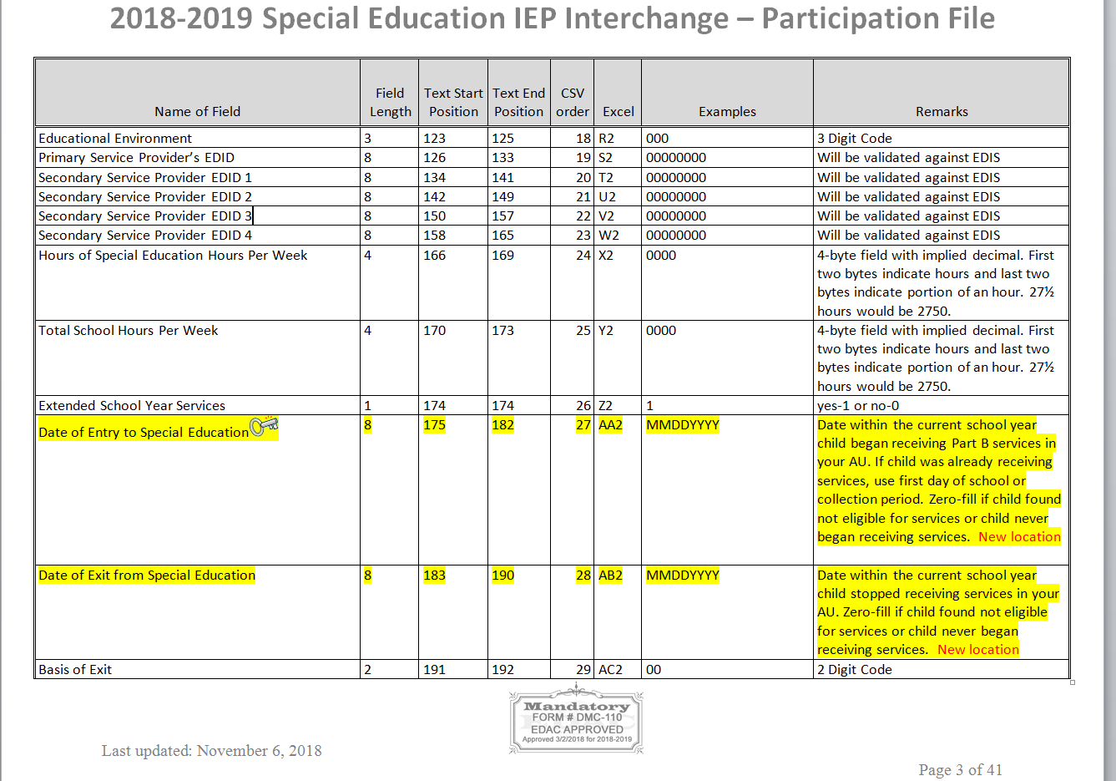

Slide 26
Field Name and Definition Example- PAI Code

Slide 27
Just a few of the applicable codes for PAI code field and definition/details for each to help determine which code to use

Slide 28
2018-2019 IEP Interchange Summary of Changes
Child File: No changes
Participation File: 4 changes
1. Field Removed- Path 2 - Date Child Referred to Part C System
2. Code Removed- Delay Code 23 “Child on the Run” from Path 2
3. Code Removed- Delay Code 28 “IEP team requested additional educational evaluation at eligibility meeting” from “Path 2 – Reason for Delay in IEP Implementation C to B”
4. 2 Fields Relocated within the file - Date of Entry to Special Education and Date of Exit from Special Education
Summary of Changes document posted here:
http://www.cde.state.co.us/datapipeline/2018-2019specialeducationiepsummaryofchanges

Slide 29
December Count Student Snapshot Criteria
In order for a IEP records to be included in the Special Education December Count Data Collection the following must be true:
Date of Entry to Special Education is December 1st or prior to December 1st of the reporting school year OR Parentally Placed in Private School is 02.
A record with a Date of Exit from Special Education prior to December 1st would not be included in the December Count.
Data from the Student Enrollment Interchange will be based on the default tagging.

Slide 30
December Count Student Snapshot Addtn’l Criteria
Pull all error-free records meeting above criteria from the Special Education Participation file and match them with records in the Student Profile Interchange. The Student Profile Interchange is the authoritative source for (SASID, LASID, Student’s First Name, Student’s Middle Name, Student’s Last Name, Student’s Gender, Student Date of birth, Student’s Ethnicity, Student Race American Indian, Student Race Asian, Student Race Black, Student Race White, Student’s Race Native Hawaiian or Other Pacific Islander, Grade level).
The Special Education Child file, the Special Education Participation file and the Student Profile file will be joined based on the following criteria: SASID, LASID, school year, district (or Admin Unit), and error free records.
If the student is not part of a district then these fields will be pulled from the Special Education Child file.
All additional fields will be pulled from the Special Education Student Participation file, except for federal race student and the ELL status, which are calculated.

Slide 31
Accessing the Data Pipeline

Slide 32
Accessing the Data Pipeline
Identity Management (IdM)
CDE provides Local Education Agencies (LEAs) a means of administering and maintaining user access to CDE applications.
IdM ensures protection of data received, collected, developed, and used by CDE in compliance with the Family Educational Rights and Privacy Act as well as other privacy mandates.
IdM Website: https://cdeapps.cde.state.co.us/index.html

Slide 33
https://cdeapps.cde.state.co.us/index.html
*single sign-on used for all CDE applications listed here
LAM Help Guide and resource modules
*LAMS: Click Access Management to add or modify IdM accounts
*Special Education Directors click Executive Director Registration to register as AU User Manager in IdM.

Slide 34
Identity Management
Responsibilities
District Superintendent
Responsible for creating and managing a user or a group of users known as the Local Access Managers (LAMs)
Local Access Manager (LAM)
Responsible for approving and administering access to CDE systems for all users within their organization.
District and Administrative Unit LAMs (access to assign 4 digit or 5 digit group roles
Data Pipeline Groups (for the purpose of this training)
Interchange
SPE – Special Education IEP
Snapshot
DEC – Special Education December Count
User - employee of a local education agency (LEA) who has been granted CDE application access by either the District or the Administrative Unit LAM

Slide 35
Special Education December Count Roles
Every Administrative Unit will have at least 1 personnel member with the DEC “Approver” role
The Special Education Director does not have to be the person with the Approver role. The director is responsible for authorizing reports and validating accuracy of reporting.
There can only be one DEC role associated with a User Name (Email)
There can be several staff members in your Admin Unit with a DEC role
Special Education December Count Snapshot
VIEW ONLY | DEC~LEAVIEWER (does NOT receive Email communication)
CREATE SNAPSHOTS | DEC~LEAUSER
FINALIZE/SUBMIT TO CDE | DEC~LEAAPPROVER

Slide 36
Identity Management Roles
Staff Interchange Roles:
STF~ LEAUSER – upload and modify staff interchange files OR
STF~LEAVIEWER – view (only) staff interchange data
Special Education IEP Role:
SPE~LEAUSER – upload and modify Special Education IEP Interchange Files
Special Education December Count Snapshot Roles:
DEC~LEAAPPROVER – Approves, creates, views Snapshot OR
DEC~LEAUSER - creates, views Snapshot OR
DEC~LEAVIEWER- views snapshot
*Choose 1 role per Group

Slide 37
Identity Management – Staff Roles
Preferred Options:
STF Associated with the 5 Digit AU Code
User may only report Special Education staff (flag=1)
Example: 64043-STF~LEAUSER
STF Associated with the 4 Digit District Code
User may report ALL staff data for the district - regular ed staff and Special Education staff or just regular ed staff
If you are reporting all staff be sure to be available to make changes to special education data in accordance with the timeline.
Example: 0030-STF~LEAUSER
Not Recommended:
STF Associated with the 4 Digit BOCES Code
User can report ALL staff for the BOCES – regular education and Special Education.
A User can only have 1 STF role associated with their login
Districts and Administrative Units to determine structure

Slide 38
Data Pipeline Process

Slide 39
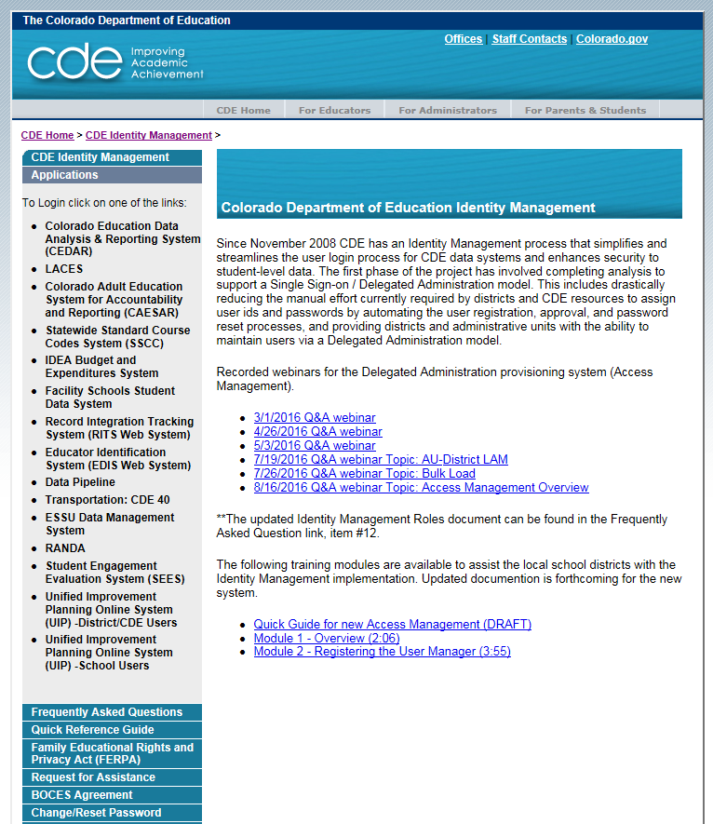
Where to access the Data Pipeline
https://cdeapps.cde.state.co.us/index.html
*single sign-on login used for all CDE applications listed here

Slide 40
Login
Username is the email address associated with your IdM account
Password specified by you

Slide 41
Correct Access
The menu items listed on the left depend upon your IdM roles
Be sure you see the ‘Special Education’ tab (SPE and/or DEC role)
Be sure you see the ‘Staff Profile’ tab (STF role) if you’re uploading staff data

Slide 42
Interchange Process Overview
Create/Update Data Files
Upload files in Data File Upload
Review Batch Maintenance
Review Error Reports in Cognos
Correct Data Files in Source System
Upload files in Format Checker
Once No Errors in All Files Needed -> Create Snapshot

Slide 43
1st Step: Format Checker *optional
Once the file is created, you have the option to run it through the Format Checker to ensure all the bytes are correct.
The system checks the first row of data only.
All fields PASS = Ready to upload

Slide 44
Step 2: Data File Upload
Click on File Upload/Data File Upload
Choose File Type and School Year. Organization should populate with your AU.
Click on Browse to locate File
Choose Replace
Hit Submit
Note message in green below. A Batch ID will be created.

Slide 45
File Upload: Email Confirmation
Check email to ensure file was successfully uploaded
Below is an email in a case where the file didn’t successfully upload. Additional details are provided
-----------------------------------------------------------------------
This message is to notify you of the Data Pipeline file upload errors. The errors must be corrected and the file must be uploaded again.
-----------------------------------------------------------------------
File Submission Processed by Data Pipeline:
Submission ID: 46765
Date: 05/02/2017 03:18 PM
Name: Lindsey Heitman
Year: 2017
User ID: heitman_l@cde.state.co.us
File Name: Participation_1617.xlsx
Error: Error in file upload with batch id : 46765

Slide 46
Step 3: Batch Maintenance – Very Important Step
Check Batch Maintenance to ensure files have processed successfully.
Processed Indicator will say “YES”. If blank or “No”, file did not process successfully
Check Record Count, Error Count, and make sure submitted date and time look accurate.
*Processed Indicator should say Yes

Slide 47
File Won’t Upload?? Check for these…
Excel, CSV, or Text formats are accepted
Excel template for IEP files posted online http://www.cde.state.co.us/datapipeline/inter_sped-iep under Templates (however, it is not necessary to use a template if your file already extracts in one of the accepted formats)
Try pasting your data into a fresh template downloaded from this site
No spaces in file name
No blank fields
Be sure the file is not open when uploading
Be sure you haven’t lost all your leading zeros on a CSV file or it won’t upload (steps for saving them posted online) http://www.cde.state.co.us/datapipeline/resources

Slide 48
Checking IEP Interchange Errors – 2 places
1. Data Pipeline-Cognos Reports-Special Education IEP:
Detail and Summary Error Report for each File

Slide 49
Pipeline Error Reports
2. Pipeline Reports- Error Reports
Recommended option for accessing Interchange and Snapshot level error reports
Dataset: Special Education IEP
File Type: select the name of the file you’re checking
Export to Excel to view errors in detail

Slide 50
SNAPSHOT PROCESS

Slide 51
Snapshot Steps
Prior to creating a snapshot:
Verify that all 4 files are uploaded and have processed successfully – Child, Participation, Staff Profile, Staff Assignment
Batch Maintenance screen
Email confirmations
Status Dashboard
Cognos Reports/Special Education December Count – Staff: District/AU Activity Report
Ideally files are error free, but not required in order to create a snapshot

Slide 52
How to Create a Special Education December Count Snapshot
1. Click on Special Education tab
2. Click Snapshot from expanded list
3. Select File Type – Sp. Ed Dec Count Snapshot
School Year – automatically populates with 2018-2019
Organization/LEA – automatically populates based on IdM role
4. Click Search

Slide 53
How to Create a Special Education December Count Snapshot
5. Click Create Snapshot button.
you should see a message display across the top left in green: “Snapshot creation triggered and processing. A notification email will be sent upon completion”
6. Watch for snapshot email confirmation. Snapshot is not finished processing until email is sent

Slide 54
Check Status Dashboard
Checking the Status of the “Snapshot”
*Email confirmation is the green light for checking status dashboard!

Slide 55
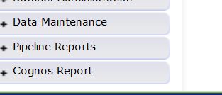
Cognos Reports
ERROR REPORTS
“COGNOS”
Opens new window
Special Education December

Slide 56
Special Education December Count Cognos Reports
Error Reports: Staff and Student have separate reports
Excluded Report: Includes excluded records – those w/ interchange errors
Included Report: Includes records that are included in the snapshot

Slide 57
Cognos DETAIL ERROR REPORT

Slide 58
View in Excel
ERROR REPORTS
“COGNOS”
Click on HTML button located on the far right top of the screen
View in HTML, PDF, XML, or Excel Format
Excel Options
2007 Data, 2007 Format, 2002 Format, CSV Format

Slide 59
Reading Error Reports
Edits are in place to assist with providing the most accurate information to CDE which is published, analyzed and reviewed by legislators, federal government, researchers, etc..
Edits should provide adequate information to assist you with determining corrections needed.
Example:
DC010: If Highest Level of Education Completed is 16 or above, and Job Class Code is 202, Subject Area of Degree cannot be 2100 zero-filled
In this case the issue is with the Subject Area of Degree field

Slide 60
Summary Warnings
Summary Warnings work a little differently than other detail errors as they may pertain to a certain select group of records or even the entire set of data depending on the warning.
Example:
DC042-Warning: More than 5 FTE Paraprofessionals (416) were reported as district-wide (9980). Paraprofessionals should be attributed to the buildings they serve
You can see which paraprofessionals are reported as school-wide in the “Included” report.

Slide 61
Correcting Snapshot Errors
View Status of December Count snapshot
Email will be sent with status
Then check Status Dashboard screen –shows if processed and # of errors
View errors in the Detail Error Reports (Pipeline Error Reports or Cognos)
Option to export the report to Excel if you’d like
Correct the errors in the appropriate Interchange File
preferably Enrich or your source system
Student/Staff files- will need to contact district respondent to resolve these errors (unless AU is submitting staff)
Re-upload your corrected files to the IEP Interchange. If errors only exist in 1 of the files, you can resubmit only the 1 file containing corrections.
Re-Create the Snapshot
Repeat as Needed

Slide 62
PIPELINE – ERROR REPORT *another option for checking snapshot errors
File Type may be:
Sp. Ed December Count Staff
Sp. Ed December Count Student
Both are ‘DC’ error codes

Slide 63
PIPELINE – ERROR REPORT
Select “View Details”

Slide 64
PIPELINE – ERROR REPORT
Select “Excel”

Slide 65
December Count Snapshot Exceptions
The Special Education December Count has 5 Allowable Exceptions.
If you receive one of the following errors it will be necessary to send us in an Exception. You may find the template under Additional Links here: http://www.cde.state.co.us/datapipeline/snap_sped-december
Student:
DC104 Age is outside of the min/max range for this grade level.
Staff:
DC033 No Special Education Director was reported.
DC043 No Child Find Coordinator was reported.
DC157 FTE total for an individual is outside of 0.005 and 1.71 allowable range
DC206 TOTAL FTE for an individual is outside of allowable range
Please see the Instructions tab for directions in completing the form. Paste the template into the Syncplicity folder and let us know via email to look for it. Once approved, CDE will upload the exceptions and let you know to recreate the snapshot bypassing the business rule for the approved record.

Slide 66
Is the # of snapshot records the # expected?
If yes
Do you have Snapshot Errors?
If Yes, check the Error Report
If no
Are there interchange errors in the file where the data comes from?
Fix Interchange errors and Recreate the Snapshot
Are there records that didn’t meet the “Criteria” for the Snapshot?
Check the Pipeline Report “Records Not in Dec”

Slide 67
Records not found in Snapshot Report
Records that are not included in the included snapshot records report may be found in the report below.
Either there is an error at the interchange or the record doesn’t meet the criteria.
Missing records are broken out by Student or Staff and file types for each
Pipeline Reports: Records not Found in December Count Snapshot

Slide 68
Step 1: UPLOAD INTERCHANGE FILES
IEP
Staff
Student
Step 2: Create Snapshot
Step 3: ONCE EMAIL is received check status dashboard
Step 4: resolve validation errors
Step 5: UPLOAD UPDATED INTERCHANGE FILES and go through steps again

Slide 69
Timeline & Resources

Slide 70
Special Education December Count Important Dates
November
December
January
Thursday November 1st: Snapshot available
Saturday December 1st: Official Count Date (or last date prior your school was in session)
Thursday December 20th: All Interchange errors resolved and at least one December Count snapshot created
Wednesday January 23rd: All errors resolved – complete snapshot
Wednesday November 28th: Interchange files uploaded – Sped Child, Sped Participation, Staff Profile, Staff Assignment
January 24 – 31 : Report Review
February
February 4 – 14: Resolving duplicates
February 14 - 21: Final Report Review
February 21st : Final Deadline

Slide 71
Timeline - Resources
Please print/reference detailed timelines online:
Special Education December Count Timeline: http://www.cde.state.co.us/datapipeline/2018-2019specialeducationdecembercounttimeline
Human Resources Timeline: http://www.cde.state.co.us/datapipeline/2018-2019humanresourcestimeline

Slide 72
Helpful Reporting Resources
At this link you will find the following helpful resources:
http://www.cde.state.co.us/datapipeline/inter_sped-iep
Special Education Grant Codes
PAI Coding Chart (PRINT!!)
Educational Environments
Facility Code Lists

Slide 73
Helpful Reporting Resources
At this link you will find the following helpful resources: http://www.cde.state.co.us/datapipeline/snap_sped-december
Staff Approval Matrix Training
Sped ESSA In-Field Crosswalk
December Count Exceptions Template

Slide 74
SAM OFFICE HOURS Webinar
Upcoming Staff Approval Matrix (SAM) Office Hours Webinar:
Wednesday December 5th from 1:00 –2:00
Link to SAM training slides posted online: http://www.cde.state.co.us/datapipeline/snap_sped-december under ‘Staff Approval Matrix Trainings’ section
Login Information:
https://cdeinfotech.adobeconnect.com/data_services/
Call-in number: 1-855-397-4421

Slide 75
Next December Count Training
Next December Count Training Webinar:
Wednesday November 14th from 11:00 –12:30
Topic: December Count content - Student and Staff and error resolution tips
Login Information:
https://cdeinfotech.adobeconnect.com/data_services/
Call-in number: 1-855-397-4421

Slide 76
CDE Contacts
Staff Interchange information:
http://www.cde.state.co.us/datapipeline/inter_staff
Annette Severson: severson_a@cde.state.co.us also HR
Lindsey Heitman: heitman_l@cde.state.co.us also Dec Count
Human Resources Snapshot information:
http://www.cde.state.co.us/datapipeline/snap_hr
Special Education December Count Snapshot information:
http://www.cde.state.co.us/datapipeline/snap_sped-december
Additional Contacts:
Orla Bolger: bolger_o@cde.state.co.us December Count Content Expert
Lauren Rossini: Rossini_R@cde.state.co.us Special Education Staff Content Expert

Slide 77
Questions?
If you have ANY questions about the Special Education December Count, please feel free to contact us. No question or concern should remain unanswered of unresolved.
We are just a phone call or email away!
Lindsey Heitman (303) 866-5759 heitman_l@cde.state.co.us
Orla Bolger (303) 866-6896 bolger_o@cde.state.co.us
Lauren Rossini (303) 866- 6688 rossini_l@cde.state.co.us
Email protocol – please include:
Administrative Unit #
Phone number where you may be reached. Be sure to get that added in Access Management.
Subject of the email
NOTE: Never send files or reports via email – contact us to determine best technical assistance avenue.

Slide 78
for your participation. We appreciate it!!!

