Slide 1
Teacher Student Data Link (TSDL)

Slide 2
Agenda
Data Uses/Reports
Initial Steps
Resources
Timeline
Interchange Process
Snapshot Process

Slide 3
Data Uses: Reporting and Analysis
Public District Course Directory (public)
Interact tool allows users to view and identify courses a district offers
Released to the public on Nov 1, 2017
Report uses state course code data
http://www2.cde.state.co.us/schoolview/coursedirectory/districtcoursedirectorydata.asp
Educator Preparation Performance Report (development):
Review of teacher preparation programs pursuant to 23-1-121
Report will use TSDL (both course enrollment and course instructor) and state course code

Slide 4
Data Reporting – CRDC on behalf of districts
Since 1968, the U.S. Department of Education (ED) has conducted the Civil Rights Data Collection (CRDC) to collect data on key education and civil rights issues in our nation's public schools
Previously, all data was reported directly from the LEA to ED. Starting for the 2013-14 collection, CDE pre-populates data if possible based on data reported from LEAs to CDE
Collection is completed every other year
TSDL data elements provide 23% of all data elements CDE pre-populates for LEAs

Slide 5
Authority To Collect
Derived from both Colorado Revised Statutes (C.R.S) and the Colorado State Board of Education’s rules:
Concerning Statutory Changes to K-12 Education, House Bill 13-12-19: 22-2-116.5
Course Participation and Student Proficiency Reports, House Bill 14-1376: 22-11-503.5
Monitoring of Written Evaluation System, C.R.S. 22-9-106 (1.5) (a-b)
Rules for administration of a statewide system to evaluate the effectiveness of licensed personnel employed by school districts and boards of cooperative services 1 CCR 301-87(6.04) (i), (A), (C) (2) (b, d, and e), and (C) (3) (a).
Commissioner Duties - reviewing the content of educator preparation programs in Colorado, C.R.S. 22-2-112 (p-q)

Slide 6
Timeline

Slide 7
TSDL Interchange Timeline
Prior to TSDL files:
Statewide Standard Course Code Submission
Open year round
Student Interchange Files uploaded
Staff Interchange Files uploaded
Interchange:
Open Wednesday, November 15th 2017
Remains open throughout the year

Slide 8
TSDL Snapshot Timeline
Date | Event
Wednesday, Nov 15th 2017 | Interchange open
Wednesday, Jan 17th 2018 | Snapshot open
Friday, June 1st 2018 | Target: All districts create a TSDL snapshot
Friday, June 15th 2018 | Target: TSDL Interchange files error free
Friday, June 22nd 2018 | Target: TSDL Snapshot error free
Friday, June 29th 2018 | Soft Deadline: Recommended date to finalize the TSDL snapshot. After this date, many school systems roll over to the next school year.
Friday, August 31st 2018 | Deadline: Snapshot must be finalized

Slide 9
Webinar Trainings
Date/Time | Topic
Tuesday, November 14th 1 -2 pm | Getting Started – What is Required?
Tuesday, December 12th 1 -2 pm | TSDL Interchange Updates and Process
Tuesday, January 9th 1 -2 pm | TSDL Interchange Edits Guide
Tuesday, February 13th 1 -2 pm | TSDL Snapshot Data Reports
Tuesday, March 13th 1 -2 pm | Overall Process Review (Interchange and Snapshot)
Tuesday, April 10th 1 -2 pm | TSDL Snapshot Process
Tuesday, May 8th 1 -2 pm | TSDL Snapshot Edits and Reports
Tuesday, June 12th 1 -2 pm | Reports Review & Finalizing Steps
Tuesday, July 10th 1 -2 pm | Status Check – Final Steps
Tuesday, August 14th 1 -2 pm | Final Review

Slide 10
Initial Steps

Slide 11
Identity Management Roles
Teacher Student Data Link Interchange Roles:
TSL~ LEAUSER – upload and modify TSDL interchange files OR
TSL~LEAVIEWER – view (only) TSDL interchange data
Teacher Student Data Link Snapshot Roles:
TLS~LEAAPPROVER – Approves, creates, views Snapshot OR
TLS~LEAUSER - creates, views Snapshot OR
TLS~LEAVIEWER- views snapshot

Slide 12
Course Codes
ALL Local Course Codes must be mapped to a State Standard Course Code
Use the SSCC (State Standard Course Code) system to map your local course codes
https://www.cde.state.co.us/datapipeline/sscc-details
Available now for update
Option available to roll over courses from 2016-17 to 2017-18
Even if you use the Standard Course Codes as your Local Course Code- they need to be mapped within the system

Slide 13
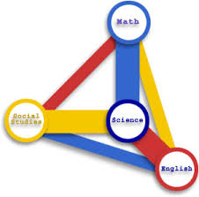
Required K-12 Courses
Mathematics
Science
Social Studies
English Language Arts
All other courses may be included but are not required to be reported

Slide 14
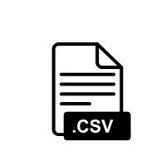
Creating Files
Pull data files from SIS Extract
Create Course Enrollment File and Create Course Instructor File
File Layouts found online at: https://www.cde.state.co.us/datapipeline/inter_teacherstudent
File Requirements:
Excel, CSV or Text File all accepted
Need 2 separate files
1st record of data must be field names/titles

Slide 15
Tips on Files
Excel, CSV, or Text formats are accepted
Simple Excel template for Course Enrollment and Course Instructor Files posted online https://www.cde.state.co.us/datapipeline/inter_teacherstudent under Templates (however, it is not necessary to use a template if your file already extracts in one of the accepted formats)
No spaces in file name
No blank fields
Be sure the file is not open when uploading
Be sure you haven’t lost all your leading zeros on a CSV file or it won’t upload (steps for saving them posted online)

Slide 16
Interchange Files
Course Enrollment
All students enrolled in a required course (mathematics, science, social studies, and English language arts) for at least 4 consecutive weeks
Each record must be unique based on: school code, local course code, section number, SASID , student's grade level and term
Course Instructor
All teachers teaching the required courses reported in the course enrollment file for at least 4 consecutive weeks
Each record must be unique based on: school code, local course code, section number, EDID and term

Slide 17
TSDL Fields
Course Enrollment File
Course Instructor File
Name of Field
School District/BOCES Code
School Code
Local Course Code
Section Number
SASID
Student's Last Name
Student's First Name
Student's Gender
Student's Date of Birth
Roster Start Date
Roster End Date
Student’s Grade Level
Term
Credits Granted
Final Grade/Course Completion Status
Name of Field
School District/BOCES Code
School Code
Local Course Code
Section Number
EDID
Staff's Last Name
Staff's First Name
Staff's Gender
Staff's Date of Birth
Term
Staff Role
Used to link records in the TSDL Snapshot

Slide 18
Interchange Flowchart
Upload files in Data File Upload
Review Batch Maintenance
Review Error Reports in Cognos/Pipeline
Correct Data Files in Source System
Create/Update Data Files
- Continue until all errors are resolved

Slide 19
Interchange Process

Slide 20
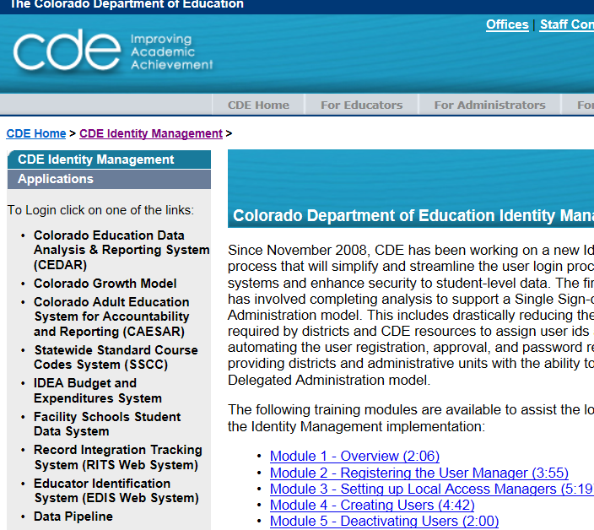
Pre-Step: Getting to Data Pipeline
https://cdeapps.cde.state.co.us/index.html

Slide 21
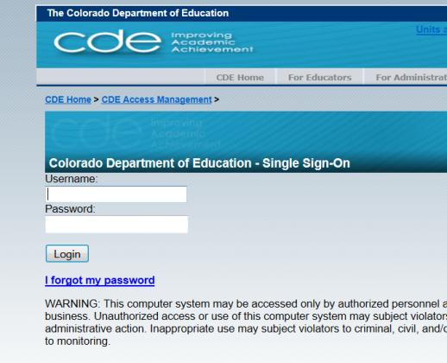
#1: Logging into Data Pipeline
Username = Email Address
Password – you created it
If forgotten password, use ‘I forgot my password’

Slide 22
Uploading Interchange Files
Format Checker - Ensures file layout is correct
Data File Upload - Upload data file
Batch Maintenance - Check Status
Error Reports - Provides errors
Correct File

Slide 23
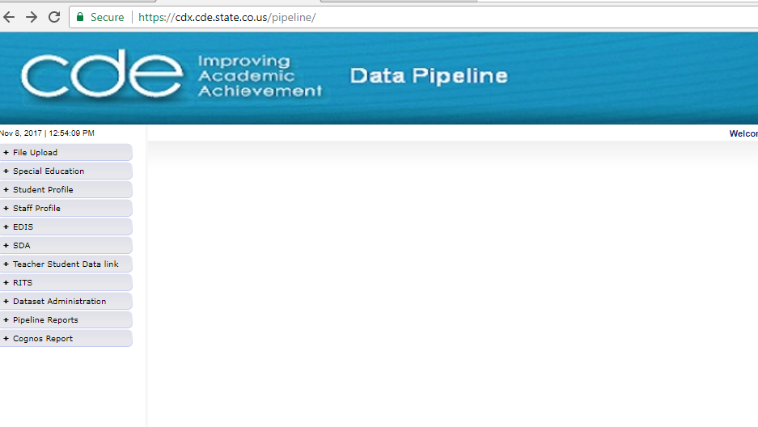
Pipeline Website Review
Batch Maintenance, Format Checker and Data File Upload
Based on your Identity Management Roles
Error reports and other validation reports

Slide 24
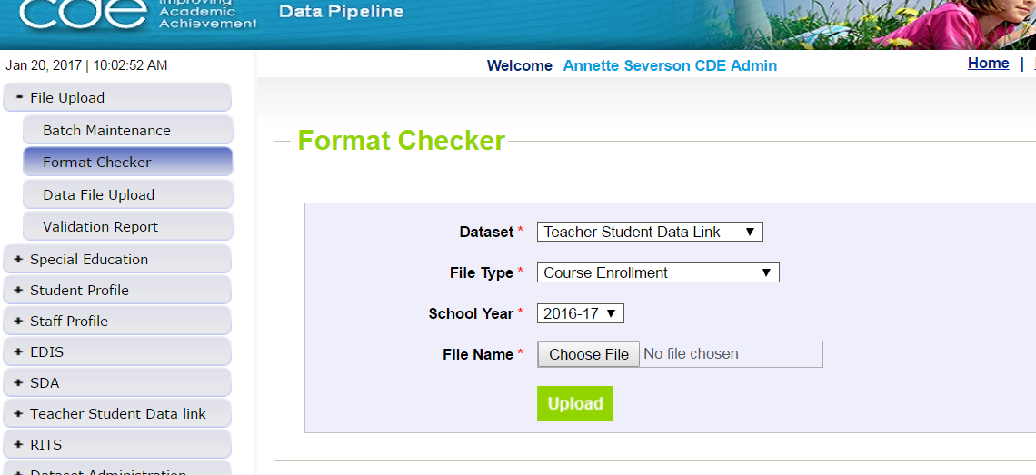
File Upload – Format Checker
Course Enrollment or Course Instructor

Slide 25
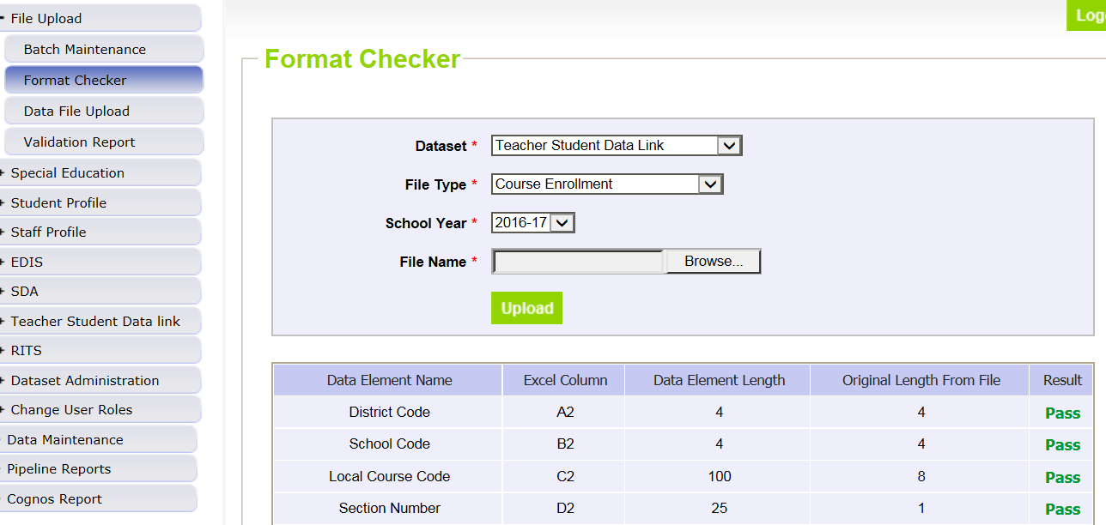
Format Checker – Upload Results

Slide 26
Format Checker Notes
Format Checker will only review the 2nd row in your file
Passing format checker Does Not Equal file will process
Green ‘Pass’ for each field is desired result
Red ‘Fail’ for a field indicates file is not in the correct format- please refer to the 2017-2018 file layout on web

Slide 27
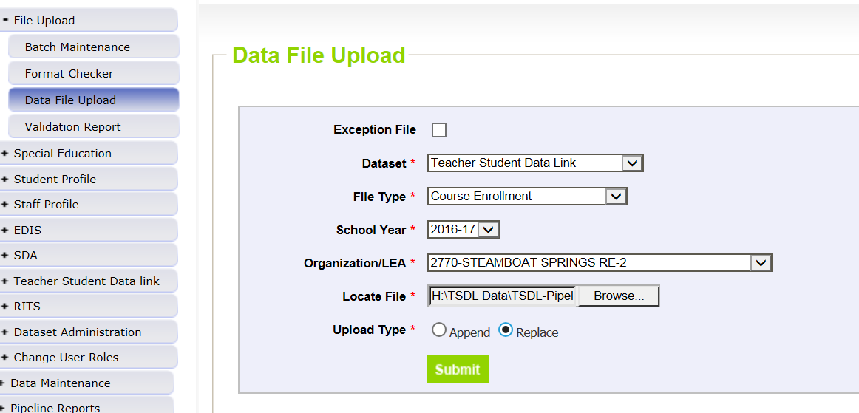
Data File Upload

Slide 28
Data File Upload Types
Append = adds file to existing file, all records from both files included
Can be tricky with fixing errors
Replace = deletes any prior data file and replaces it with the file being uploaded
RECOMMENDED

Slide 29
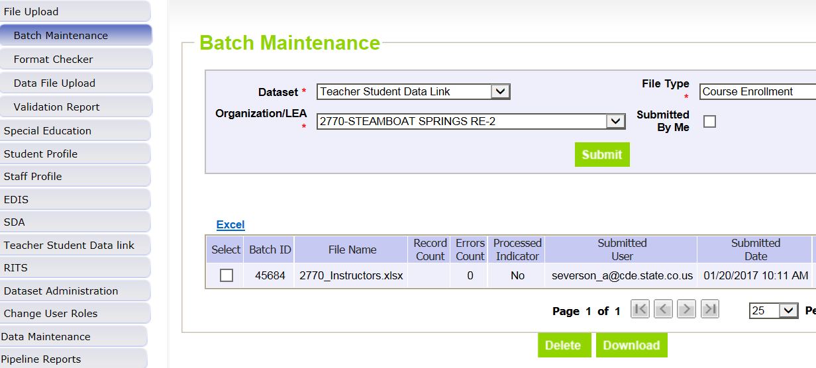
Batch Maintenance Screen – Not Processed

Slide 30
File Not Processed – Next Steps
Ensure file has all green ‘pass’ in format checker
YES?
Open file and review all records are formatted the same as the 2nd row
Be sure all codes and dates have leading zeros included
NO?
Review file layout posted online and re-format the file
For further assistance, contact Annette Severson
DO NOT INCLUDE THE FILE IN ANY EMAILS

Slide 31
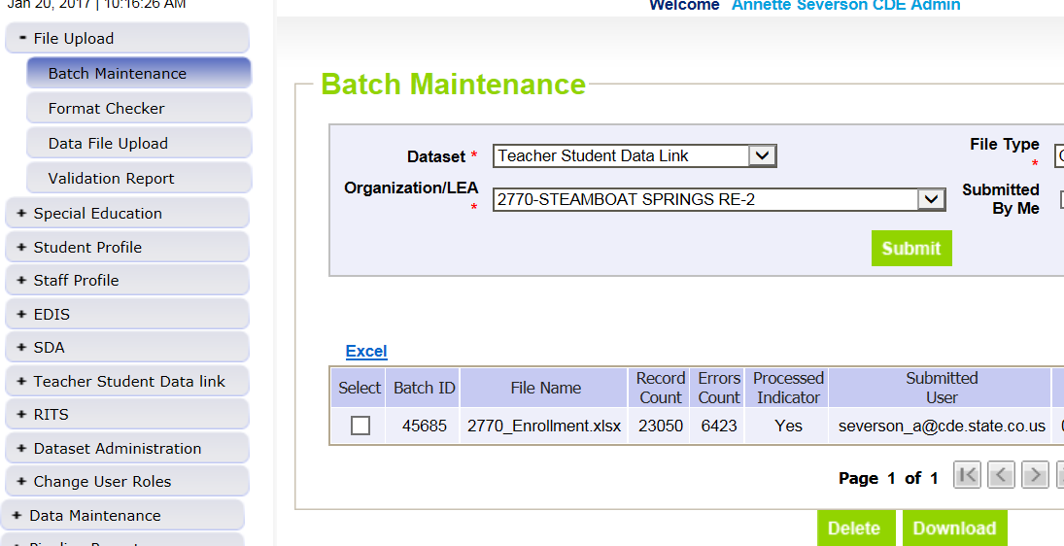
Batch Maintenance – File Processed

Slide 32
File Processed – Next Steps
Use same screen to see the Number of Errors:

Slide 33
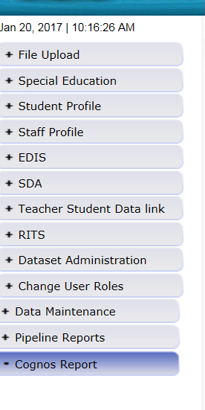
Review Errors in Detail
2 methods available:
Data Pipeline Reports -> Error Reports
Cognos Reports – > Teacher Student Data Link

Slide 34
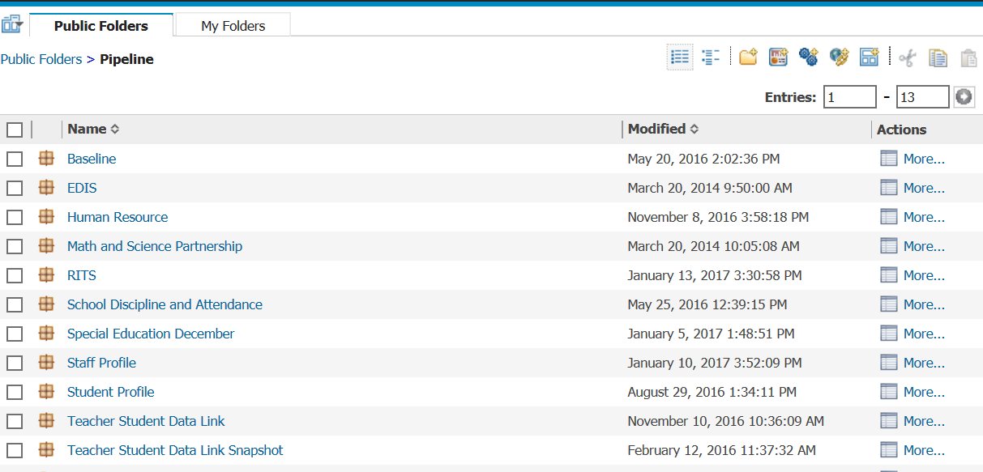
Clicking on Cognos Reports- Opens in a new Screen
These dates are to be ignored

Slide 35
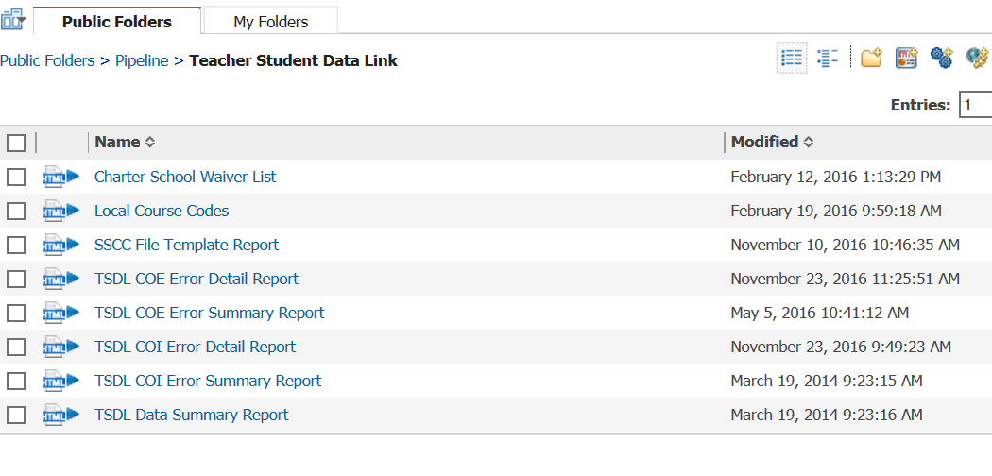
TSDL Interchange Errors
Detail Reports – provides detailed records with descriptions of error
Summary Reports – provides a count of records by type of error
*Do Not Send Error reports via email to CDE for assistance

Slide 36
Error Reports
Error Detail Report
Provides specific records causing the error with the error description
Can select to View ALL error records or 1 type of error at a time
Error Summary Report
Provides a count of errors generated per error type and description
Resubmit either file as needed for corrections for all data errors to be resolved
Be sure to update source file with corrections as well

Slide 37
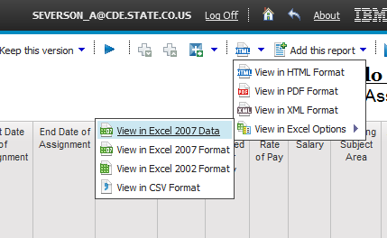
Error Detail Report- Excel
Download error reports into excel, records can be sorted to assist with making data corrections in file(s)

Slide 38
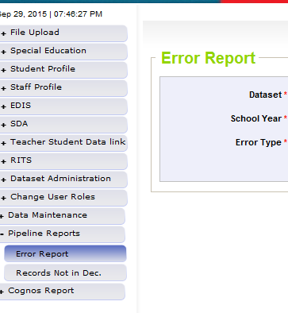
Pipeline Reports
Search:
Dataset = Teacher Student Data Link
School Year = 2016-2017
Error type = Errors and Warnings
File Type: Course Enrollment or Course Instructor
Org/LEA = Code
Click ‘Search’

Slide 39
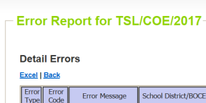
Pipeline Error Reports – Viewing Details
Summary of Errors in File are next provide
Click on ‘View Details’ to view each record with the error
Choose ‘Excel’ to download error report in Excel – recommended

Slide 40
Correcting Errors
Correct the errors in the file:
May have to fix errors in both Course Enrollment and Course Instructor files
Keep file versions – in case updated file causes even more errors, you can re-start using a prior file version
CDE does not maintain these versions, once the file has been replaced, all prior data files have been deleted in pipeline
Resubmit your data records using the same process and replacing your existing data file using the Data File Upload tool
All errors must be corrected, all warnings should be reviewed

Slide 41
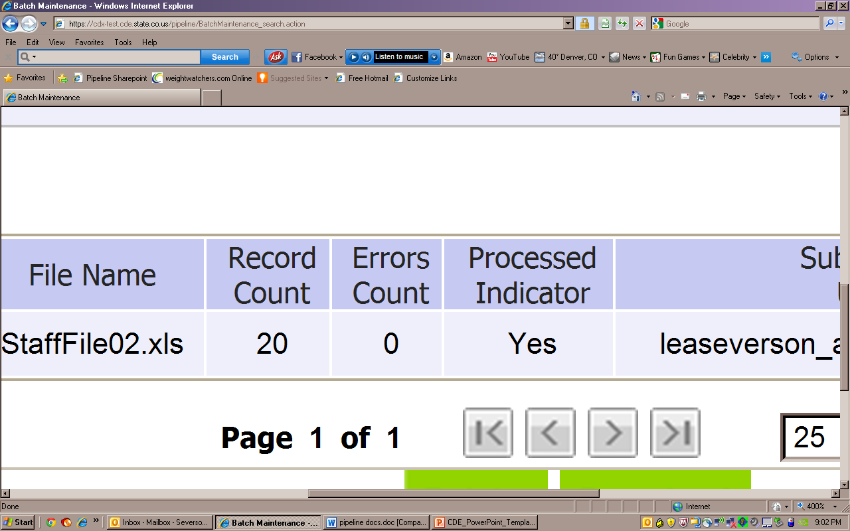
Batch Maintenance: No Errors

Slide 42
Next Steps – TSDL Snapshot
Course Enrollment File= Processed and Zero Error Count
Course Instructor File = Processed and Zero Error Count
Create TSDL Snapshot (opens in January)

Slide 43
Snapshot Process

Slide 44
Snapshot Flowchart
Interchange files uploaded and error free
Create Snapshot ( pipeline step)
Additional Business Rules
Errors? Correct Errors in Interchange Files
Upload corrected interchange files
No errors? Review Reports and Finalize if Accurate

Slide 45
Teacher Student Data Link Snapshot: Access
Local Access Manager (LAM) will need to assign you prior to logging into Pipeline
TLS_LEAAPPROVER – creates, views and finalizes data
TLS_LEAUSER – create and review snapshot data
TLS_LEAVIEWER – View the data only (not modify or submit)
Can only be assigned one or the other.

Slide 46
Creating Snapshot Steps
Log into Data Pipeline
Click on Teacher Student Data Link tab (on the left)
Select ‘Snapshot’ from the expanded list
Enter appropriate search criteria (Teacher Student Data Link Snapshot/2016-2017/Org Code)
Click on Search (green button on bottom)
Select ‘Create Snapshot’
New message should appear: “Snapshot creation triggered and processing. A notification email will be sent upon completion.”

Slide 47
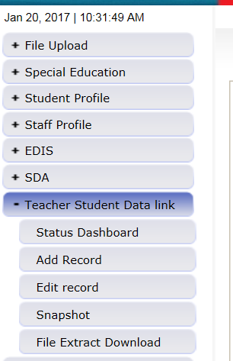
#2 and #3: Selecting Teacher Student Data Link -> Snapshot
#2
#3

Slide 48
#4 and #5: TSDL Snapshot Screen
#4
#5

Slide 49
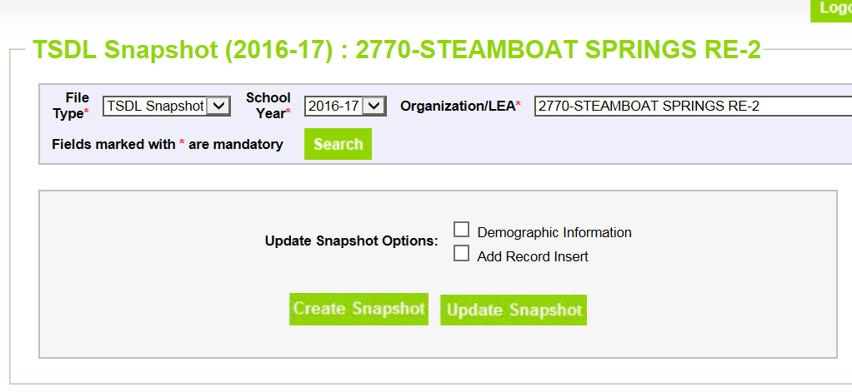
#6 and #7: Creating Snapshot- Screenshot
#6
#7

Slide 50
Next Steps
View Status of TSDL snapshot
Email will be sent with status
Status Dashboard screen –shows if processed and # of errors
View Snapshot errors in Cognos or Data Pipeline
Make corrections to Teacher Student Data Link interchange files
Upload updated Teacher Student Data Link interchange files
Re-create Teacher Student Data Link snapshot

Slide 51
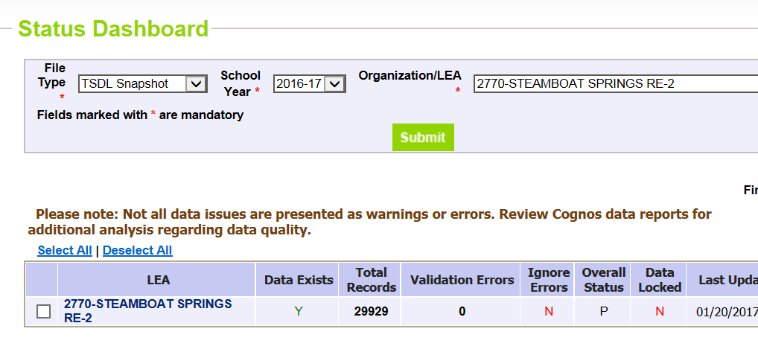
Status Dashboard Screen
Y = snapshot successful!
N= snapshot wasn’t taken/no data in snapshot
Date/Time of Snapshot created
# of Snapshot Record Errors

Slide 52
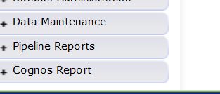
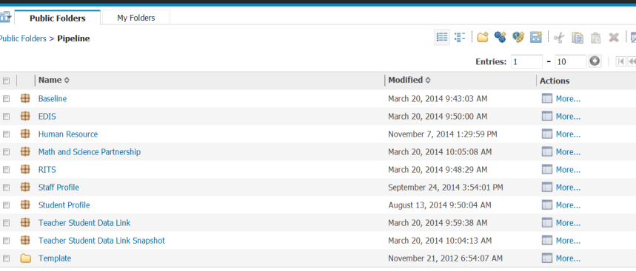
Accessing Cognos Reports
Opens new window
Teacher Student Data Link Snapshot

Slide 53
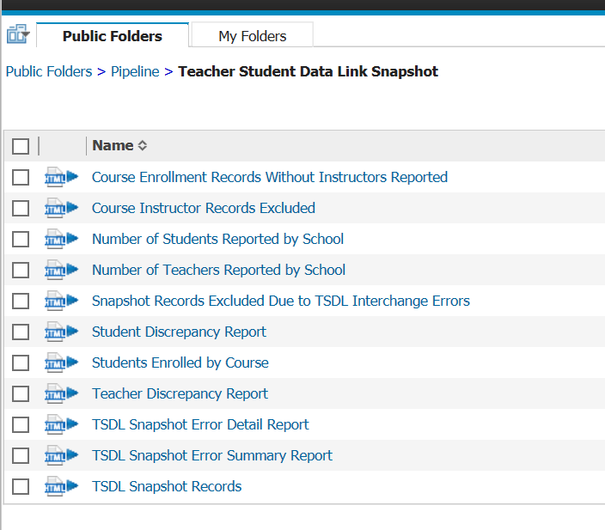
Teacher Student Data Link Cognos Reports

Slide 54
View Errors – Teacher Student Data Link Error Detail Report

Slide 55
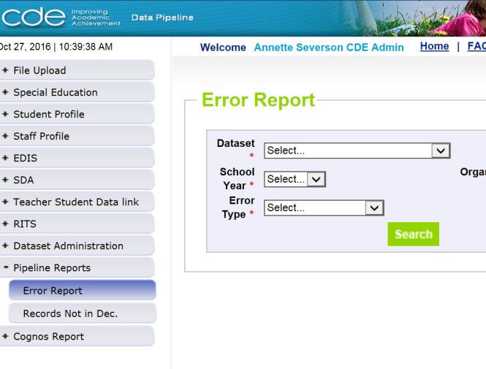
Viewing Errors in Data Pipeline

Slide 56
Edits
Edits are in place to assist with providing most accurate information to CDE which is published, analyzed and reviewed by legislators, federal government, researchers, etc.
Edits should provide adequate information to assist you with determining corrections needed.

Slide 57
Finalizing Steps
Once all Errors are resolved in Snapshot…
Review, review, review data reports for accuracy!
If mistakes/misreporting is found, correct files again and create new snapshot
If data reports are all accurate- you may finalize the data by submitting it to CDE
http://www.cde.state.co.us/datapipeline/tsdl-snap-reports-guide
Cognos Reports also discussed in further detail in the February Training: https://www.cde.state.co.us/datapipeline/inter_teacherstudent
Cognos Reports will also be discussed in May and June trainings

Slide 58
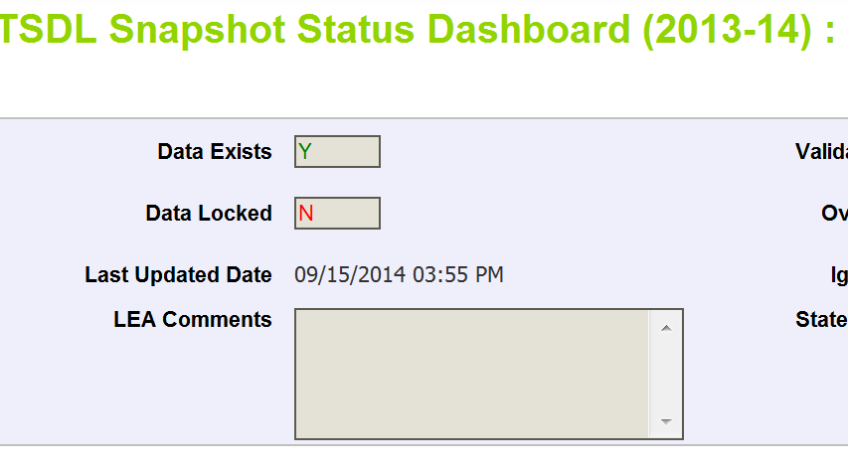
Finalizing Data
Once data is accurate-all reports reviewed and correct…
TLS~LEAAPPROVER for district will need to ‘Submit to CDE’
TSDL Snapshot Status Dashboard (2016-2017):
Submit to CDE

Slide 59
Resources and Contact Information

Slide 60
TSDL Interchange Resources
Course Code Documentation found at:
https://www.cde.state.co.us/datapipeline/sscc-details
TSDL Interchange Documentation found at: http://www.cde.state.co.us/datapipeline/inter_teacherstudent
Deadlines
File layouts and definitions
Defects
Business Rules
Trainings
Additional Resources – Frequently Asked Questions

Slide 61
TSDL Snapshot Resources
TSDL Snapshot Documentation found at: http://www.cde.state.co.us/datapipeline/tsdl
Deadlines
File layouts and definitions
Defects
Trainings
For assistance with either Interchange or Snapshot:
Annette Severson
Severson_a@cde.state.co.us
303-866-6824

Slide 62
Thank You for Joining!
MARCH
March 1st - Yellowstone National Park established, 1872
March 11th – Daylight Savings Time begins
March 11th – April 2nd: March Madness
March 14th - Pi Day
March 17th – St. Patrick’s Day
March 20th – The first day of Spring
Our next TSDL webinar will be April 10th from 1 – 2 pm
Snapshot Process

