Slide 1
Teacher Student Data Link (TSDL)
February 2018 Training

Slide 2
Authority To Collect
Derived from both Colorado Revised Statutes (C.R.S) and the Colorado State Board of Education’s rules:
Concerning Statutory Changes to K-12 Education, House Bill 13-12-19: 22-2-116.5
Course Participation and Student Proficiency Reports, House Bill 14-1376: 22-11-503.5
Monitoring of Written Evaluation System, C.R.S. 22-9-106 (1.5) (a-b)
Rules for administration of a statewide system to evaluate the effectiveness of licensed personnel employed by school districts and boards of cooperative services 1 CCR 301-87(6.04) (i), (A), (C) (2) (b, d, and e), and (C) (3) (a).
Commissioner Duties - reviewing the content of educator preparation programs in Colorado, C.R.S. 22-2-112 (p-q)

Slide 3
Agenda
Course Taking Reports
Educator Preparation Program Reports
Migrant Education
Civil Rights Data Collection (CRDC)
Cognos Reports
Resources and Contact Information
Timeline

Slide 4
Course Taking Reports

Slide 5
About the report
As outlined in legislation (HB 14-1376), the report must include:
Student participation in each core course level (math, English, science and social science) disaggregated by student groups; and
When available, the proficiency levels of students in each core course level as measured on the statewide assessments, disaggregated by student groups.
Schools and districts are required to conduct an analysis of the course enrollment data in their Unified Improvement Plans (UIPs). If disparities are discovered, then actions should be documented in the action plan.

Slide 6
About the report
English Language Arts, Math, Science, and Social Studies course only
TSDL
Student October/EOY
Assess-ment Data
CMAS ELA, CMAS Math, PSAT/SAT EBRW*, PSAT/SAT Math
Course Taking Report
Participation in Courses by Title and Rigor
Assessment Performance by Course (by Title and Rigor)
*EBRW = Evidence-Based Reading and Writing

Slide 7
About the report
http://www.cde.state.co.us/cdegen/studentopportunitygaps
Levels of Course Taking Report
 | District | School
Password-Protected | Includes student level drill-down No suppressions applied Counts/means rolled up to district level Accessible through identity management role permissions | Includes student level drill-down No suppressions applied Counts/means rolled up to school level Accessible through identity management role permissions
Public | N of 16 suppression applied to all data Counts/means rolled up to district level Accessible through report website | N of 16 suppression applied to all data Counts/means rolled up to school level Accessible through report website

Slide 8
About the report
The landing page lets you select your school (or district) and the year
The district reports have a separate landing page

Slide 9
About the report
The Overview/Background Data tab displays enrollment data for context

Slide 10
About the report
The Participation and Achievement Data tab displays counts of students enrolled by subject and course level.
Assessment data is not yet available.

Slide 11
About the report
Current report
Includes 2015 and 2016 data
Available now (all levels)
Includes:
Course participation
Enrollment data
Next year’s reports
Will include 2017 and 2018 data
Available 11/1/2018
Will include:
Course participation
Enrollment data
Assessment performance by course enrollment
Mean scale score
Assessment participation

Slide 12
About the report
For questions related to the Course Taking Reports, contact B Sanders:
Sanders_b@cde.state.co.us
303.866.2865

Slide 13
Educator Preparation Reports

Slide 14
Educator Preparation Program (EPP) Reports
Anticipated first release approximately late 2018/early 2019
A joint agency report co-authored by CDE and Colorado Dept. of Higher Education
To fulfill statutory requirements in CRS titles 22 and 23. To include data on:
Preparation program enrollment & completers
Educator outcomes:
student academic growth
educator placement
educator mobility and retention
educator performance evaluation ratings
Enrollment and completions reported for all preparation programs, but outcomes only reported for new teachers
Reports will be produced annually
TSDL data are necessary because each teacher must be connected to their own students’ growth and achievement

Slide 15
Statutory Requirements: Educator Preparation Report
22-2-112 and 23-1-121 (Annual Report on Effectiveness of Educator Preparation Programs)
22-2-112(1) Subject to the supervision of the state board, the commissioner has the following duties:
…
(q) (I) To assist the state board in reviewing the content of educator preparation programs offered by institutions of higher education within the state. In so doing, the commissioner shall direct the department to collaborate with the department of higher education to prepare an annual report on the effectiveness of educator preparation programs.
(II) For purposes of this paragraph (q), the department shall use data collected from an educator in his or her first three years of placement as the educator of record.
(III) The report required pursuant to this paragraph (q) must include, but need not be limited to, the correlation between different in the state, including ucator preparation programs, and student academic growth, educator placement, educator mobility and retention,rmance evaluation ratings.
(IV) The department shall work collaboratively with educator preparation programs and the department of higher education and make the report prepared pursuant to this paragraph (q) available to the public on its web site no later than thirty days after its completion. The department shall share the information with educator preparation programs to inform curriculum and program improvements.

Slide 16
Migrant Education

Slide 17
TSDL and Migrant Education
The Migrant Education Program pulls on the following fields from TSDL to populate its Student Information System.
Migrant children often enroll in multiple schools and school districts for varying amounts of time each year.
Without timely access to the critical information contained in these records, school personnel may not be able to enroll migrant students, make appropriate grade and course placement decisions, and ensure the accrual of secondary school course credits.
Term
District Code
School Code
State Course Code
Local Course Code
Section Number
Course Title
SASID
Student’s Last Name
Student’s First Name
Gender
Student’s DOB
Roster Start Date
Roster End Data
Grade Level
Credits Granted
Final Grade

Slide 18
TSDL/Migrant Data Quality Issues
In addition to fields required for all students, districts are required to report the following two fields for students identified as migrant in grades 8-12.
Credits Granted
Final Grade
When reviewing the Migrant data pulled:
There were 146 records where the fields for credit granted and/or final grade fields were left blank (null).
There were 527 records where the state course code field was left blank (null).
There were 1,643 records where Term field was left blank (null).
There were 51 records where the Local Course Title field was left blank (null)

Slide 19
Migrant Contact Information
Brenda Meyer
Migrant Data Senior Consultant
303.866.6744
meyer_b@cde.state.co.us

Slide 20
Civil Rights Data Collection (CRDC)

Slide 21
Data Reporting – CRDC on behalf of districts
Since 1968, the U.S. Department of Education (ED) has conducted the Civil Rights Data Collection (CRDC) to collect data on key education and civil rights issues in our nation's public schools
Previously, all data was reported directly from the LEA to ED. Starting for the 2013-14 collection, CDE pre-populates data if possible based on data reported from LEAs to CDE
Collection is completed every other year
TSDL data elements provide 23% of all data elements CDE pre-populates for LEAs

Slide 22
TSDL Data Used for CRDC
Student’s Grade Level (for Course)
Student’s Gender
State Course Codes:
Algebra I and II
Geometry
Advanced Math
Calculus
Biology
Chemistry
Physics
IB Classes
AP Classes
Final Grade/Course Completion Status
Roster Start and End Dates

Slide 23
Cognos Reports

Slide 24
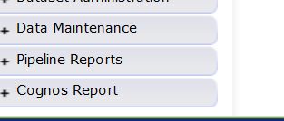
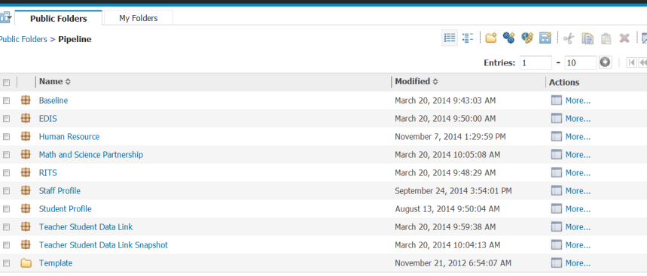
Accessing Cognos Reports
Opens new window
Teacher Student Data Link Snapshot

Slide 25
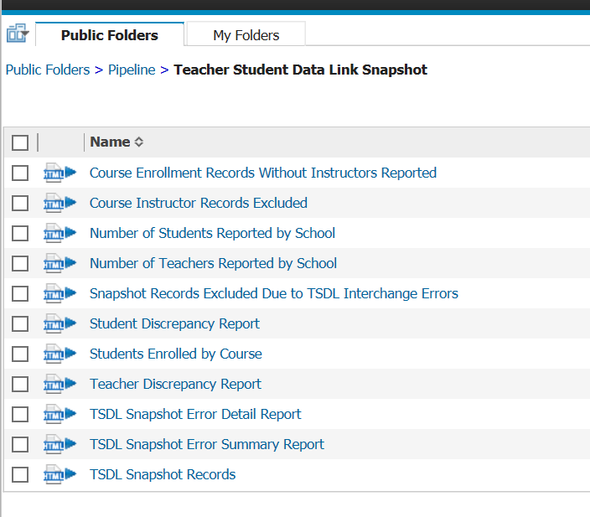
Teacher Student Data Link Cognos Reports

Slide 26
Course Enrollment Records Without Instructors Reported
Provides student records where no instructor is linked
Instructors and students are linked using:
Local course code
Section number
Term
School
Not all instructors are required to be reported- which may explain records in this report (college courses, courses taught by staff not employed by district)

Slide 27
Course Instructor Records Excluded
Provides instructor records where no student is linked
Instructors and students are linked using:
Local course code
Section number
Term
School
Students would need to be reported in Course Enrollment file for these instructors to be included

Slide 28
Snapshot Records Excluded Due to TSDL Interchange Errors
Records not included in the snapshot due to interchange errors
Correct the interchange errors and re-create the snapshot if this report is populated with data

Slide 29
Reports by School
Number of Students Reported by School
Provides unduplicated count of SASIDs by school code
Number of Teachers Reported by School
Provides unduplicated count of EDIDs by school code

Slide 30
Discrepancy Reports
Student Discrepancy Report
Includes Students reported in Student School Association file (student interchange) with attendance code between 01 and 08 and enrolled for 4 weeks or more but are not included in the TSDL Snapshot
Teacher Discrepancy Report
Displays teachers (job class code 201 to 206) reported in the HR snapshot but not reported in the TSDL Snapshot file

Slide 31
Students Enrolled by Course
Number of students enrolled by school and local course code

Slide 32
TSDL Snapshot Records
Displays all records for the TSDL snapshot

Slide 33
Timeline

Slide 34
TSDL Snapshot Timeline
Date | Event
Wednesday, Nov 15th 2017 | Interchange open
Wednesday, Jan 17th 2018 | Snapshot open
Friday, June 1st 2018 | Target: All districts create a TSDL snapshot
Friday, June 15th 2018 | Target: TSDL Interchange files error free
Friday, June 22nd 2018 | Target: TSDL Snapshot error free
Friday, June 29th 2018 | Soft Deadline: Recommended date to finalize the TSDL snapshot. After this date, many school systems roll over to the next school year.
Friday, August 31st 2018 | Deadline: Snapshot must be finalized

Slide 35
Webinar Trainings
Date/Time | Topic
Tuesday, November 14th 1 -2 pm | Getting Started – What is Required?
Tuesday, December 12th 1 -2 pm | TSDL Interchange Updates and Process
Tuesday, January 9th 1 -2 pm | TSDL Interchange Edits Guide
Tuesday, February 13th 1 -2 pm | TSDL Snapshot Data Reports
Tuesday, March 13th 1 -2 pm | Overall Process Review (Interchange and Snapshot)
Tuesday, April 10th 1 -2 pm | TSDL Snapshot Process
Tuesday, May 8th 1 -2 pm | TSDL Snapshot Edits and Reports
Tuesday, June 12th 1 -2 pm | Reports Review & Finalizing Steps
Tuesday, July 10th 1 -2 pm | Status Check – Final Steps
Tuesday, August 14th 1 -2 pm | Final Review

Slide 36
Resources and Contact Information

Slide 37
TSDL Interchange Resources
Course Code Documentation found at:
https://www.cde.state.co.us/datapipeline/sscc-details
TSDL Interchange Documentation found at: http://www.cde.state.co.us/datapipeline/inter_teacherstudent
Deadlines
File layouts and definitions
Business Rules
Trainings

Slide 38
TSDL Snapshot Resources
TSDL Snapshot Documentation found at: http://www.cde.state.co.us/datapipeline/tsdl
Deadlines
File layouts and definitions
For assistance with either Interchange or Snapshot:
Annette Severson
Severson_a@cde.state.co.us
303-866-6824

Slide 39
Thank You for Joining!
Our next TSDL webinar will be March 13th from 1 – 2 pm
Overall Process Review (Interchange and Snapshot)

